Slide 2
The Best Solution - Carbon Fee & Dividend
Oil, Gas, and Coal Fossil Fuel
Companies
At extraction point
US Treasury Department
Pay $100/ton
100% refund
US Households
Raise prices
Fossil fuel-based products
Expensive
Non
fossil products
Cheap
Notes:
If you want to use less of something, make it more expensive.
Think of cigarettes and alcohol.
The best solution is to charge fossil fuel companies a fee.
Energy producers should bear the full cost of the products they provide.
At the point where they pump the oil, or mine the coal, or extract the natural gas.
The fee starts at $10/year and then steadily rises by $10 per year for ten years until it hits $100
Everything that contains fossil fuels, or uses fossil fuels is more expensive which discourages use.
All the fees collected from fossil fuel companies are refunded to households to compensate for the higher prices.
The effect is that people buy less of the expensive things that use fossil fuels, and more of cheaper things that don’t use fossil fuels.
A carbon fee of $100 per ton makes coal uneconomical.
Coal costs about $50/ton before the fee, and $100 to $150 per ton after the fee.
Coal is phased out completely in the USA by 2025.
LET’S GO OVER THIS ONE MORE TIME
The carbon fee starts at $10 and increases over ten years to $100
The fossil fuel companies pay a $100 fee to the government on every ton of carbon in the fuel.
When they pump or mine the fossil fuels from the earth
100% of the fees collected by the government are refunded to households in equal shares.
The higher cost of fossil fuel is a powerful market force that affects every part of the economy.
RESULT
The world community of economists agree that this is the fastest, cheapest, simplest, least-gamable, and most effective solution.
And government does not grow: it doesn’t get to keep or spend the money.
CFD is administered by existing government agencies like the US Treasury Department
Businesses anticipate the higher cost of fossil fuels and shift investment to clean energy.

Slide 3
Carbon Fee and Dividend
How It Works
Apply a fee to carbon-based fuels
Base fee on CO2 released
Fee starts low, increases steadily each year
100% of revenue is returned to households
2/3 of Americans break even or come out ahead
Predictable fee for business
Does not change the size of government
Fast, cheap, simple, non-partisan

Slide 4
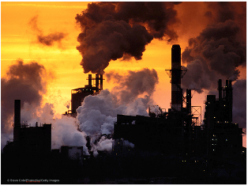
Carbon Fee and Dividend
In Ten Years, Clean Energy Becomes Cheaper than Carbon-based Energy
Notes:
In ten years, CFD will increase to $100 / ton.
Products will have all their costs included in their price
Contain fossil fuels
Made using fossil fuels
Transported using
Clean energy is now cheaper
Products made using clean energy are cheaper
The economy benefits
The environment benefits
(more details)
All of the proceeds from the carbon fee have been recycled back into the economy
We KNOW the benefit are greater than the costs

Slide 5
Carbon Fee and Dividend
Border Tax Adjustments
Price Carbon or Pay a Border Tariff
Notes:
We often hear, What about China?
Carbon Fee and Dividend includes border fee adjustments so that
Tariffs are charged on goods (including fossil fuels) imported into the U.S. from countries that don’t have comparable carbon pricing.
US companies that export manufactured goods to countries without carbon pricing receive refunds of carbon fees.
This levels the playing field for US businesses, and encourages other countries to implement a carbon fee.
Exception
Fossil fuels exported from the US are not eligible for border fee adjustments (carbon fee is not refunded)

Slide 6
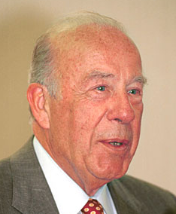
Carbon Fee and Dividend Economists & Conservatives Agree
“It’s not a tax if the government doesn’t keep the money”
George Shultz, Secretary of State to Reagan
“... tax those things we would like to have less of”
Gregory Mankiw, Harvard Professor & economic advisor to George W. Bush
Notes:
Broad support from almost all economists, both liberal and conservative.
Conservatives like:
Revenue neutral
Less regulation
Market-based
No growth in government
Liberals like carbon tax
Good for the environment
Lots of revenue for the government
Compromise is CFD.
George Schultz is an icon of the Conservative right. He says:
1) Revenue Neutral – Key point for Republicans: all money raised goes back to households: does not increase the size of the government.
2) Use market-based forces. Charge polluters the social cost of the pollution they emit.
Harvard’s Greg Mankiw, economic advisor to President George W. Bush and Mitt Romney.
Among economists, the issue is largely a no-brainer…of 41 prominent economists about this statement: “A tax on the carbon content of fuels would be a less expensive way to reduce carbon-dioxide emissions than would a collection of policies such as ‘corporate average fuel economy’ requirements for automobiles.” Ninety percent of the panelists agreed.

