Slide 1


Novel Use of GIS for Spatial Analysis of Fingerprint Patterns
Steve Taylor, Earth and Physical Sciences, Western Oregon University
Ryan Stanley, Geology & Geography, West Virginia University
Emma Dutton, Forensic Services Division, Oregon State Police
Pat Aldrich, Natural Sciences and Mathematics, Western Oregon University
Bryan Dutton, Biology Department, Western Oregon University
Sara Hidalgo, Natural Sciences and Mathematics, Western Oregon University

Slide 2
Introduction
  Project Background
GIS Methodology
  Data Model
  Standardized Coordinate System
  Workflow
Example Applications
  Pattern Characterization
  Geometric Morphometrics
  Monte Carlo Simulations
Summary and Conclusion

Slide 3
NOVEL LINKAGES: GIS AND FINGERPRINT MAPPING
So a Geologist, Biologist and Forensic Scientist walk into a bar…the bartender asks: “How are fingerprints like a volcano?” The Geologist says: “I’m not sure, but I bet we can use GIS to find out”. The punch line follows…
Fundamental
Map Elements
Points
Lines
Polygons
Newberry Volcano
Fingerprint Spatial Data in a GIS
Raster Data | Fingerprint Images
Points | Fingerprint Minutiae
Lines | Fingerprint Ridges
Polygons | Fingerprint Convex Hulls

Slide 4
Western Oregon University
Fingerprint Analysis and Characterization Team
“FACT” Interdisciplinary Collaboration:
Earth Science, Biology and Forensic Science
Three-year National Institute of Justice grant
Project Title: “Application Of Spatial Statistics To
Latent -Print Identifications: Towards Improved
Forensic Science Methodologies”
Project Goal: To apply principles of GIS and spatial
analysis to fingerprint characterization

Slide 5
PROJECT IMPETUS
Feb 2009 National Academy of Science report: “Strengthening Forensic Science in the United States: A Path Forward”
Recommendation 3: Indicated need to improve the scientific accuracy and reliability of forensic science evidence, specifically impression-based evidence, including fingerprints

Slide 6
Objectives
Use Geographic Information Systems spatial analyses techniques to:
Evaluate fingerprint characteristics or attributes
    Minutiae type (bifurcations and ridge endings)
    Minutiae distribution (per finger / pattern type)
    Ridge line distribution
Establish robust probabilistic models to
    Quantify fingerprint uniqueness and
    Establish certainty levels for latent print comparisons

Slide 7
METHODOLOGY

Slide 8
FINGERPRINT MORPHOLOGY AND FEATURES
IDENTIFICATION:
-Minutiae Position
-Minutiae Type
-Minutiae Direction
-Ridge Counts
-Ridge “Flow”
-Print Type
ASSUMPTION:
Fingerprints are Biologically Unique
Minutiae Points
Print Type = LS
Friction Ridge
Lines
Master 1_1li

Slide 9
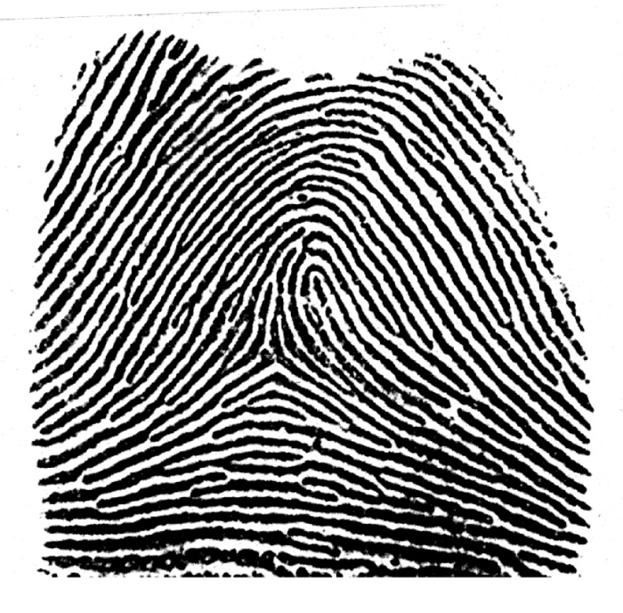
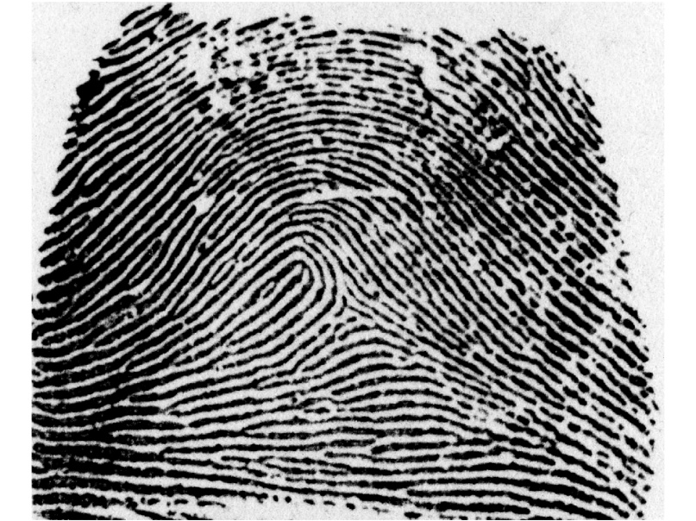
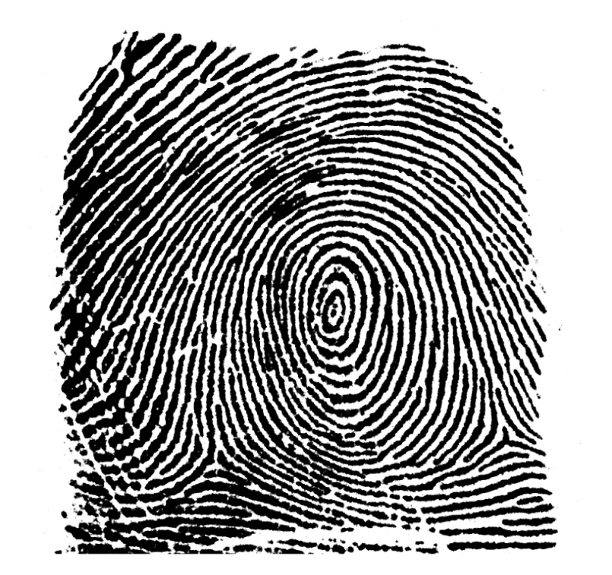
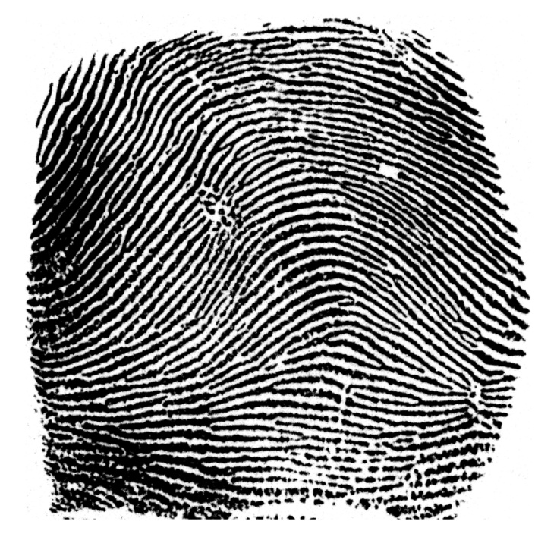
PRIMARY FINGERPRINT TYPES
Right Slant Loop
Left Slant Loop
Arch
Whorl

Slide 10
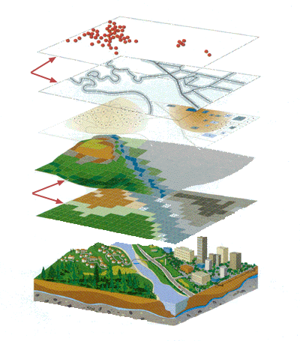
Research Design: Application of GIS
GIS: A collection of hardware and software that integrates digital map elements with a relational database.
Cartography + Database Technology + Statistical Analysis
Vector
Customers
Core to Minutiae Distances
and Ridge Counts
Streets
Parcels
Minutiae
Raster
Elevation
Land Usage
Fingerprint Skeleton
Real World
Fingerprint Image
Source: ESRI
A. Example GIS Application
B. GIS Applied to Fingerprints
Notes:
So some of you may be wondering, what exactly is a Geographic Information System? Well, in the simplest terms, a GIS can be thought of as a collection of software that combines cartography, statistical analysis, and database technology.
GIS has historically been used as a research and decision making tool in the earth sciences. It is used to map the real world and store that digital data in separate layers. For example, information about land usage, soil types, elevation, and tax parcels can all be stored as separate layers, and then later superimposed for visualization or used for conducting a study.
Similarly, fingerprints can be modeled in a GIS, whereby fingerprint features such as ridges and minutiae are captured from a fingerprint image and stored in separate layers.
A GIS works with two primary data types: Raster and Vector. Raster data consists of a matrix of square cells organized into rows and columns, where each cell contains a value representing information. Rasters are digital aerial photographs, satellite imagery, or even scanned maps.
Vector data consists of only points, lines, and polygons. Streets, rivers, and tax parcels can be modeled as vector layers. There are merits to both raster and vector data types, although vector features can be spatially queried or attributed with tabular data.
In our application of GIS, vector layers, such as fingerprint ridges and minutiae, are derived from the raster fingerprint image. These vector layers can be stored in a database and queried according to their attributes.
10

Slide 11
Fingerprint Data Management
Fingerprint image acquisition and minutiae detection
Georeferencing and verification
GIS data conversion and management
  Raster fingerprint images
  Vector minutiae point layers
  Vector friction ridge line layers
Spatial analysis of ridge line and minutiae distributions
Statistical analysis and probability modeling

Slide 12
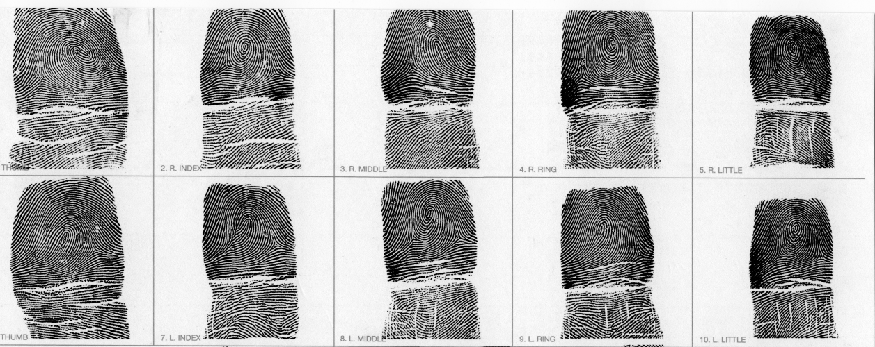
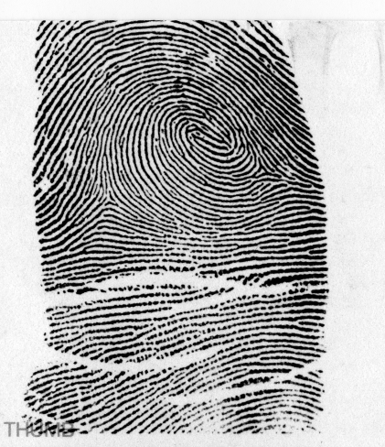
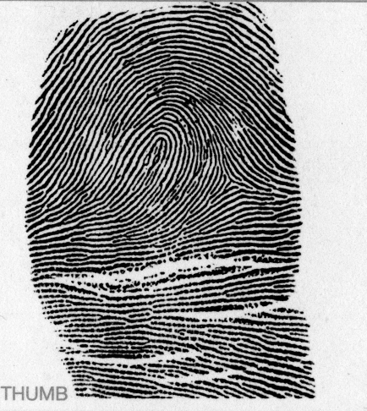
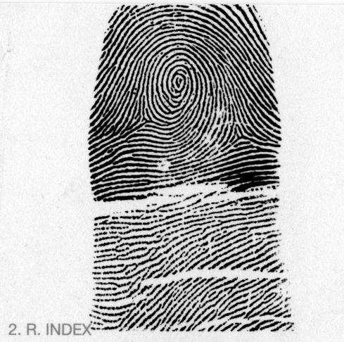
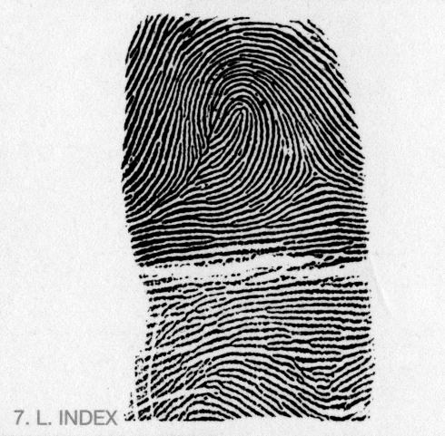
Scan, Segregate & Image Enhancement
Noise filter, black/white balance, contrast & brightness enhancements
Notes:
12

Slide 13
Geo-referencing: Standardized Coordinate System
Core Location
  Arches = highest point of recurve
  Loops = highest point of recurve of 1st full loop
  Whorls = center ridge ending or bulls eye
Core centered at (100,100) mm in Cartesian space
Print oriented with basal crease parallel to X-axis
Notes:
13

Slide 14
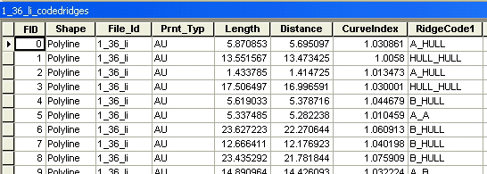
GIS Data Conversion
Fingerprint Image
Fingerprint Minutiae
100
100
100
100
Skeletonized Ridge Lines
Ridge and Minutiae Attribute Data
100
100

Slide 15
Fingerprint Skeletonization and Vectorization
Core to Delta Ridge Count
Ridges | 16
Distance | 11.11 mm
Line Density | 1.53 ridges/mm
Coded Ridgeline Attributes
Notes:
As part of our methods, fingerprints are skeletonized and vectorized so we can perform spatial analyses on the ridgeline geometries. Once the ridges are in vector form, we can draw lines between fingerprint features and spatially intersect the lines to determine ridge counts between points. We’ve created a tool that counts ridges between the delta and core of a fingerprint. This finger has 16 ridges between the core and delta.
Vectorized ridge lines lack attribute data when they are initially created, so we built a tool that analyzes the geometry of vectorized fingerprint ridges and codes ridges based upon the features that exist at the ridgeline endpoints. Here we’ve identified six different ridgeline types based upon their ending features. Additionally, line length and line curvature are calculated for each ridge. Once these ridges have been coded, they can be queried from a database or compared to other fingerprint skeletons. It also allows us to create minutiae point files directly from the vectorized fingerprint.
15

Slide 16
FACT Fingerprint Database
Table 1. Frequency of Pattern Type by Finger and Hand
FINGER | Left Loop | Right Loop | Double Loop Whorl | Whorl | Arch | Tented Arch | TOTAL
Left Index | 125 | 45 | 28 | 58 | 18 | 30 | 304
Right Index | 48 | 110 | 15 | 78 | 21 | 36 | 308
Left Thumb | 173 | 2 | 66 | 41 | 9 | 0 | 291
Right Thumb | 2 | 152 | 63 | 74 | 6 | 0 | 297
TOTAL | 348 | 309 | 172 | 251 | 54 | 66 | 1200
HAND | Left Loop | Right Loop | Double Loop Whorl | Whorl | Arch | Tented Arch | TOTAL
Left Hand | 298 | 47 | 94 | 99 | 27 | 30 | 595
Right Hand | 50 | 262 | 78 | 152 | 27 | 36 | 605

Slide 17
Project Data Model and Analytical Workflow
100 - Data Collection Methods | 200 - Pattern Characterization Methods | 300 – Statistical/Probability Modeling Methods
Image Database Entry | Dart Board Min-Point Frequency-Density Quadrat | Minutiae Azimuth Frequency Histograms
Core-to-Minutia Point-to-Point Digitization
Delta-to-Minutia Point-to-Point Digitization | Thiessen Polygons I (Clipped to Hull)
Minutia-to-Minutia Point-to-Point Digitization I (w/o Core + Delta) | Thiessen Polygons II (Dissolved by Min-Type) | Minutiae Azimuth Frequency Rose Diagrams
Minutia-to-Minutia Point-to-Point Digitization II (with Core + Delta) | TIN Polygons | Radar Plot Minutiae Positions (azimuth vs. dist. from core)
Ridge Counts | Min-Point Frequency Density Quadrat (2 mm Grid) | Nearest Neighbor Analysis
Ridgeline Skeletonization |  | Principle Components Analysis (PCA)
Core-Only Point Layer | Ridge Line Frequency Density Quadrat (2 mm Grid)
Delta-Only Point Layer
Convex & Detailed Hull Bounding Polygons |  | Generalized Procrustes Analysis (GPA)
Axis Layer (Longitudinal/Transverse) | Ridge Line Frequency Density TIN-Based & Thiessen Polygon-Based | Thin-Plate Spline (TPS) Deformation Modeling
Minutiae Buffers
Coded Ridgelines | Superimposition
Landmark/Semilandmark Designation

Slide 18
Example GIS-Based Extension
TIN (Delaunay) Triangles
1. Vectorized fingerprint
2. Minutiae
3. TIN polygons
4. TIN polylines
5. TIN ridge counts
Notes:
Triangular irregular networks (TIN) have been used by the GIS community for many years and are a digital means to represent surface morphology. TINs are a form of vector-based digital geographic data and are constructed by triangulating a set of points based on the Delaunay triangulation method. The points are connected with a series of edges to form a network of triangles.
In our project, TIN triangles are created by triangulating fingerprint minutiae. Once TIN polygons are created from a minutiae pattern, they are spatially intersected with the corresponding vectorized fingerprint ridges to obtain ridge counts.
18

Slide 19
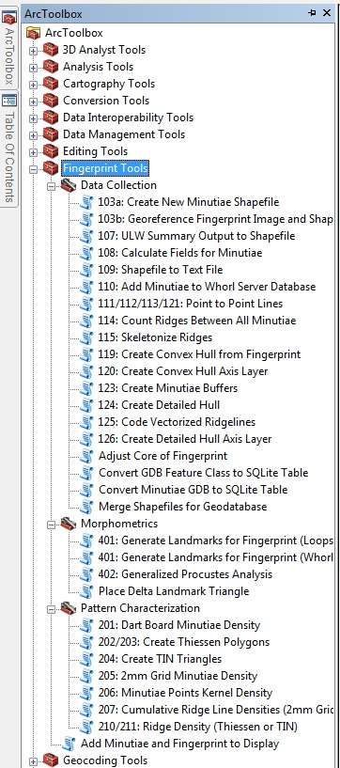
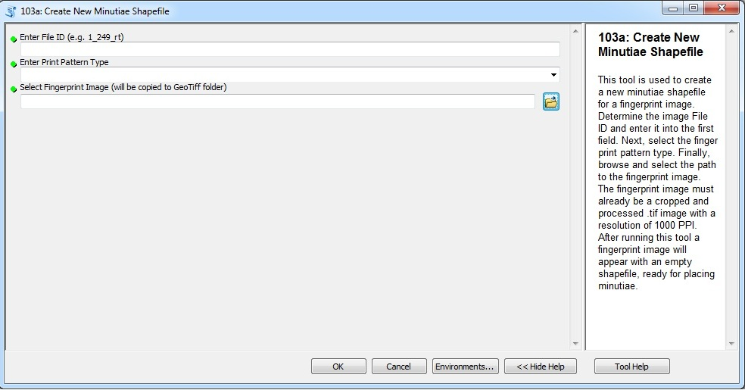
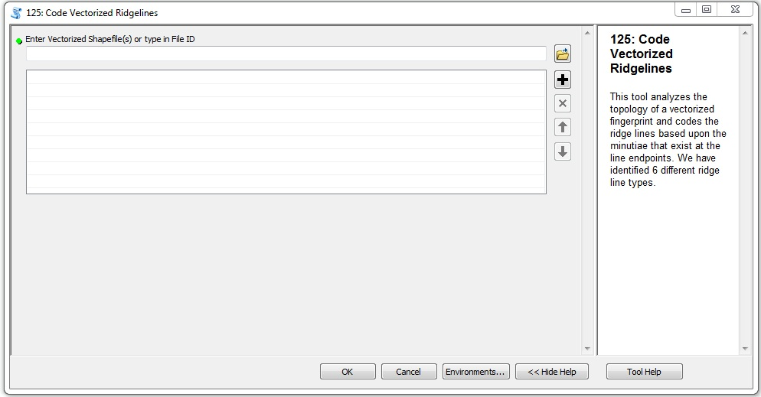
Custom Python Scripting and Fingerprint Analysis Tools

Slide 20
EXAMPLE APPLICATIONS:
Pattern Characterization

Slide 21
2-mm Grid Cell Minutiae Density
All Minutiae
0 0.001 0.01 0.036 0.076 0.14 0.436
A. Left Slant Loops
n = 348
C. Whorls
n = 251
E. Arches
n = 54
B. Right Slant Loops
n = 309
D. Double Loop Whorls
n = 172
F. Tented Arches
n = 66
Notes:
Again this slide shows all six print pattern classes. Each figure depicts a grid composed of 2mm by 2mm cells with minutiae density values coded in each cell. They are symbolized such that the red regions depict more minutiae per sq. mm, and the blue regions show fewer minutiae per sq. mm. In the left and right slant loops, minutiae are denser near the delta regions. This clustering of minutiae in the delta regions is consistent with the rose diagrams I previously displayed. Whorl print types have similar minutiae distributions, but arches and tented arches differ. Tented arches are denser in the center, likely due to the center up thrusting ridge found in tented arches.
21

Slide 22
2-mm Grid Cell Ridge Line Density
A. Left Slant Loops
C. Whorls
E. Arches
B. Right Slant Loops
D. Double Loop Whorls
F. Tented Arches
Notes:
Now only bifurcation density values are displayed. Each print type shows that bifurcations are densest near and below the core regions.
22

Slide 23
Minutiae / Ridge Frequency Ratio
Compared minutiae / ridge count ratios above and below the core for 188 vectorized fingerprints (all pattern types)
Paired t-test:
  t = -24.525, df = 187
  mean difference = -0.19
  p-value < 2.2e-16
Difference in minutiae / ridge ratios above and below core is significant with a p < 2.2e-16
Above Core
Minutiae: 33
Ridge Lines: 81
Minutiae/Ridge Ratio: 0.41
Below Core
Minutiae: 63
Ridge Lines: 100
Minutiae/Ridge Ratio: 0.63
Notes:
We know that minutiae and ridges are unevenly distributed around the core with more minutiae and ridges below the core. Using 188 vectorized fingerprints, we obtained minutiae to ridge frequency ratios above and below the core and conducted a paired t-test using the ratios. After normalizing by ridge frequency below and above the core we see that there is still a significant difference in the distribution of minutiae. This means some factor other than pure ridge counts may be contributing to the uneven distribution of minutiae above and below the core.
23

Slide 24
Findings: Pattern Characterization
Project Compilation:
  1,200 fingerprints
  102,000 minutiae
  20,000 ridge lines
Avg. No. Minutiae per Print = 85.1
Ridge Ending/Bifurcation Ratio = 1.4
Minutiae and ridge lines most densely packed in the region below the core, with the greatest line-length density surrounding the core
Increased ridge line curvature associated with increased minutiae density

Slide 25
EXAMPLE APPLICATION:
Geometric Morphometrics

Slide 26
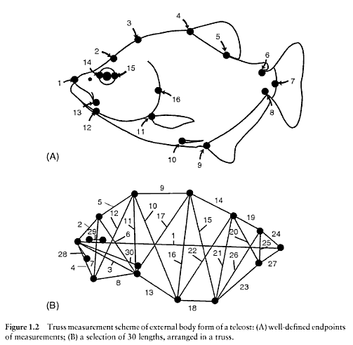
Geometric Morphometrics
A spatial statistical method to study biological shape
Requires the designation of points or areas that are homologous across samples (landmarks and semi-landmarks)
Allows shape variation analysis across samples by removing size and rotation effects
Figure from Zelditch, M.L., D.L. Swiderski, H.D. Sheets, and W.L. Fink. 2004. Geometric Morphometrics for Biologists: A Primer. Elsevier Academic Press: London.

Slide 27
Fingerprint Morphometrics
Example Left Slant Loop

Slide 28
Findings: Geometric Morphometrics
Geometric morphometric techniques are applicable to fingerprint patterns
Potential Research Directions:
  Geometric comparison of fingerprint types between left and right hands
  Analysis of hyper-variable regions of fingerprints outside landmarks and semilandmarks
  Analysis of the effects of elastic skin deformation and spatial distortion in fingerprints

Slide 29
EXAMPLE APPLICATION:
Monte Carlo Simulation and Estimating False Match Probabilities

Slide 30

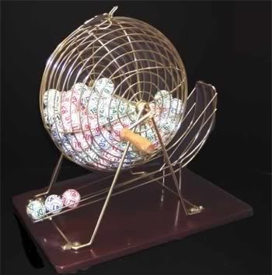
Monte Carlo Simulation
Iterative random sampling of select minutiae to obtain probabilities of false matches based on coordinate location and point attributes
9 grid-filter cells, each overlapping by 50% across entire print space
3-5-7-9 minutiae systematically sampled in each grid cell
Simulation iterated 1000 times per print per grid cell
50 prints selected across four pattern types (LS Loops, RS Loops, Whorls, Double Loop Whorls) yielding a total of 50,000 iterations per grid cell

Slide 31
Monte Carlo Simulation:
Looking for False matches
Legend
Fingerprint Convex Hull
Ridge Ending
Bifurcation
Core
Delta
120
Grid Cell 7
Grid Cell 8
Grid Cell 9
Grid Cell
110
Y Coordinate (mm)
Grid Cell 6
Grid Cell
Grid Cell 4
100
Grid Cell 5
90
Grid Cell 1
Grid Cell 2
Grid Cell 3
Grid Cell
80
70
80
90
100
110
120
130
X Coordinate (mm)
Notes:
This iterative simulation is known as a Monte Carlo Simulation. A monte carlo simulation is similar to the lottery. Think about how the lottery works. You have 49 numbers total. Every week, 7 of those numbers are drawn at random. You then compare those 7#s to the ticket you have in your hand (and everyone else with a ticket does the same thing). If you match you are the winner. We are doing the same thing with our data. We take a fingerprint, and randomly draw a set number of minutia. We then compare that set to our entire database. If that set matches, we have a possible false match. We do this process 1000s of times to get an estimate of how likely a region on a fingerprint will produce a false match.
In addition, we want to mimic what latent examiners are seeing. They rarely get a whole fingerprint. So we have carved up the fingerprint into 9 different boxes and then perform our simulation within those boxes.
31

Slide 32
Example False Match – 7 Minutiae, Grid Cell 5
Selected Print:
LS Loop – Left Index
False Match:
Whorl – Left Thumb
Y Coordinate (mm)
Y Coordinate (mm)
X Coordinate (mm)
Matching Minutiae
X Coordinate (mm)

Slide 33
Findings: Monte Carlo Simulations
The probability of a false match decreased as the number of selection attributes increased in the MC model.
The probability of a false match decreased as the number of selected minutiae increased.
The probabilities obtained in this study are aligned with other published results that utilize alternative methods and sample sources.

Slide 34
Summary and Conclusion

Slide 35
Techniques in Geographic Information Systems were successfully applied to spatially analyze fingerprint patterns
The georeference protocol developed for this study provides a standardized coordinate system that allows complex analysis of minutiae and ridgeline distributions across fingerprint space
A wide variety of spatial analysis tools were developed in the GIS software environment to characterize fingerprint features and statistically characterize distributions between print types
GIS application to fingerprint analysis, identification and pattern characterization represents an untapped resource
The project-related GIS tools and preliminary results offer promising contributions to the advancement of fingerprint analysis and forensic science in the near future.

Slide 36
FUTURE WORK
Apply rubber sheeting and ortho-rectification techniques to elastic skin deformation associated with traditional analog print collection techniques
Conduct Nearest Neighbor false-match simulations using randomly chosen clusters of minutiae
Refine Monte Carlo simulations to capture false-match probabilities at higher minutiae counts
Expand the project database to include fingerprint samples beyond the existing Oregon data set
Standardize the GIS tools and data framework

Slide 37
Acknowledgements
National Institute of Justice (Grant Award # 2009-DN-BX-K228)
Western Oregon University
Oregon State Police, Forensic Services Division and ID Services Division
Undergraduate and Graduate Student Assistants
This project was supported by Award No. 2009-DN-BX-K228 awarded by the National Institute of Justice, Office of Justice programs, U.S. Department of Justice. The opinions, findings, and conclusions or recommendations expressed in this publication/program/exhibition are those of the author(s) and do not necessarily reflect those of the Department of Justice.

