Slide 1
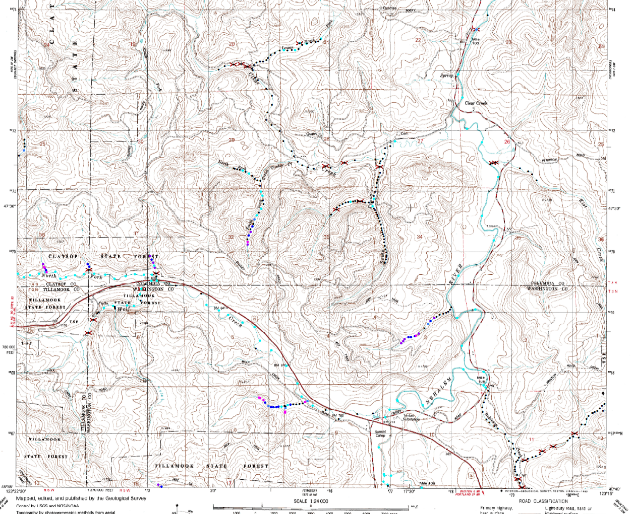
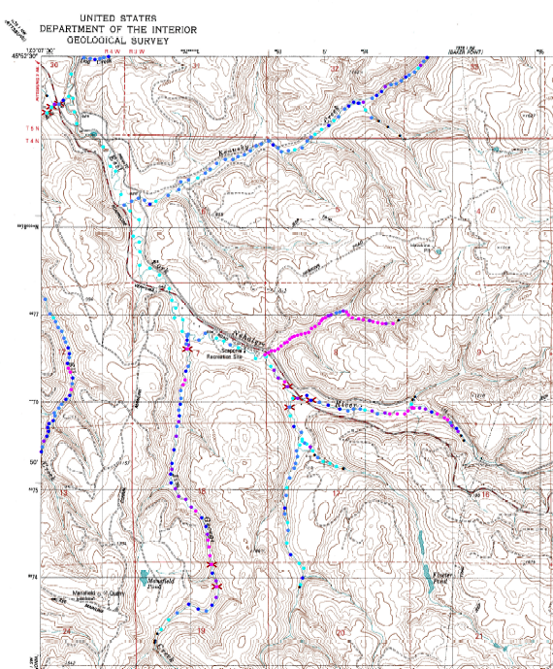
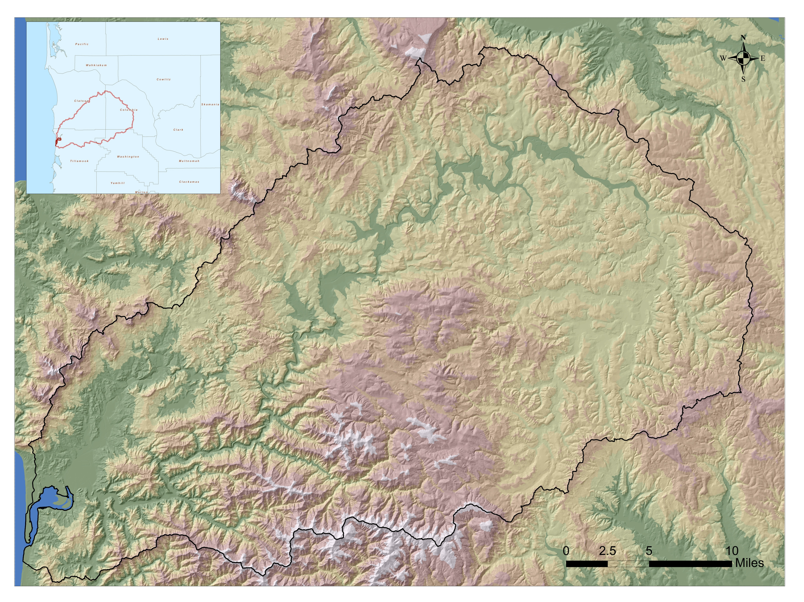
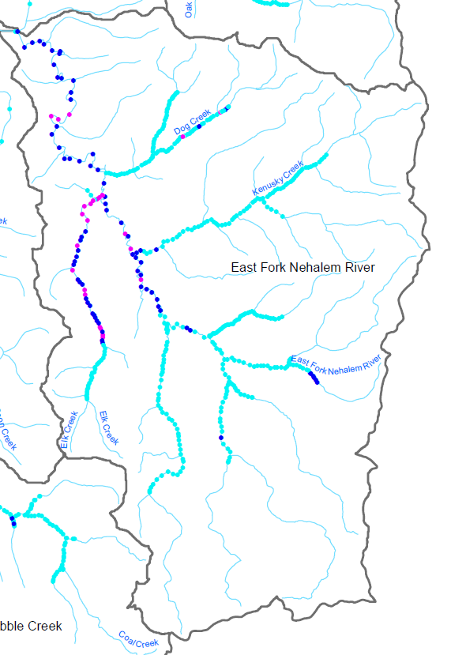
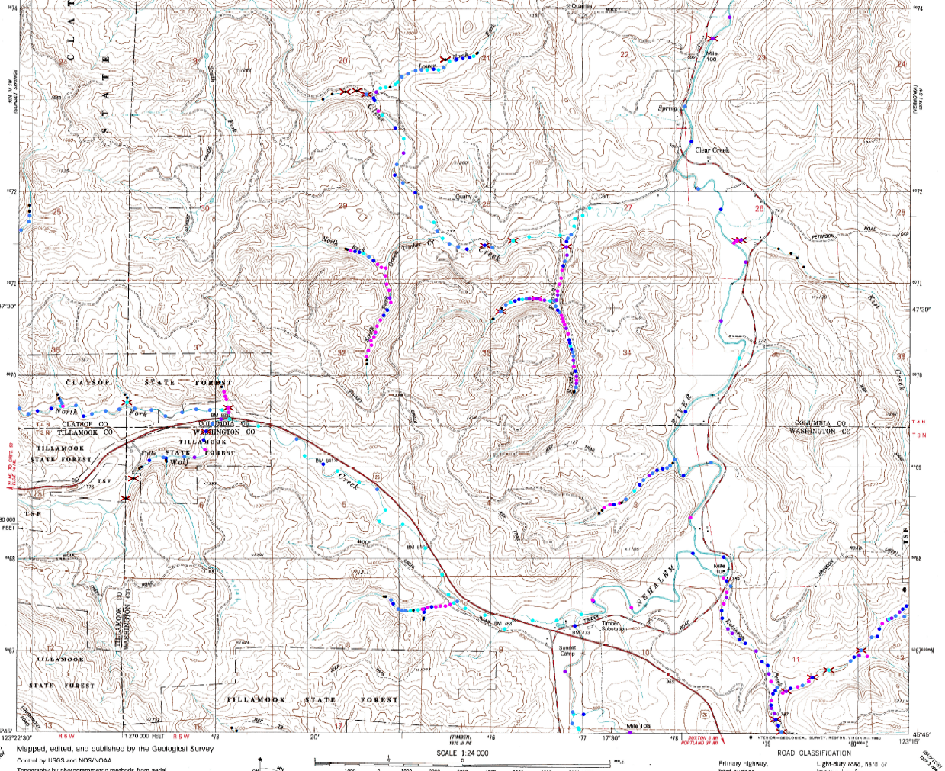
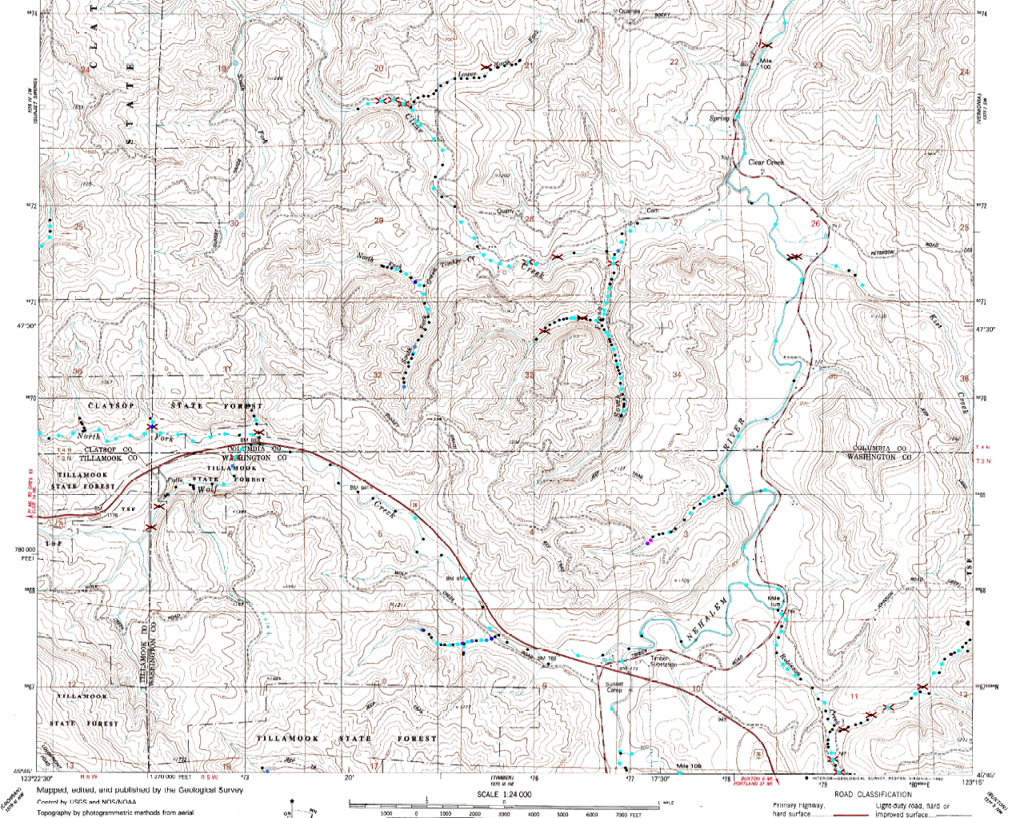
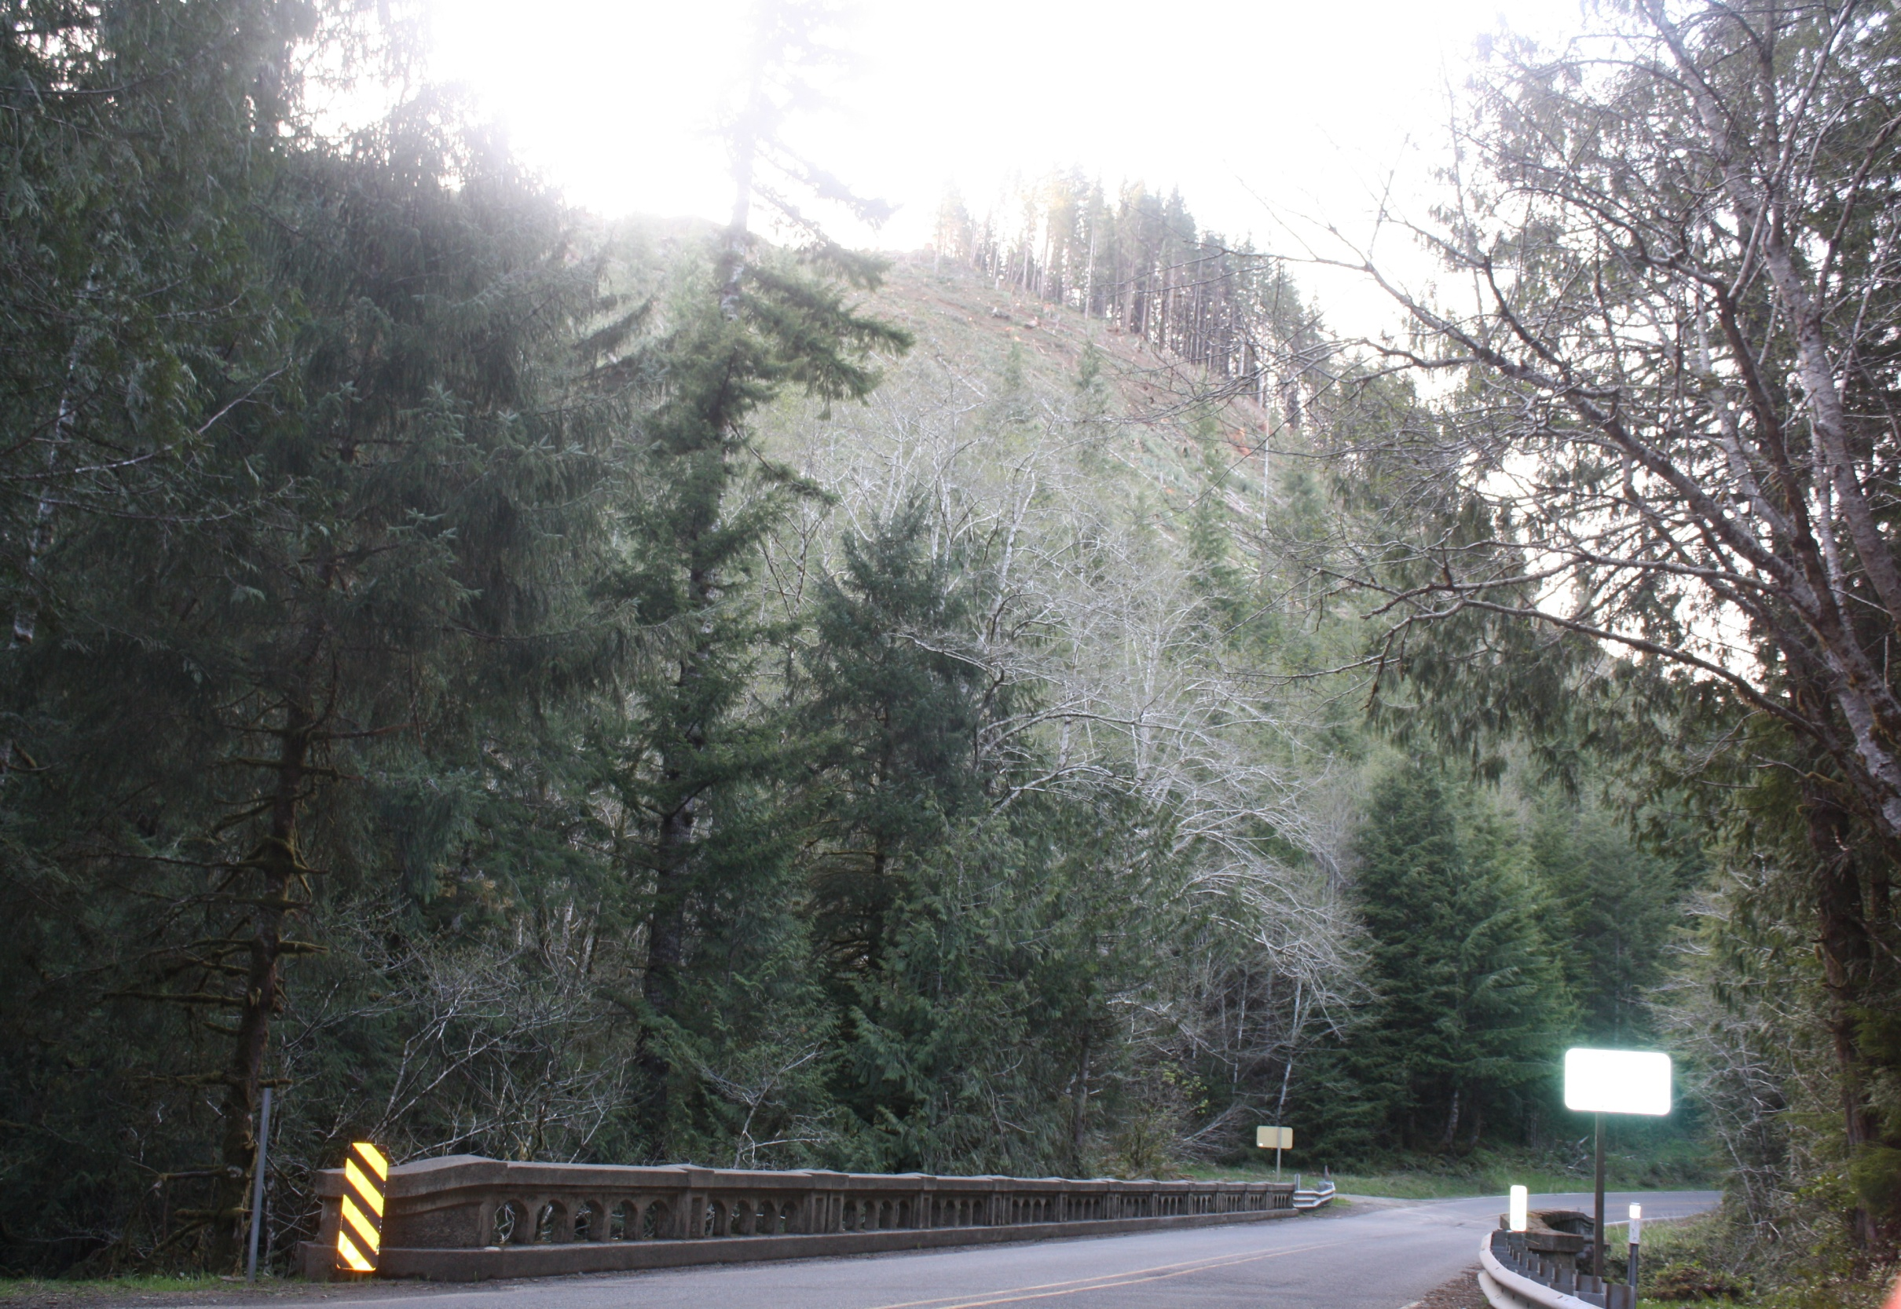
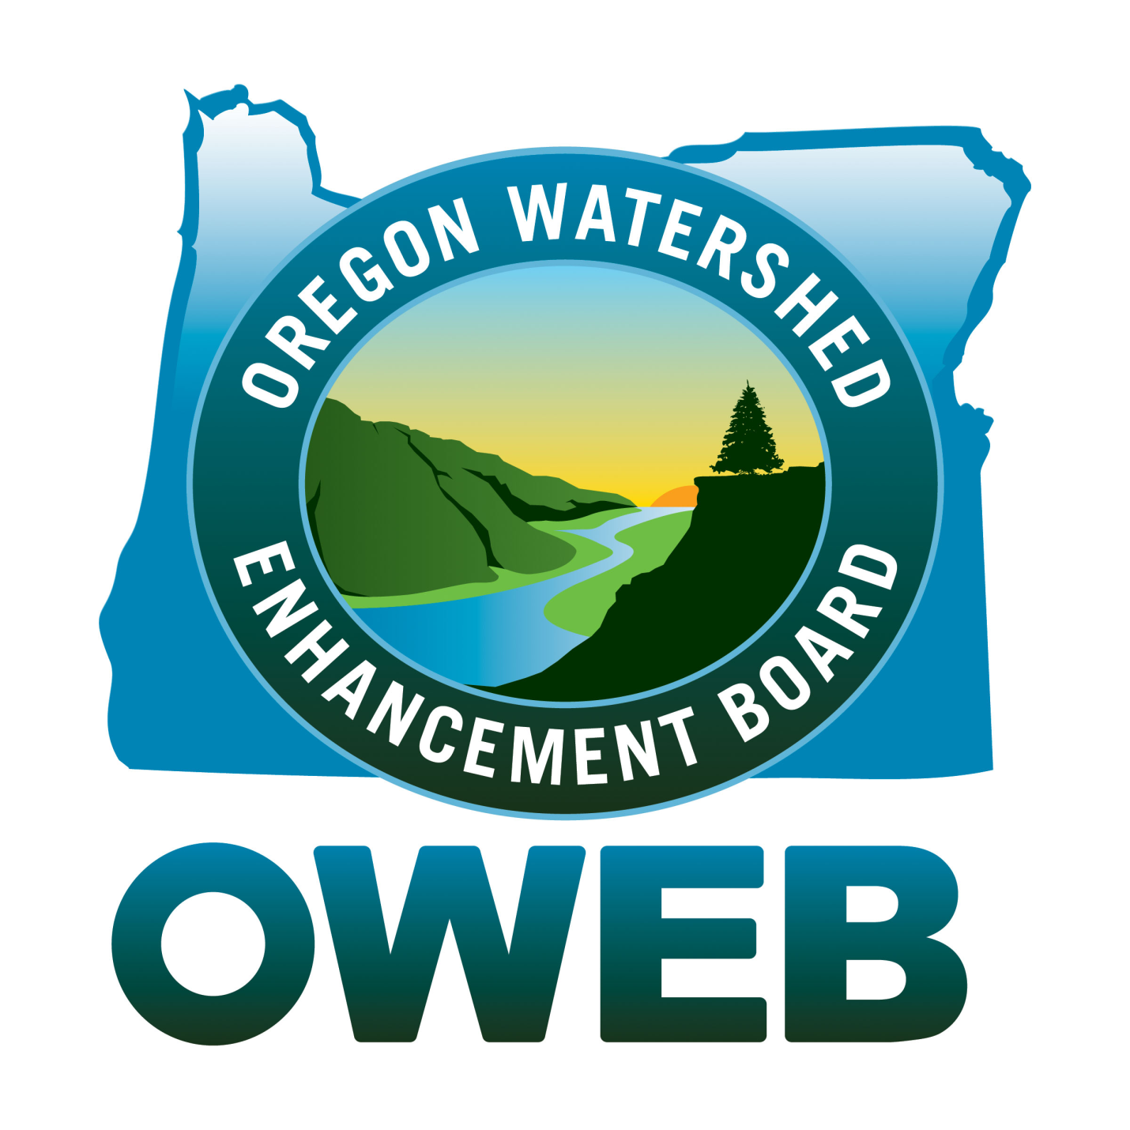
Georeferencing Rapid Bio-Assessment Survey Data: GIS Applications in the
Upper Nehalem Watershed, Oregon.
William Vreeland
Earth and Physical Sciences Department, Western Oregon University, Monmouth, Oregon 97361
Faculty Mentor: Steve Taylor
Abstract:
Rapid Bio-Assessment (RBA) Surveys were conducted in the Upper Nehalem Watershed over three summers commencing in 2008. These surveys involved observations of fish counts, riparian pool surface dimensions, and population densities at numerous locations throughout the watershed. The data gathered were georeferenced using linear referencing tools available in ArcMap and subsequently used to generate a series of salmonid distribution maps. These materials were created to provide assessment information to stakeholders in the upper Nehalem Watershed, and support additional research on the geology, geomorphology, and riparian habitat conditions in north coastal Oregon. Georeferenced RBA map products are available at wou.edu/las/physci/taylor/nehalem/nehalem_rba_maps.htm.
Discussion:
Rapid Bio-Assesment (RBA) of fish populations in the Upper Nehalem watershed were conducted during the summers of 2008-2010 by Bio-Surveys LLC. Field data were recorded and entered into a database format, which in turn were converted by the Western Oregon University GIS lab into georeferenced data layers. Georeferencing was accomplished by an algorithm which transformed stream distance from tributary mouth into routed event themes. Tributaries were uniquely identified by the latitude and longitude coordinates (LLID) at the junction with the next stream order. The converted distances were georeferenced using tools in the ArcGIS Linear Referencing Tools, including conversion of the tributary network into upstream routes. This procedure resulted in a points shapefile projected in UTM Zone 10N, NAD27. Each unique, geo-referenced map location, or point, was attributed with field observations of pool dimensions, stream conditions, fish species, and fish counts from snorkel surveys of every 5th pool. Nearly 8,000 pool observations from throughout the Upper Nehalem Watershed were converted to georeferenced feature classes over the period of the study. Technical assistance from Ryan Stanley enabled production of more than 100 individual 7.5-minute USGS Topographic maps in PDF format at 1:24,000 scale, overlain with data iterated by year, fish species, and quadrangle. These materials were created to provide information to stakeholders in the upper Nehalem Watershed, and support additional ongoing research into environmental systems, morphologies, and processes in north coastal Oregon.
Figure 4a
Figure 2
Figure 4b
Figure 3
Figure 1
Acknowledgements
This work would not have been possible without the guidance and dedication of Dr. Steve Taylor. Financial support provided by The Upper Nehalem Watershed Council with funds derived from the Oregon Lottery and distributed by the Oregon Watershed Enhancement Board.
Figure 4c
Guide to Figures
Figure 1. Location Map of Nehalem Watershed in North Coastal Oregon.
Figure 2. Excerpt of Bacona Quad showing 2009 Coho densities.
Figure 3. Excerpt of Bacona Quad showing stream visibility (turbidity).
Figure 4a. Excerpt of Clear Creek Quad depicting 2009 Juvenile densities.
Figure 4b. Excerpt of Clear Creek Quad depicting 2009 Coho densities.
Figure 4c. Excerpt of Clear Creek Quad depicting 2009 Cutthroat densities.
Figure 5. Recently logged slope near Soapstone Creek.
Figure 5
Email: vreelandw@wou.edu

