Slide 1
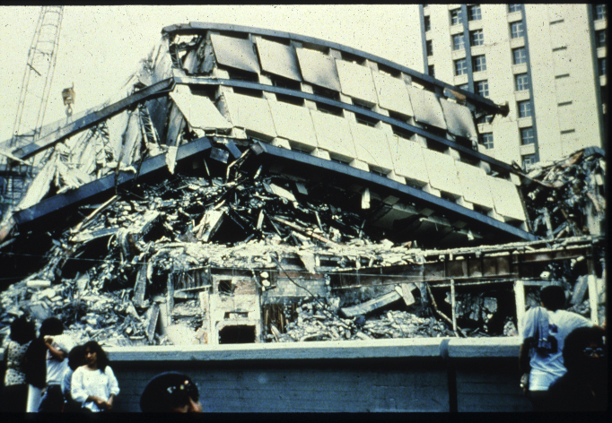
ES104 Earthquakes
Deadliest Historic Earthquakes:
Shensi, China, Jan. 23, 1556
Tangshan, China, July 27, 1976
Aleppo, Syria, Aug. 9, 1138
Sumatra, Indonesia, Dec. 26, 2004
Haiti, Jan 12, 2010
Damghan, Iran, Dec. 22, 856
Haiyuan, China, Dec. 16, 1920
Largest Magnitude Earthquakes in History:
Valdivia, Chile, 22 May 1960 (M9.5)
Prince William Sound, Alaska, Mar. 1964 (M9.2)
Sumatra, Indonesia, 26 Dec. 2004 (M9.1)
Sendai, Japan, 11 March 2011 (M9.0)
Kamchatka, Russia, 4 November 1952 (M9.0)
Bio-bio, Chile, 27 February 2010 (M8.8)

Slide 2
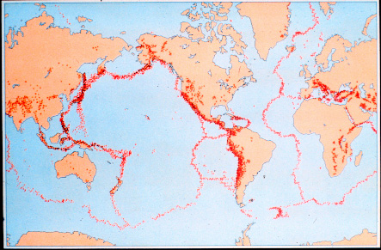
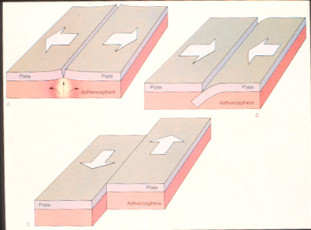
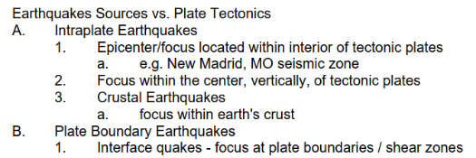
Global Seismic Distribution of Historic Epicenters

Slide 3
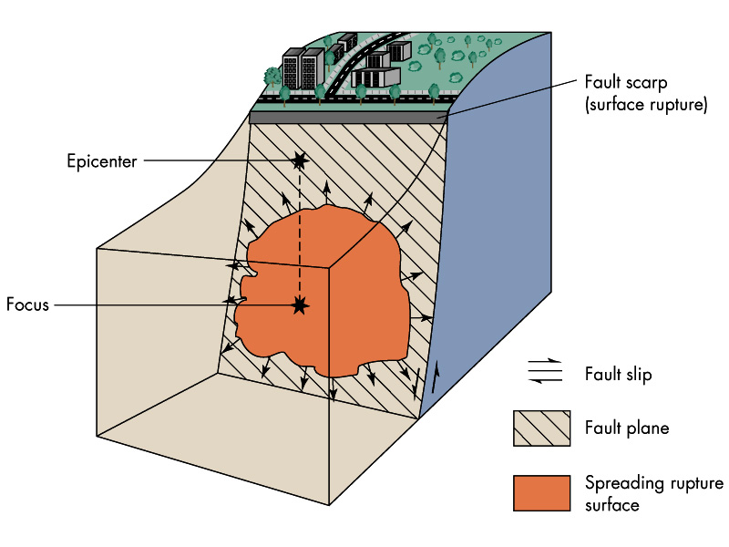
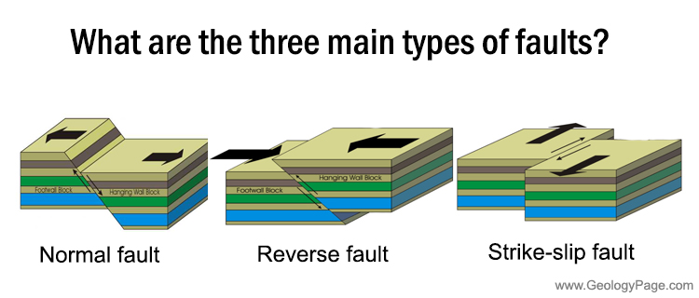
Fault-Rupture Earthquake Sources

Slide 4
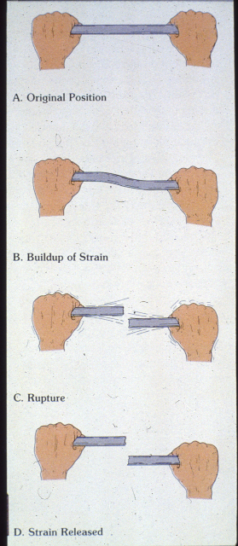
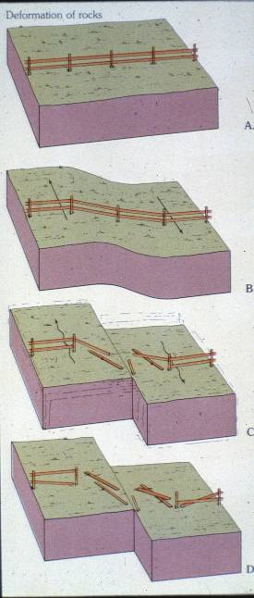
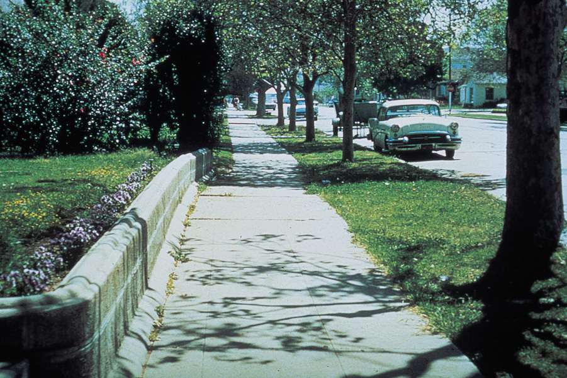
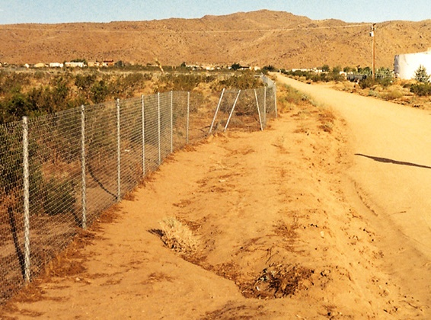
Tectonic Forces and Rock Deformation (Compression vs. Tension)

Slide 5
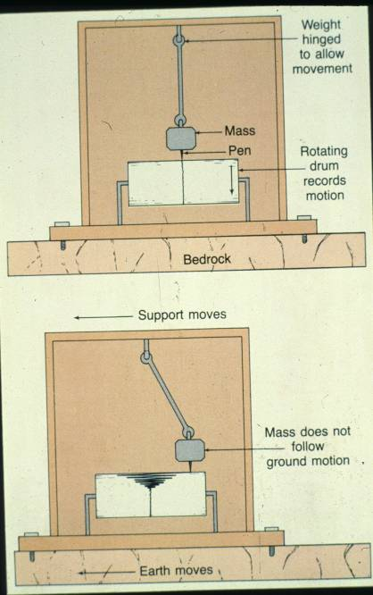
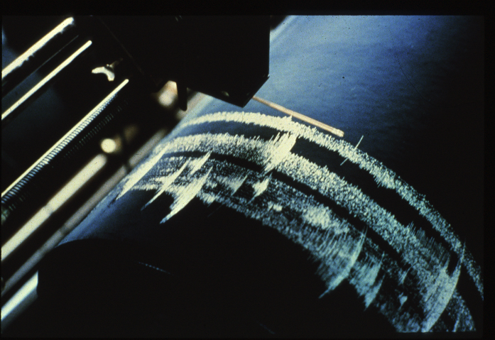
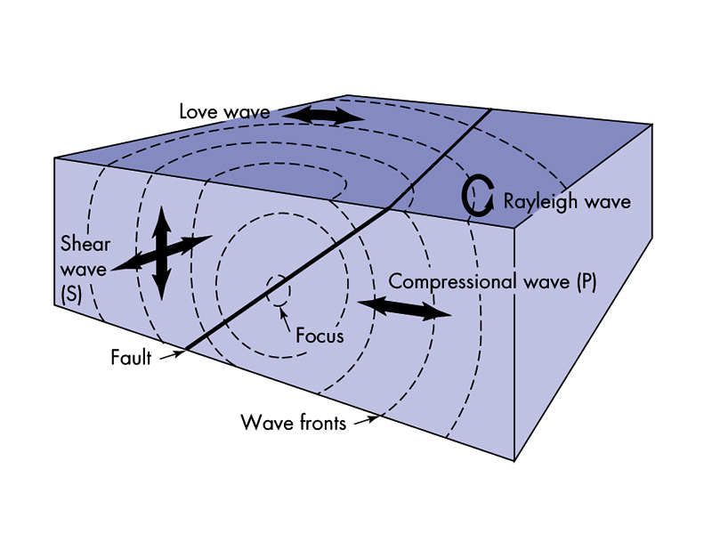
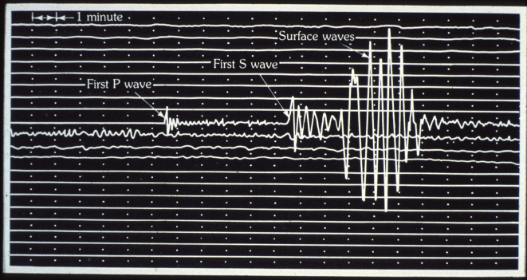

Slide 6
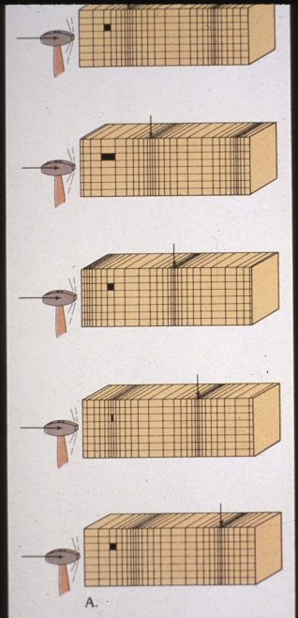
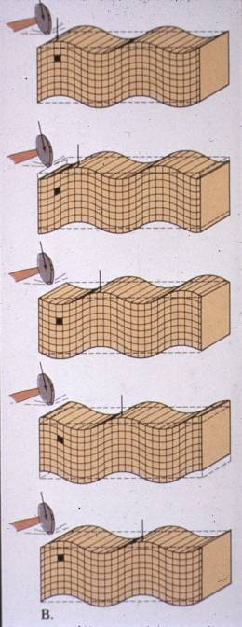
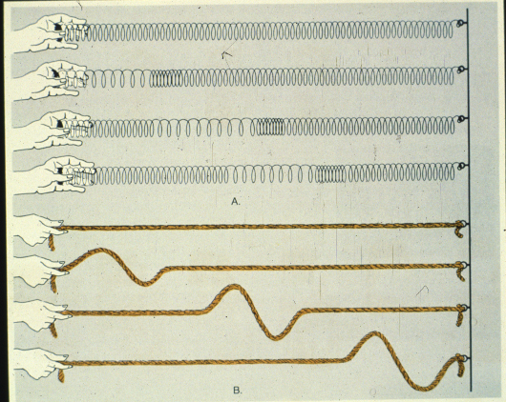
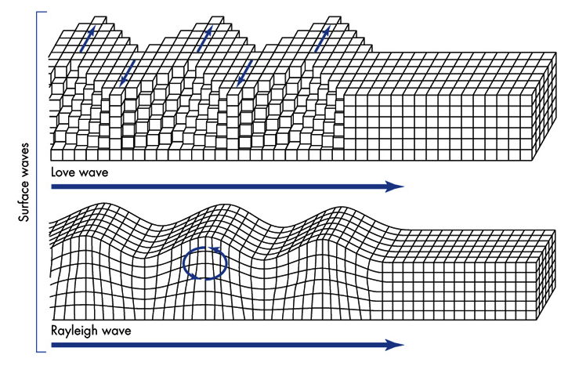
P Waves (Fast)
S Waves (Medium)
Seismic Wave Velocity
P Waves
S Waves
Surface Waves (Slow)

Slide 7
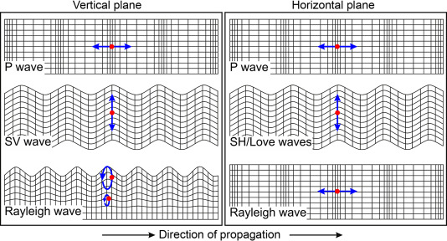
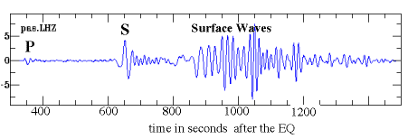
Seismic Wave Races: EQ Focus to Seismic Station Time Trials
S Waves (Medium – Second to Arrive))
P Waves (Fast – First to Arrive)
Surface Waves (Slower – Last to Arrive)

Slide 9
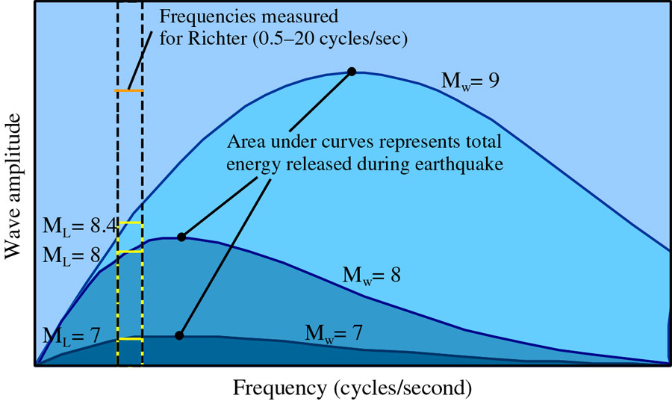
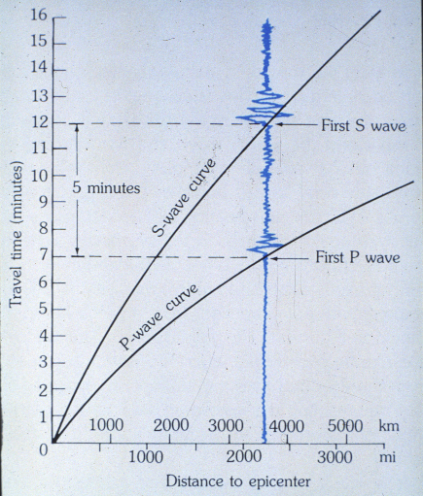
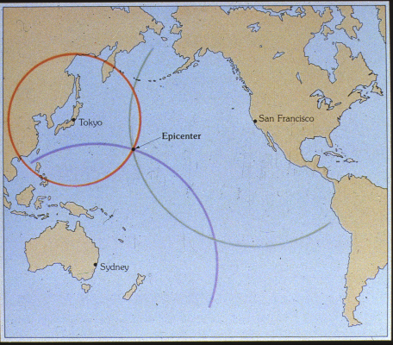
Seismic Magnitude and Epicenter Location

Slide 10
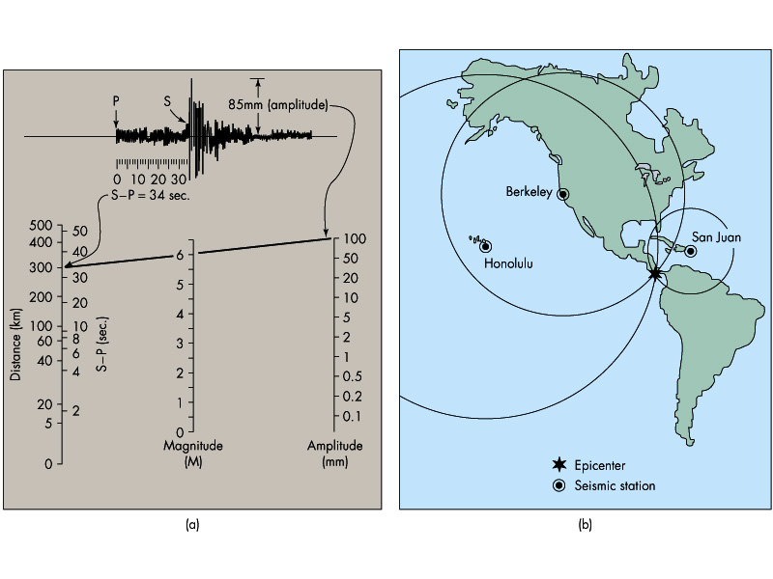
Seismic Magnitude and Epicenter Location

Slide 11
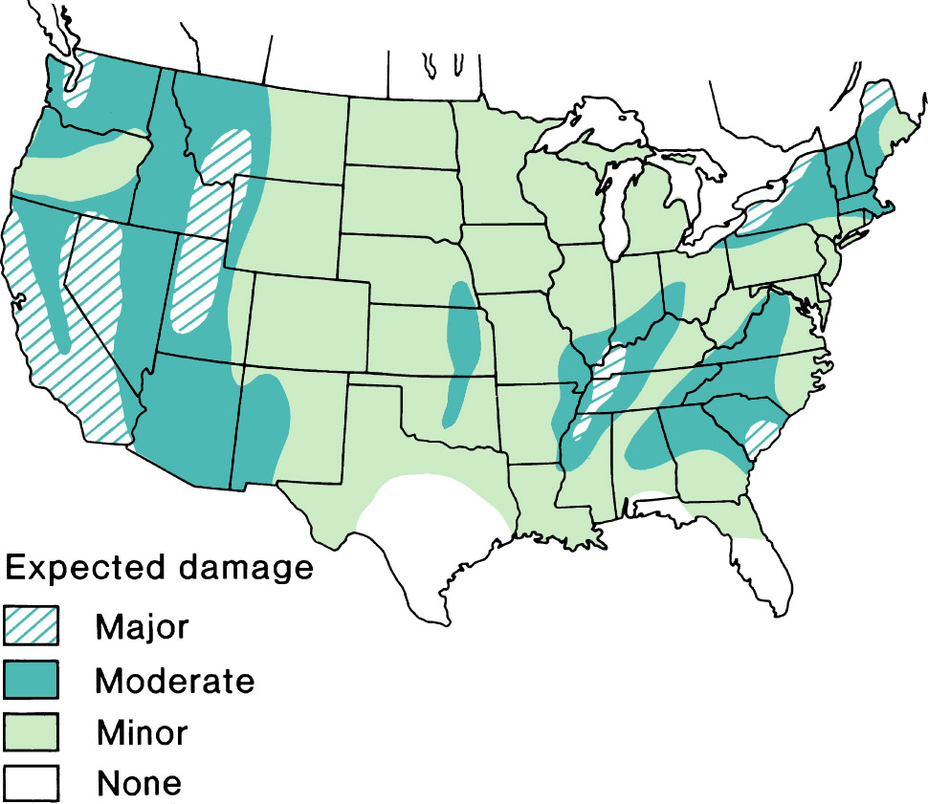
Earthquake Risk Map in the U.S.

Slide 12
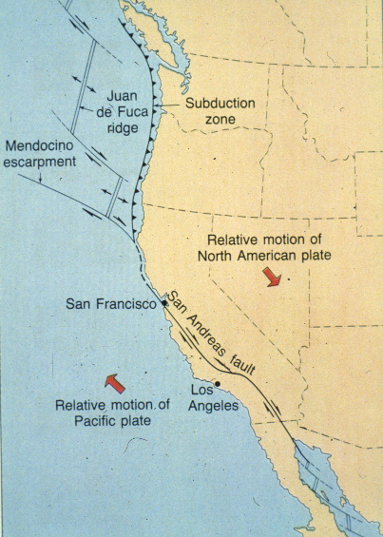
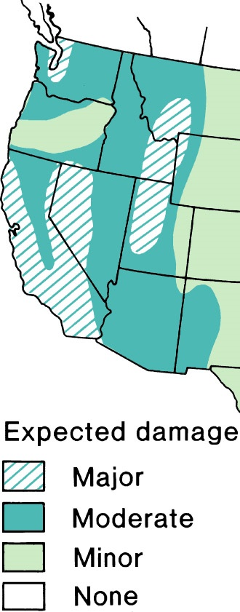
Plate Tectonics Controls Earthquake Occurrence

Slide 13
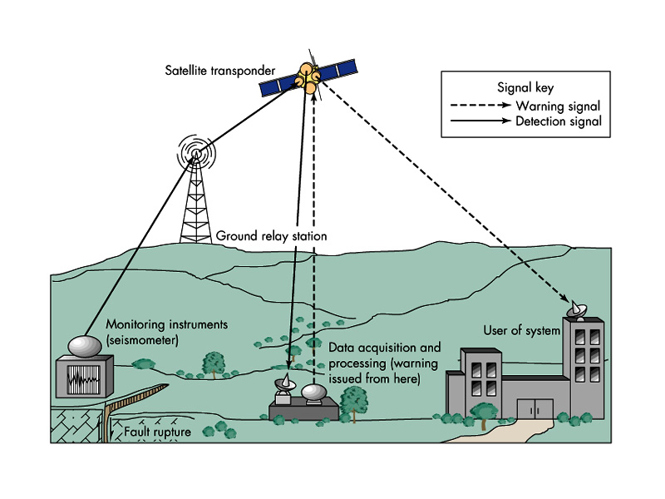
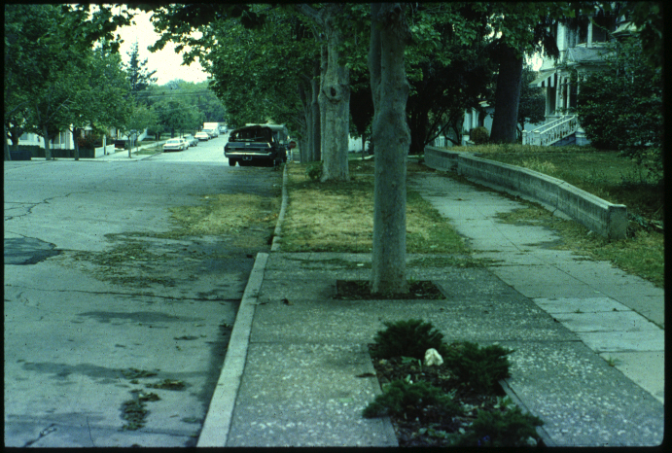
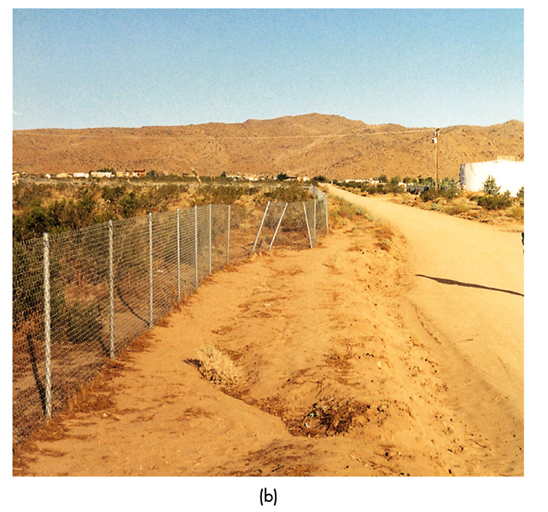
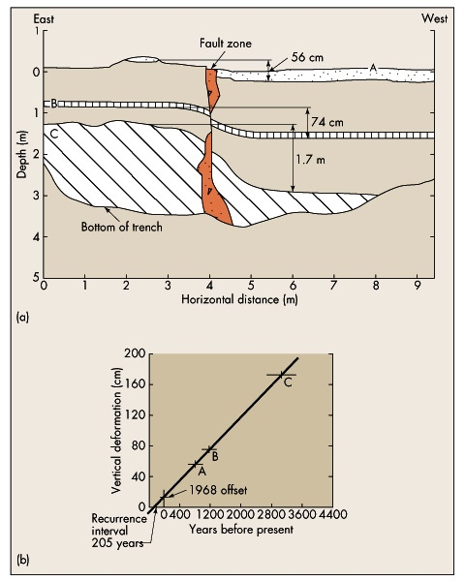
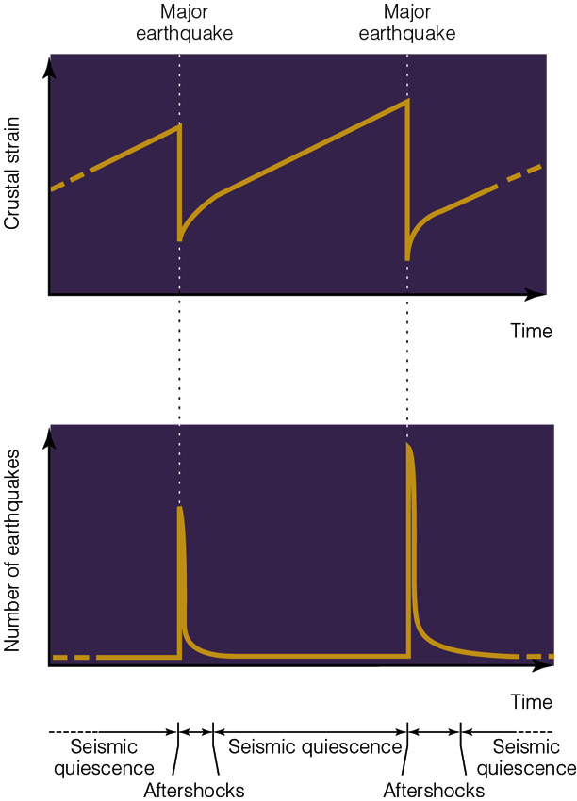
Seismic Monitoring and Warning Systems
Real-Time Ground Deformation Studies
Seismograph Stations
Fault Trenching / Paleoseismology Studies

Slide 14
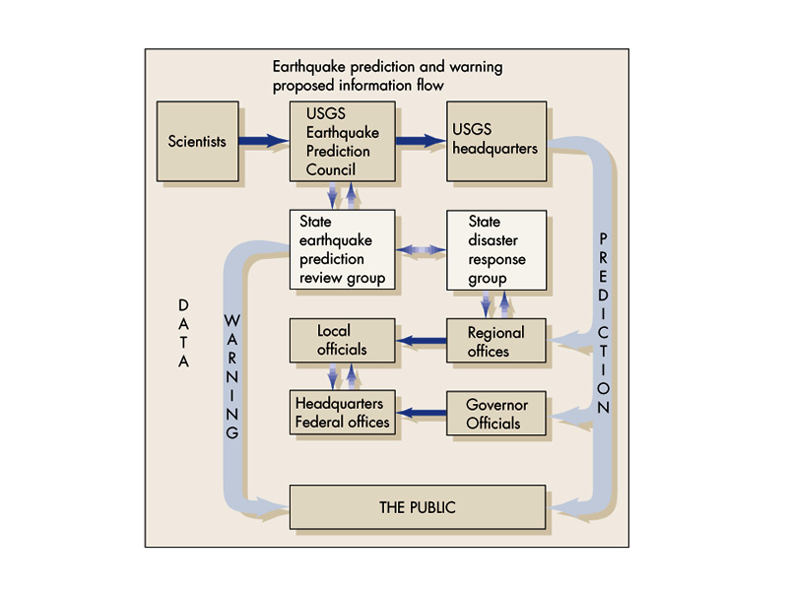

Slide 15
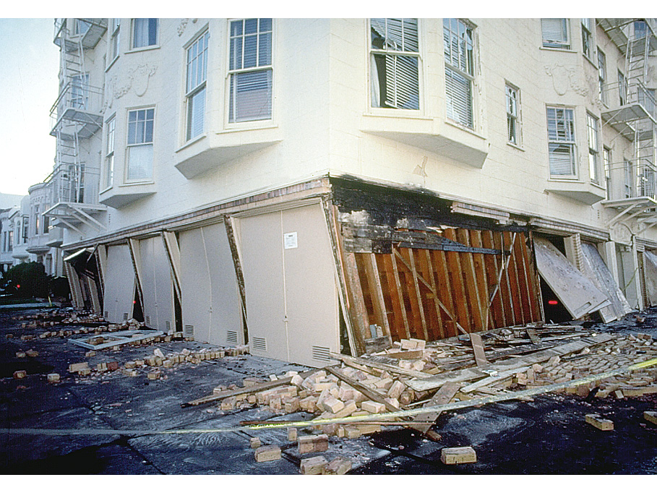
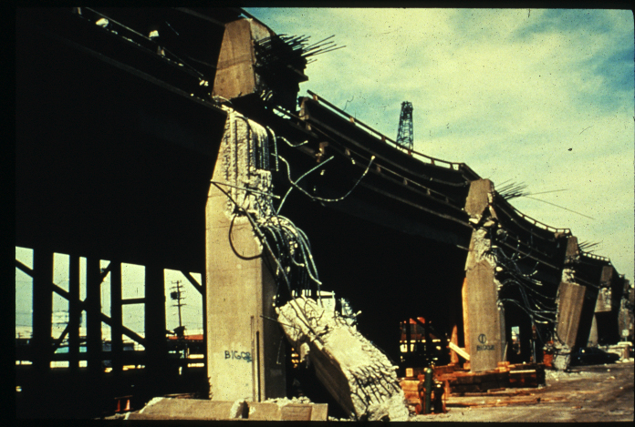
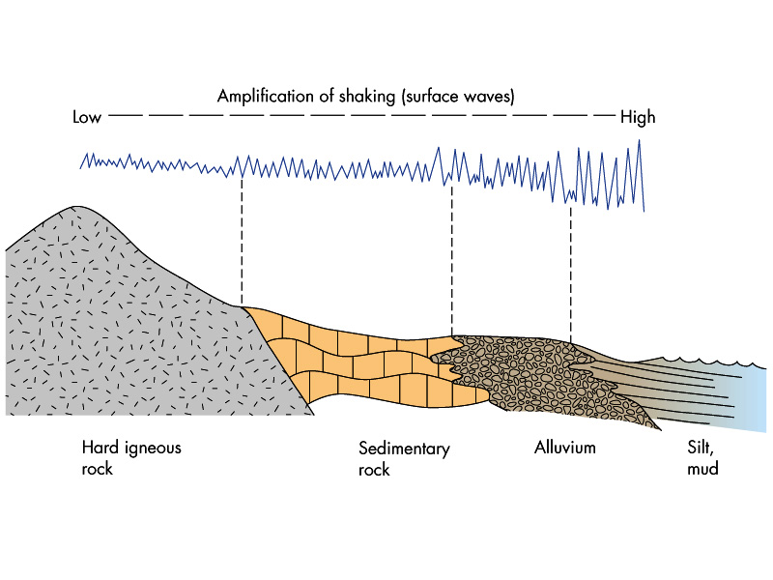
Ground Shaking Magnitude as a Function of Materials
Hard Bedrock
Soft Bedrock
River Gravel
Wet Bay Mud

Slide 16
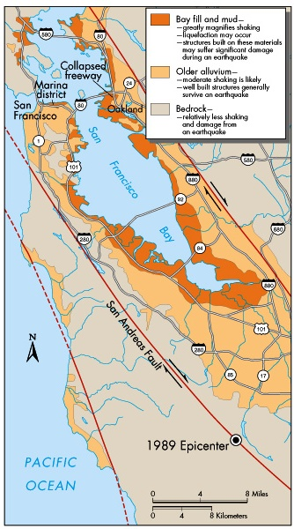
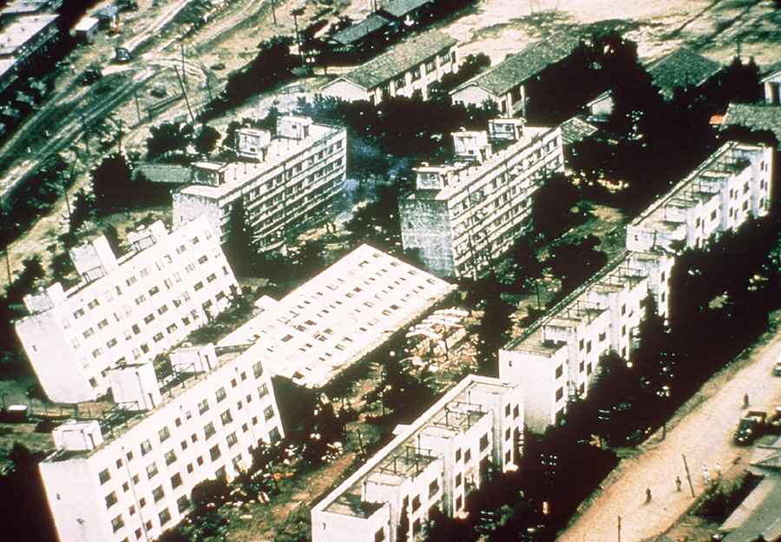
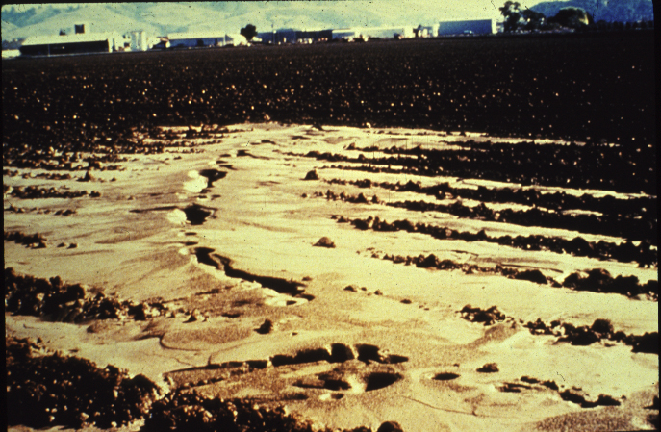
Liquefaction Hazards

Slide 17
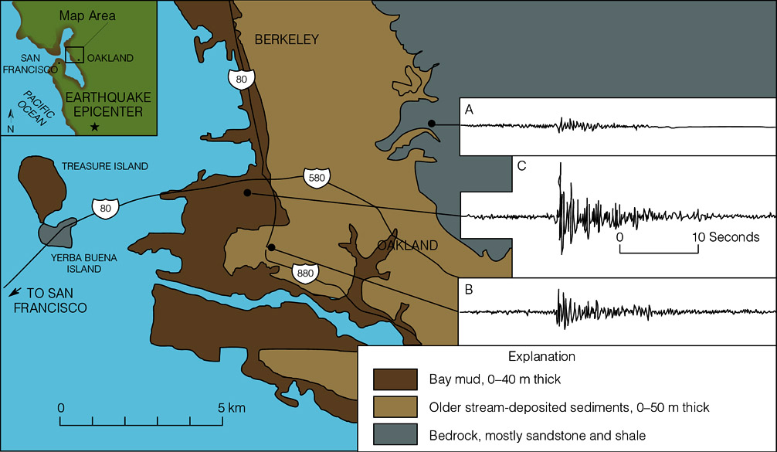
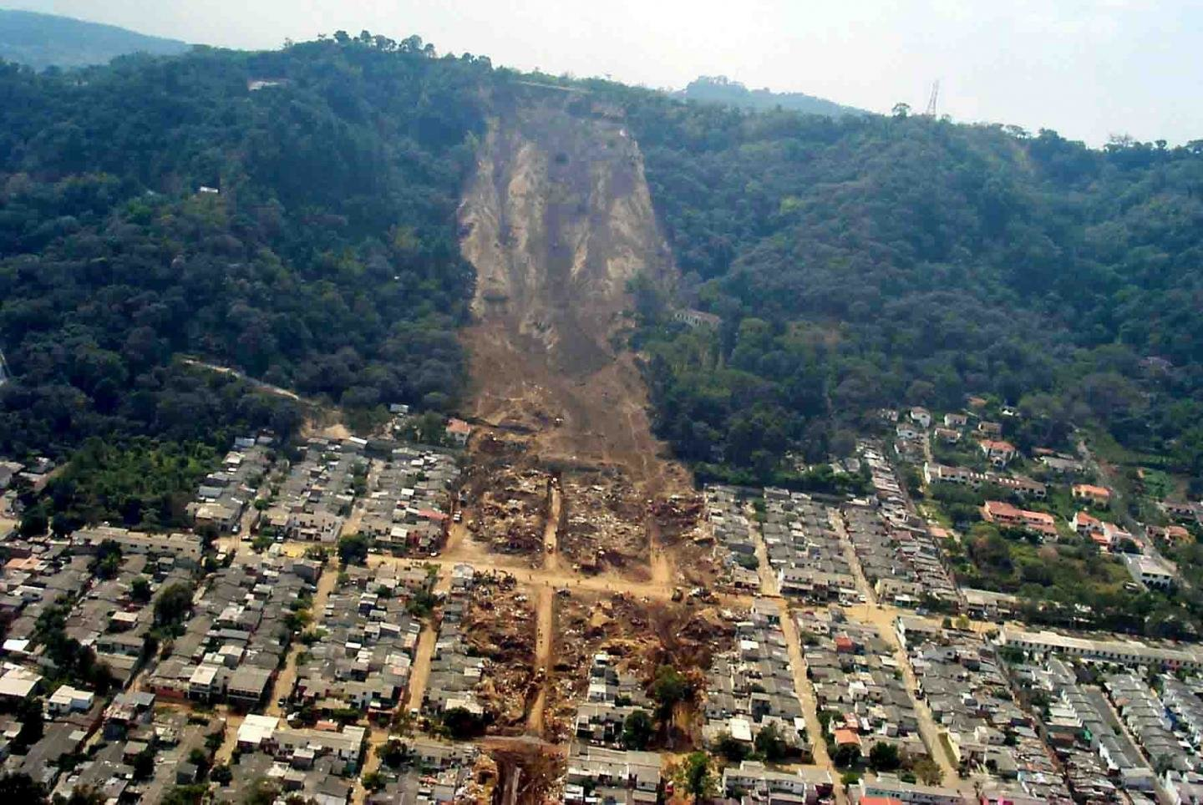
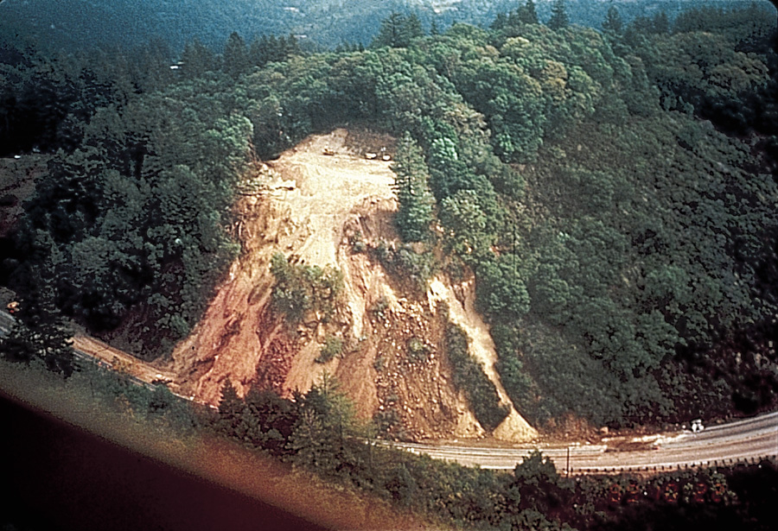
Co-Seismic Landslide Hazards

Slide 18
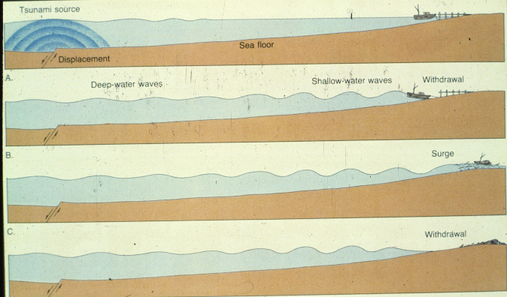
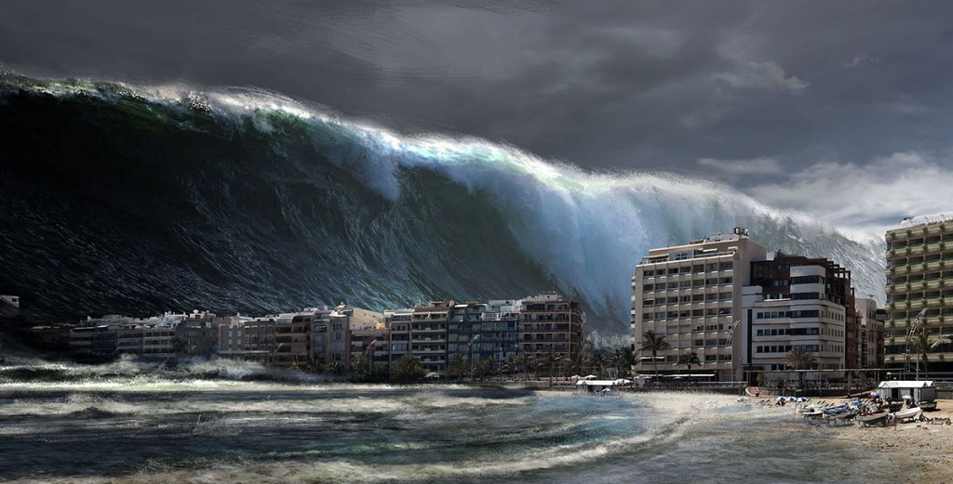
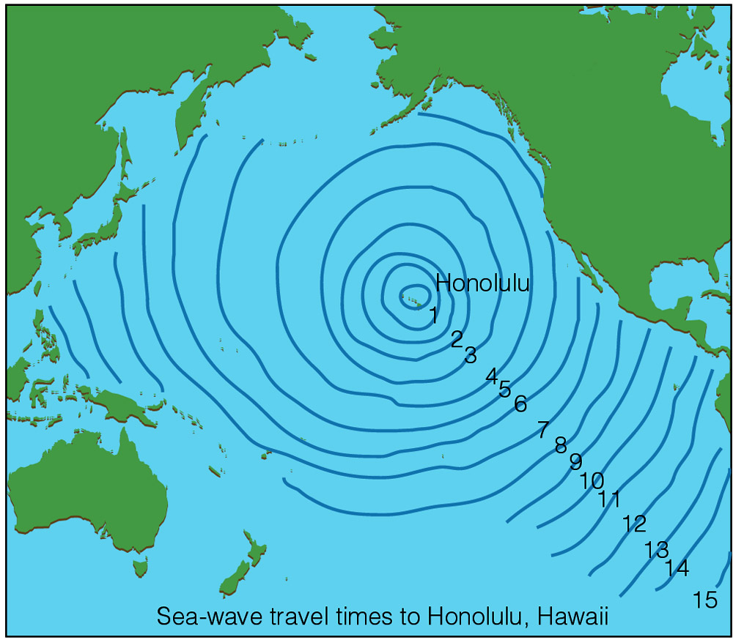
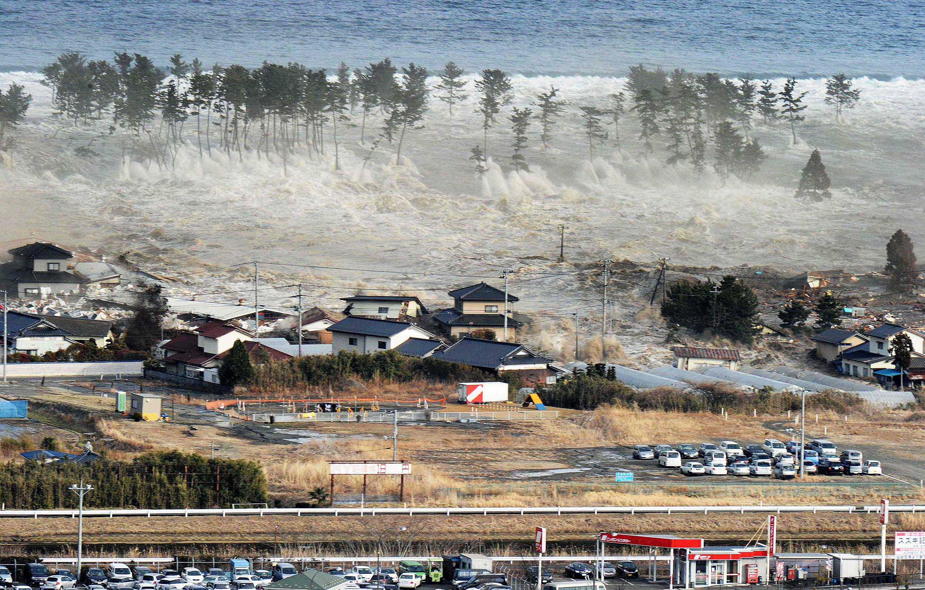
Tsunami Hazards
…bad day at the beach

Slide 19
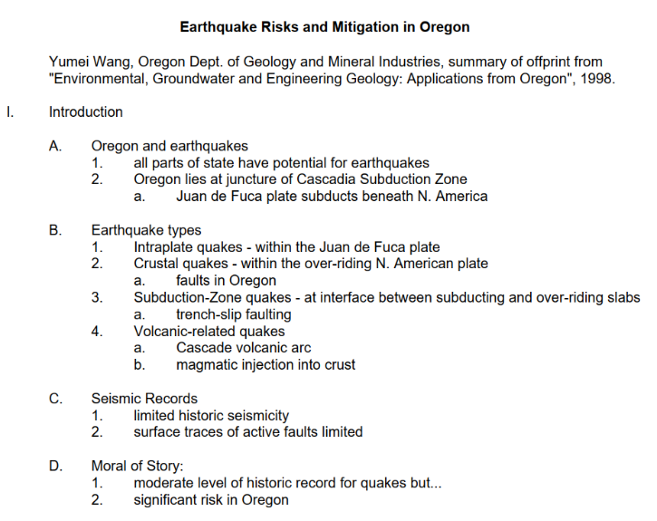
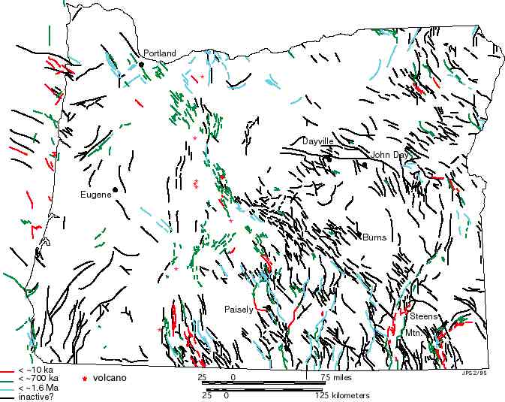
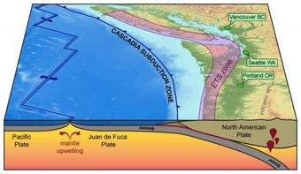
Oregon Fault Map
Cascadia Subduction Zone

Slide 20
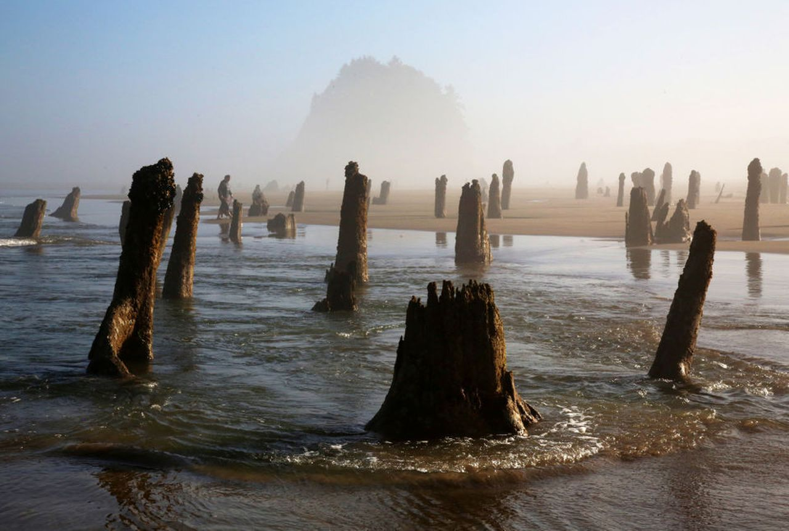

Slide 22
Global Seismology – Window to the Earth’s Interior

