Slide 1
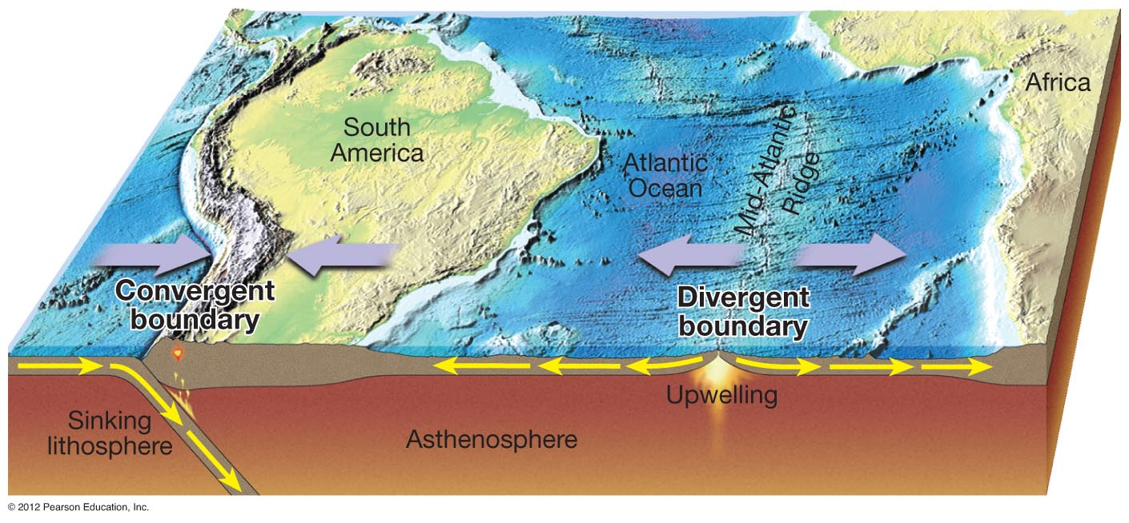
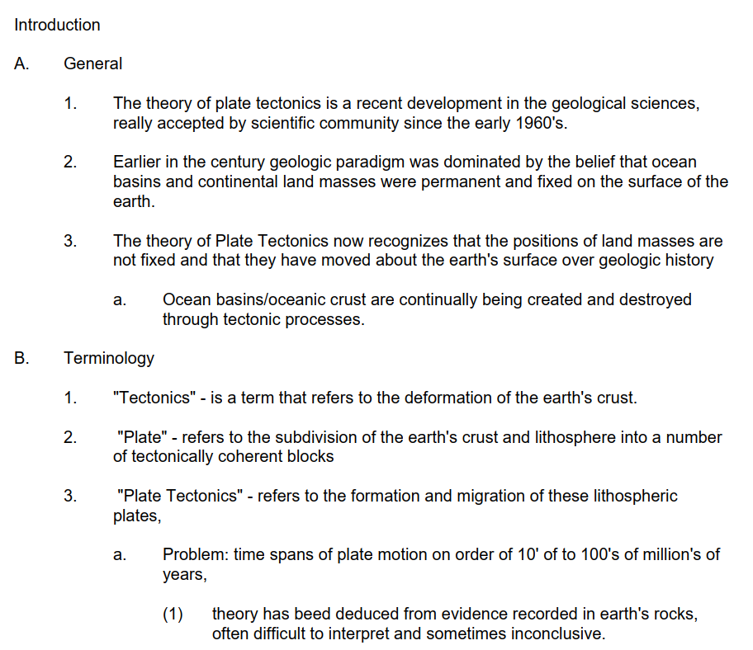
ES104 Plate Tectonics

Slide 2
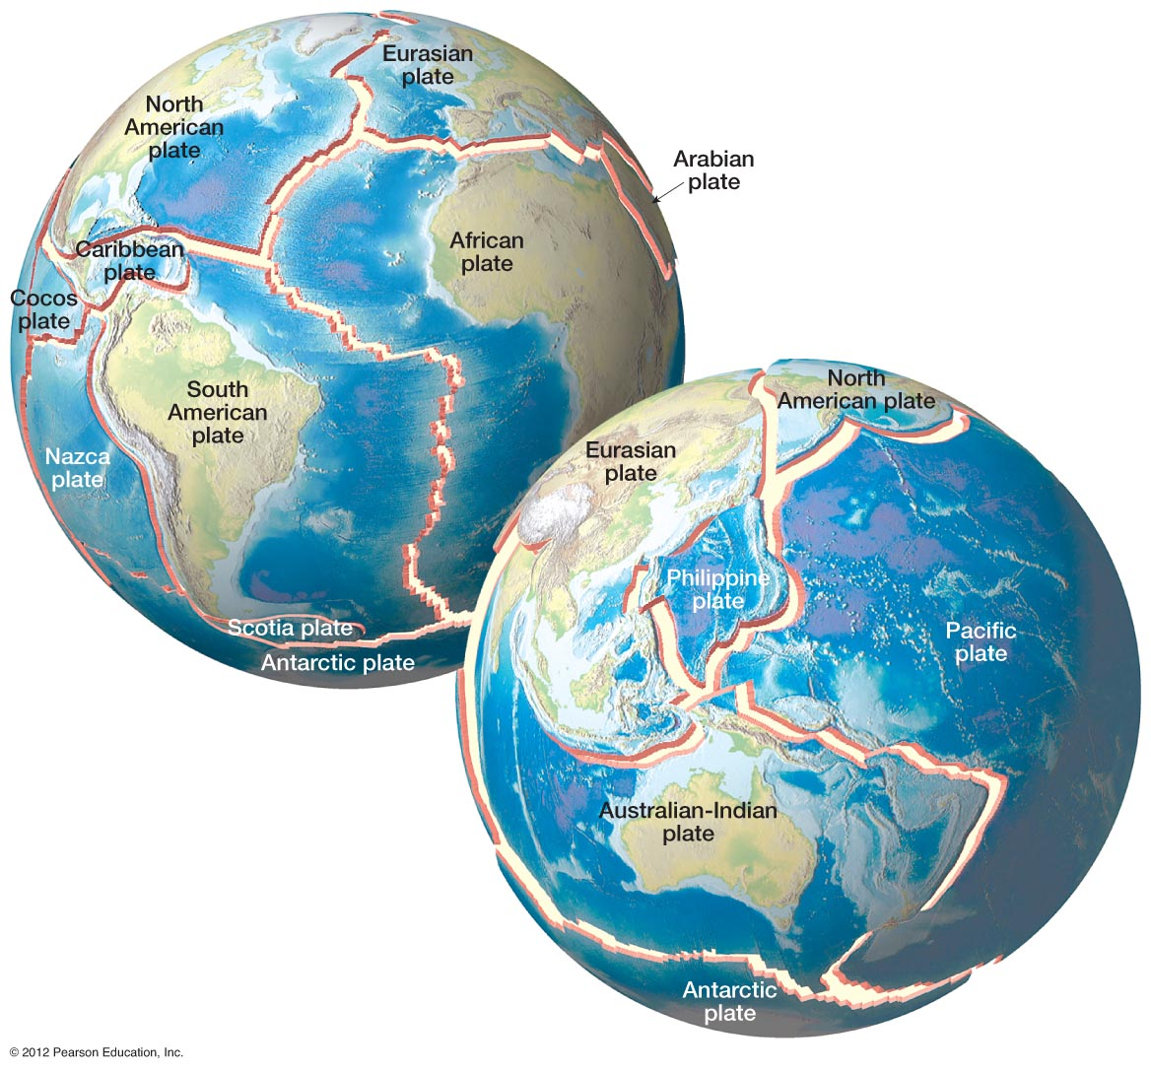
Geothermal Heat Energy
Transforms to Mechanical
Energy via Mantle Convection
Plate Tectonics: Geothermal Energy in Action
Notes:
FIGURE 1.16

Slide 3
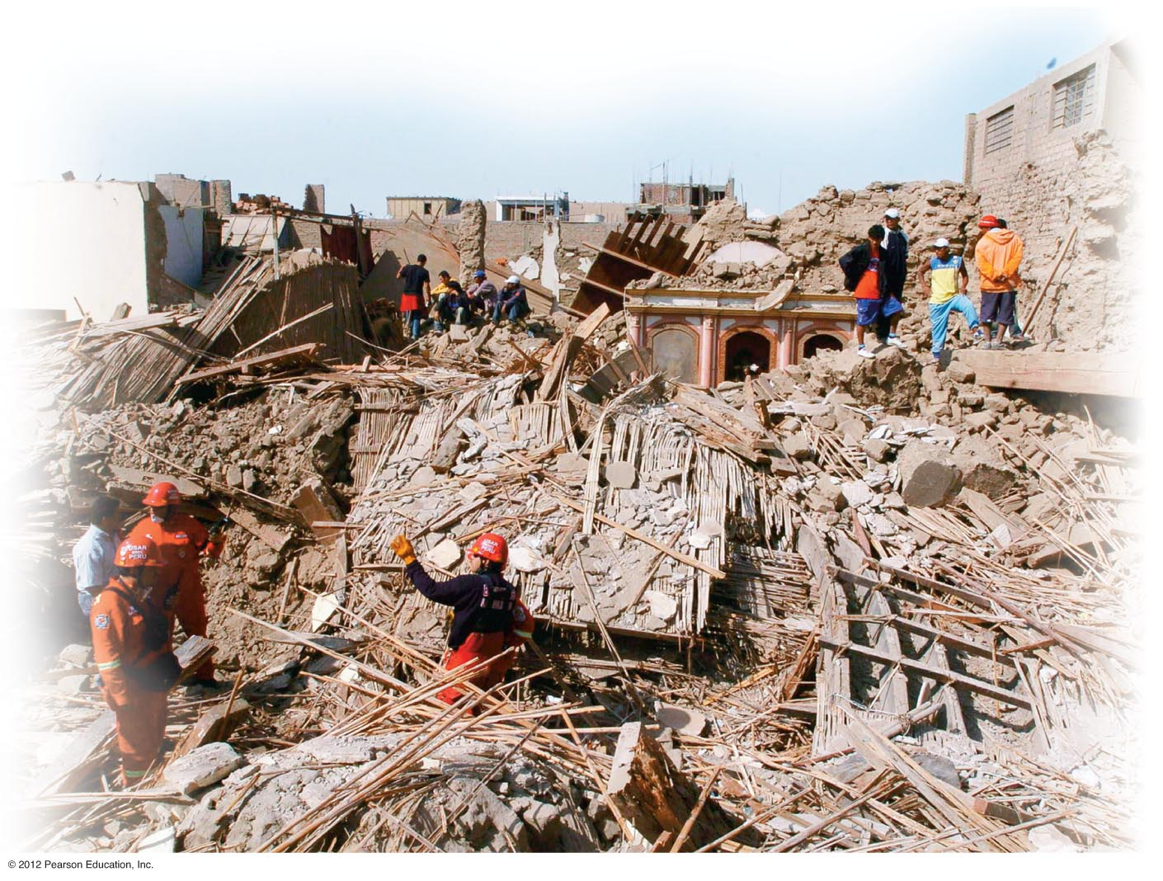
Plate Tectonics: Driver of Earthquakes
Notes:
FIGURE 7.8

Slide 4
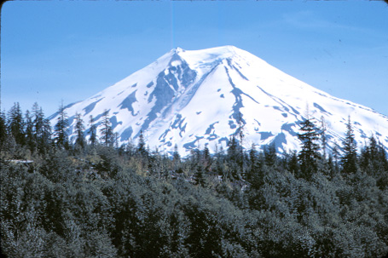
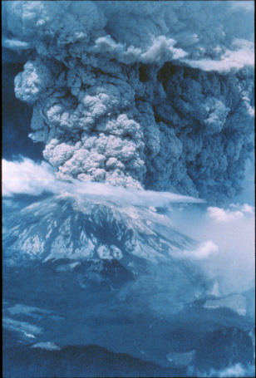
Plate Tectonics: Driver of Volcanism

Slide 5
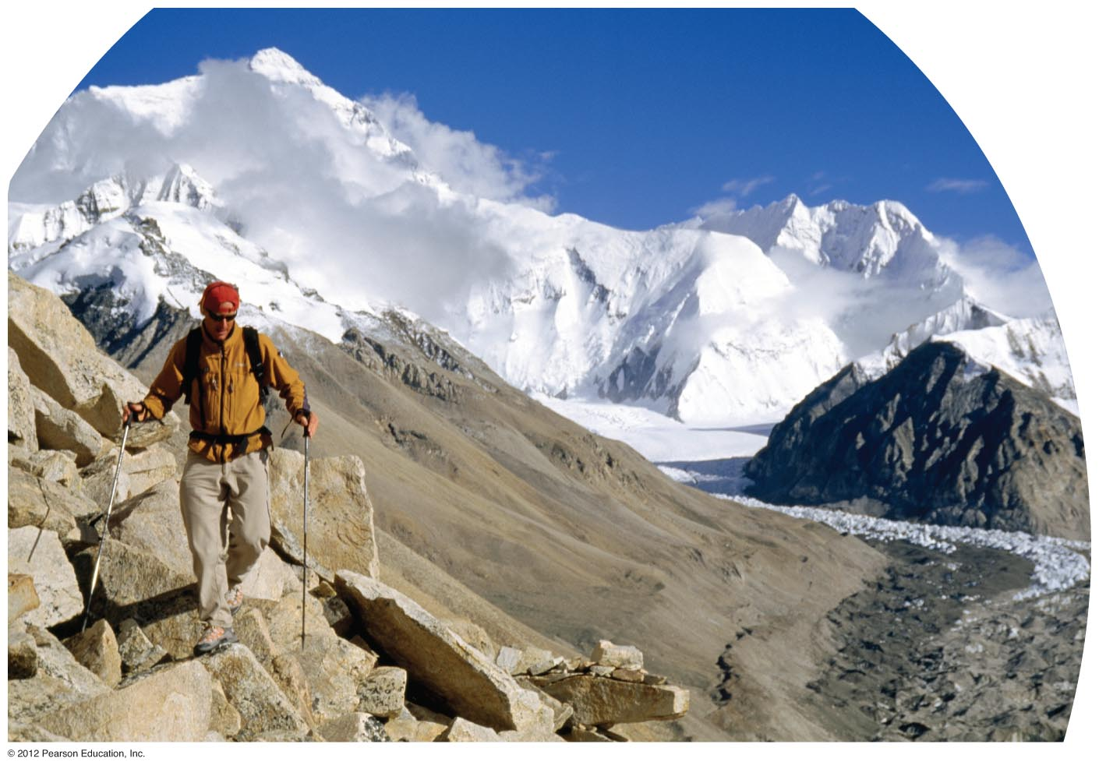
Plate Tectonics: Mountain Building, Uplift, Creator of
Continents and Ocean Basins
Notes:
Chapter 7 Opener

Slide 6
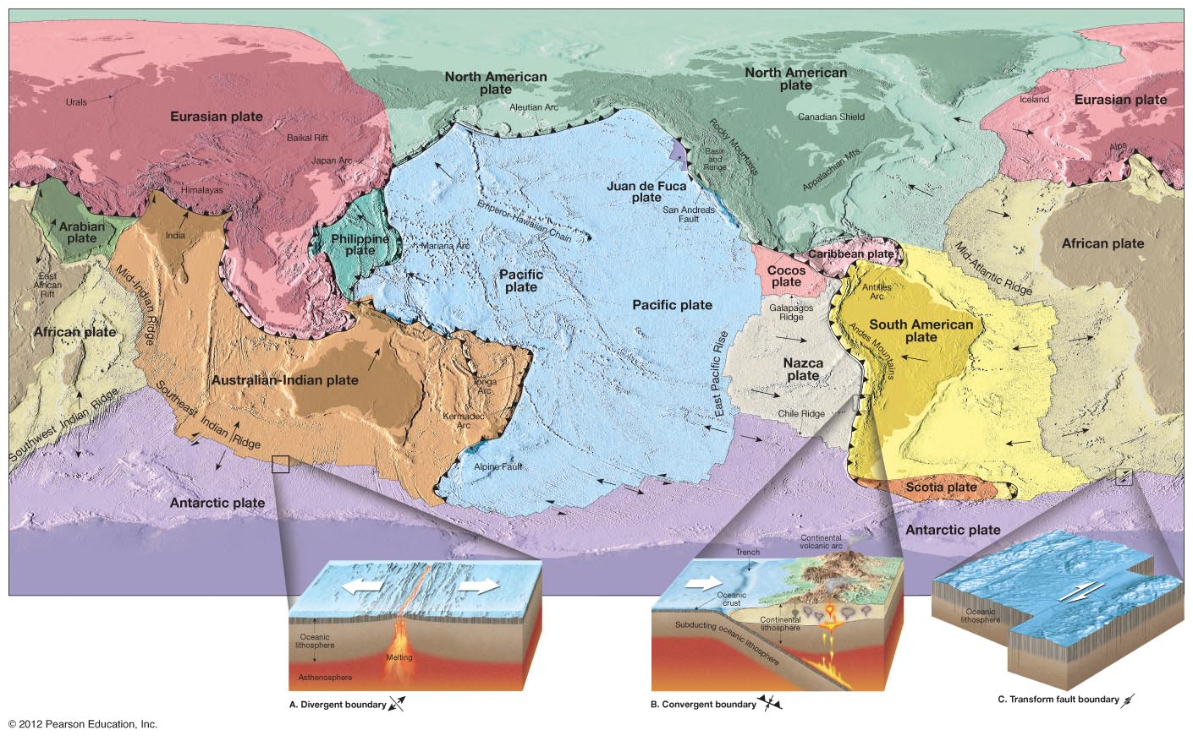
Plate Tectonic Map of Planet Earth
Notes:
FIGURE 7.10A

Slide 7
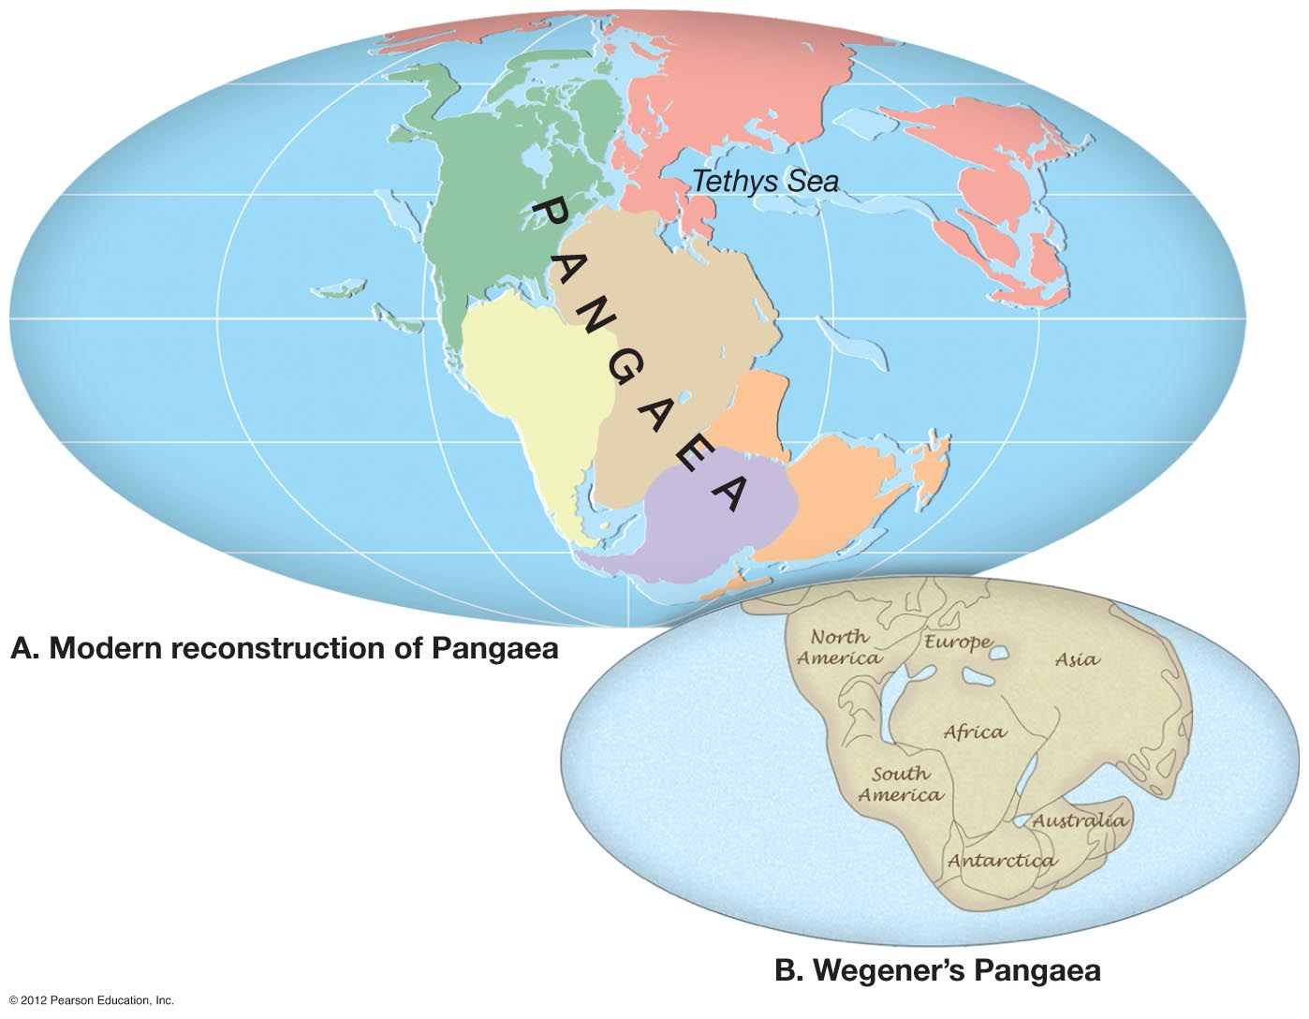
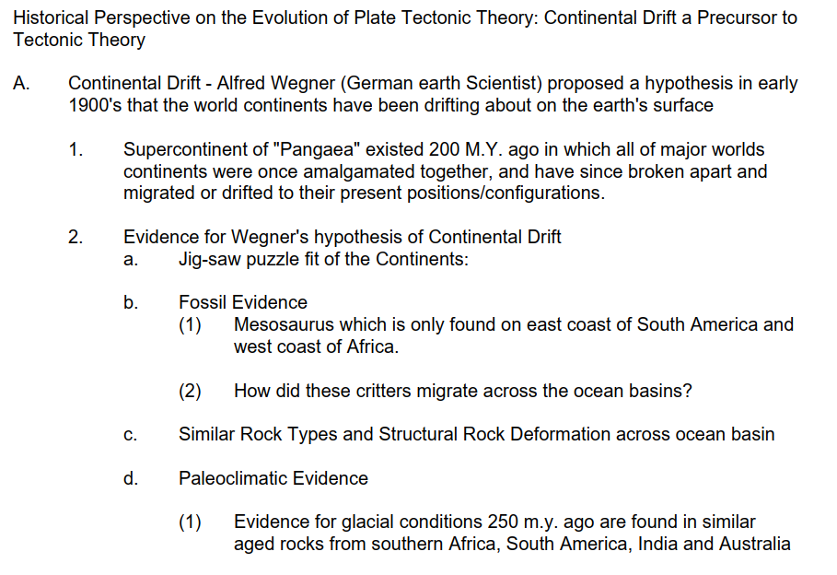

Birth of the Plate Tectonic Theory:
1930’s – 1960’s Scientific Revolution
Beginnings: 1930’s – 1950’s Alfred Wegner’s “Continental Drift” Hypothesis
Notes:
FIGURE 7.2

Slide 8
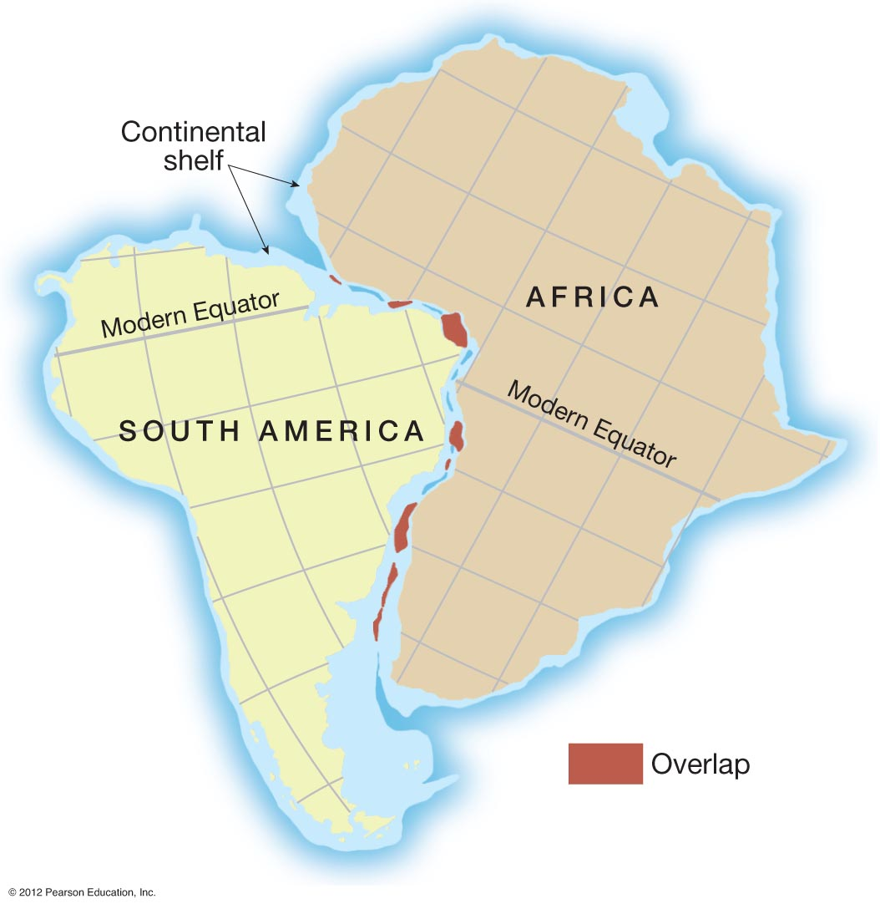
Wegner “Continental Drift” Evidence: Jig-Saw Fit of Continents
Notes:
FIGURE 7.3

Slide 9
Wegner “Continental Drift” Evidence: Ancient Pangaea Puzzle Map
Science Question: Why do the continent shapes appear to fit together like a puzzle?

Slide 10
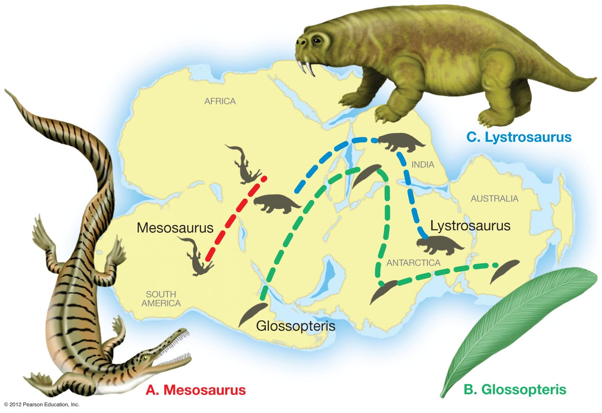
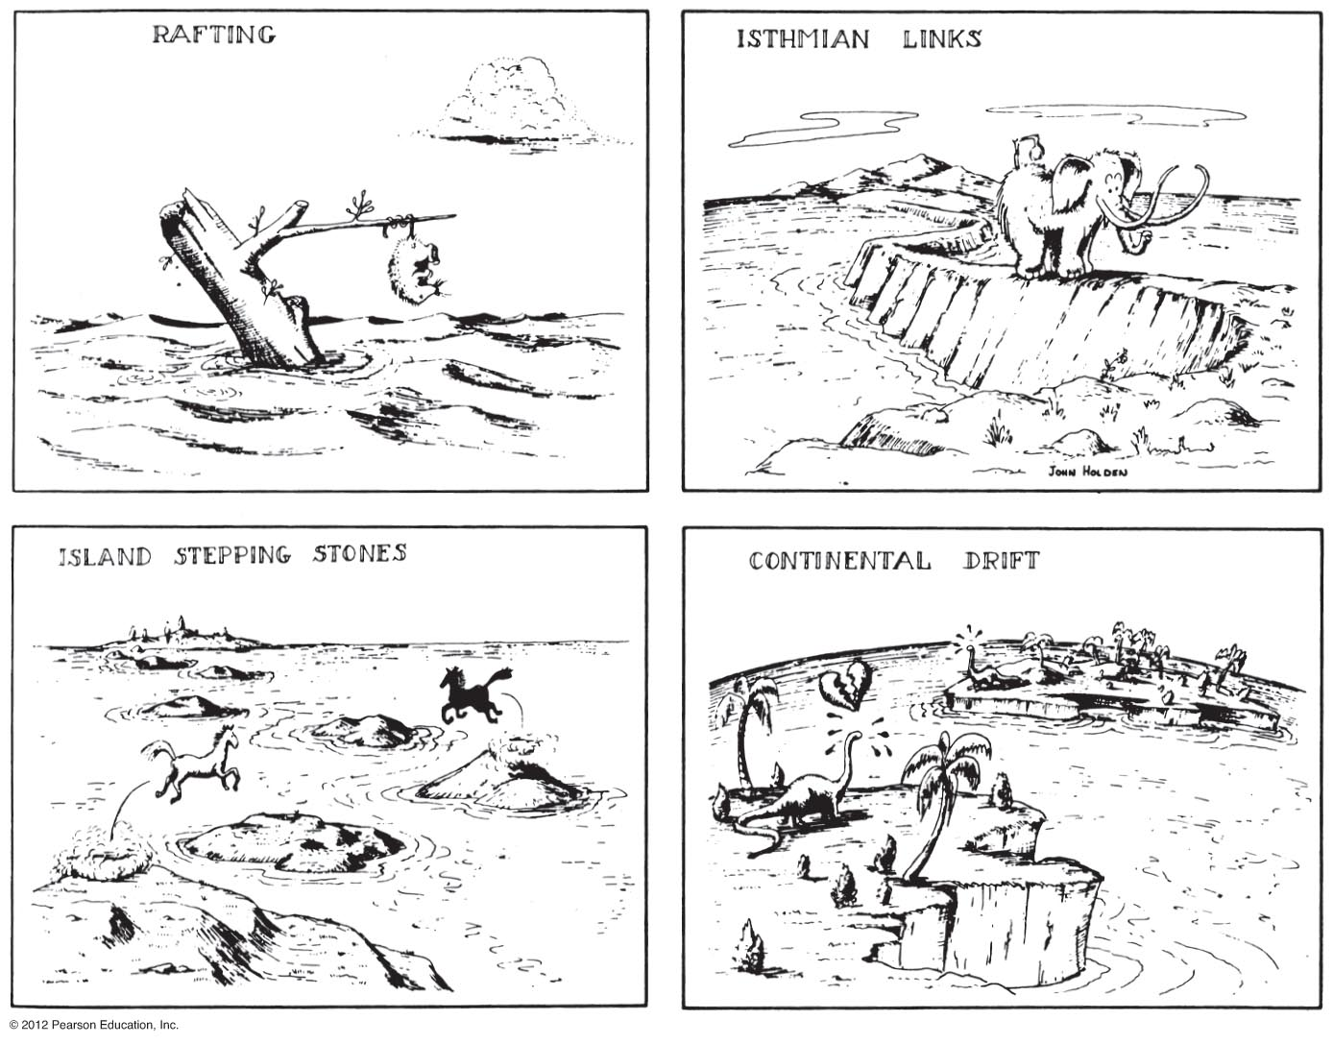
Wegner “Continental Drift” Evidence: Puzzle-Map Fossil Correlation?
Notes:
FIGURE 7.4

Slide 11
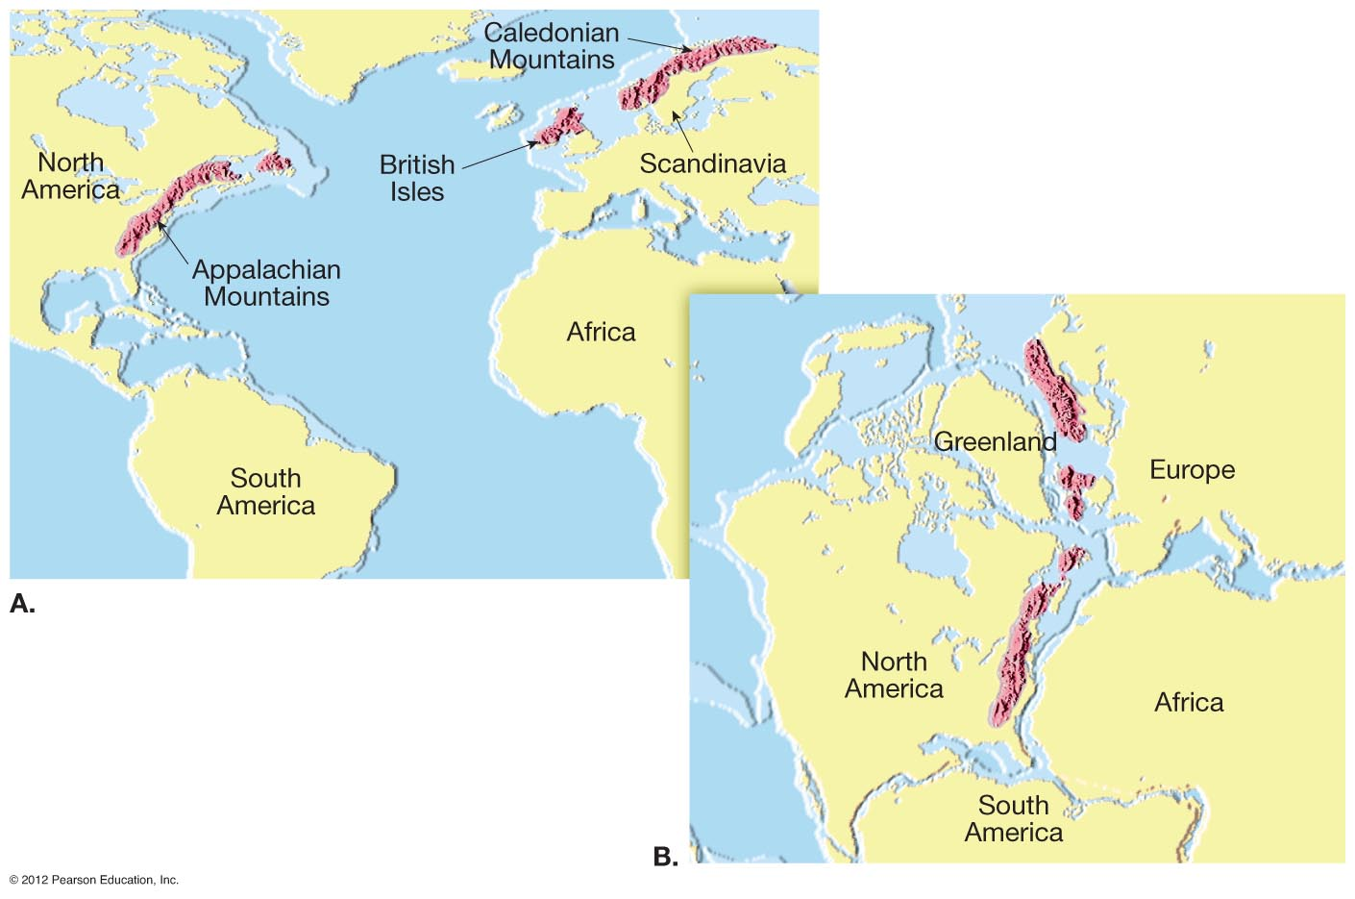
Wegner “Continental Drift” Evidence: Puzzle-Map Rock Correlation?
Notes:
FIGURE 7.6

Slide 12
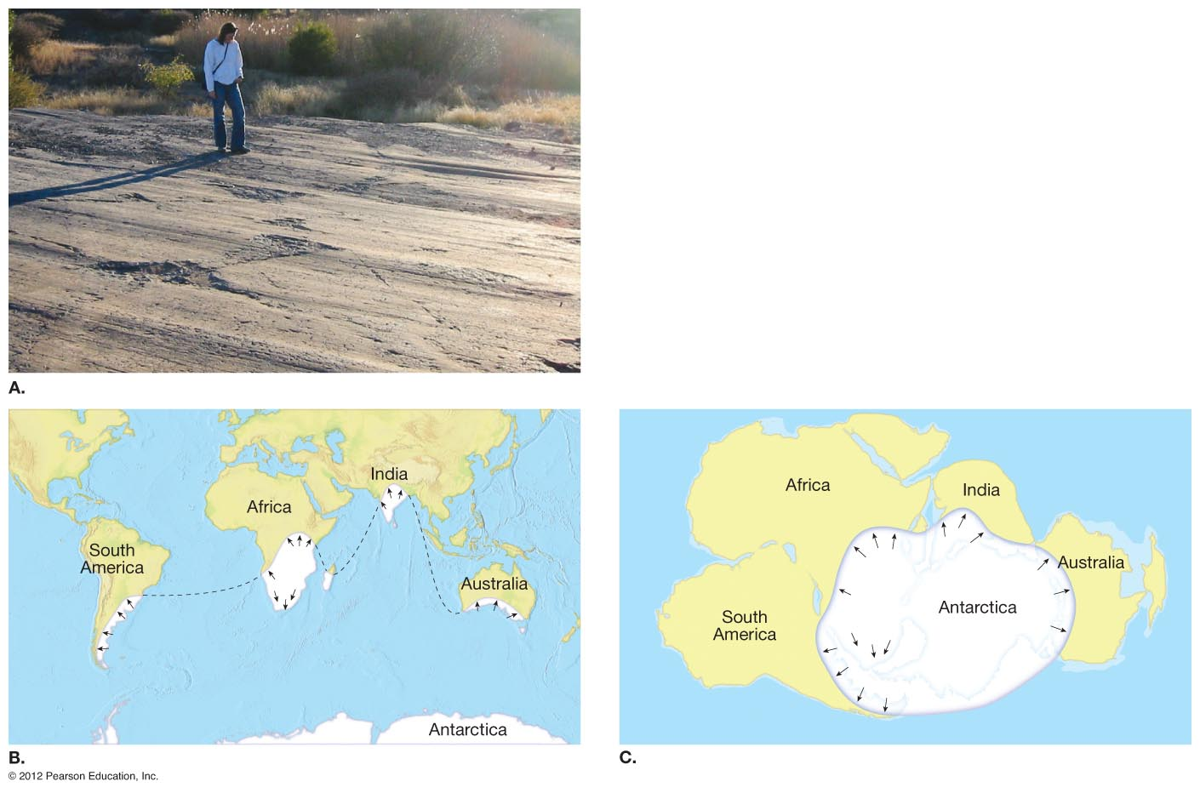
Wegner “Continental Drift” Evidence:
Puzzle-Map Glacial Evidence Correlation?
Notes:
FIGURE 7.7

Slide 13
Scientific Advances: 1960’s – 2020’s Modern Plate Tectonic Theory
Notes:
FIGURE 7.9

Slide 14
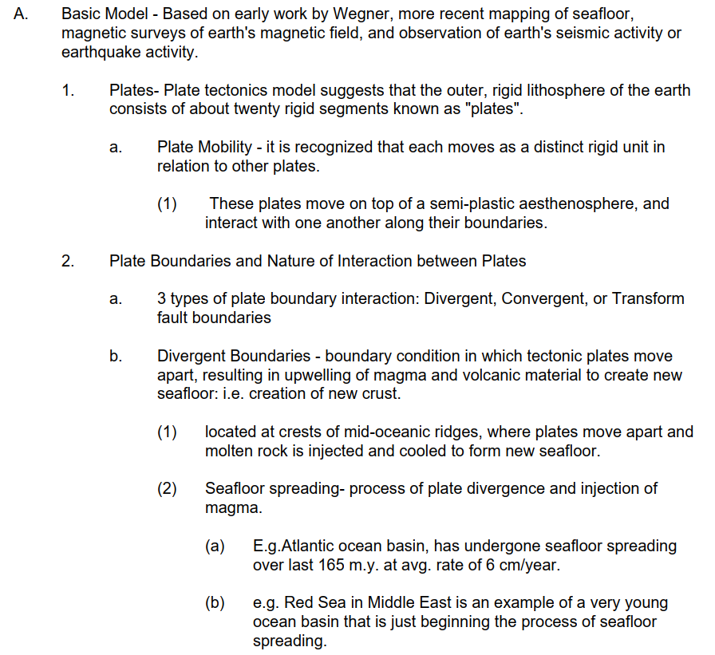
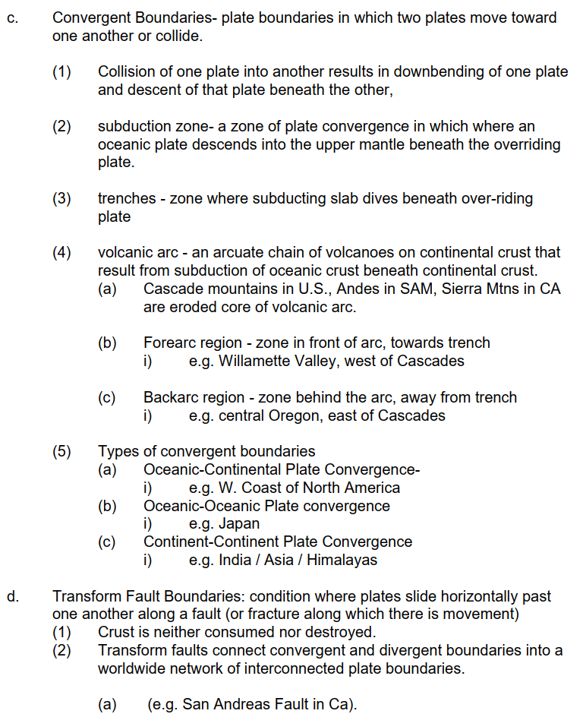
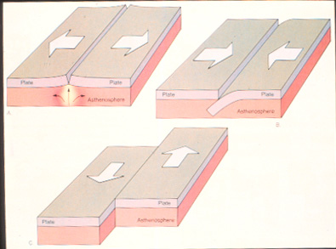
Modern Plate Tectonic Theory
PLATE MOTION TYPE
Convergent
Divergent
Transform

Slide 15
Plate Tectonic Map of Planet Earth
Notes:
FIGURE 7.10A

Slide 16
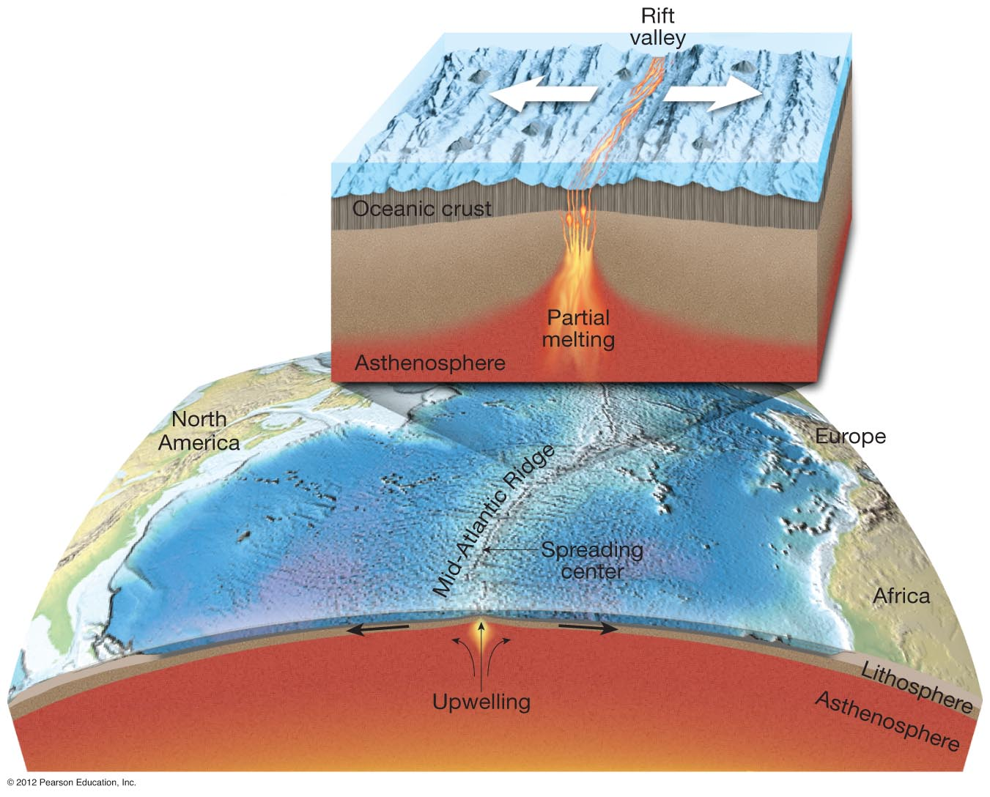
Divergent: Seafloor Spreading
Notes:
FIGURE 7.11

Slide 17
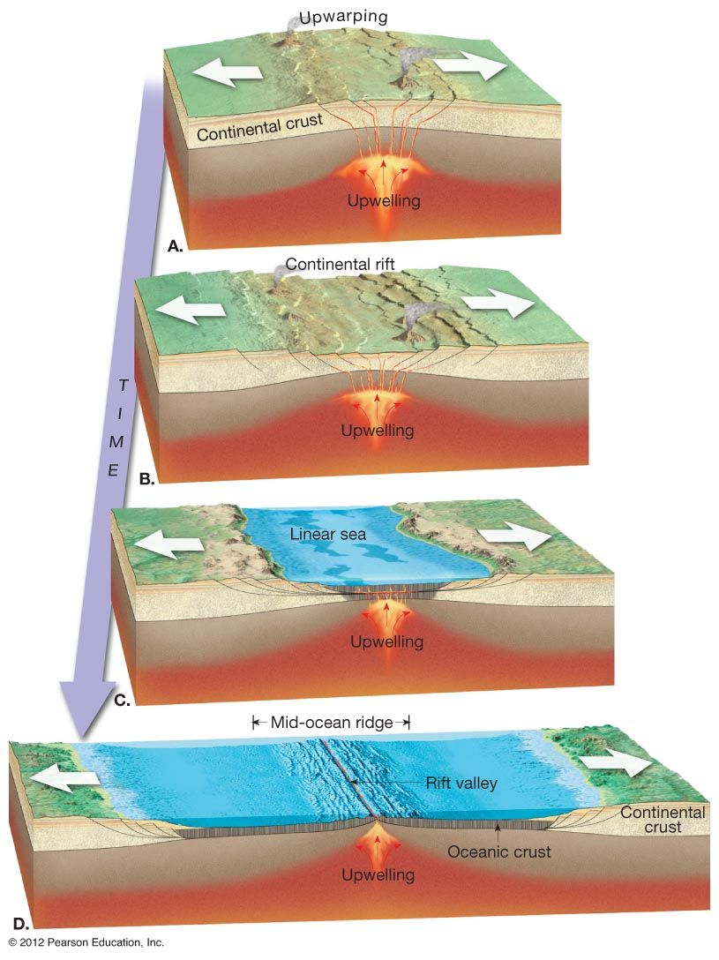
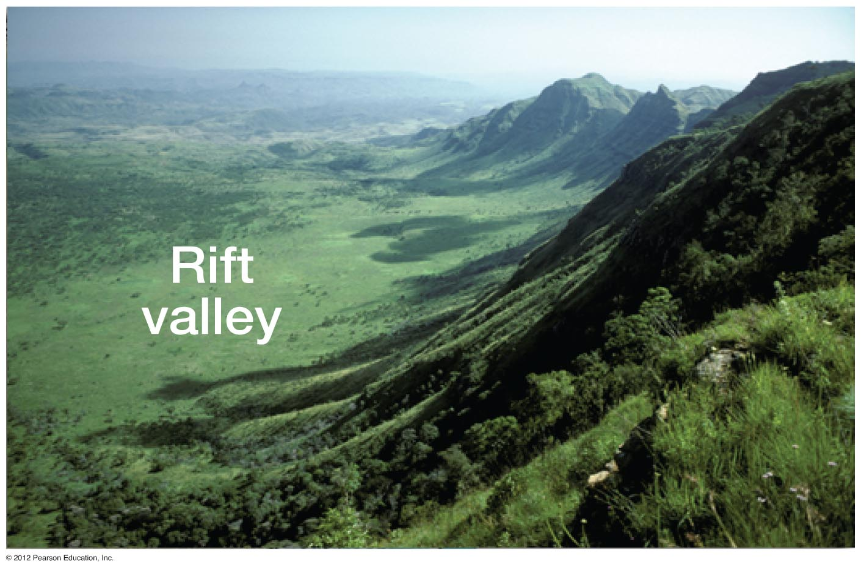
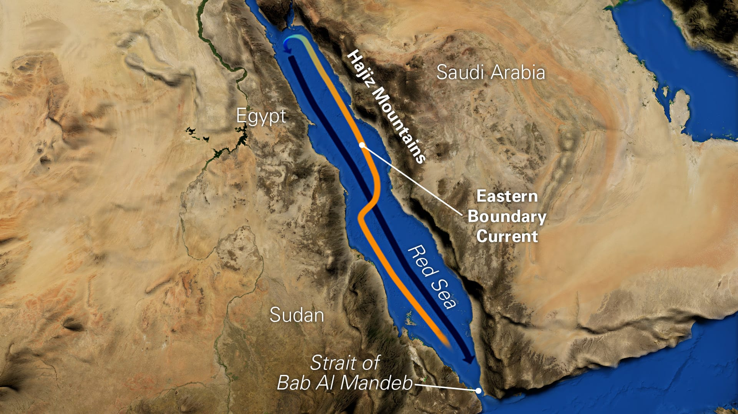
Divergent: Continental Rifting
Notes:
FIGURE 7.12

Slide 18
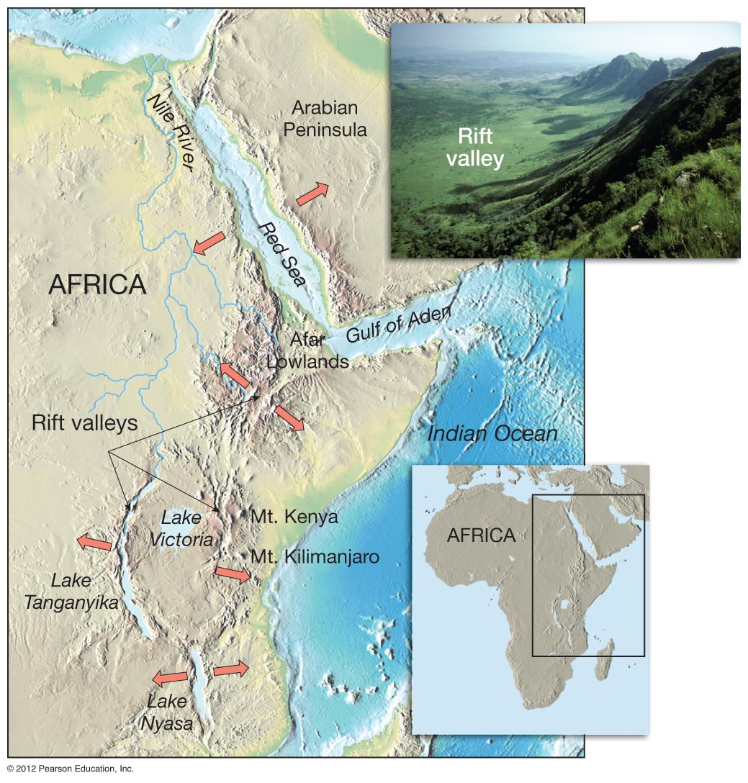
Divergent: East African Rift
Notes:
FIGURE 7.13

Slide 19
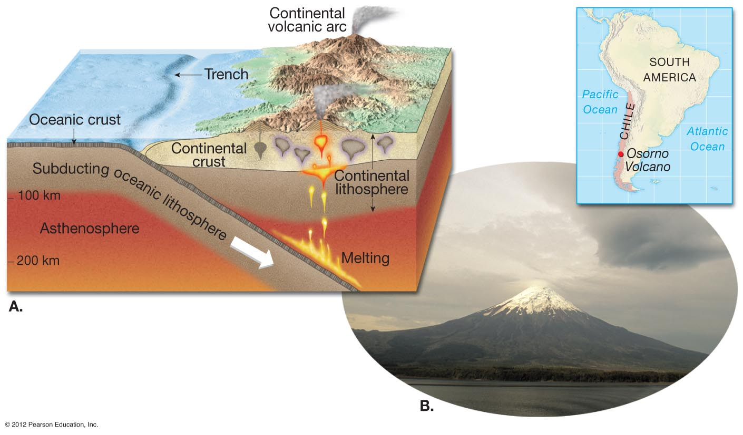
Convergent: Oceanic-Continental Subduction
Notes:
FIGURE 7.15

Slide 20
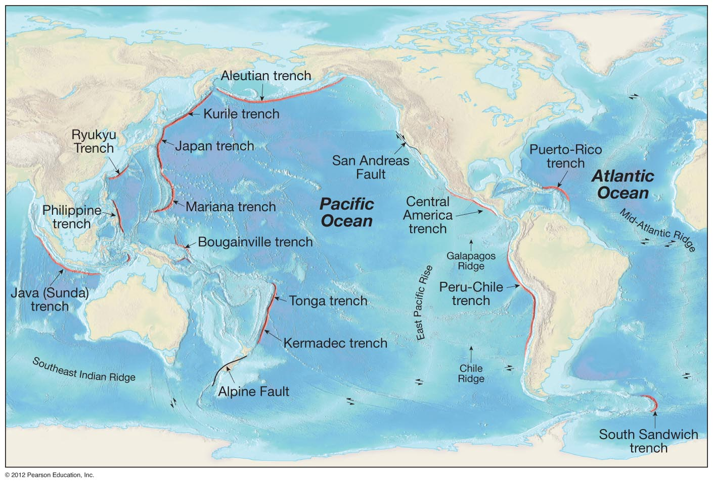
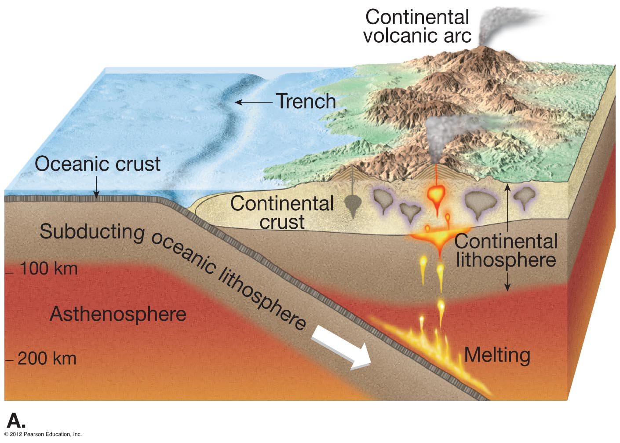
Convergent: Subduction Trenches of the World
Notes:
FIGURE 7.14

Slide 21
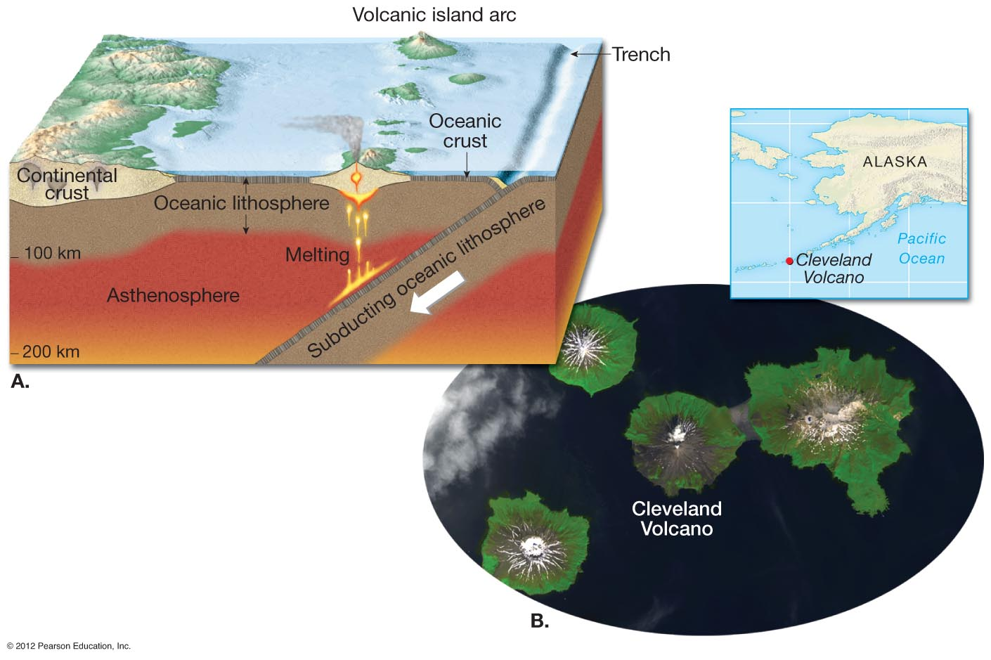
Convergent: Oceanic-Oceanic Subduction and Volcanic Arcs
Notes:
FIGURE 7.16

Slide 22
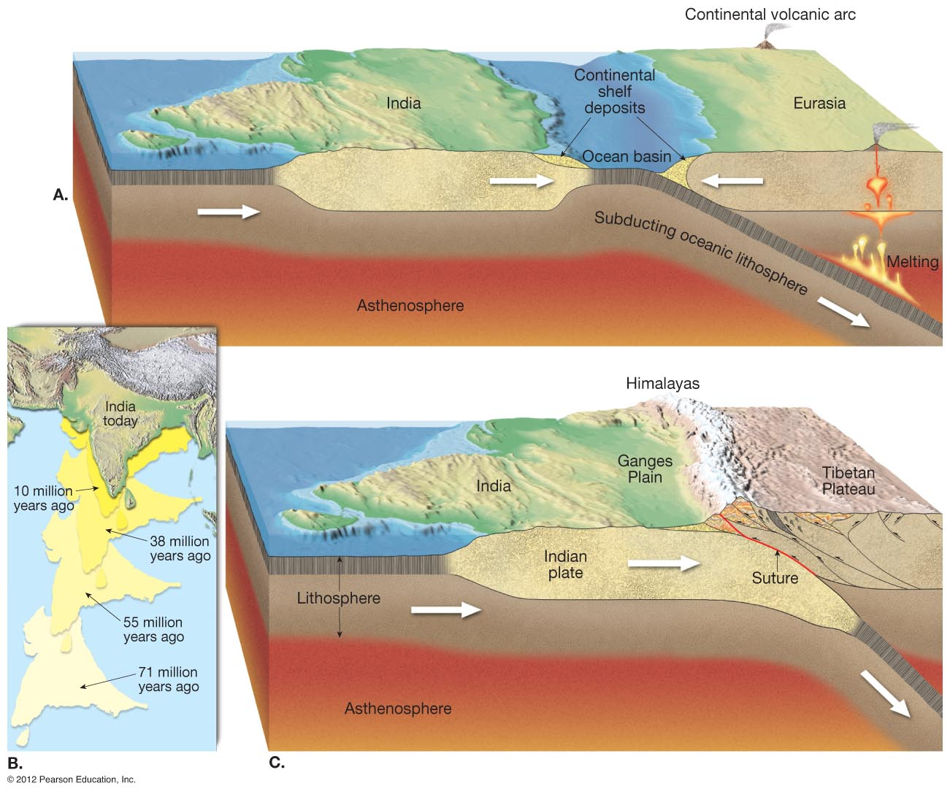
Convergent: Continental-Continental Subduction
Notes:
FIGURE 7.17

Slide 23
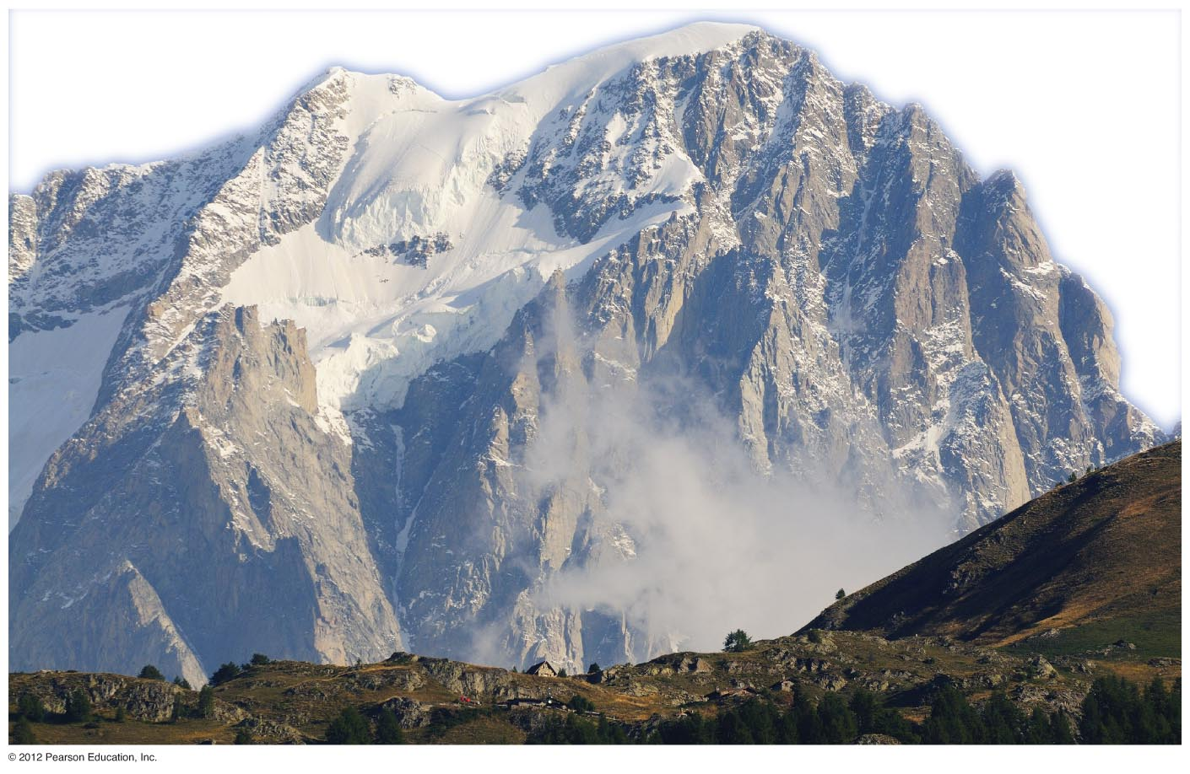
Himalayan Mountains: Continental-Continental Collision and Uplift
Notes:
FIGURE 7.18

Slide 24
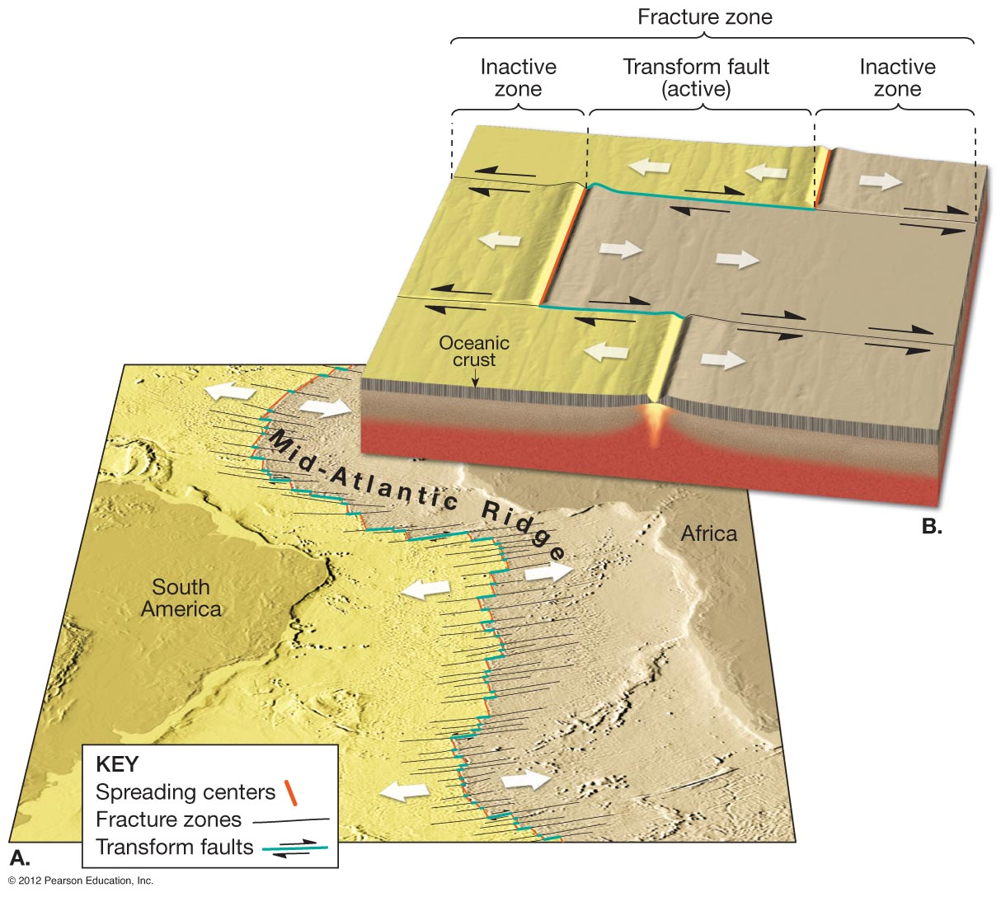
Transform Boundaries and Seafloor Spreading
Notes:
FIGURE 7.19

Slide 25
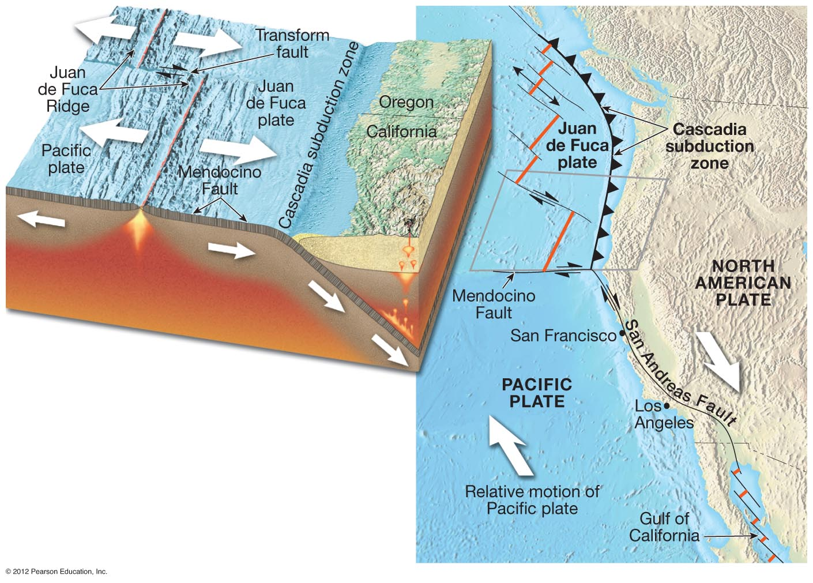
Western U.S. Transform-Subduction Complex:
San Andreas Transform to South; Cascadia Subduction to North
Notes:
FIGURE 7.20

Slide 26
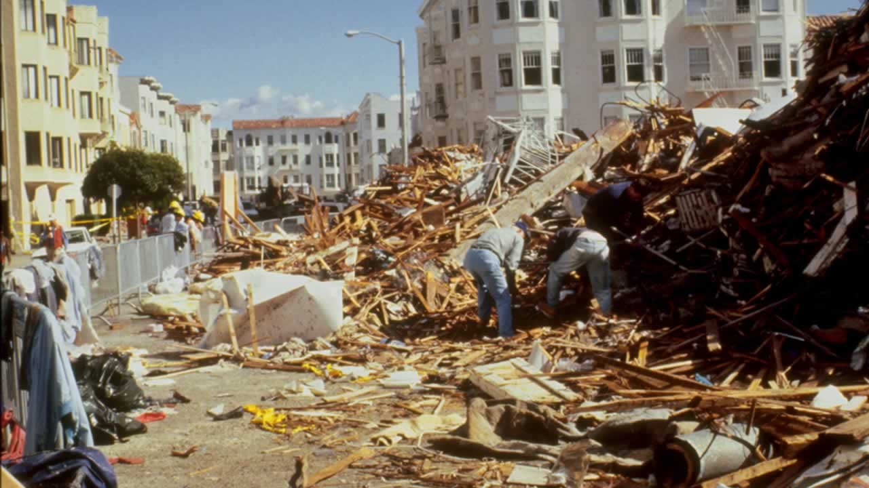
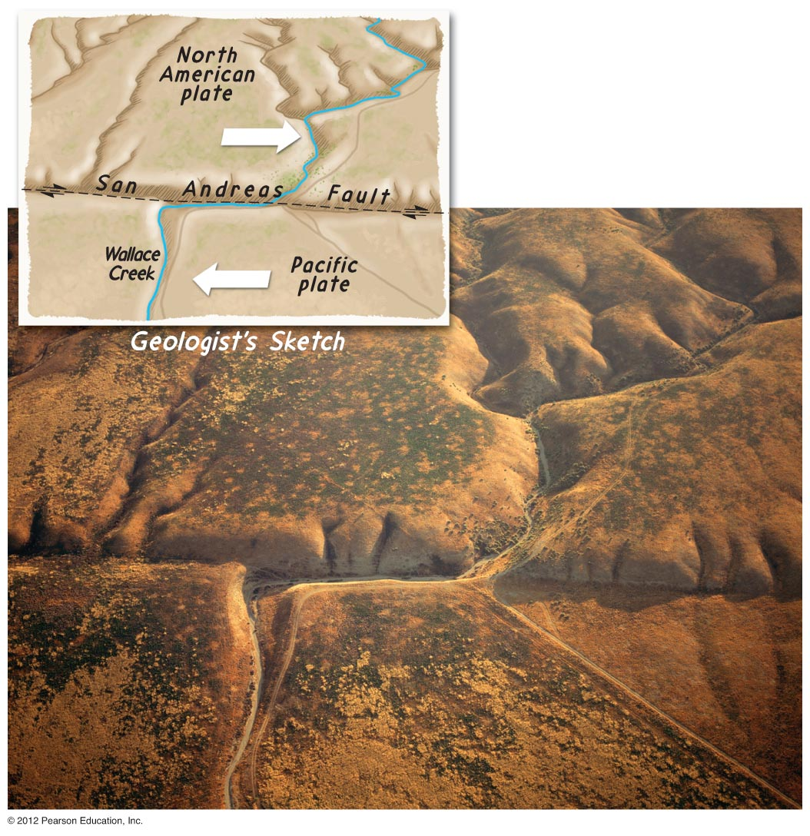
California San Andreas Transform Zone
Notes:
FIGURE 7.21

Slide 27
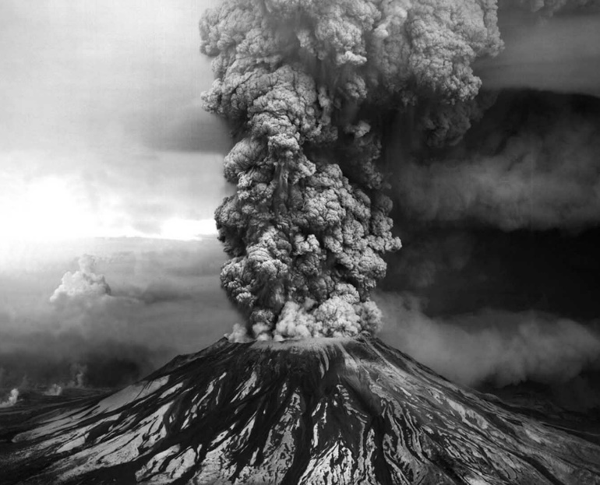
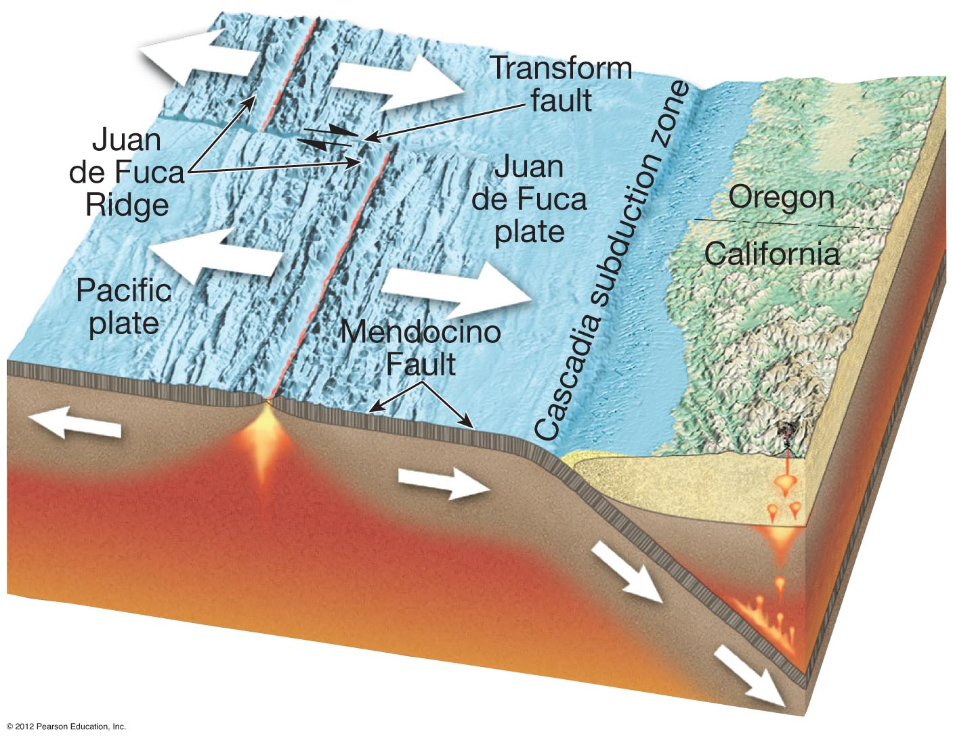
Pacific Northwest-Oregon Cascadia Subduction Zone
Notes:
FIGURE 7.20A

Slide 28
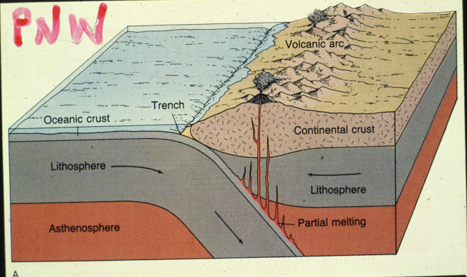
CASCADIA SUBDUCTION ZONE

Slide 29
SCIENTIFIC EVIDENCE FOR MODERN THEORY
OF PLATE TECTONICS 1940’S – 2020’S

Slide 30
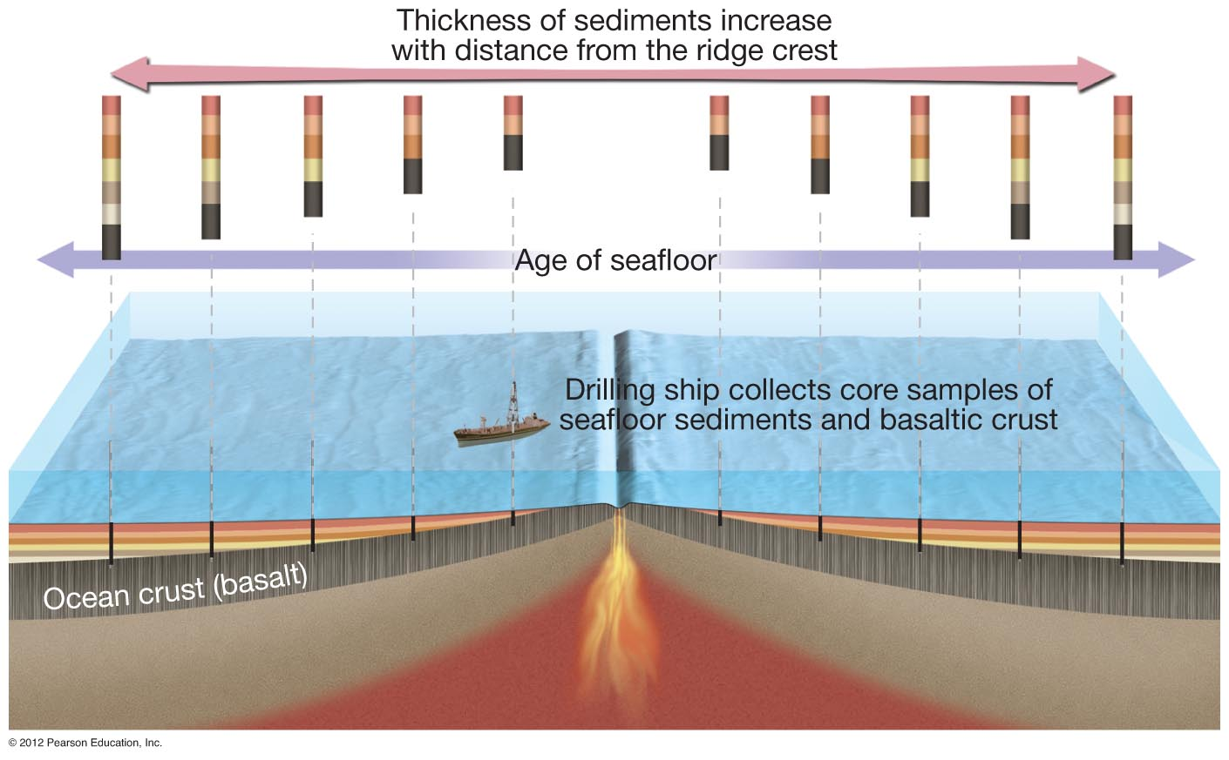
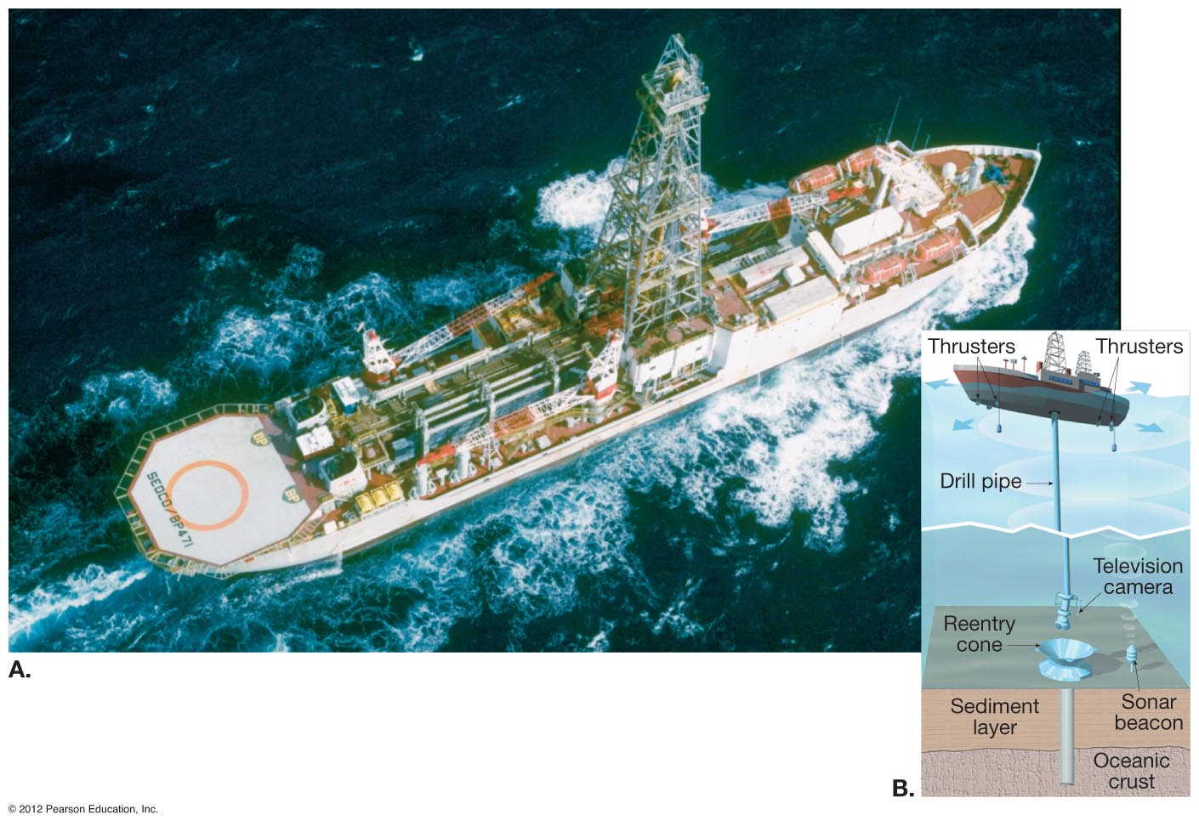
Plate Tectonic Evidence: Seafloor Spreading / Mid-Ocean Ridge
Notes:
FIGURE 7.22

Slide 31
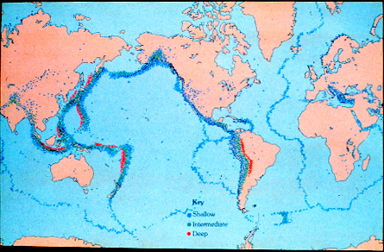
Plate Tectonic Evidence: Global Distribution of Earthquake Epicenters

Slide 32
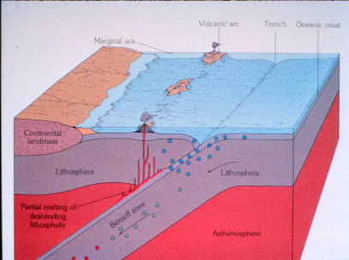
Plate Tectonic Evidence: Depth Distribution of Earthquake Focii

Slide 33
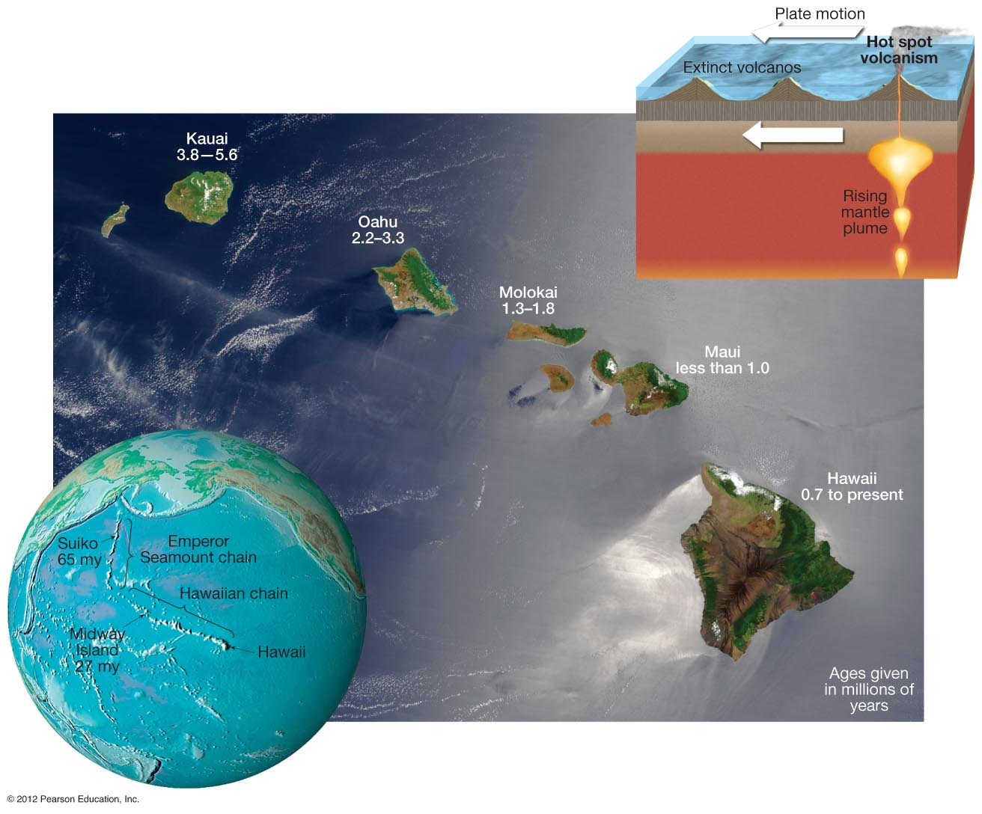
Plate Tectonic Evidence: Hawaiian Hot-Spot Track
Notes:
FIGURE 7.24

Slide 34
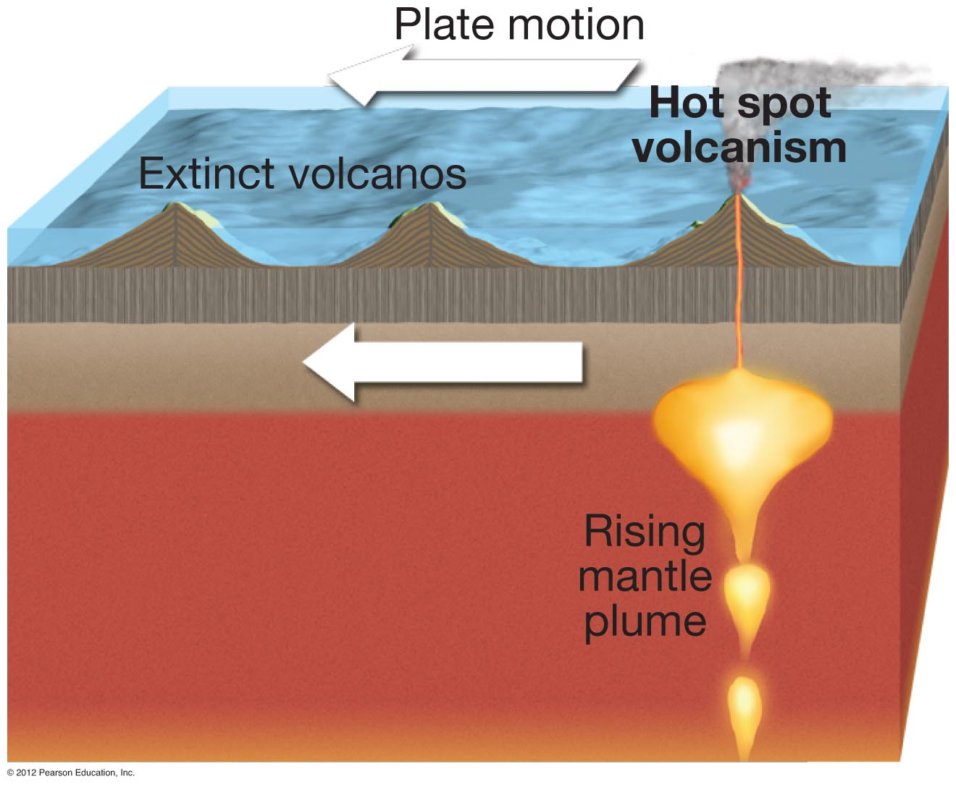
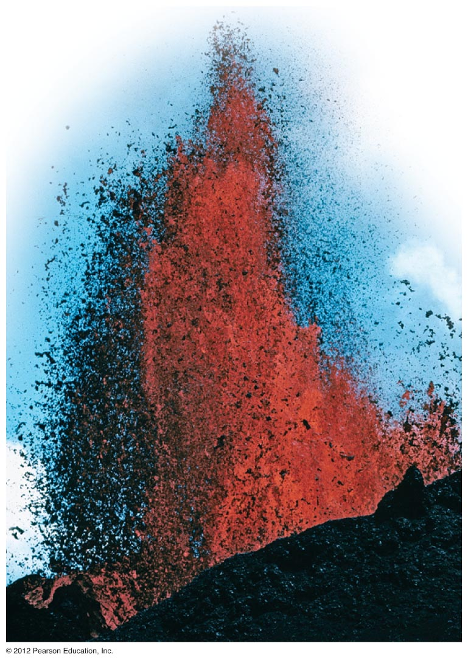
Notes:
FIGURE 7.24B

Slide 35
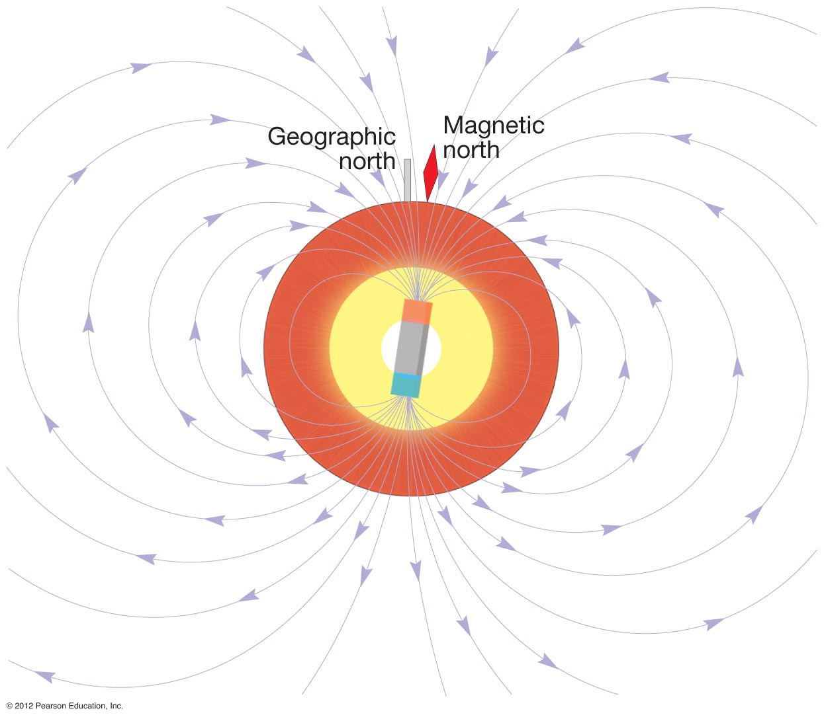
Plate Tectonic Evidence: Paleomagnetic Reversals
Notes:
FIGURE 7.26

Slide 36
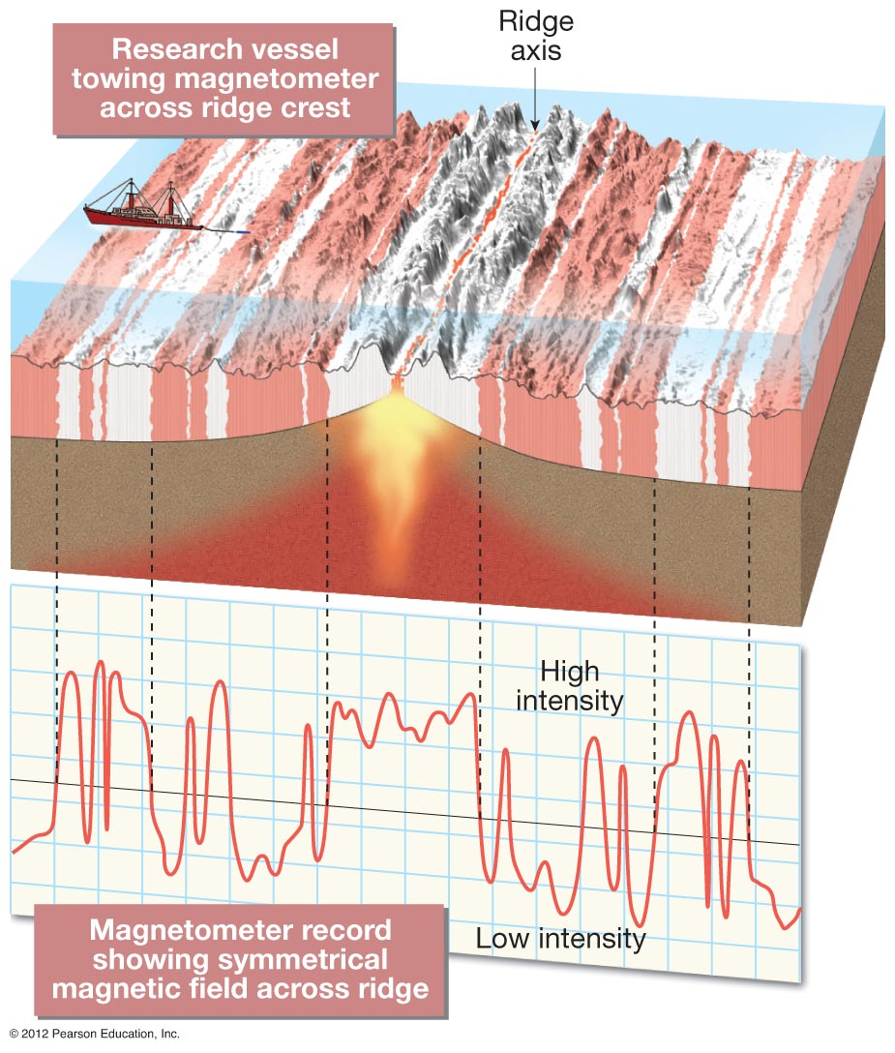
Plate Tectonic Evidence: Paleomagnetic Seafloor Stripes
Notes:
FIGURE 7.30

Slide 37
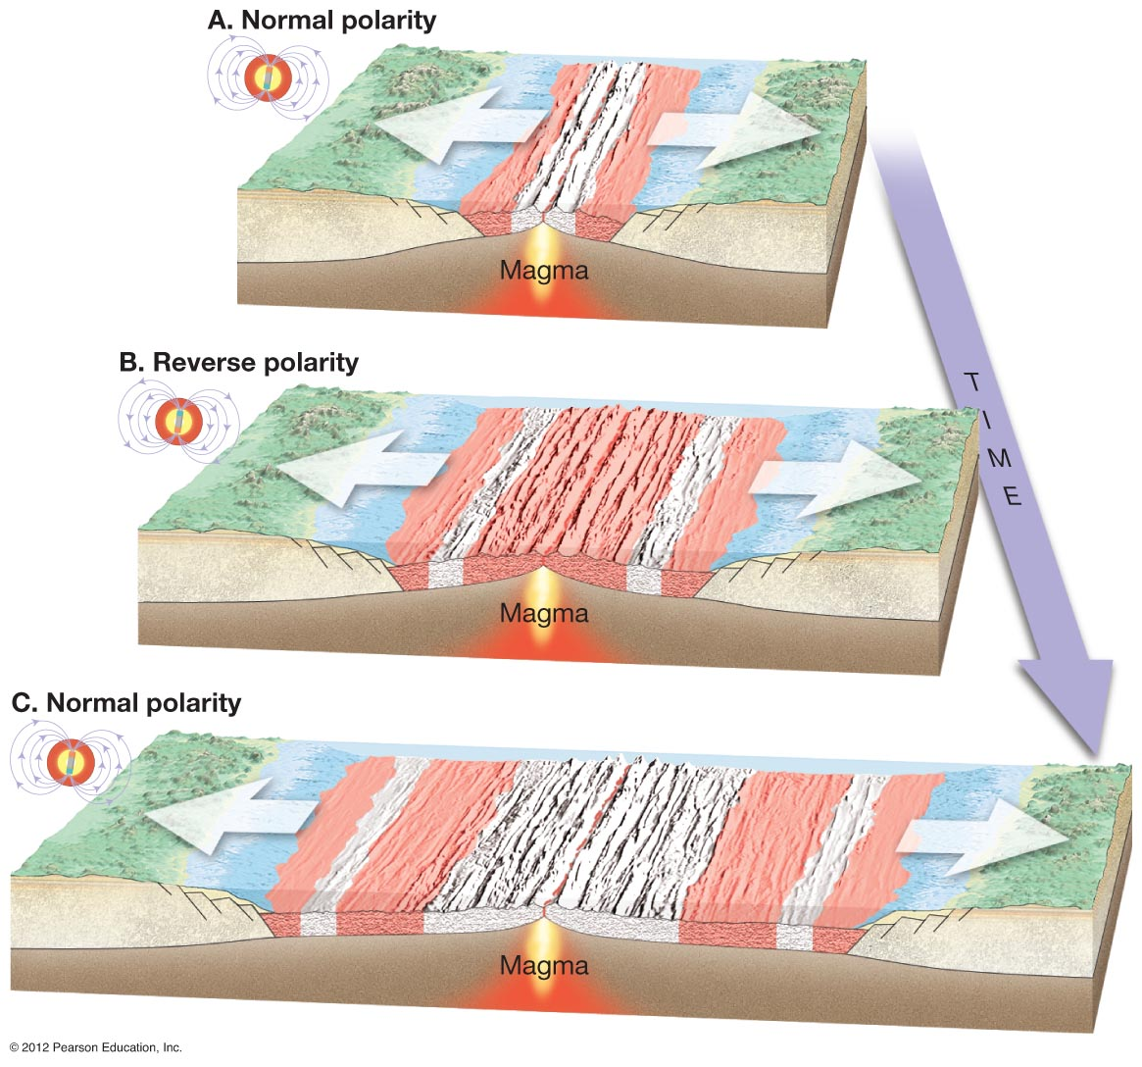
Plate Tectonic Evidence: Paleomagnetic Seafloor Stripes
Notes:
FIGURE 7.31

Slide 38
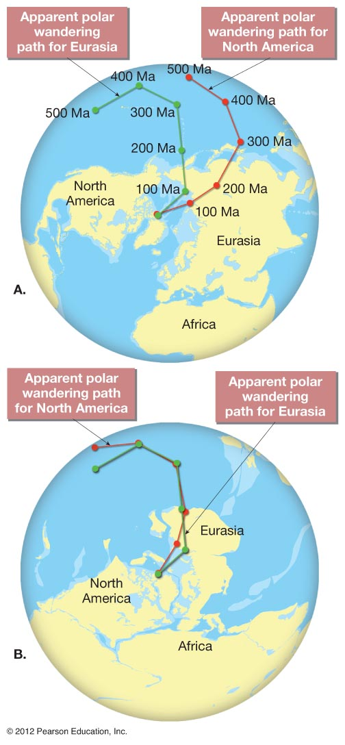
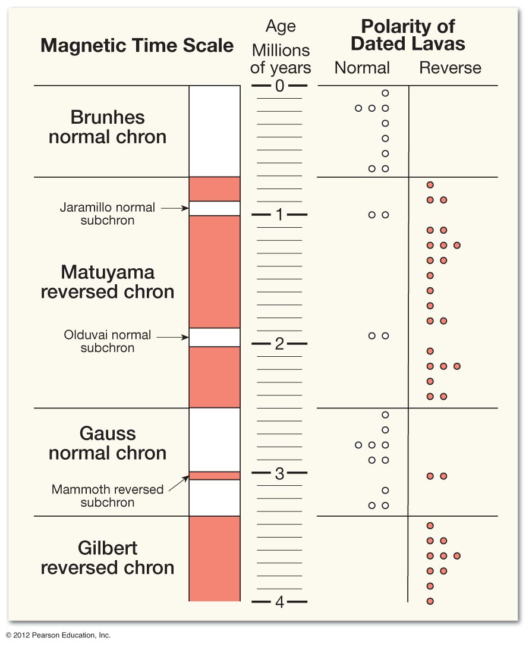
Plate Tectonic Evidence:
Paleomagnetic Continental Rock Record
Notes:
FIGURE 7.27

Slide 39
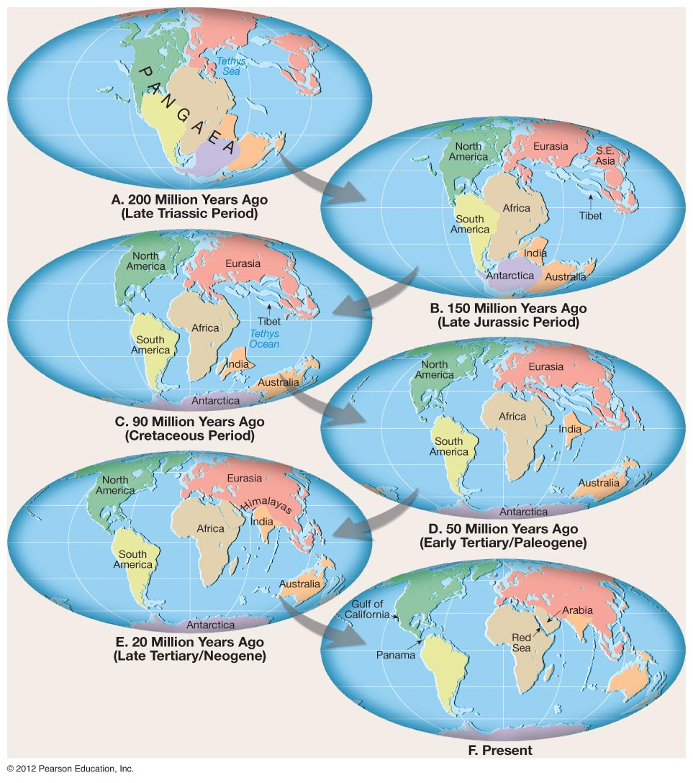
Plate Tectonic Evolution of Dynamic Planet Earth:
Paleogeographic Reconstruction of Wegner’s Pangaea
Notes:
FIGURE 7.A

Slide 40
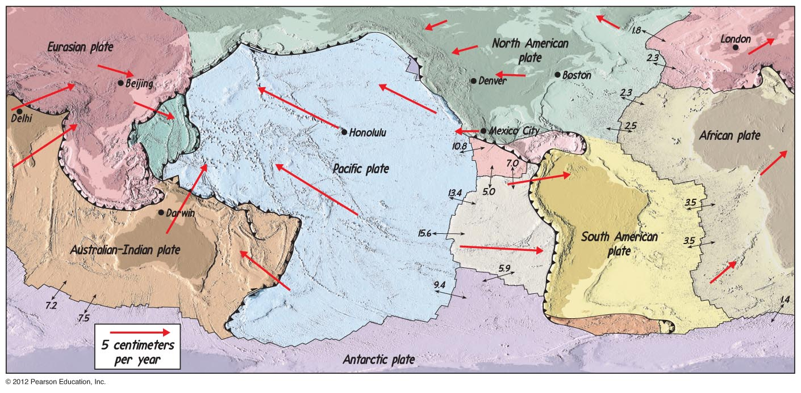
Plate Tectonics: Present-Day Plate Motion Vectors and Velocities
Notes:
FIGURE 7.32

Slide 41
DRIVING FORCES? WHAT CAUSES THE DYNAMIC PLATE MOTIONS?
GEOTHERMAL ENERGY!
Notes:
FIGURE 7.33

Slide 42

Plate Forces: A balance of heat, density, and gravity
Geothermal Heat Energy Transforms to Mechanical Energy via Mantle Convection
Notes:
FIGURE 7.34

Slide 43


Plate Forces: Mantle Convection – Heat Transfer to Mechanical Energy
Notes:
FIGURE 7.35

