Slide 1
ES104 Exploring Physical Earth
Course Introduction

Slide 2
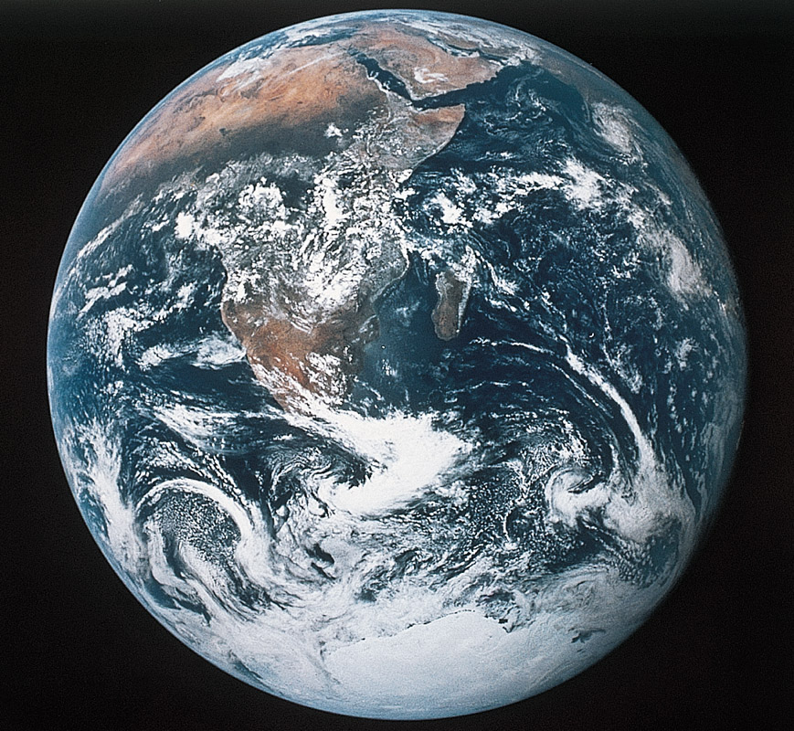
Welcome to ES104 Exploring the Physical Earth
Earth System Science – The study of energy, matter, and transfer processes of Planet Earth; with subdisciplines of geology, meteorology, hydrology, oceanography, and astronomy. An integrated science that dovetails with Biology and Envronmental Science.
The
Earth
Figure 1.18
Home Base Planet Earth

Slide 3
Content Topics and Learning Modules
Basics of physical science (matter, energy, heat, states of matter, physical properties of Earth components, deep time)
Earth’s place in the solar system (Sun, planets, origin and organization of the solar system)
Plate tectonics: theory and dynamics
Earth materials, minerals, igneous rocks
Earthquakes and seismology
Volcanoes and igneous processes
Geologic hazards and human connections to dynamic Earth processes

Slide 4
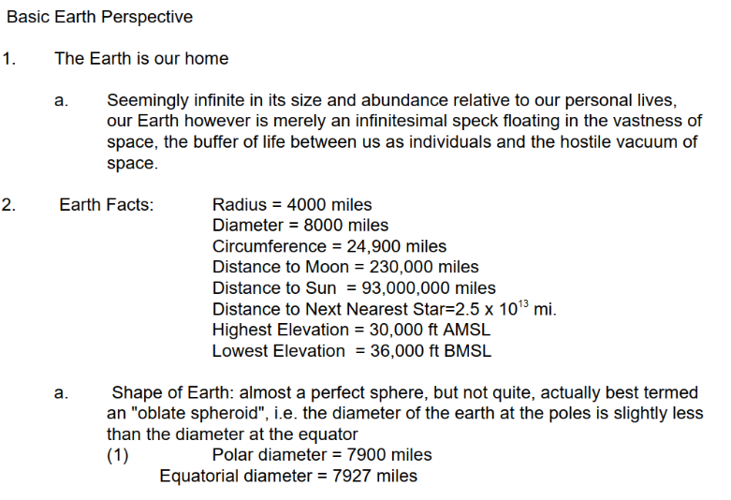
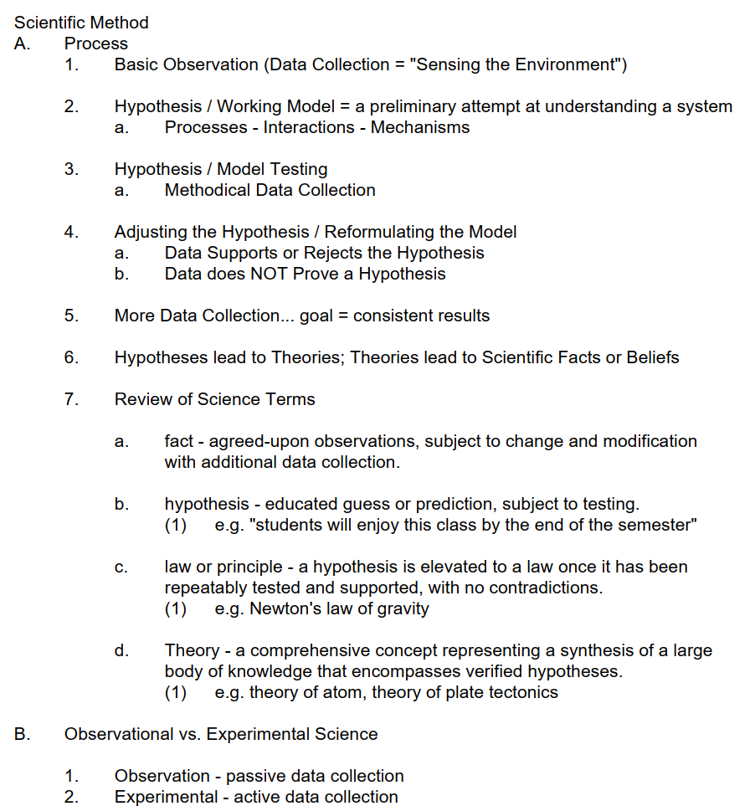
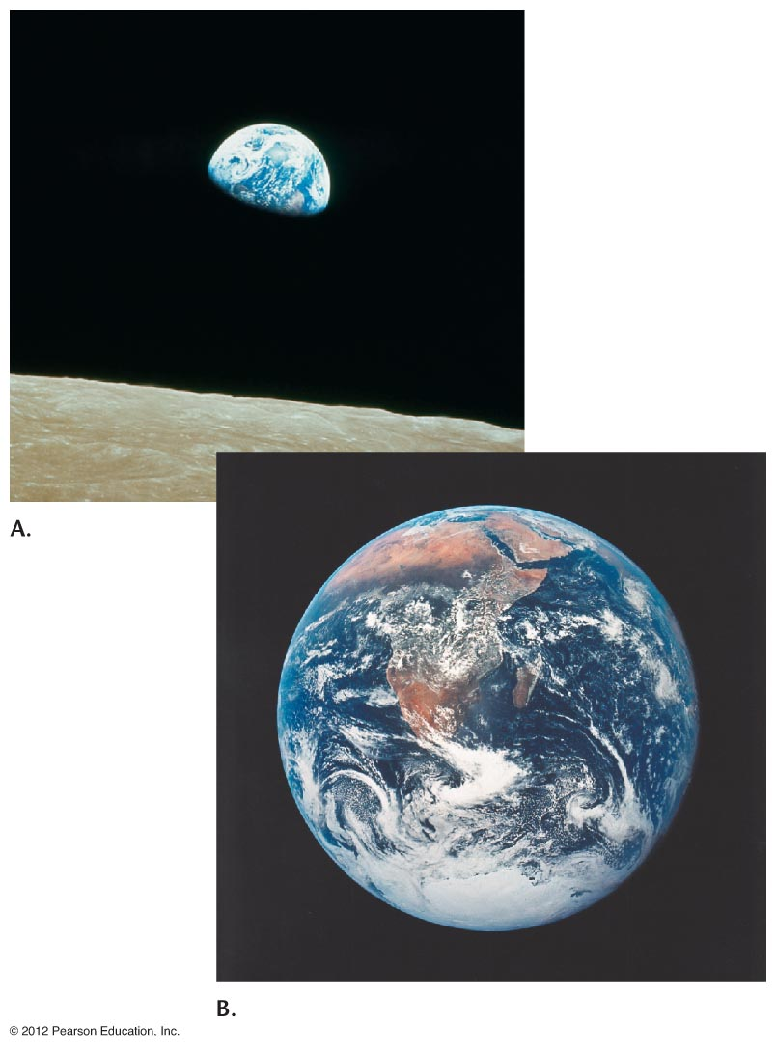
BASIC CONCEPTS

Slide 5
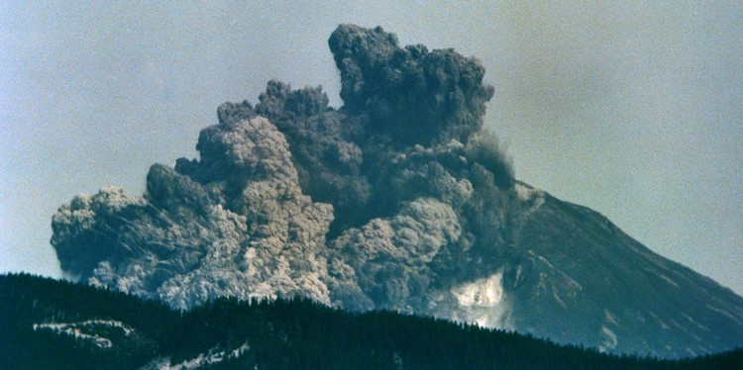
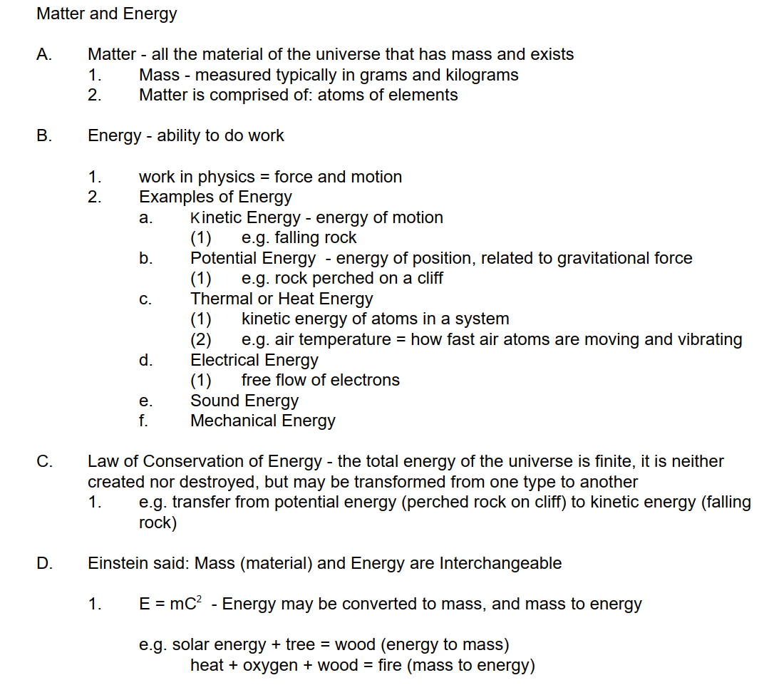
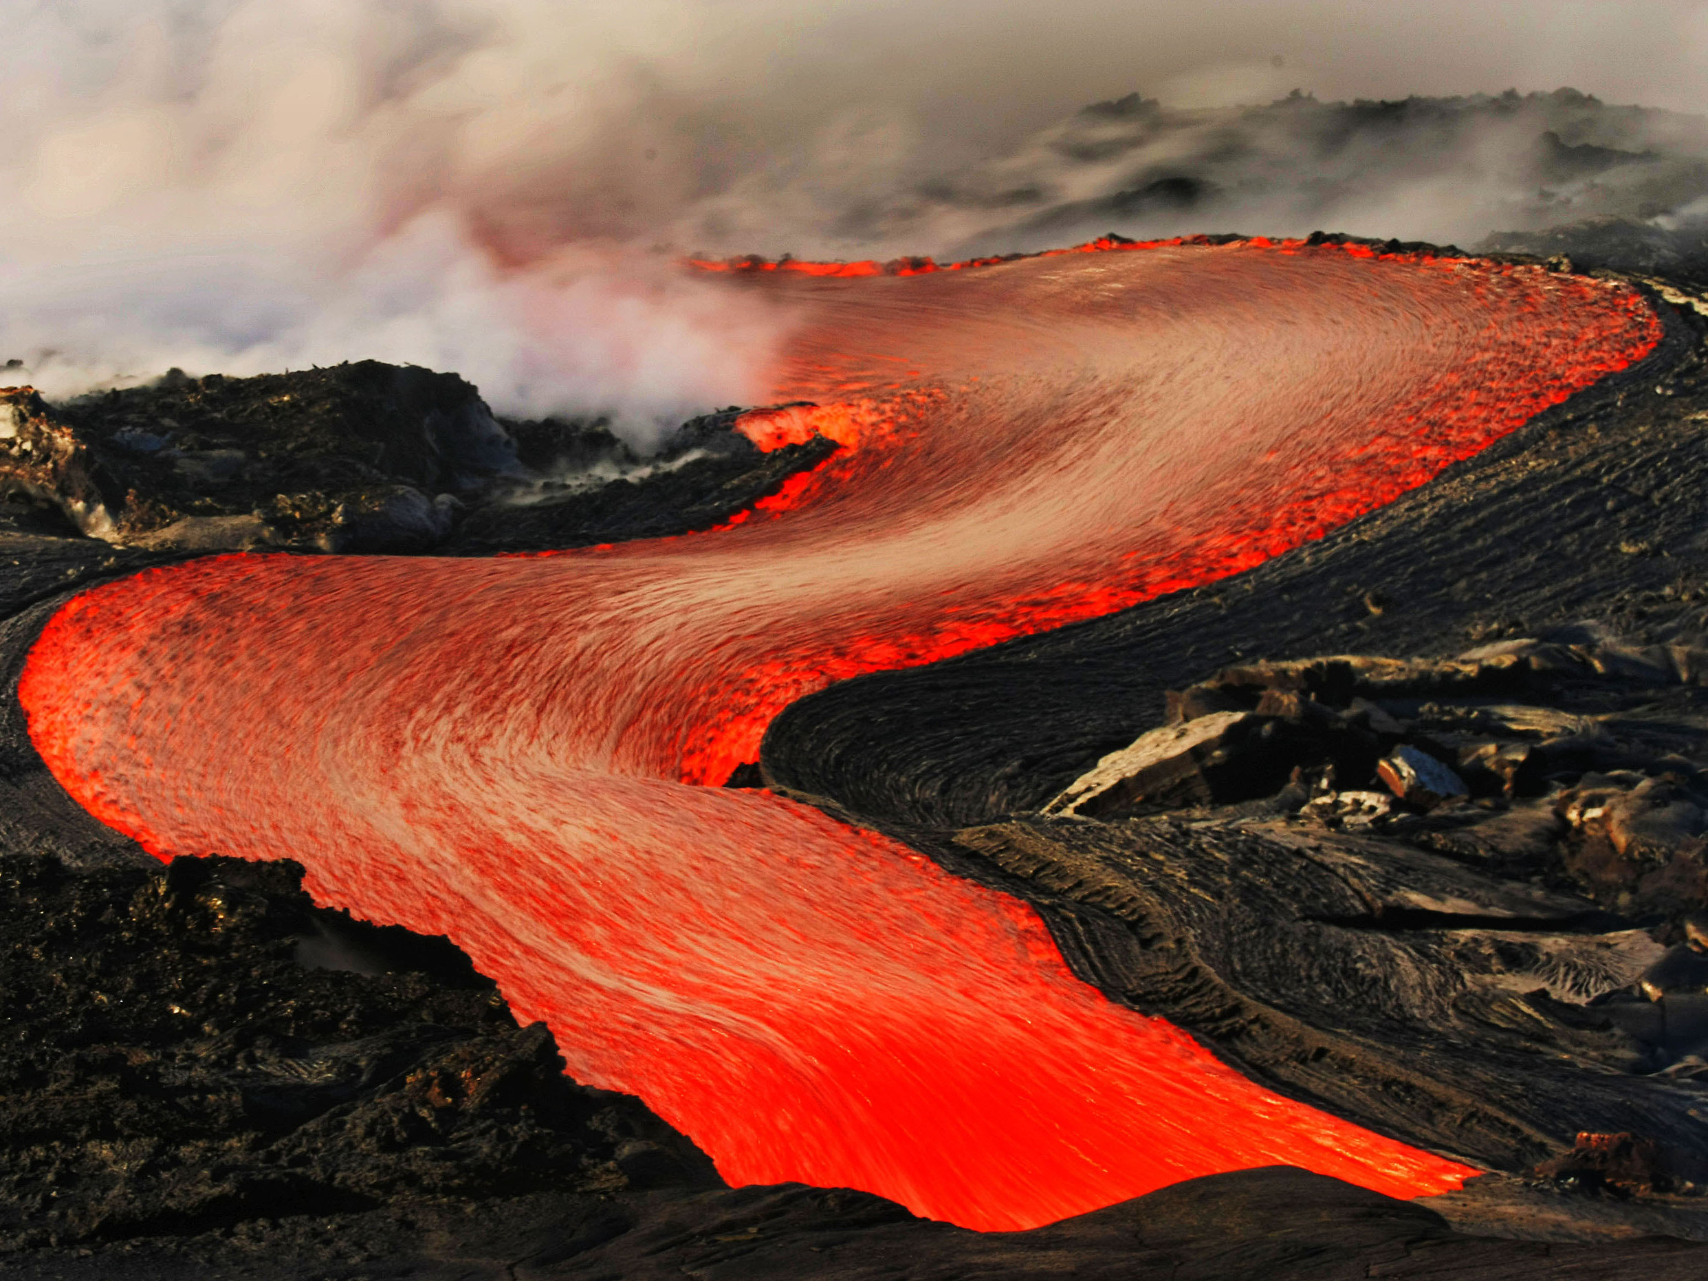
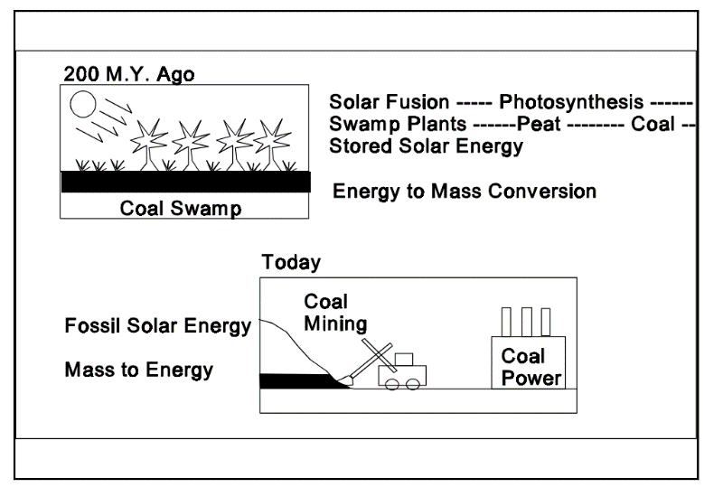
MASS AND ENERGY

Slide 6
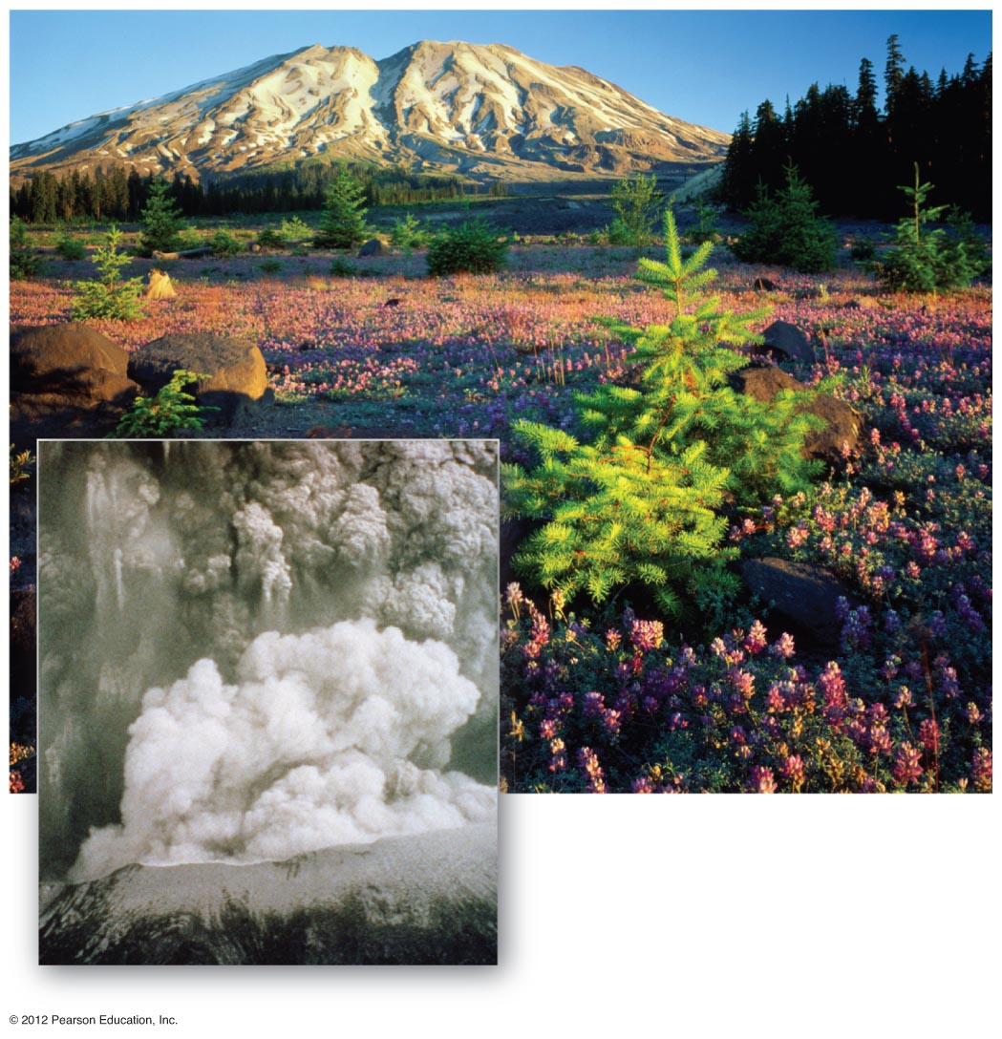
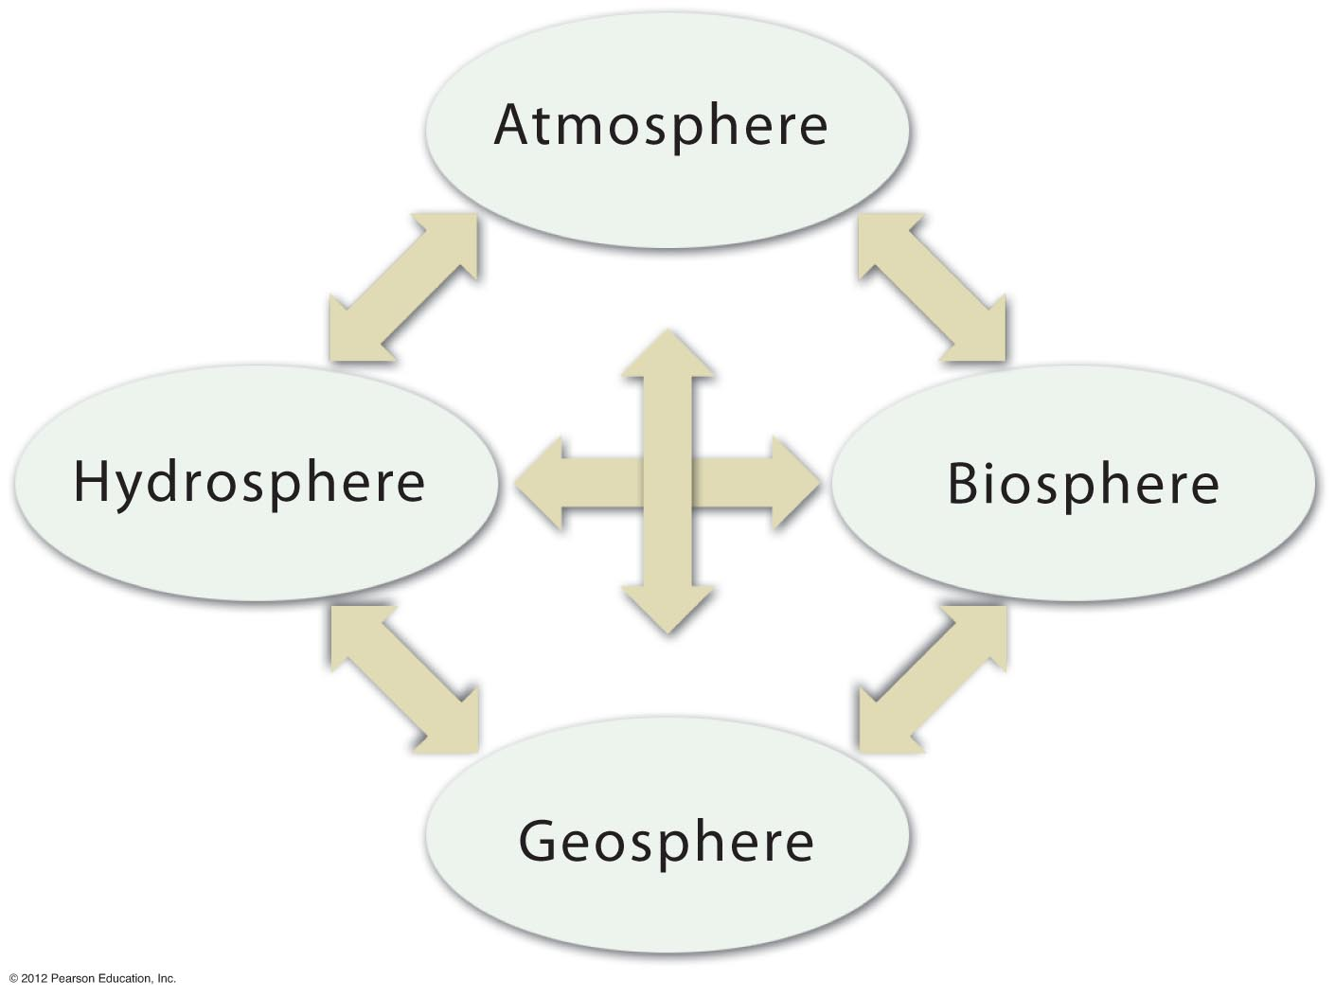
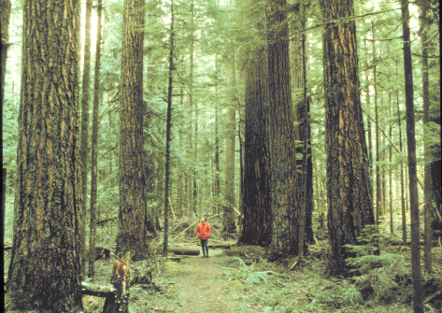
Notes:
FIGURE 1.21

Slide 7
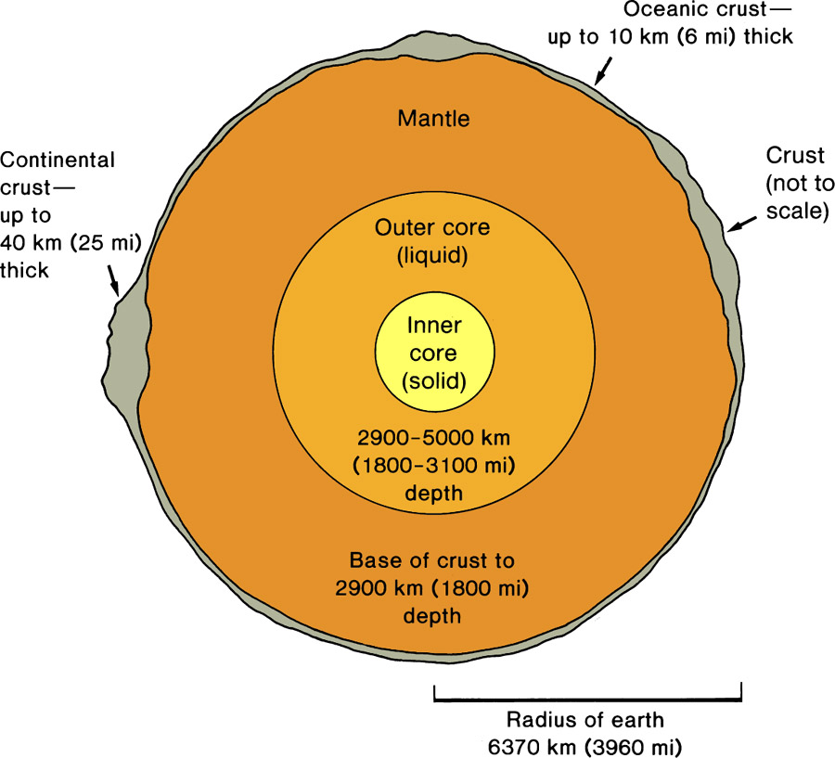
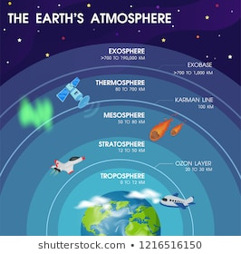
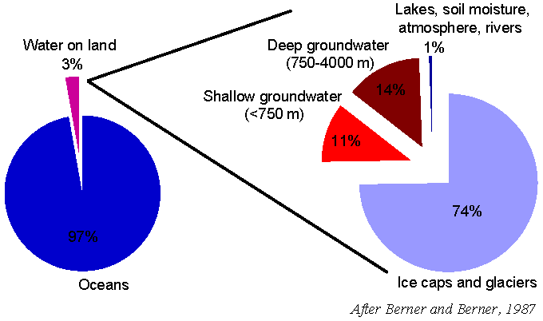
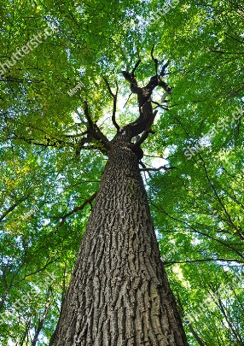
Earth System – a dynamic space ship with transfers of Mass and Energy
Four Subsystems: Geosphere (Lithosphere), Atmosphere, Hydrosphere, Biosphere
GEOSPHERE
-Solid Earth
-Near-Surface:
Minerals, Rocks
Soil
-47% Oxygen
-27% Silicon
-8% Aluminum
-18% Cations
+Others
ATMOSPHERE
-Gaseous Envelope
-78% Nitrogen
-21% Oxygen
-1% All Others
-Troposphere near
surface
HYDROSPHERE
-Water World Blue Planet
-97% H2O + dissolved ions
-Oceans
-Groundwater, Surface Water
-Glacial Ice
BIOSPHERE
-Life: Plants & Animals
-CHON – Carbon, Hydrogen,
Oxygen, Nitrogen
-Photosynthesis-Based Food
Chain
Human Habitat “Critical Zone”: surface nexus of atmosphere, hydrosphere and geosphere

Slide 8
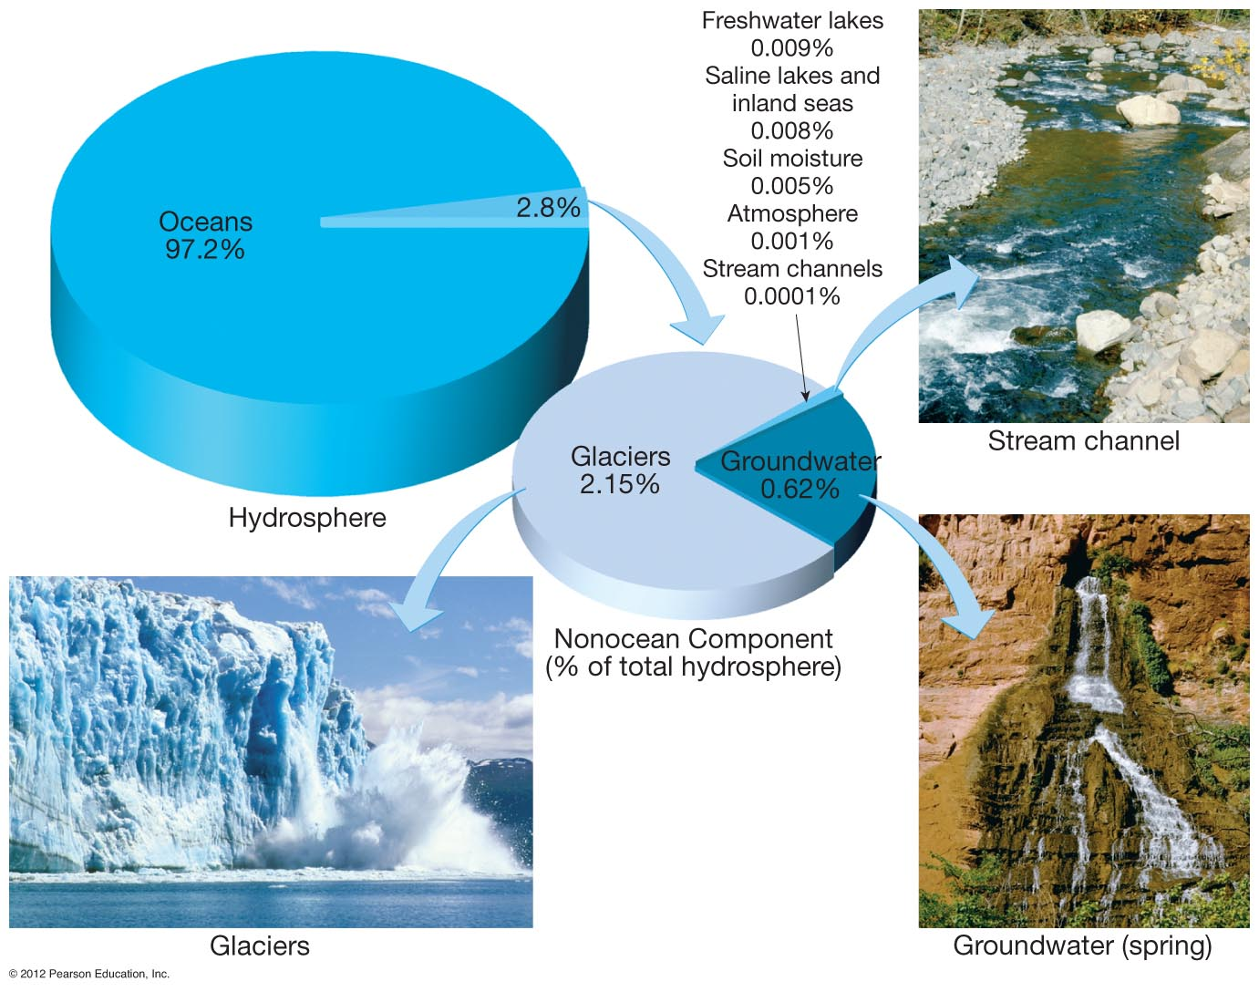
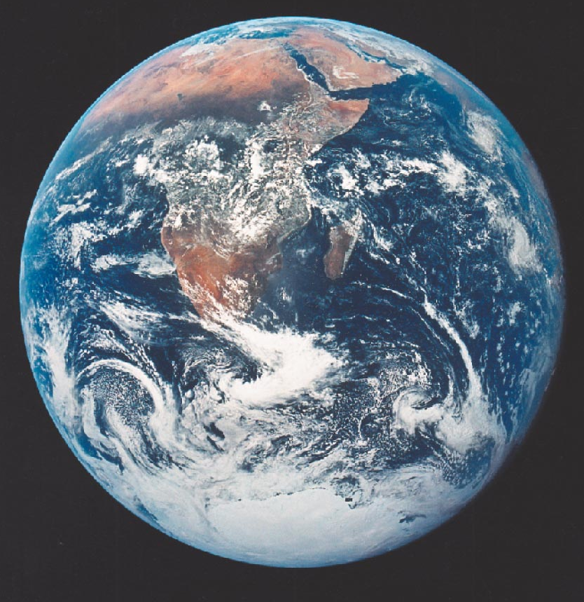
EARTH - THE “BLUE PLANET”
WATER = LIFE
Notes:
FIGURE 1.11

Slide 9
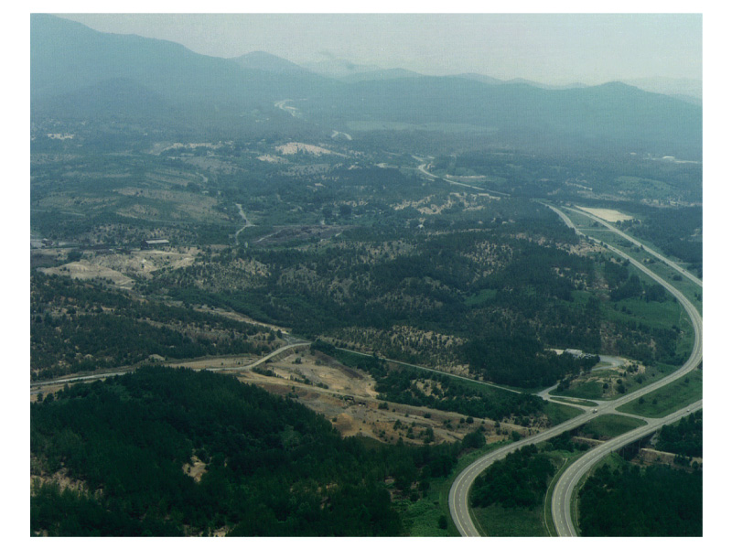
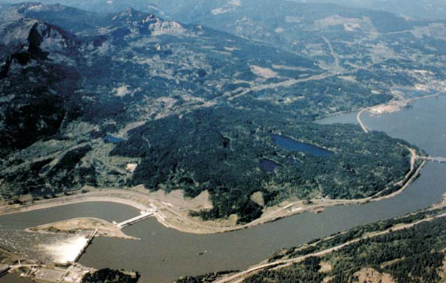
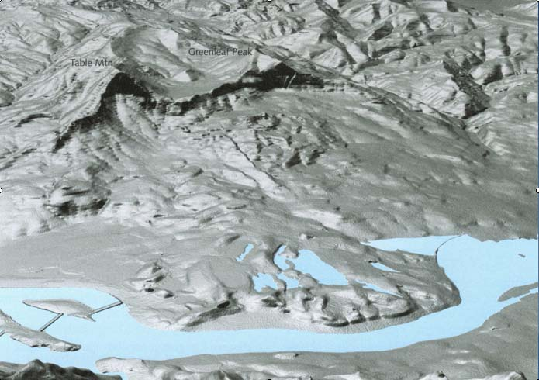
Earth System – Fundamental Driving Energy Sources: Geothermal, Solar, Gravity

Slide 10
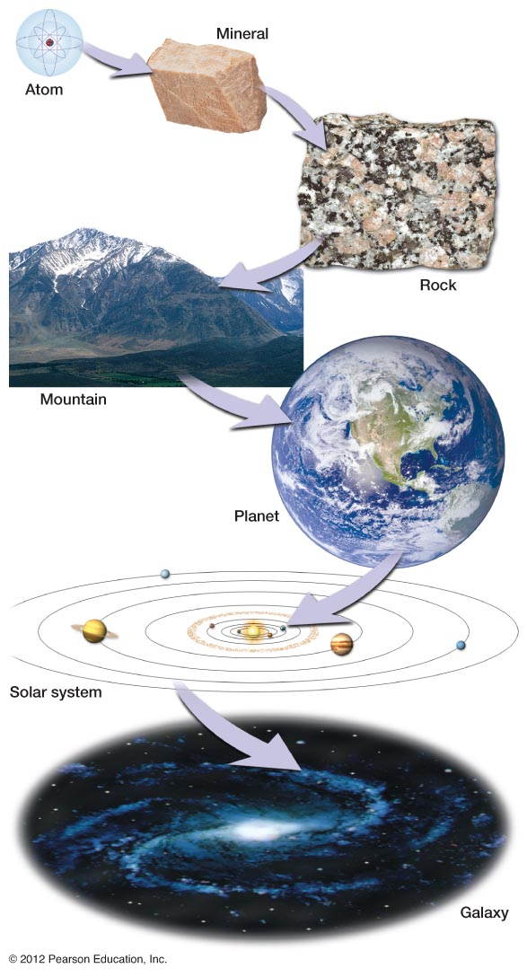
SPATIAL SCALING: The Earth in Context
Atomic = 10⁻¹⁰ meters
Rock Outcrop = 10² meters
Mountain Range = 10⁵ meters
Planet Earth 10⁷ = meters
Solar System 10¹² = meters
Milky Way Galaxy = 10²¹ meters
Notes:
FIGURE 1.6

Slide 11
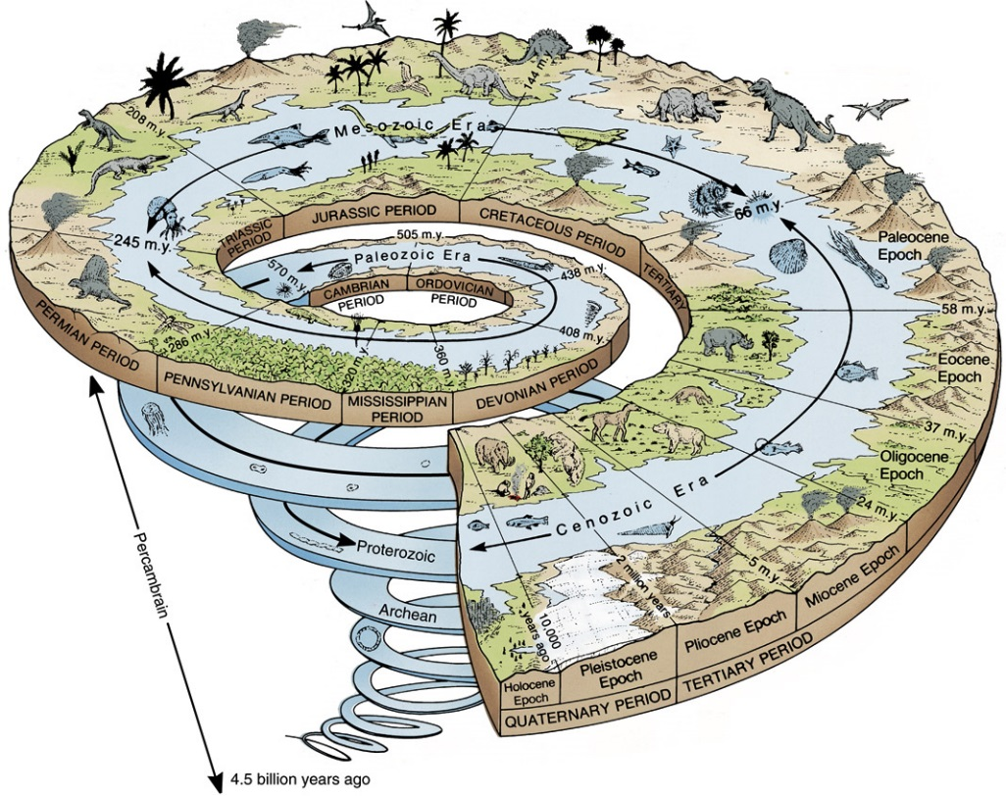
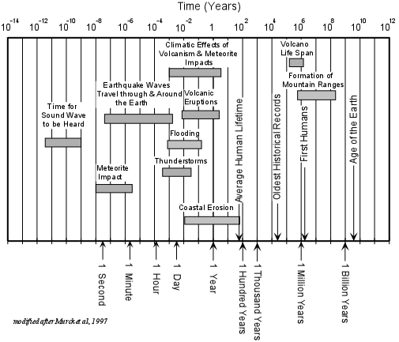
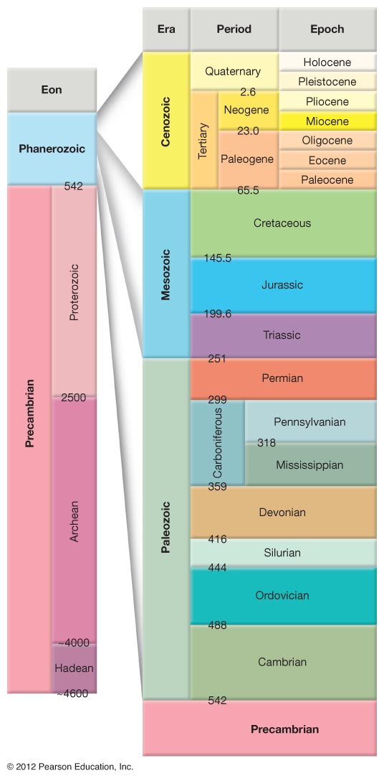
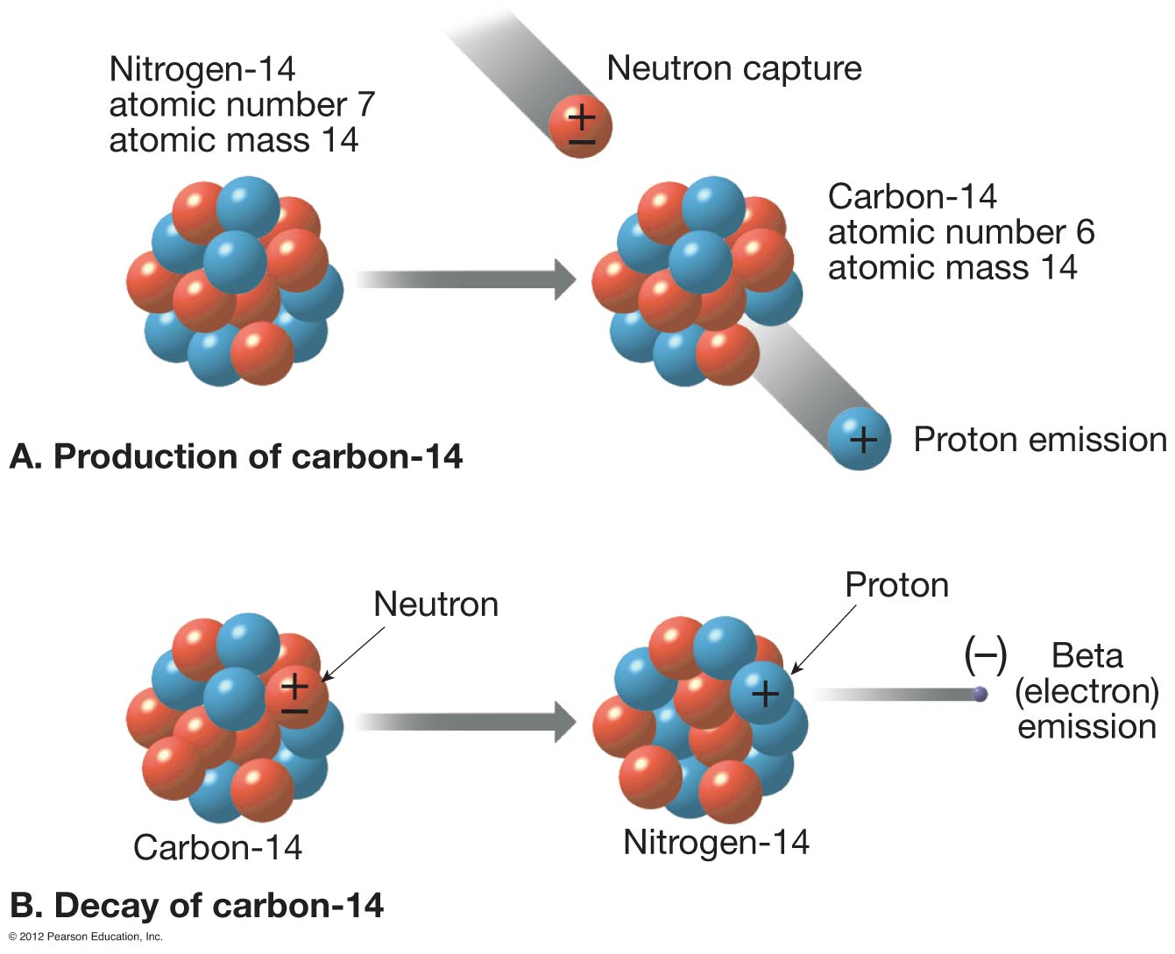
Earth Processes and Deep Geologic Time

Slide 12
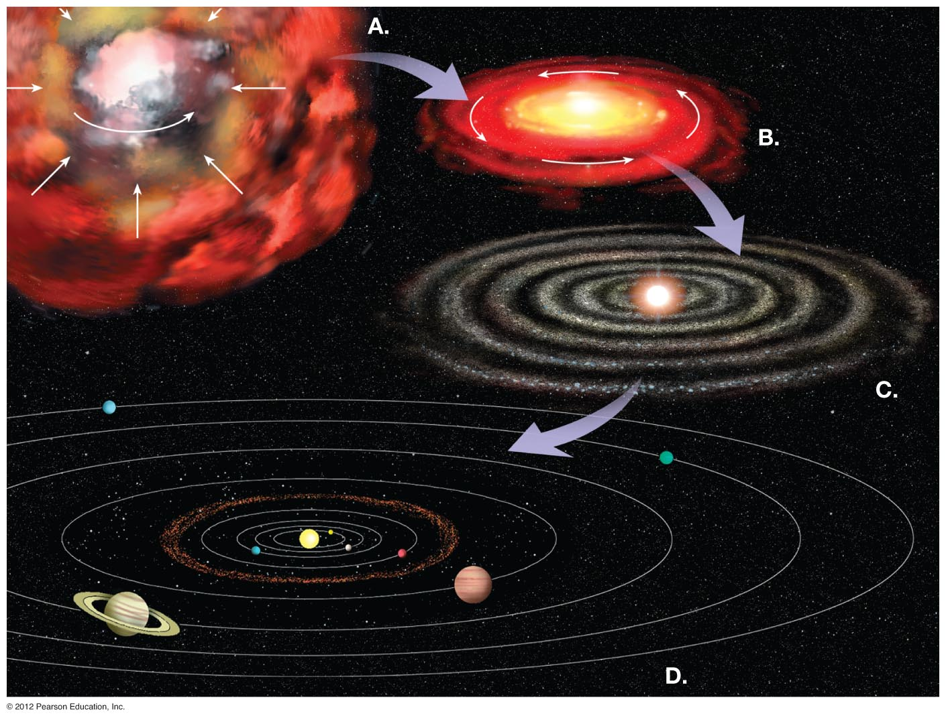
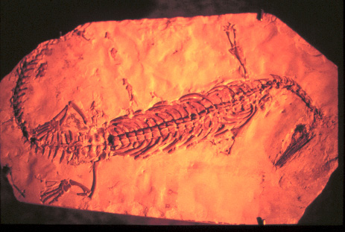
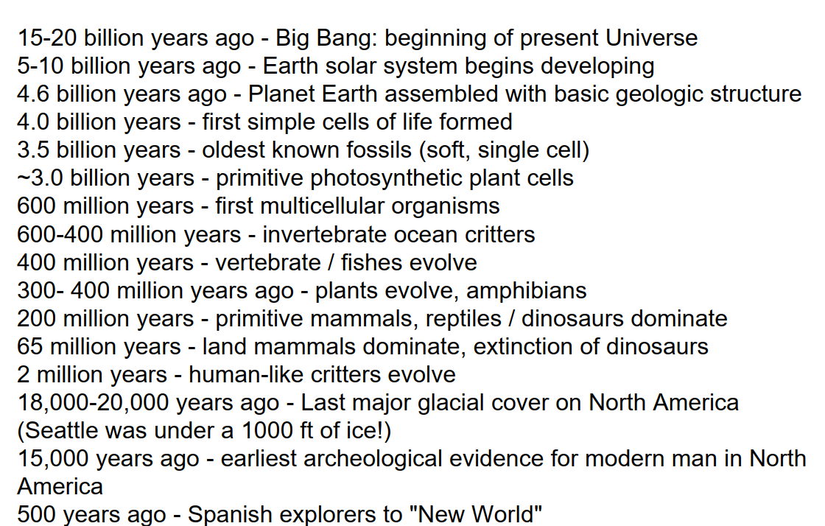
A Brief History of the Universe and Planet Earth:
Notes:
FIGURE 1.8

Slide 13
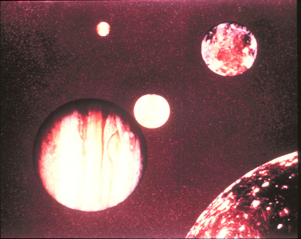
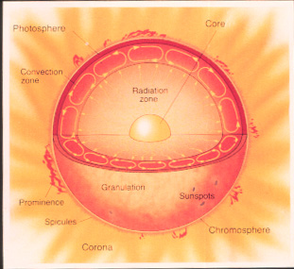
Sun and the Solar System

Slide 14
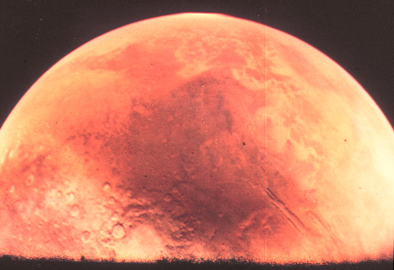
Planetary Geology – The Earth in Contrast

Slide 15
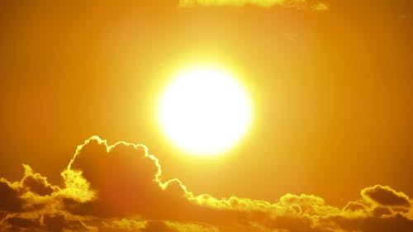
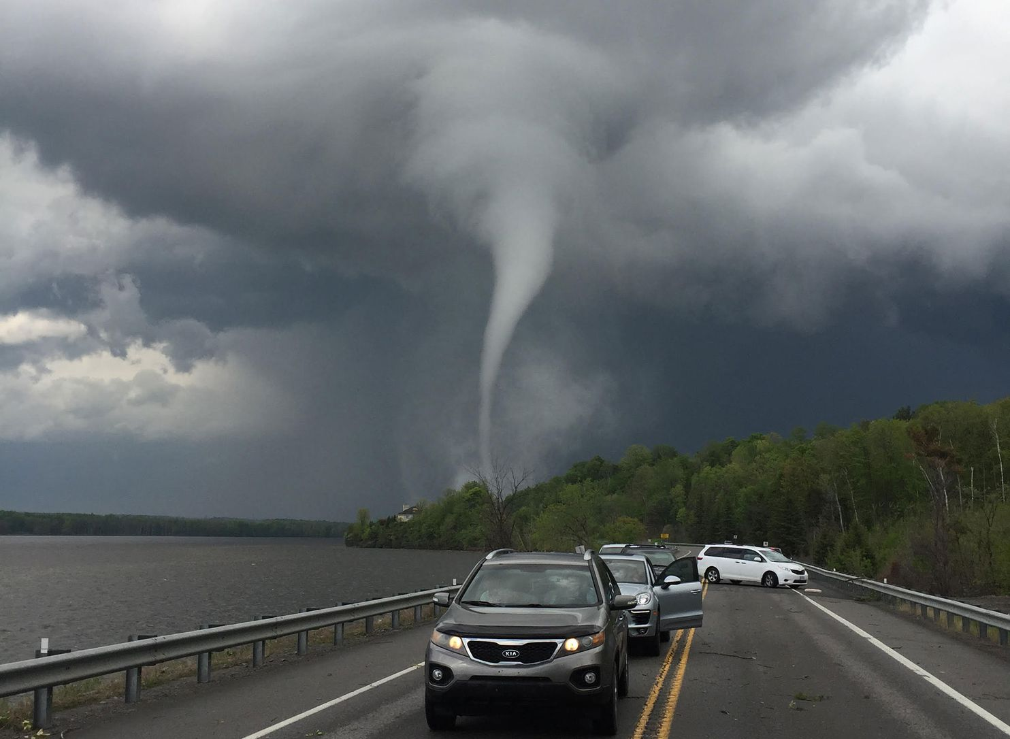
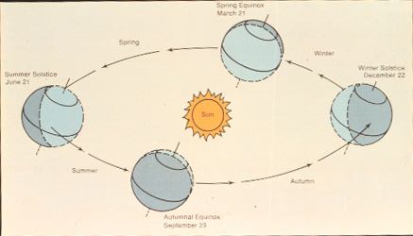
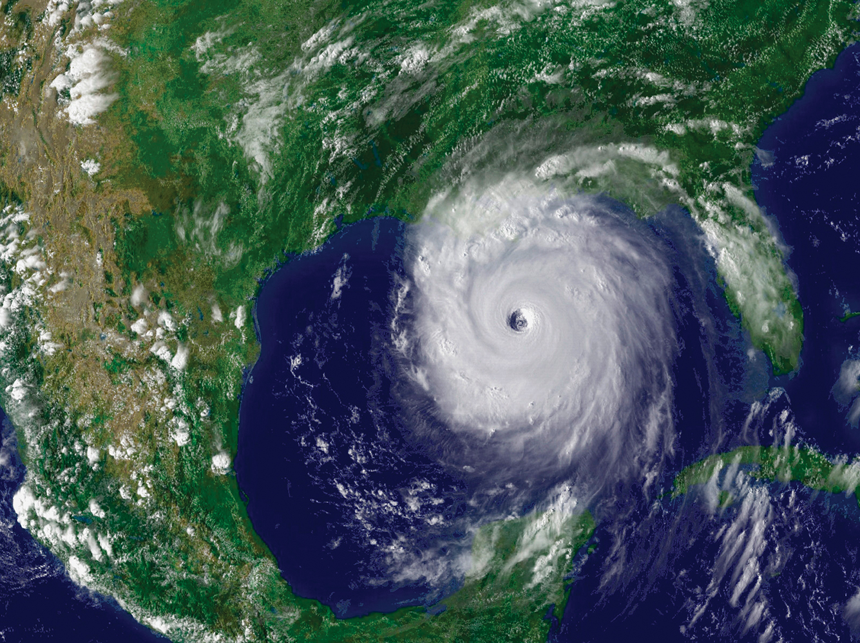
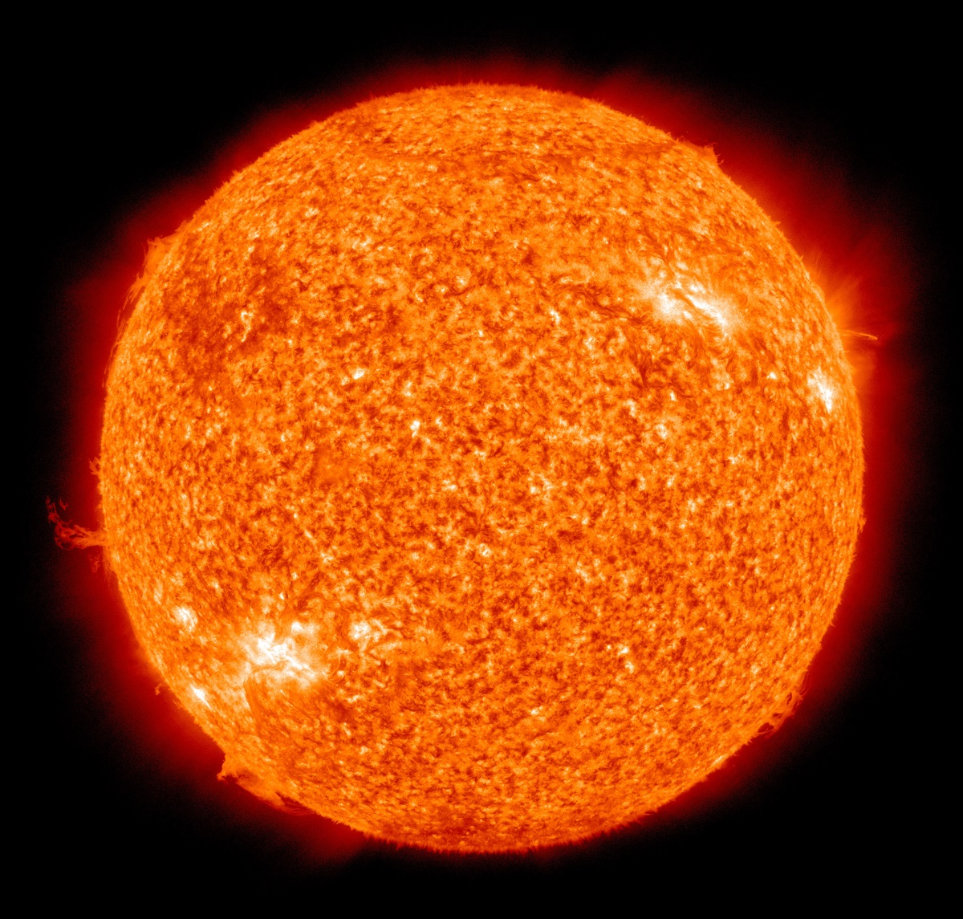
The Sun Star: Earth’s External Energy Source
Solar Heat Engine for Ocean and Atmosphere; Energy for Life

Slide 16
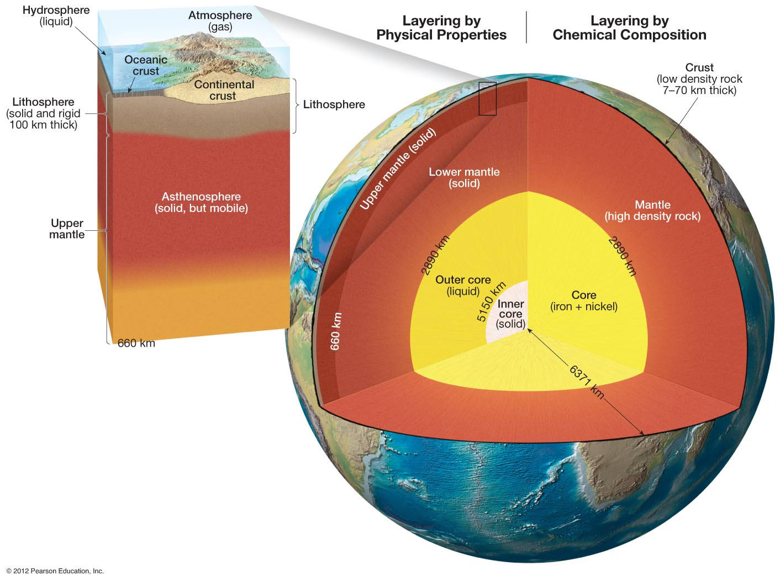
GEOSPHERE
Notes:
FIGURE 1.14

Slide 17
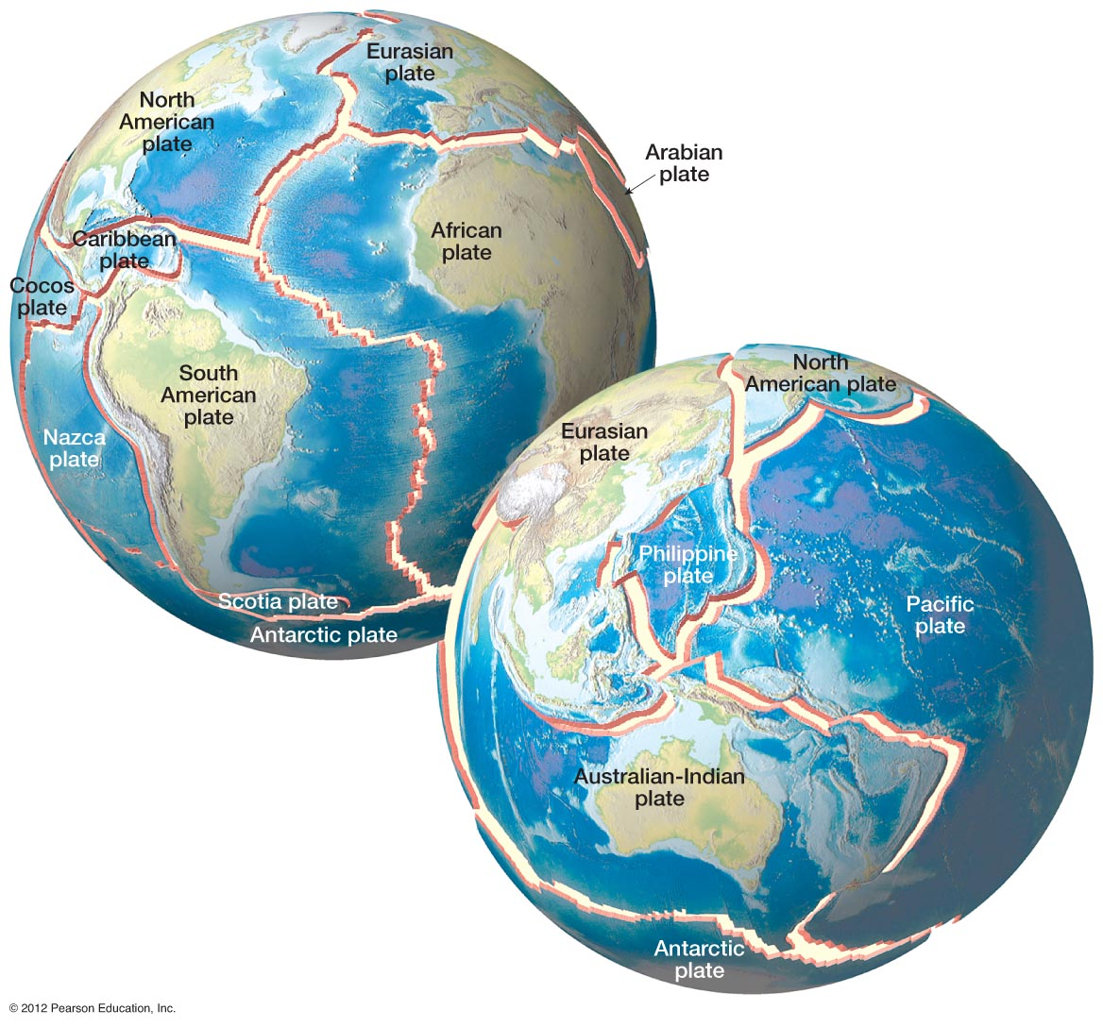
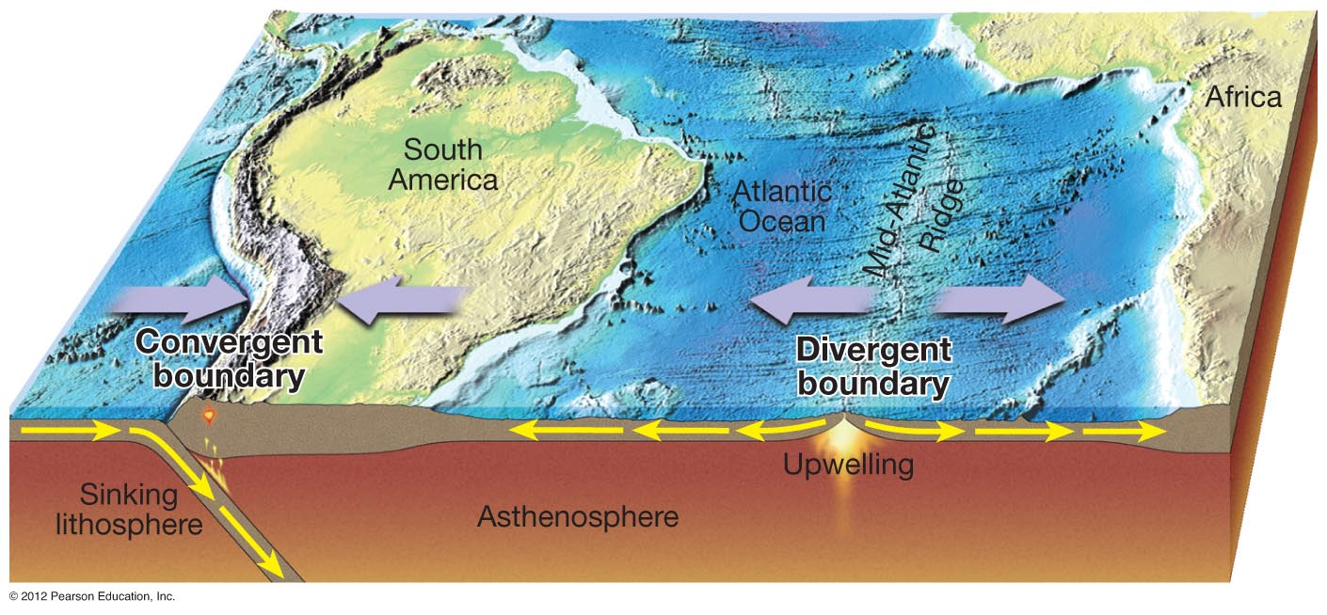
Geothermal Heat Energy
Transforms to Mechanical
Energy via Mantle Convection
Plate Tectonics: Geothermal Energy in Action
Notes:
FIGURE 1.16

Slide 18
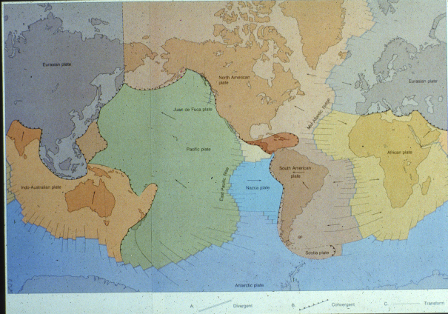
Plate Tectonics: Geothermal Energy in Action

Slide 19
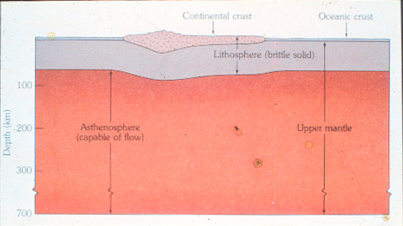
Anatomy of a Tectonic Plate

Slide 20
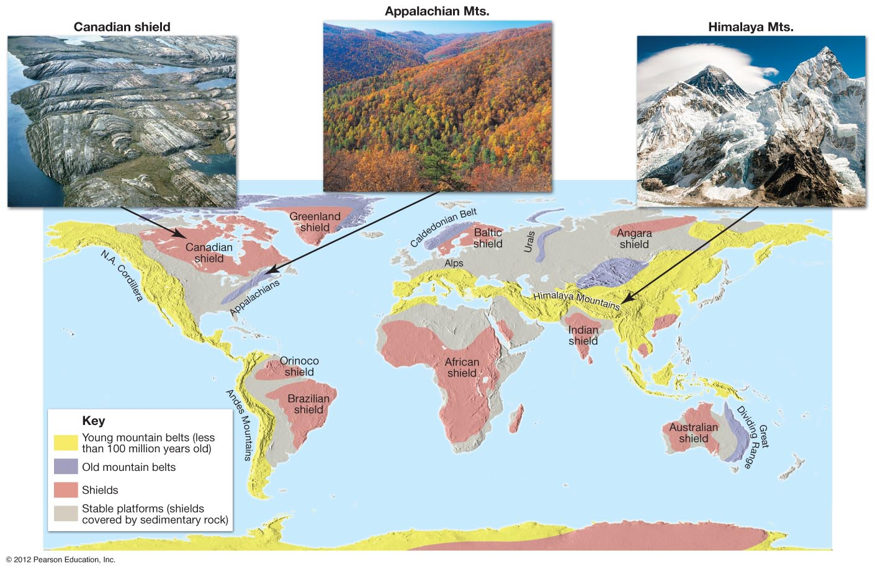
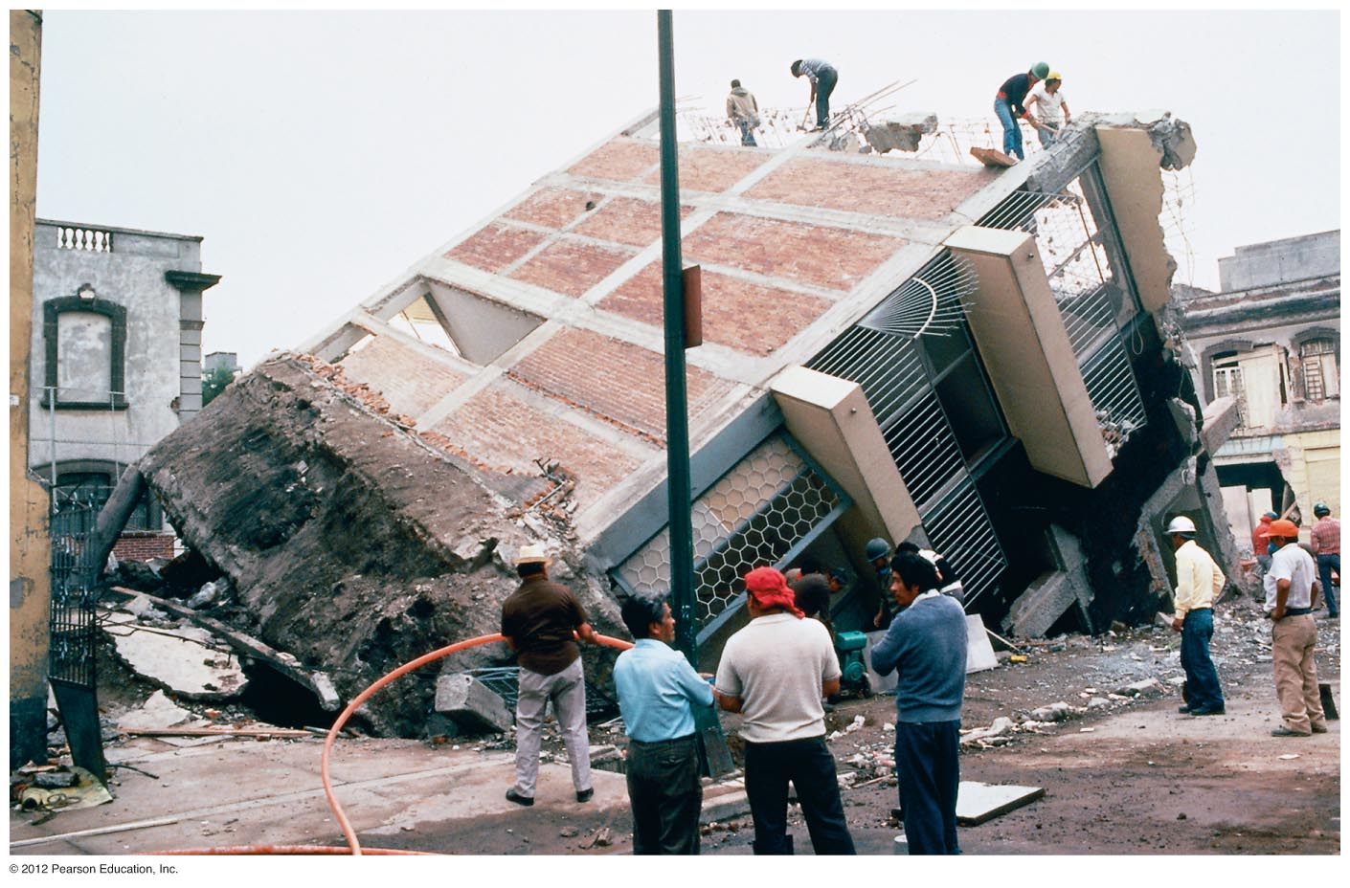
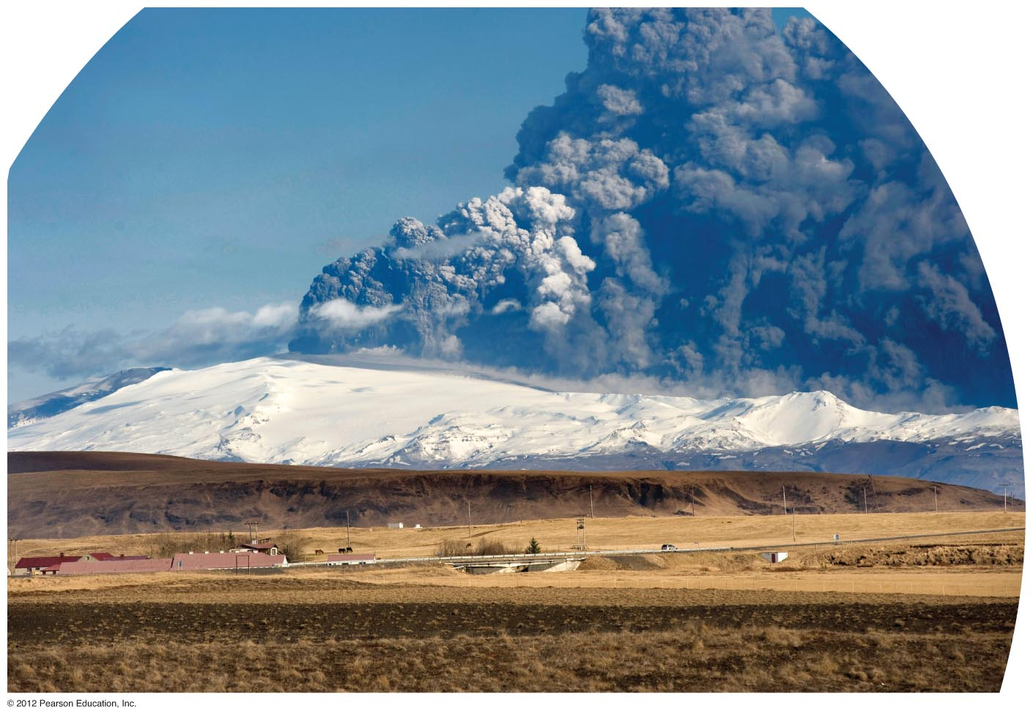
Plate Dynamics: Mountain Building-Volcanism-Earthquakes
Notes:
FIGURE 1.19

Slide 21
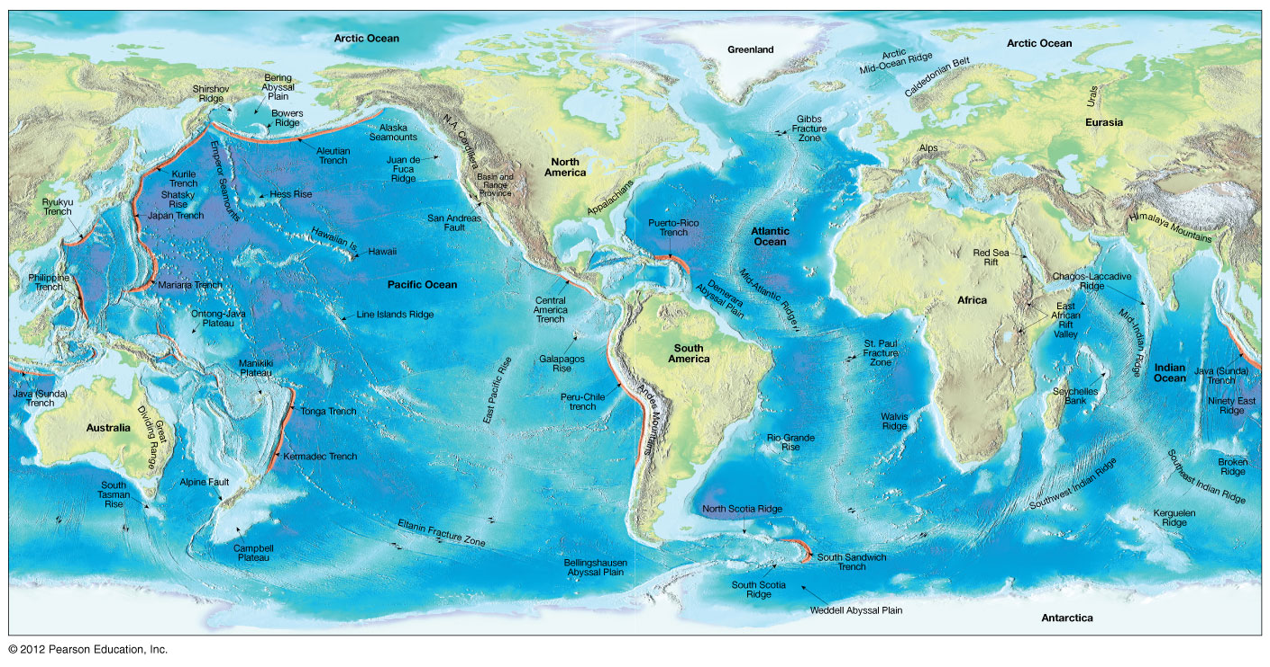
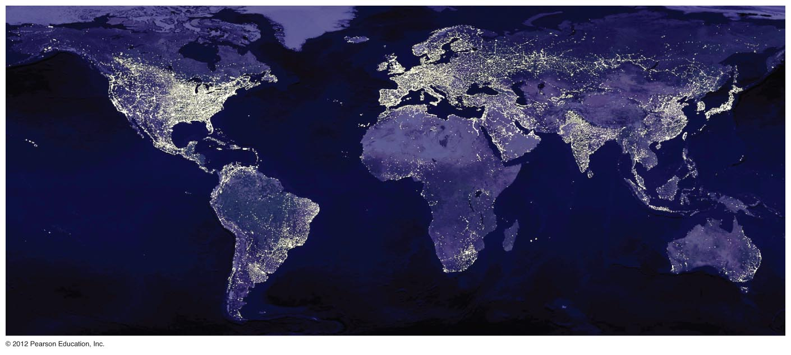
Plate Dynamics: Present-Day Global Geography
Notes:
FIGURE 1.18

Slide 22
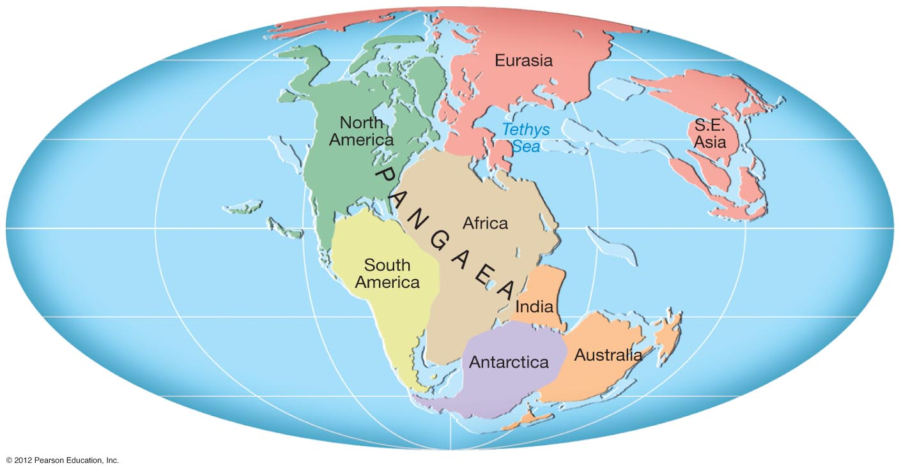
Plate Dynamics 200 m.y. Ago: Ancient Global Paleogeography
Tethys Ocean
Tethys Ocean
Notes:
FIGURE 1.15

Slide 23
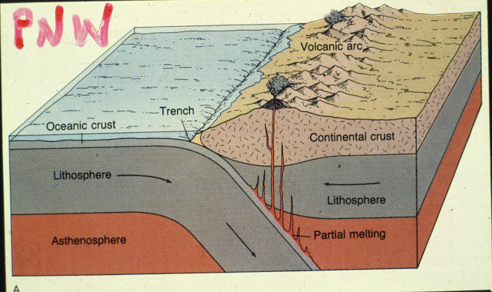
CASCADIA SUBDUCTION ZONE

Slide 24
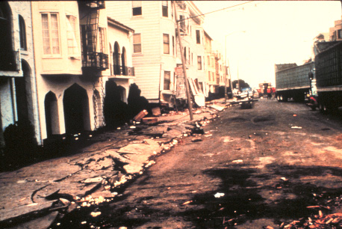
EARTHQUAKES AND SEISMIC SHAKING

Slide 25
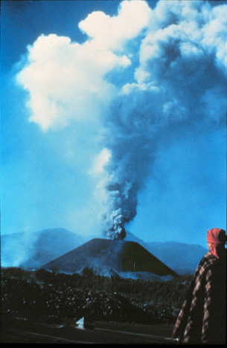

VOLCANISM (MR. SPOCK THE ANCIENT PROPHET)
Notes:
FIGURE 1.21

Slide 26


IGNEOUS LANDSCAPES – MAGMATIC PROCESSES

Slide 27



EARTH RESOURCES AND
HUMAN SYSTEMS

