Slide 1
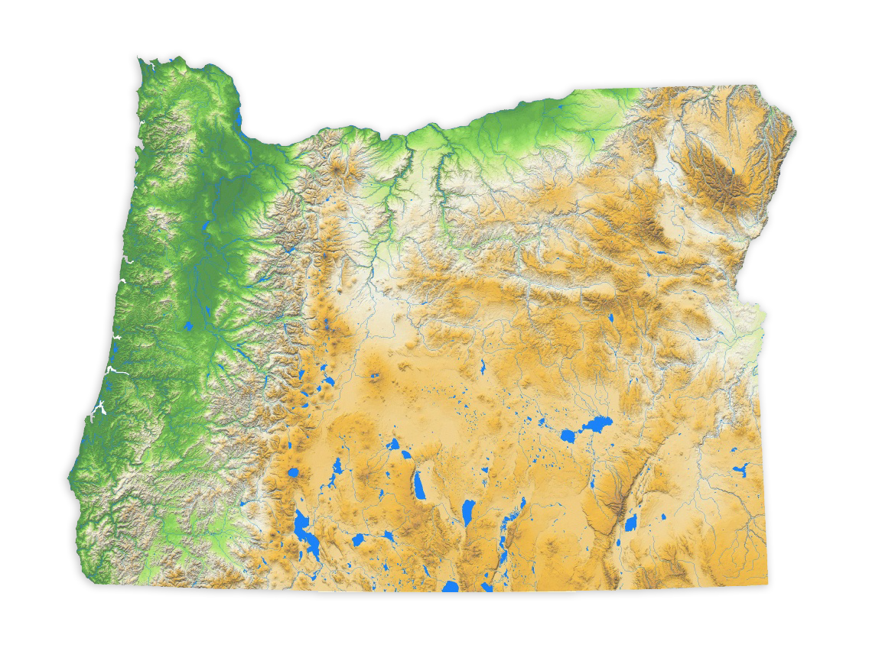
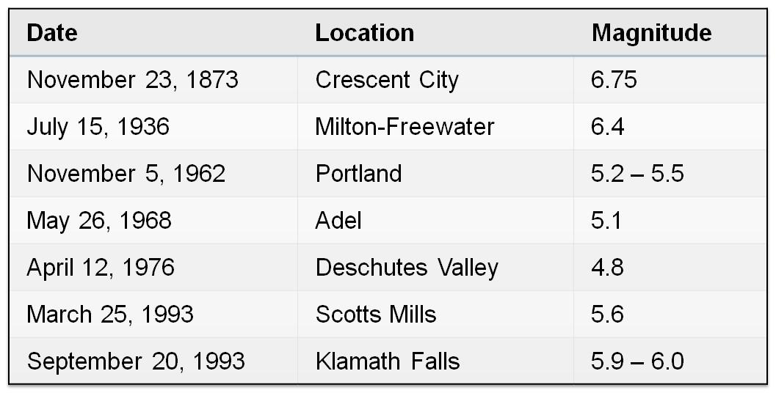
Your Poster Title Here… in Arial, Bold, 60-80 Points
YOUR NAME HERE…in Arial, 44 Points, Bold
Earth and Physical Department
Western Oregon University
ABSTRACT
The first section includes an abstract of your project topic. This section was set in Arial, 36 points. Boldfacing the section type is an option.
PROJECT OVERVIEW (Arial: 44 Points, Bold)
This section of the poster might serve a number of purposes: background information, methods, or system design. An important point with posters is to rely on visuals rather than longs blocks of text to communicate. Figures 2 and 3 show two more possible layouts for posters.
Figure 1. Location map of study area… (caption: 32 points, bold).
Table 1. Important tables of numbers and concepts.
INTRODUCTION (Arial: 44 Points, Bold)
The introductory section should define the topic and show its importance. A good test is whether the poster can orient the audience to these two aspects in 20 seconds. Shown in Figure 1 is a possible layout for a poster. This section was set in Arial, 36 points. Boldfacing the section type is an option.
RESULTS AND DISCUSSION
One section of a poster should present the results with discussion. Often the results can be depicted with graphs, such as for an experiment, or with drawings such as with a design. No matter the type selected for the sections, you should still use a bold sans serif for the headings.
Figure 4. Fifth possible layout for poster (caption: 32 points, bold).
Figure 2. Second possible layout for poster (caption: 32 points, bold).
CONCLUSION (Arial 44 Points)
The final section of the poster generally provides conclusions and summary; what’s the take-home message and punchline of your story?. This section was set in Arial, 36 points. Boldfacing the section type is an option.
Acknowledgments (Arial, 36 points, bold)
In this template, acknowledgments are set in Arial, 32 points. Try to keep the acknowledgments to one or two lines.
References (Arial, 36 points, bold)
First reference in Arial, 32 points, with a reverse indent: alphabetical or numerical order.
Second reference in Arial, 32 points, with a reverse indent: alphabetical or numerical order.
Figure 3. Third possible layout for poster (caption: 32 points, bold).

