Slide 1
Solid Waste Management and Landfills

Slide 2
Waste Disposal and Management
LANDFILL DESIGN

Slide 3
Hazardous Chemical Exposure and Risk

Slide 4
Hazardous Chemical Exposure and Risk

Slide 5
Site Subsurface Hydrogeology:
Primary Contaminant Pathway (Gravity, Infiltration, and Time)

Slide 6
Landfill Site Selection

Slide 8
Environmental Engineering and Control Measures

Slide 9
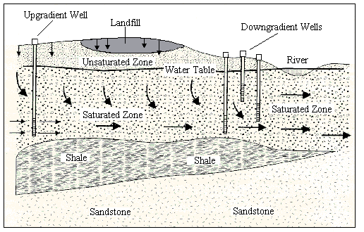
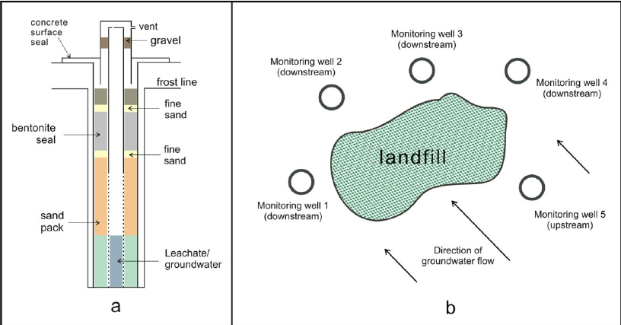
Environmental Engineering and Control Measures
1. Groundwater Monitoring System

Slide 10
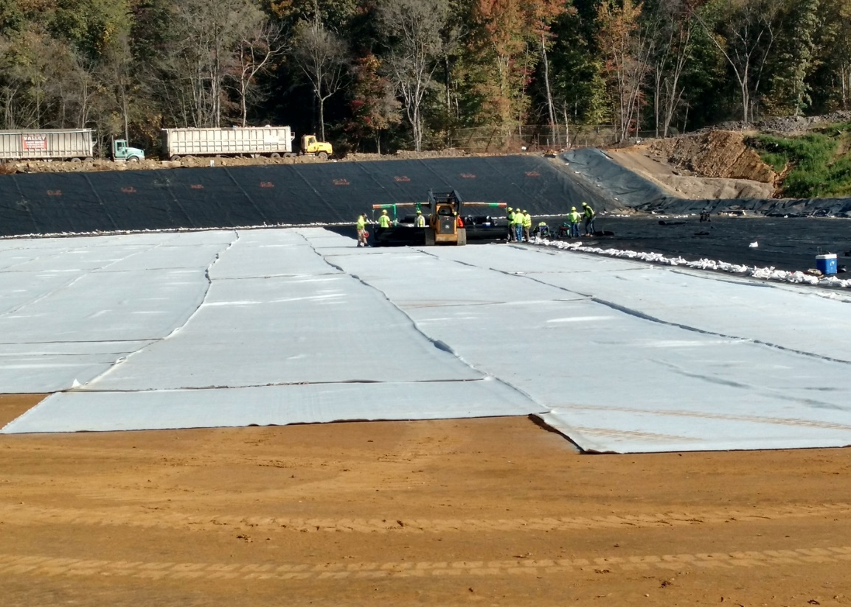
Environmental Engineering and Control Measures
2. Leachate Control System

Slide 11
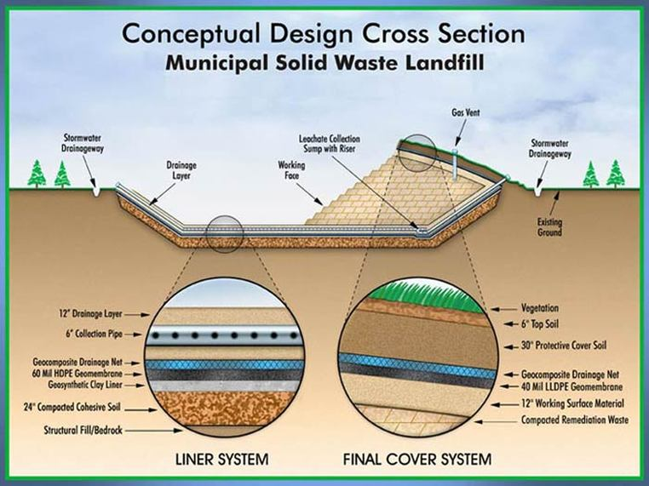

Slide 12
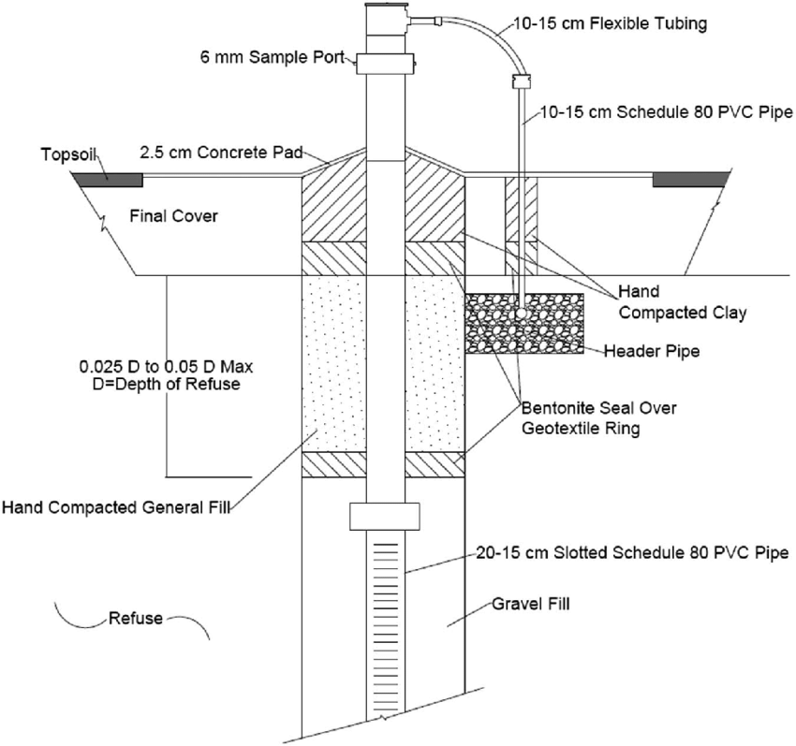
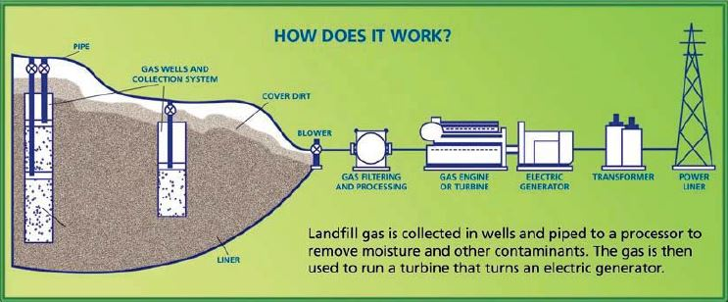
Environmental Engineering and Control Measures
3. Landfill Gas and Methane Control System

Slide 13
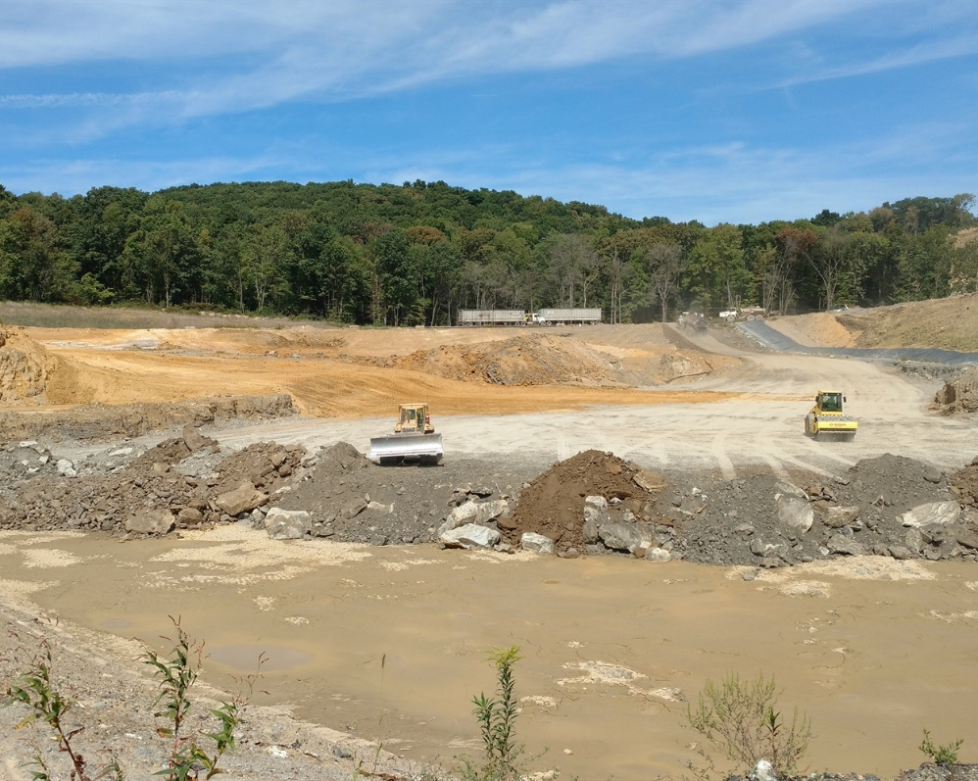
Environmental Engineering and Control Measures
Other Control Components

Slide 14
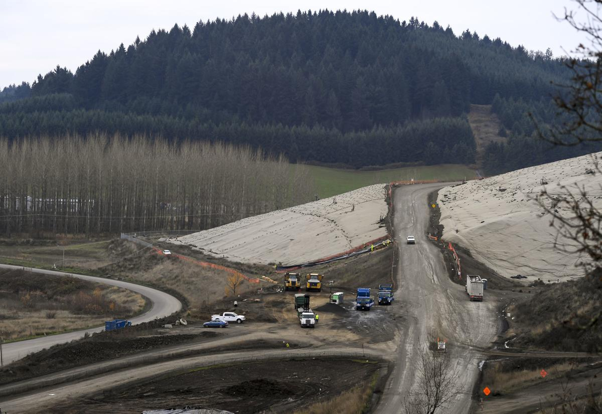
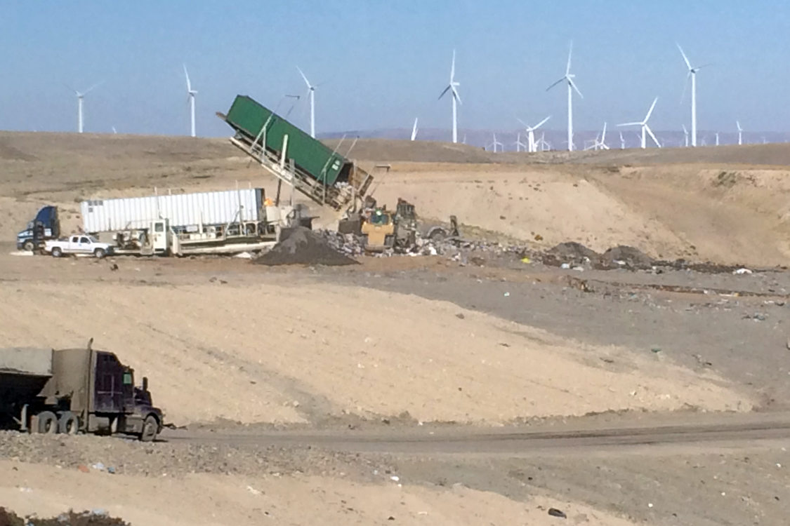
Oregon Regional Landfills
Coffin Butte Landfill – Adair Village
Mid-Willamette Valley Municipal and Residual Waste (Polk, Benton, Lincoln Counties, Portland)
Columbia Ridge Landfill – Arlington
Largest landfill in Oregon, Municipal, Residual, and Hazardous Waste
Statewide, Washington and Oregon

