Slide 1
Introduction to LIDAR Mapping Technology
LIDAR (Light Detection and Ranging)
ALSM (Airborne Laser Swath Mapping) and laser altimetry
LASER (Light Amplification by the Stimulated Emission of Radiation)
Amplified electromagnetic radiation of a specific frequency and wavelength generated by stimulated emission.
The radiation emitted by a laser consists of a coherent beam of photons, all in phase and having the same polarization
Commonly generated in the UV-Visible-IR spectral range

Slide 2
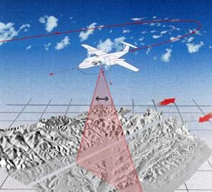
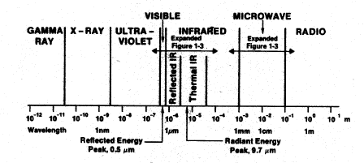
Laser Pulse Generators
Airborne topographic mapping lidars - use 1064 nm diode-pumped YAG lasers
Bathymetric systems generally use 532 nm diode-pumped YAG lasers
Scanner and optics
Photodetector and receiver electronics
Position and navigation systems
Computer System, Memory Management and Data Processing Software

Slide 3
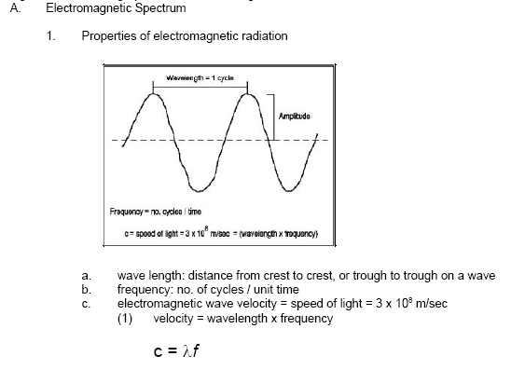
Laser Pulse Reflection
T =
Two-way
Travel
time
D = distance
c = D / (T/2)

Slide 4
Airborne Laser Swaths / Flight Operations
Data Management System
Laser Pulse Generation
Laser Pulse Detection
Post-Processing / Error Corrections
Post-Processing / Data Filtering
Digital Modeling
Image Production

Slide 5
laser scanning systems are capable of emitting up to 100,000 pulses per second

Slide 7
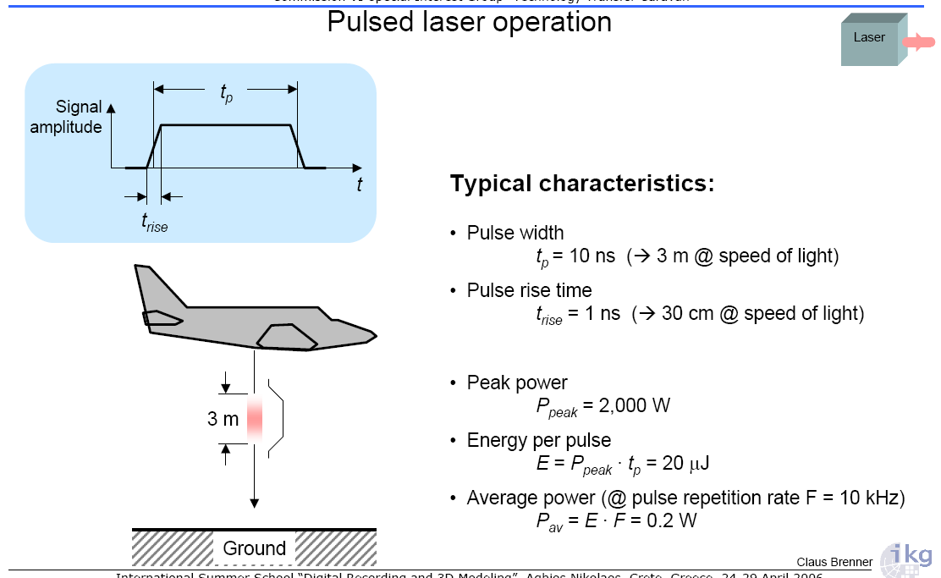

Slide 14
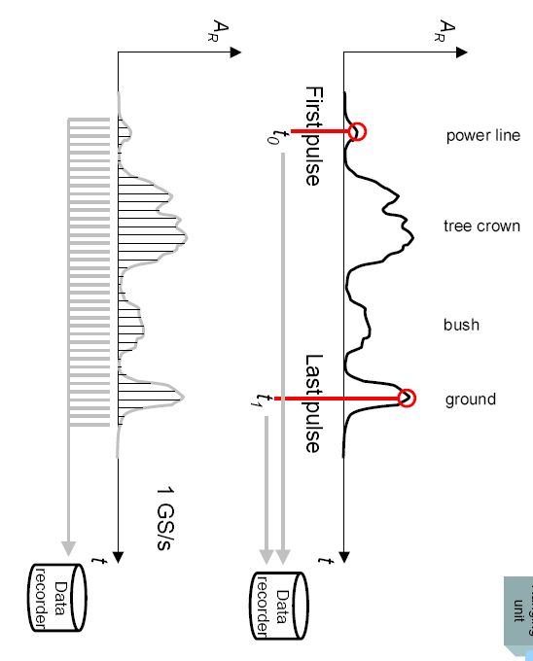

Slide 15
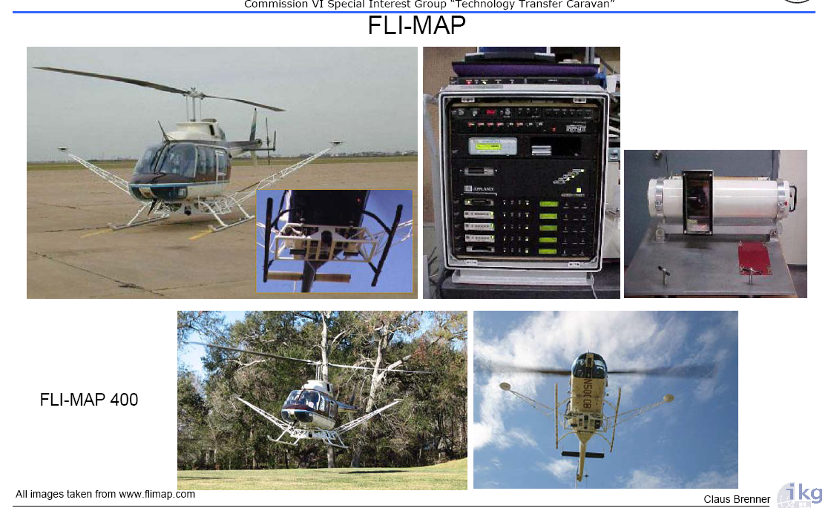

Slide 16
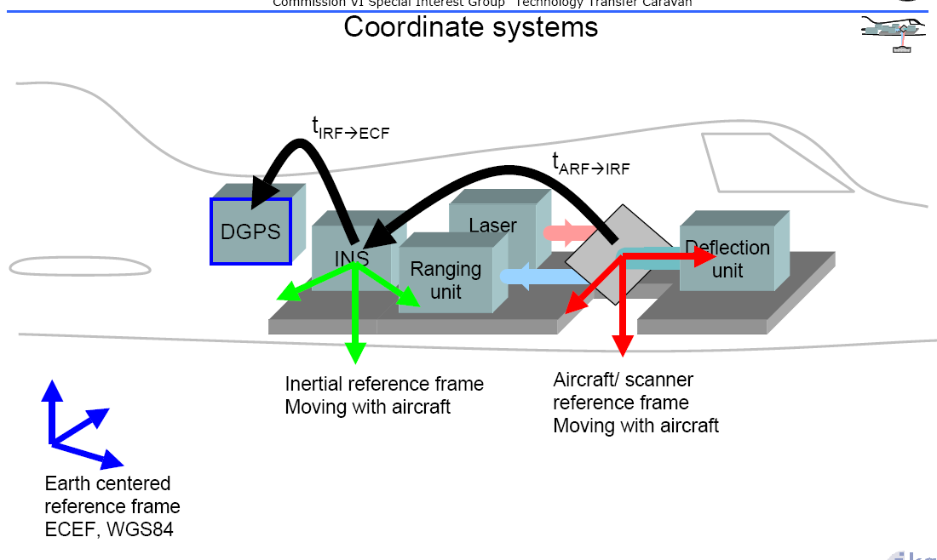

Slide 18
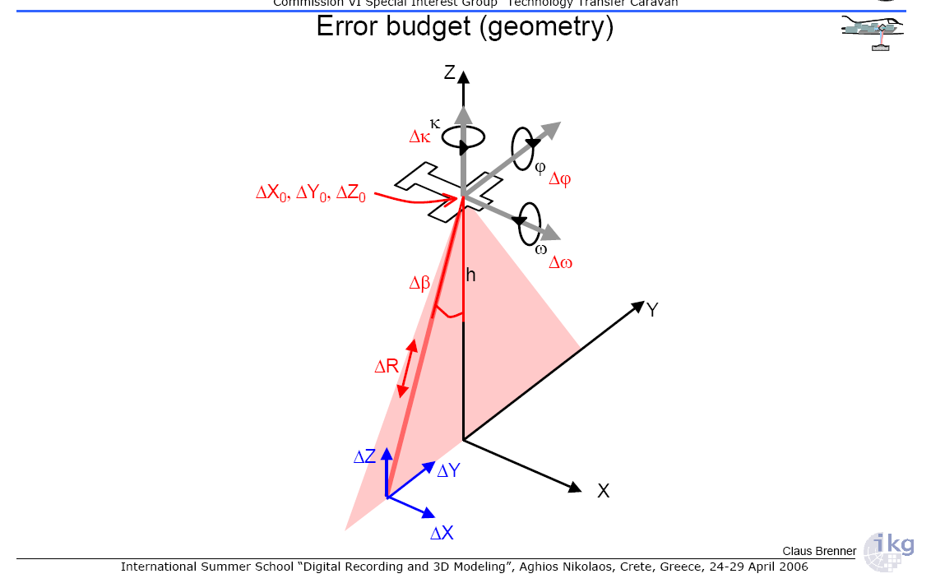

Slide 22
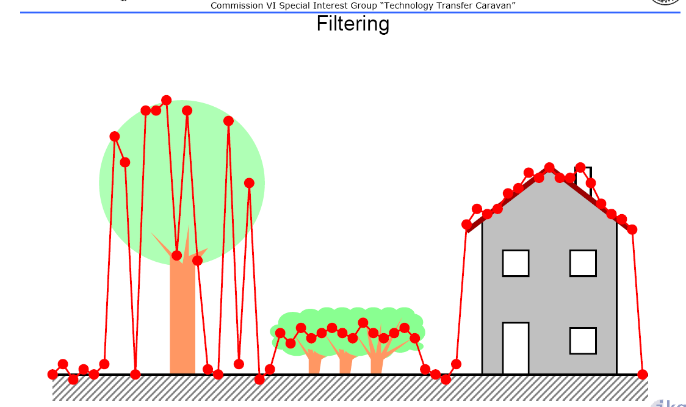

Slide 27
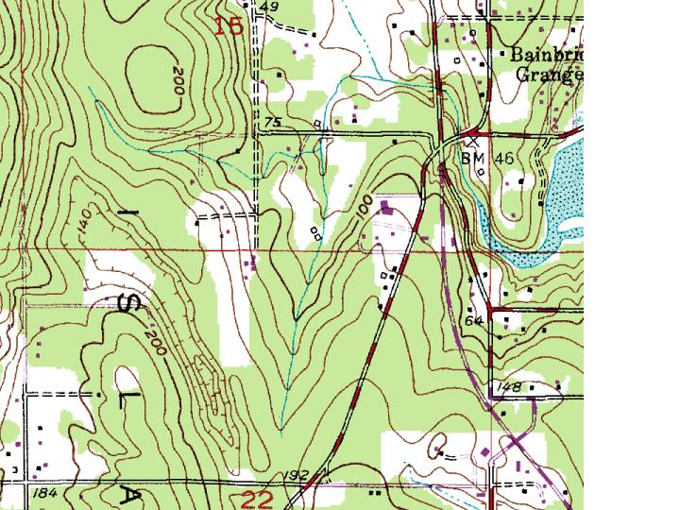
Bainbridge Island, WA Example – 7.5-Min DRG

Slide 28
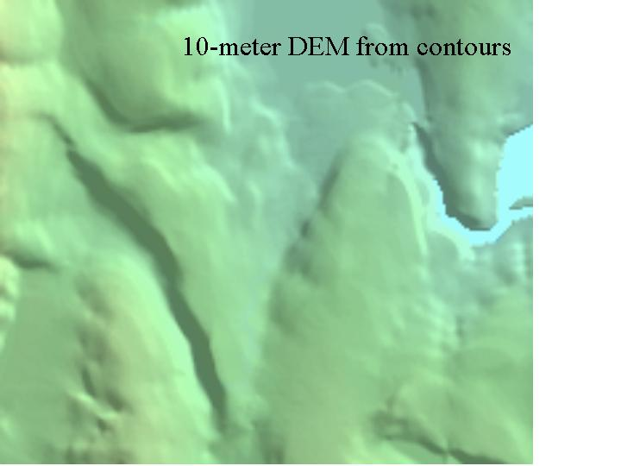
Bainbridge Island, WA Example – 10 m DEM

Slide 29
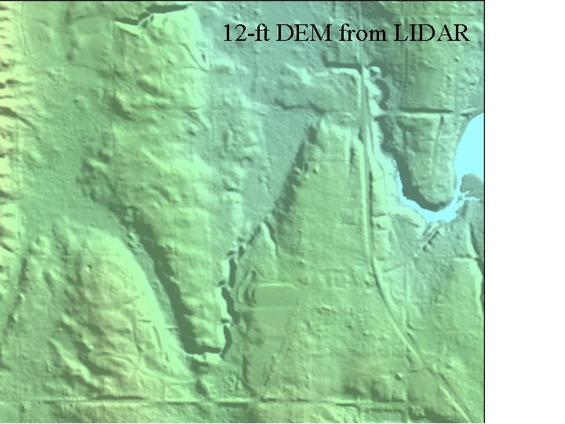
Bainbridge Island, WA Example – LIDAR 3.6 m DEM
3.6 m

Slide 30
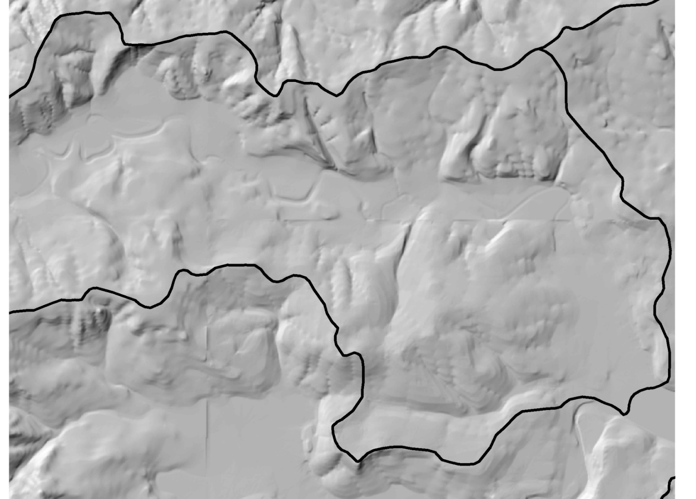
Upper Nehalem Watershed, Rock Creek Example – 10 m DEM

Slide 31
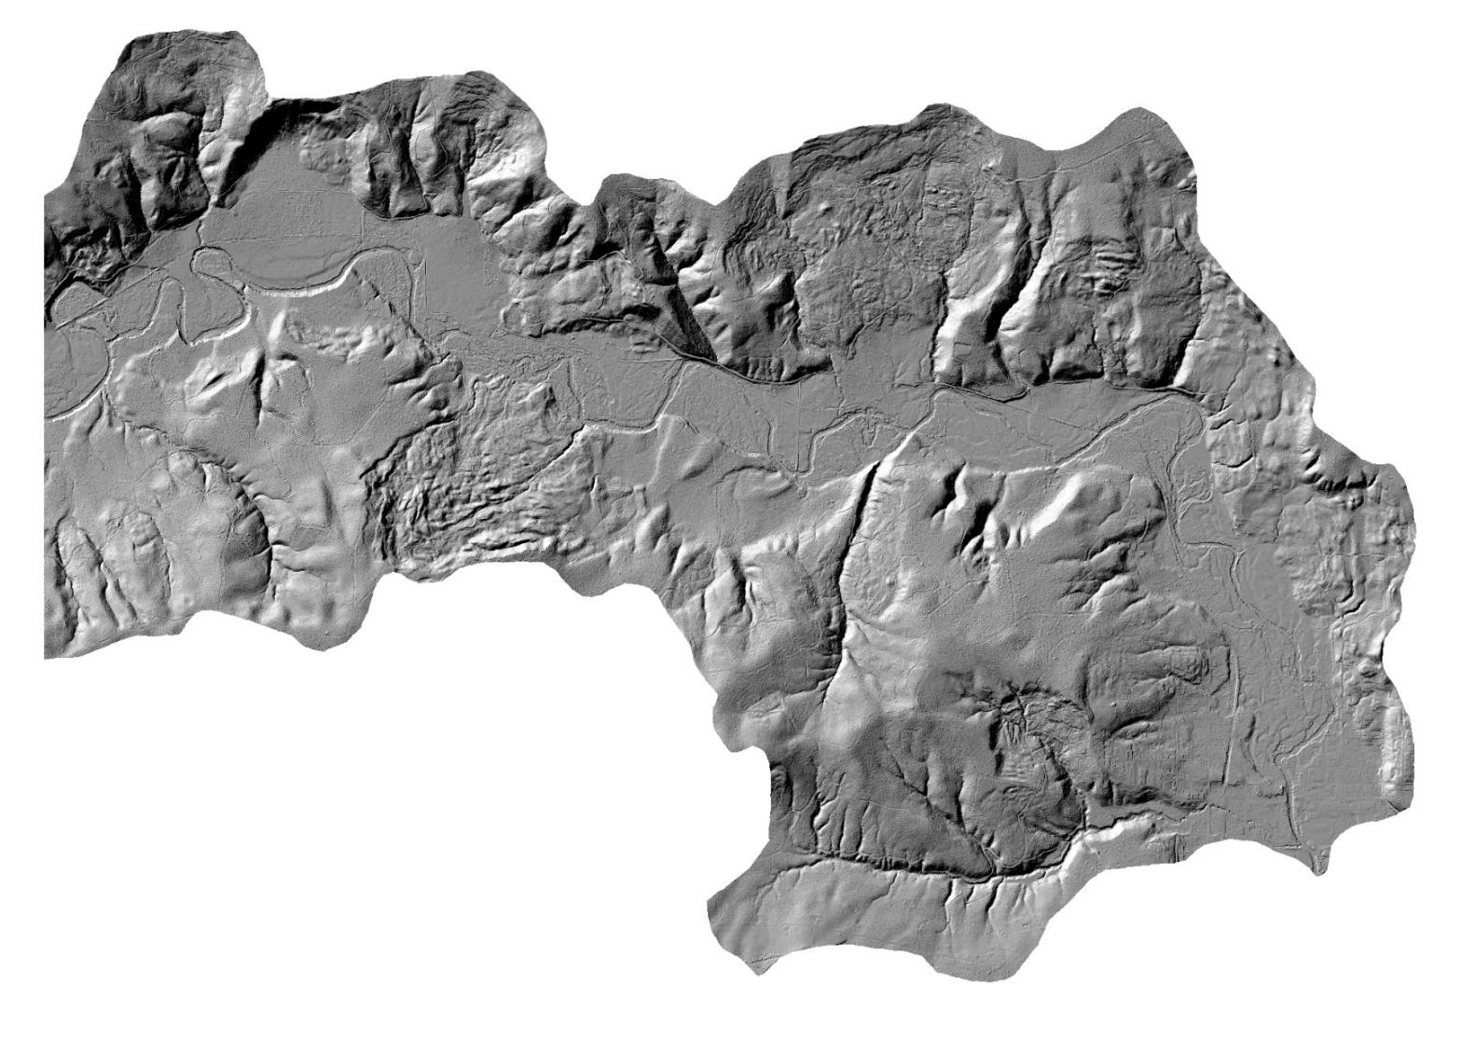
Bainbridge Island, WA Example – LIDAR 1.0 m DEM

