Slide 1
Introduction to River Restoration

Slide 2
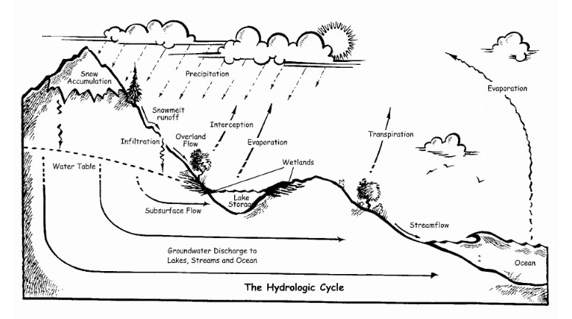

Slide 3
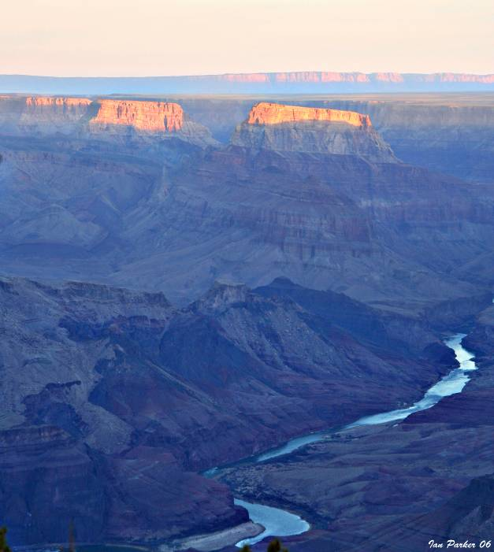
Geoscience in the U.S.
Scientific history rooted in the study of rivers
John Wesley Powell: 1869 tour of Grand Canyon
  1881 appointed second director of USGS
  Geologic studies and topographic mapping
  Investigations of rivers and water resources
Georef Citations: Keywords “river or fluvial” >198,000 entries dating back to 1801 (AGI, 2007)

Slide 4
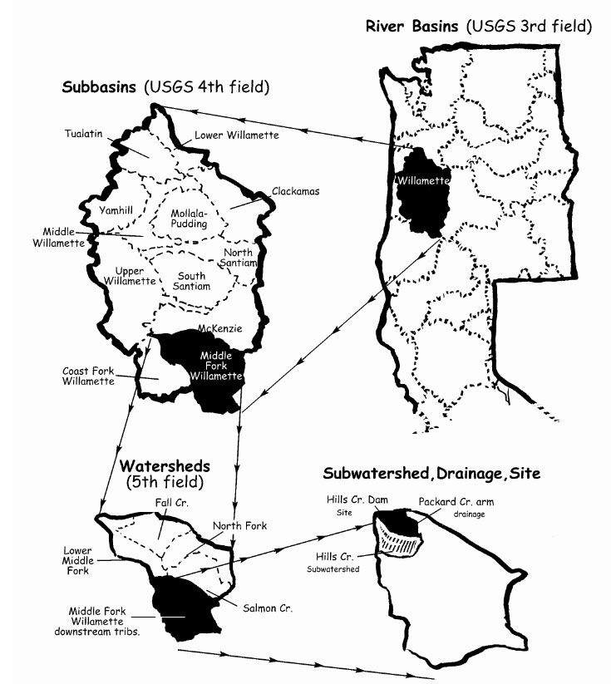
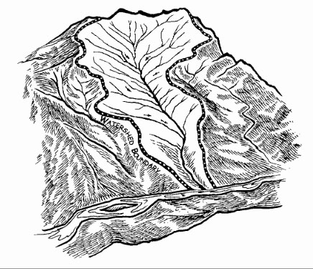

Slide 5
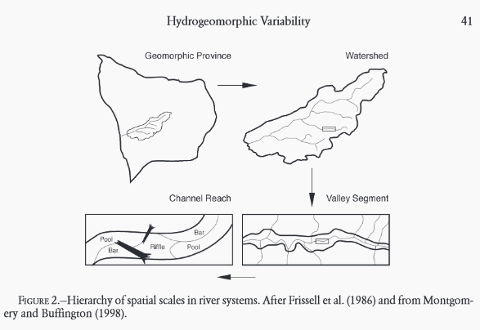

Slide 6
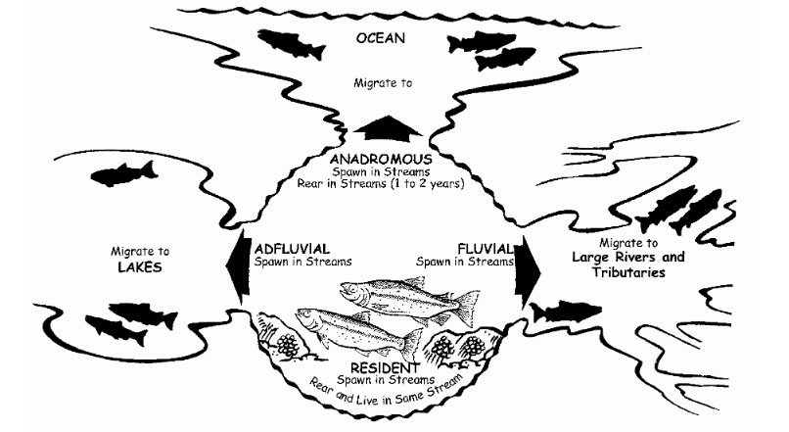

Slide 7
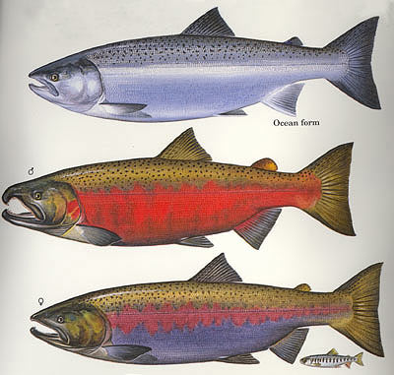
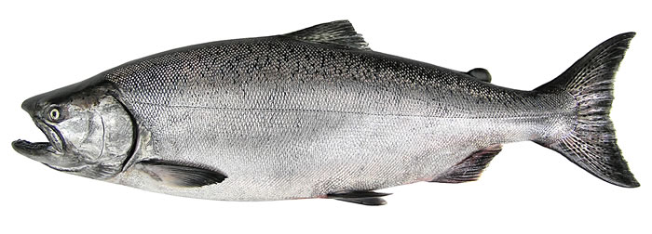
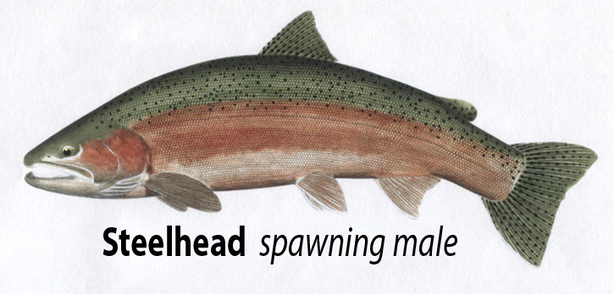
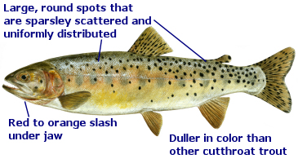
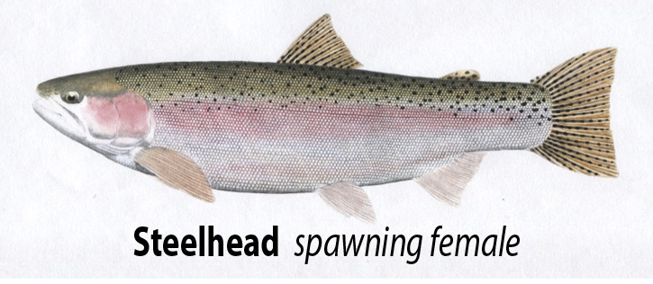
Chinook
Coho

Slide 8
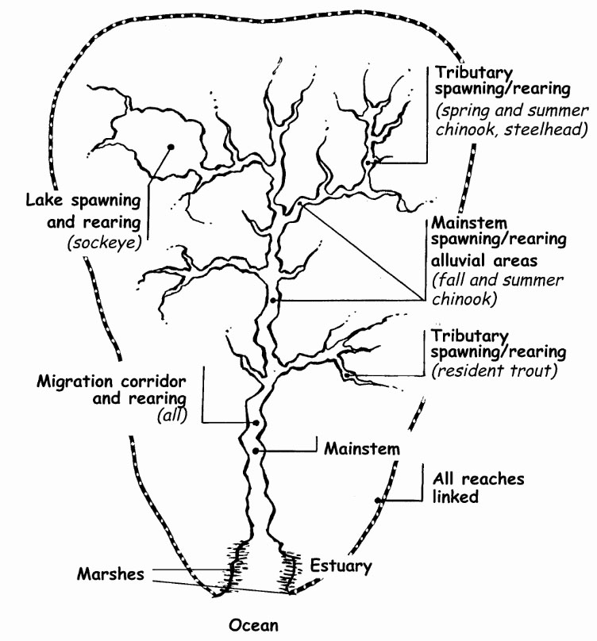

Slide 9
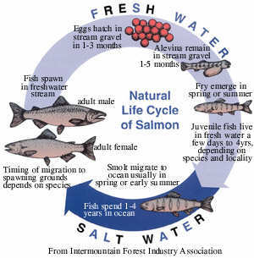
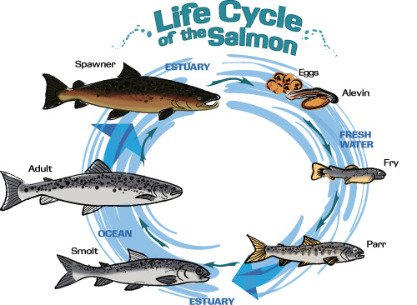
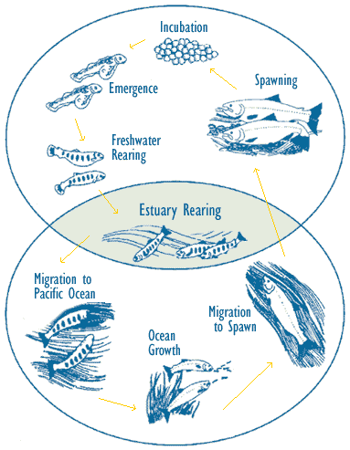

Slide 10
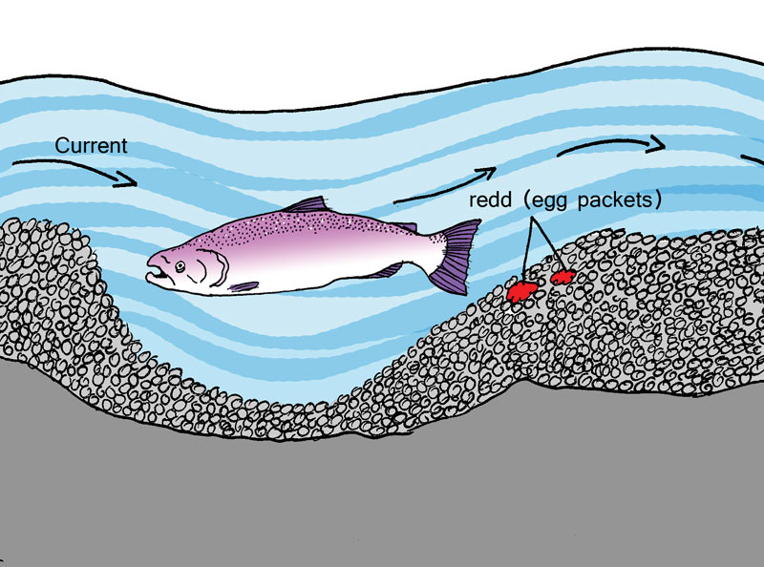
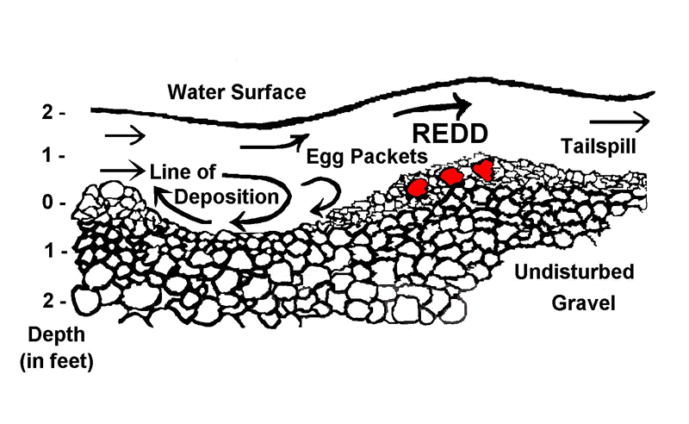
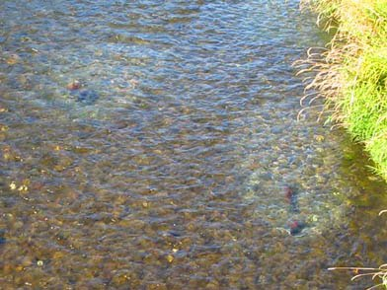

Slide 11
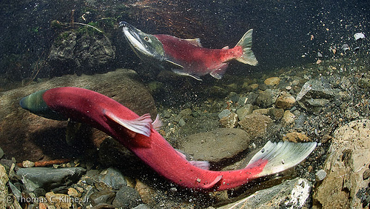
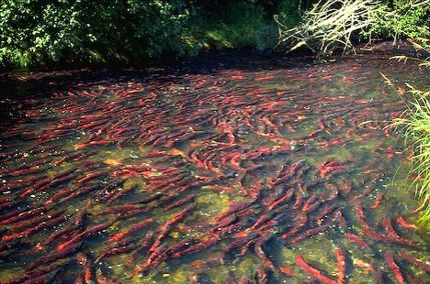
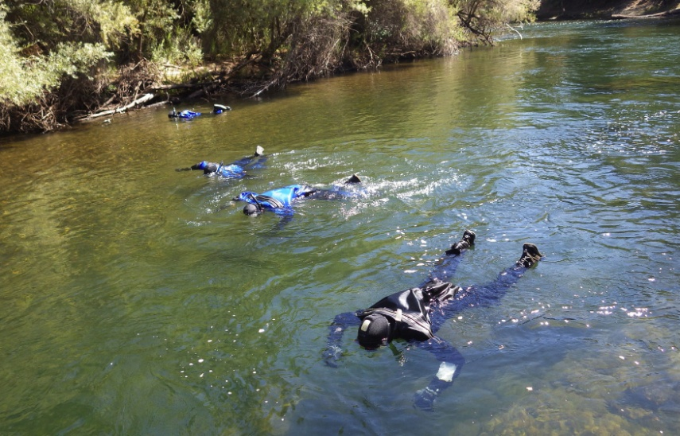
Sockeye Spawning
Humans Spawning

Slide 12
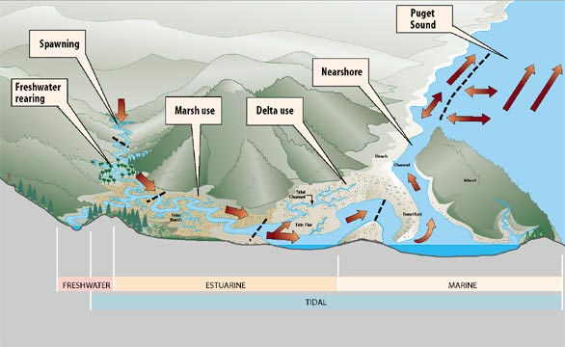

Slide 13
River Restoration Defined
“assisting the establishment of improved hydrologic, geomorphic, and ecological processes in a degraded watershed system and replacing lost, damaged, or compromised elements of the natural system”

Slide 14
Watershed Systems
Characterized by geology, landforms, and climate
Affected by local biotic and abiotic influences
Comprised of multivariate subsystems with
interdependent process-response mechanisms
Watershed Assessment Objectives
Identify features and processes important to fish habitat
Determine the influence of natural processes
Understand human activities and evaluate effects of
land management
River management projects require a multi-disciplinary team approach
OWEB (1999) Watershed Assessment Manual

Slide 15
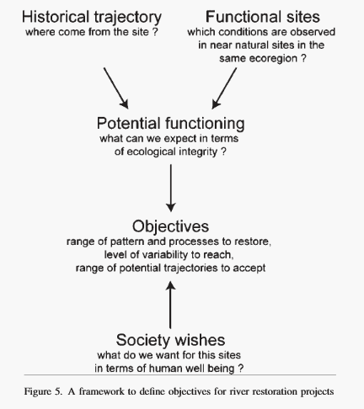

Slide 16
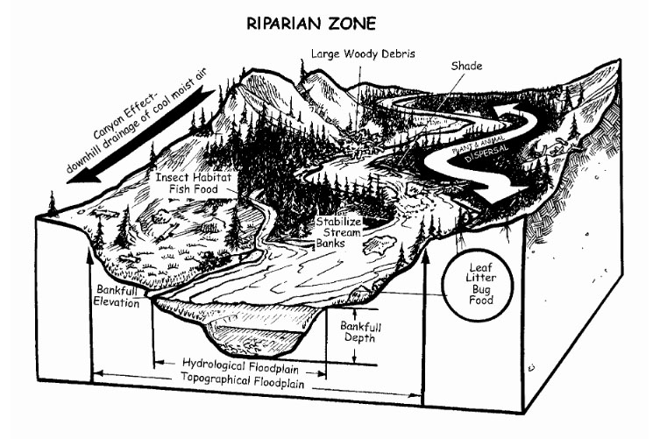
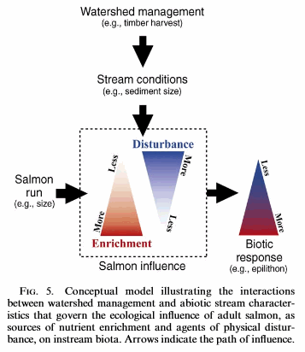
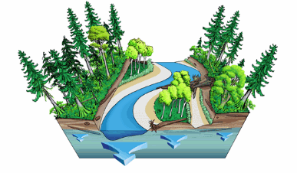

Slide 17
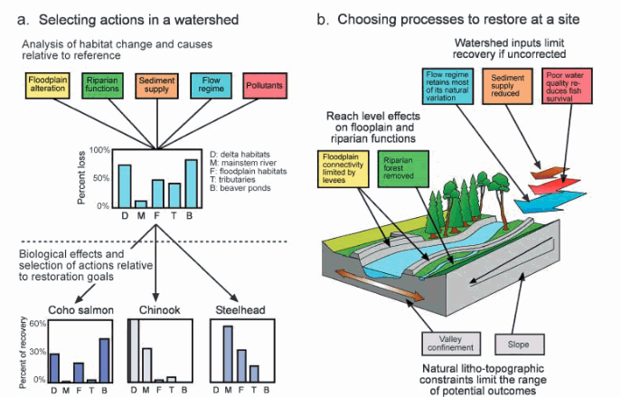

Slide 18
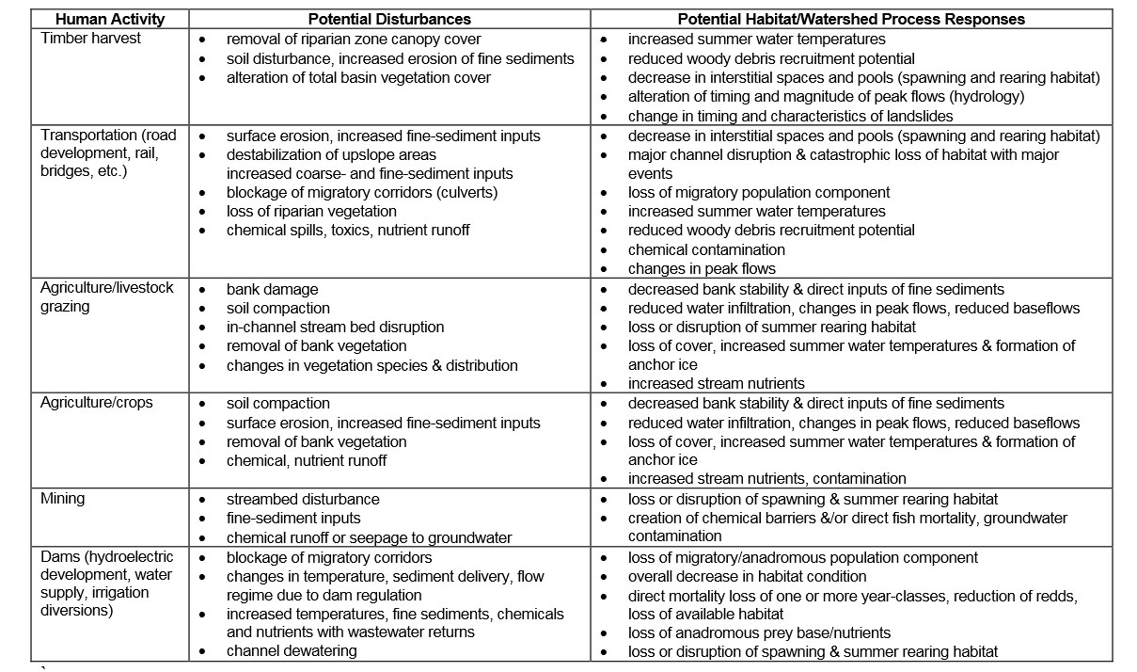

Slide 19
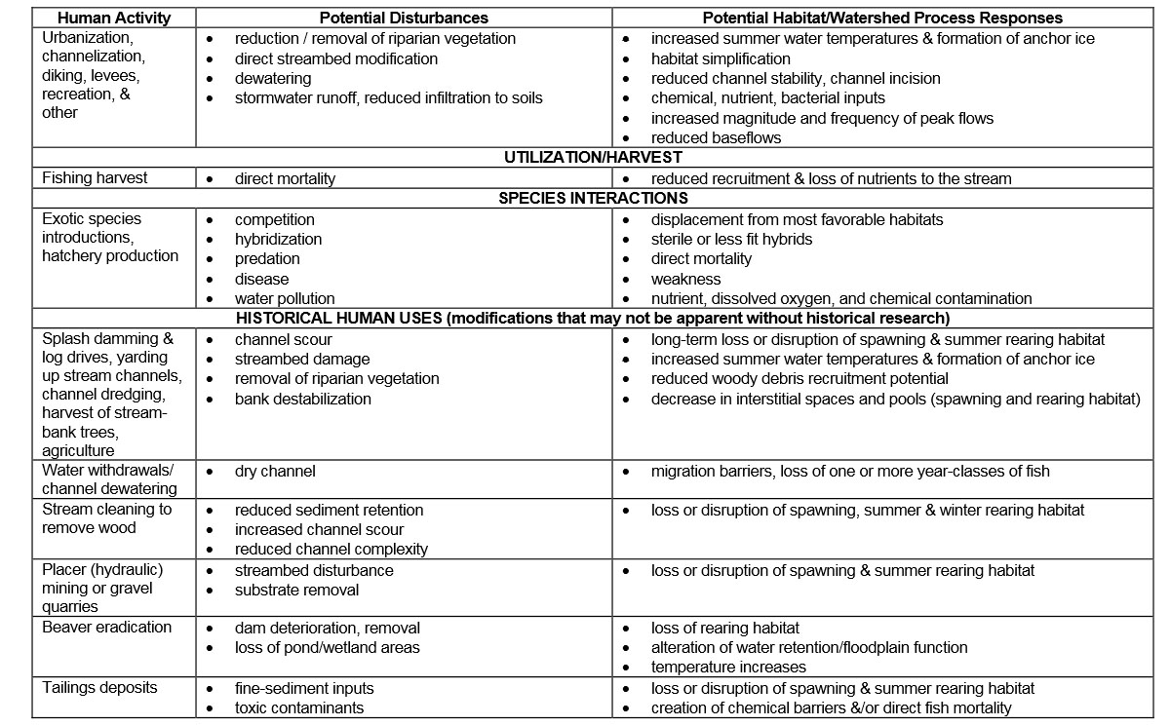

Slide 20
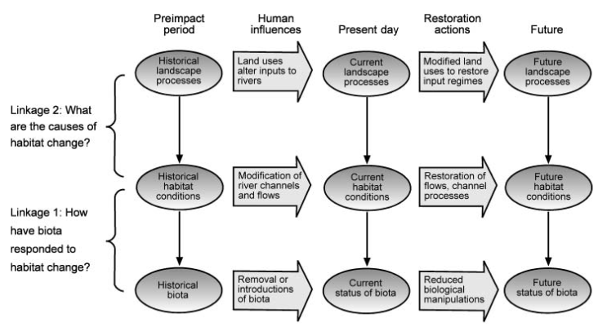

Slide 21
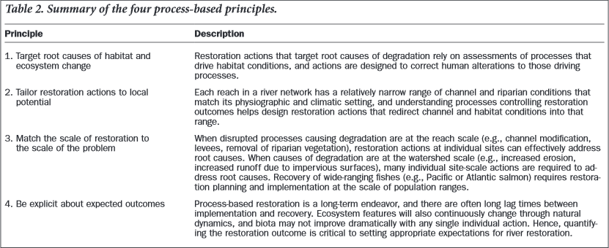

Slide 22
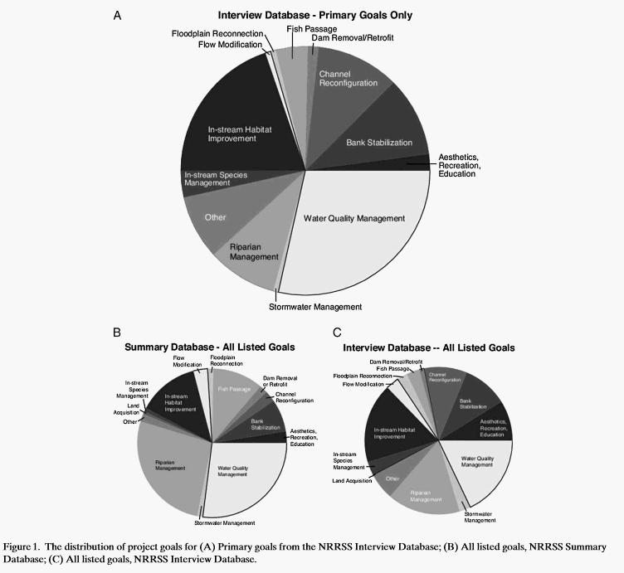

Slide 23
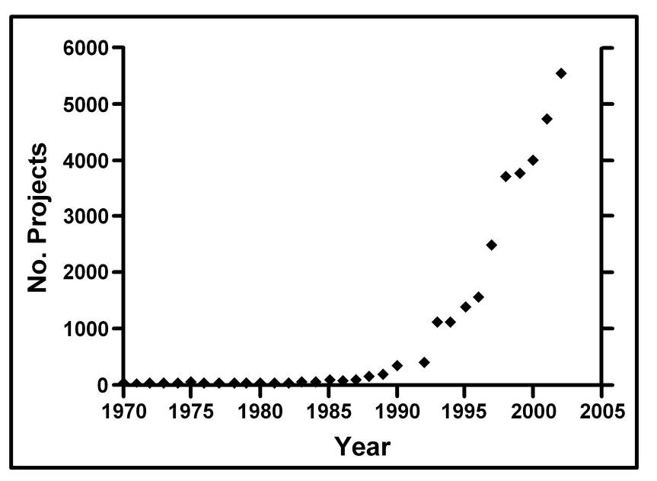
Census of U.S. River Restoration Projects
Oregon Plan (OWEB) Outcomes
>90 assessments since 1999
~$180,000,000 in restoration
65 projects/1000 km river length
(K. Bierly, (OWEB); Bernhardt et al., 2005)
National River Restoration
Synthesis Database

Slide 24
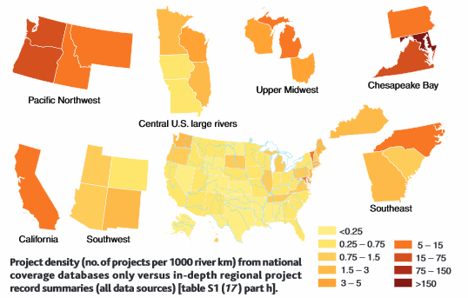

Slide 25
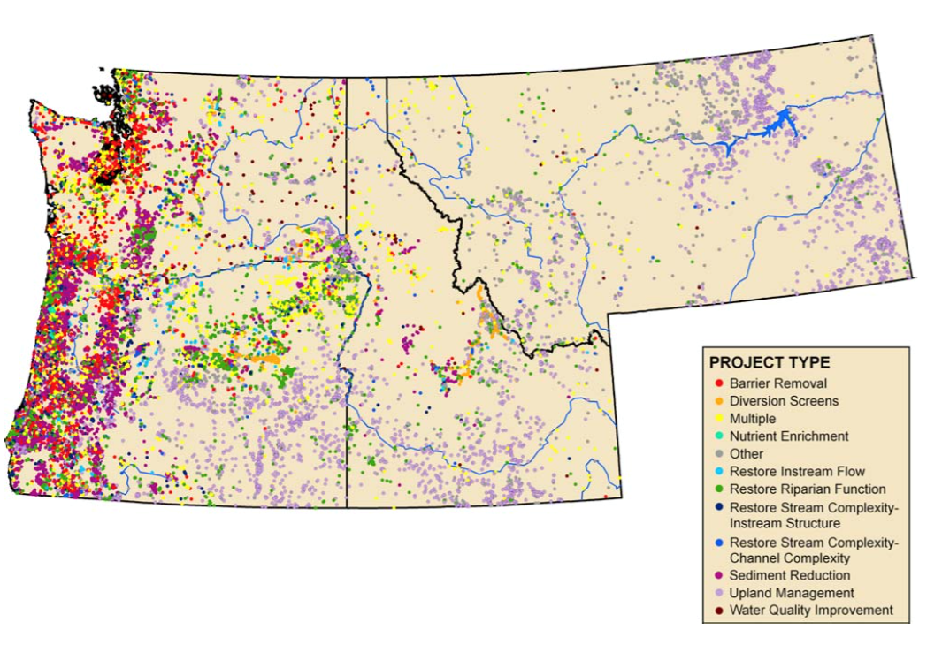

Slide 26
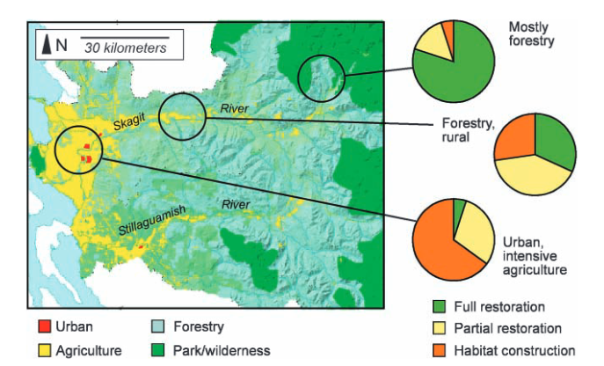

Slide 27
Watershed Project Activities Involving the Practice of Geology
Map / air photo interpretation of geologic features
Geologic and geomorphic mapping
Geomorphic analysis (processes and landforms)
Interpretation of the geologic record
Hydrogeology and aquifer characterization
Engineering geology (erosion and slope stability)
Evaluation of geologic hazards

Slide 28
A Review of Stream Restoration Techniques and a Hierarchical Strategy for Prioritizing Restoration in Pacific Northwest Watersheds
North American Journal of Fisheries Management 22:1–20, 2002 American Fisheries Society 2002. (Philip Roni)

Slide 29
Overview
This presentation will cover the following…
Area of study and species habitat studied
Restoring Habitat methodology (steps)
Discuss applied habitat restoration techniques for different outcomes.

Slide 30
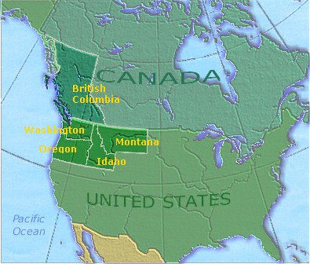
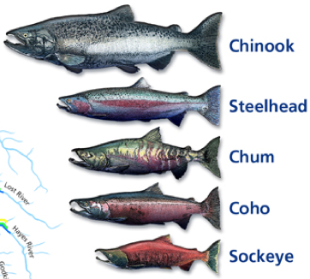
Area of study and species habitat studied
Pacific Northwest specifically Washington and Oregon.
Species habitat (Salmonids). Specifically pacific varieties' of salmon and steelhead trout.

Slide 31
Restoring Habitat methodology
Proper restoration of a river habitat requires a structured approach.
Step1: Identifying the types and natural rates of habitat-forming processes.
This guides our understanding of the potential of the landscape to form salmonid habitats.
Provides reasonable expectations of how a restored watershed or stream reach will function.

Slide 32
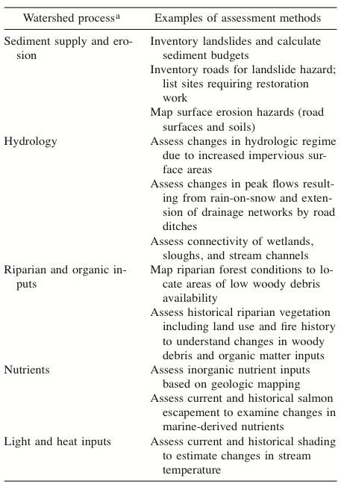
Restoring Habitat methodology
(step 2)
Determine where processes are altered.
This step uses many evaluation techniques:
Assessment of wildfire probabilities
Rates of sediment supply from landslides
Dynamics of riparian forests
Stream temperature regimes

Slide 33
Deciding how to restore disrupted processes
(Step 3)
As funding for restoration projects in never open ended.One of the essentials is the decision of what to restore for the best results.
Habitat reconnection: Remerging isolated portions of steams.
Road improvement: Reducing erosion, and supply of excess sediment.
Riparian restoration: Incorporation of LWD’s, and lessening grazing inspired erosion.
Instream habitat restoration: Creating channel complexity and habitat for fish.
Nutrient enrichment: Restoring nutrient quality to stream.

Slide 34
Habitat reconnection
This form of river restoration, attempts to provide better fish infrastructure, in a number of ways.
One method is connecting or improving routes used by fish for travel upstream. (such as reconnecting an oxbow lake)
Another method is providing access to more Estuaries.
Estuaries allow juvenile fish more habitat to forge, and develop in. They also have a psychological effect.

Slide 35
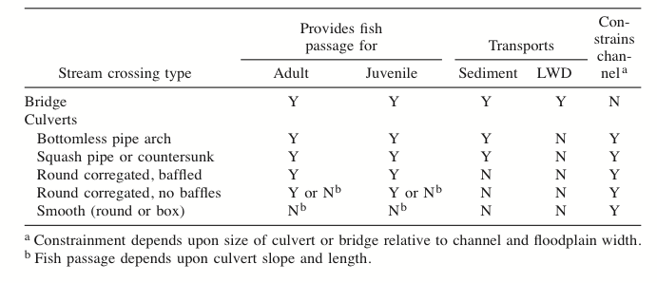
Habitat reconnection cont…
Improving fish routes.
Bridges are thought to be of the most benefit for fish.
Culverts not so much. Because they prevent LWD’s and sediment from flowing freely.

Slide 36
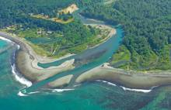
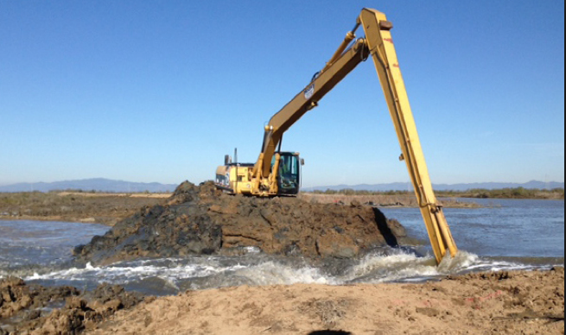
Habitat reconnection cont… (Estuaries)
Estuaries are important foraging areas for juvenile fish.
Some Salmon species are known to use estuaries for up to 15 weeks.
Some techniques for restoring estuary habitat are the following:
Breaching dikes
Removing fill
planting emergent and submergent plants

Slide 37
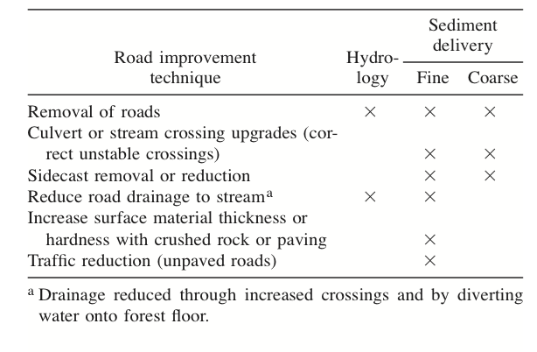
Road improvement
Roads can harm streams and salmon habitat by:
Increasing delivery of fine sediment.
Altering landslide frequency
Changing stream hydrology.
Impede the movement of LWD’s and some nutrients downstream.
The removal or alteration of roads can have positive restorative effects.
Road improvement techniques and
their impacts

Slide 38
Road improvement cont…
Road erosion can be arrested in a number of ways:
Better road design and maintenance.
Using crushed rock (7.6–15.2 cm).
Using the hardest rock available, reduces the generation of sediment.
Over stream crossings, the construction of bridges is preferred over culverts. This allows more LWD’s to pass through, instead of clogging.

Slide 39
Riparian Restoration
Riparian areas in the coastal Pacific Northwest have transformed from conifer-dominated to hardwood-dominated forests.
These hardwoods, do not provide a long term source of large Woody debris (LWD). Long term plans for reintegrating conifers, show promise of meeting demand for LWD’s.
The implementation of grazing fences has been shown to arrest upland and stream bank erosion. Erosion has been shown to alter stream flow, affect water quality and water temperature.

Slide 40
Instream habitat restoration
Techniques for compensating for stream simplification and habitat include:
Large woody debris
Boulder placement
Increasing pool frequency and depth.
Incorporation of quality spawning gravel.
Artificial structures such as weirs and wire gabions.
Consideration: Most in stream techniques used tend to have a 10-20 year lifespan.

Slide 41
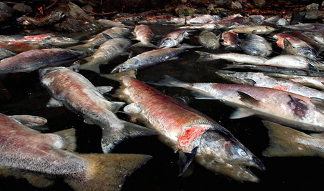
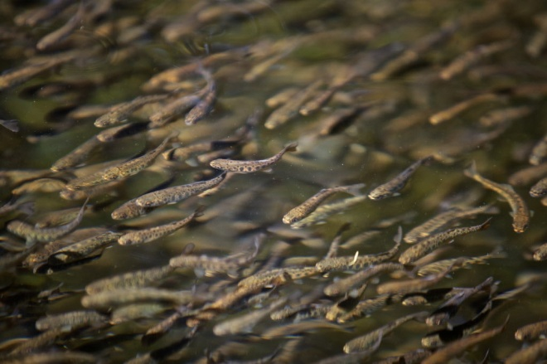
Nutrient enrichment
Dead Salmon
After spawning, salmon die, which inheritably, enriches the waters for juvenile salmon production.
Two primary techniques to increase nutrient availability:
The addition of inorganic N and P to streams during summer.
The distribution of hatchery-spawned salmon carcasses in streams.
Considerations: Too much nutrient enrichment, especially N and P, can have negative impacts. Concentrating in downstream areas.
Water/Time
Nutrients For:
Future Salmon

Slide 42
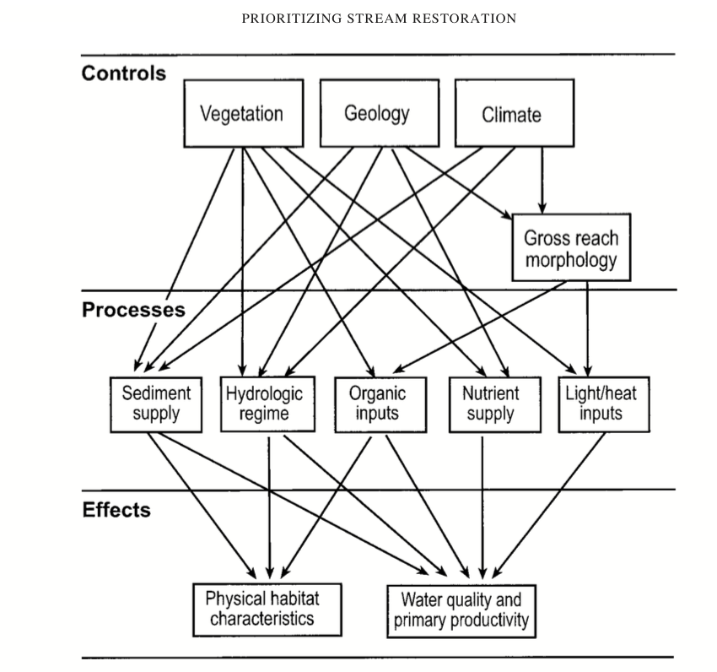
Conclusion
Habitat restoration comes in many forms.
There are outside factors that influence the method of restoration.
Depending on the environment or reach under consideration for restoration. There are different techniques that should be applied.

