Slide 1
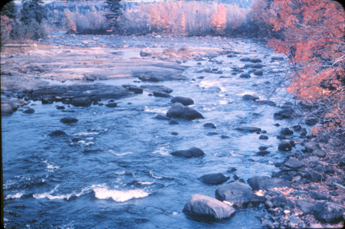
Rivers and Flood Hydrology

Slide 2
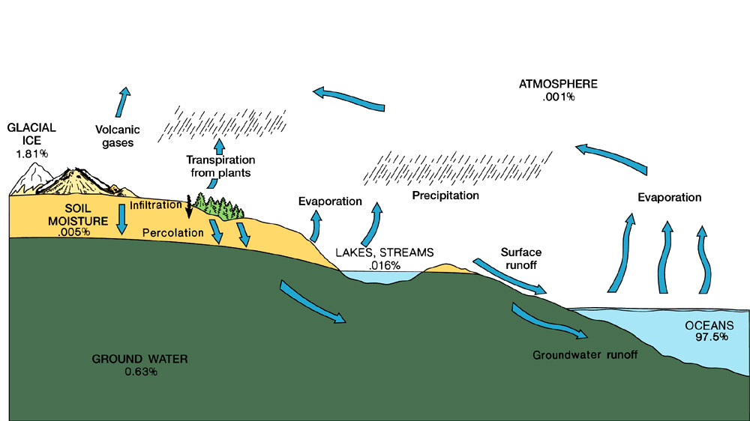
Hydrologic Cycle

Slide 3
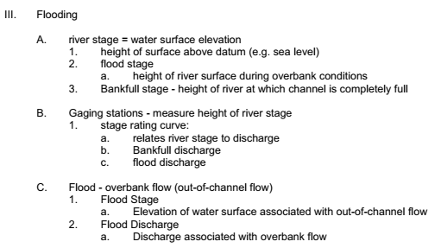
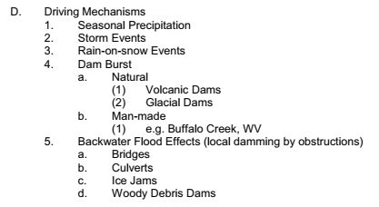
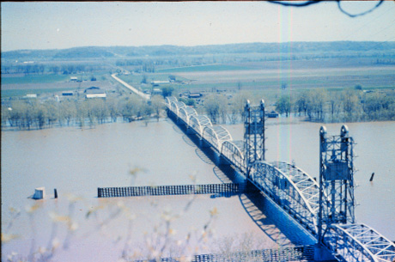

Slide 4
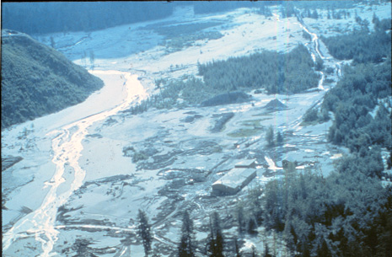
Braided Pattern - Over Capacity

Slide 5
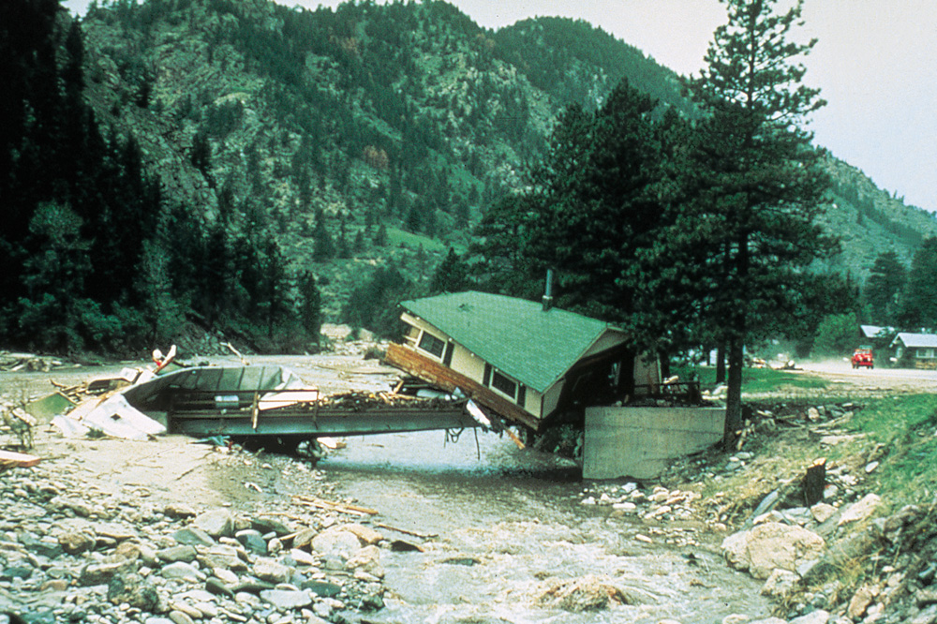

Slide 6
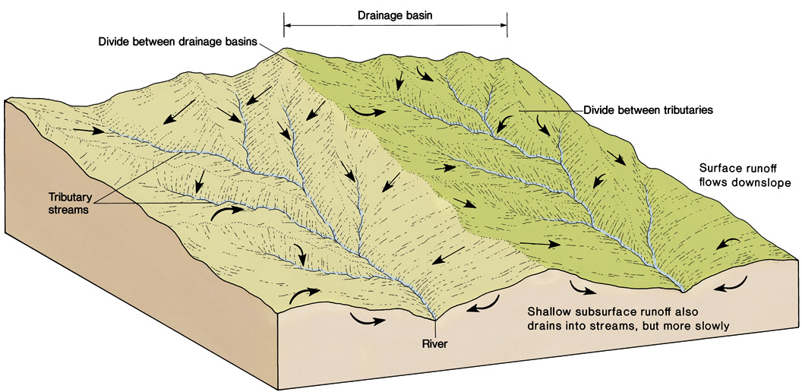
WATERSHEDS AND DRAINAGE BASINS

Slide 7
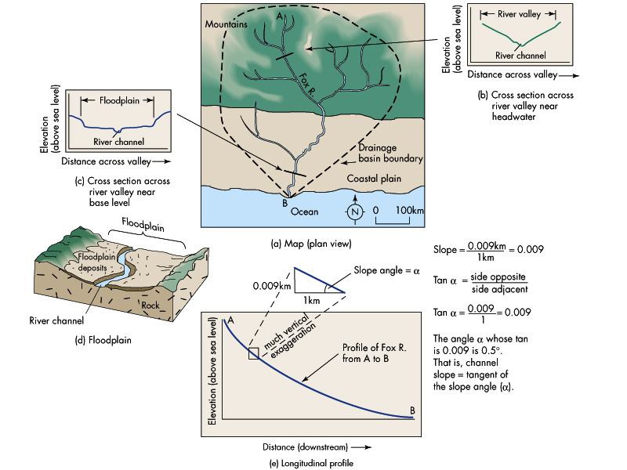

Slide 8
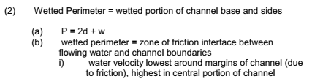
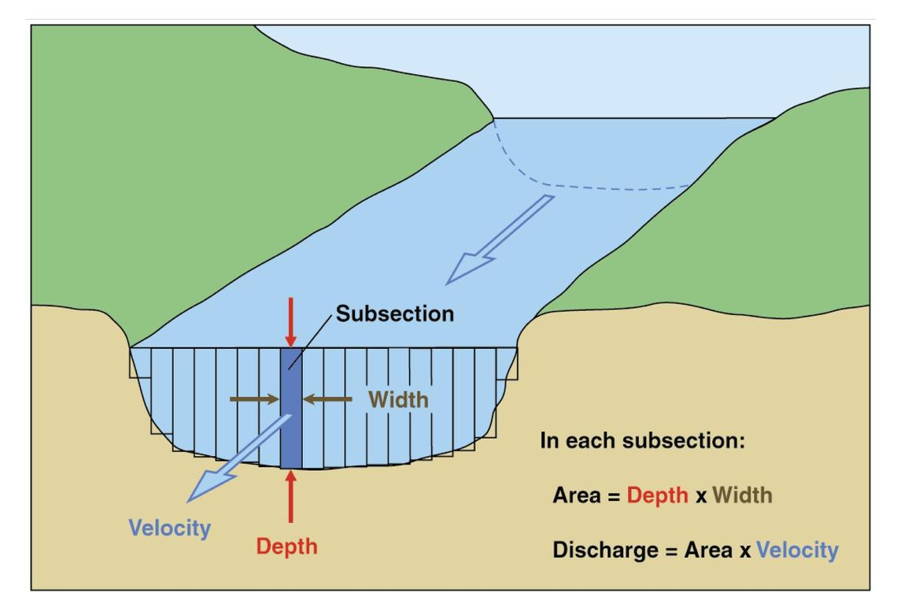
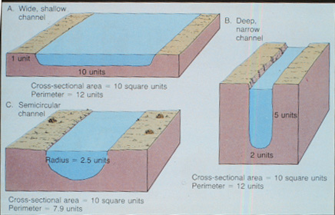
Q=AV

Slide 9
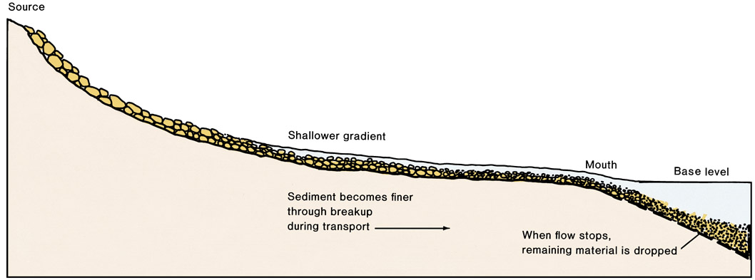
Longitudinal Profile of Stream

Slide 10
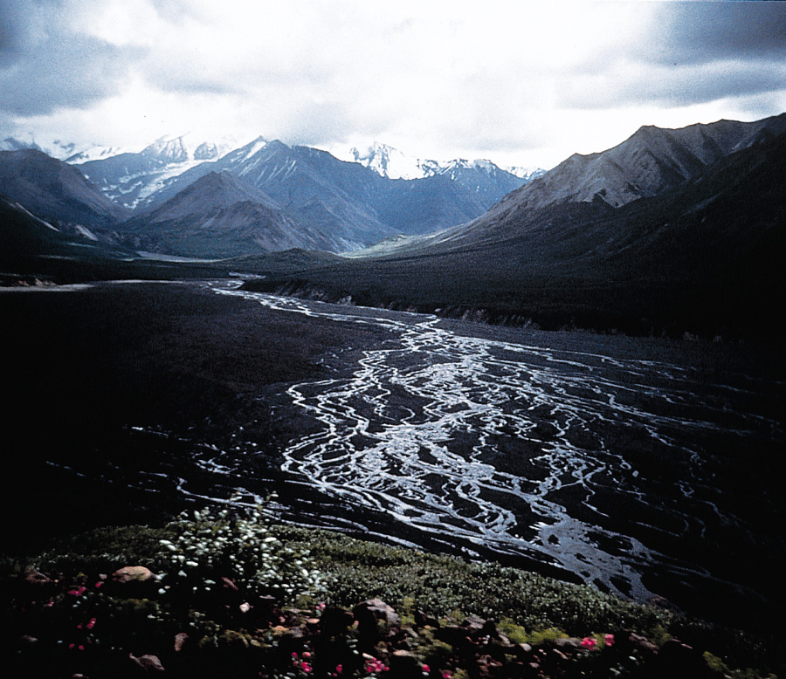
Braided Streams
Figure 6.7

Slide 11
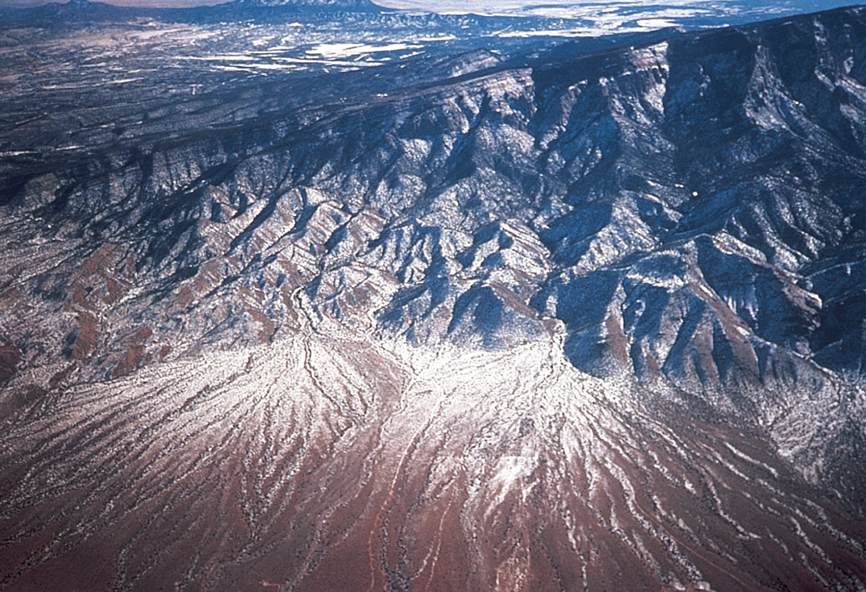

Slide 12
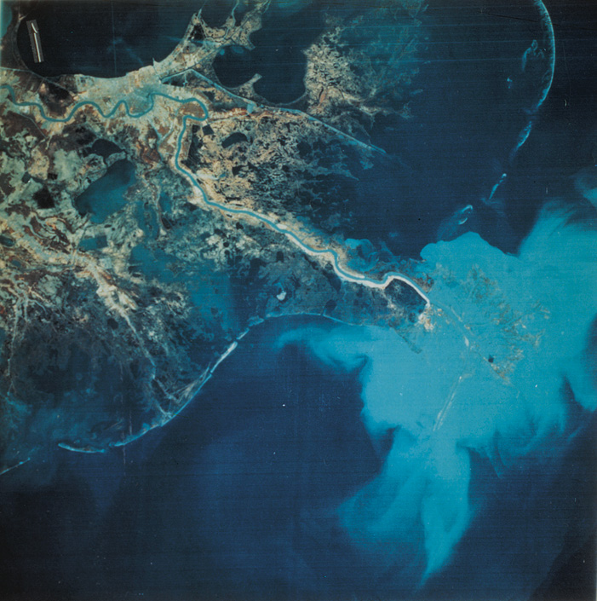

Slide 13
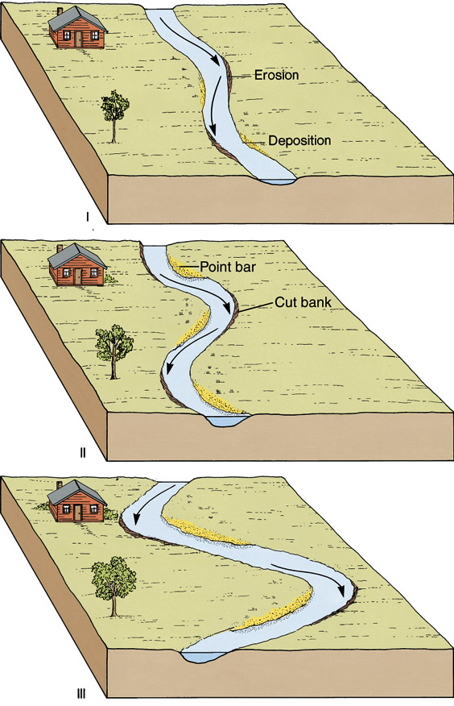
Development
of Meanders
Figure 6.6

Slide 14
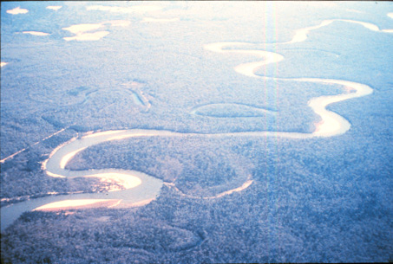
Meandering river
Oxbows
Point Bar

Slide 15
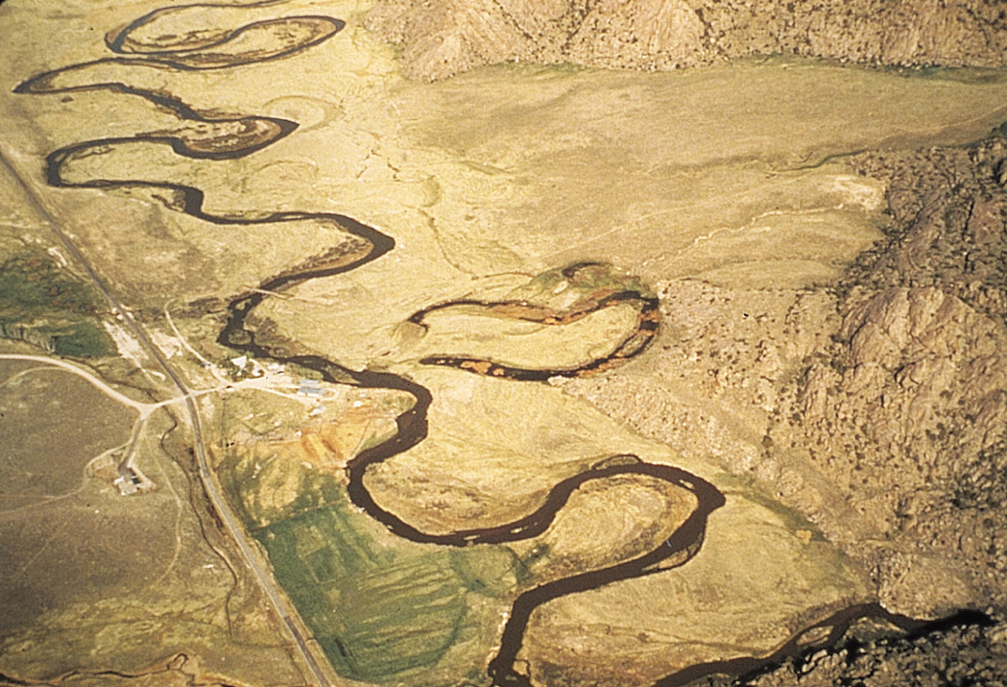
Meandering Stream
Figure 6.9

Slide 16
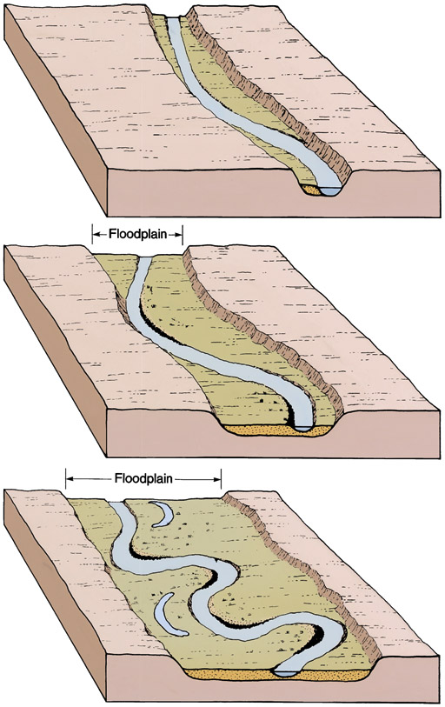
Development
of Floodplain
Figure 6.8

Slide 17
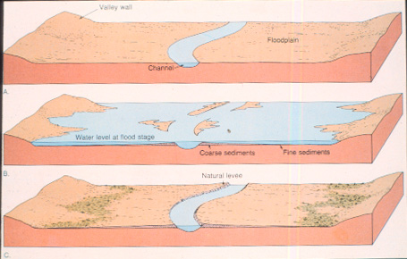
Floodplain Development

Slide 18
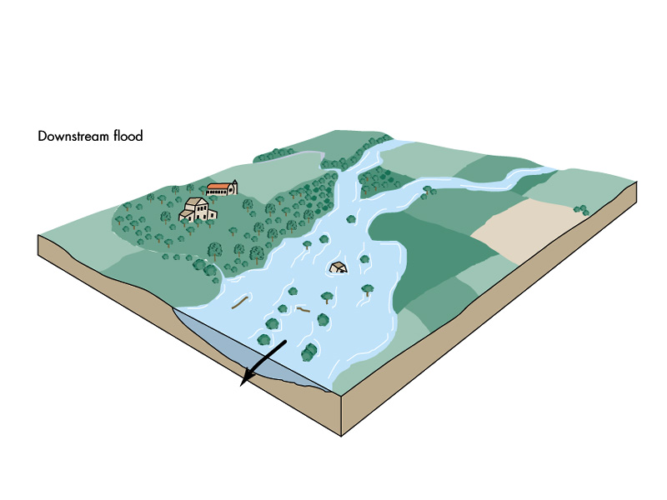

Slide 19
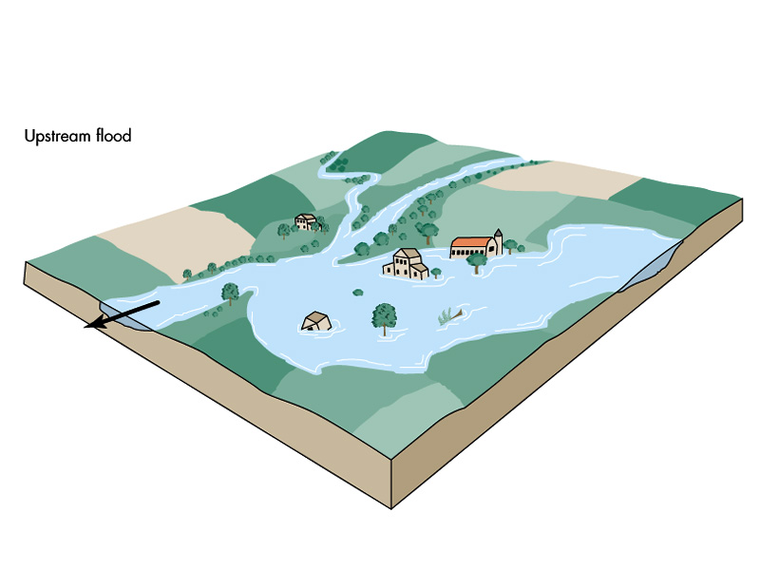

Slide 20
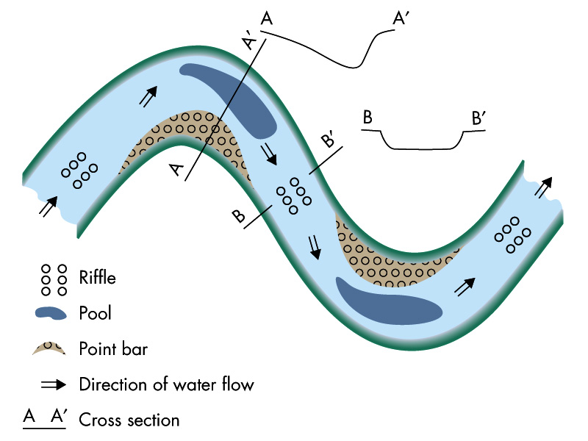

Slide 21
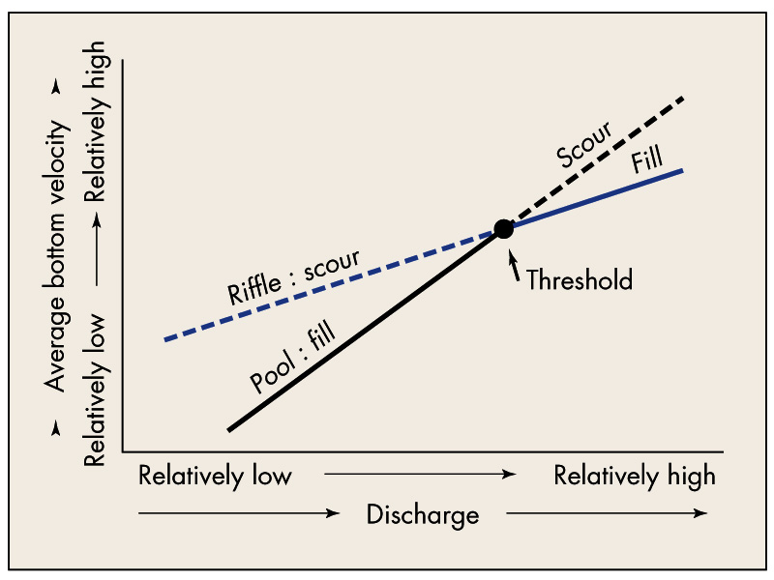

Slide 22
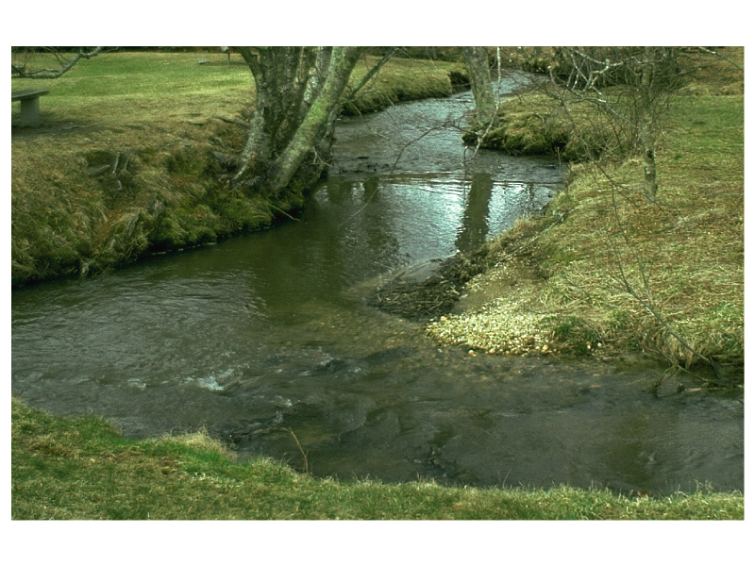

Slide 23
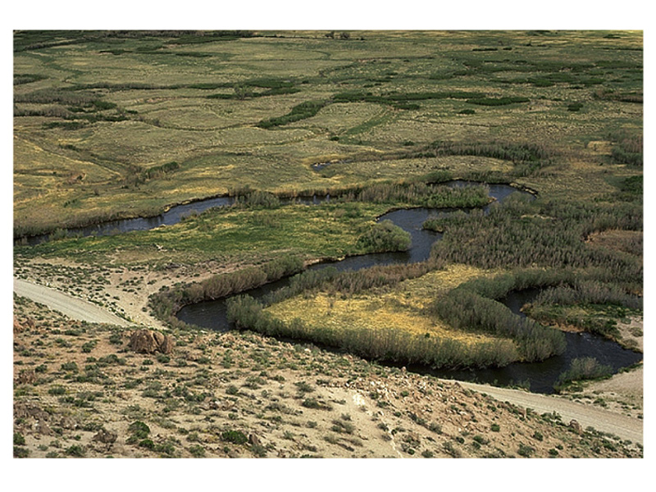

Slide 24
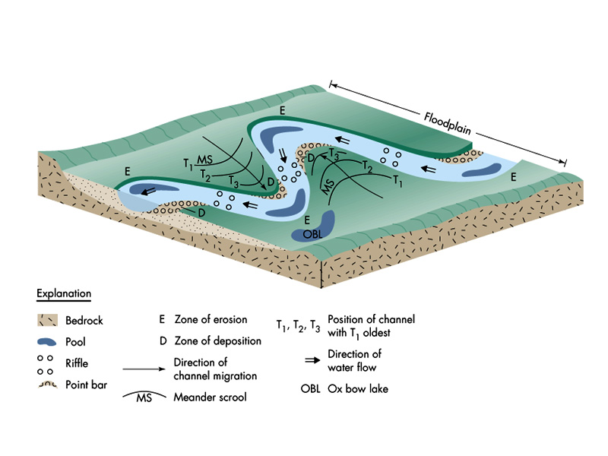

Slide 25
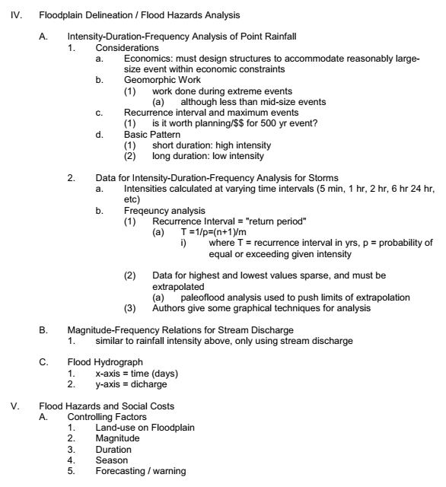

Slide 26
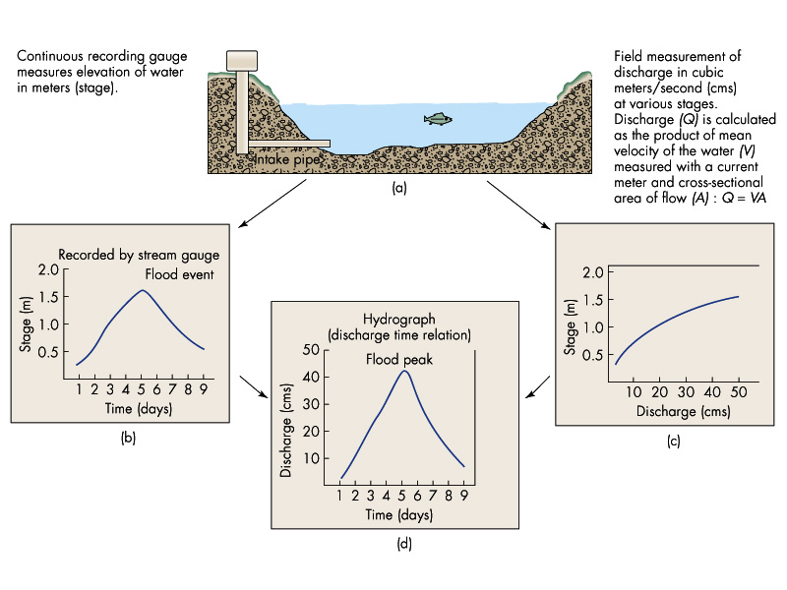

Slide 27
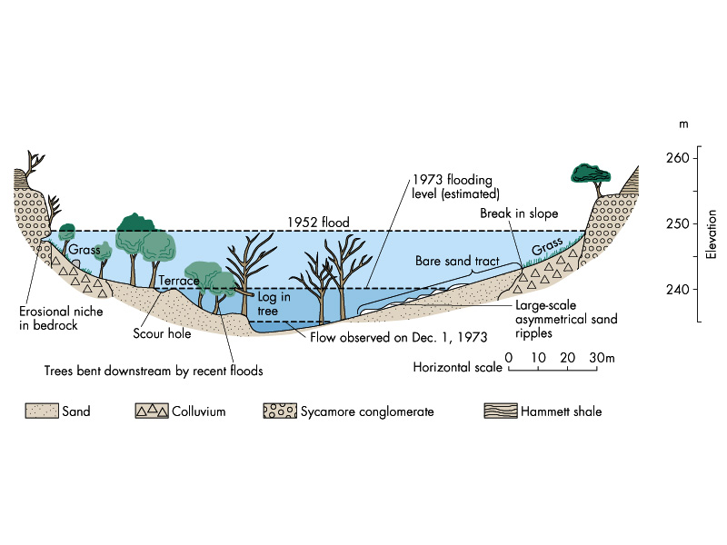

Slide 28
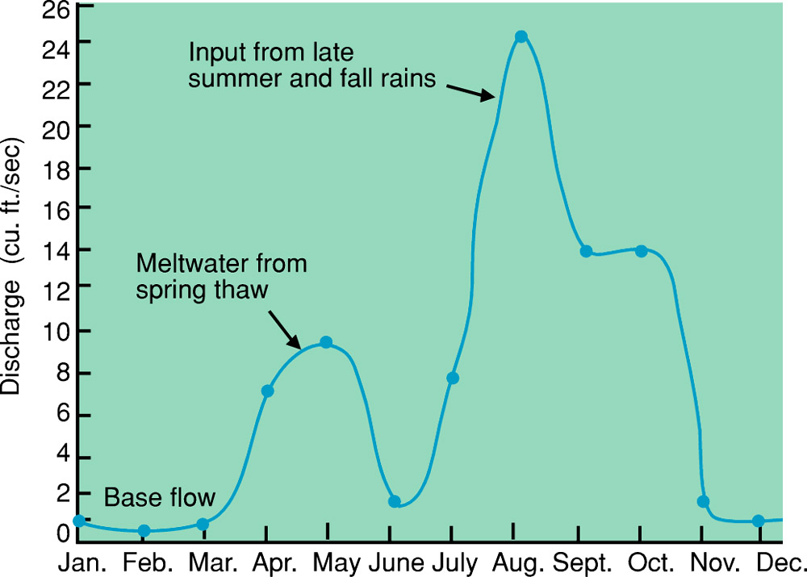
Hydrograph
Figure 6.11
Hydrographs
U. S. Geological Survey Open-File Report 79-681

Slide 29
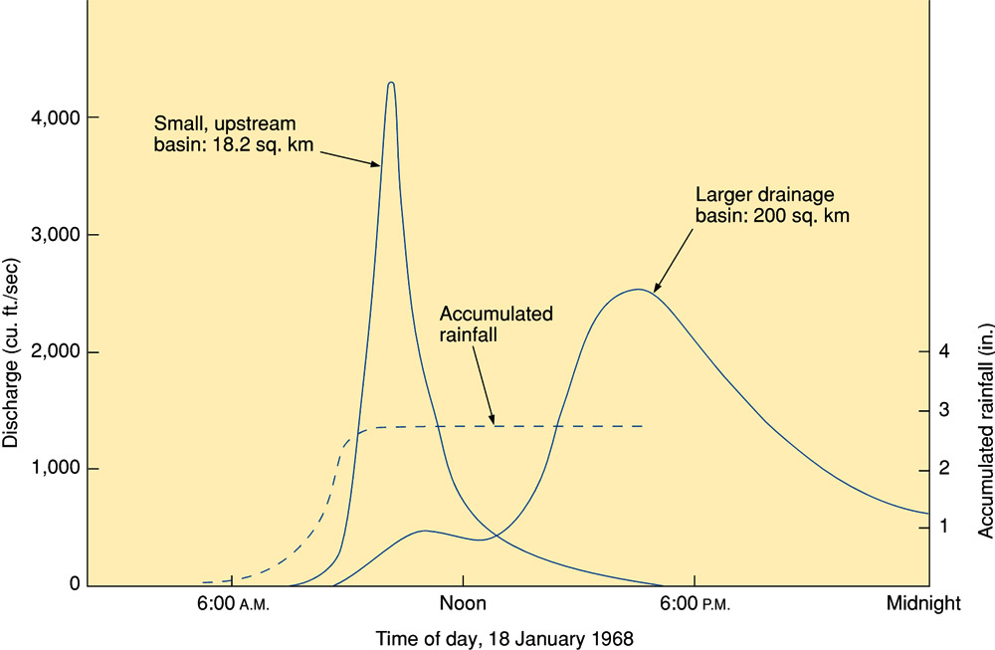
Flood Hydrograph and Mudflow
Figure 6.12a
Water Resources Division, U. S. Geological Survey

Slide 30
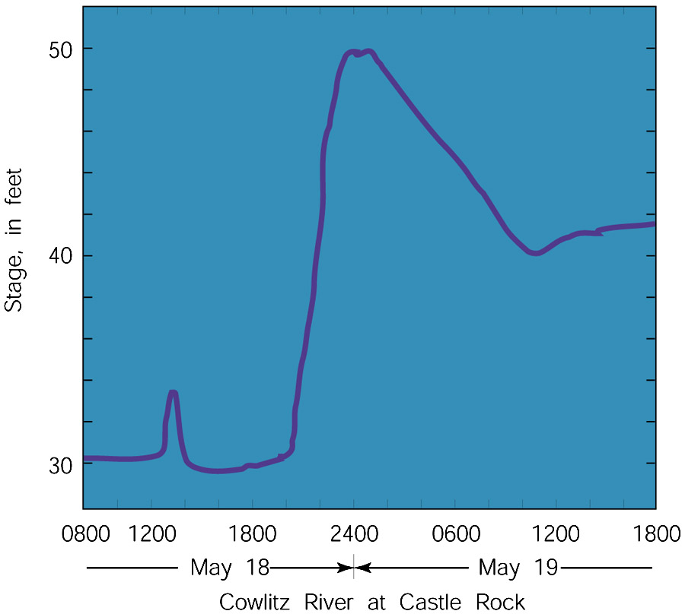
Flood Hydrograph and Mudflow
Figure 6.12b
Mt. St. Helens Eruption:
Glacial Meltwater
After U. S. Geological Survey

Slide 31
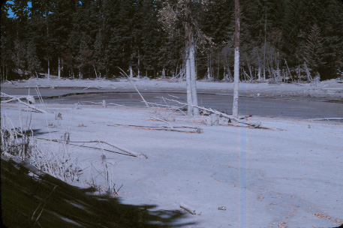

Slide 32
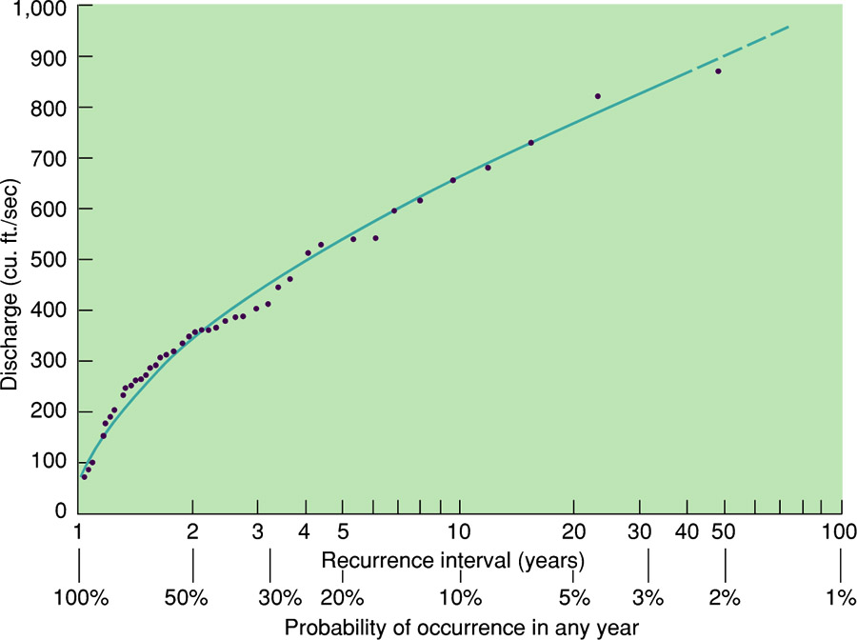
Flood-Frequency Curve
Figure 6.13
U. S. Geological Survey Open-File Report 79-1060

Slide 33
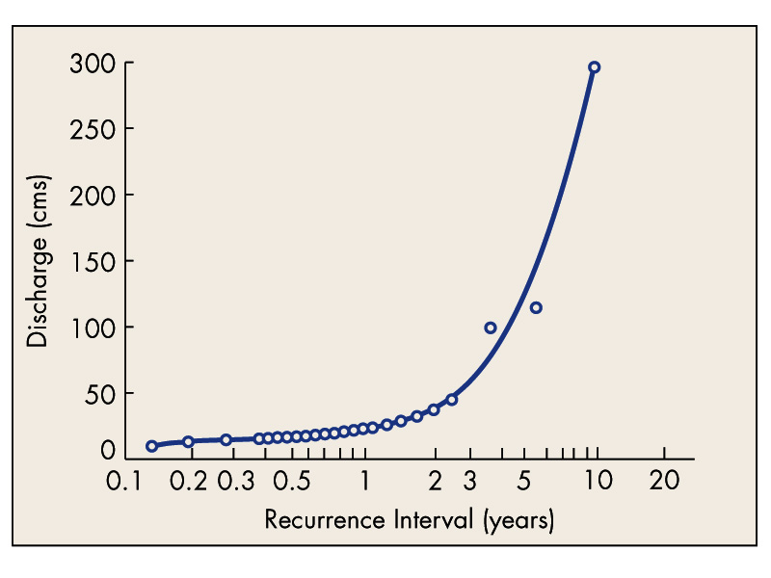

Slide 34
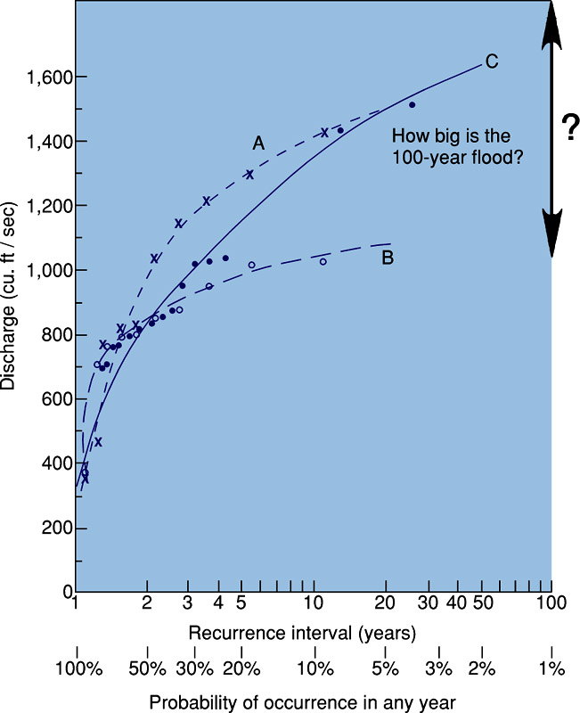
Flood-Frequency
Curve
Box 6.1 Figure 1

Slide 35
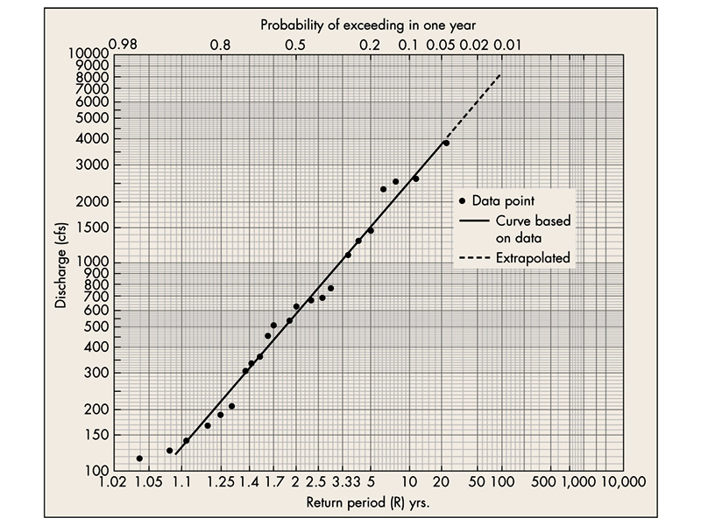

Slide 36
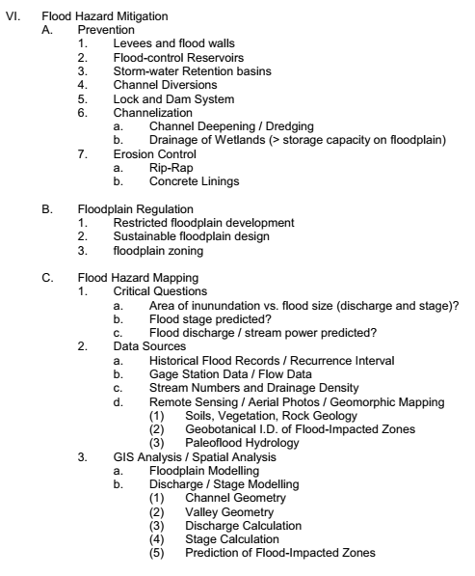

Slide 37
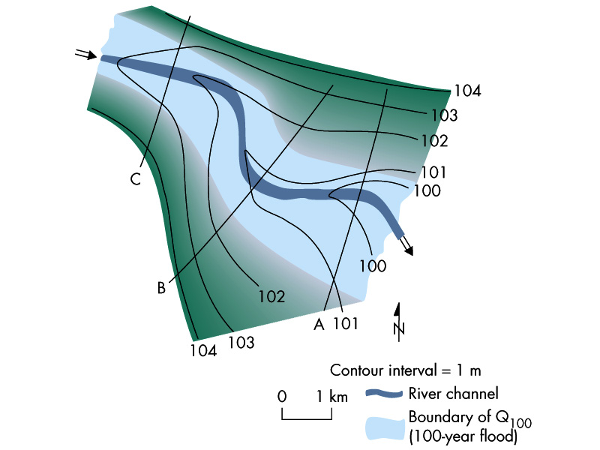

Slide 38
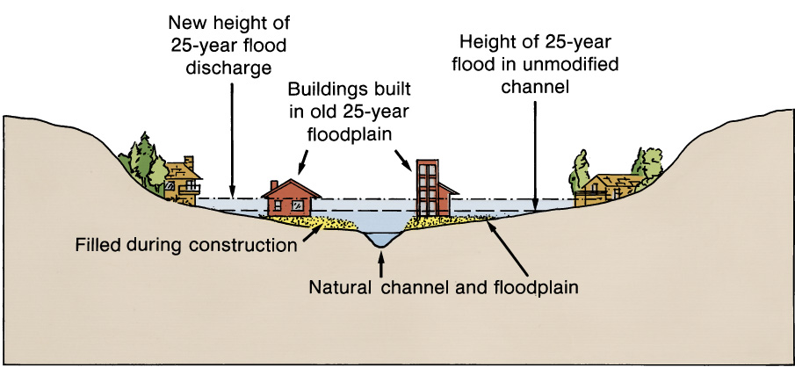
Increase in Flood Stage
Figure 6.15

Slide 39
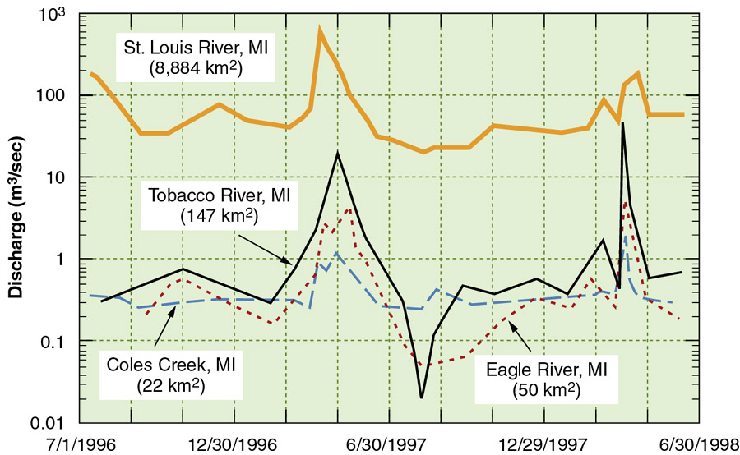
Hydrographs of Rivers
Box 6.4 Figure 2

Slide 40
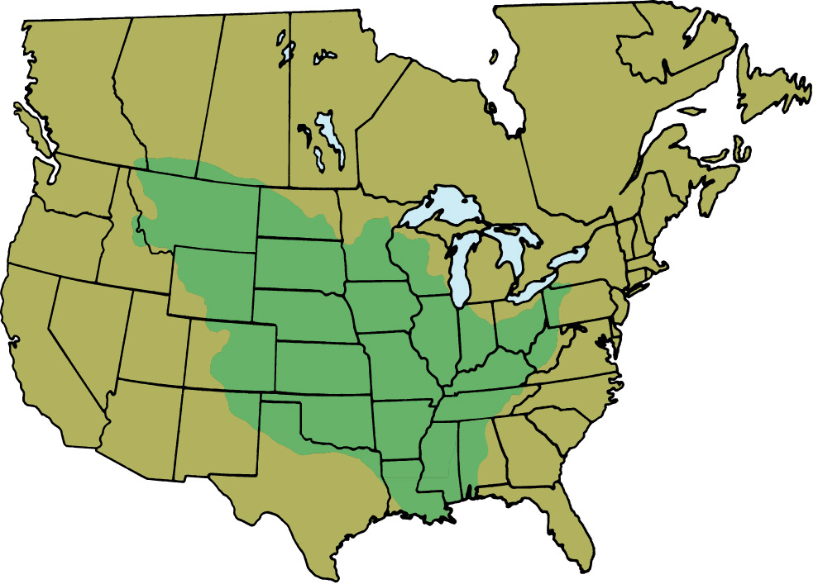
Mississippi River’s Drainage Basin
Box 6.2 Figure 1
U. S. Geological Survey Circular 1001

Slide 41
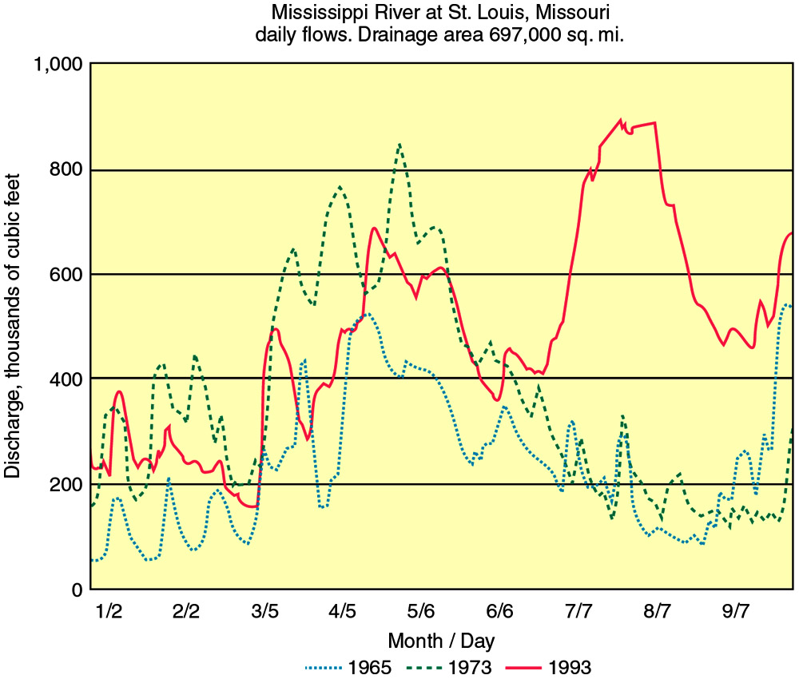
1993 Mississippi Flooding
Box 6.2 Figure 2
Hydrograph data courtesy U. S. Geological Survey

Slide 42
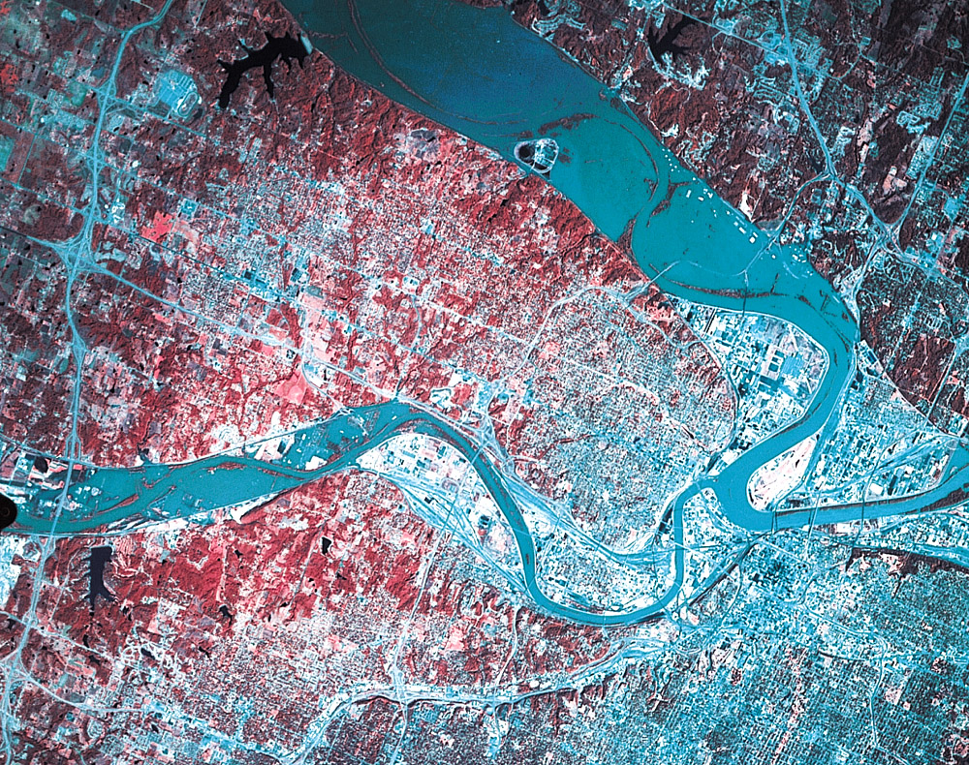
Mississippi Basin Flooding
Box 6.2 Figure 3

Slide 43
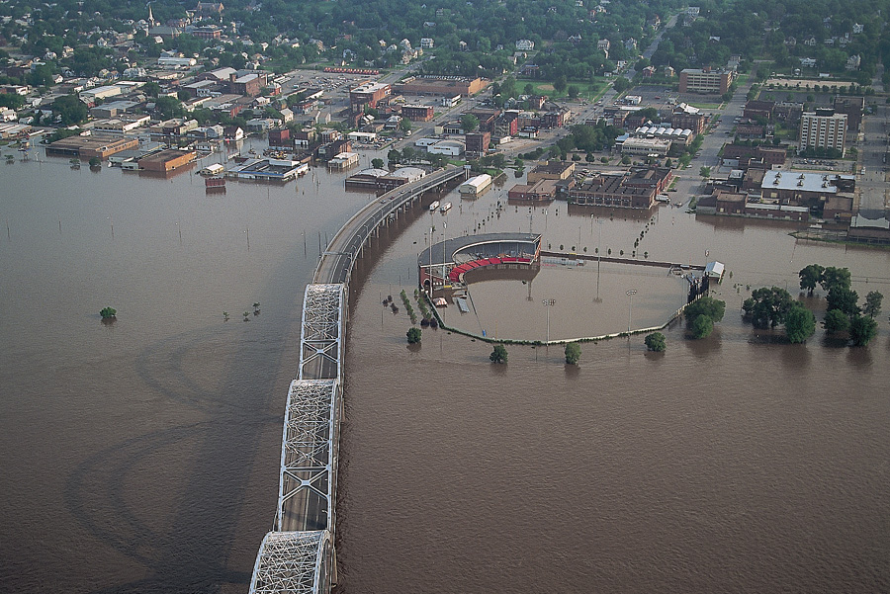
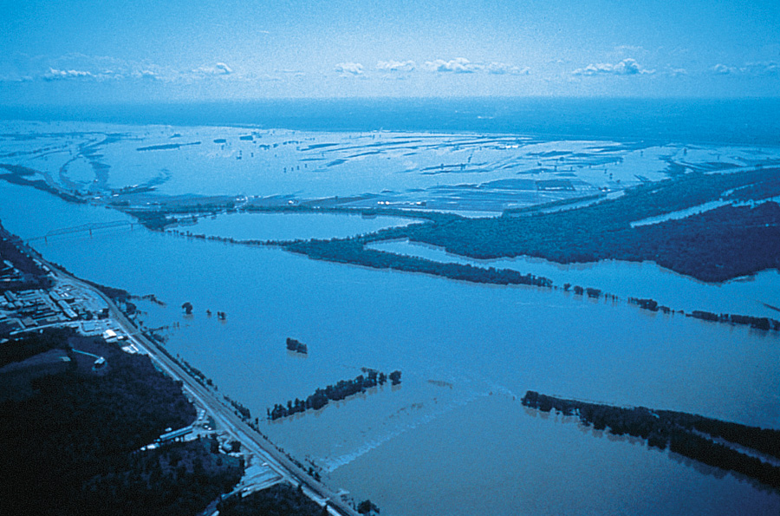
Consequences of Mississippi Flooding
Box 6.2 Figure 4a, b
A
B

Slide 44
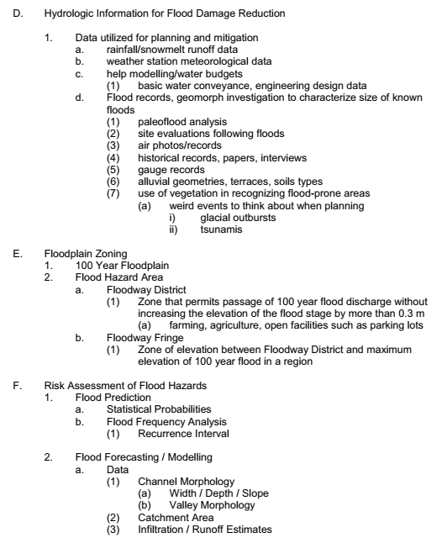
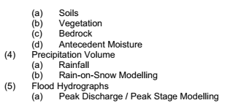

Slide 45
Negatives of Levees
Figure 6.19a, b
A
B

Slide 46
Dam Construction
Figure 6.20

Slide 49
Base Level Changes

Slide 50
A
B

Slide 51
Retention Pond
Figure 6.17a, b
A
B

Slide 52
Levees
Figure 6.18

Slide 57
Hydrograph Reflecting Modification
Figure 6.14

