Slide 1
Mass Wasting and
Landslide Processes

Slide 2
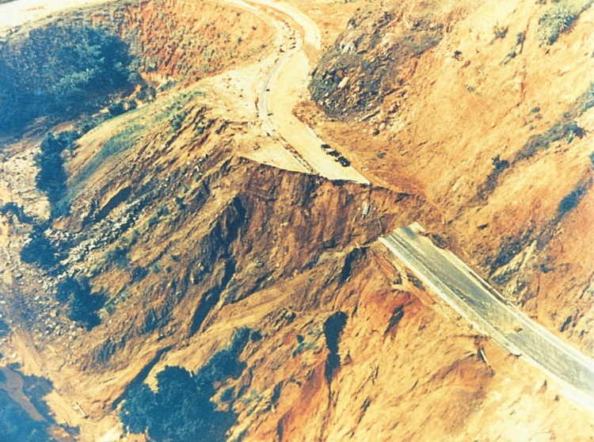
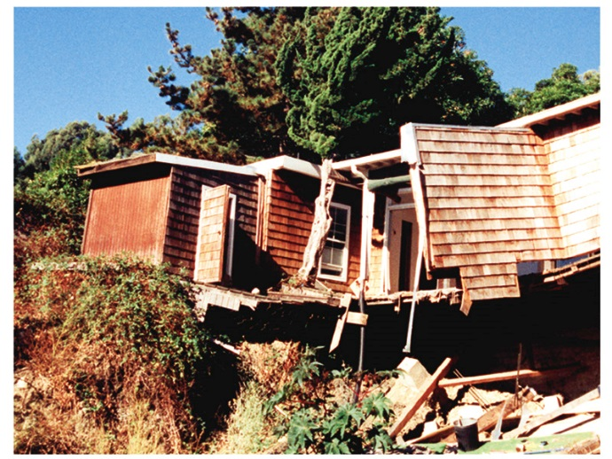
INTRODUCTION
Landslide Defined: “general term used to describe the downslope movement of soil, rock, and organic materials under the effects of gravity and also the landforms that result from such movement”
ALIAS WORDS
“Mass Movement”
“Mass Wasting”
“Landslide”
“Mudslide”
Global Occurrence and Hazard
All Climatic Conditions and Terrains
Cost Billions in Annual Monetary / Property Losses Responsible for 1000’s of annual deaths and injuries
Cause long-term economic disruption, population displacement, and negative effects on environment.

Slide 3
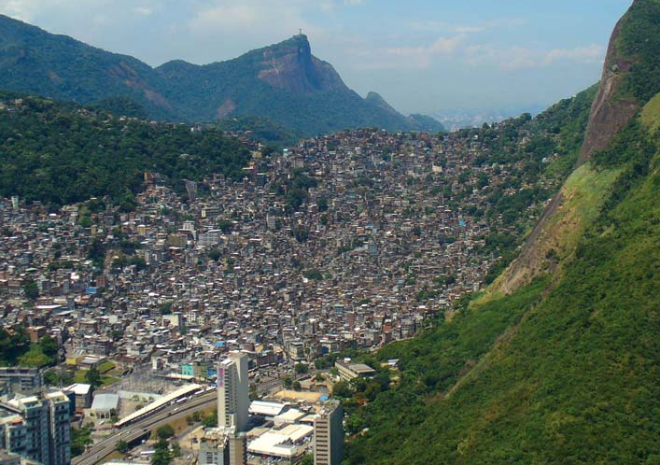
MASS WASTING AND HUMAN HAZARDS
Growing populations with geographic restrictions
Development drivers to occupy unstable, steep, or remote areas
Stabilizing landslide-scarred areas is too costly
Forced migration; inhabitants have no other places to relocate
Brazil

Slide 4
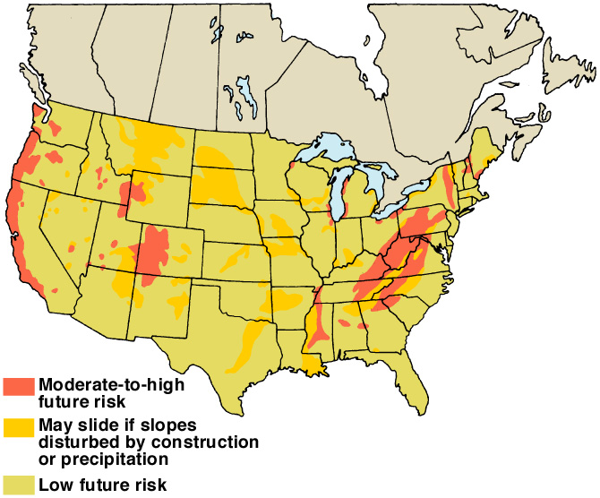
Landslide Potential
U.S.
After U. S. Geological Survey Professional Paper 950, 1978

Slide 5
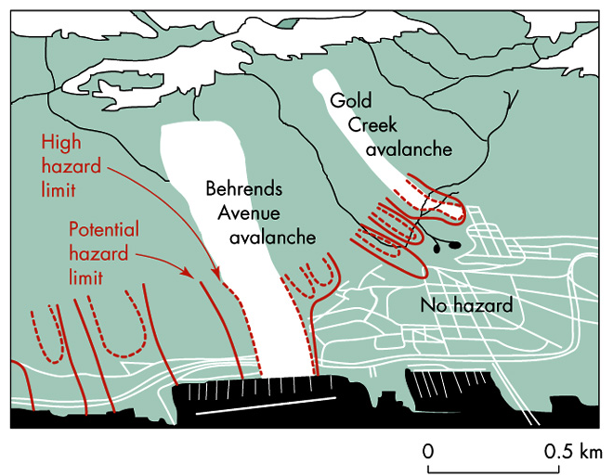
Landslide Hazards Mapping is the Key Basis to
Public Safety and Warning Systems

Slide 6
Fundamental Principles

Slide 7
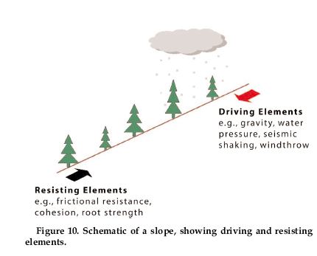
GRAVITY AND SLOPE ANGLE ARE THE DRIVING FACTORS
0º slope angle stable
30º slope angle unstable
90º slope angle
Free Fall
Pulling Force Toward Center of Earth
Newton’s Law of Gravitational Attraction G ~ (m¹ x m² / r²)

Slide 8
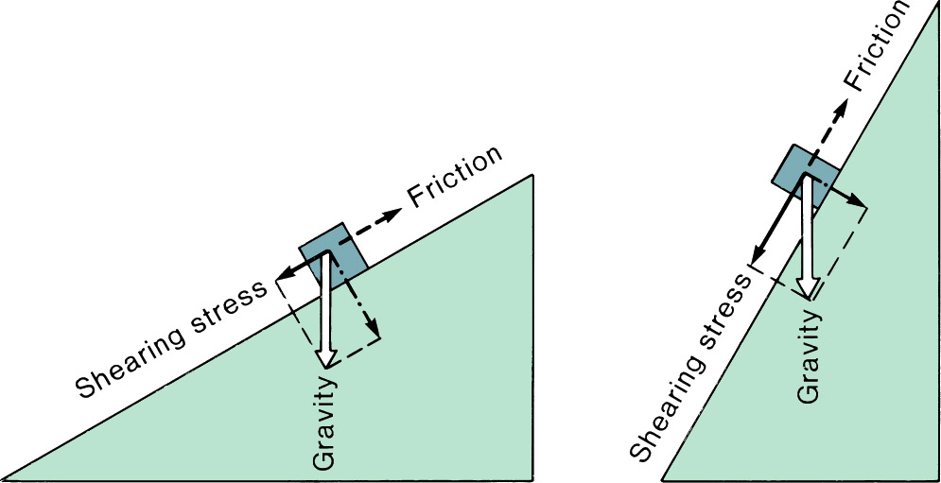
Effects of Slope Geometry

Slide 9
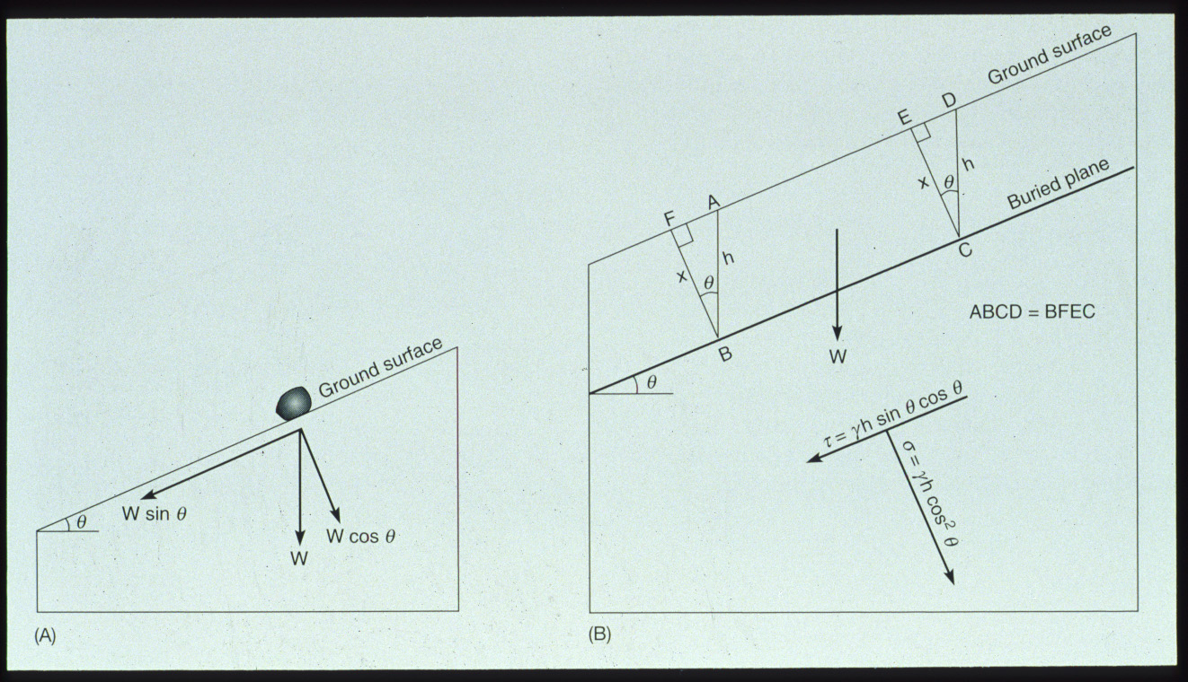

Slide 10
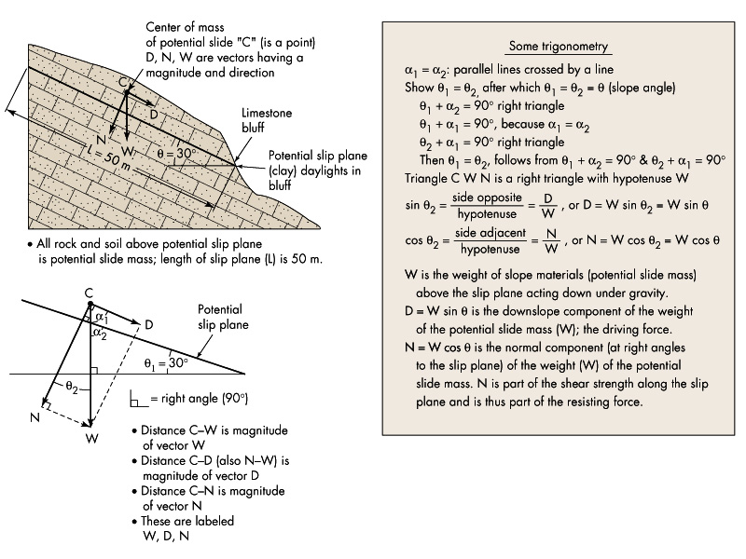

Slide 11
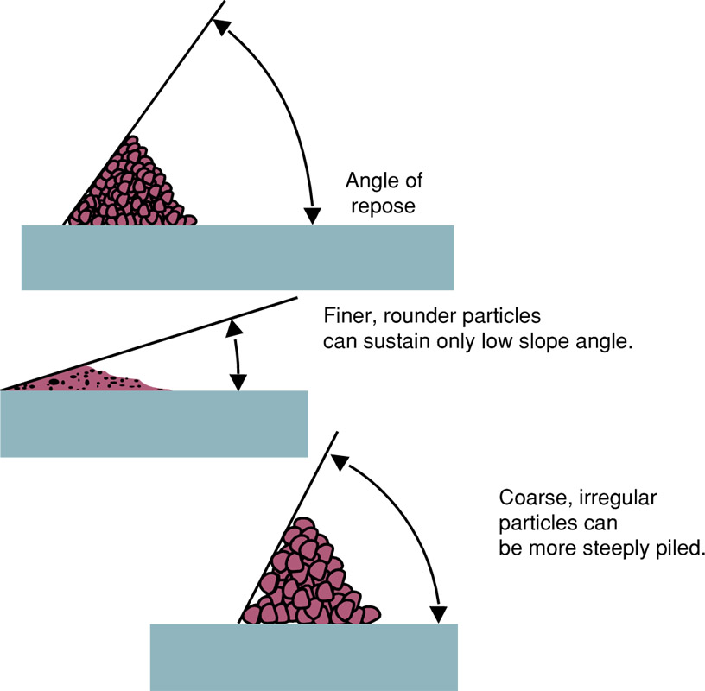
Angle
Of
Repose

Slide 12
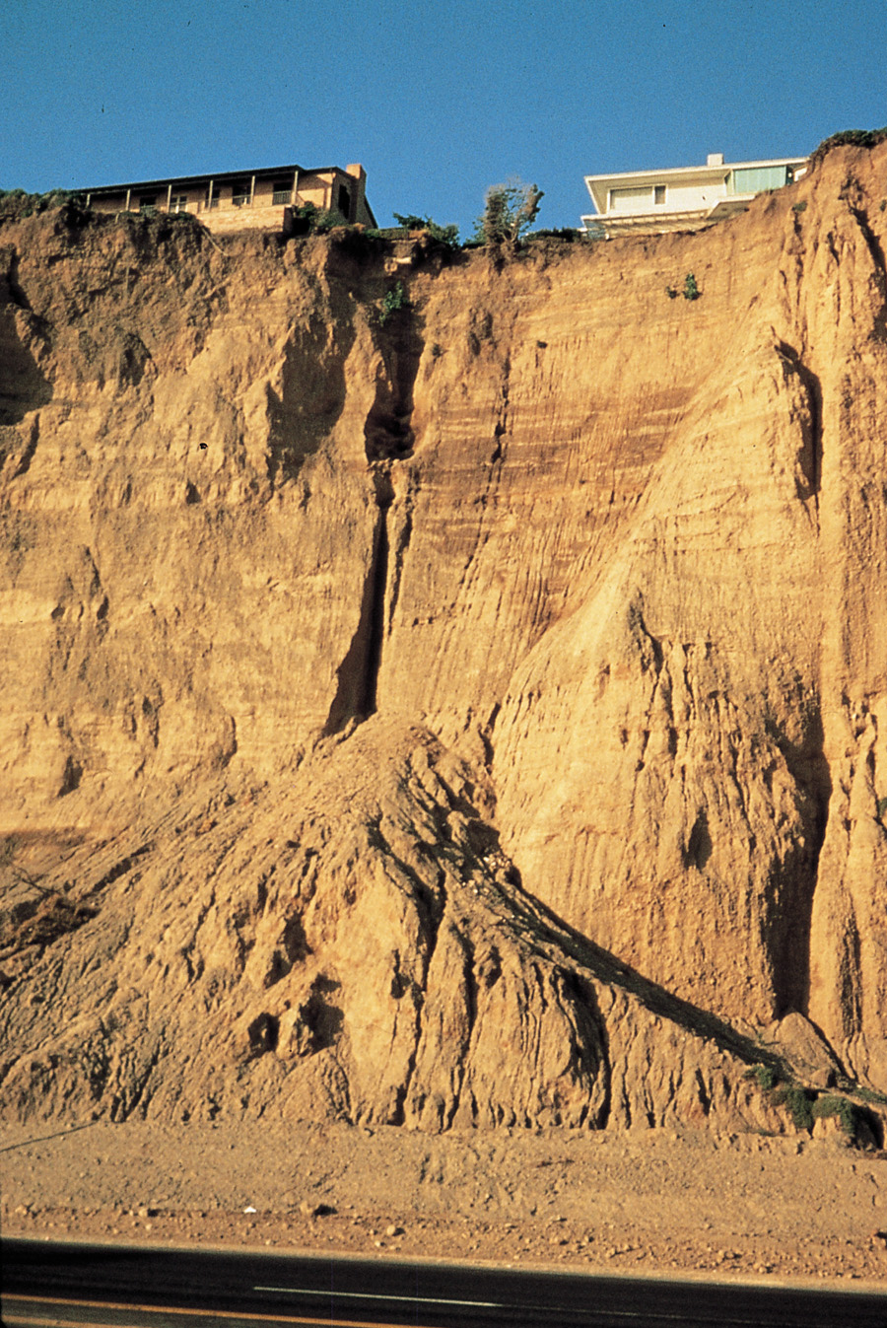
Angle
Of
Repose

Slide 13
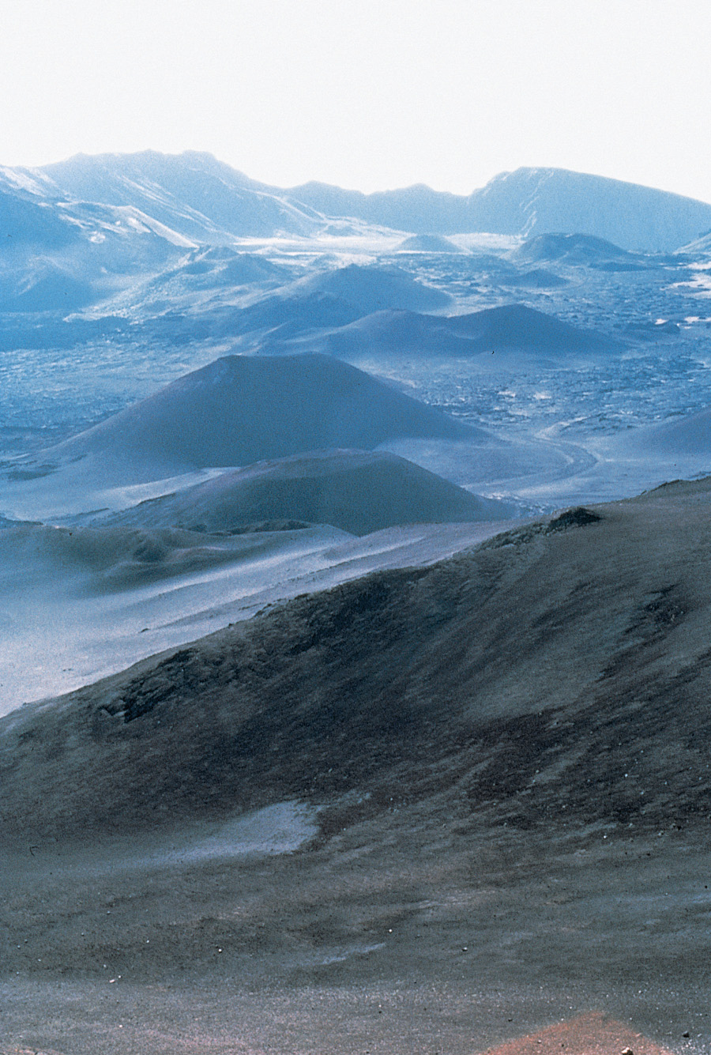
Cinder Cones and Angle
of Repose

Slide 14
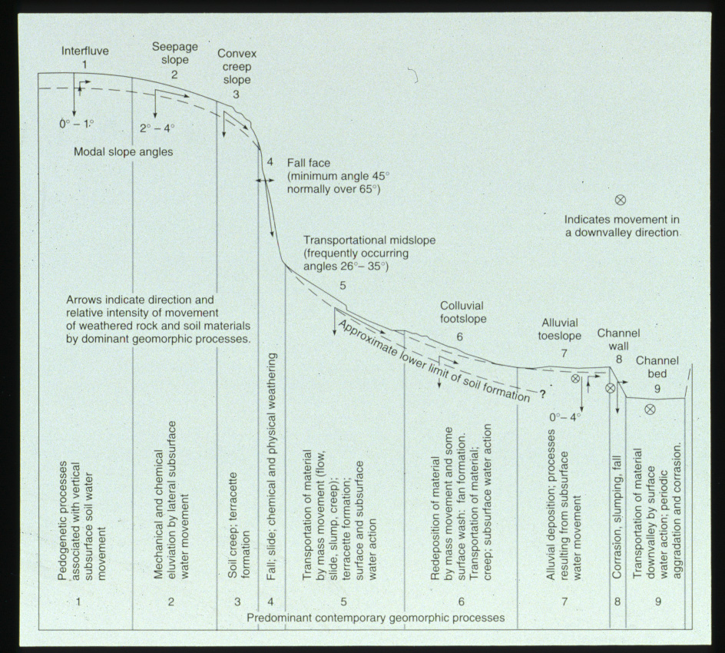
Idealized Hillslope Morphology

Slide 15
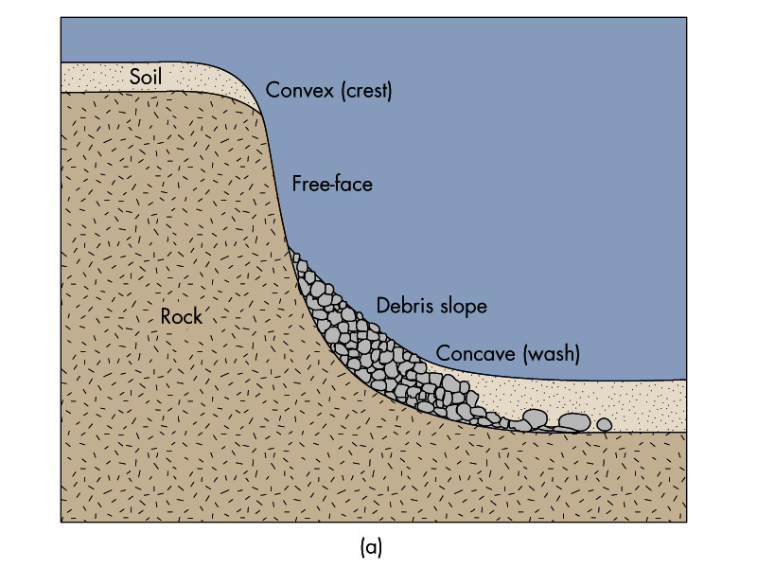

Slide 16
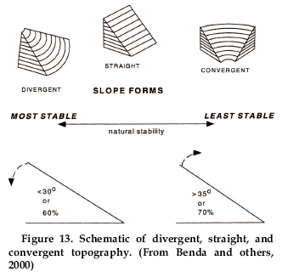
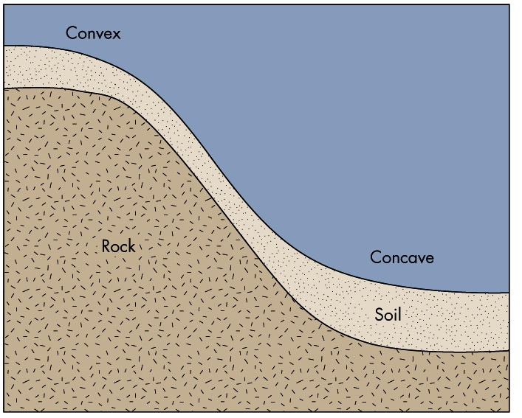

Slide 17
Mass Wasting Processes
and Classification

Slide 18
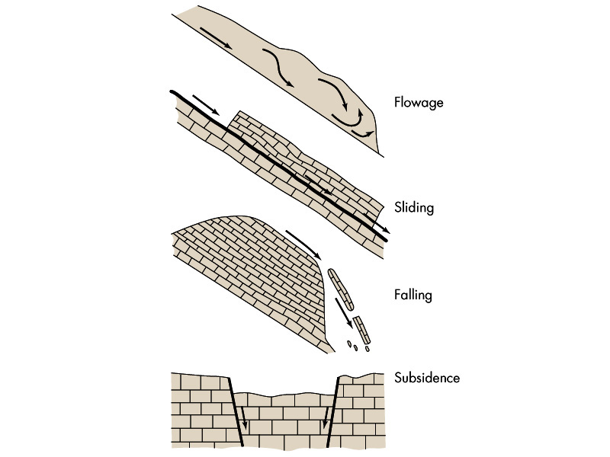

Slide 19
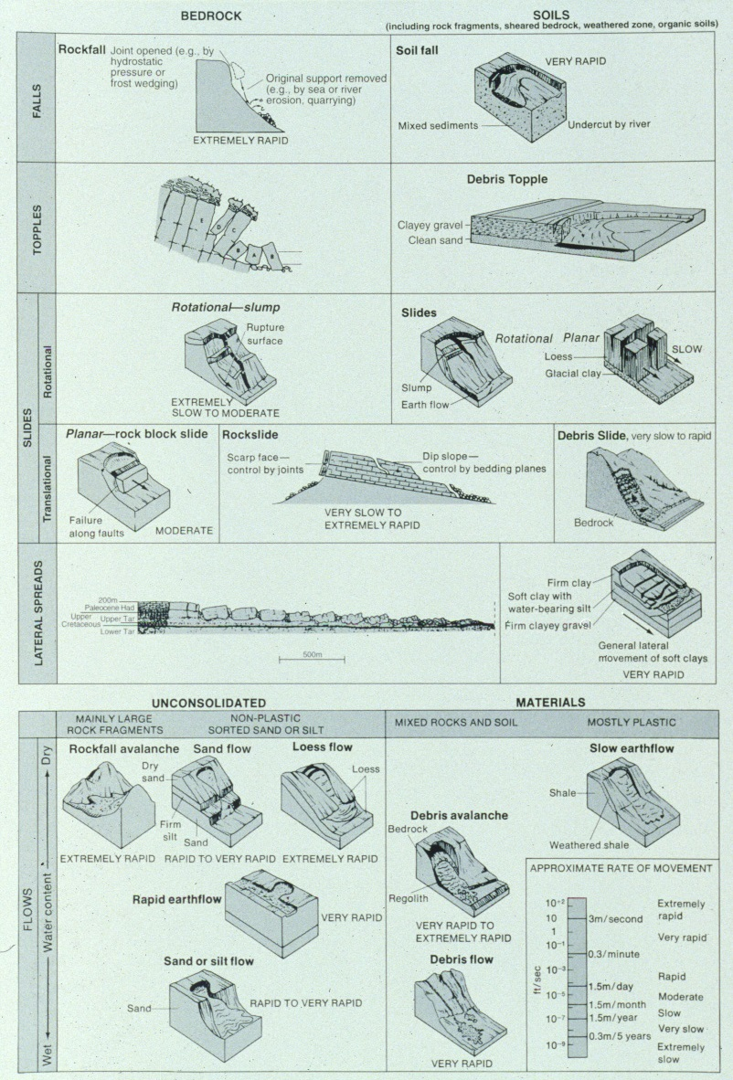
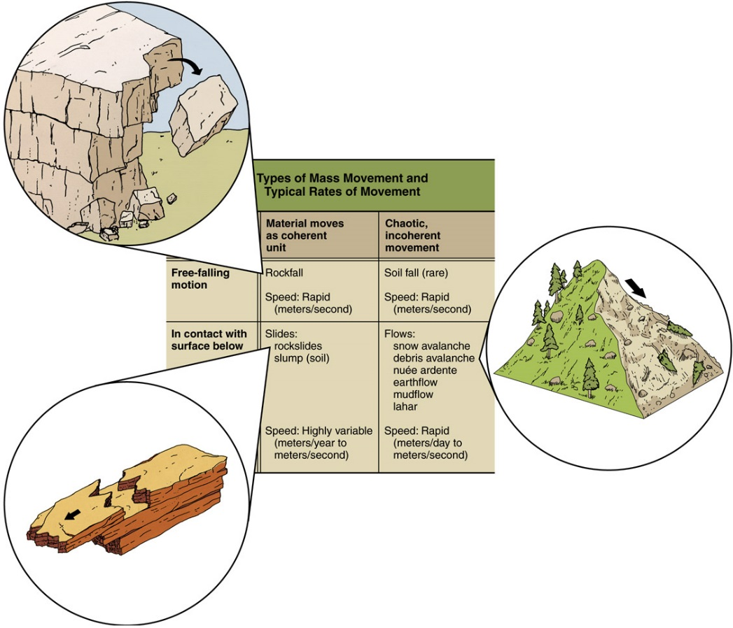
Mass Wasting Classification
Rock
Earth
Debris
BEDROCK vs. REGOLITH
Special Case Scenarios:
Lahar – Volcanic Debris Flow
Debris Avalanche
Snow Avalanche
Creep – Slow Flow

Slide 20
FALL
ROTATIONAL SLUMP
PLANAR SLIDE
TOPPLE
Hummocky
Topography
SPREAD
FLOW

Slide 21
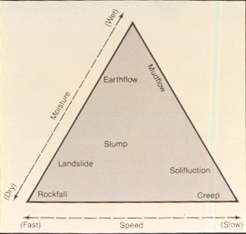
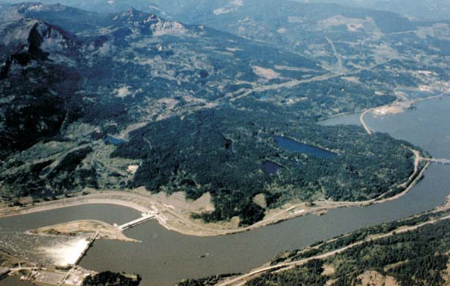
Mass Movements Processes and Characteristics
Fall Topple Slide Flows Spreads
Rotational Planar
Occurrence-Size
Velocity
Triggering
Mechanisms
Effects
Small-
Scale
Small-
Scale
Medium to
Large
Medium to
Large
Medium to
Large
Medium to
Large
Instant
Slow to
Fast
Slow to
Fast
Slow to
Fast
Slow to
Fast
Slow to
Fast
Excavation
Freeze-Thaw
Heavy Rainfall, Deforestation Co-Seismic Shaking
The larger the mass + volume + footprint of the failure zone, and the
faster the process, the more catastrophic / hazardous to human life
Bridge of the Gods Landslide, Stevenson, WA

Slide 22
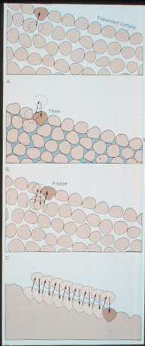
VOLCANIC LAHAR
SLOW SOIL CREEP

Slide 23
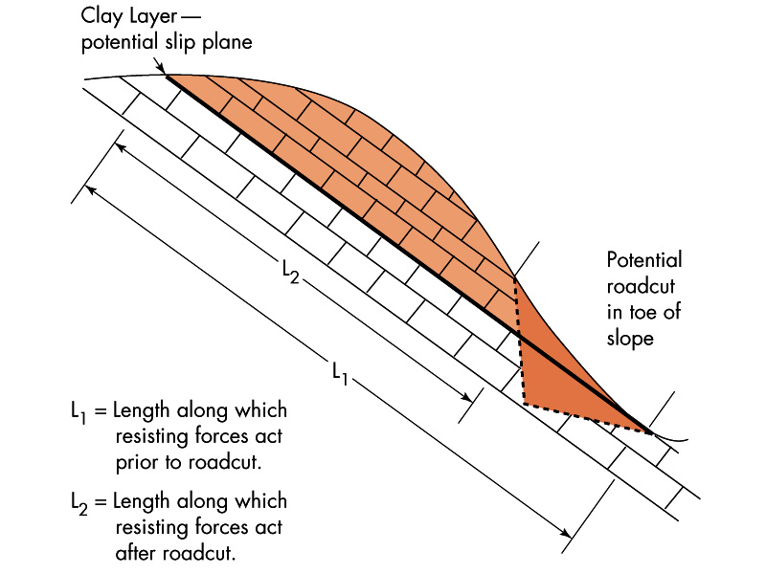
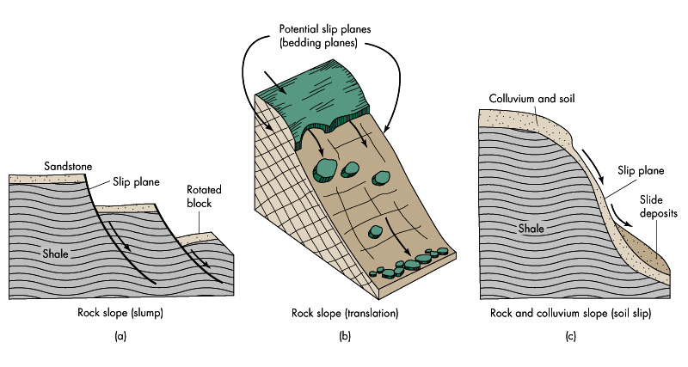
Mass Wasting Variables – Slope Stability
Hillslope Gradient / Slope Steepness
Soil / Regolith Thickness and Composition
Precipitation and Soil Moisture Content
Bedrock Structure (Dip, Fractures, Faults)
Co-Seismic Ground Shaking
Volcanic Activity
Climate, Human Land Use and Vegetation

Slide 24
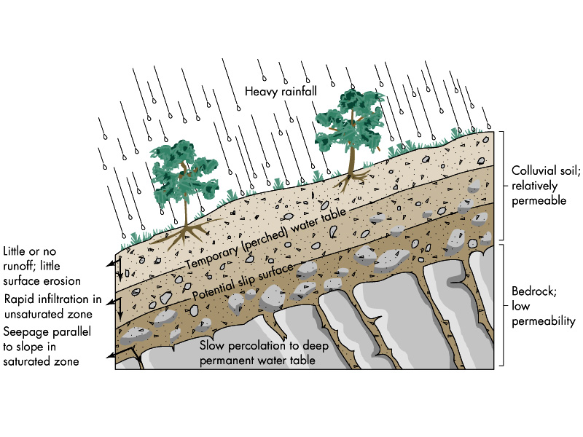
Soil Water Saturation, High Antecendent Soil Moisture and Seasonal Precipitation Patterns Promote Slope Failure

Slide 25
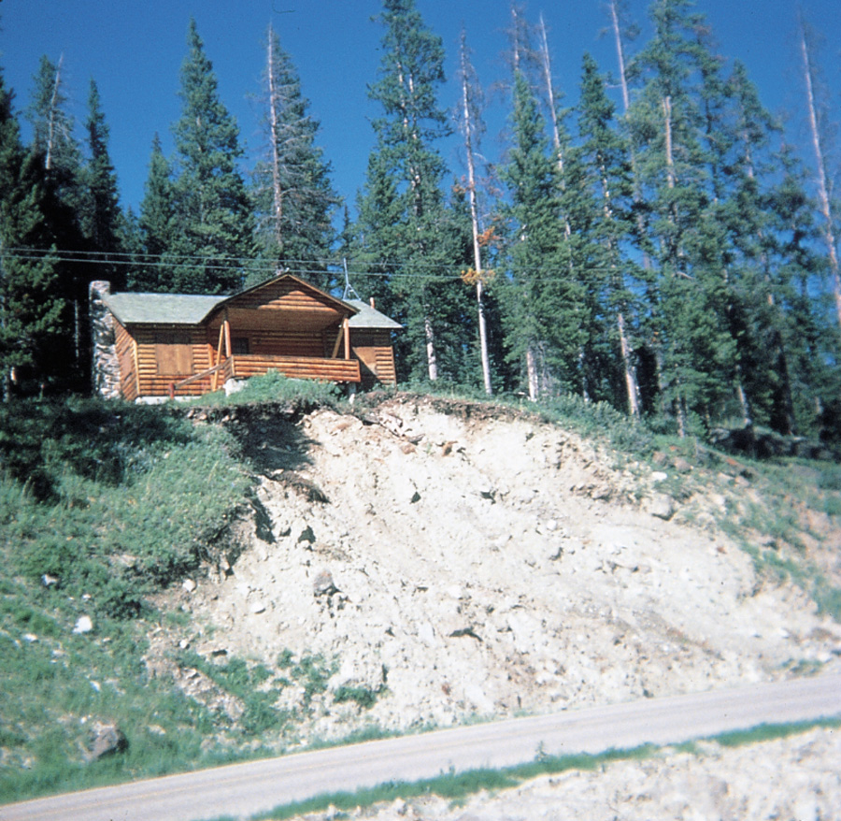
Failure of Steep, Unvegetated Slope
Deforestation and Fire Decreases Root Strength Promotes Slope Failure

Slide 26
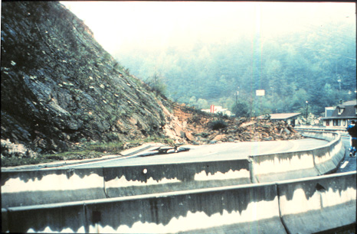
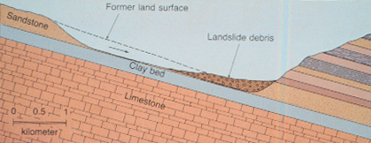
Bedrock Dip-Slope Weaknesses
Bedding Plane Failure
Rock-Block Slide
Excavation, Undercutting and Over-steepening Promotes Slope Failure

Slide 27
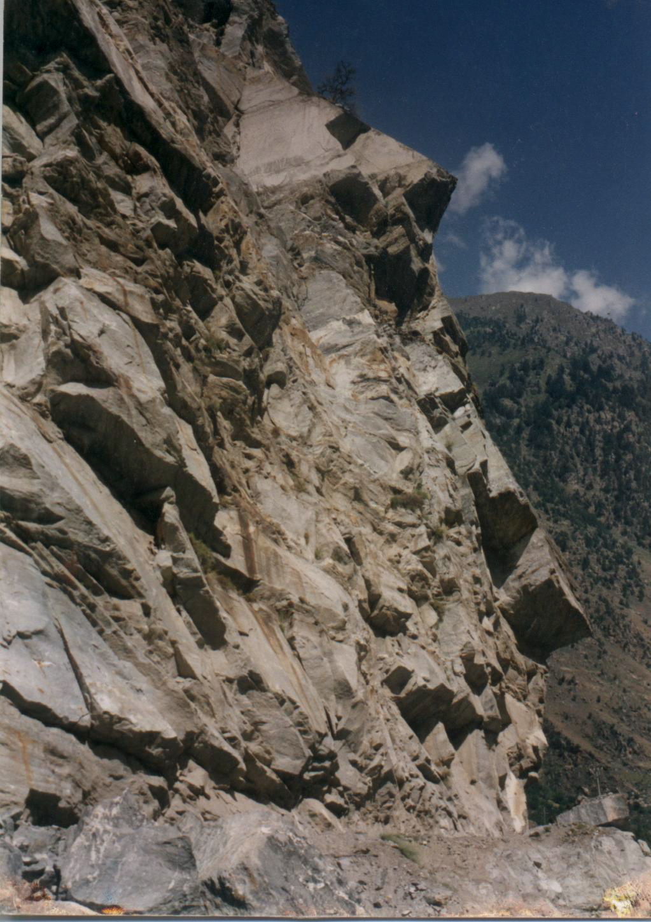
Copyright © Vikram Gupta 2002
Notes:
Rockfall due to wedge failures, Satluj Valley Higher Himalayas, India.

Slide 28
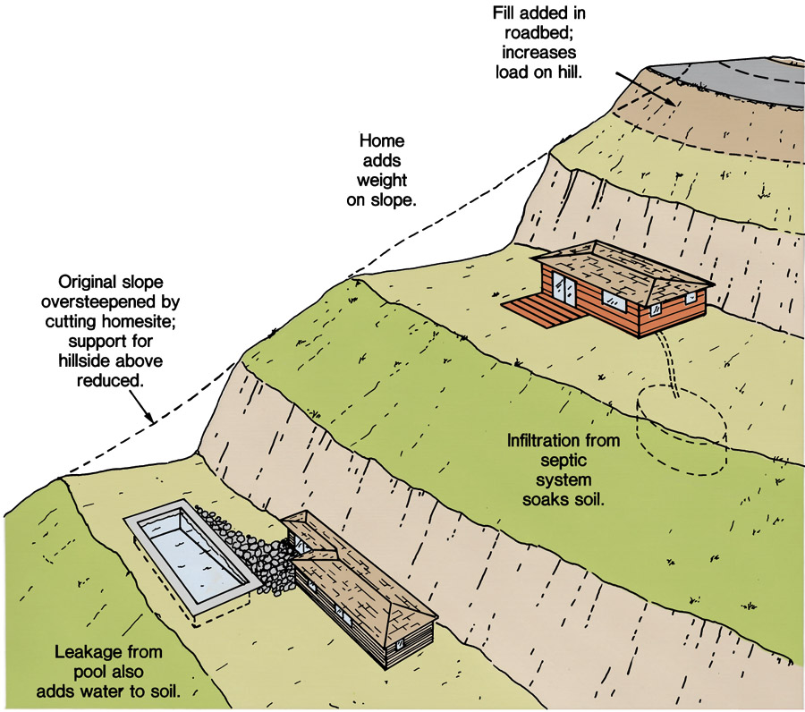
Construction and Human Habitation
Artificial Cuts / Fills + Poor Drainage Promotes Slope Failure

Slide 29
Processes and Examples

Slide 30
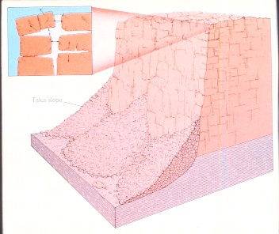
Talus Slope
Scree
Rock Fall Mechanisms

Slide 31
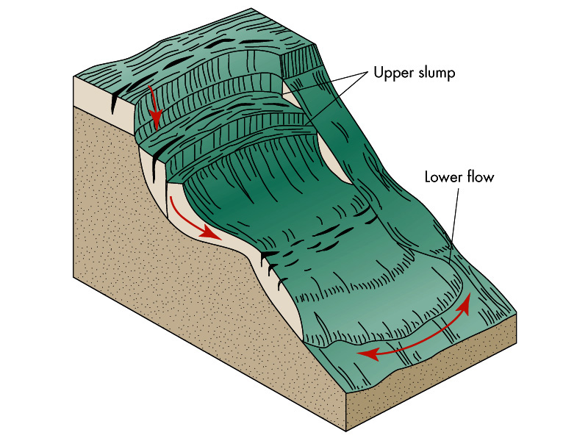

Slide 32
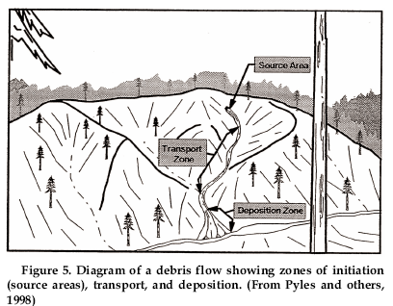
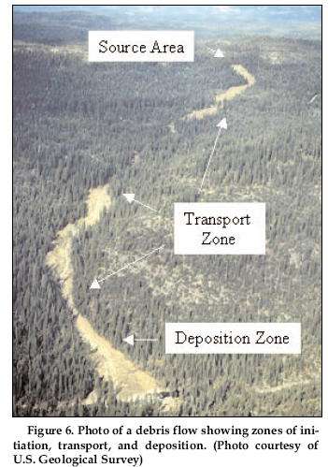
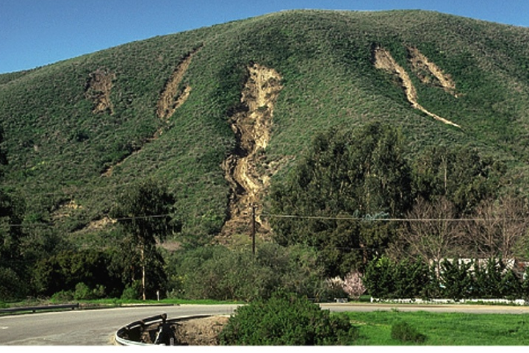
DEBRIS FLOW ANATOMY

Slide 33
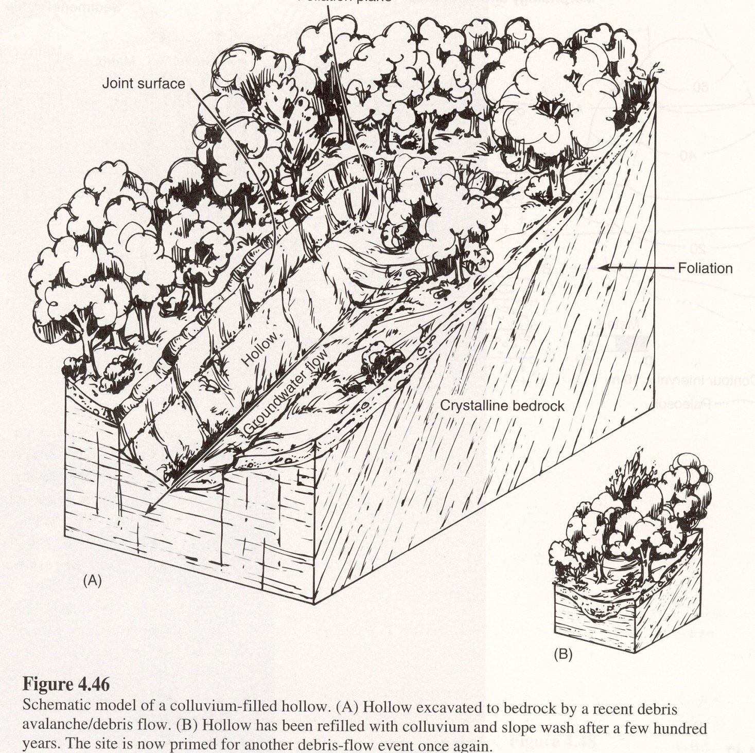
DEBRIS FLOW: Hollow-Head Shotgun Model
-Colluvium-Filled Hollows
-Convergent Hillslope Topography
-Convergent Groundwater Flow / Infiltration

Slide 34
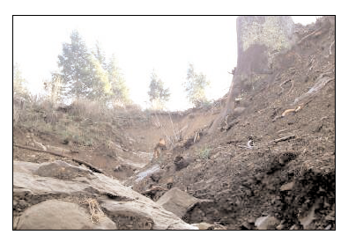
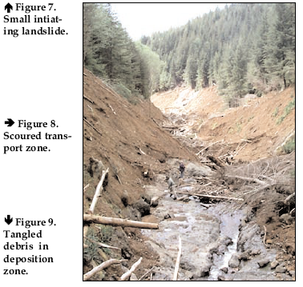
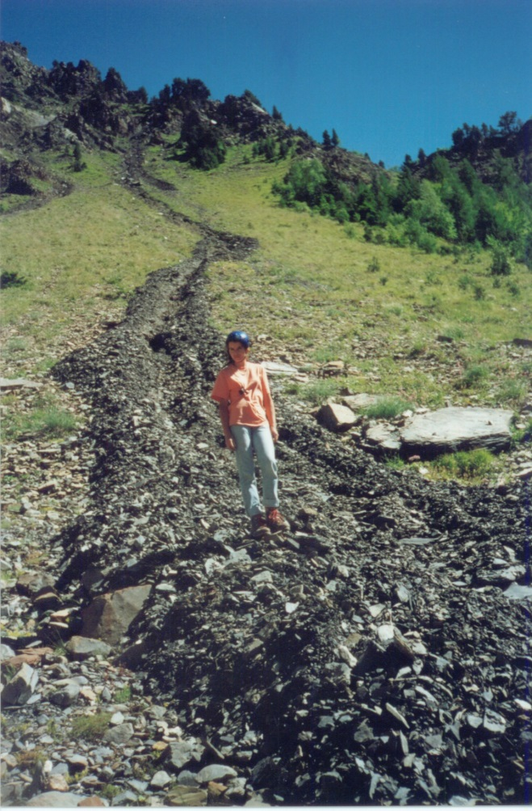
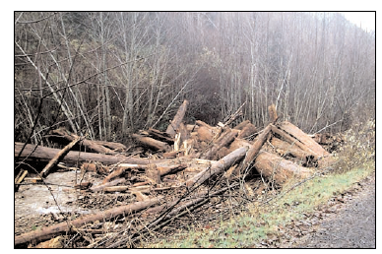
Head Scarp
Channel Scour
Debris Levees
Large Wood Jams
DEBRIS FLOW EVIDENCE

Slide 35
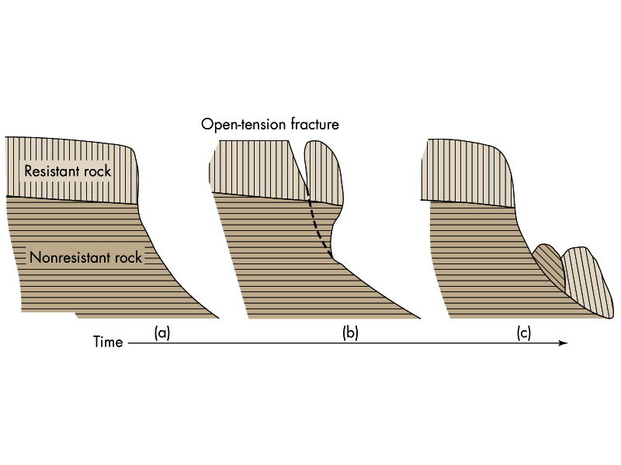

Slide 36
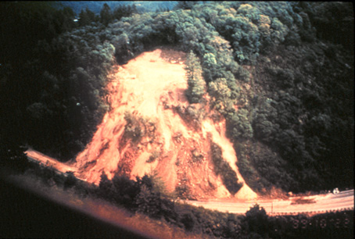

Slide 37
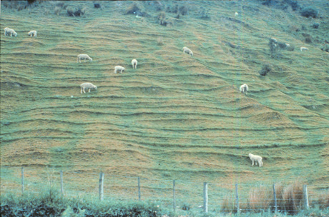
Soil Creep and Animal Compaction
Terracettes

Slide 38
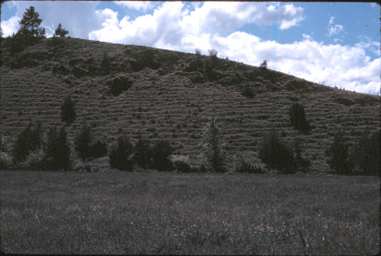

Slide 39
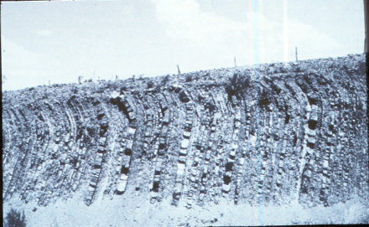
Rock Creep

Slide 40
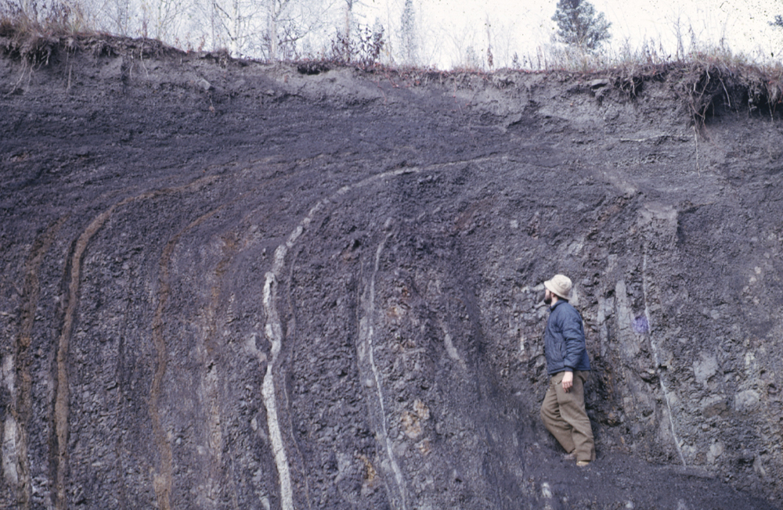
Copyright © Frank Nicholson 2002
Notes:
Down slope frost creep visually demonstrated in multi coloured shales with vertical bedding The surface slope is from left to right. Frost creep has bent the beds down slope, with an increasing amount of movement towards the surface. Section in borrow pit south of Dawson, Yukon, Canada.

Slide 41
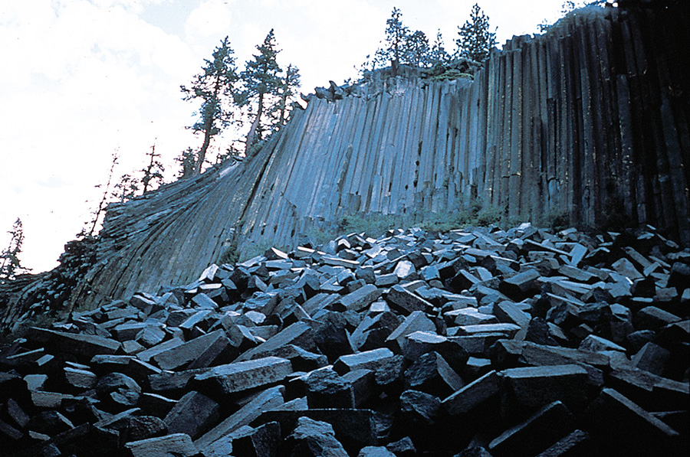
Rock Fall Devil’s Postpile National Monument

Slide 42
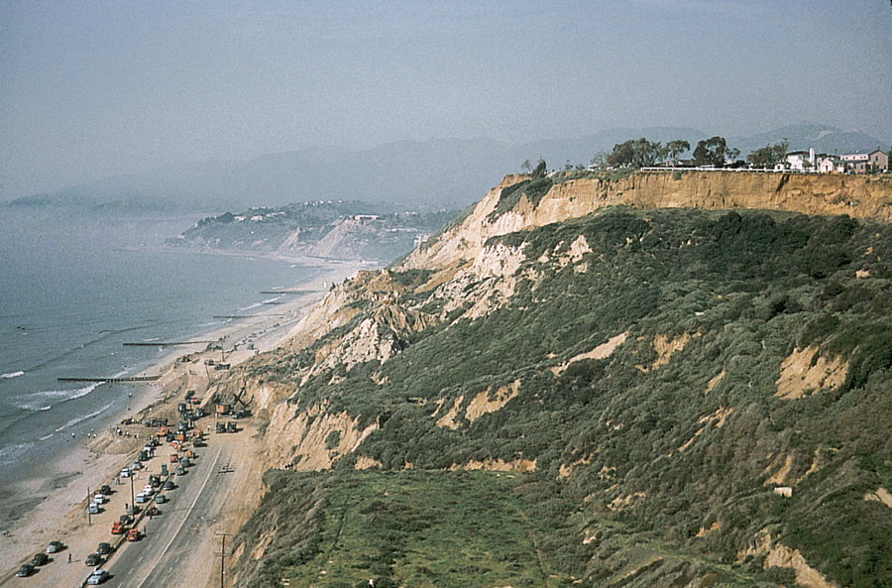
Slump in Pacific Palisades, California
Uplifted Marine Terrace

Slide 43
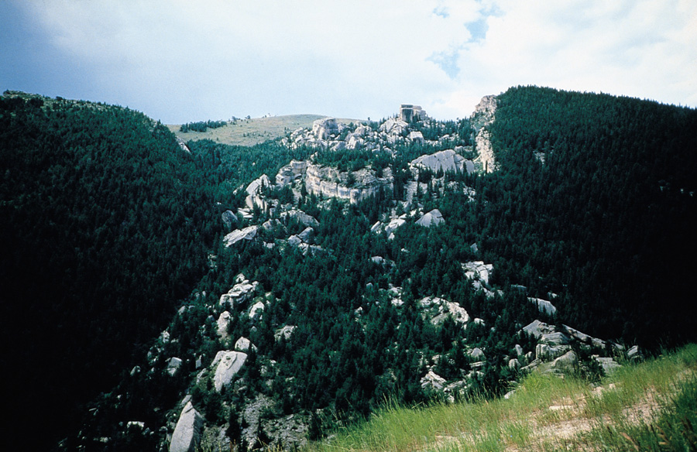
“Fallen City” Rockslide

Slide 44
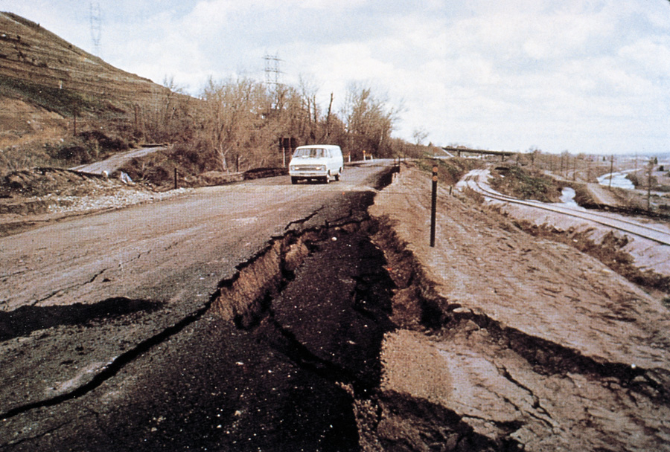
Instability of Expansive Clay
Lateral Spread

Slide 45

Earthflow

Slide 46

Grain Flow

Slide 47


Failure of Vegetation on Slopes
B
A

Slide 48

Signs of Creep

Slide 49

Signs of Creep

Slide 50

Effects of Slopewash and Creep
Copyright © Bernie Bauer 2002
Notes:
Hillslope processes (presumably sheet wash and soil creep) have removed approximately 1 meter of soil to expose the root system of the tree. On the other hand, the roots look pretty grizzly and uniform, so there may have been a landslide episode decades ago that stripped the topsoil off the hill. Photo taken in the mountains immediately north of Lake Arrowhead, California.

Slide 51

Evidence of Slope Instability

Slide 52

More Evidence of Slope Instability

Slide 53

Large-Scale
Rock Avalanche

Slide 54

Catastrophic Avalanche

Slide 55

Erosion
and Slope
Failure

Slide 56

Puget Peak Debris Avalanche

Slide 57


River-Damming
Landslide near
Thistle, Utah

Slide 58


Damage from Portuguese Bend Landslide
A
B

Slide 59

Landslide

Slide 60


Slide 61


Slide 62


Slide 63

Copyright © Christiane Mainzer 2002
Notes:
Aerial of the La Conchita slump. Santa Barbara County,California. March 1995. Classic slump clearly detailing the scarp, slump and flow at base of the movement. An orchard is at the top of the slope.

Slide 64


Slide 65


Slide 66


Slide 67


Slide 68


Slide 69


Slide 70



Slide 71
Prevention and Remediation

Slide 72


Slide 73


Slide 74


Slide 75


Slide 76


Slide 77


Slide 78


Slide 79

Copyright © Keith Richards 2002
Notes:
Impacts of logging, Sabah, Borneo.

Slide 80

Copyright © Stephane Veyrat-Charvillon 2002
Notes:
Revegetation on slopes to stop erosion next to the torrent; located in Isere - French North Alps.

Slide 81


Slide 82

Reduce Consequences of Slope Instability

Slide 83

Reduce Consequences of Slope Instability

Slide 84

Reduce Consequences of Slope Instability

Slide 85

Slope Stabilization

Slide 86

Slope Stabilization

Slide 87

Retaining Wall

Slide 88


Stabilizing a Slope
A
B

Slide 89

Improved
Drainage
A
B

Slide 90

Improved Drainage

Slide 91

Stabilizing a Slope

Slide 92

Stabilizing a Slope

Slide 93

ONLY YOU CAN PREVENT LANDSLIDES…

