Slide 1
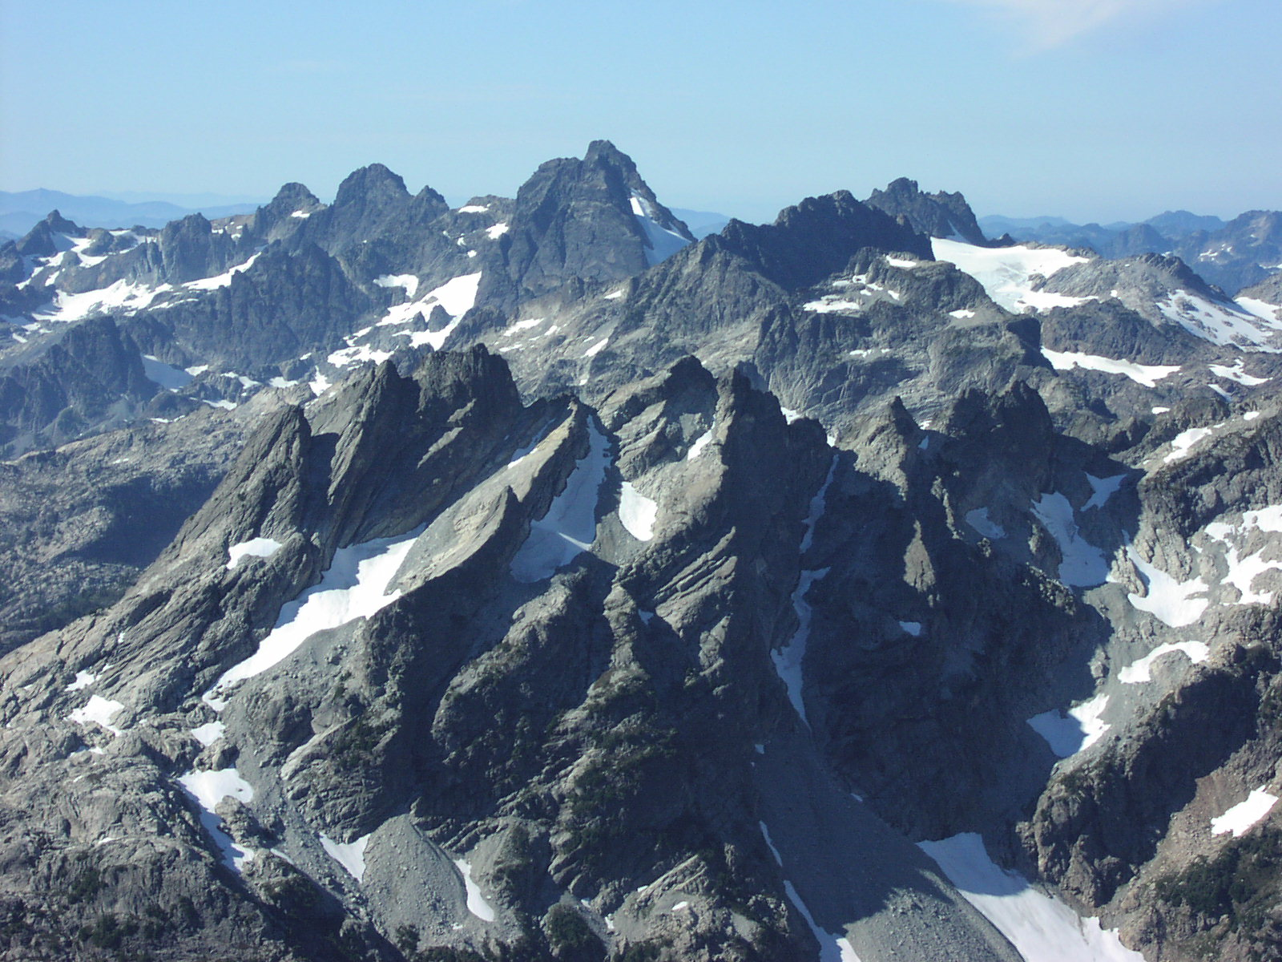

Slide 2
An Overview of Cleanup Projects in DEQ Northwest Region Voluntary Cleanup Program
Dan Hafley, R.G., Project Manager
Cleanup and Portland Harbor Section
Oregon DEQ

Slide 3
NWR Voluntary Cleanup
Approximately 200 active sites
Region covers Portland metro area, extends west to coast
Approximately 15 staff including geologists, hydrogeologists, engineers, and toxicologists
Work as interdisciplinary teams on projects

Slide 4
Types of Cleanup Sites
Large sites typically current or active industrial, many situated on Willamette River
  Gas Plants
  Bulk Fuel Facilities
  Rail Yards
  Ship Construction and Dismantling
  Pesticide Manufacturers

Slide 5
Other Cleanup Sites
Medium to small sites, more varied
Dry cleaners
Gas Stations
Landfills/Dumps
Other small industrial (plating, misc. manufacturing, etc.)
Mom & Pop operations

Slide 6
Typical Contaminants - Soil
Petroleum Hydrocarbons (gas, diesel, lube oils)
Volatile Organic Compounds (benzene, solvents including PCE and TCE)
Semi-Volatile Organics (phenols, PAHs)
Metals (lead, arsenic, chromium)
Poly-Chlorinated Biphenyls (PCBs)
Dioxins and Furans

Slide 7
Typical Contaminants - Groundwater
Dry cleaning (PCE) or industrial solvents (TCE, 1,1,1-TCA)
Petroleum components including BTEX and Polynuclear Aromatic Hydrocarbons (PAHs)

Slide 8
CLEANUP GOALS
Cleanup to risk-based concentrations, currently defined as one-in-a-million (1 x 10-6) risk
Requires identification of potentially exposed human and ecological “receptors”
In past, focused on human risk based on exposure to groundwater or soil. More emphasis now on ecological receptors, particularly in water (sediments)

Slide 9
Types of Cleanup Actions
Passive
No Action – contaminants don’t pose significant risk to humans or critters
Monitoring – ensure stable situation does not change. Common for groundwater
Active
Dig and Haul
Containment (capping)
Various in-place (“in-situ”) treatments

Slide 10
In-Situ Treatments
Chemical – injection of chemicals to destroy contaminants or alter their physical properties to allow treatment or removal
Thermal – application of heat to destroy or liberate contaminants
Biological – Injection of bugs (typically bacteria) and/or nutrients to stimulate biodegradation

Slide 11
Cleanup Project Examples
Union Station – Excavation and capping (simple)
Cadet Mfg. – In-Situ Chemical Oxidation (intermediate)
ICN – Electrical Resistive Heating (complex)

Slide 12
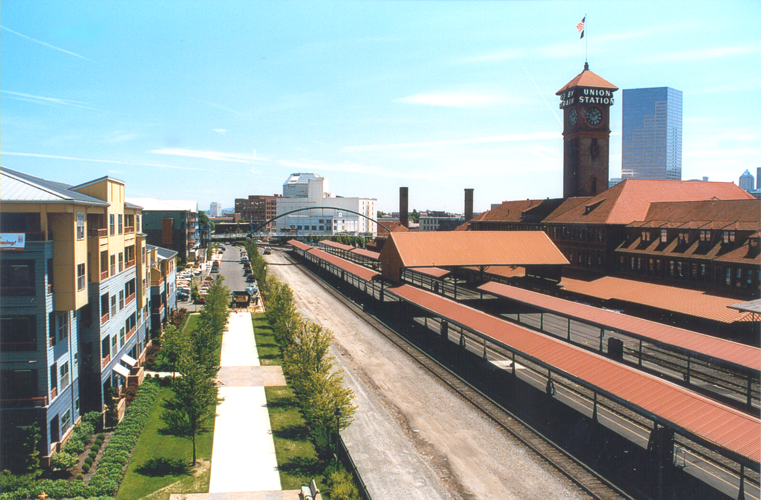
The Yards at Union Station: An Award Winning Brownfields Project

Slide 13
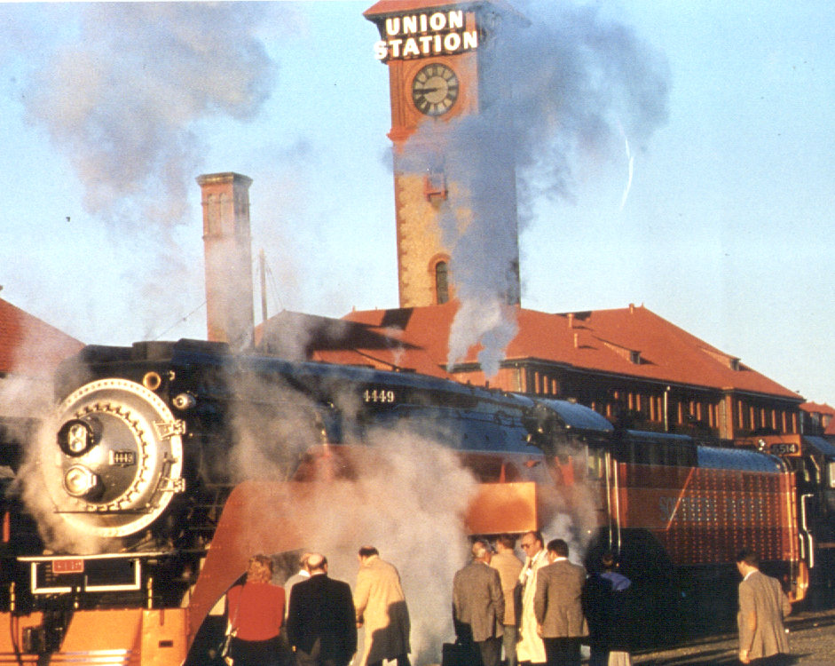
Site History
Wetlands and small lake prior to 1890, later filled with 3 million yards of material
Operated as rail yard from late 1800s to 1970s
Purchased by City of Portland for redevelopment in 1987

Slide 14
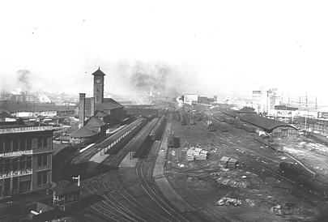
Union Station Yards - Circa 1912

Slide 15
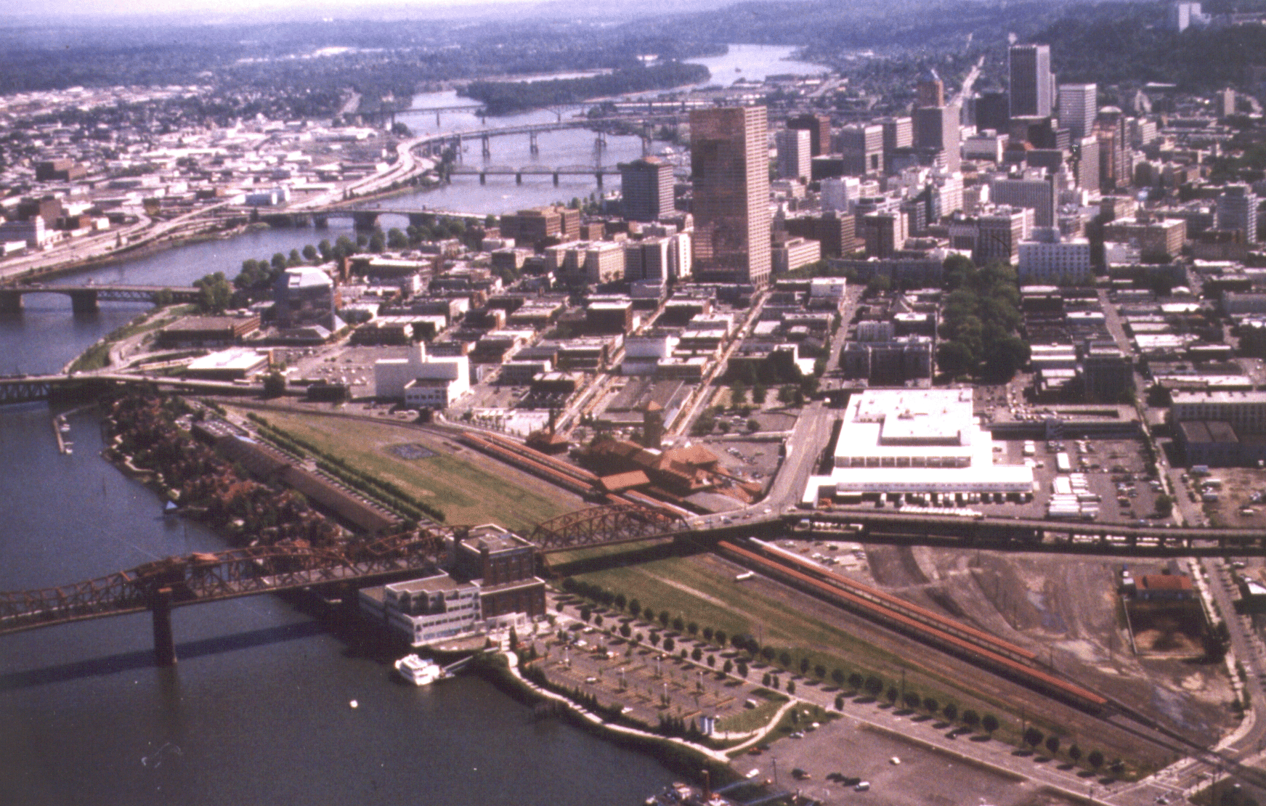
Union Station Yards - Circa 1988

Slide 16
Discovery of Environmental Problems
During geotechnical exploration, borings encountered crude oil in soil and groundwater in southern site
Discovery of oil led to further assessment, which resulted in the discovery of site-wide contamination

Slide 17
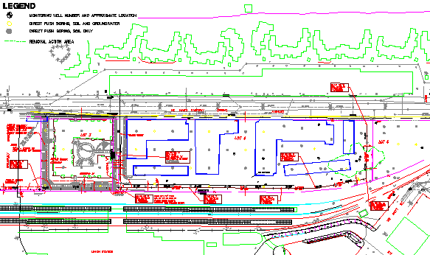
Exploration Plan
Extensive Soil and Groundwater Sampling Performed

Slide 18
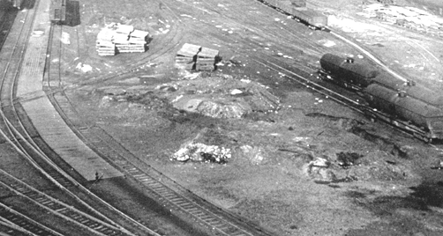
Crude Oil Release
Crude Oil in Soil and Groundwater
Area Affected - 5,000 square feet of property.
Corrective Action - Approximately 3,000 cubic yards of oil-containing soil removed.

Slide 19
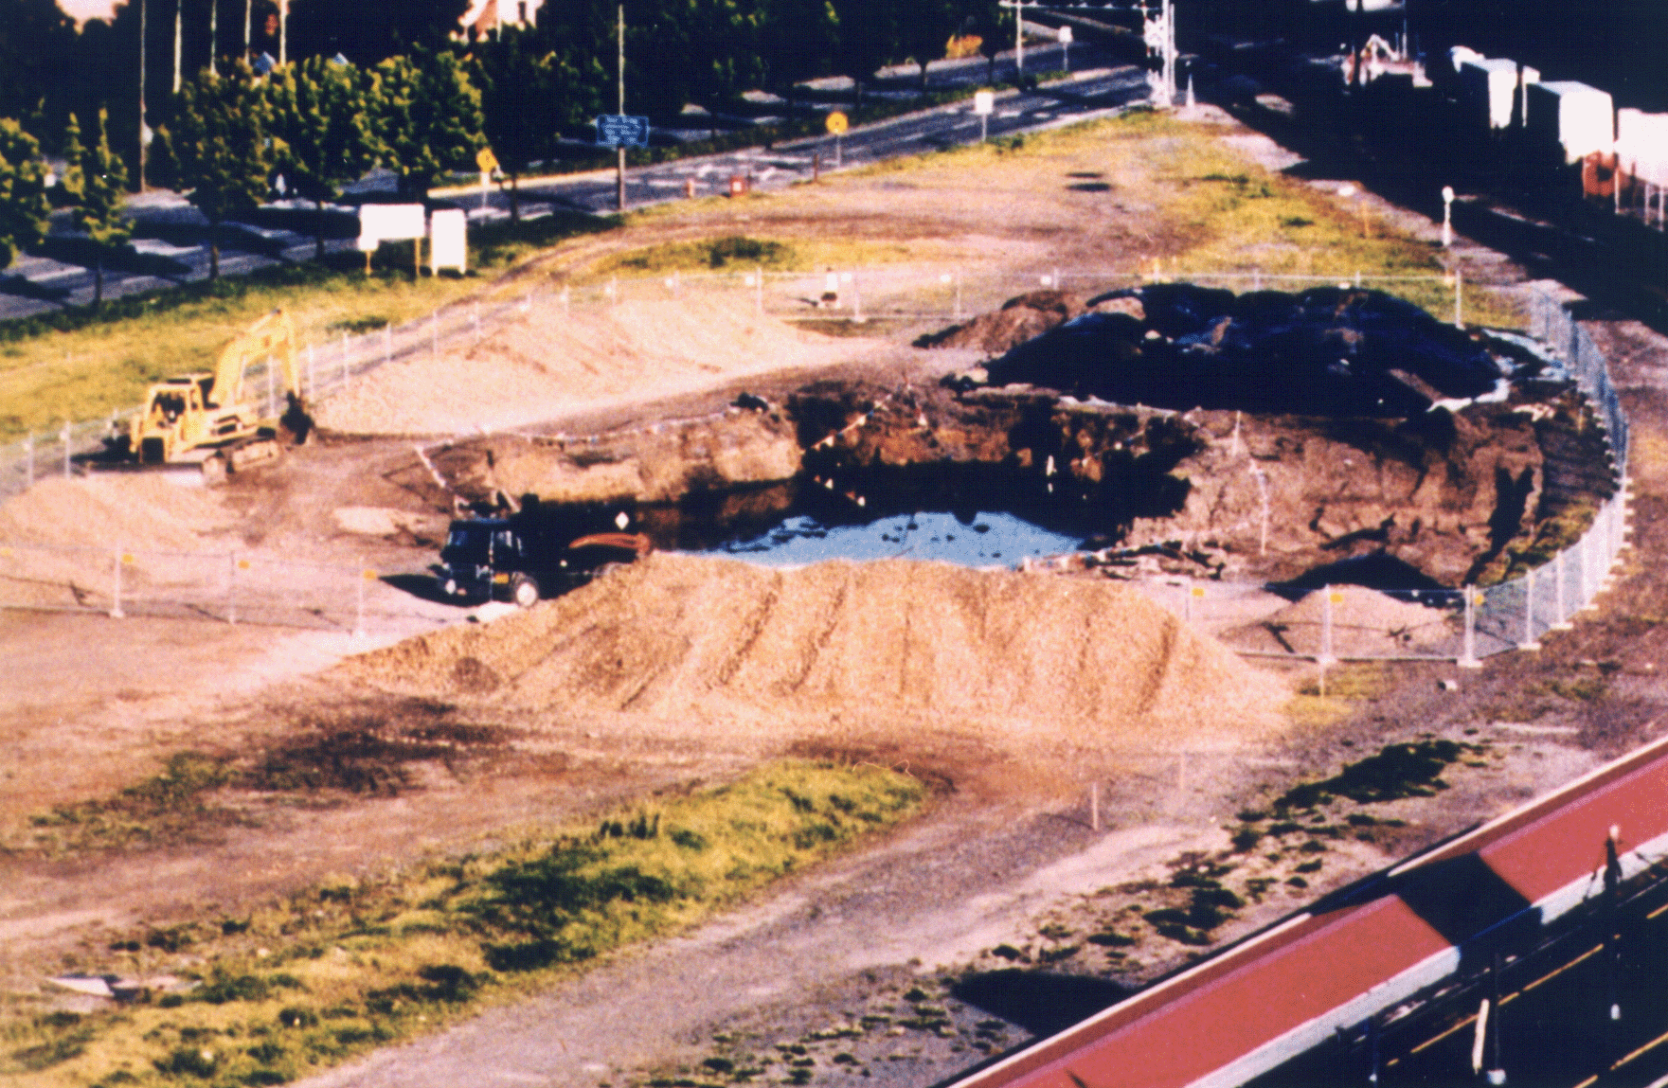
Crude Oil Soil Remediation

Slide 20
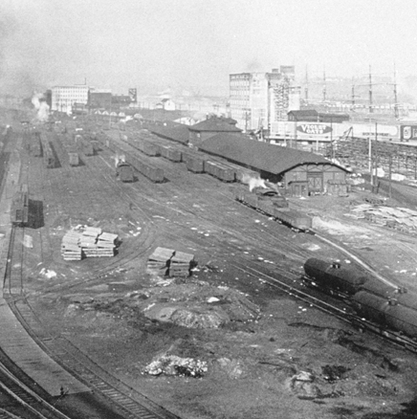
Site-Wide Soil Contamination
Lead, Arsenic and Fuel Hydrocarbons in Soil
Area Affected - Entire 6.1 acre site.
Corrective Action - Surface capping and institutional controls.

Slide 21
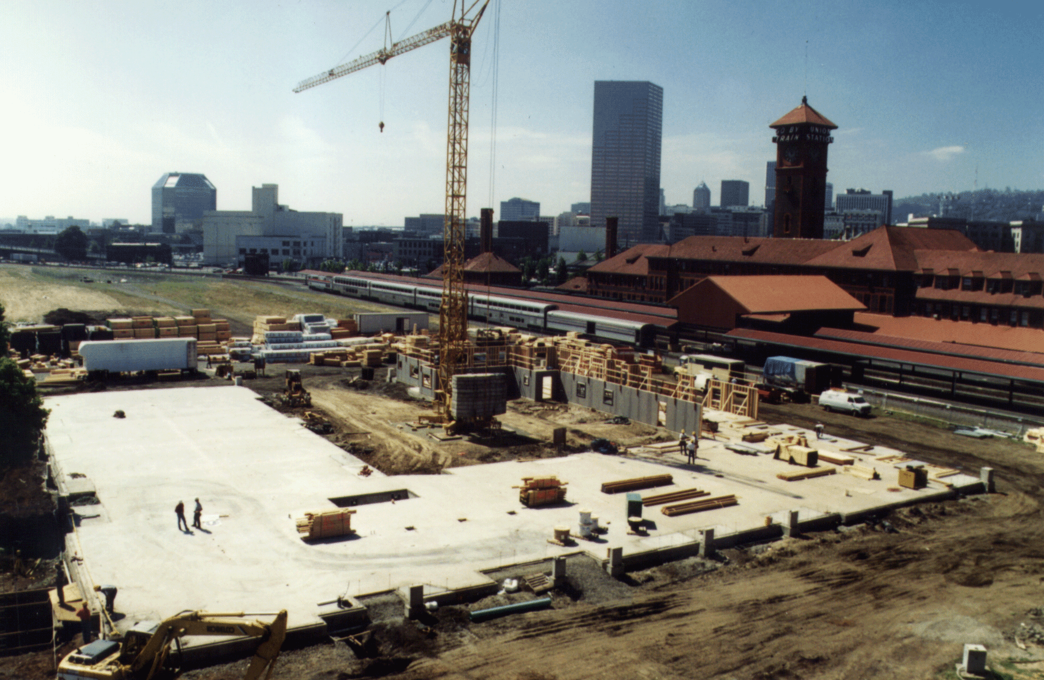
Surface Capping

Slide 22
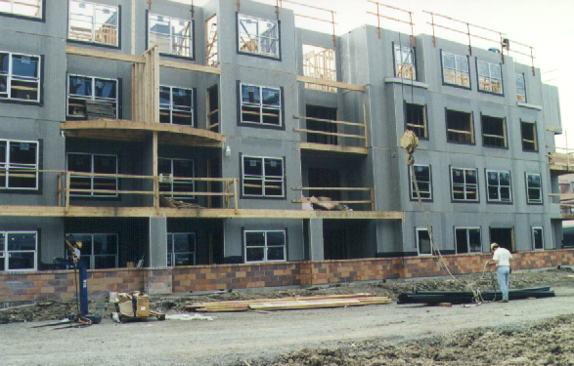
Cap Construction
Fabric “demarcation” layer over contaminated soil throughout site
Fabric covered with combination of soil, buildings and road
Yearly cap inspection required
Cap maintenance required “forever”

Slide 23
Phase A Housing
Project groundbreaking March 1997. Project completed in March 1998.
Consists of 158 units of housing. Half of units reserved for persons earning <50% of median income, and half reserved for persons earning <60% of median income.
Phase A Housing currently near 100% occupancy.

Slide 24
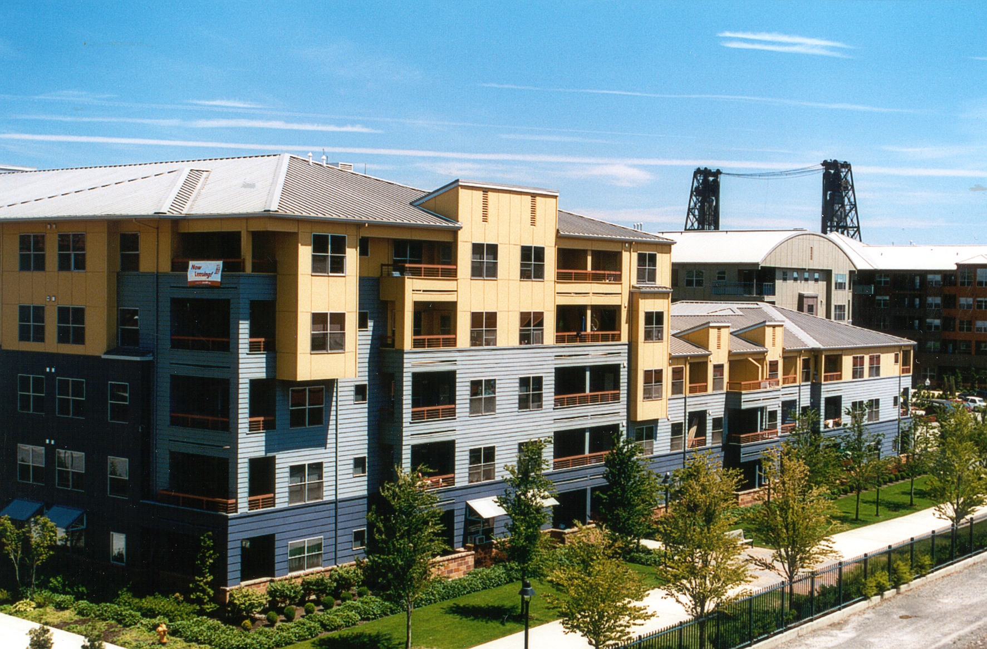
Phase A Housing

Slide 25
Phase B Housing
Project groundbreaking September 1998. Project completed in January 2000.
Consists of 321 units of housing. Forty percent of units reserved for persons earning <60% of median income, and the balance of units are market rate.
Phase B Housing currently near 100% occupancy.

Slide 26
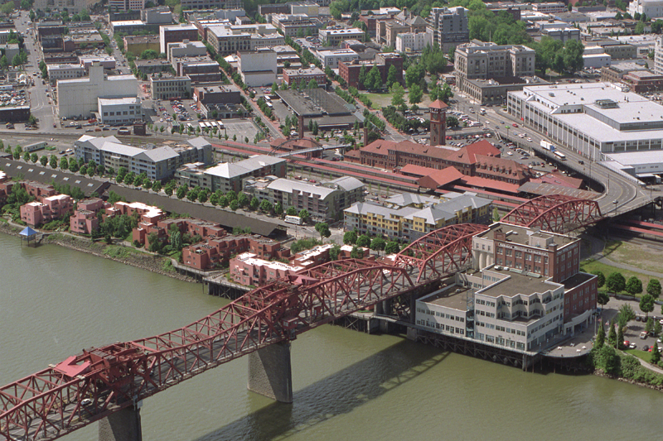
Phase B Housing

Slide 27
Cost-Sharing Arrangements
Site owner able to negotiate and execute cost recovery agreement with prior owner (railroad).
Out-of-pocket cost to current owner (City of Portland) for environmental assessment and remediation was $300,000.
Total project cost $2,650,000.

Slide 28
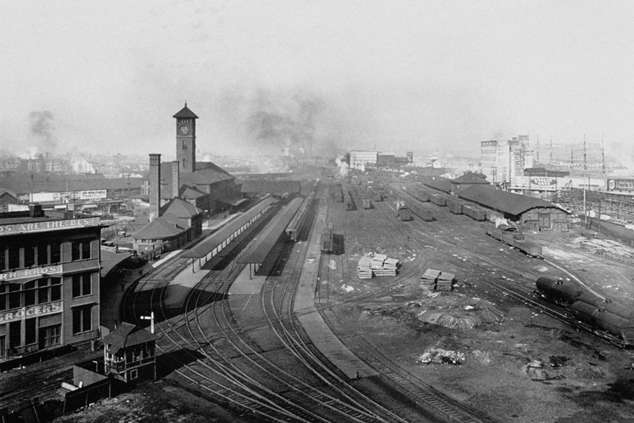
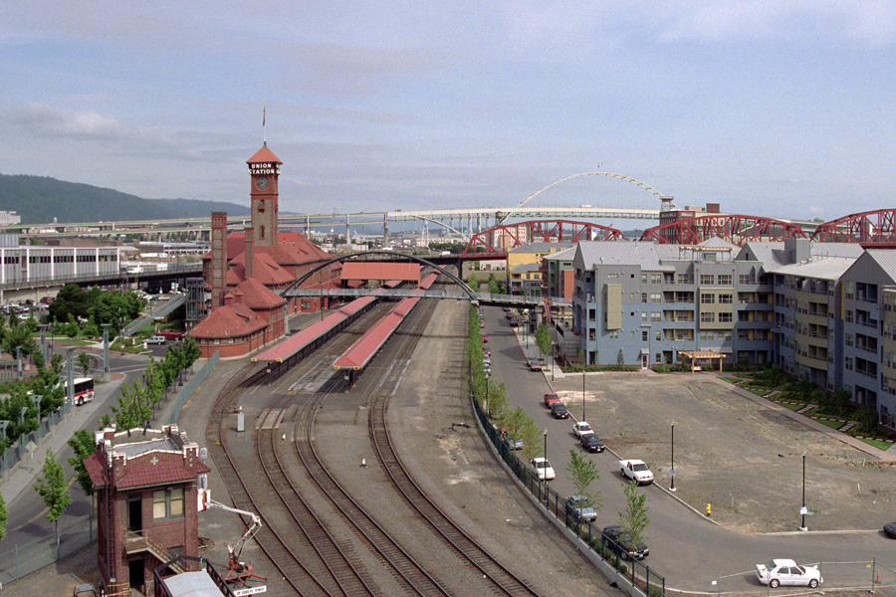

Slide 29
Cadet Manufacturing – A Non Award-Winning Cleanup Currently in Progress

Slide 30
CADET MANUFACTURING BACKGROUND
Heater manufacturing in late 1960s and early 1970s
Small operation (less than 5 acres)
Use and release of solvents including TCE for metal degreasing
Site vacant since 1970s. Contamination discovered in late 1990s during sewer line install through property
Voluntary Cleanup investigation started in 1998, included intensive negotiations with bankrupt Cadet insurers to get money for cleanup
$2.5 million settlement in 2001.

Slide 31
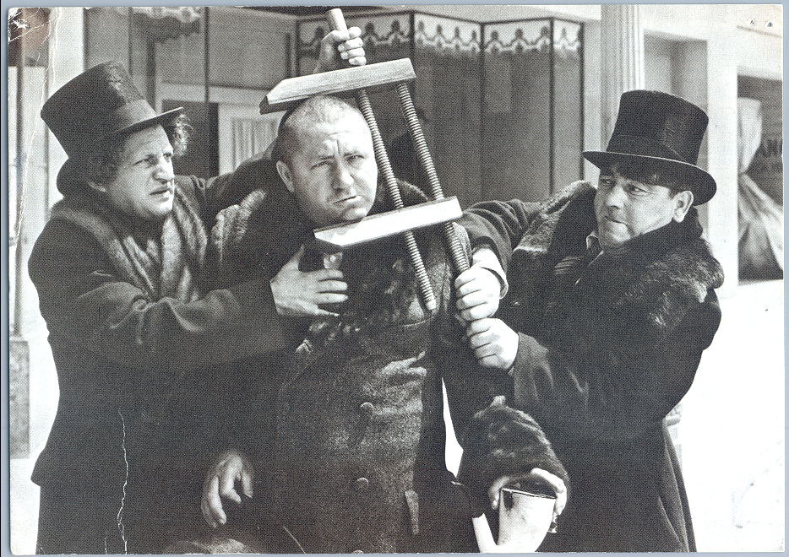
SETTLEMENT NEGOTIATIONS

Slide 32
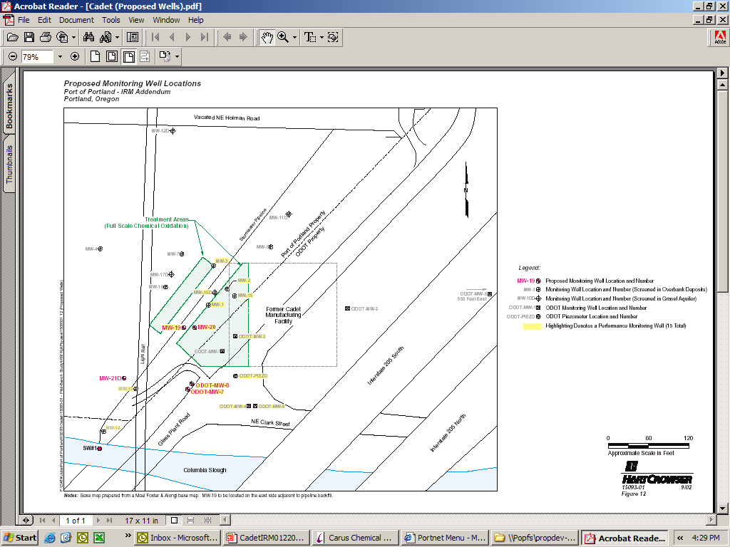
CADET SITE MAP

Slide 33
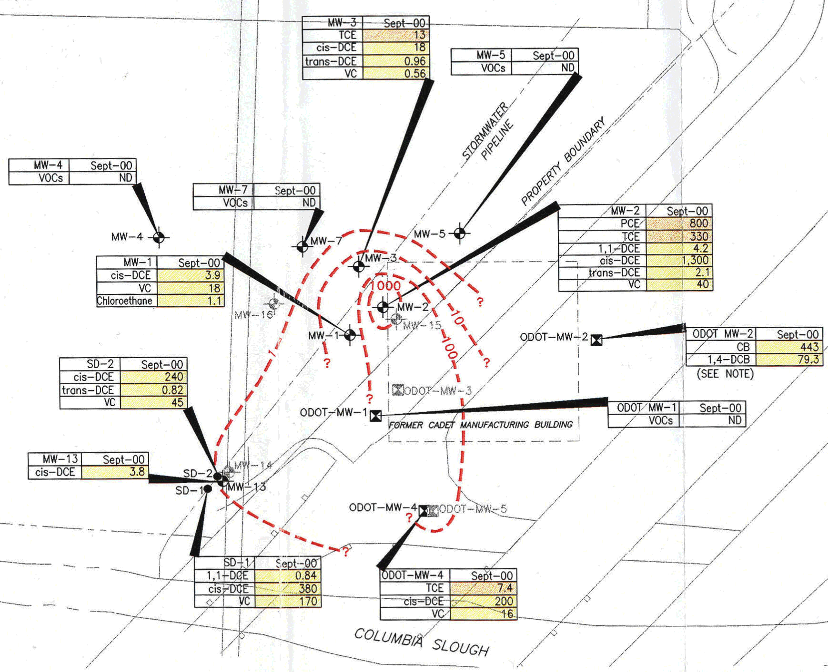
CADET GROUNDWATER CONTAMINATION

Slide 34
ENVIRONMENTAL ISSUES
High VOC (PCE, TCE, DCE, VC) groundwater contamination (6200 ppb PCE, 2300 ppb TCE)
Site adjacent to City of Portland backup wellfield
Drinking water aquifer present at 50’ below ground surface
Site groundwater discharges to Columbia River channel (Columbia Slough)

Slide 35
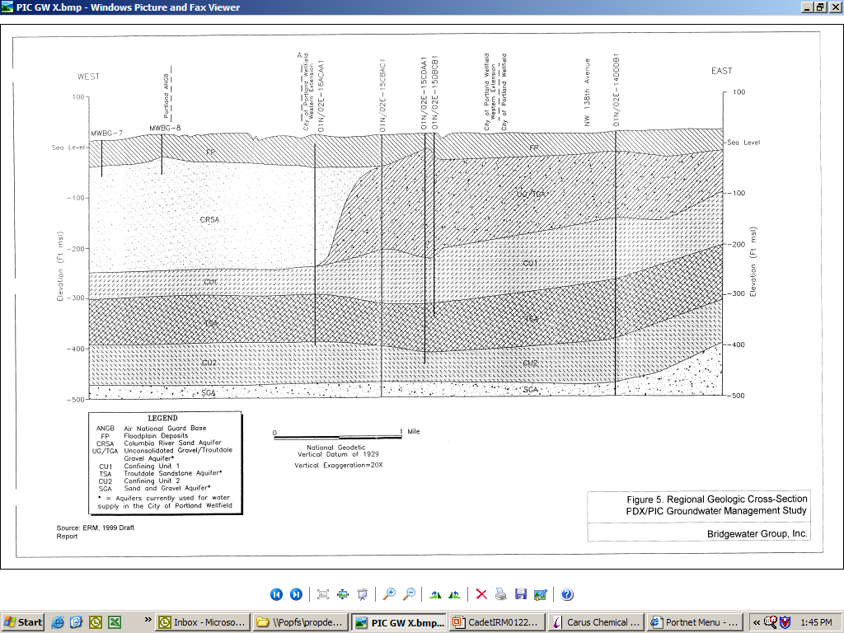
REGIONAL GEOLOGIC CROSS-SECTION

Slide 36
INTERIM REMEDIAL MEASURE
Based on presence of solvents and location in wellfield, DEQ determined that immediate action was necessary
Evaluation of wide variety of emergency treatment options performed
Chemical treatment with sodium permanganate selected
Chemical oxidation is an innovative, cost-effective and fast cleanup technology
Lab and field testing performed to determine if treatment will work, how much chemical to use and at what concentration

Slide 37
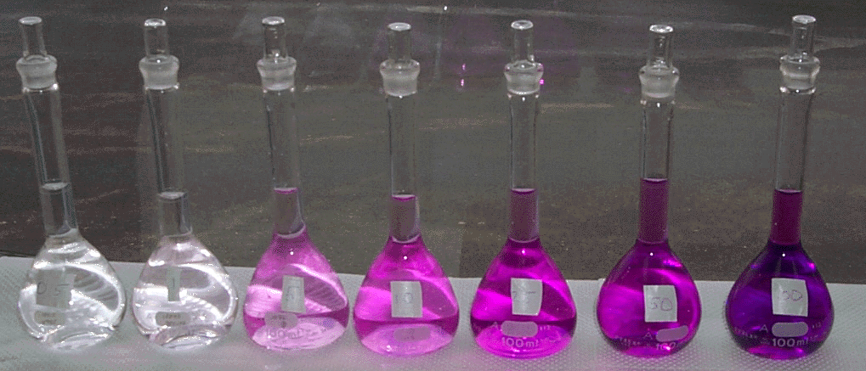
PERMANGANATE CONCENTRATIONS
0.5
1
5
10
25
50
100
Permanganate Concentration, milligrams KMnO₄ / Liter = ppm
Conversion Factors:
(milligrams KMnO₄ / Liter) x (0.8978) = (milligrams NaMnO₄ / Liter)
(milligrams KMnO₄ / Liter) x (0.7516) = (milligrams MnO₄⁻/ Liter)
Note: ppm x 10,000 = %
Notes:
Example:
A sample is dosed with 1 mg/L KMnO₄ and allowed to
react for 30 minutes.
At the end of that time, the residual KMnO₄ is 0.3 mg/L
The PV₃₀ for that sample is 0.7 mg/L
PV₃₀ = (1.0 mg/L - 0.3 mg/L) = 0.7mg/L

Slide 38


IN-SITU CHEMICAL OXIDATION
INJECTION PROCESS
Reagent is injected and occupies set volume
Reagent
Injection
Well
Monitoring
Well
Spread of
Reagent
Screened
Section
Residual
DNAPL
Water Table
Contaminated
Aquifer
Groundwater Flow Direction

Slide 39
TREATMENT DESIGN
Concentration - 200 g/L NaMnO4 in water solution
43 injection points, spaced 15’ radially, in high contamination areas
Injection interval depths every 5’
Inject 200 gallons of NaMnO4 per injection interval, total 800 to 1,000 gallons per location
57,300 pounds of sodium permanganate
Permanganate health and safety issues.
Only one manufacturer – delivered by tanker from Illinois
Injections completed February 2003

Slide 40
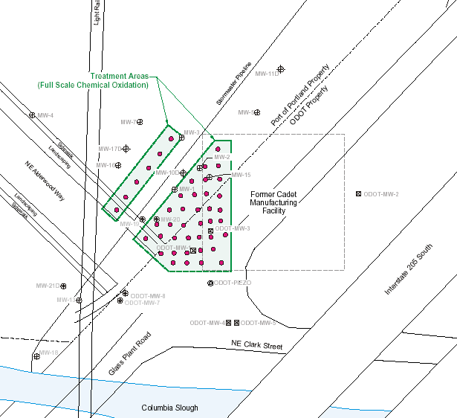
CHEMICAL OXIDATION
TREATMENT AREAS

Slide 41
FUTURE CADET ACTIVITIES
Cost of Phase 1 treatment $450,000 including $320,000 for chemicals
Preliminary results mixed – good results in upper unit, not so good lower
Delivery of chemical to treatment area is critical, difficult in fine-grained soil
Based on results, treatment will likely be needed, will consider tretment to stimulate natural biologic breakdown (anaerobic bacteria)

Slide 42
Case Summary:
Electrical Resistance Heating
ICN Pharmaceuticals, Inc.
Portland, Oregon
Notes:
Why don’t we just remove all the DNAPL source material? The answer is that it’s never easy and sometimes not possible with existing technologies.
Lack of reliable cost and performance data is often cited as a major impediment to deploying innovative source removal technologies like electrical resistance heating. Here we have a classic “chicken or the egg” scenario (or is it a “Catch 22”?) By definition, an innovative technology is one that is lacking in either cost or performance data (or both) – if this information were known, then the technology would no longer be innovative. Innovation also implies risk – if there was no risk, there would be a lot more innovators! Cost and performance data will come as the technologies are used, instrumented, and accepted. As shown in the previous slide, the DNAPL Team is currently tracking some 20 case examples where innovative DNAPL remediation technologies are being used and obtaining cost and performance data is a high priority.
Most DNAPL remediation technologies work by making the DNAPL more mobile which raises concerns that the DNAPL could migrate in an uncontrolled manner. This concern can be addressed during design of the remediation system, for example by maintaining hydraulic containment using pumping wells or other means. Our experience in looking at these sites and talking with regulators and technology vendors is that uncontrolled migration is not a common occurrence.
The uncertain benefit of partial source removal, in particular how groundwater will respond to mass removal, is probably the biggest reason why problem holders and regulators are hesitant to go after DNAPL sources more aggressively. The way in which we manage this uncertainty has political and societal implications. For instance, removing 85% of the DNAPL mass certainly sounds good, but if it ultimately means that you will only have to pump & treat for 100 years instead of 500 years, then is it worth the effort? EPA’s Technology Innovation Office (TIO), the U.S. Army Environmental Center, and other federal agencies, are currently funding studies to evaluate this question.
Fear of failure is always a key reason that promising innovative technologies are not considered as a remedial option and DNAPL source reduction technologies are no different. Regulators, consultants, PRPs – we all have nothing to lose by playing it safe and doing what everyone else does – even if it may not be the best thing to do. We hear the concern of PRPs that they will be asked to invest in one of these expensive DNAPL source removal technologies AND still be required to operate their pump and treat systems for an indefinite amount of time. Regulators are beginning to understand this dilemma and are seeing the benefit of being more flexible in setting remedial action objectives and establishing exit criteria in order to see more aggressive action take place at their sites.

Slide 43
Site Background
ICN Pharmaceuticals, Inc. joined DEQ’s Voluntary Cleanup Program in 1992
Former clinical laboratory: 1960-1980
Primary contaminants: chlorinated solvents (TCE and daughter compounds) as well as benzene and toluene
Former dry well considered source of groundwater contamination - suspected DNAPLs present
Site located in Portland Wellfield, many nearby wells
Notes:
Why don’t we just remove all the DNAPL source material? The answer is that it’s never easy and sometimes not possible with existing technologies.
Lack of reliable cost and performance data is often cited as a major impediment to deploying innovative source removal technologies like electrical resistance heating. Here we have a classic “chicken or the egg” scenario (or is it a “Catch 22”?) By definition, an innovative technology is one that is lacking in either cost or performance data (or both) – if this information were known, then the technology would no longer be innovative. Innovation also implies risk – if there was no risk, there would be a lot more innovators! Cost and performance data will come as the technologies are used, instrumented, and accepted. As shown in the previous slide, the DNAPL Team is currently tracking some 20 case examples where innovative DNAPL remediation technologies are being used and obtaining cost and performance data is a high priority.
Most DNAPL remediation technologies work by making the DNAPL more mobile which raises concerns that the DNAPL could migrate in an uncontrolled manner. This concern can be addressed during design of the remediation system, for example by maintaining hydraulic containment using pumping wells or other means. Our experience in looking at these sites and talking with regulators and technology vendors is that uncontrolled migration is not a common occurrence.
The uncertain benefit of partial source removal, in particular how groundwater will respond to mass removal, is probably the biggest reason why problem holders and regulators are hesitant to go after DNAPL sources more aggressively. The way in which we manage this uncertainty has political and societal implications. For instance, removing 85% of the DNAPL mass certainly sounds good, but if it ultimately means that you will only have to pump & treat for 100 years instead of 500 years, then is it worth the effort? EPA’s Technology Innovation Office (TIO), the U.S. Army Environmental Center, and other federal agencies, are currently funding studies to evaluate this question.
Fear of failure is always a key reason that promising innovative technologies are not considered as a remedial option and DNAPL source reduction technologies are no different. Regulators, consultants, PRPs – we all have nothing to lose by playing it safe and doing what everyone else does – even if it may not be the best thing to do. We hear the concern of PRPs that they will be asked to invest in one of these expensive DNAPL source removal technologies AND still be required to operate their pump and treat systems for an indefinite amount of time. Regulators are beginning to understand this dilemma and are seeing the benefit of being more flexible in setting remedial action objectives and establishing exit criteria in order to see more aggressive action take place at their sites.

Slide 44
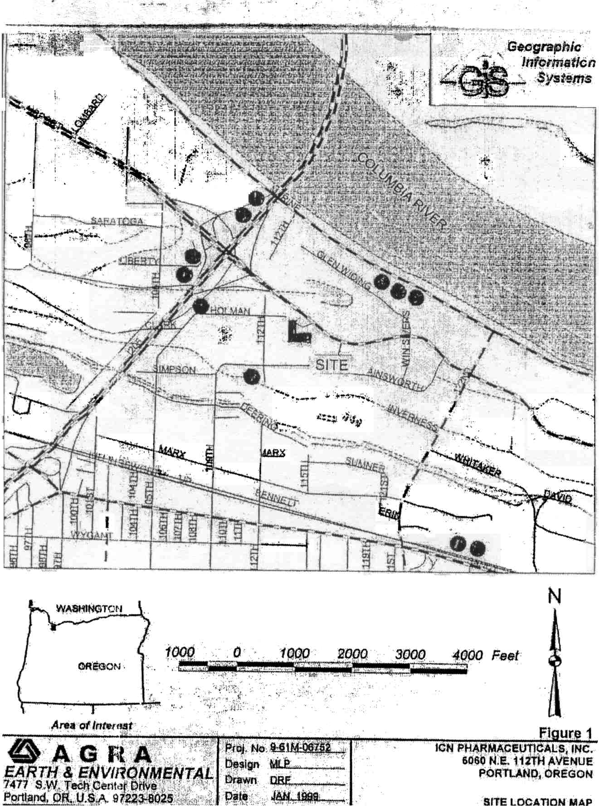
Site Proximity to City Wells

Slide 45
Site Geology
Fine-grained “Overbank Deposits” to 60 ft bgs
Gravels (Troutdale Gravels) from 60 to 220 feet bgs represent uppermost drinking water aquiferandTroutdale Gravel Aquifer consisting of unconsolidated and cemented gravels (approx. 175 ft thick)

Slide 46
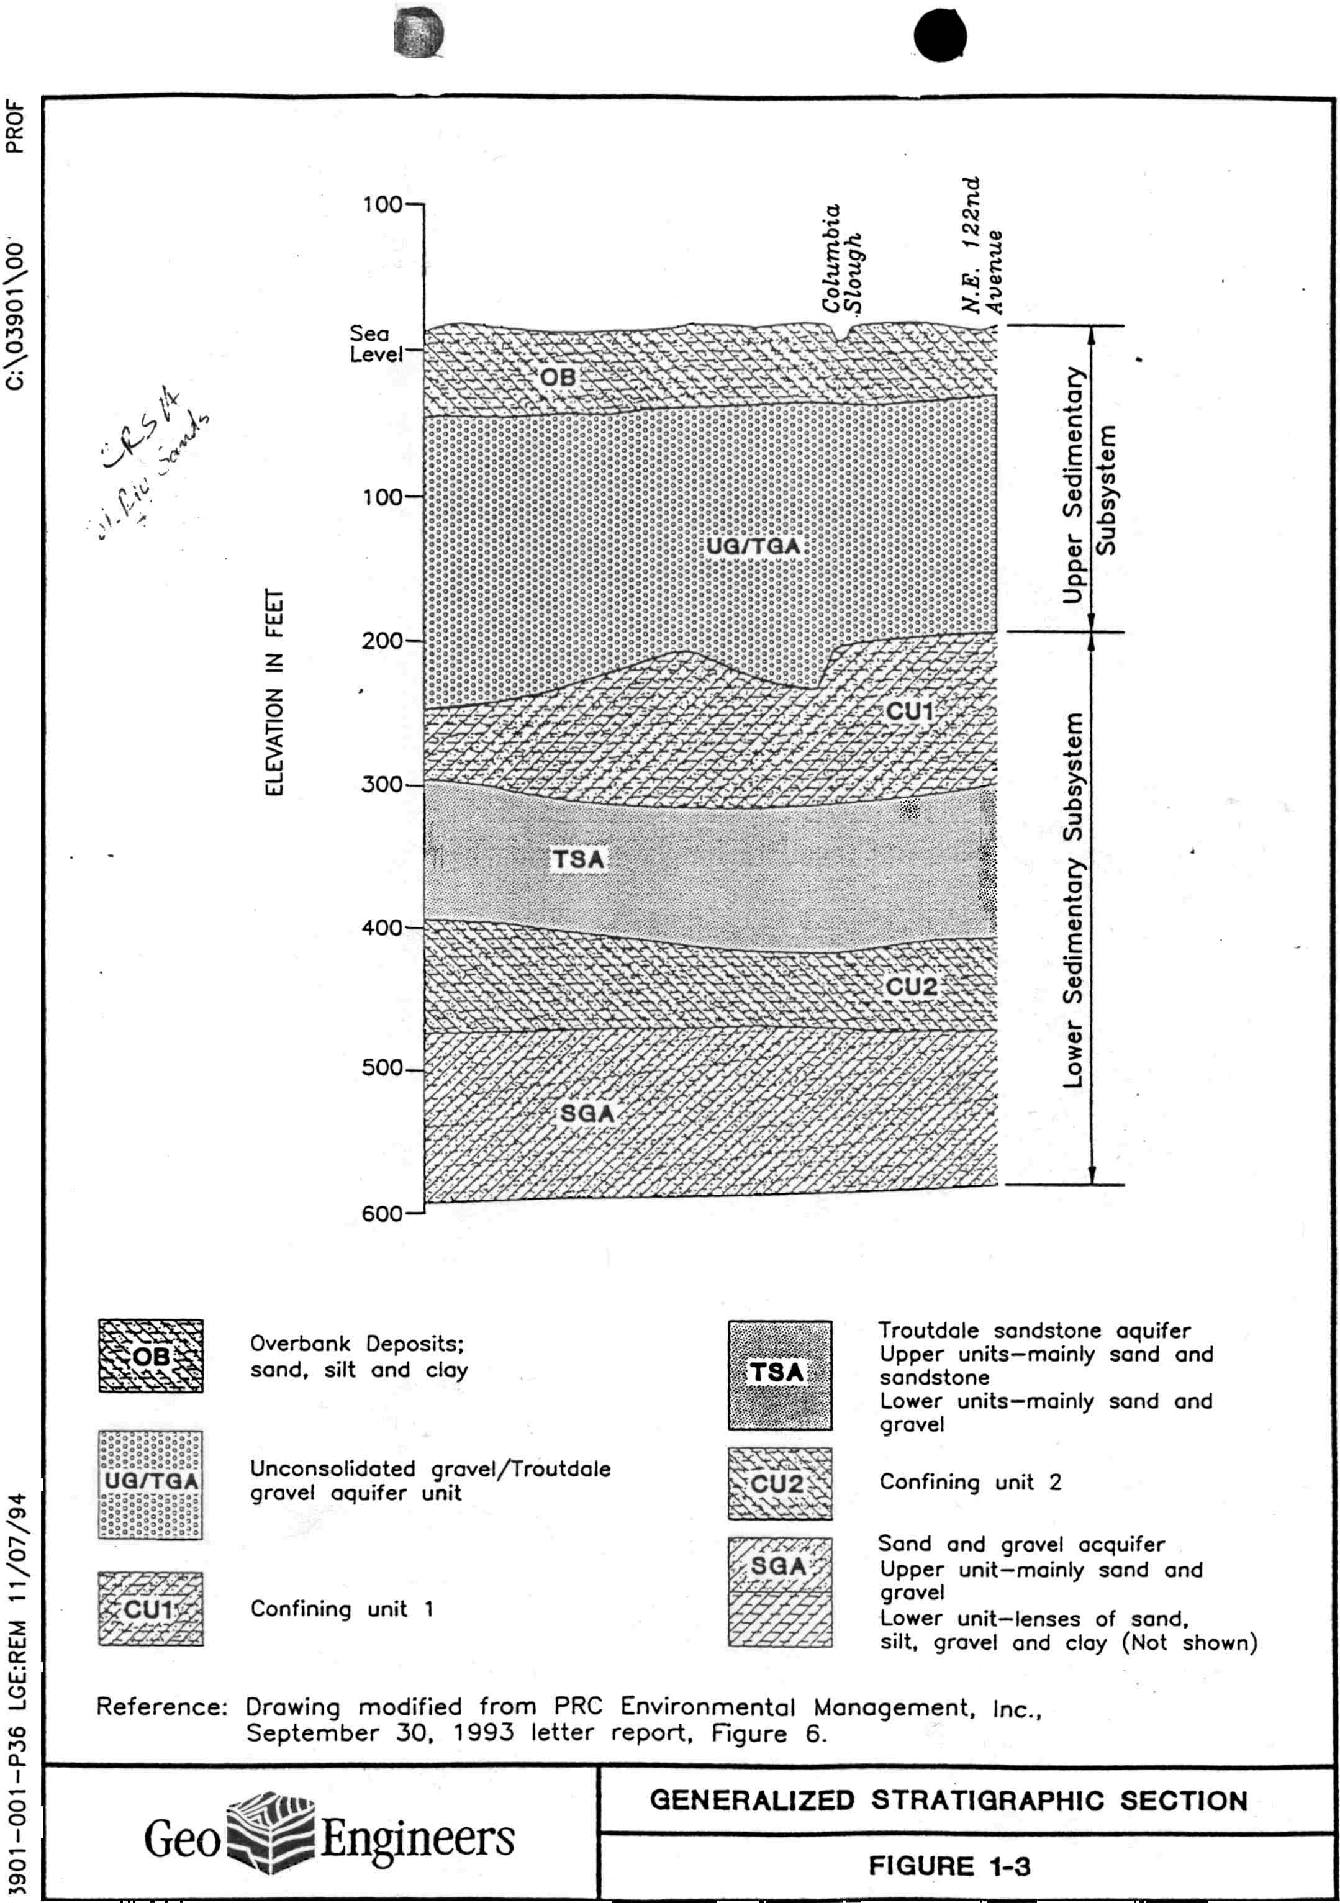
Stratigraphic Cross-Section

Slide 47
Source Zone Description
Very high concentrations of solvents (to 250,000 ppb) including area of residual free product (DNAPL)
Free product zone 120 by 80 ft oblong centered on former dry well
Contamination extending to >100 feet below ground surface and drinking water aquifer
Between 1992 and present, many of phases of soil and groundwater investigation completed including installation of 60+ wells, some as deep as 200 feet
Nearly all contamination determined to have migrated to groundwater, mostly present in shallow silts

Slide 48
Remedial Approach
Electrical resistive heating selected as interim action
Operational strategy
  Deliver electrical current to metal probes installed to 50 feet throughout site
  Boil groundwater to 100C and vaporize contaminants
  Collect vapors in vapor extraction system at surface
Other treatment options not expected to work, too slow, or too expensive

Slide 49
Treatment System
Initial system: 60 electrodes, 53 vapor extraction points, 13 pressure monitoring points, 8 thermocouple strings, and 950 kW transformer
Later expanded to include 13 additional electrodes and 67 “electrode vents”, plus instrumentation
SVE system recovers contaminants in multiple phases (steam/vapors/liquids) and separates into liquid and vapor streams for treatment and discharge

Slide 50
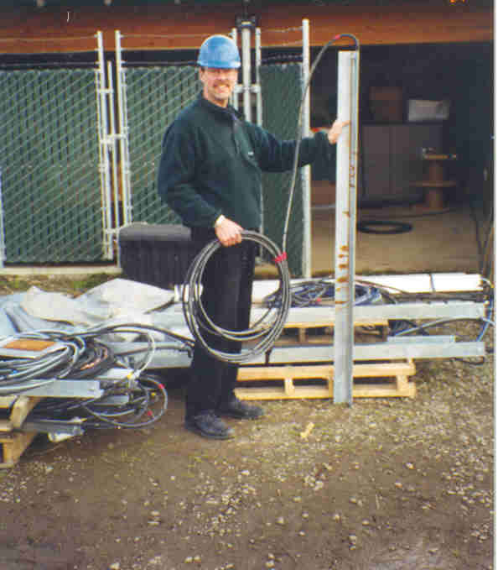

Slide 51
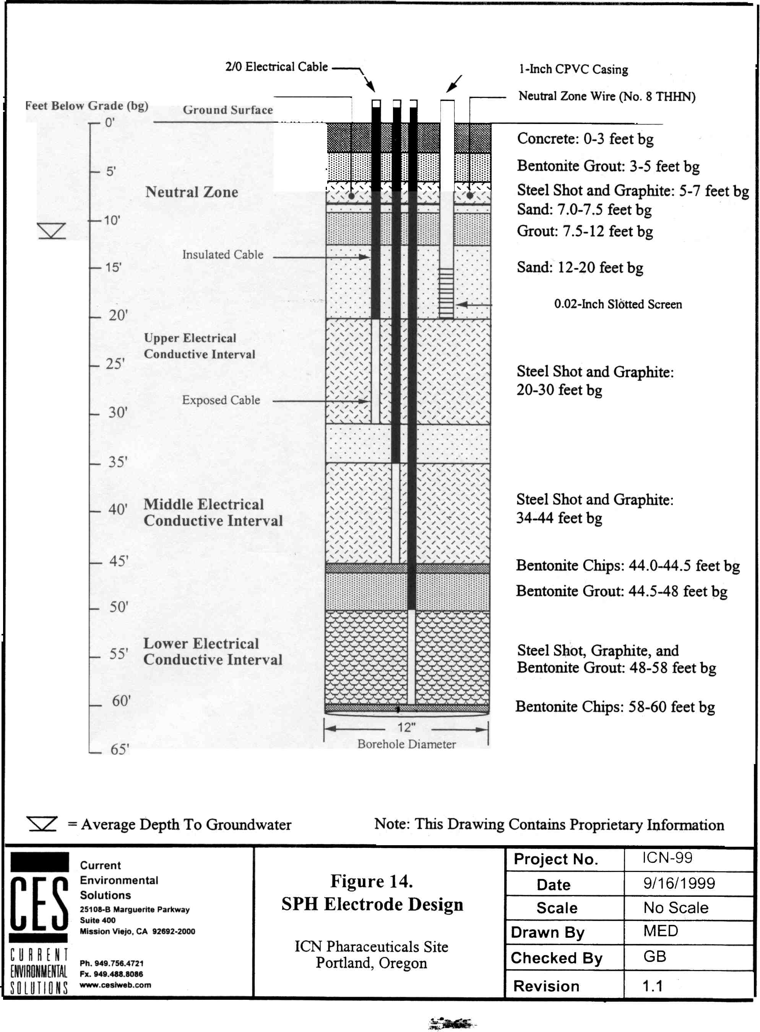

Slide 52
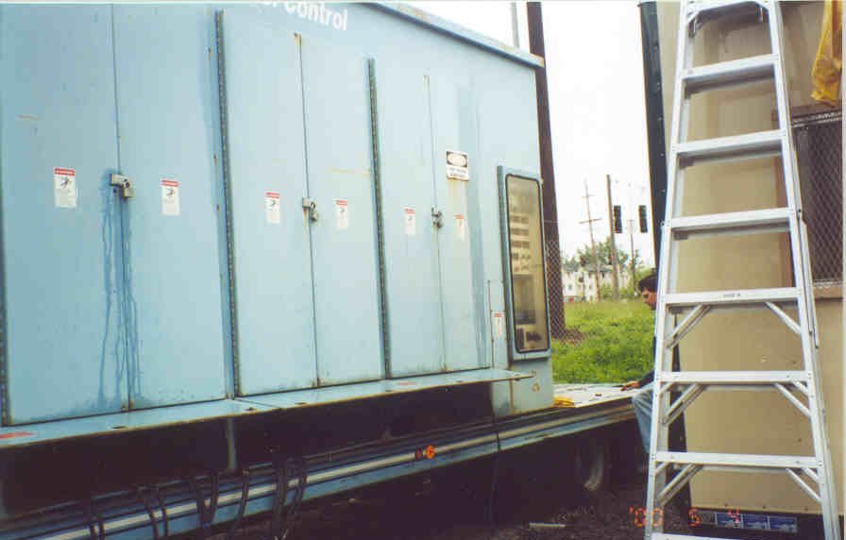

Slide 53
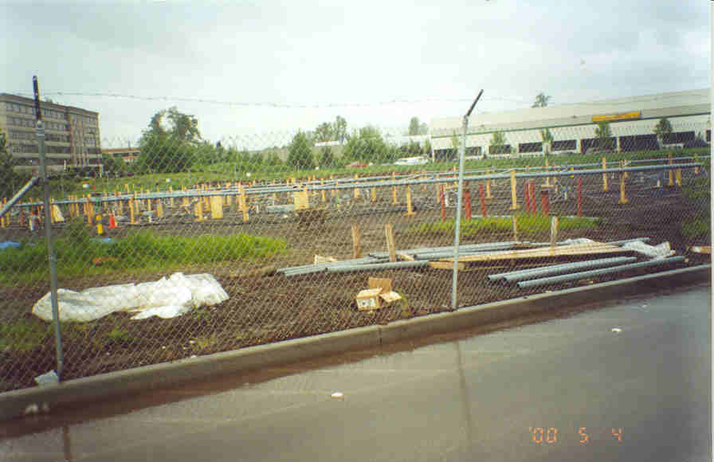

Slide 54
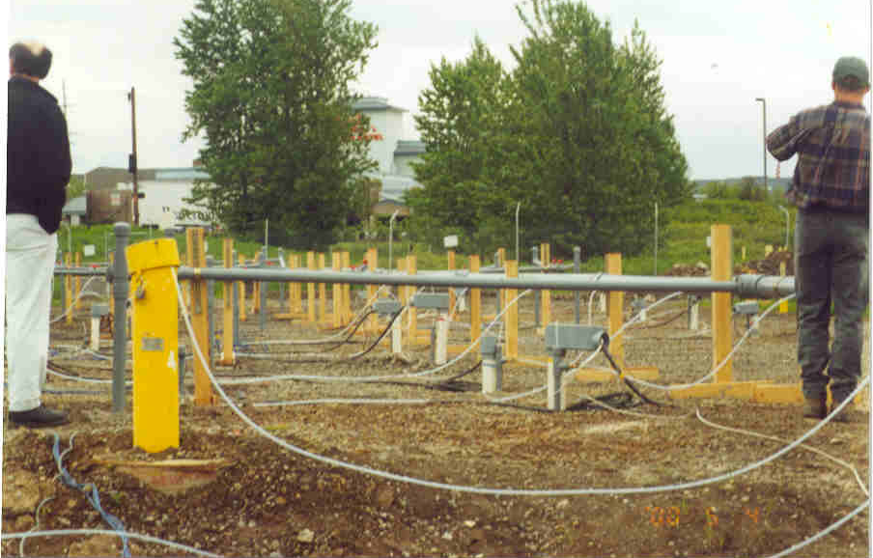

Slide 55
Problems
Movement of steam in subsurface erratic, short-circuiting to surface
Sampling of very hot water for groundwater monitoring dangerous/difficult
Failure (melting) of monitoring well casing despite use of heat-resistant inserts
Work completed during energy shortage. Electricity costs very high

Slide 56
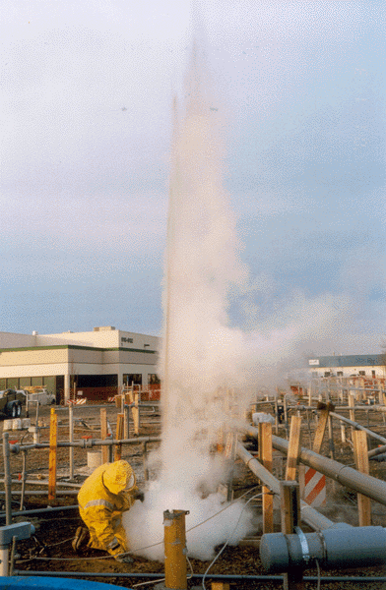
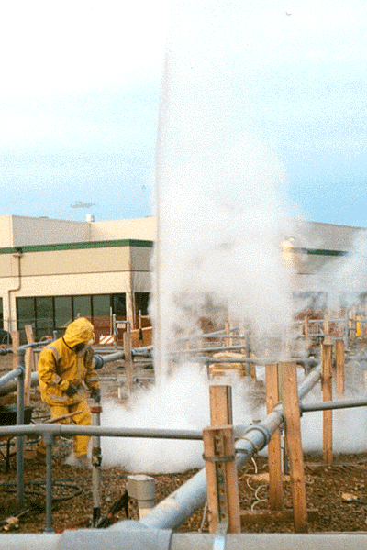
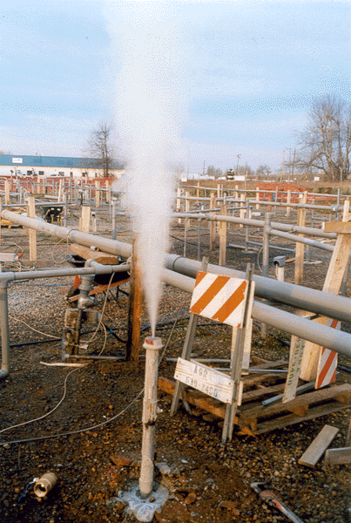
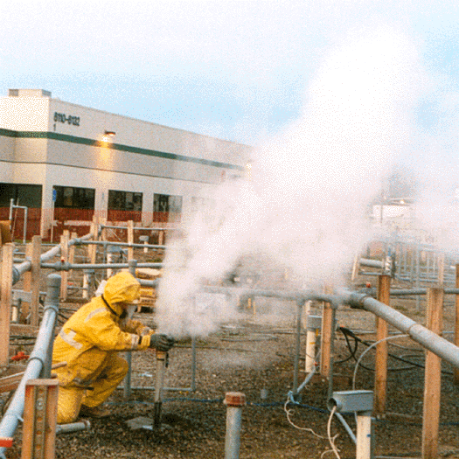

Slide 57
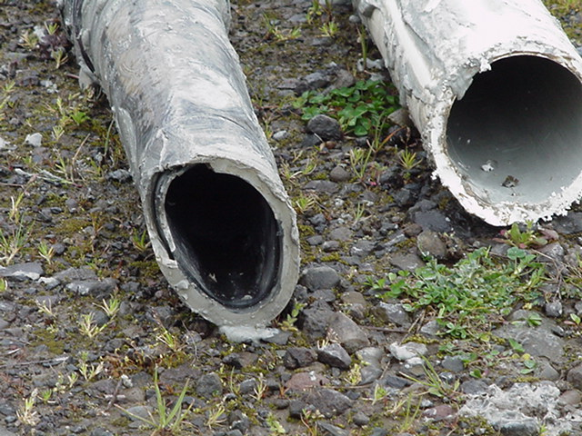

Slide 58
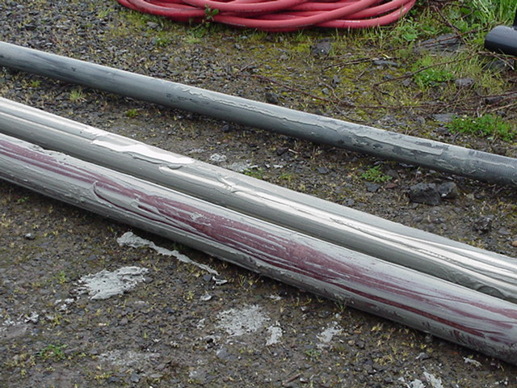

Slide 59
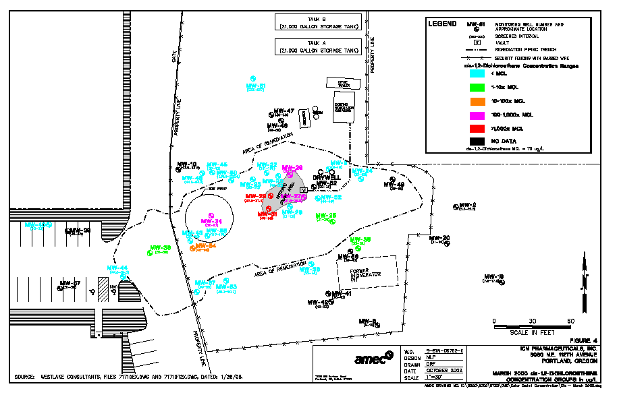

Slide 60
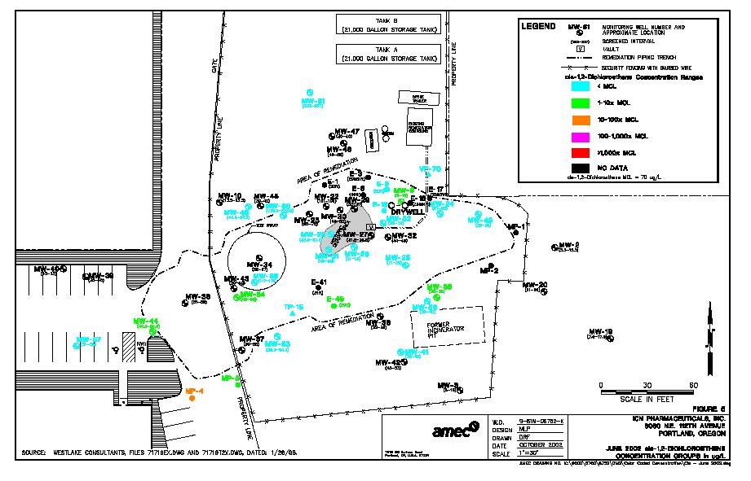

Slide 61
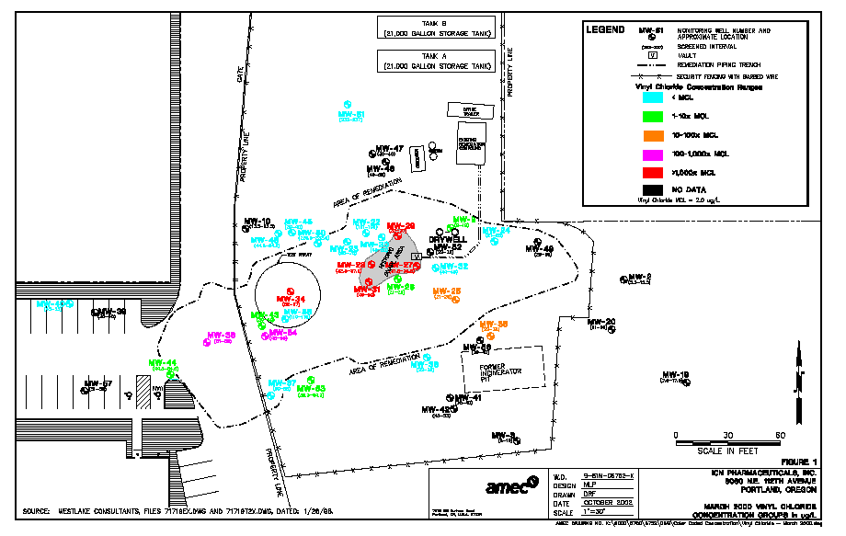

Slide 62
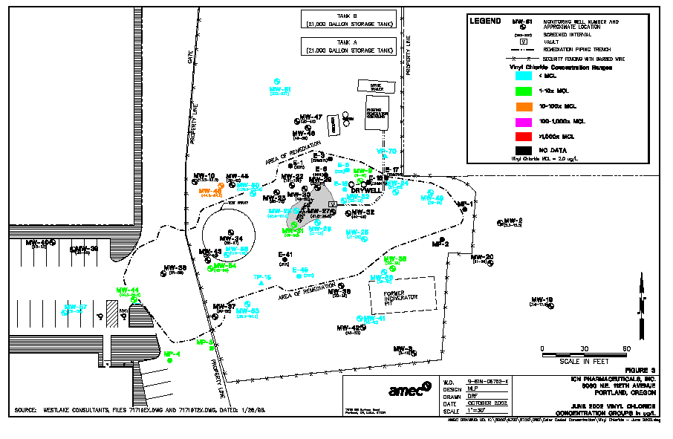

Slide 63
Analysis
Heating system operated for approximately one year, much longer than expected
Currently using existing infrastructure to complete a “polishing” step to get rid of remaining contamination – biosparging
Approx. 96 gallons of total VOCs recovered, much more eliminated by biodegradation enhanced by heat (thermophilic bacteria)
Free product completely removed, one of first successful “in-situ” treatments of DNAPL in country
Cost pretty high – probably $2+ million

