Slide 1
Local and Downstream Impacts of Contemporary Forest Practices on Sediment Yield
A Skaugset, N Zegre, A Simmons,
& H Owens

Slide 2
Cast of Characters
Amy Simmons
Alex Irving
Nic Zegre
Dennis Feney
Tim Royer
Emily Sinkhorn
Matt Meadows
Chris Surfleet

Slide 3
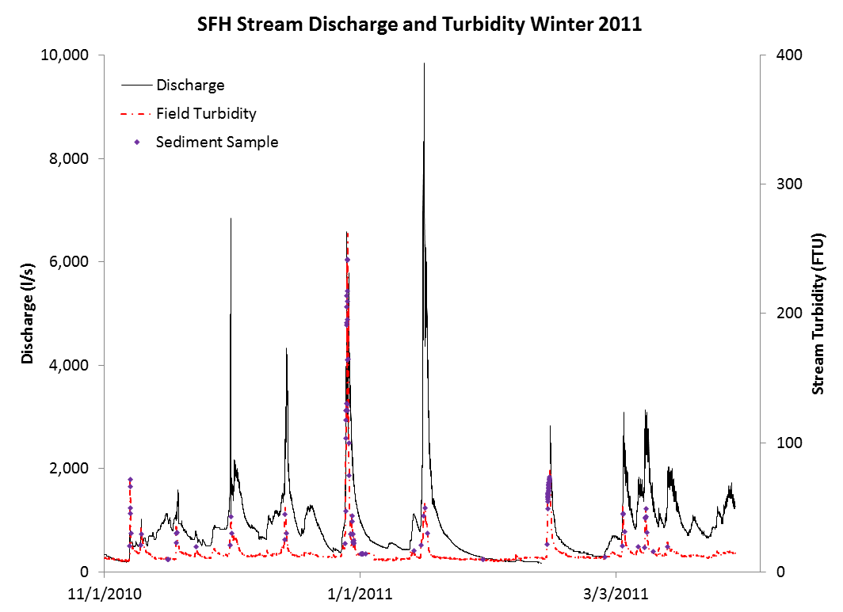

Slide 4
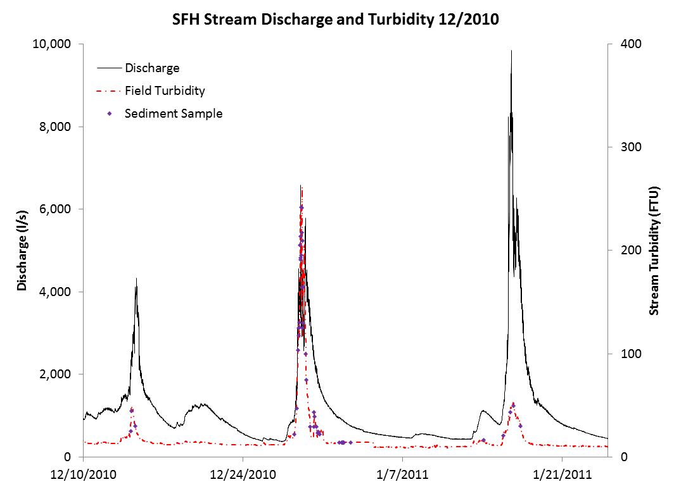

Slide 5
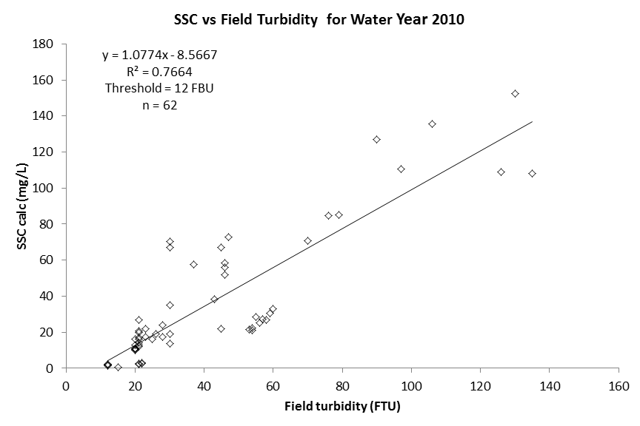

Slide 6
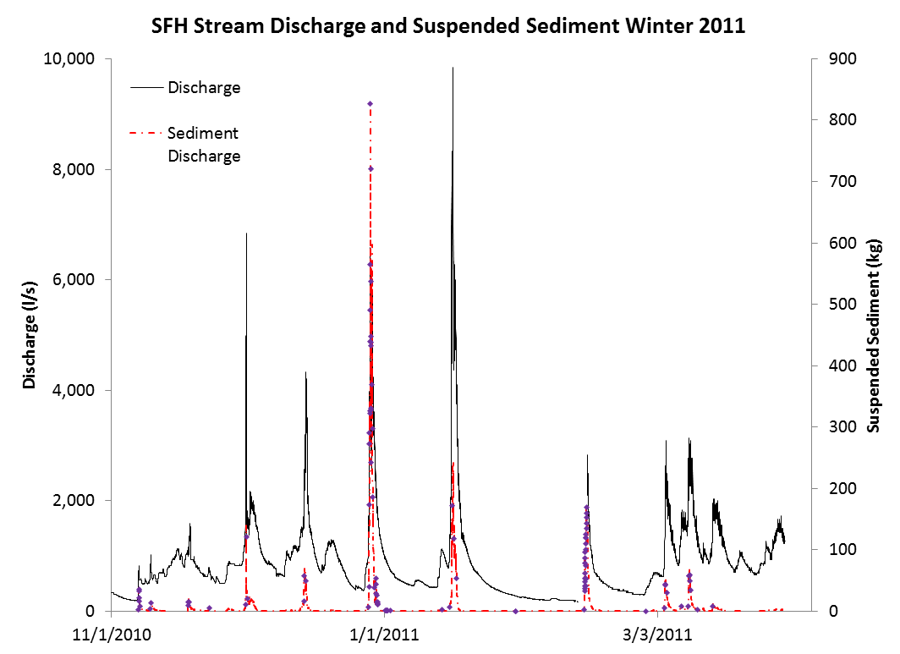

Slide 7
Sediment Yield Calculations
Discharge is very important to the calculation of sediment yield.
Sediment yield is highly skewed to the few days with the greatest discharge.
Sediment yield will be highly correlated to discharge.
Increases in water yield should correlate with increases in sediment yield.

Slide 8
Regional Sediment Yield Values
Watershed Study | Year of data collection | Sediment Yield (kg/ha/yr)
HJ Andrews – WS2 | 57-76 | 18.4
Coyote Creek – WS4 | 66-79 | 76.5
Alsea – Flynn Creek | 59-73 | 162
Caspar Creek - NFC | 63-76 | 295
NFH | WY05 | 117
NFH | WY07 | 554
NFH | WY10 | 65
NFH | WY11 | 259
NFH - Ave | 05-11 | 249

Slide 10
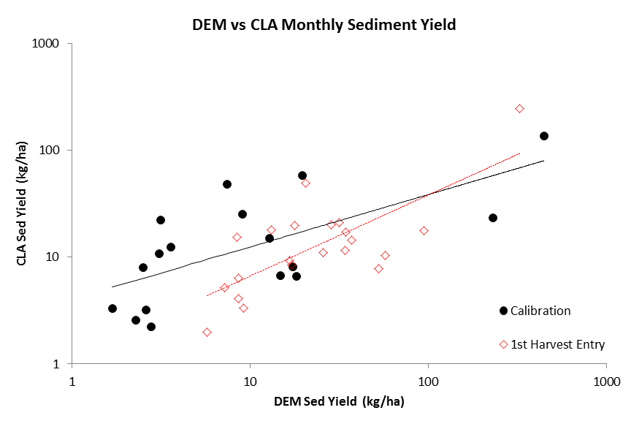

Slide 11
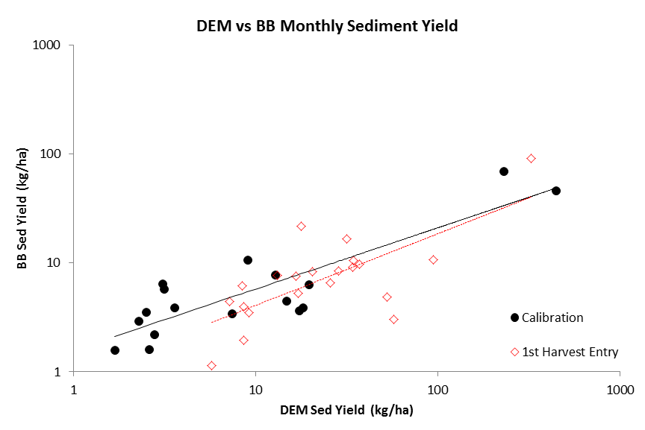

Slide 12
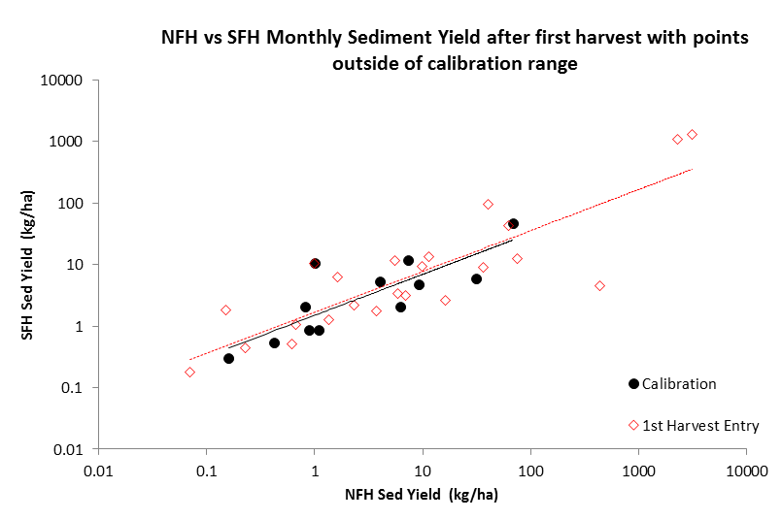

Slide 13
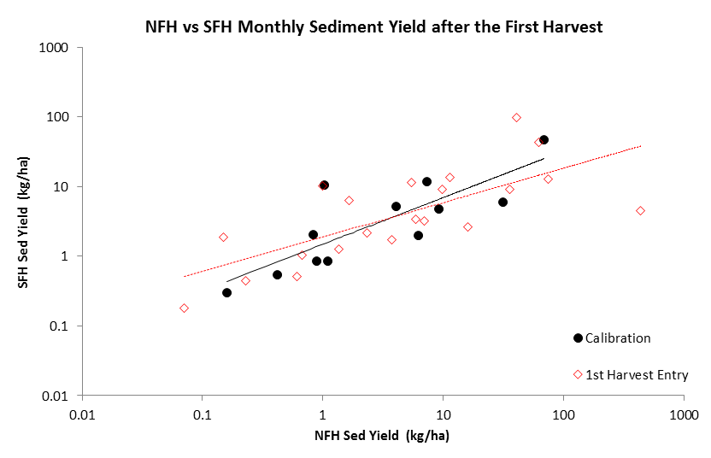

Slide 15
Watershed Study Sediment Yield Results
Watershed Study | Increase in Sediment Yield (kg/ha/yr) | Increase (%)
HJ Andrews – WS1 | 86 | 420
HJ Andrews – WS3 | 802 | 3,900
Alsea – Needle Branch | 251 | 325
Alsea – Deer Creek | 183 | 123
Caspar Creek - SF | 1,475 (1st yr increase) | 335
Caspar Creek - SF | 2,510 (6 yr increase) | 212
Caspar Creek - NF | 188 | 89

Slide 17
Sediment Yield Results
Sediment yield results from contemporary forest practices are not consistent with the findings in the seminal literature.
Historically, sediment yield has doubled or tripled or greater vs contemporary increases in the 20 to 40% range.
Why is that?

Slide 18
Buffer strips

Slide 19
Clearcut size limits and adjacency constraints

Slide 20
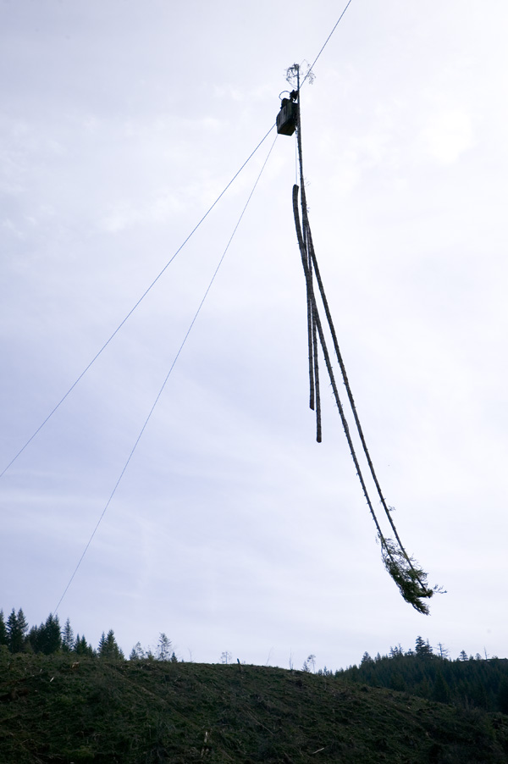
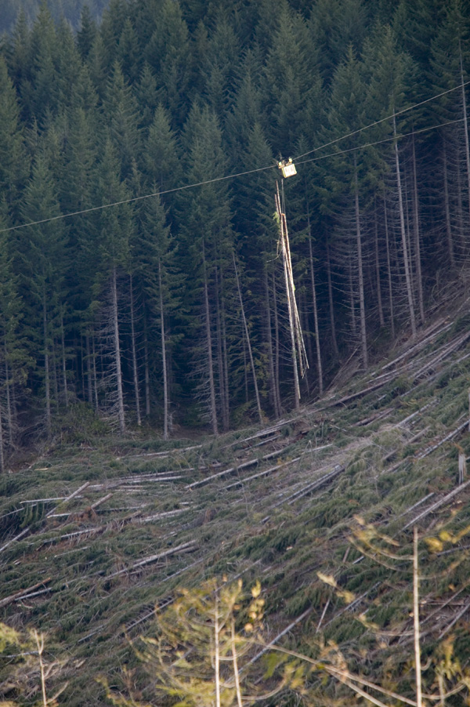
Skyline Logging Systems

Slide 21
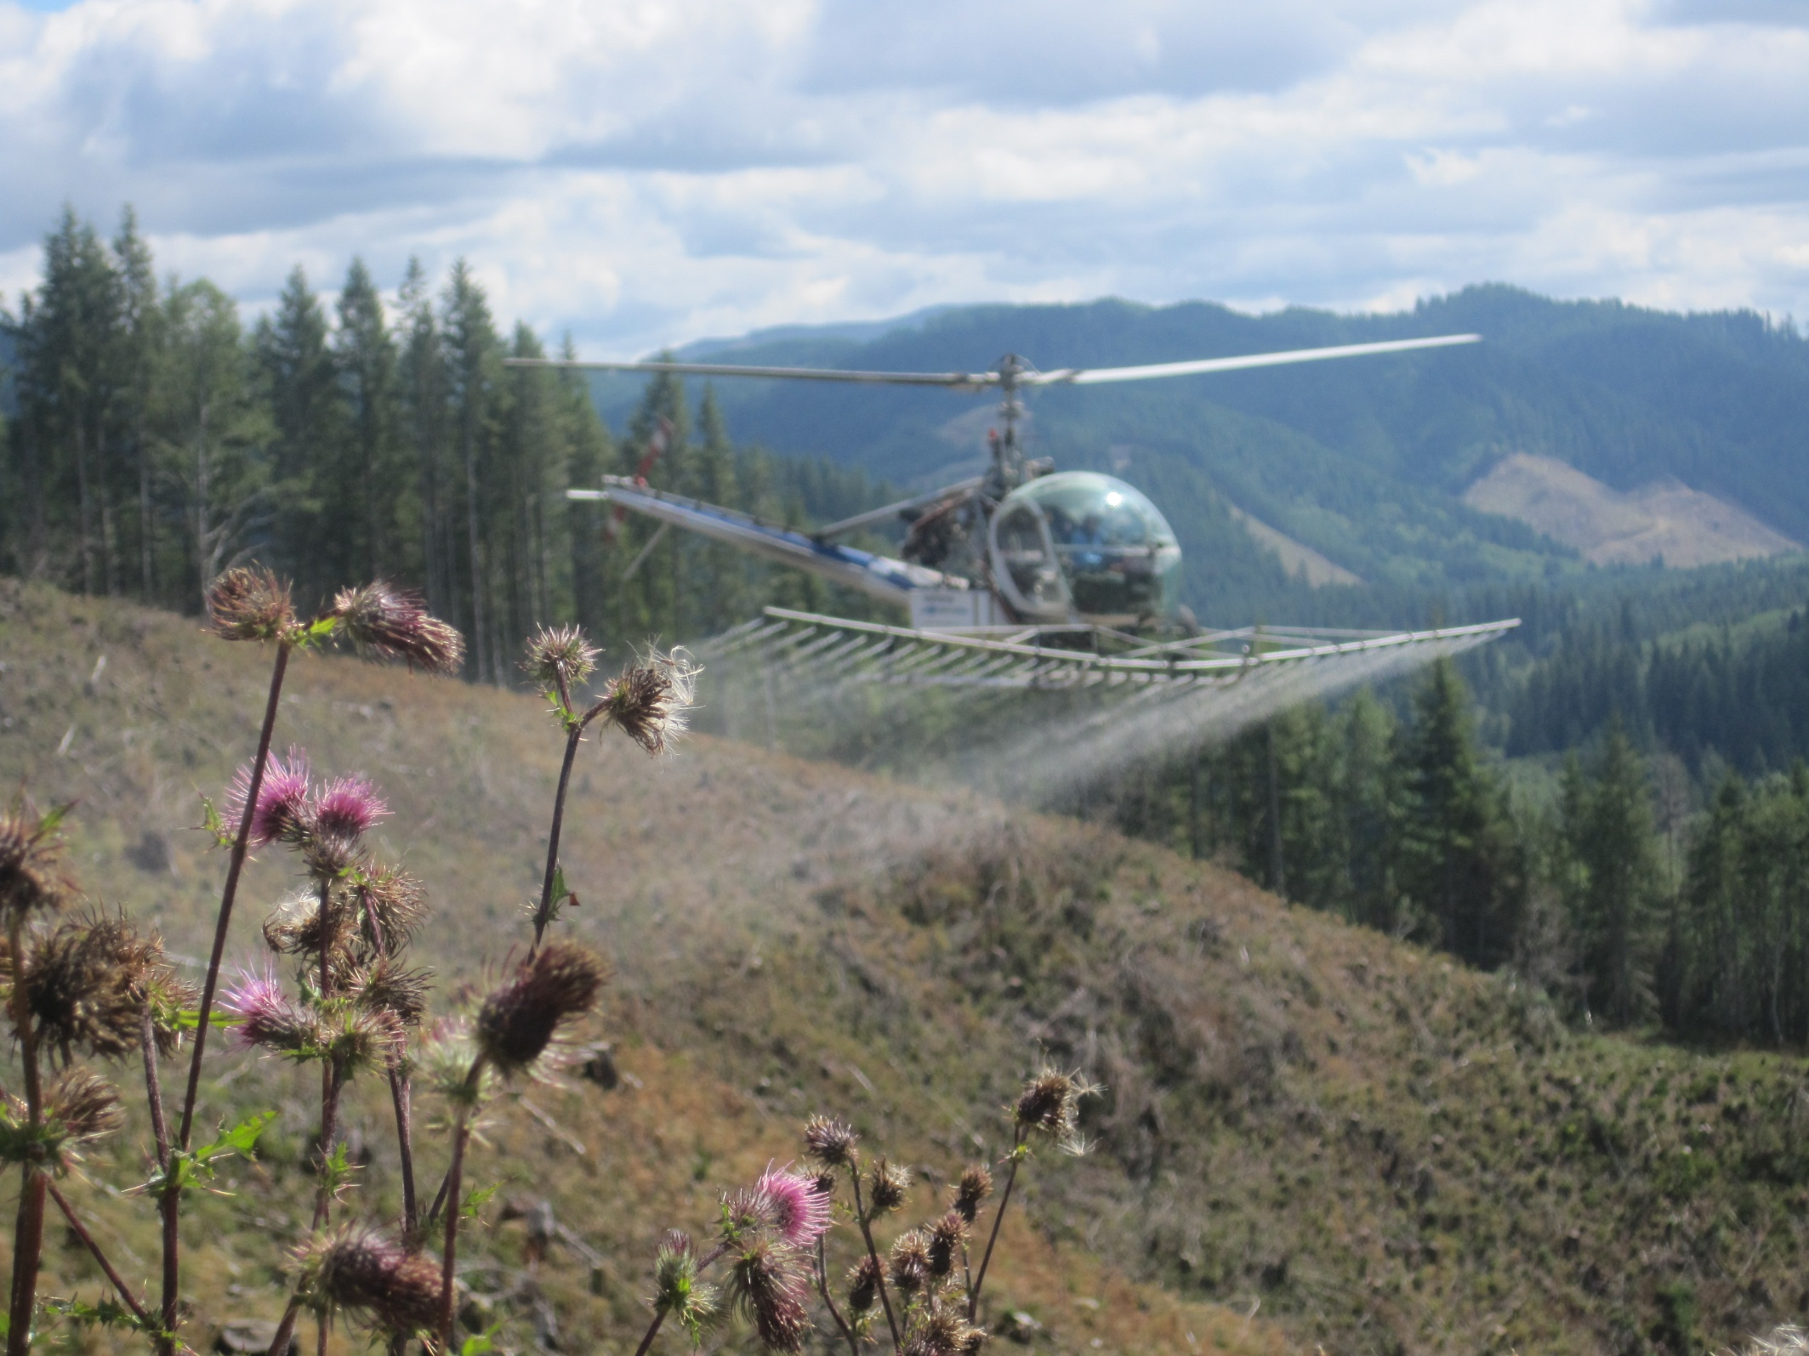
Site Preparation

Slide 22
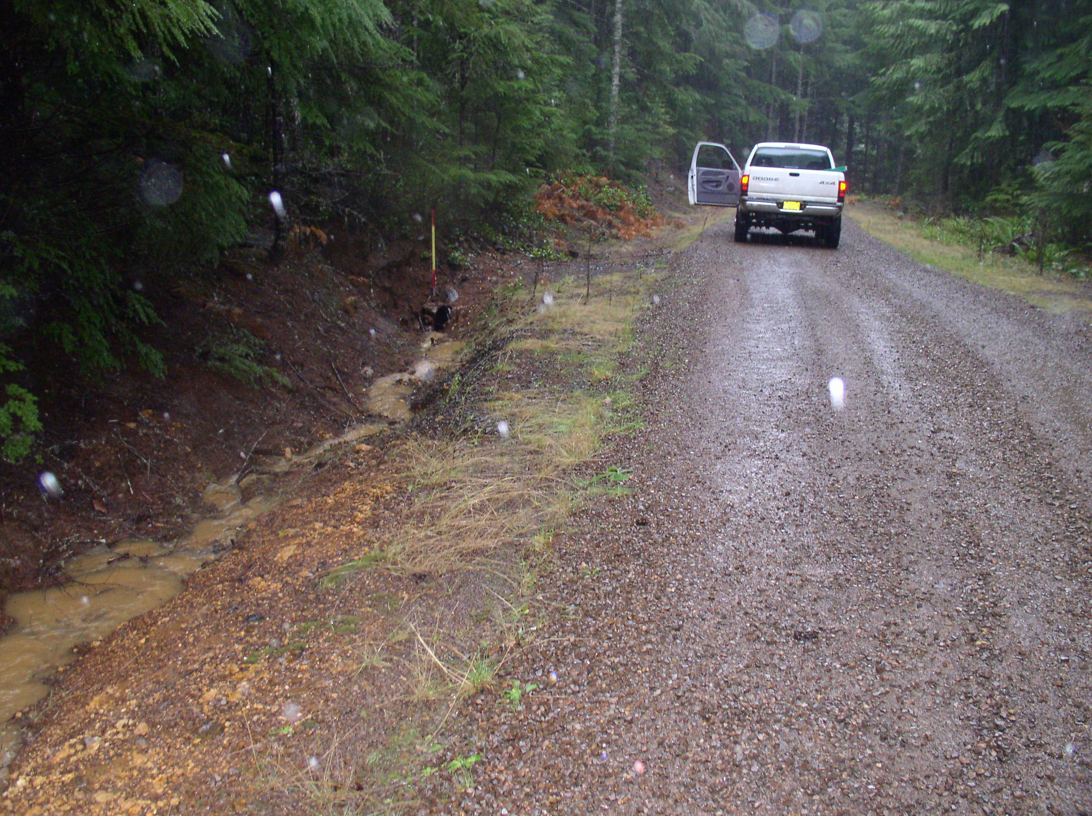
Location, construction, maintenance, and, especially connectivity, of roads.

Slide 23
Transfer Processes in Steep Forested Catchments
Debris Avalanche
Slump or earthflow
Soil creep
Root Throw
Litterfall
Solution transport
Surface movement
Hillslope Process
Stream Channel Process
Dissolved load
Suspended load
Debris torrent
Bed load
Modified from Swanson et al., 1982

Slide 24
What I Think I Think
Sediment yield result do not appear to be consistent with the findings in the seminal literature.
The results appear to be more muted, with increases in the 20% to 40% range.
These results are in agreement with and correlate with the increases in water yield.
A testable hypothesis is that the increase is due to increased stream power due to increased water yield.
An alternative hypothesis is that the increase is due to an increased erosion rate of the watershed due to logging.

Slide 25
Thank You!
Douglas County

Slide 26
