Slide 1
The Influence of Contemporary Forest Management on Stream Nutrient Concentrations in an Industrialized Forest in the Oregon Cascades

Slide 2
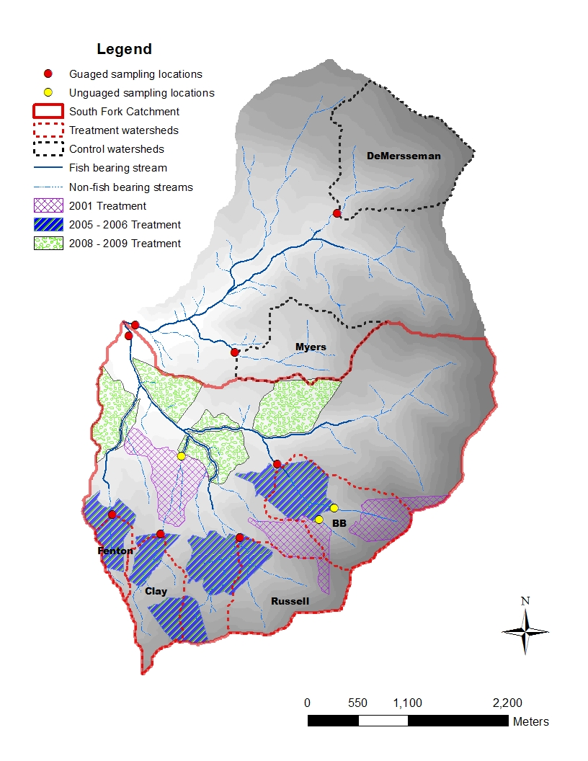
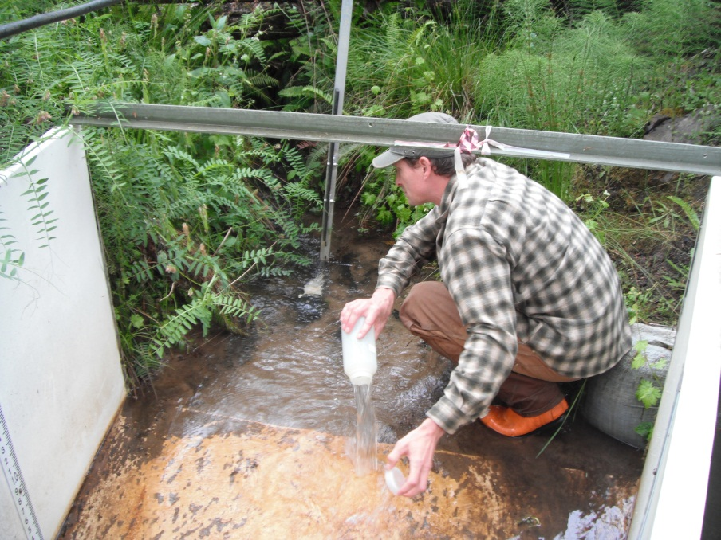
Stream water chemistry analysis
Sampling locations:
Sampling began in October 2002 at the eight gauged stations
Three locations were added in January 2003

Slide 3
Stream water chemistry analysis
Stream water chemistry:
Samples were tested for concentrations of several nutrients, specific conductance, pH, and alkalinity
Nutrients analyzed:
organic and inorganic nitrogen
Phosphorus (P)
Sodium (Na)
Calcium (Ca)
Magnesium (Mg)
Potassium (K)
Sulfate (SO₄)
Chloride (Cl)
Silicon (Si)

Slide 4
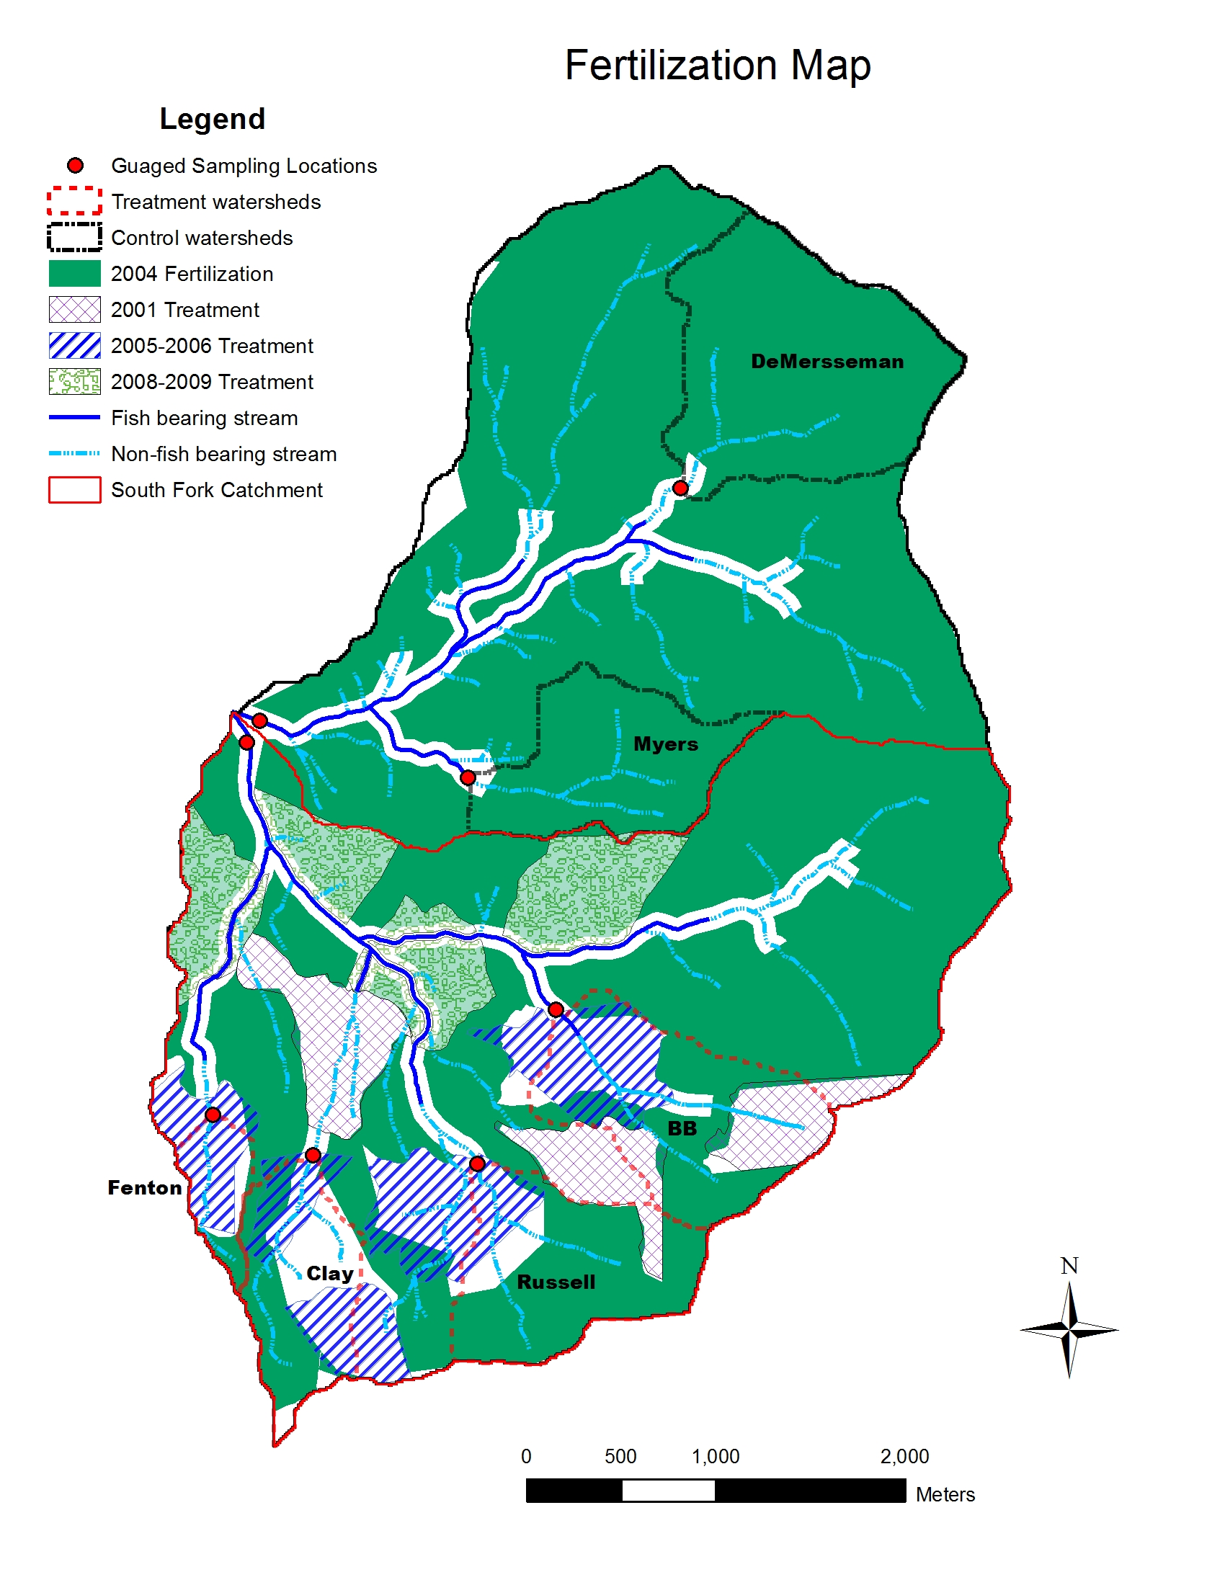
Fertilization
Fertilizer was applied to both watersheds in the fall of 2004
Existing clearcuts and imminent clearcuts did not receive fertilizer
The North Fork received 25% more fertilizer per hectare
Fish-bearing streams: 60 foot buffer strips
Non-fish-bearing streams: no protection
Fenton received no fertilizer

Slide 5
Nutrient response results
Most nutrients did not show an appreciable response to timber harvest
Ammonia showed an increase in all watersheds
Phosphorus did not display a response across watersheds
Na, Ca, Mg, K, SO₄, Cl, Si, alkalinity and specific conductance showed a decrease across all watersheds
- greatest decreases observed in the treatment watersheds
Nitrate showed the only statistically significant increase
“impact” will refer to concentration of nitrate

Slide 6
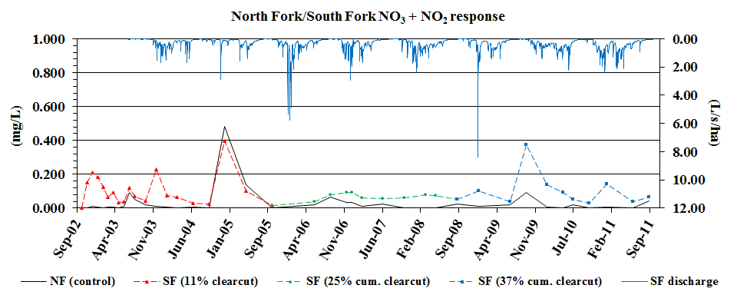
Nitrate response
Strong seasonal fluctuation during the calibration period

Slide 7
Nitrate response
Strong seasonal fluctuation during the calibration period
Muted seasonal response during the first post-treatment period

Slide 8
Nitrate response
Strong seasonal fluctuation during the calibration period
Muted seasonal response during the first post-treatment period
More pronounced seasonal response during the second post-treatment period

Slide 9
Nitrate response
Nitrate concentrations in the North Fork exceed concentrations in the South Fork for the first time during the study

Slide 10
Nitrate response
Concentrations in the South Fork during October 2009 were questionably high

Slide 11
Nitrate response
Concentrations in the South Fork during October 2009 were questionably high
Concentrations in the North Fork indicate something other than a treatment effect was responsible

Slide 12
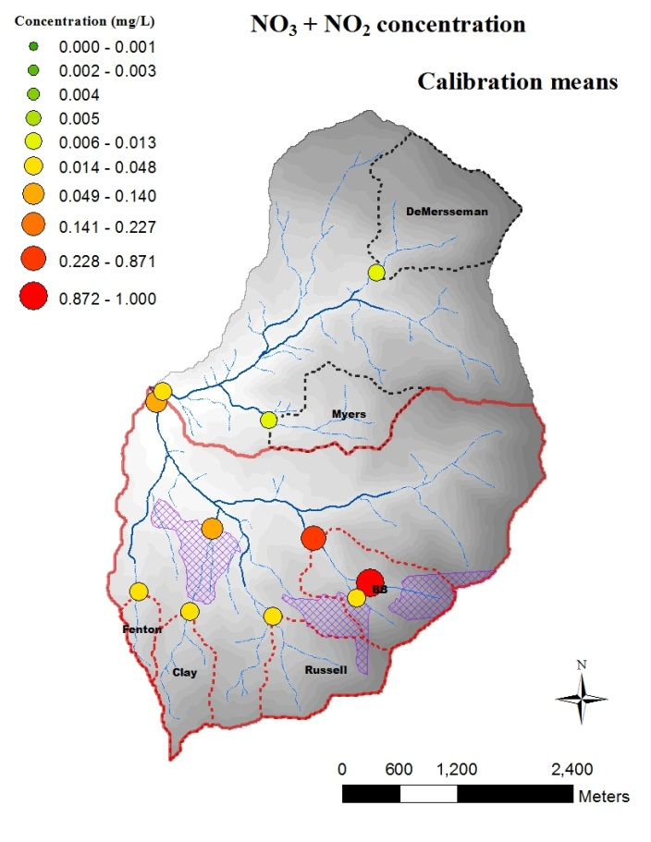
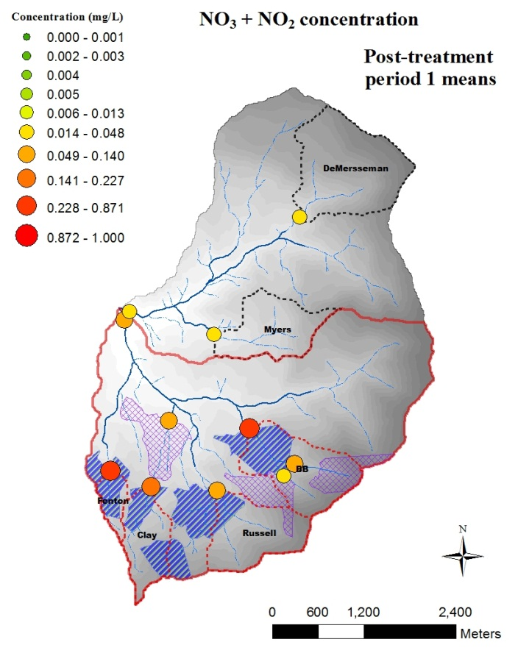
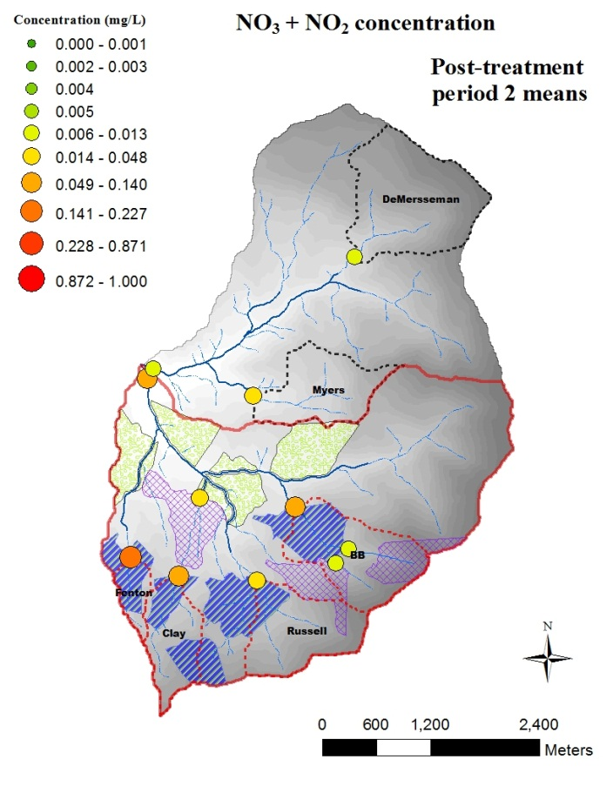
Nitrate response

Slide 13
Nitrate response

Slide 14
Magnitude of response relative to magnitude of disturbance

Slide 15
Magnitude of response relative to magnitude of disturbance

Slide 16
Magnitude of response relative to magnitude of disturbance

Slide 17
Nitrate response
A single clearcut located 3,400 meters away on a steep slope produced a greater signal in the South Fork than five clearcuts combined

Slide 18
Discharge vs. concentration

Slide 19
Discharge vs. concentration

Slide 20
Discharge vs. concentration

Slide 21
Discharge vs. concentration

Slide 22
South Fork discharge: 2005 & 2010

Slide 23
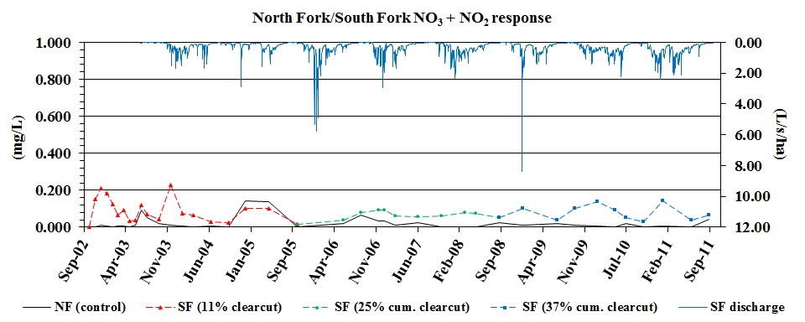
Discharge vs. concentration

Slide 24
Nitrate response

Slide 25
Longitudinal attenuation & post-harvest recovery
In-stream uptake of stream water nutrients (attenuation) was strong in the headwater streams
Lower Clay clearcut provided information about attenuation in streams without riparian zones
The removal of the canopy appears to increase in-stream uptake
North BB clearcut returned to [assumed] pre-harvest concentrations after six years

Slide 26
Annual stream export
Probably a 16-fold increase in annual stream export
A portion of this increase is due to fertilizer
Average input of nitrate from precipitation is approximately 0.7 kg/ha/yr
Input was roughly equal to output

Slide 27
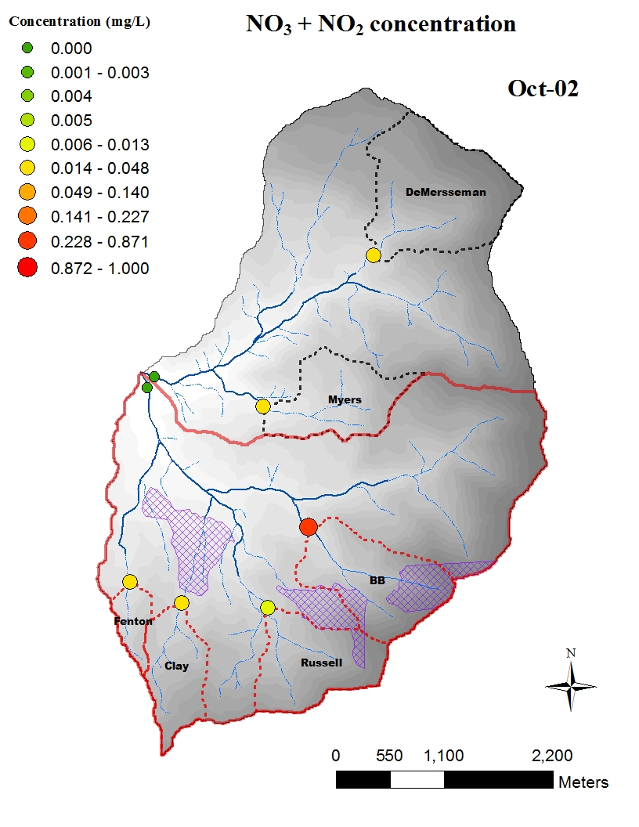
Calibration period

Slide 28
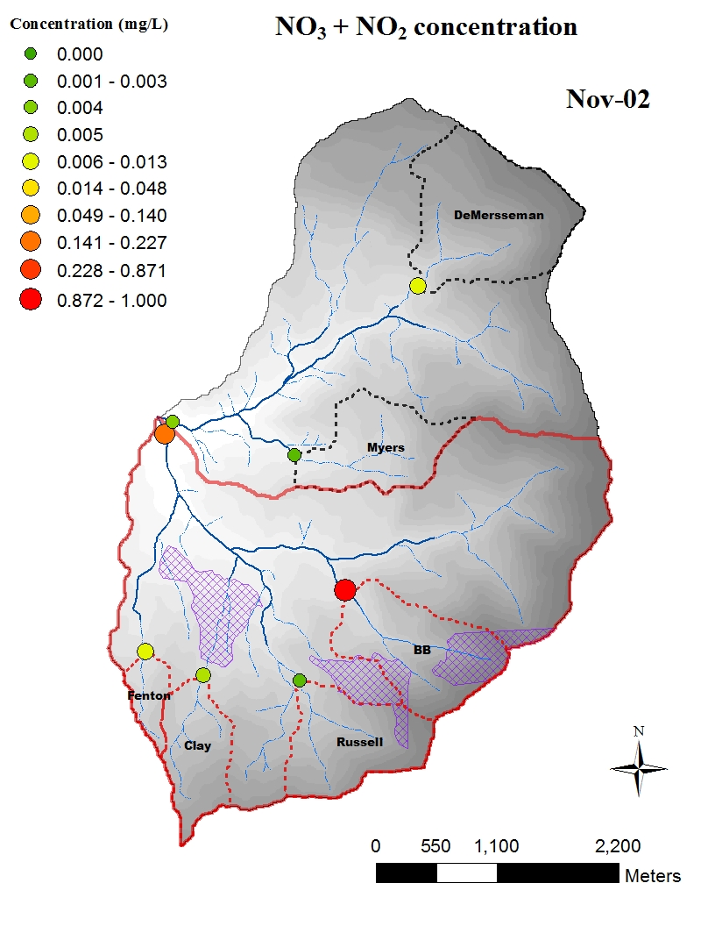
Calibration period

Slide 29

Calibration period

Slide 30
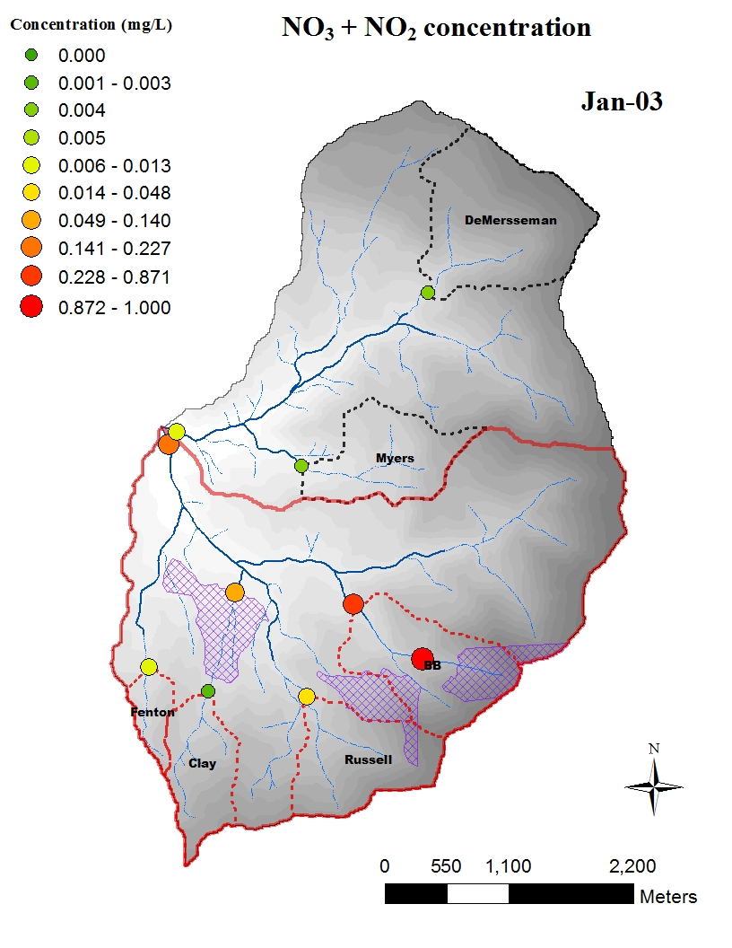
Calibration period

Slide 31
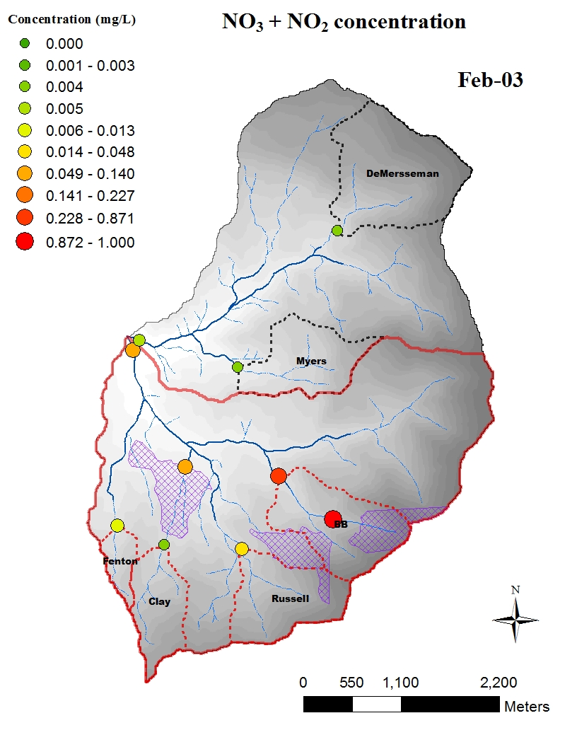
Calibration period

Slide 32

Calibration period

Slide 33

Calibration period

Slide 34
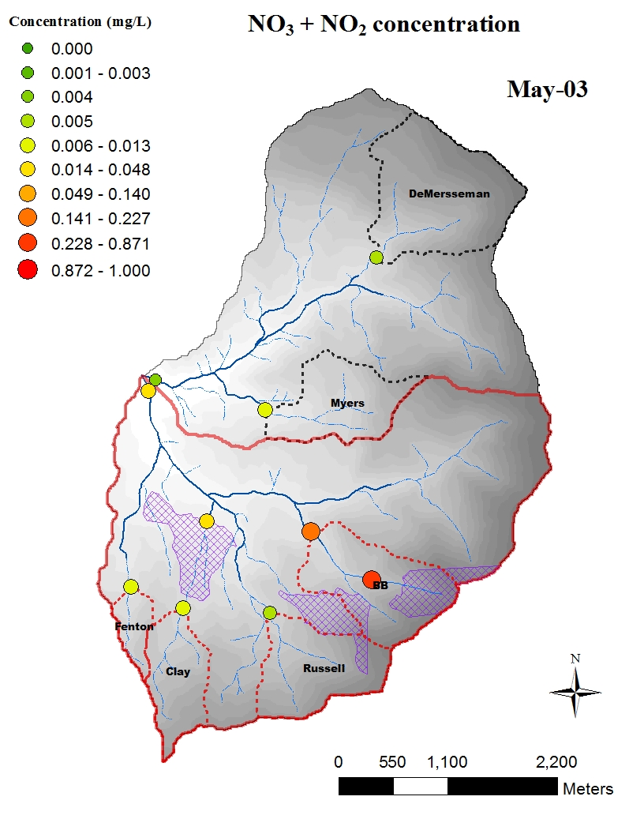
Calibration period

Slide 35

Calibration period

Slide 36
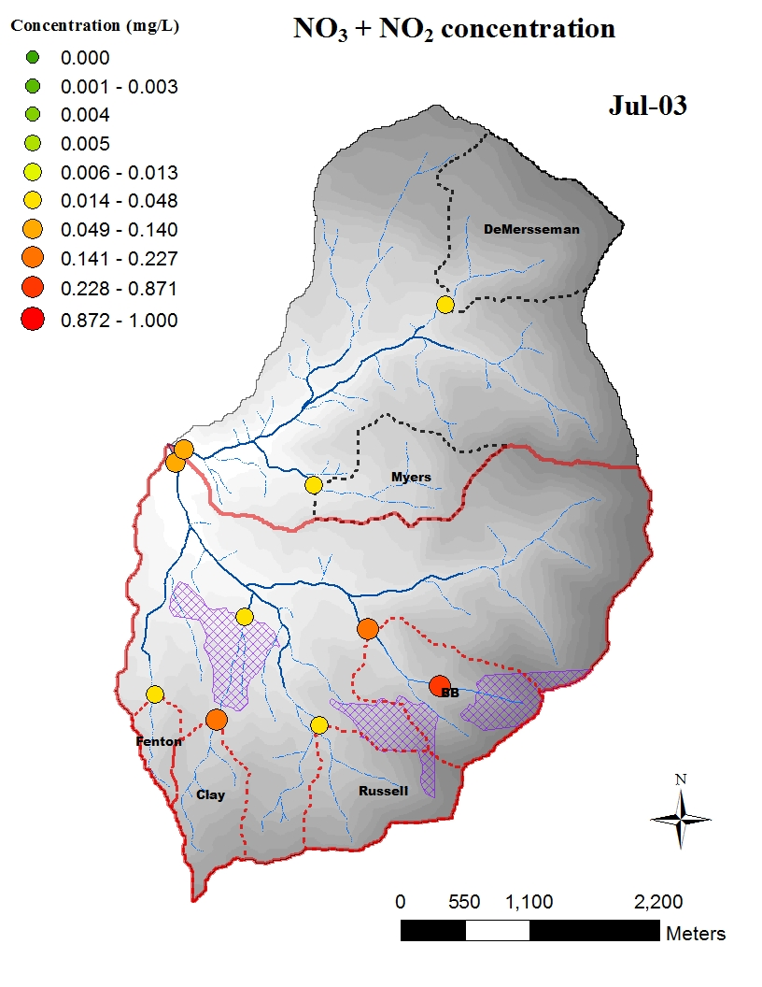
Calibration period

Slide 37

Calibration period

Slide 38

Calibration period

Slide 39
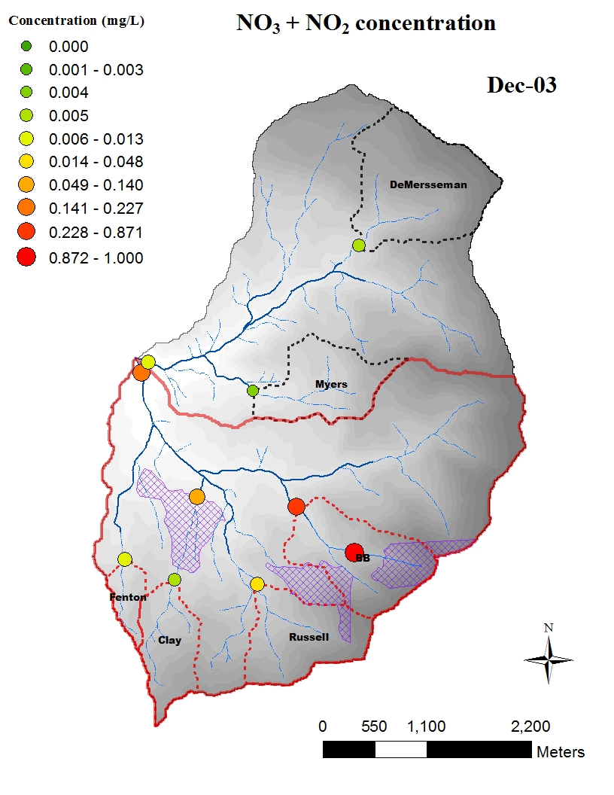
Calibration period

Slide 40

Calibration period

Slide 41

Calibration period

Slide 42

Calibration period

Slide 43

Calibration period

Slide 44

Fertilization

Slide 45

Fertilization

Slide 46
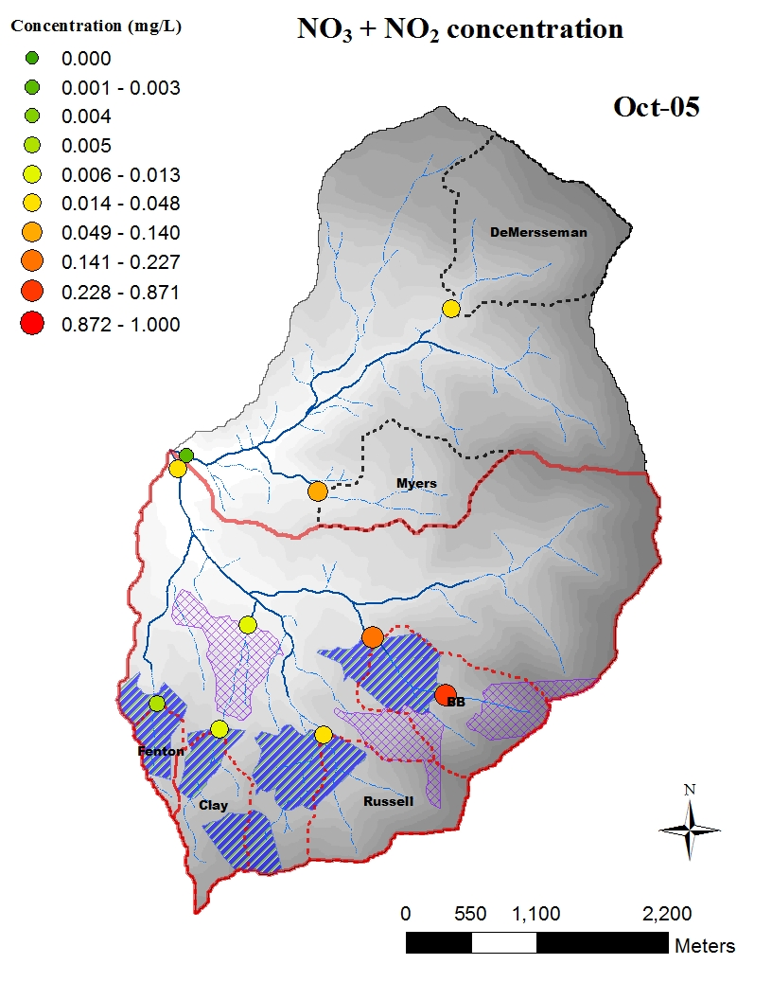
Post-treatment period 1

Slide 47
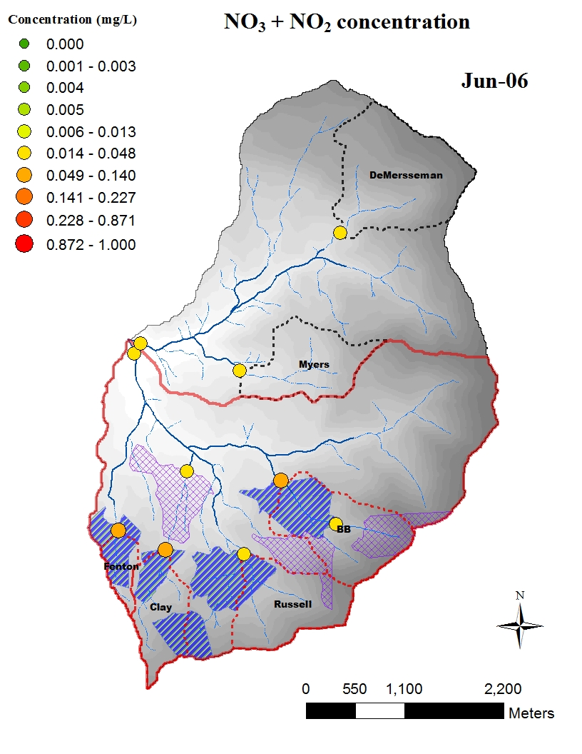
Post-treatment period 1

Slide 48
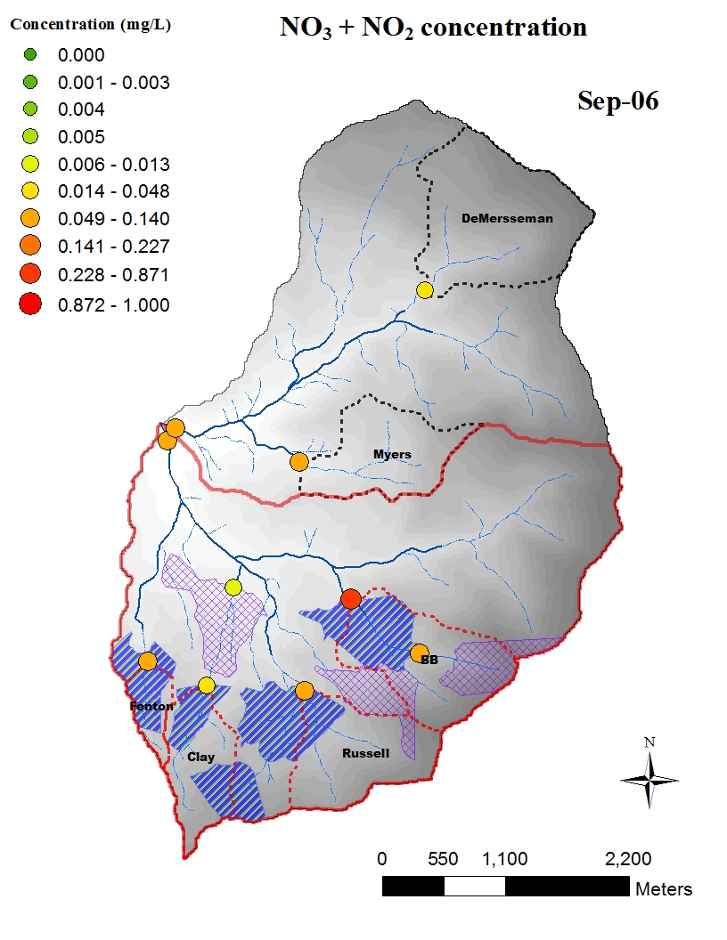
Post-treatment period 1

Slide 49

Post-treatment period 1

Slide 50

Post-treatment period 1

Slide 51

Post-treatment period 1

Slide 52

Post-treatment period 1

Slide 53

Post-treatment period 1

Slide 54

Post-treatment period 1

Slide 55

Post-treatment period 1

Slide 56
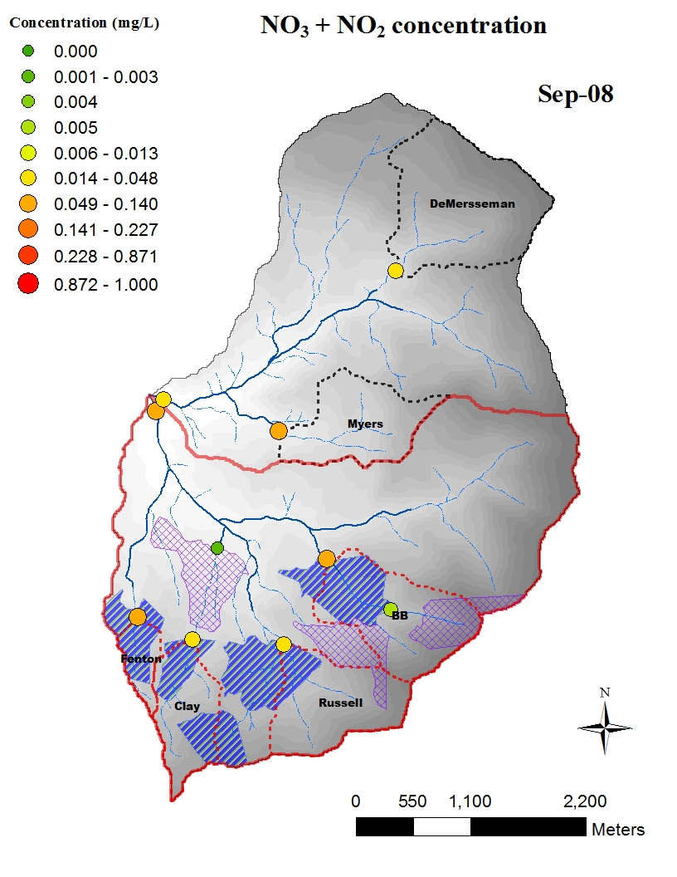
Post-treatment period 1

Slide 57
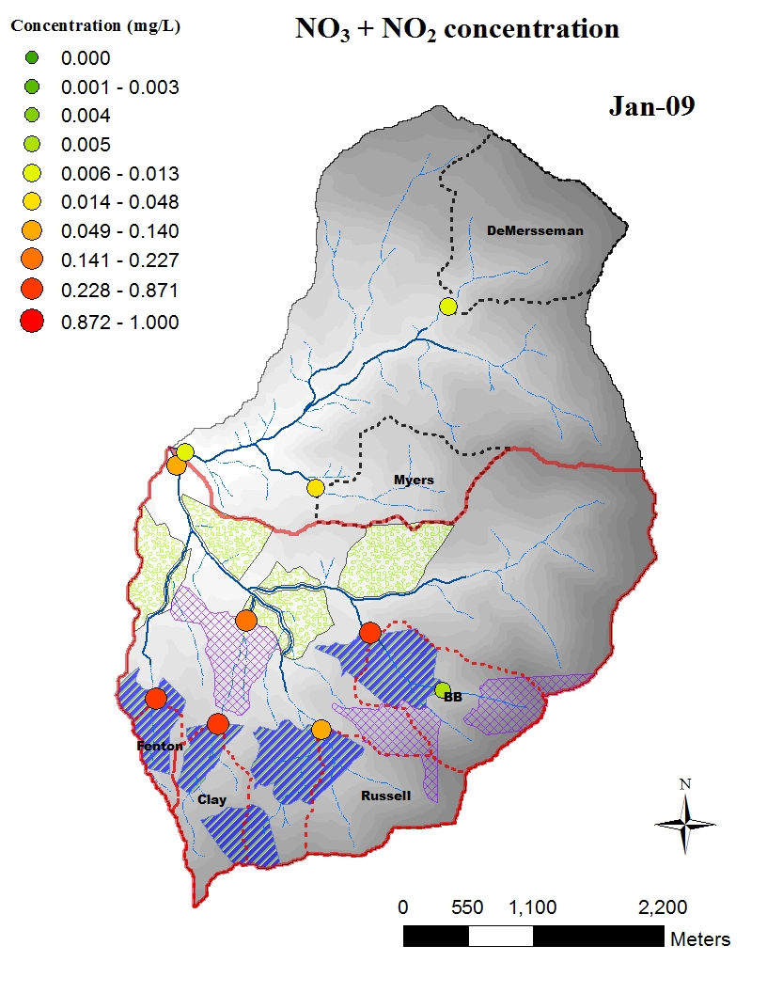
Post-treatment period 2

Slide 58
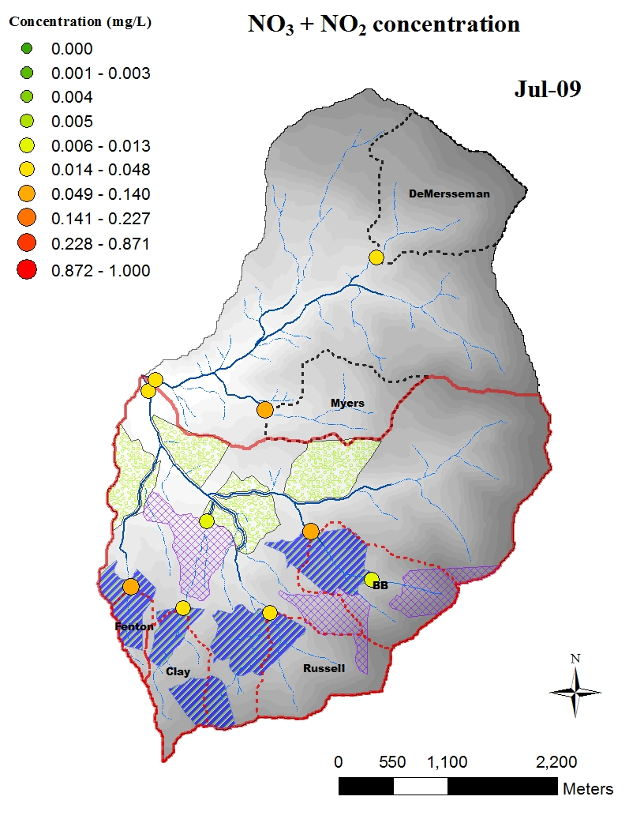
Post-treatment period 2

Slide 59
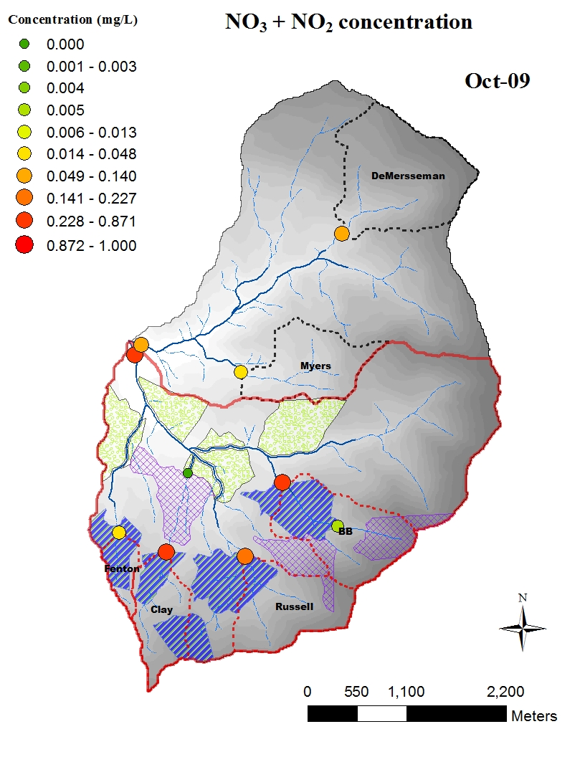
Post-treatment period 2

Slide 60

Post-treatment period 2

Slide 61
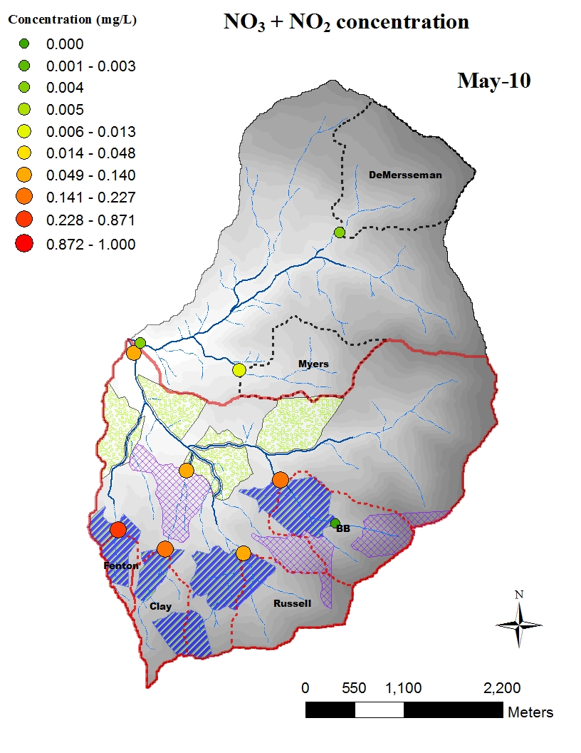
Post-treatment period 2

Slide 62
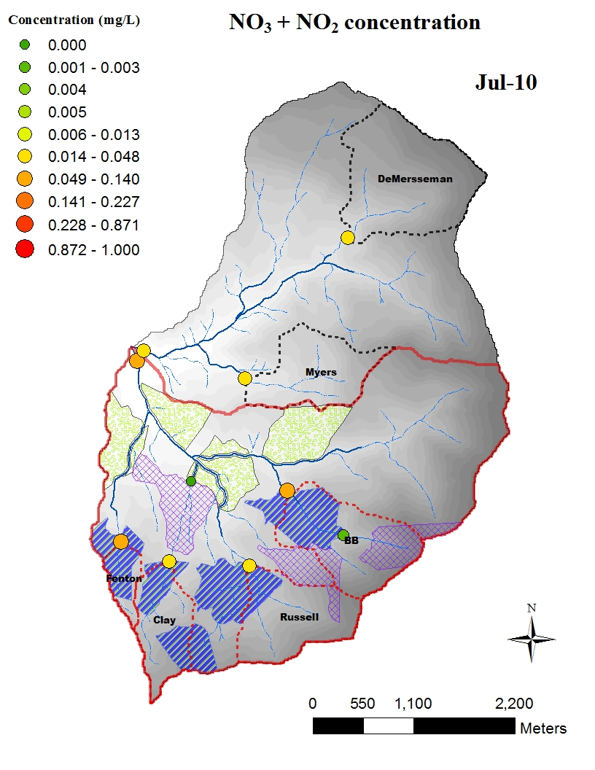
Post-treatment period 2

Slide 63

Post-treatment period 2

Slide 64

Post-treatment period 2

Slide 65

Post-treatment period 2

Slide 66

Post-treatment period 2

Slide 67
Conclusions
Forest management resulted in an statistically significant increase in stream water concentrations of nitrate, but….
These increases were not biologically significant
Local impacts to fish-bearing streams were approximately equal to the cumulative impacts from non-fish-bearing streams
A clearcut located on a steep slope is capable of producing a downstream impact greater than several moderately sloped clearcuts
Output from the system was roughly equivalent to the input

Slide 68
Conclusions
Topography was a much stronger predictor of the magnitude of response than was the size of the clearcut
Antecedent moisture conditions and discharge can have a profound influence on stream water concentration
The other nutrients did not appear to respond to timber harvest, BUT…
The use of urea fertilizer may have caused an increase in in-stream uptake of several nutrients

