Slide 1
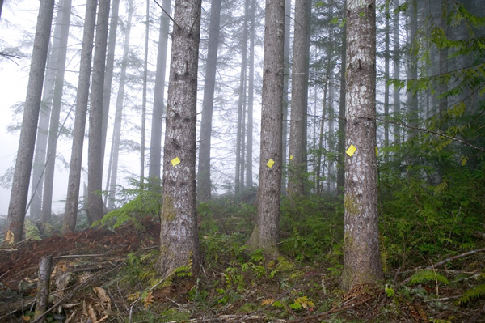
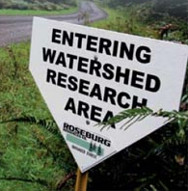




Local & Downstream Impacts of Contemporary Forest Harvesting Practices on Watershed Hydrology
Nicolas Zègre
Forestry & Natural Resources
West Virginia University
Notes:
Thanks for coming everyone, nice to see another solid turn out. I think it’s the controversial issues that really brings people out, and I think we’ve got the granddaddy of em all. So we’re going to talk about ___.
This is sort of rough go through of my proposal presentation. I’ve added some base information for a broader audience so hopefully what is presented will register with most everybody. That said, if you have questions related to something that didn’t make sense, I would encourage you to ask during the presentation rather than waiting till the end so everybody tracking along. Mindful of time, but I’d rather keep people engaged throughout.

Slide 2
Co-authors, Collaborators, & Acknowledgements
  Arne Skaugset |Amy Simmons |Hazel Owens
        Oregon State University
  Nicholas Som|Lisa Ganio
  USFW & Oregon State University
  Roseburg Forest Products
  Dan Newton |Dick Beeby
Notes:
This is just sort of a quickie outline highlighting the major components of the presentation.
I’ll present some basic info about the hydrologic cycle, specifically focusing on catchment hydrology.
Then I’ll introduce MTM into the equation and some of its impacts on hydrology.
Then I’ll talk about IH and how we can apply it to this question
Then we’ll get into the specifics of this study, what we’re trying to achieve and how we’ll do that.

Slide 3
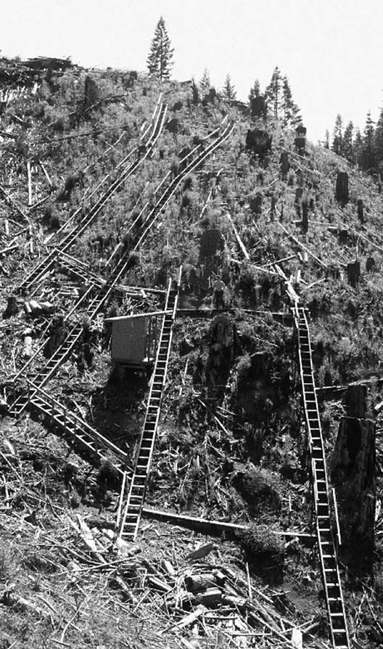
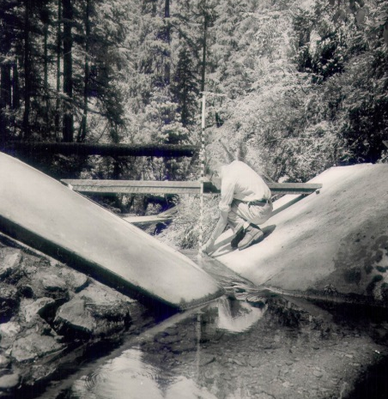
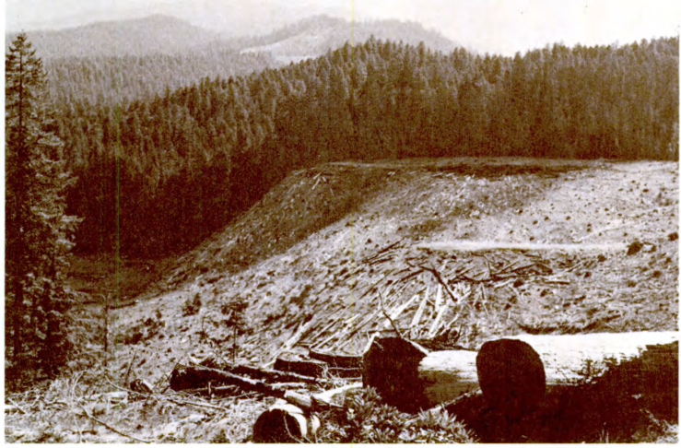
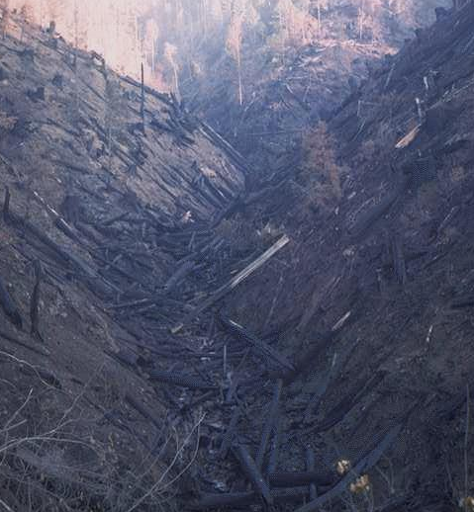
FOREST HARVESTING & HYDROLOGY
First catchment study – Wagon Wheel Gap, CO Bates [1921]
Ice & Stednick [2004]
Classic Western Studies –
  Oregon – Alsea |HJ Andrews |Coyote Creek
  California – Caspar Creek
J. Rothacher - 1957
USFS – 1976
Ice & Stednick [2004]
OSU archives
Notes:
So another key component to quantifying hydrologic response residence time within a watershed.
So we’ll go to our animation again to demonstrate that each droplet of water will take a unique path to the outlet (if it isn’t evapotranspired), and from the distribution of all the transit times of these flow paths we can figure mean residence time within a waterhsed.
And these are important considerations for both water quality as contact time is a critical factor in biogeochemical reactions and water quantity in that mean residence time will describe how quick or flashy our storm response is.

Slide 4
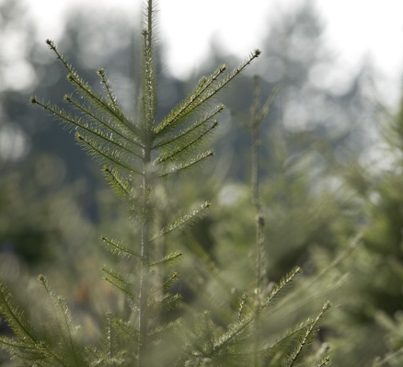
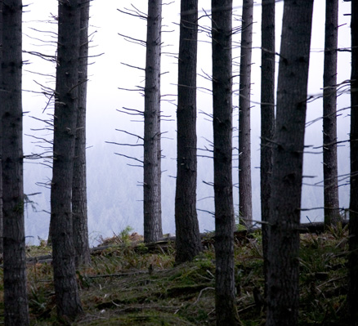
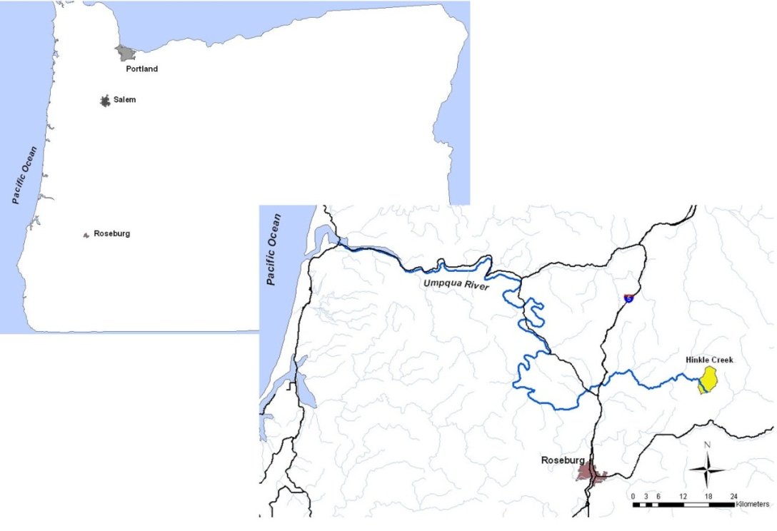
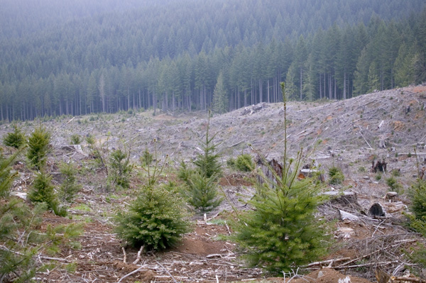
HINKLE CREEK PAIRED WATERSHED
Fill knowledge gaps of current forest harvesting practices
HINKLE CREEK
  Western foothills Oregon Cascades
  Owned and managed by Roseburg Forest Products
  60-yr harvest regenerated
  Parent geology is basalt and rhyolite flows
  Deep, well drained silty clay loams, clay loams, gravelly clay loams, and gravelly loams
Notes:
So another key component to quantifying hydrologic response residence time within a watershed.
So we’ll go to our animation again to demonstrate that each droplet of water will take a unique path to the outlet (if it isn’t evapotranspired), and from the distribution of all the transit times of these flow paths we can figure mean residence time within a waterhsed.
And these are important considerations for both water quality as contact time is a critical factor in biogeochemical reactions and water quantity in that mean residence time will describe how quick or flashy our storm response is.

Slide 5

HINKLE CREEK PAIRED WATERSHED
Study design – paired/nested
  Basin-scale
    North Fork Hinkle (reference)
    South Fork Hinkle (treatment)
  Headwater-scale
    2 reference
    4 treatment
Notes:
So another key component to quantifying hydrologic response residence time within a watershed.
So we’ll go to our animation again to demonstrate that each droplet of water will take a unique path to the outlet (if it isn’t evapotranspired), and from the distribution of all the transit times of these flow paths we can figure mean residence time within a waterhsed.
And these are important considerations for both water quality as contact time is a critical factor in biogeochemical reactions and water quantity in that mean residence time will describe how quick or flashy our storm response is.

Slide 6
HINKLE CREEK PAIRED WATERSHED
Study design
  Paired, nested watershed study
Notes:
So another key component to quantifying hydrologic response residence time within a watershed.
So we’ll go to our animation again to demonstrate that each droplet of water will take a unique path to the outlet (if it isn’t evapotranspired), and from the distribution of all the transit times of these flow paths we can figure mean residence time within a waterhsed.
And these are important considerations for both water quality as contact time is a critical factor in biogeochemical reactions and water quantity in that mean residence time will describe how quick or flashy our storm response is.

Slide 7
HINKLE CREEK PAIRED WATERSHED
Study design
  Paired, nested watershed study
  Evaluate for local & downstream changes
Notes:
So another key component to quantifying hydrologic response residence time within a watershed.
So we’ll go to our animation again to demonstrate that each droplet of water will take a unique path to the outlet (if it isn’t evapotranspired), and from the distribution of all the transit times of these flow paths we can figure mean residence time within a waterhsed.
And these are important considerations for both water quality as contact time is a critical factor in biogeochemical reactions and water quantity in that mean residence time will describe how quick or flashy our storm response is.

Slide 8
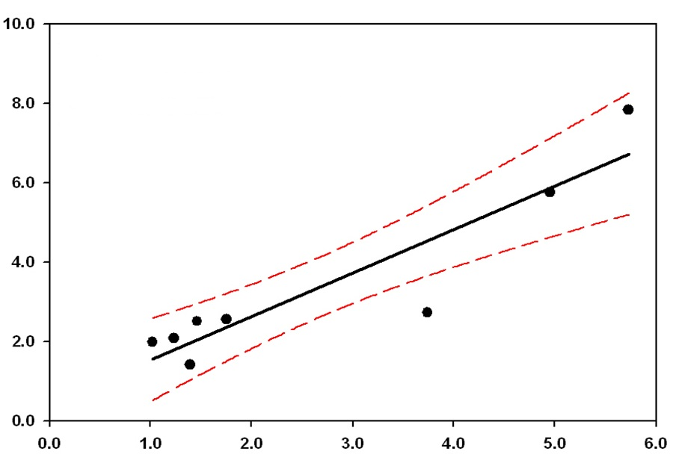
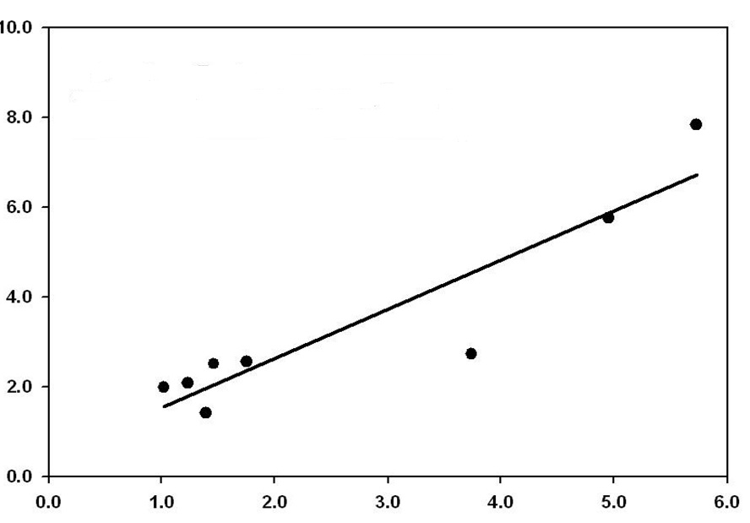
HINKLE CREEK PAIRED WATERSHED
Notes:
So another key component to quantifying hydrologic response residence time within a watershed.
So we’ll go to our animation again to demonstrate that each droplet of water will take a unique path to the outlet (if it isn’t evapotranspired), and from the distribution of all the transit times of these flow paths we can figure mean residence time within a waterhsed.
And these are important considerations for both water quality as contact time is a critical factor in biogeochemical reactions and water quantity in that mean residence time will describe how quick or flashy our storm response is.

Slide 9
HINKLE CREEK PAIRED WATERSHED
Study design – ~19 km² |1,9oo ha 3rd order watershed
Notes:
So another key component to quantifying hydrologic response residence time within a watershed.
So we’ll go to our animation again to demonstrate that each droplet of water will take a unique path to the outlet (if it isn’t evapotranspired), and from the distribution of all the transit times of these flow paths we can figure mean residence time within a waterhsed.
And these are important considerations for both water quality as contact time is a critical factor in biogeochemical reactions and water quantity in that mean residence time will describe how quick or flashy our storm response is.

Slide 10
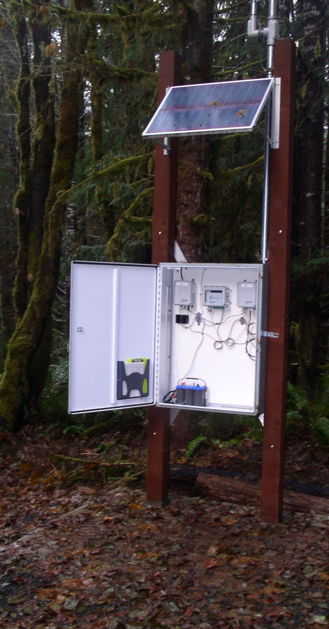
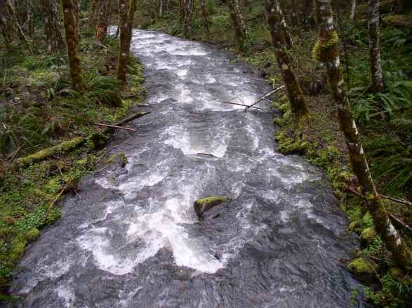
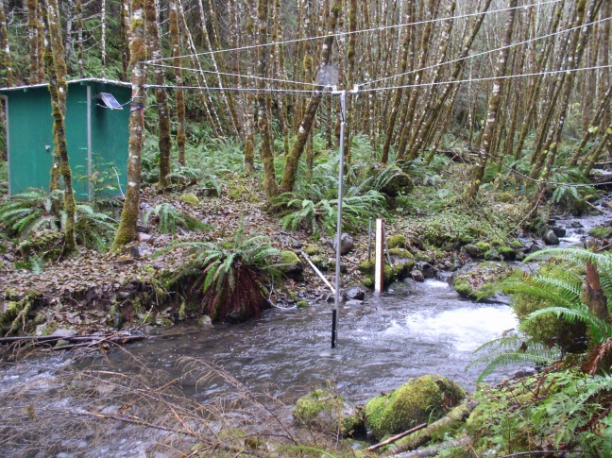
HINKLE CREEK PAIRED WATERSHED
Study design – HYDROMETRIC INSTRUMENTATION
  Basin-scale
    Measured by the USGS – 30 min
Notes:
So another key component to quantifying hydrologic response residence time within a watershed.
So we’ll go to our animation again to demonstrate that each droplet of water will take a unique path to the outlet (if it isn’t evapotranspired), and from the distribution of all the transit times of these flow paths we can figure mean residence time within a waterhsed.
And these are important considerations for both water quality as contact time is a critical factor in biogeochemical reactions and water quantity in that mean residence time will describe how quick or flashy our storm response is.

Slide 11
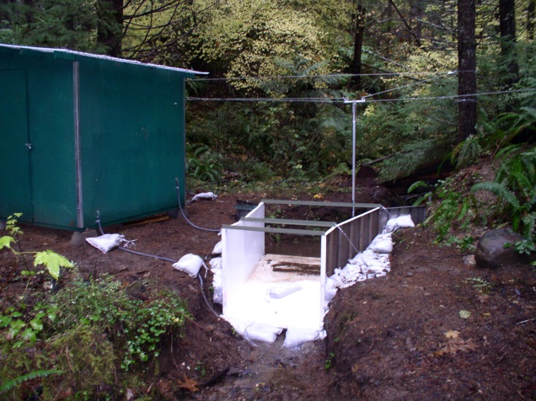

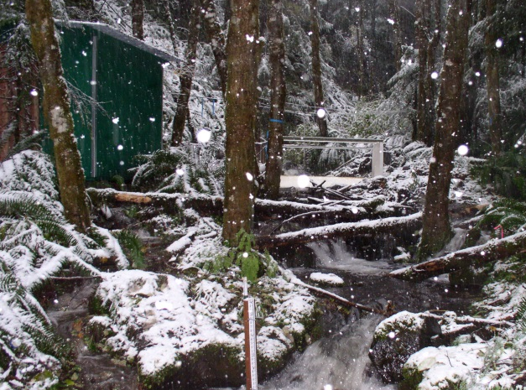
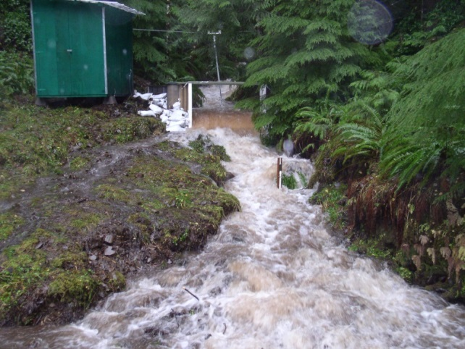
HINKLE CREEK PAIRED WATERSHED
Study design – HYDROMETRIC INSTRUMENTATION
  Headwater-scale
    modified Parshall flumes & pressure transducers (10 min)
Notes:
So another key component to quantifying hydrologic response residence time within a watershed.
So we’ll go to our animation again to demonstrate that each droplet of water will take a unique path to the outlet (if it isn’t evapotranspired), and from the distribution of all the transit times of these flow paths we can figure mean residence time within a waterhsed.
And these are important considerations for both water quality as contact time is a critical factor in biogeochemical reactions and water quantity in that mean residence time will describe how quick or flashy our storm response is.

Slide 12
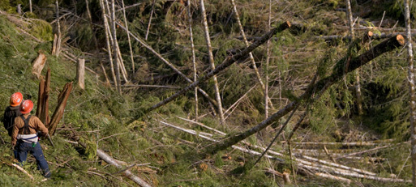
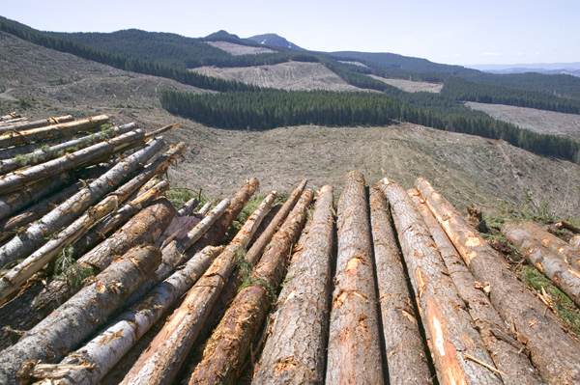
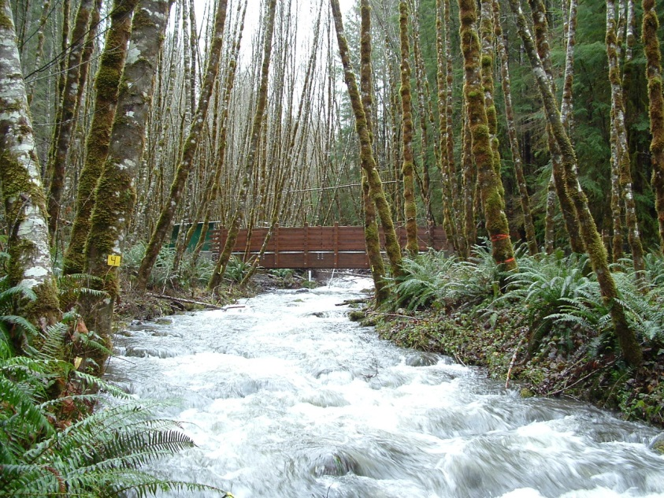
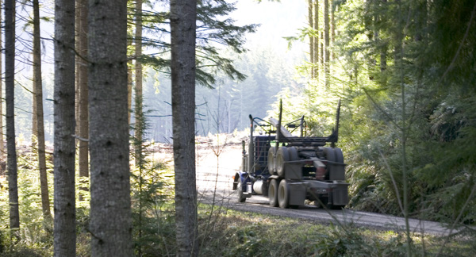
HINKLE CREEK PAIRED WATERSHED
Study design – HYDROLOGIC METRICS
    Max. instantaneous peakflow
    Storm quick flow
    Mean monthly streamflow
Notes:
So another key component to quantifying hydrologic response residence time within a watershed.
So we’ll go to our animation again to demonstrate that each droplet of water will take a unique path to the outlet (if it isn’t evapotranspired), and from the distribution of all the transit times of these flow paths we can figure mean residence time within a waterhsed.
And these are important considerations for both water quality as contact time is a critical factor in biogeochemical reactions and water quantity in that mean residence time will describe how quick or flashy our storm response is.

Slide 13
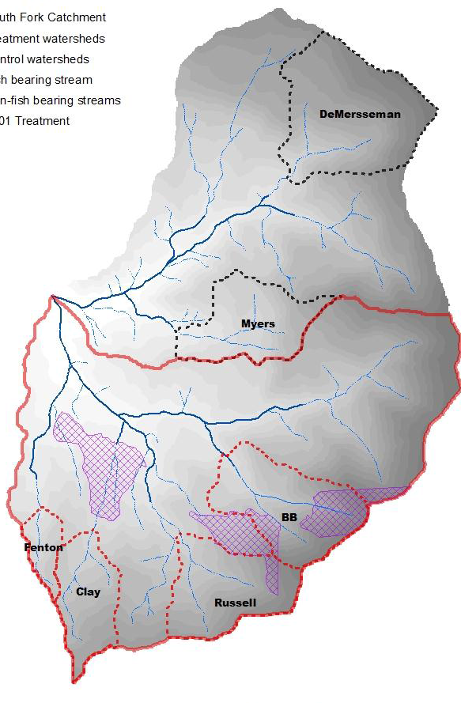

HINKLE CREEK PAIRED WATERSHED
Study design – HARVESTING TREATMENTS
    Pre-study harvest entry 2001 (11%)
Notes:
So another key component to quantifying hydrologic response residence time within a watershed.
So we’ll go to our animation again to demonstrate that each droplet of water will take a unique path to the outlet (if it isn’t evapotranspired), and from the distribution of all the transit times of these flow paths we can figure mean residence time within a waterhsed.
And these are important considerations for both water quality as contact time is a critical factor in biogeochemical reactions and water quantity in that mean residence time will describe how quick or flashy our storm response is.

Slide 14
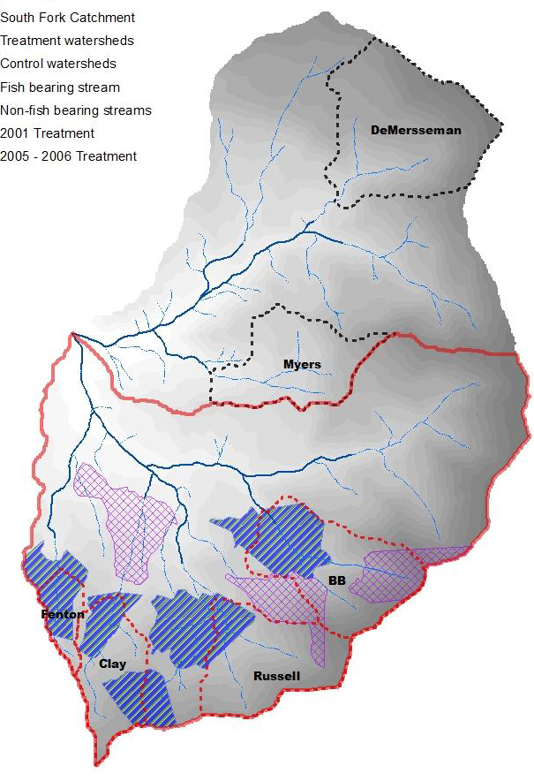
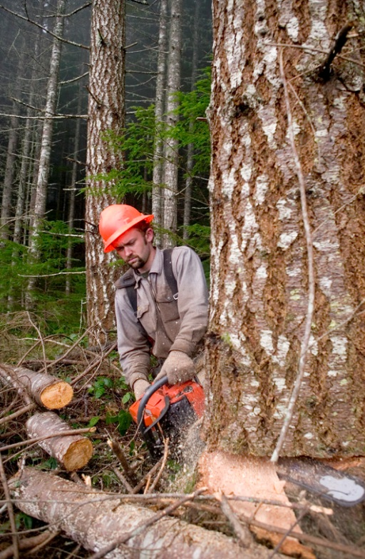
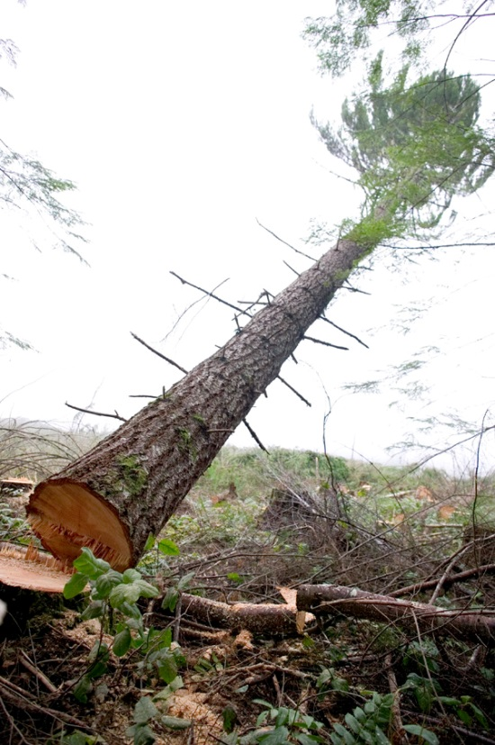
HINKLE CREEK PAIRED WATERSHED
Study design – HARVESTING TREATMENTS
  1st harvest entry 8/2005 – 4/2006
    Adjacent to non-fish bearing streams (type N)
    5 clearcut units (1.52 km²|380 acres)
    12.2 mmbf |3,281 loads of logs
31%
65%
38%
13%
Notes:
So another key component to quantifying hydrologic response residence time within a watershed.
So we’ll go to our animation again to demonstrate that each droplet of water will take a unique path to the outlet (if it isn’t evapotranspired), and from the distribution of all the transit times of these flow paths we can figure mean residence time within a waterhsed.
And these are important considerations for both water quality as contact time is a critical factor in biogeochemical reactions and water quantity in that mean residence time will describe how quick or flashy our storm response is.

Slide 15
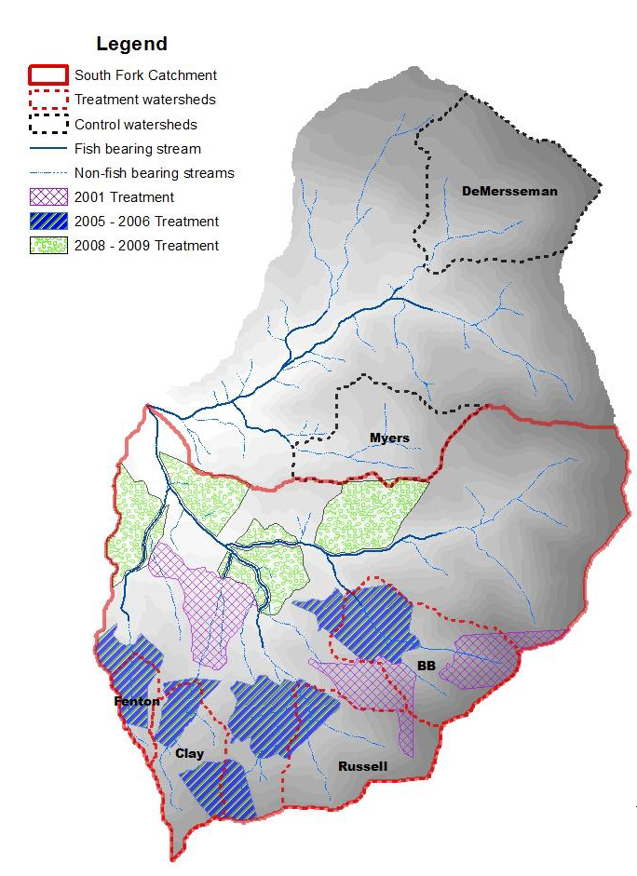
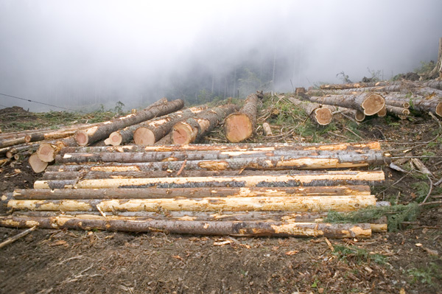
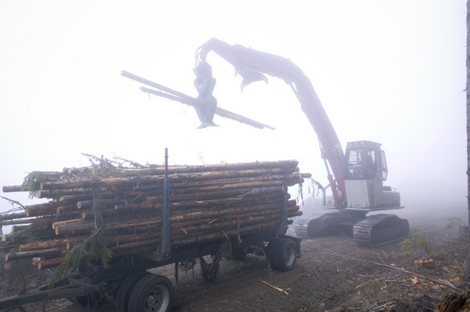
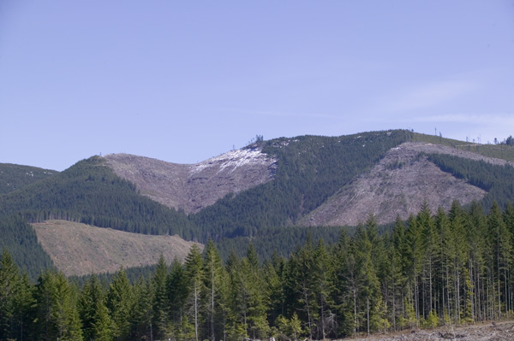
HINKLE CREEK PAIRED WATERSHED
Study design – HARVESTING TREATMENTS
  2nd harvest entry 8/2008 – 3/2009
    Adjacent to small and medium (type F)
    4 clearcut units (1.31 km²|324 acres)
    7.6 mmbf |2,059 loads of logs
Notes:
So another key component to quantifying hydrologic response residence time within a watershed.
So we’ll go to our animation again to demonstrate that each droplet of water will take a unique path to the outlet (if it isn’t evapotranspired), and from the distribution of all the transit times of these flow paths we can figure mean residence time within a waterhsed.
And these are important considerations for both water quality as contact time is a critical factor in biogeochemical reactions and water quantity in that mean residence time will describe how quick or flashy our storm response is.

Slide 16
HINKLE CREEK PAIRED WATERSHED
Notes:
So another key component to quantifying hydrologic response residence time within a watershed.
So we’ll go to our animation again to demonstrate that each droplet of water will take a unique path to the outlet (if it isn’t evapotranspired), and from the distribution of all the transit times of these flow paths we can figure mean residence time within a waterhsed.
And these are important considerations for both water quality as contact time is a critical factor in biogeochemical reactions and water quantity in that mean residence time will describe how quick or flashy our storm response is.

Slide 17
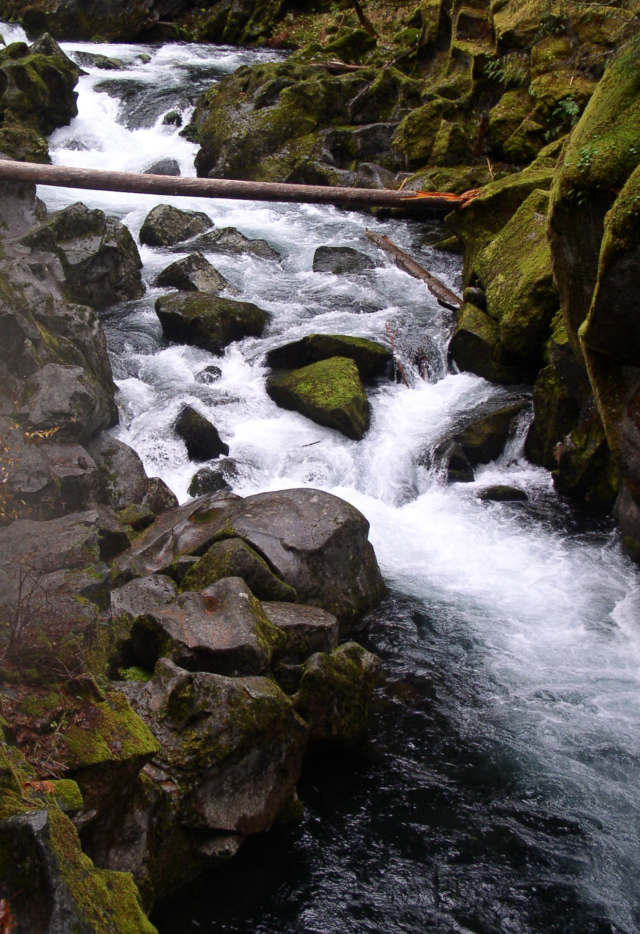
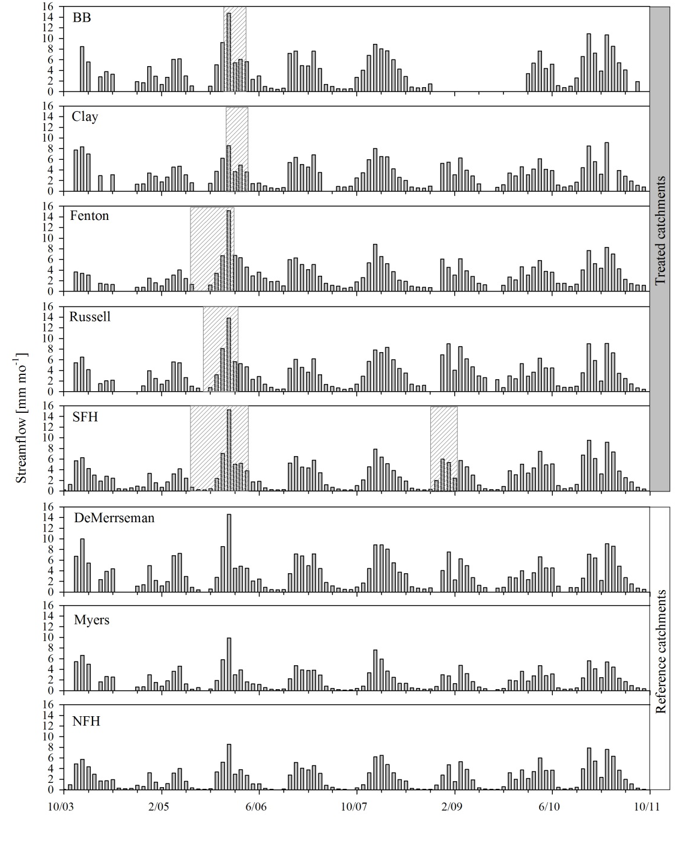
Notes:
So another key component to quantifying hydrologic response residence time within a watershed.
So we’ll go to our animation again to demonstrate that each droplet of water will take a unique path to the outlet (if it isn’t evapotranspired), and from the distribution of all the transit times of these flow paths we can figure mean residence time within a waterhsed.
And these are important considerations for both water quality as contact time is a critical factor in biogeochemical reactions and water quantity in that mean residence time will describe how quick or flashy our storm response is.

Slide 18
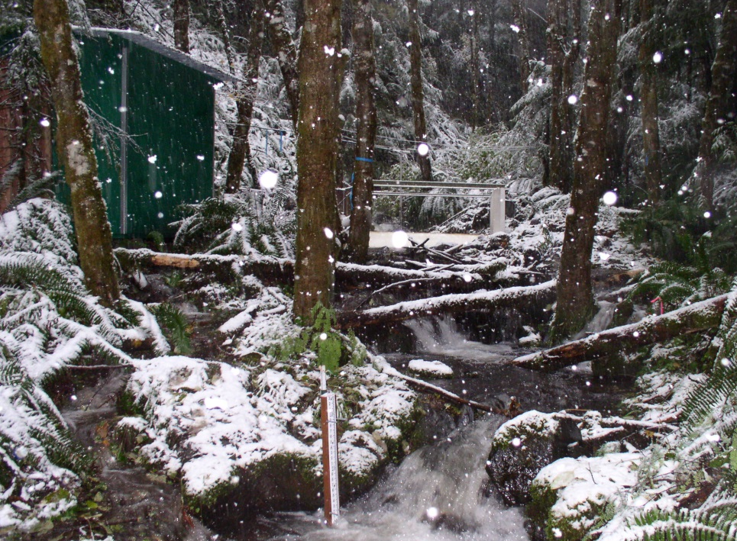
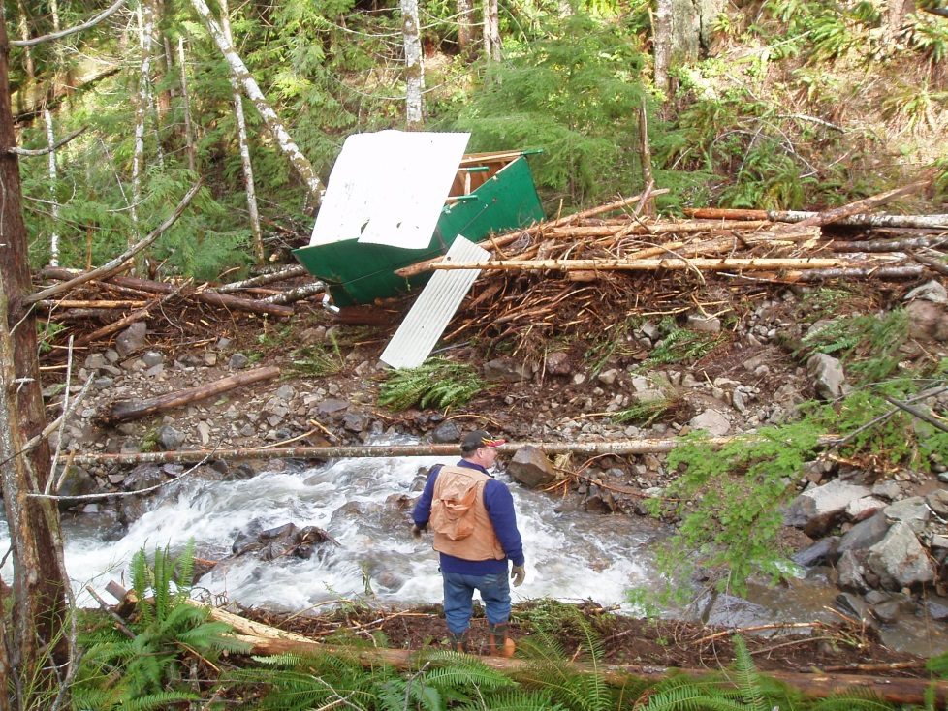
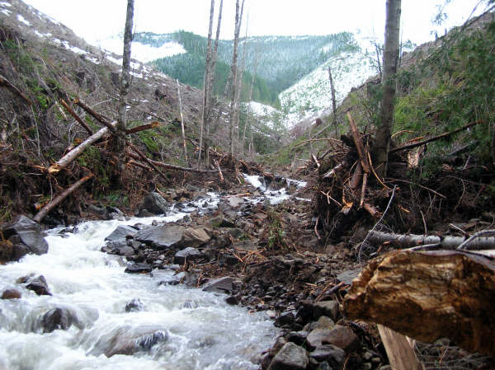
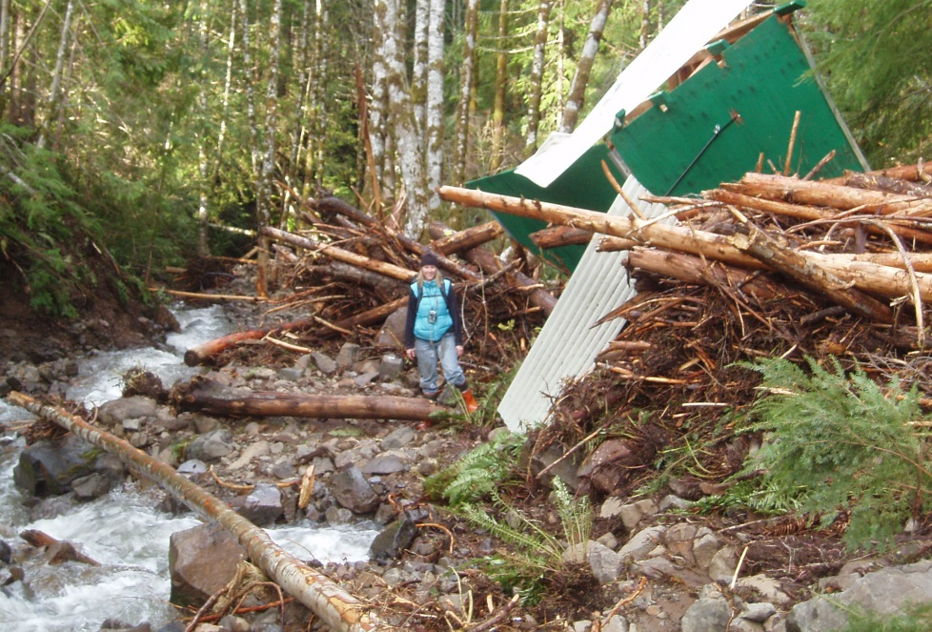
HINKLE CREEK PAIRED WATERSHED
Notes:
So another key component to quantifying hydrologic response residence time within a watershed.
So we’ll go to our animation again to demonstrate that each droplet of water will take a unique path to the outlet (if it isn’t evapotranspired), and from the distribution of all the transit times of these flow paths we can figure mean residence time within a waterhsed.
And these are important considerations for both water quality as contact time is a critical factor in biogeochemical reactions and water quantity in that mean residence time will describe how quick or flashy our storm response is.

Slide 19
HINKLE CREEK PAIRED WATERSHED
Notes:
So another key component to quantifying hydrologic response residence time within a watershed.
So we’ll go to our animation again to demonstrate that each droplet of water will take a unique path to the outlet (if it isn’t evapotranspired), and from the distribution of all the transit times of these flow paths we can figure mean residence time within a waterhsed.
And these are important considerations for both water quality as contact time is a critical factor in biogeochemical reactions and water quantity in that mean residence time will describe how quick or flashy our storm response is.

Slide 20
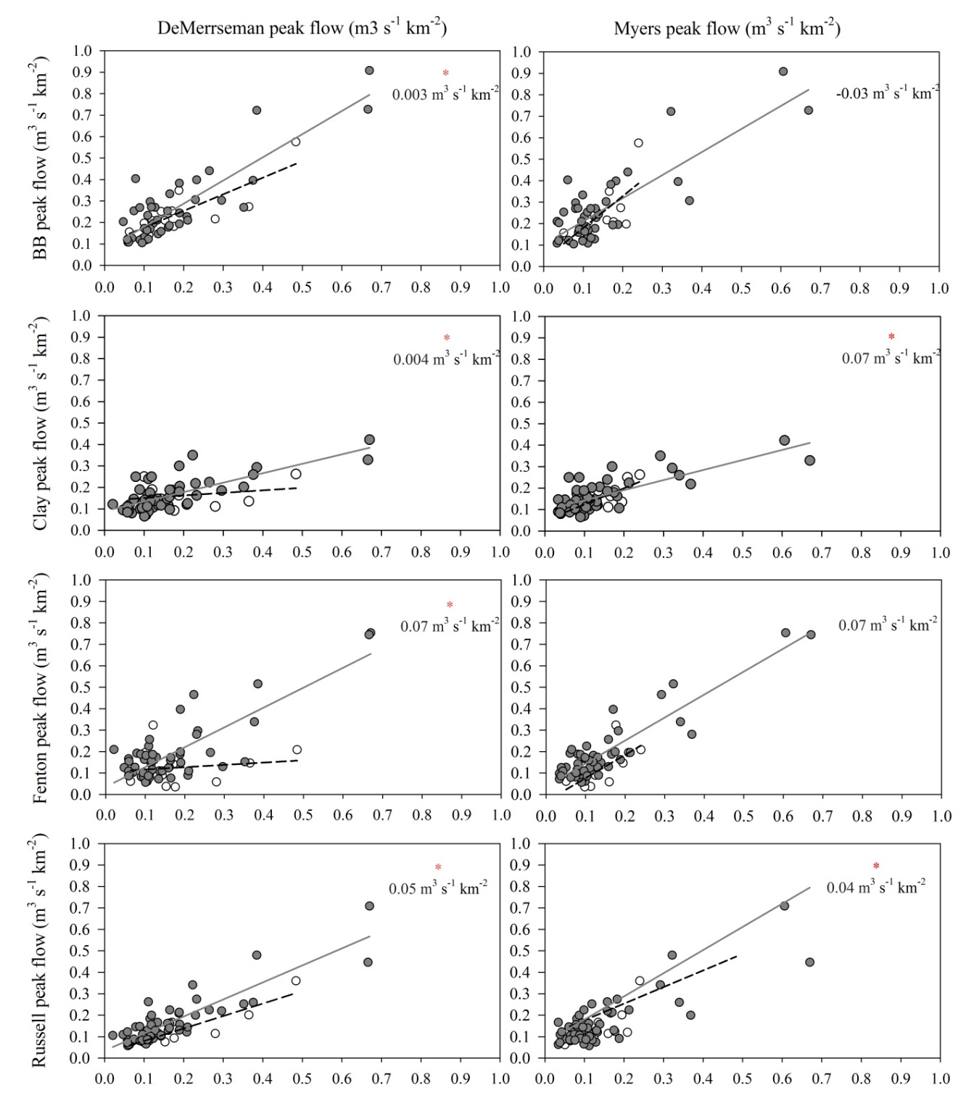
HARVESTING EFFECTS
LOCAL
PEAK FLOW
Notes:
So another key component to quantifying hydrologic response residence time within a watershed.
So we’ll go to our animation again to demonstrate that each droplet of water will take a unique path to the outlet (if it isn’t evapotranspired), and from the distribution of all the transit times of these flow paths we can figure mean residence time within a waterhsed.
And these are important considerations for both water quality as contact time is a critical factor in biogeochemical reactions and water quantity in that mean residence time will describe how quick or flashy our storm response is.

Slide 21
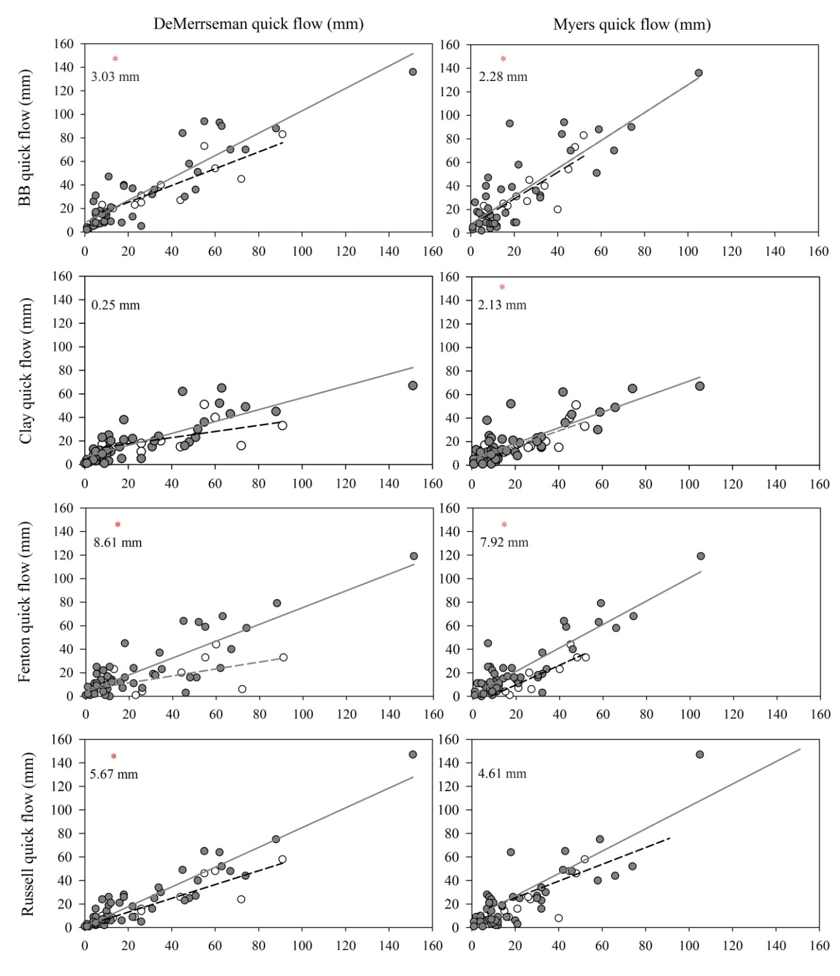
HARVESTING EFFECTS
LOCAL
QUICK FLOW
Notes:
So another key component to quantifying hydrologic response residence time within a watershed.
So we’ll go to our animation again to demonstrate that each droplet of water will take a unique path to the outlet (if it isn’t evapotranspired), and from the distribution of all the transit times of these flow paths we can figure mean residence time within a waterhsed.
And these are important considerations for both water quality as contact time is a critical factor in biogeochemical reactions and water quantity in that mean residence time will describe how quick or flashy our storm response is.

Slide 22
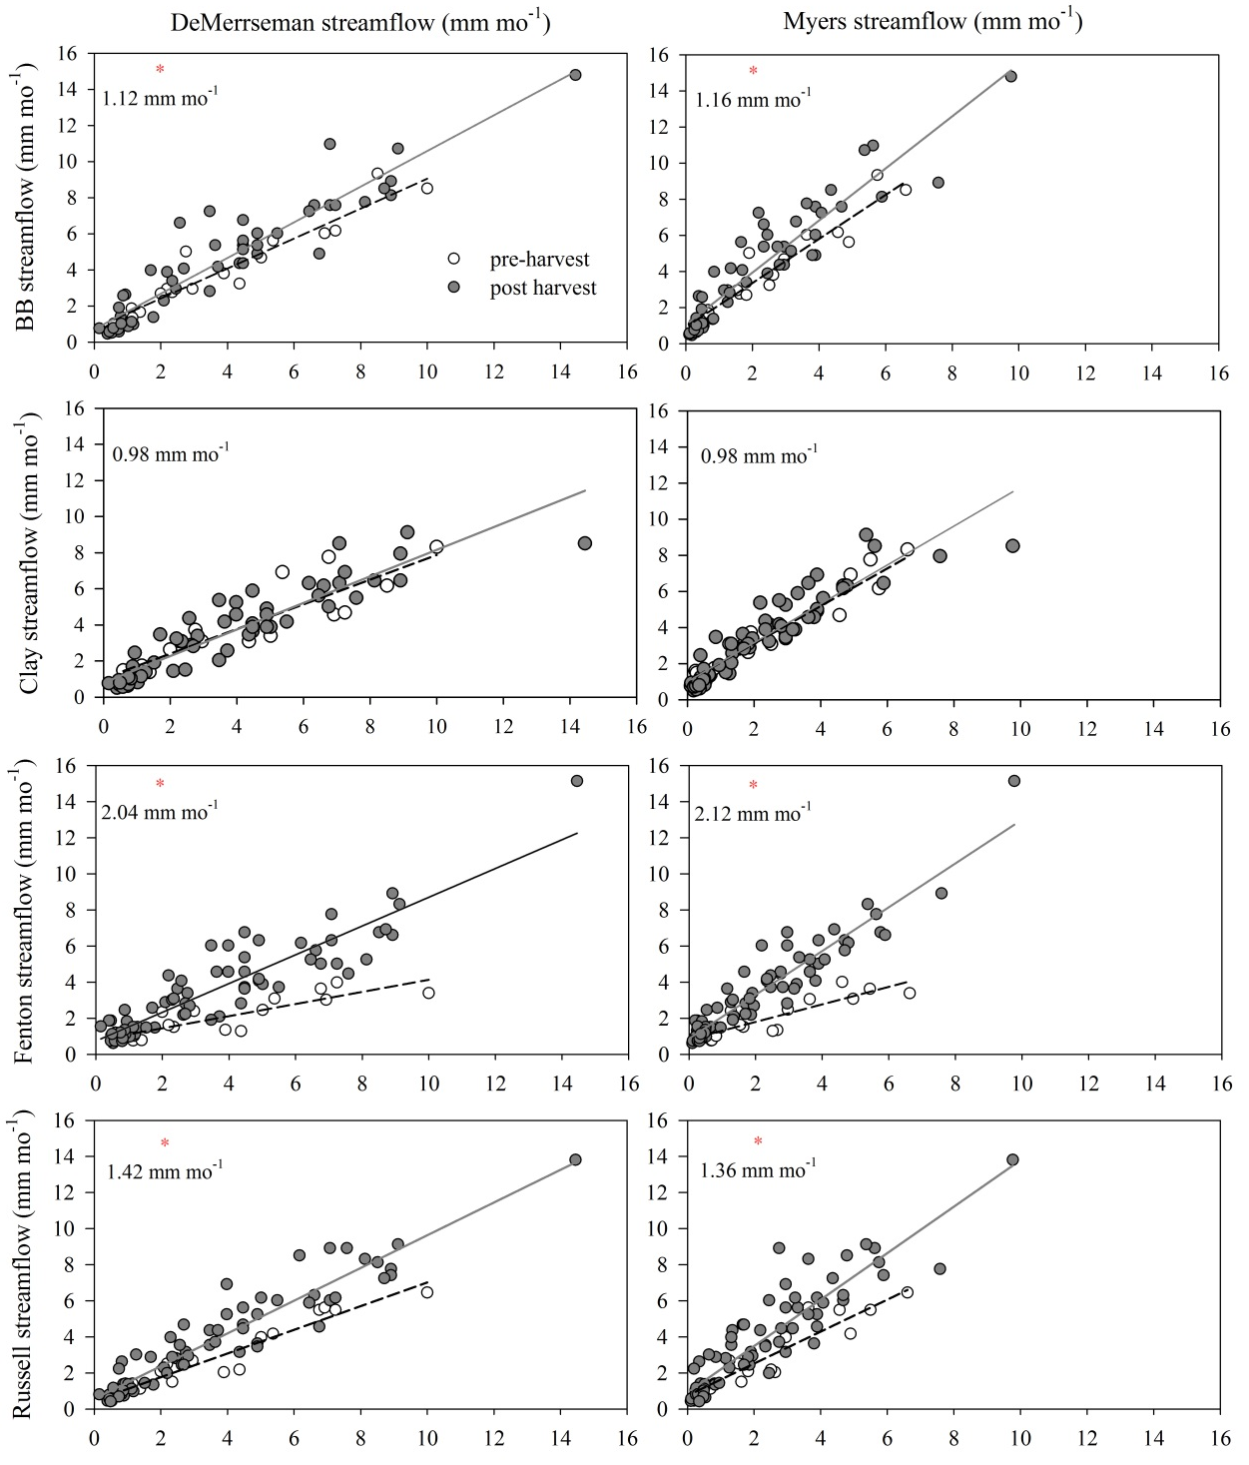
HARVESTING EFFECTS
LOCAL
MONTHLY
STREAM FLOW
Notes:
So another key component to quantifying hydrologic response residence time within a watershed.
So we’ll go to our animation again to demonstrate that each droplet of water will take a unique path to the outlet (if it isn’t evapotranspired), and from the distribution of all the transit times of these flow paths we can figure mean residence time within a waterhsed.
And these are important considerations for both water quality as contact time is a critical factor in biogeochemical reactions and water quantity in that mean residence time will describe how quick or flashy our storm response is.

Slide 23


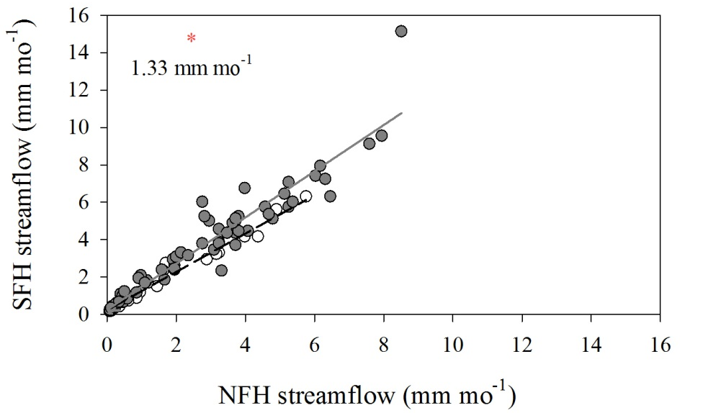
HARVESTING EFFECTS
DOWNSTREAM
PEAK FLOW
QUICK FLOW
MONTHLY
STREAMFLOW
Notes:
So another key component to quantifying hydrologic response residence time within a watershed.
So we’ll go to our animation again to demonstrate that each droplet of water will take a unique path to the outlet (if it isn’t evapotranspired), and from the distribution of all the transit times of these flow paths we can figure mean residence time within a waterhsed.
And these are important considerations for both water quality as contact time is a critical factor in biogeochemical reactions and water quantity in that mean residence time will describe how quick or flashy our storm response is.

Slide 24
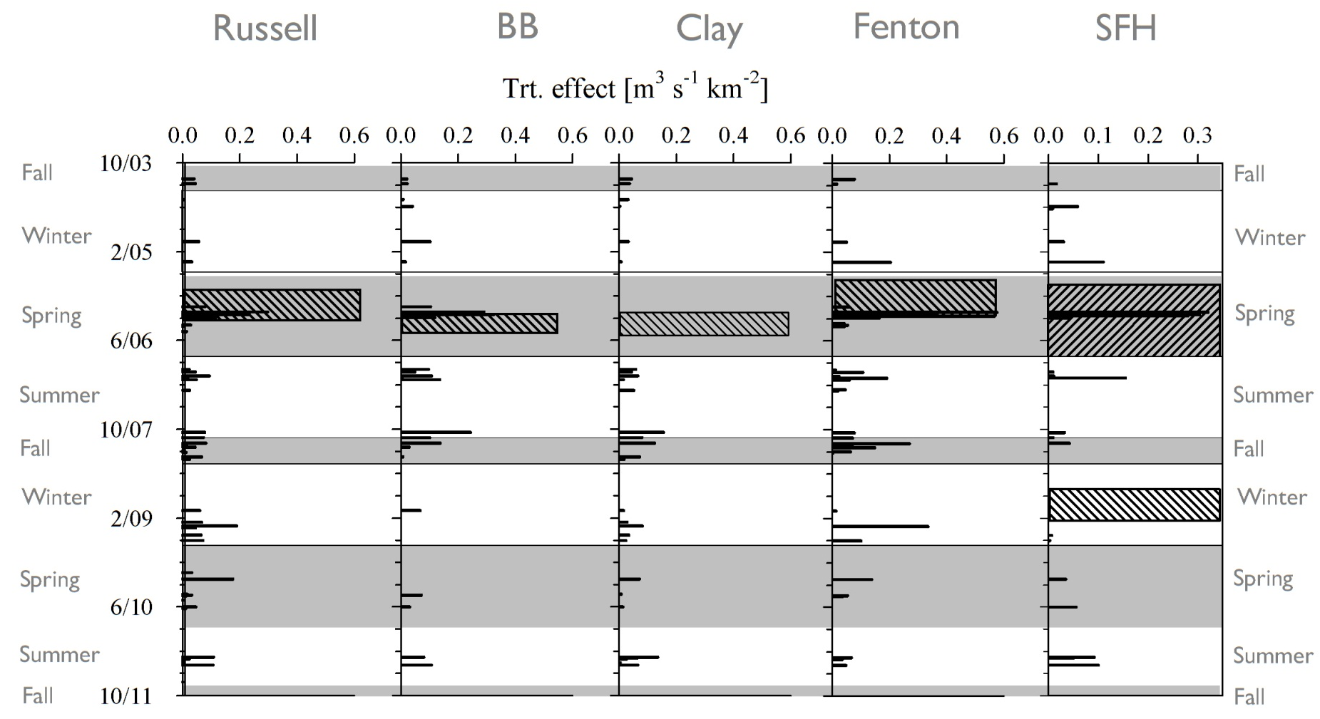
HARVESTING EFFECTS
SEASONAL CHANGES
PEAK FLOW
**
*
**
*
-
* sig. 1 ref catchment
** sig. both ref catchments
- not sig α=0.05
Notes:
So another key component to quantifying hydrologic response residence time within a watershed.
So we’ll go to our animation again to demonstrate that each droplet of water will take a unique path to the outlet (if it isn’t evapotranspired), and from the distribution of all the transit times of these flow paths we can figure mean residence time within a waterhsed.
And these are important considerations for both water quality as contact time is a critical factor in biogeochemical reactions and water quantity in that mean residence time will describe how quick or flashy our storm response is.

Slide 25
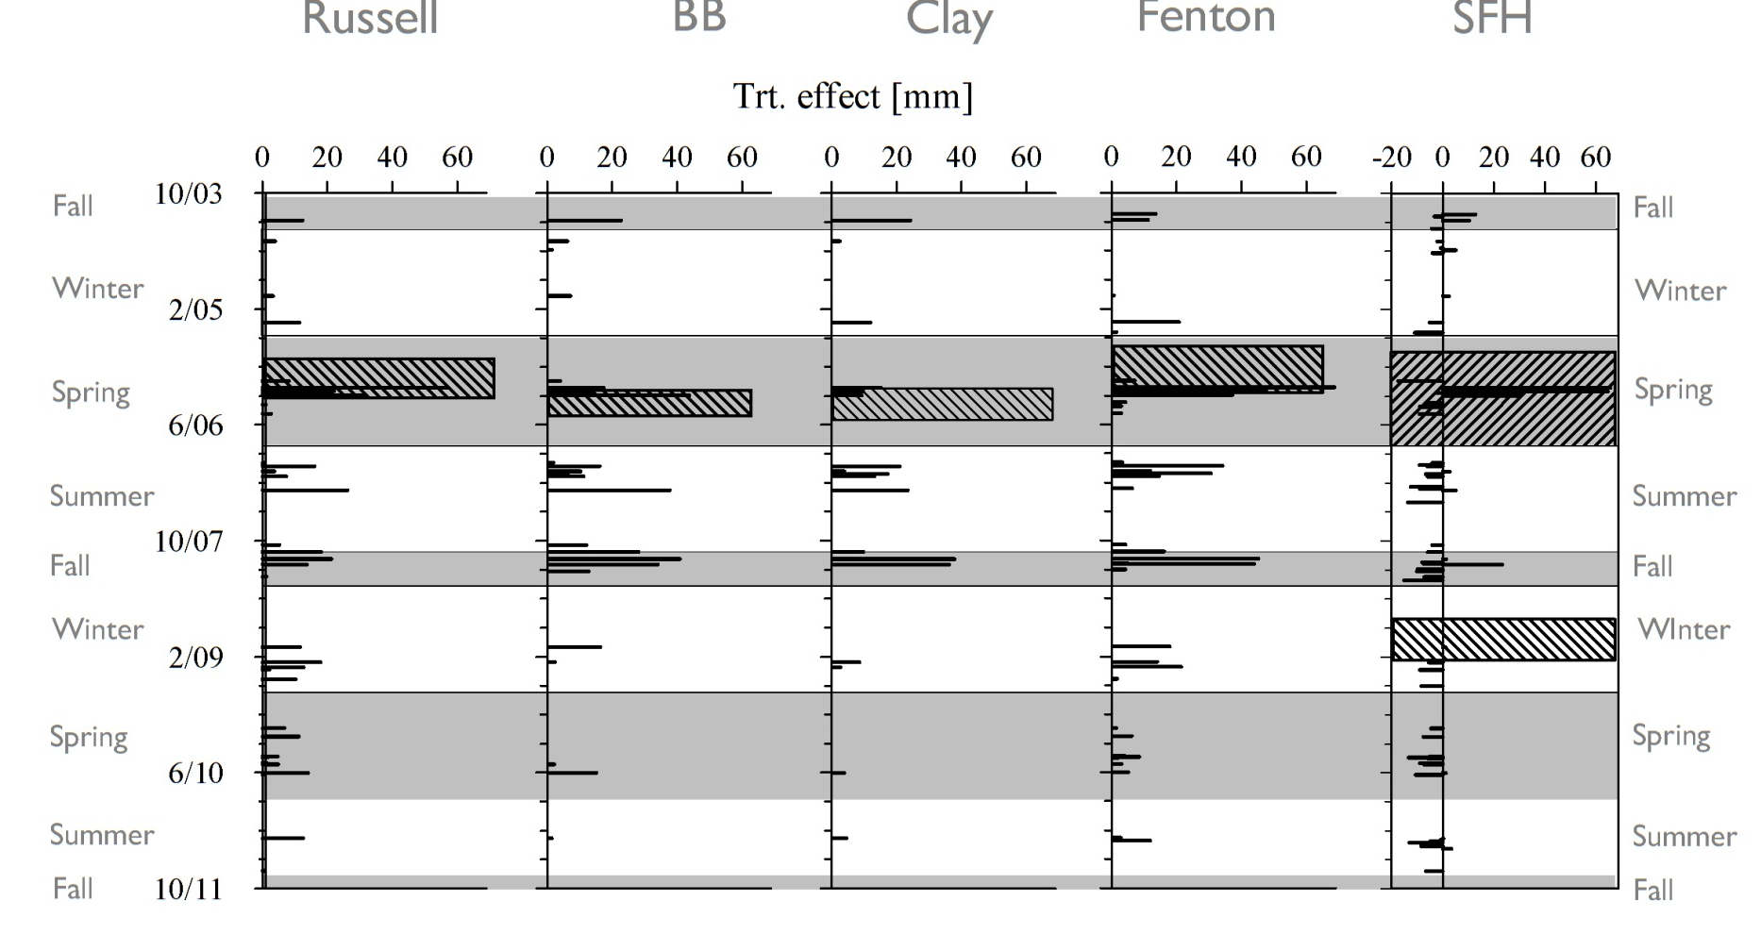
SEASONAL CHANGES
QUICK FLOW
HARVESTING EFFECTS
*
**
*
**
*
* sig. 1 ref catchment
** sig. both ref catchments
- not sig α=0.05
Notes:
So another key component to quantifying hydrologic response residence time within a watershed.
So we’ll go to our animation again to demonstrate that each droplet of water will take a unique path to the outlet (if it isn’t evapotranspired), and from the distribution of all the transit times of these flow paths we can figure mean residence time within a waterhsed.
And these are important considerations for both water quality as contact time is a critical factor in biogeochemical reactions and water quantity in that mean residence time will describe how quick or flashy our storm response is.

Slide 26
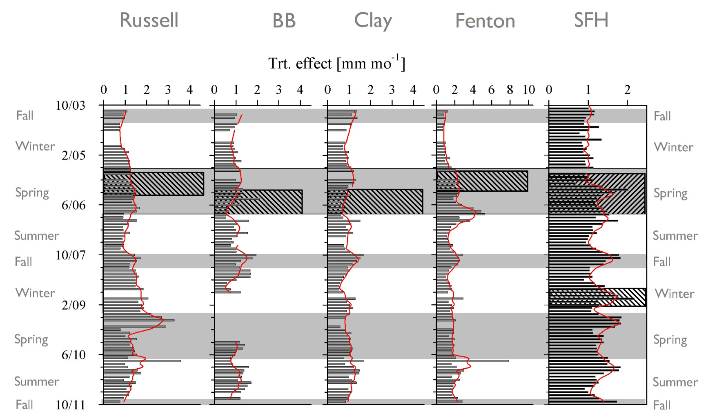
SEASONAL CHANGES
MONTHLY STREAMFLOW
HARVESTING EFFECTS
**
**
*
**
*
* sig. 1 ref catchment
** sig. both ref catchments
- not sig α=0.05
Notes:
So another key component to quantifying hydrologic response residence time within a watershed.
So we’ll go to our animation again to demonstrate that each droplet of water will take a unique path to the outlet (if it isn’t evapotranspired), and from the distribution of all the transit times of these flow paths we can figure mean residence time within a waterhsed.
And these are important considerations for both water quality as contact time is a critical factor in biogeochemical reactions and water quantity in that mean residence time will describe how quick or flashy our storm response is.

Slide 27
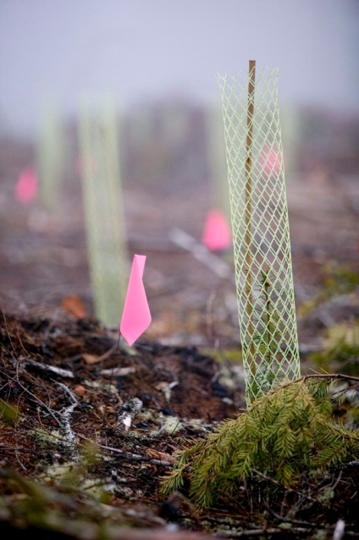

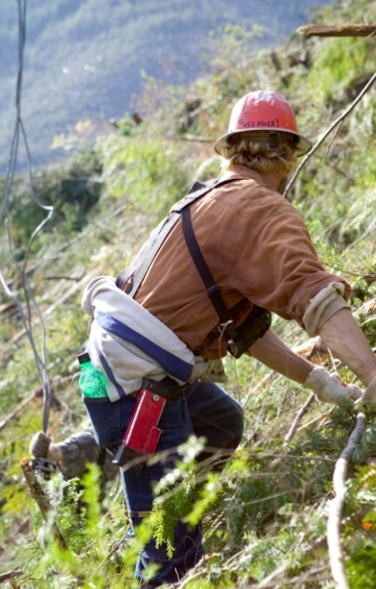
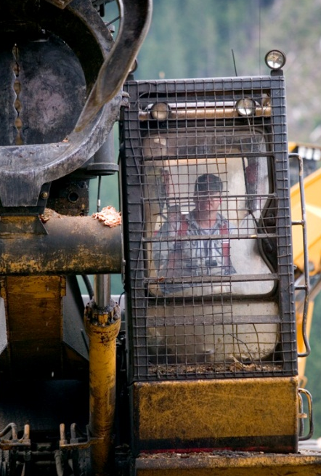
SUMMARY OF HYDROLOGY STUDY
  Significant increases in monthly streamflow, peak flow and quick flow at local scale
  Significant increases in monthly streamflow and significant decrease in quick flow at downstream scale
  Seasonal changes:
    Greatest QF increases during summer / fall;
    Greatest Q increases during spring / summer
  Impact of harvesting on peak flows limited to storms < 2-yrs return
Notes:
So another key component to quantifying hydrologic response residence time within a watershed.
So we’ll go to our animation again to demonstrate that each droplet of water will take a unique path to the outlet (if it isn’t evapotranspired), and from the distribution of all the transit times of these flow paths we can figure mean residence time within a waterhsed.
And these are important considerations for both water quality as contact time is a critical factor in biogeochemical reactions and water quantity in that mean residence time will describe how quick or flashy our storm response is.

Slide 28
CONTINUING & FUTURE WORK
  Change detection at different time-scales (e.g. seasonal) & storm definition
  Understand decreases in quickflow at downstream scale
  Quantify hydrologic recovery
  Models to generate hypotheses of process change
Notes:
So another key component to quantifying hydrologic response residence time within a watershed.
So we’ll go to our animation again to demonstrate that each droplet of water will take a unique path to the outlet (if it isn’t evapotranspired), and from the distribution of all the transit times of these flow paths we can figure mean residence time within a waterhsed.
And these are important considerations for both water quality as contact time is a critical factor in biogeochemical reactions and water quantity in that mean residence time will describe how quick or flashy our storm response is.

Slide 30
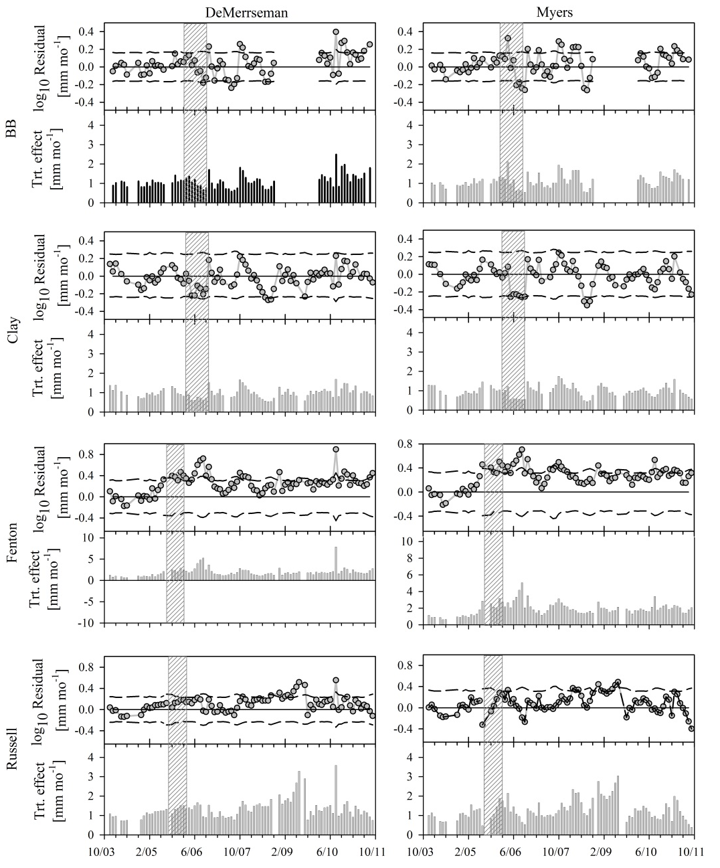
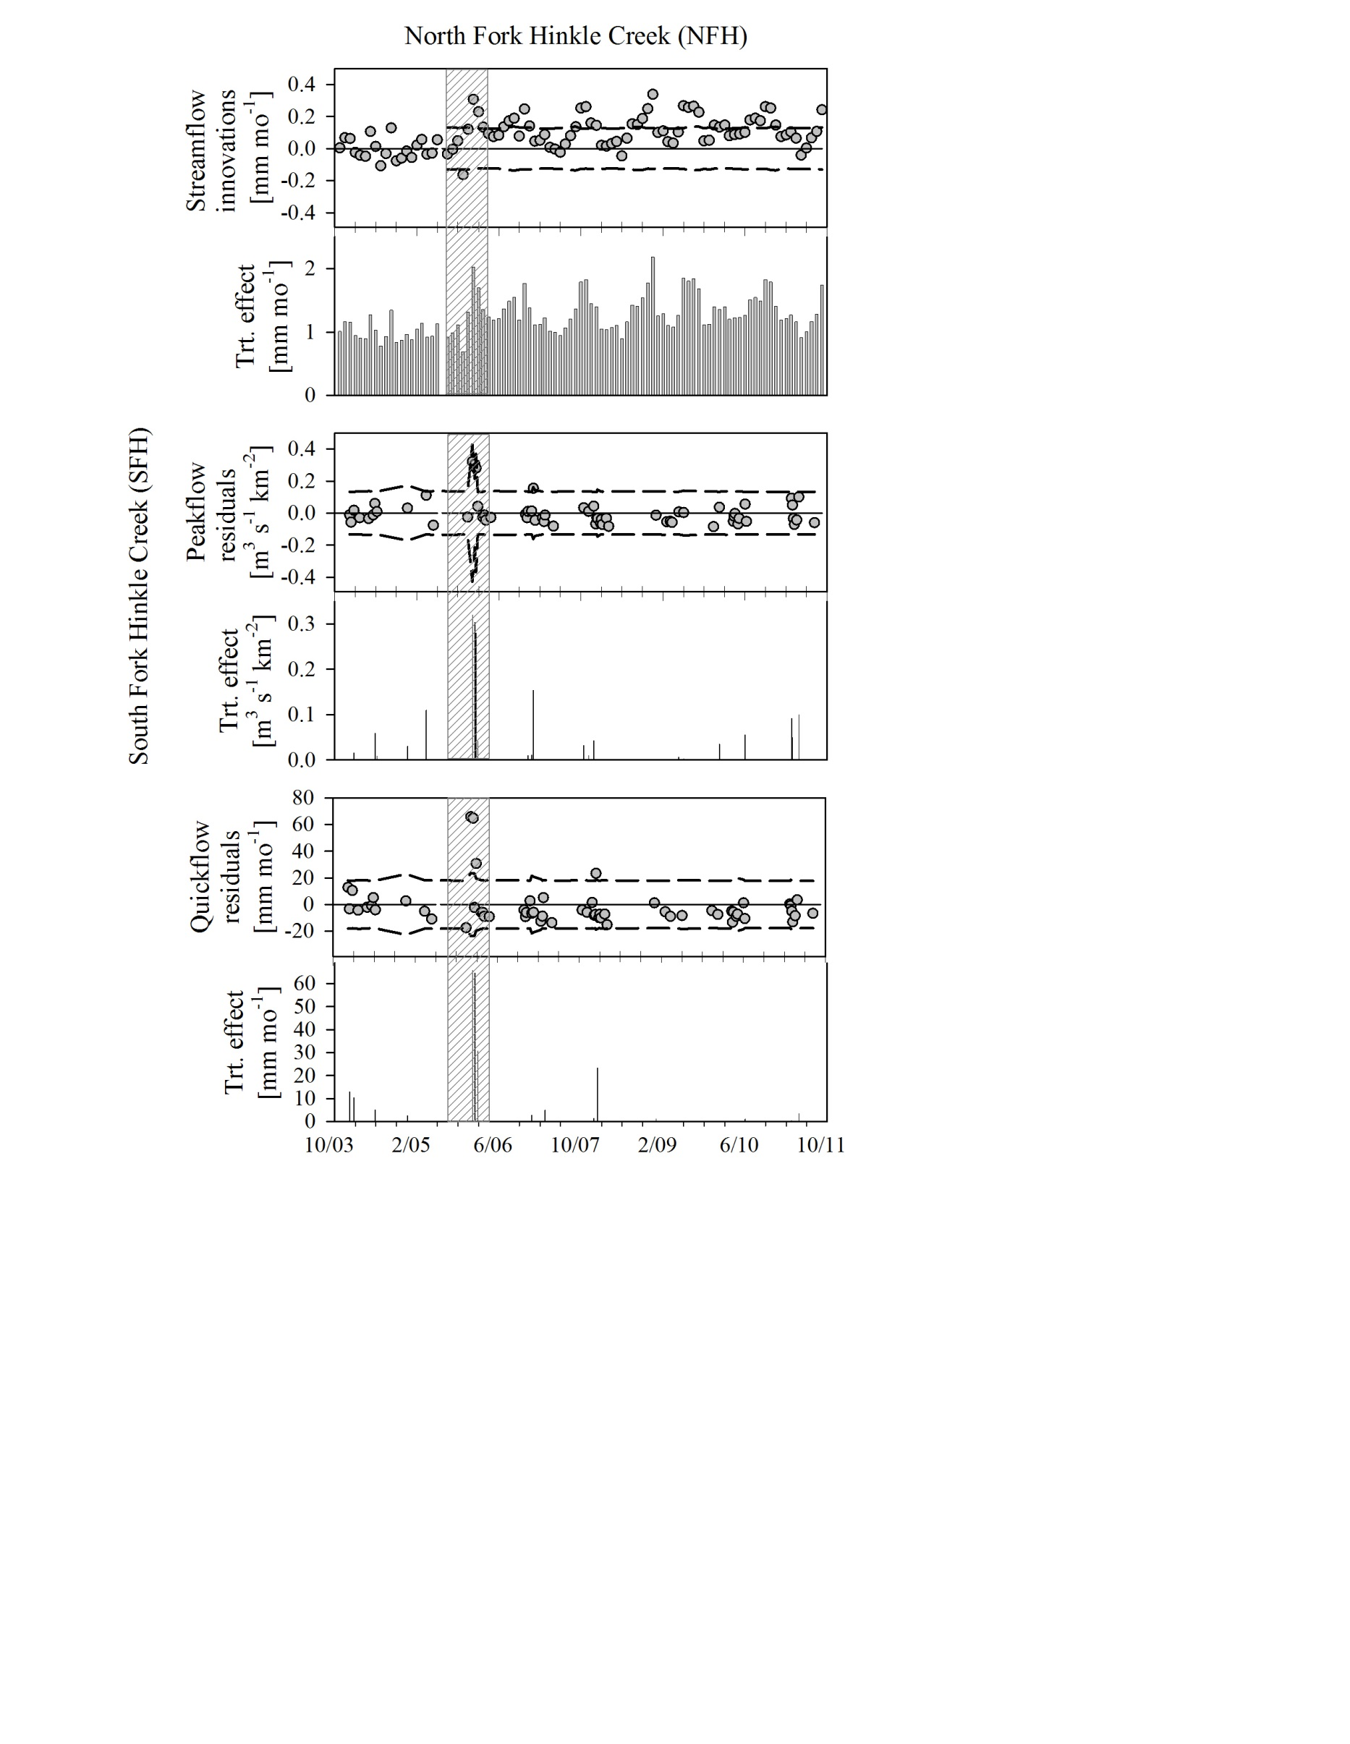
STREAMFLOW
Notes:
So another key component to quantifying hydrologic response residence time within a watershed.
So we’ll go to our animation again to demonstrate that each droplet of water will take a unique path to the outlet (if it isn’t evapotranspired), and from the distribution of all the transit times of these flow paths we can figure mean residence time within a waterhsed.
And these are important considerations for both water quality as contact time is a critical factor in biogeochemical reactions and water quantity in that mean residence time will describe how quick or flashy our storm response is.

Slide 31
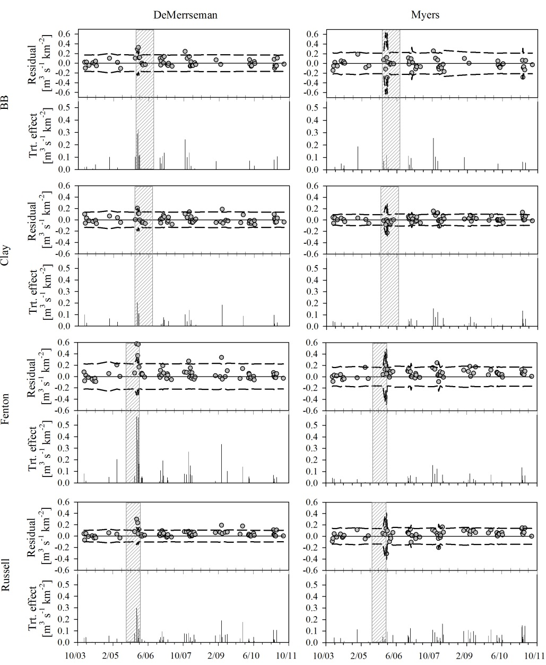
PEAK FLOW
Notes:
So another key component to quantifying hydrologic response residence time within a watershed.
So we’ll go to our animation again to demonstrate that each droplet of water will take a unique path to the outlet (if it isn’t evapotranspired), and from the distribution of all the transit times of these flow paths we can figure mean residence time within a waterhsed.
And these are important considerations for both water quality as contact time is a critical factor in biogeochemical reactions and water quantity in that mean residence time will describe how quick or flashy our storm response is.

Slide 32
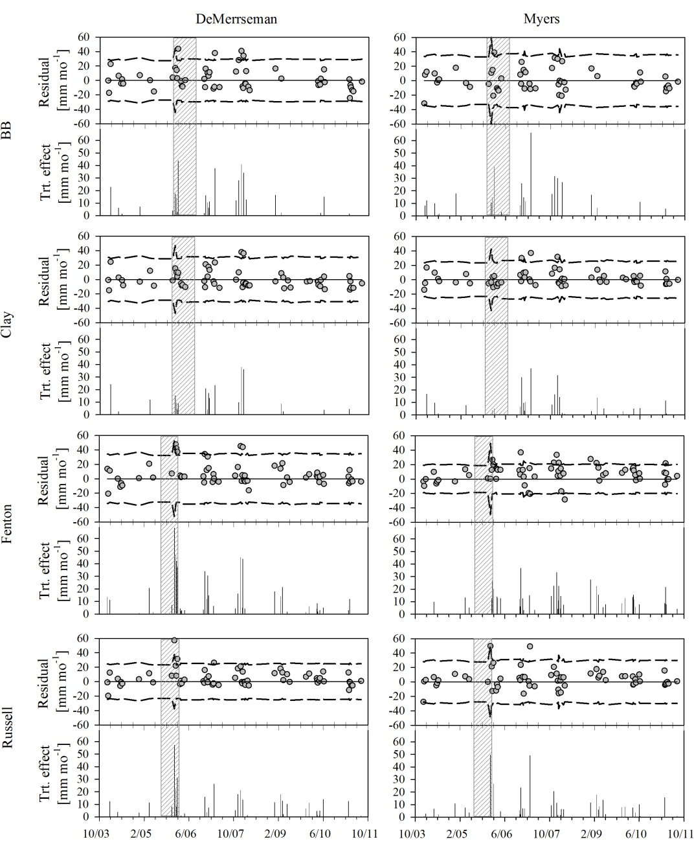
QUICK FLOW
Notes:
So another key component to quantifying hydrologic response residence time within a watershed.
So we’ll go to our animation again to demonstrate that each droplet of water will take a unique path to the outlet (if it isn’t evapotranspired), and from the distribution of all the transit times of these flow paths we can figure mean residence time within a waterhsed.
And these are important considerations for both water quality as contact time is a critical factor in biogeochemical reactions and water quantity in that mean residence time will describe how quick or flashy our storm response is.

