Slide 1
LARGE WOOD AND LOG JAMS
Department of Forestry 2004
Stream Habitat Restoration Guidelines

Slide 2
Overview
Methodology
LWD benefits
Approaches to establishing LWD structures
How LWD creates habitat
LWD application considerations
LWD designs
Recommendations for placement of LWD’s

Slide 3
Methodology
Large wood is typically applied to address a deficiency of habitat and natural channel-forming processes.
Typically caused by:
Urbanization
Logging
Agriculture
Road building

Slide 4
Methodology cont…
Large wood and log jam placement may accelerate the natural recovery of streams.
Used to promote stability in incising channels while providing additional habitat value.
LWD Placement should be viewed as a short term solution.
Objective is to provide habitat while natural processes are restored.

Slide 5
LWD benefits
Absorbs the force of high flows and reduces bank erosion.
Recruits additional wood and gravel via stream bank scour.
Retains and sorts spawning gravel.
Provides movement pathways for terrestrial wildlife.

Slide 6
LWD benefits cont…
Creates pool habitat for fish by concentrating flows and creating scour around structures.
Retains organics (wood, detritus, carcasses) that provides nutrients to aquatic organisms.
Providing cover and food for both aquatic and terrestrial species.

Slide 7
Approaches to establishing LWD structures
Placed large wood
This approach is the deliberate placement of wood in streams and floodplains to form discrete structures at specific locations.
Placed LW and logjams create habitat directly
use natural processes that scour and deposit

Slide 8
Approaches to establishing LWD structures
Large wood replenishment
Introduction of LW to a stream.
Intent to re-establishing natural LW loading volumes and distributions.
LW is delivered without mechanical anchoring.
Allows high flow events to arrange it naturally.

Slide 9
Approaches to establishing log structures
Trapping mobile wood
Intent: Trapping mobile wood during high flow events.
Uses the natural process of delivery, transport, and storage of wood in a stream.
Creates habitat-forming structures.

Slide 10
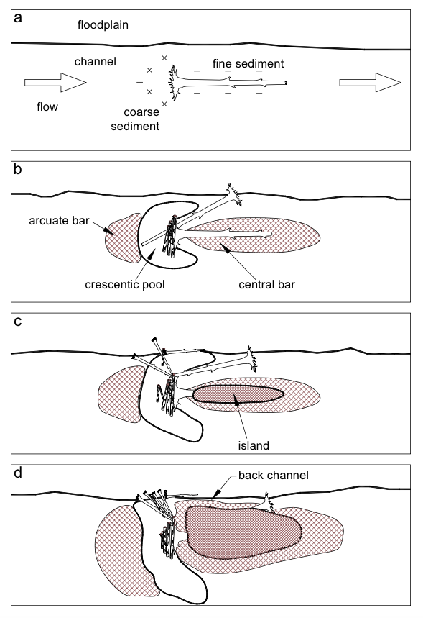
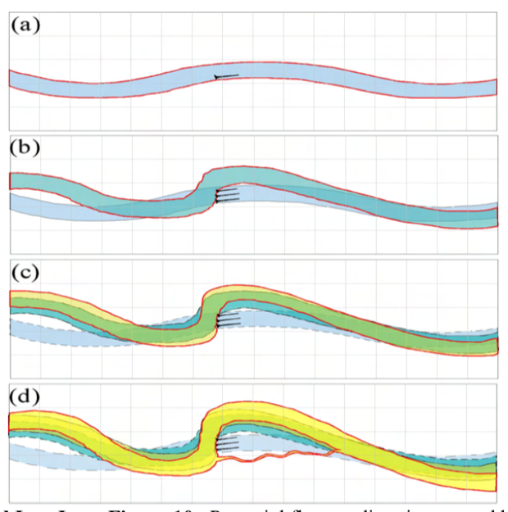
How does LWD create habitat?
Small area perspective
Reach scale or larger

Slide 11
LWD application considerations
LWD is added to a stream purely for its habitat value.
LWD should be applied when:
A biological or geomorphic need for in-stream wood and wood-related habitat is justified.
Or when existing riparian trees are too small to provide natural LW recruitment

Slide 12
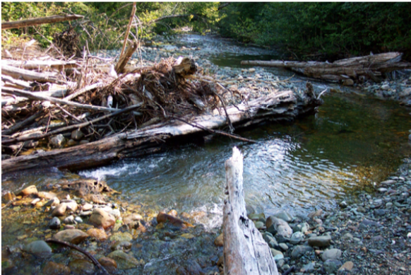
LWD application considerations
How LWD should not be used:
For channel stabilization.
Should not be placed in degrading streams.
Unless the cause of degradation is addressed.

Slide 13
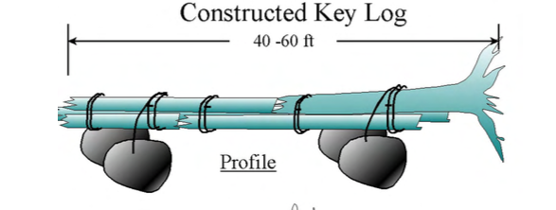
LWD designs-- Artificial large log
Used when large logs are impossible to deliver to a site due to their size or weight.
A large log can be made from smaller logs.
Anchored by boulder and cables.

Slide 14
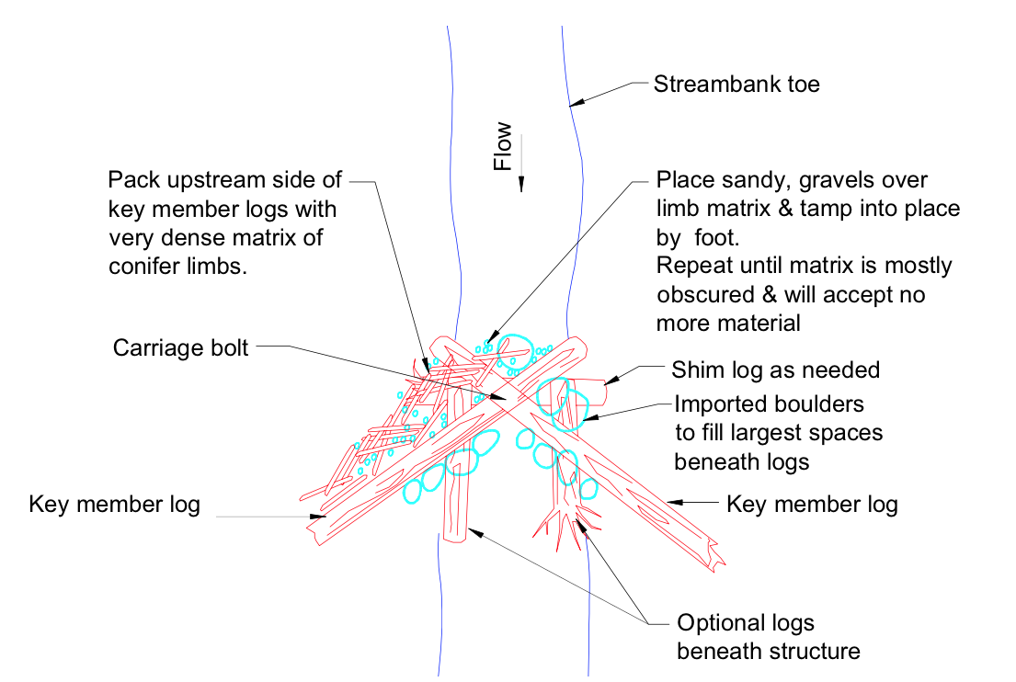
LWD designs--- Log Jams

Slide 15
Recommendations for placement of LWD’s
STREAM TYPE | AVG SIZE | RECOMMENDATION
Smaller streams | (<10m wide) | Single or multiple pieces of wood can be effectively used.
Medium-sized streams | (10 to 20 m wide) | Woody debris should lie within the active channel, or intrude into it significantly.
Large streams | (>20 m wide) | Only recommended in the form of anchored structures. Woody debris should lie within the active channel, or intrude into it significantly.

Slide 16
Costs
A small to moderate-sized log jam could take up to a half a day to build.
And can cost approximately $600 to install using a medium-sized excavator.
Total costs for logjams may range from approximately $1,000 to over $50,000 depending on the size of project.

Slide 17
Conclusion
Large wood is typically applied to address a deficiency of habitat and natural channel-forming processes.
LWD Placement should be viewed as a short term solution.
Objective is to provide habitat while natural processes are restored.
Types of LWD techniques are: Placed large wood, Large wood replenishment and Trapping mobile wood

