Slide 1
Side Channel and Off Channel Habitat Restoration
Washington Dept. Forestry, 2004, Side Channel Restoration
Dylan Castle

Slide 2
Overview
Description of Side Channels
Benefits of Side Channels
Risks of Restoration
Restoration Site Considerations
  Goal of restoration
  Selecting a good site

Slide 3
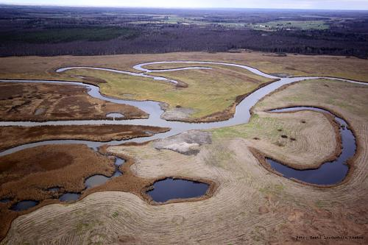
Side Channels
Small watered remnants of river meanders
  Abandoned River Channels
  Oxbow Lakes
  Lower Ends of Terrace Tributaries

Slide 4
Types of Side Channels
Overflow Channels
  Relic river channels
  Directly connected during times high flow
  Very dynamic due to influx of debris
  Helps clean and re-distribute spawning material

Slide 5
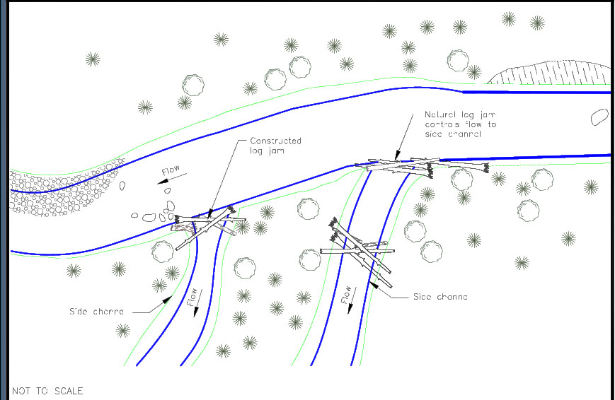
Types of Side Channels
Perc Channels
  Relic river or floodplain channels
  Primarily supplied from hyporheic zone
  Winter and summer refuge for juvenile fish
  Spawning habitat for fish and amphibians
  Foraging habitat for many birds and mammals

Slide 6
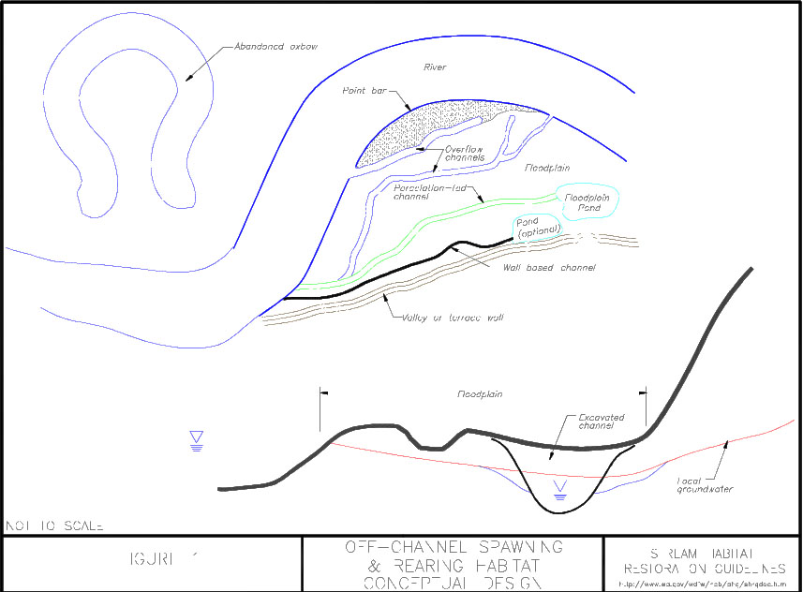
Types of Side Channels
Floodplain Ponds
  Natural or constructed ponds
  Ponds, oxbows, gravel pits or mill ponds

Slide 7
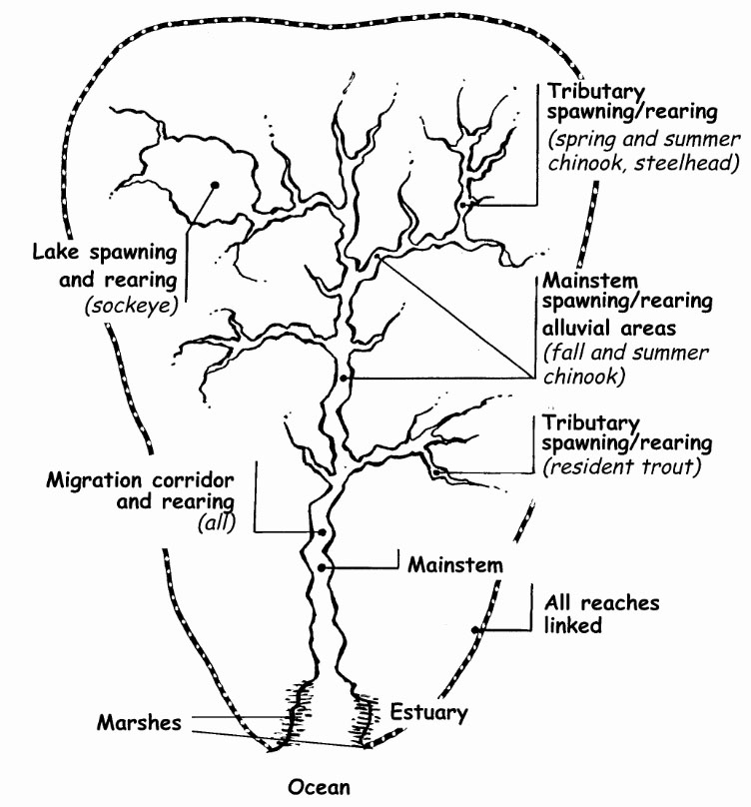
Side Channel Benefits
Critical habitat for salmonids
Protection from storms and predators
Spawning areas for chum and coho
Rearing habitat for fry

Slide 8
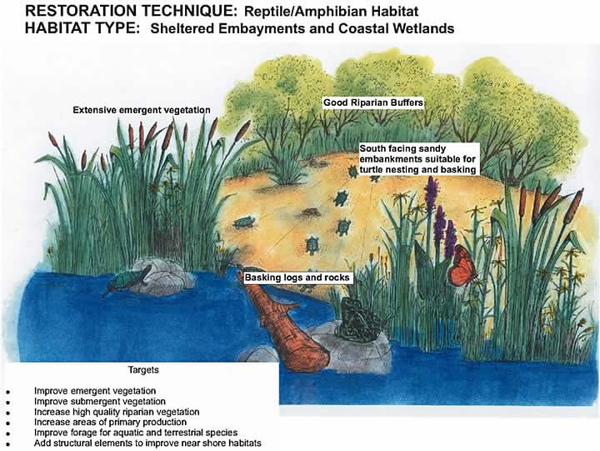
Benefit Other Wildlife
Rearing of many amphibians
Reproductive habitat for many bird species
Many organisms feed on salmon carcasses
Vegetation diversity

Slide 9
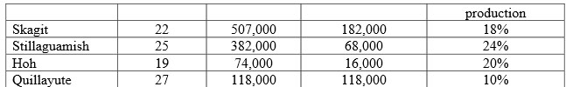
Benefits Cont.
Average length (inches) of coho and chinook, respectively
  Unfertilized river: 30.38 and 41.25
  Unfertilized Pond: 46.38 and 56.61
  Fertilized Pond: 49.60 and 66.52
  61% length increase for coho and 62% for chinook

Slide 10
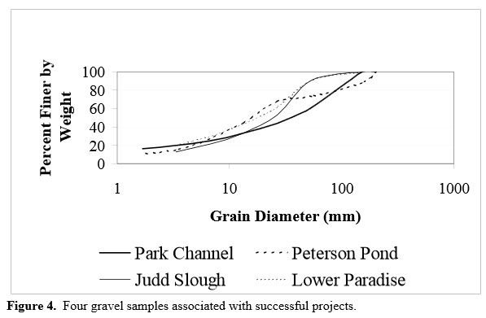
Site Restorations
Side Channels are naturally occurring
Habitat loss mostly from restriction or constraints
Restorations need to
be self-sustaining
Easiest restorations are removing restrictions

Slide 11
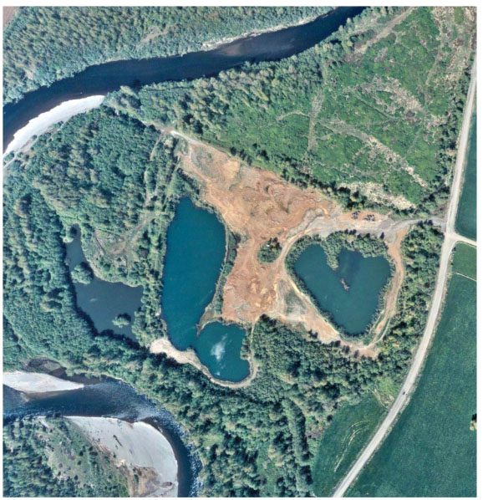
Site Restorations
Selecting a good site is critical
  Geologic Conditions
  River channels
  Vegetation
  Groundwater
  Elevation
  Annual Flows
  Water Quality

Slide 12
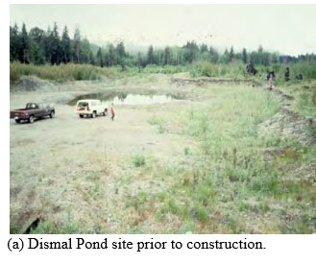
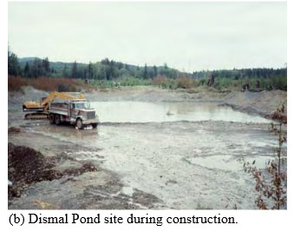
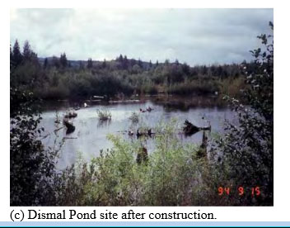
Site Restorations
Data Needs
  Current Fish Use - Flow Rates
  Topography - Water Levels/Quality
  Establishing Baseline

Slide 13
Site Restorations Risks; Habitat
Increase Turbidity
Vegetation and Wildlife Displacement
Soil Displacement
Bed or Bank Scour
Avulsion
High velocity flows can
displace woody material

Slide 14
Site Restorations Risks; Wildlife
Fish stranded in restored channels.
Little water turnover
No vegetative cover
Most risks are easily manageable and most are only temporary.

Slide 15
Monitoring
Monitoring biological data is critical to determining success
Fish Counts
  Adults, not smolt
Development of Vegetation
  Photographs
Maintenance should be minimal

Slide 16
Conclusion
Side channels: small watered remnants of river meanders
Provide spawning and rearing habitat for salmonids
Habitat for birds and amphibians
Allows diversification of vegetation
Many factors to consider when determining possible site
  Vegetation, water quality and flow, current use, groundwater

Slide 17
