Slide 1
Fundamentals of River Restoration and Salmonid Fisheries
OWEB, 1999, Fundamentals of River Restoration and Salmonid Fisheries

Slide 2
Their definition of river restoration:
“assisting the establishment of improved hydrologic, geomorphic, and ecological processes in a degraded watershed system and replacing lost, damaged, or compromised elements of the natural system”

Slide 3
Overview
What is a Watershed?
Patterns in Watershed Conditions
Water Dynamics
Soil and Sediments
Vegetation
Wetlands
Water Quality
Fisheries Resources
Conclusion

Slide 4
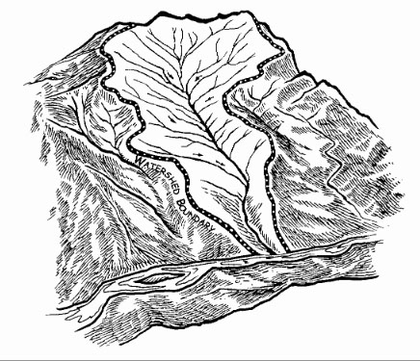
What is a Watershed
“Area of land that drains downslope to the lowest point”- OWEB
  Drainage pathways can be surficial or underground
Assessments should occur at the watershed level due to connectivity
Activity affecting the watershed at one location will affect the watershed downstream

Slide 5
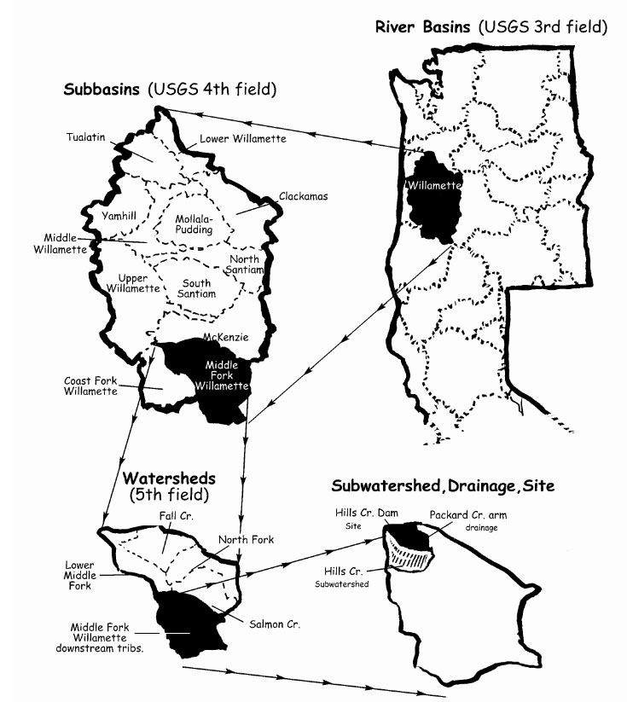
What is a Watershed Cont.
Watersheds are broken into categories
  River Basins
  Sub-basins
  Watershed
    Sub-watershed
    Drainage
    Site

Slide 6
Regional Patterns in Watershed Conditions
Watersheds determined by geology, climate, and disturbances
  Geology: uplifting can influence slope and orientation of bedrock
  Climate: elevation, precipitation, and vegetation
  Disturbances: large or small scale
    Small Scale: trees blown into a stream
    Large Scale: fire or flood
    Natural part of watershed evolution
    Human activities can increase timing and intensity
      i.e. roads creating impervious surfaces

Slide 7
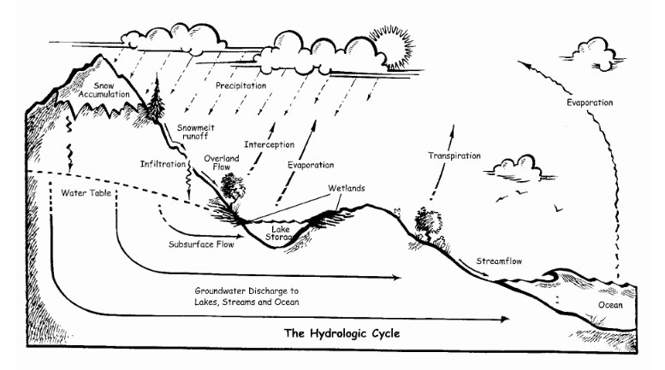
Water Dynamics
Water Cycle
Precipitation uses three pathways on Earth’s surface
  Intercepted by vegetation and evaporated or transpired back to atmosphere
  Move downslope on surface or through soil to stream system
  Stored in snowpack, groundwater, ponds, or wetlands for a period of time

Slide 8
Water Dynamics Cont.
Precipitation is generally less than infiltration rates
  Little surface runoff or overland flows occur
Decreases in infiltration rates can cause larger peak flows
  Reduce water storage and result in low flows

Slide 9
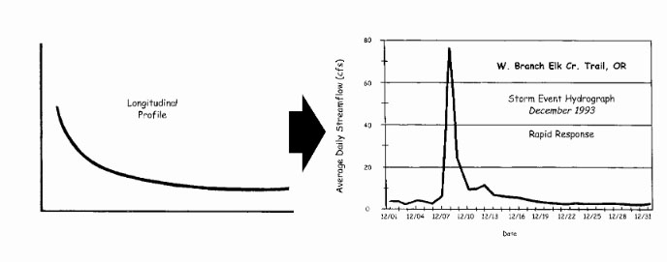
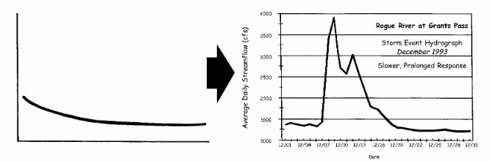
Hydrologic Data
Steep slopes and/or thin soil move water relatively quickly
Larger watersheds, deep soils, and extensive storage sites tend to move water slower

Slide 10
Soil Erosion and Sediment in Streams
Sediment Derived from
  Erosion of upland areas
  Lateral movement of stream channels
  Downcutting of stream beds
Sediment balance is important
  Fine sediment can blanket spawning gravel and cover rock surfaces for insects
  Suspended sediments can cloud water

Slide 11
Soil Erosion and Sediment in Streams Cont.
Humans have little control over natural sedimentation
  Organisms have adapted to local sedimentation rates
Can only control human-induced sedimentation
Some sources of Sediment
  Slope instability
  Urban runoff
  Surface erosion from crop, range, and burned land.
  Road instability

Slide 12
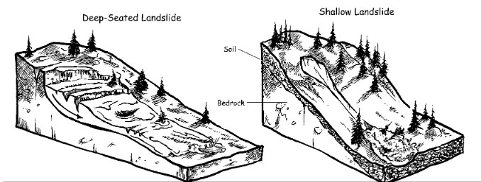
Soil Erosion
Number of mechanisms can move soil downhill or into streams
  Raindrop Splash: splattered soil grain from raindrops, can accumulate downhill
  Ravel: movement of soil downhill from gravity
  Surface rilling: soil carried by overland flow.
  Landslides

Slide 13
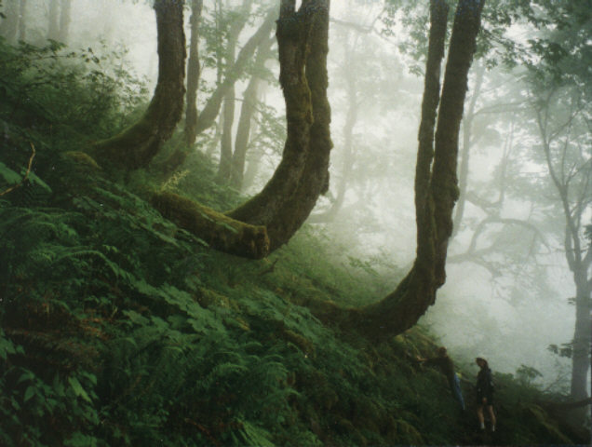
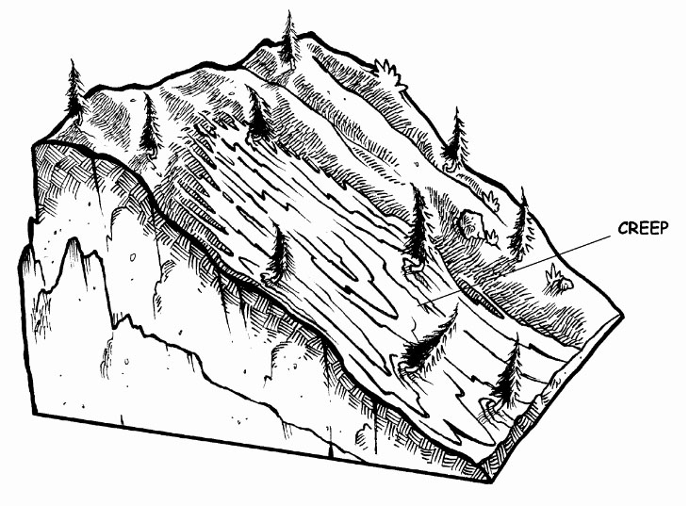
Soil Erosion
Mass Wasting (creeps and flows): gravity moves soil downhill

Slide 14
Vegetation
Factors of Vegetation
  Water temperature
  Sediment delivery
    Reduces soil compaction
  Amount and timing of runoff
    Filters Toxins
  Food and shelter for living organisms
  Large woody debris
  Decrease erosion

Slide 15
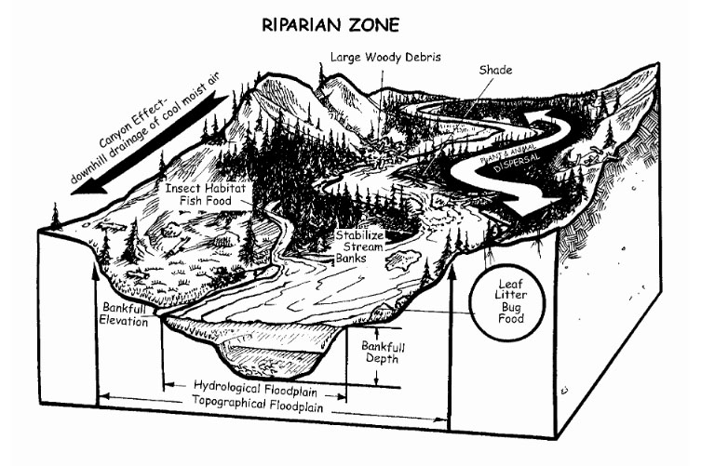
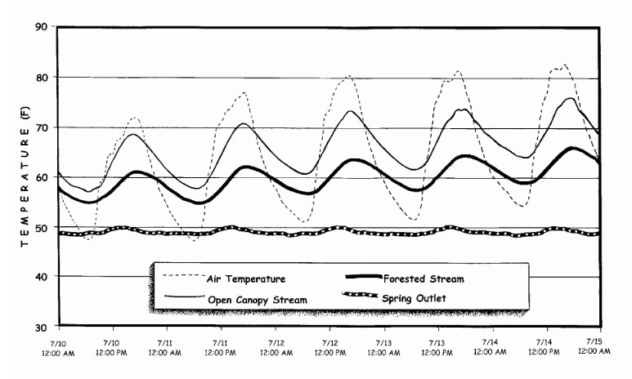
Riparian Zones
Vegetation decreases fluctuation of water temperatures

Slide 16
Wetlands
Provide Variety of important functions
  Water quality improvement
    Assimilate nutrients and filter toxins
  Flood attenuation and desynchronization
    Alleviate flooding by storing water or delaying runoff
  Groundwater recharge and discharge
    Recharge aquifers by storing water
  Fish and wildlife
    Provide food and habitat

Slide 17
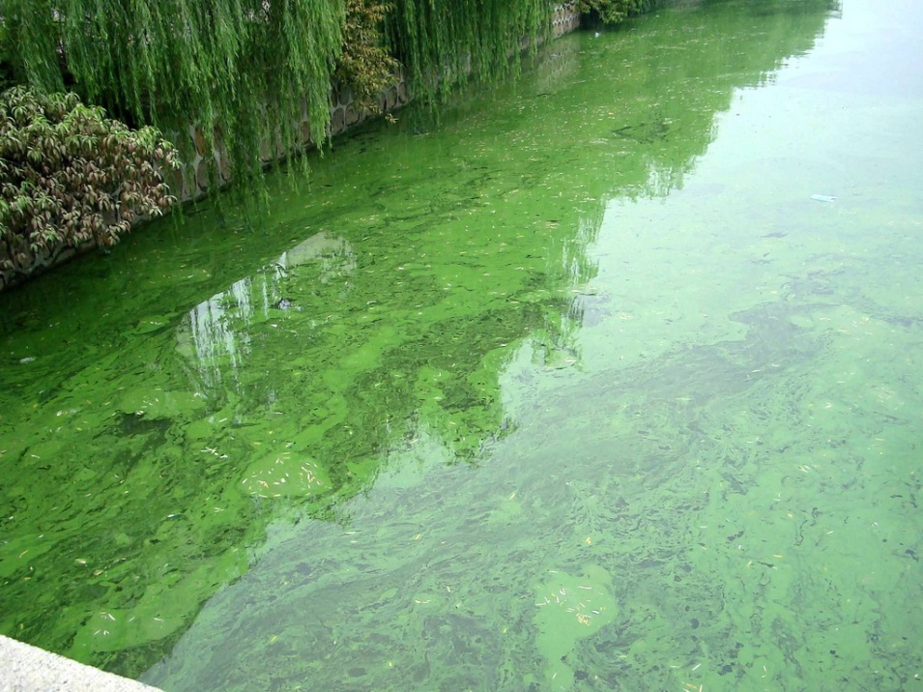
Water Quality
Nutrients
  Stimulate growth of algae and plants
    Produce food for aquatic insects which are eaten by fish
    Excessive growth (blooms) can cause oxygen deficiencies
    Phosphorous and nitrogen are controlling nutrients and are monitored most
Bacteria
  Used to test water quality for drinking
  Indicate contamination by sewage, feedlots, grazing, and urban runoff

Slide 18
Water Quality Cont.
Cool Temperatures and dissolved oxygen
  Essential for salmonids and aquatic community
  64ºF established as basis of sub-lethal for salmonids
Toxic Contaminants
  Runoff from pesticides or herbicides
  Urban runoff

Slide 19
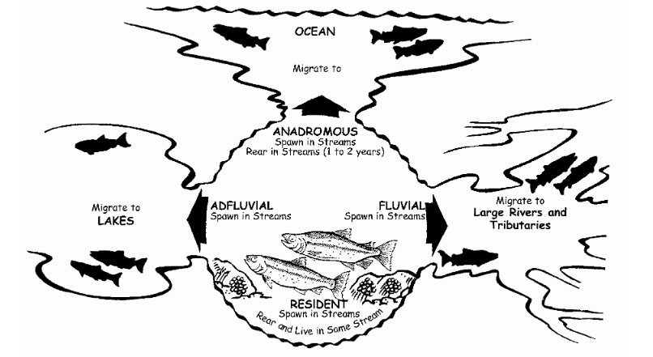
Fisheries Resource
Best indicator of watershed health

Slide 20
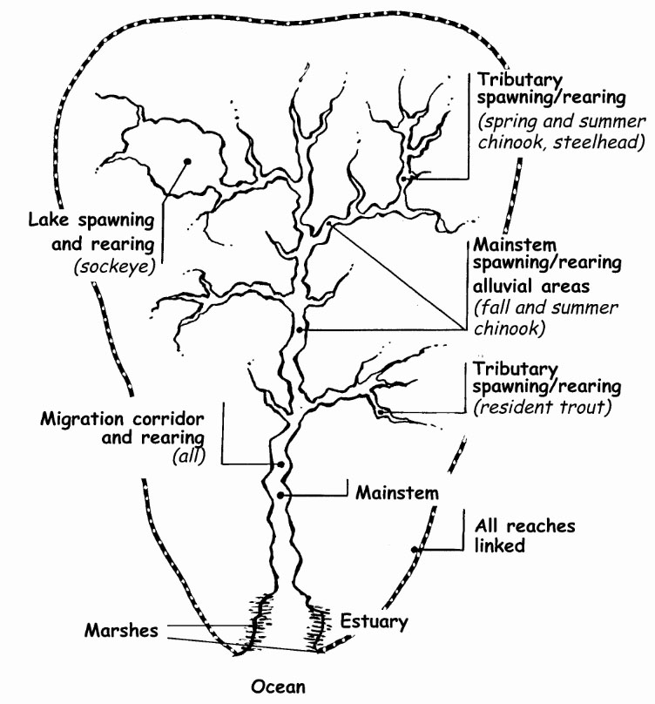
Fisheries Resource
Chinook (king)
  Spawn in large main channels
Coho
  Spawn in small, low-gradient tributaries
Sockeye
  Spawn in lakes
Steelhead and Trout
  Spawn in tributaries

Slide 21
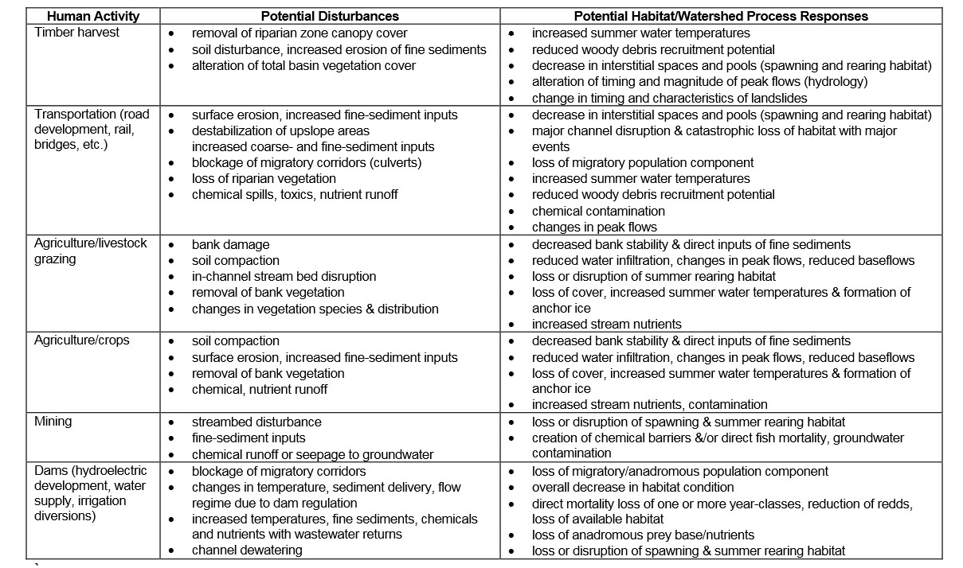
Human Impacts

Slide 22
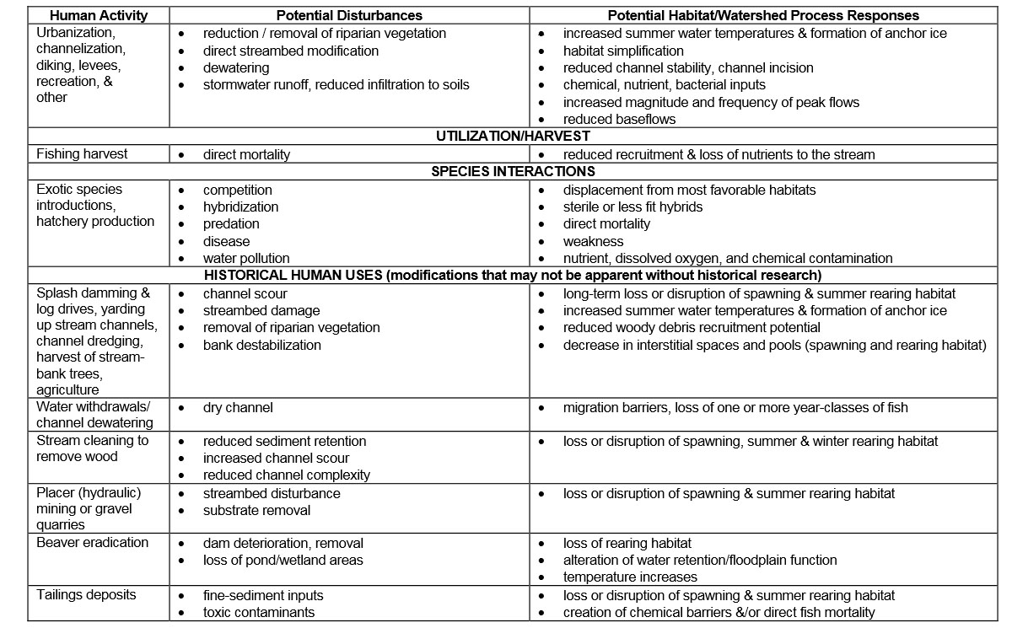
Human Impacts Cont.

Slide 23
Conclusion
Watershed: area of land that drains downslope to the lowest point
Watersheds determined by geology, climate, and disturbances
Can only control human-induced sedimentation
Vegetation is critical in healthy watersheds
Water quality is vital for living organisms

