Slide 1
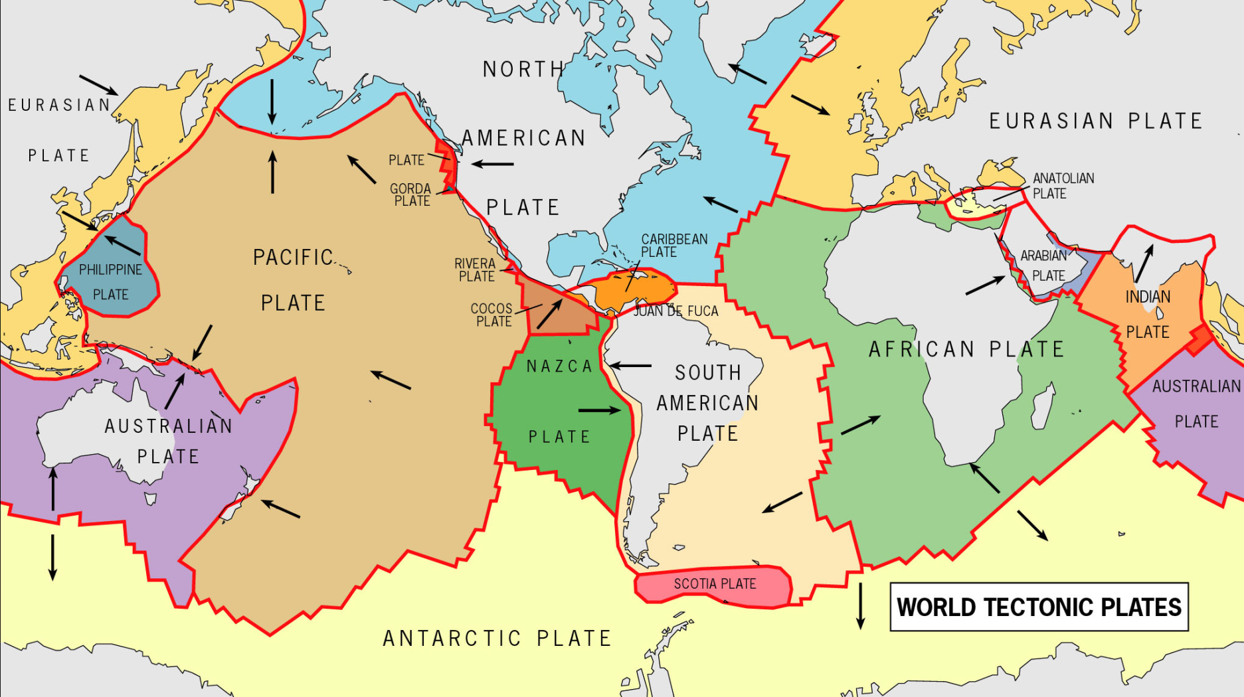
Numerical Methods
Numerical recognition of alignments in monogenetic volcanic areas: Examples from the Michoacán-Guanajuato Volcanic Field in Mexico and Calatrava in Spain.
J.M. Cebriá, C. Martín-Escorza, J. López-Ruiz, D.J. Morán-Zenteno, B.M. Martiny
Journal of Volcanology and Geothermal Research 201
(2011) pages 73-82
http://academic.evergreen.edu/g/grossmaz/HAMMVM/world_tech_plates_map.jpg

Slide 2
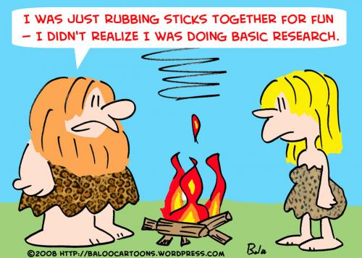
Early Research
Average orientations of nearby cones (Kear 1964)
Density mapping of cones
(Porter 1972)
Statistical analysis based on nearest-neighbour and quadrant methods (Tinkler 1971)

Slide 3
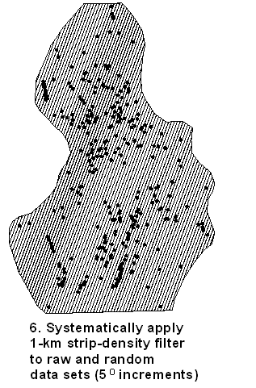
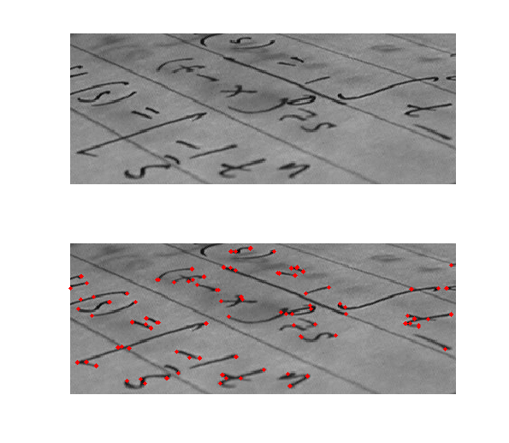
(1) Spatial Transform methods
(Wadge and Cross 1988)
(2) Azimuth methods
(Lutz 1986)
(3) Strip methods
(Zhang and Lutz 1989)
http://upload.wikimedia.org/wikipedia/en/5/5f/Corner.png
Steve Taylor and Jeff Templeton

Slide 4
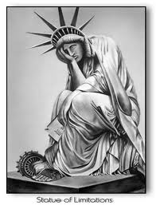
Limitations
(1) Spatial Transform methods
(Wadge and Cross 1988)
Simulates human visual capability
(2) Azimuth methods
(Lutz 1986)
Dependent on shape of study area
(3) Strip methods
(Zhang and Lutz 1989)
Fails to address small scale features
http://blog.radioleft.com/blogimages/StatueOfLimitations.jpg

Slide 5
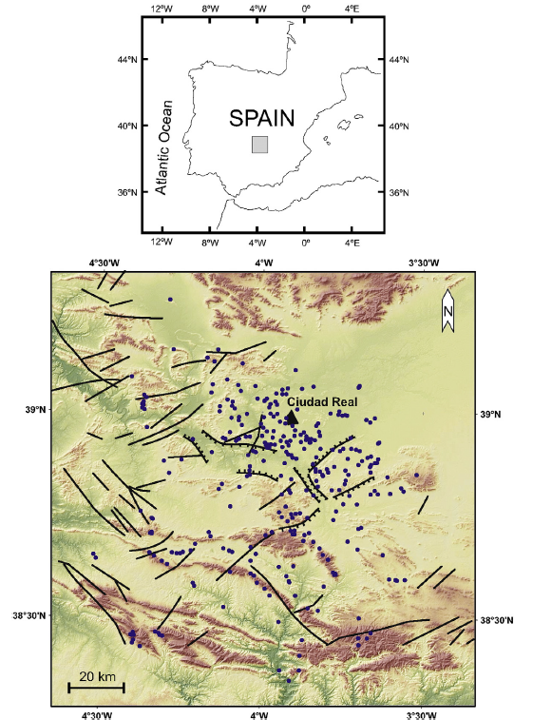
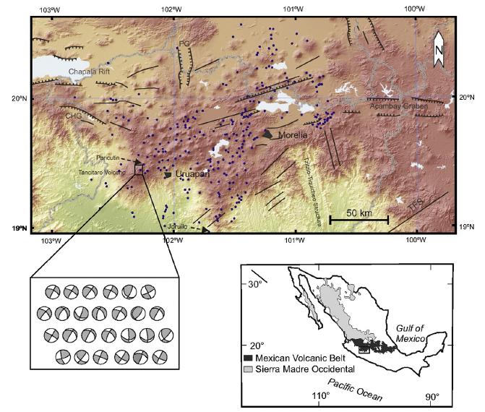
Location Maps
Michoacán-Guanajuato Volcanic Field, Mexico
(Arc magmatism)
Calatrava, Spain
(Intraplate magmatism)

Slide 6
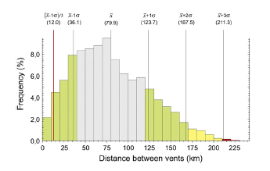
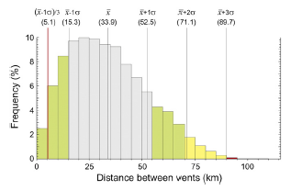
Distance Between Vents
MGVF (skewness 0.51)
Calatrava (skewness not given)

Slide 7
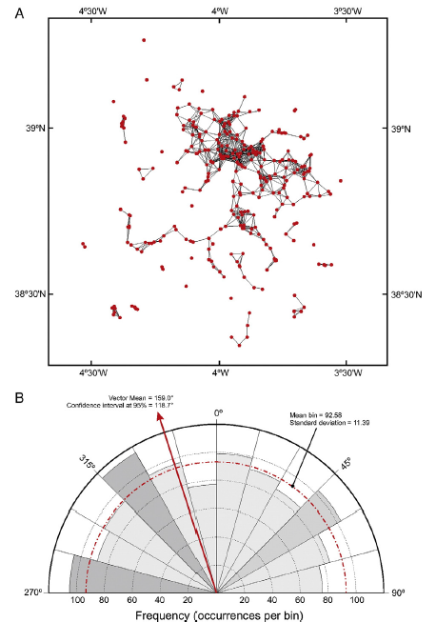
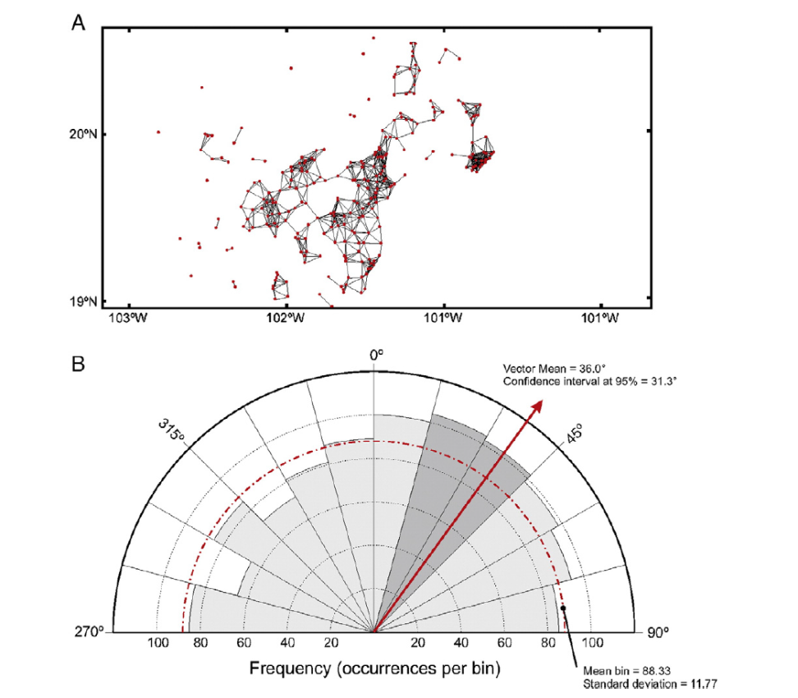
Lineaments of lines shorter than one third of one standard deviation below mean
MGVF lines less than 12 km
Calatrava lines less than 5 km

Slide 8
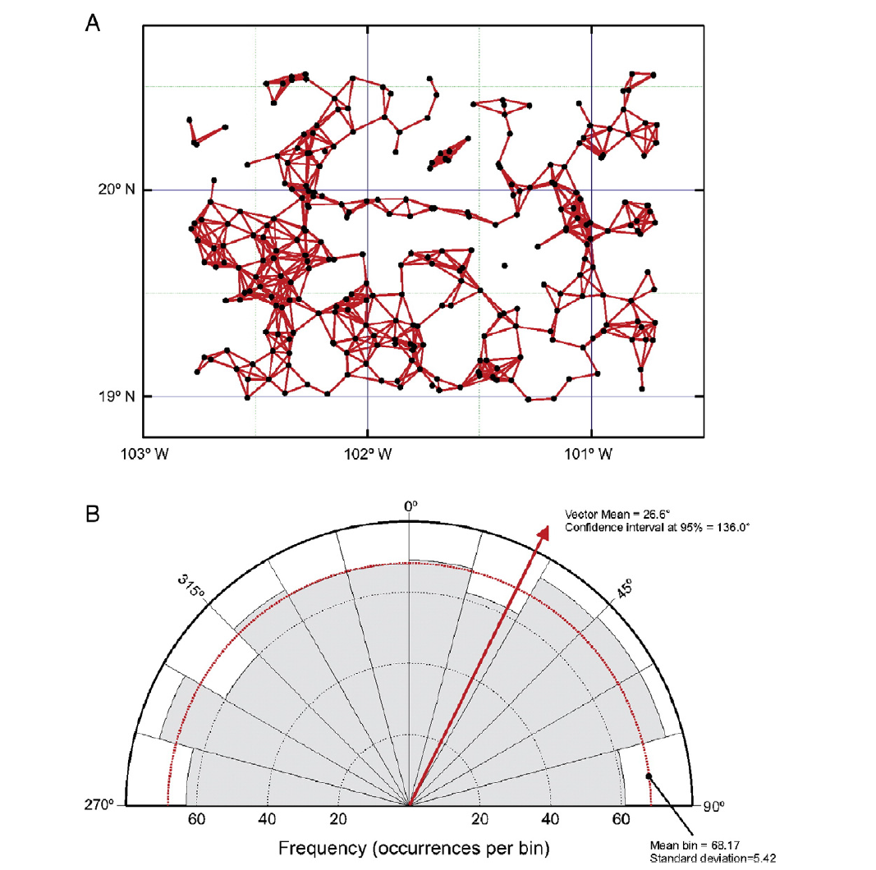
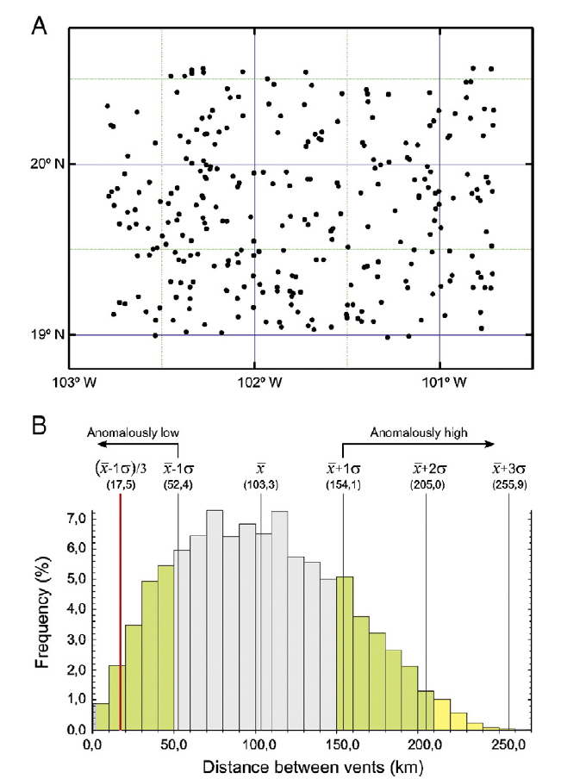
Random Lineaments skewness 0.26

Slide 9
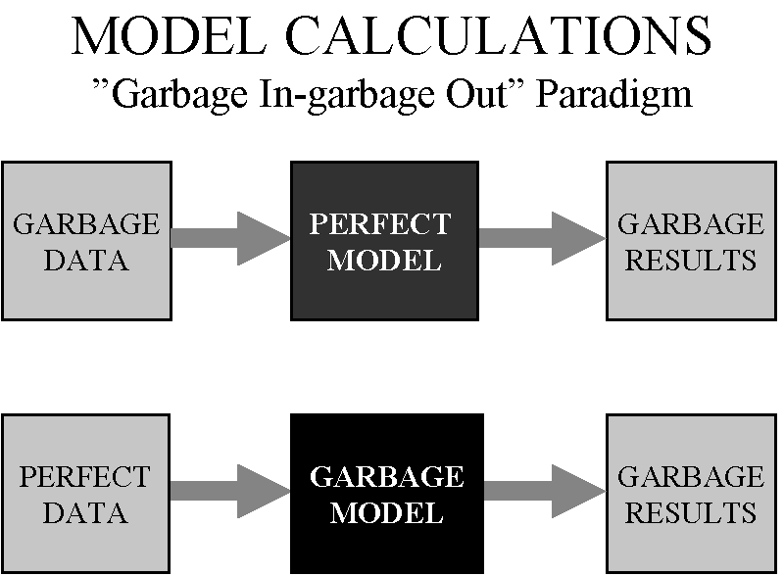
Caution !
“Straight application of quantitative methods to identify possible
alignments in the geological record may produce mathematically acceptable results but also meaningless from a geological point of
view. To avoid this, any attempt at numerical recognition of alignments resulting from a geological process should be supported by field observations.”
http://blog.potterzot.com/wp-content/uploads/2007/09/garbage_paradigm.gif

Slide 10
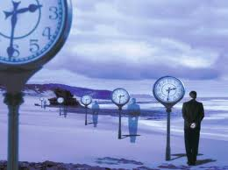

Further Thoughts
Temporal
Chemical
..and spatial

Slide 11


