Slide 1
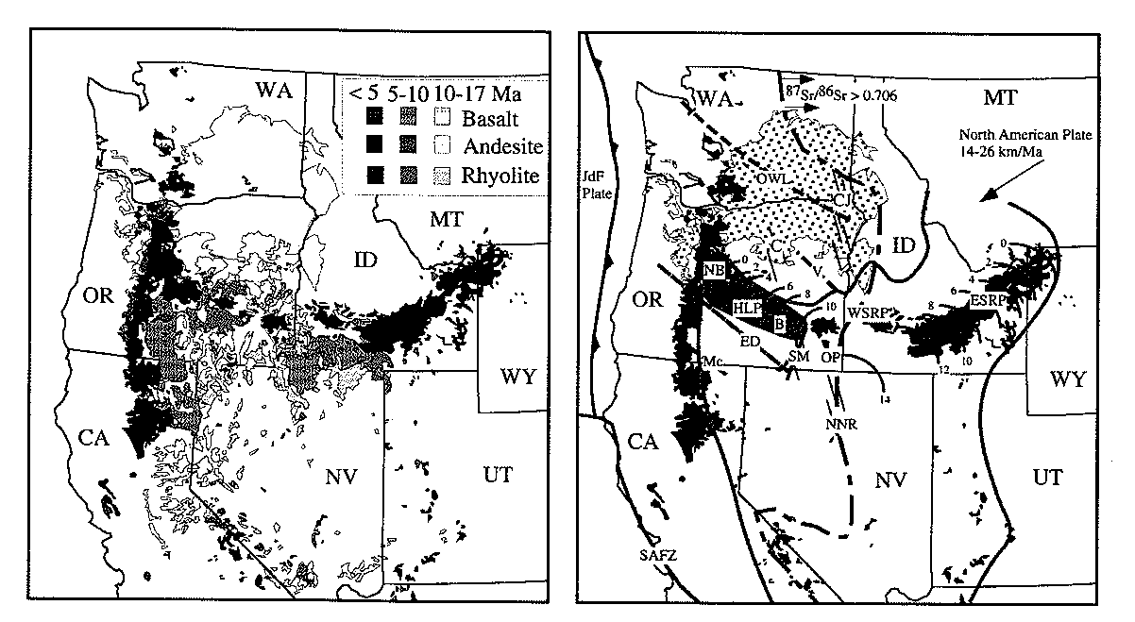
Active Tectonics Basin and Range p. 438-441

Slide 2
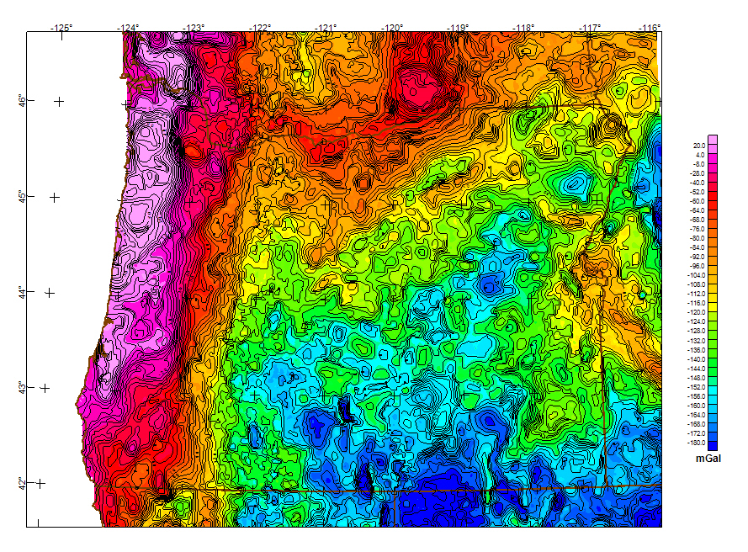
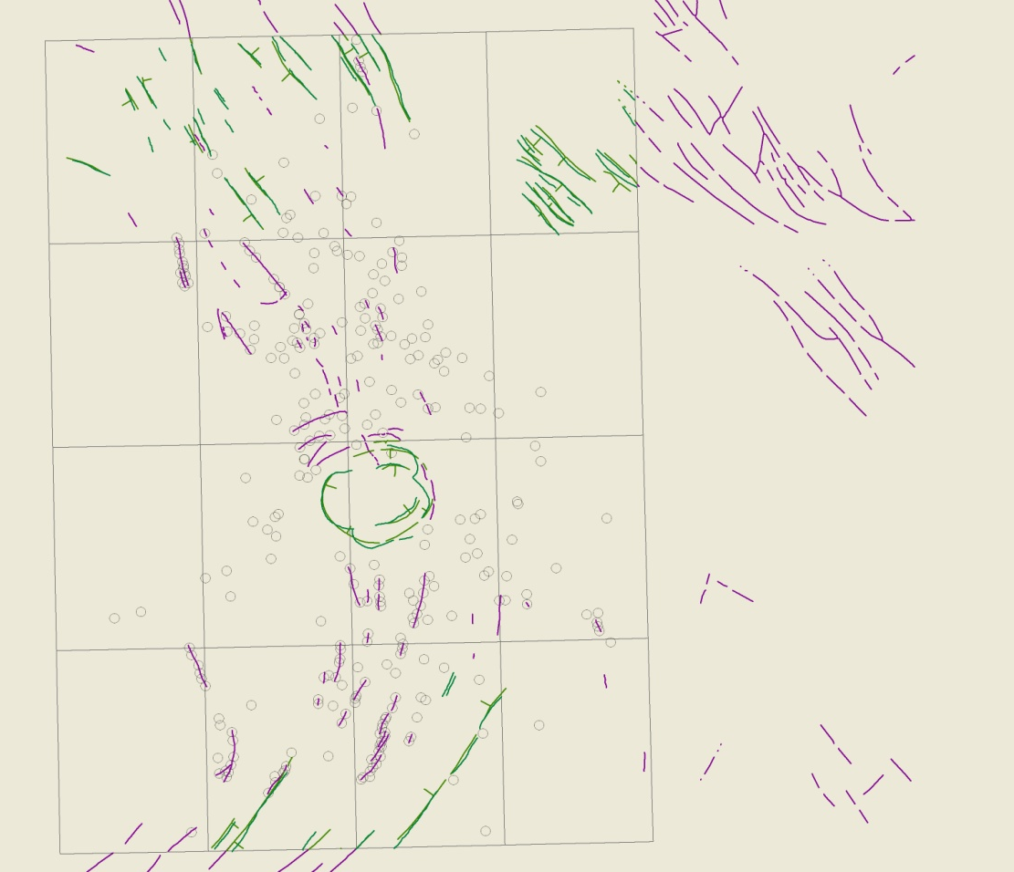
Geophysical Data
1 gal
= (1 cm/s²)

Slide 3
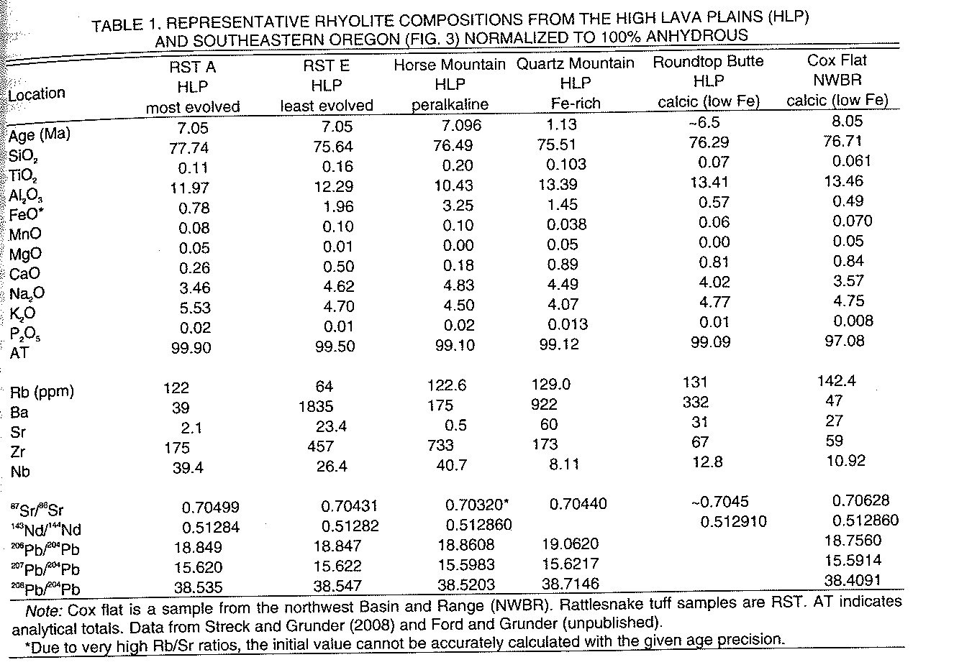
Geochemical Data

Slide 4
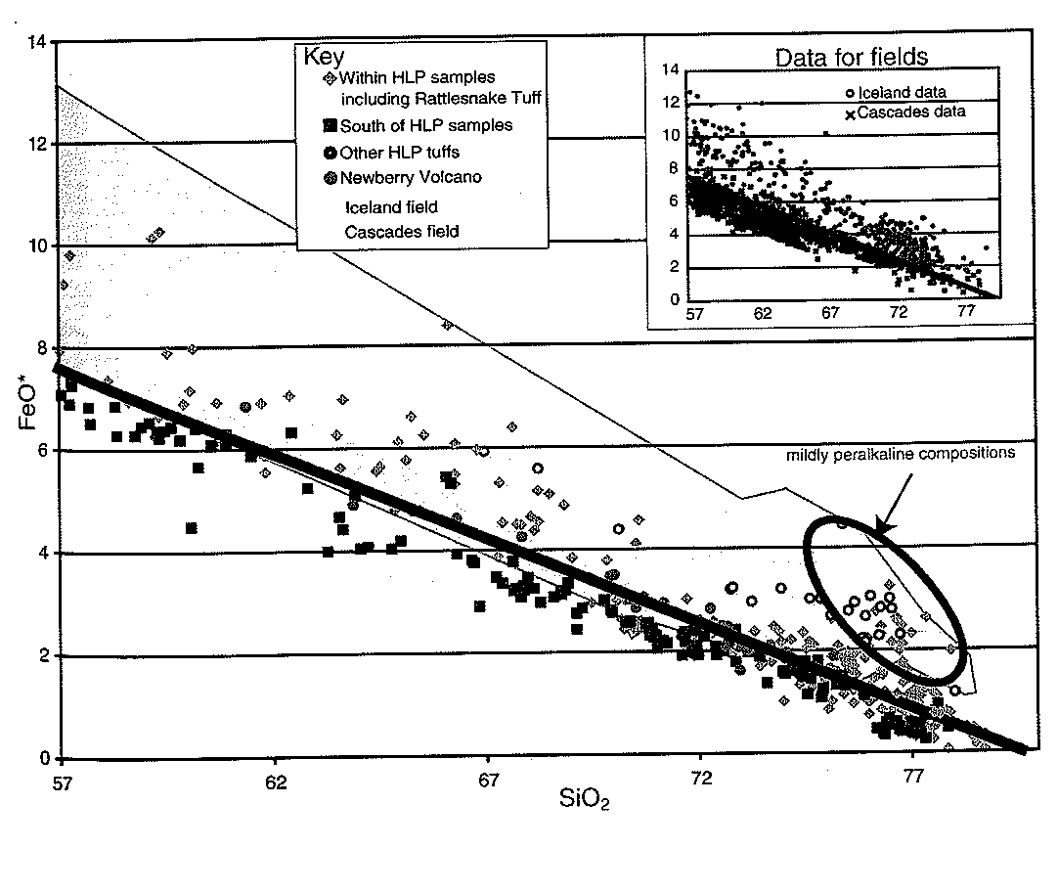

Slide 5
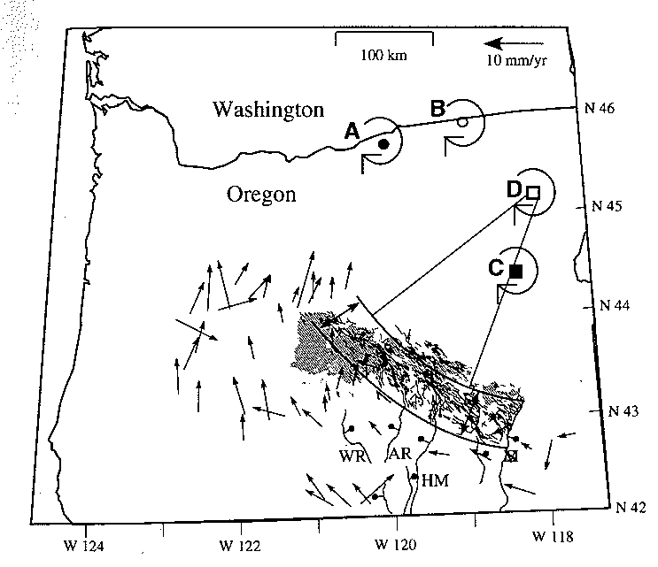
Active Tectonics

Slide 6
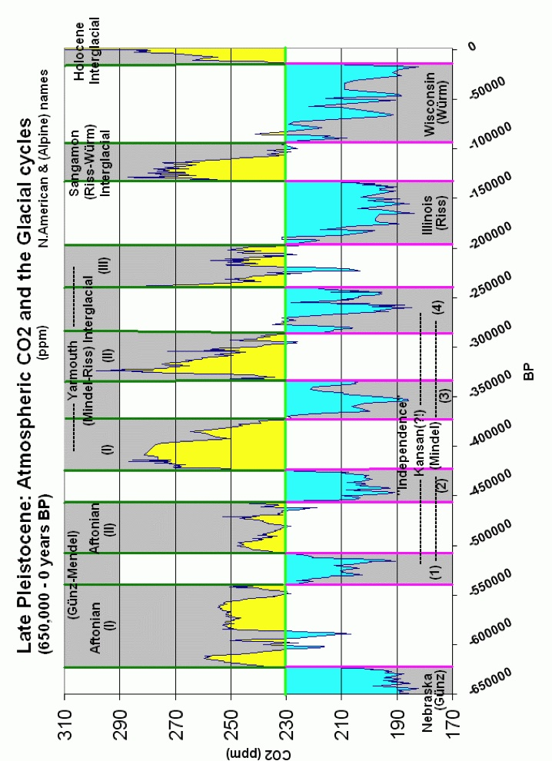

Slide 7
Spatio-temporal progression
50 and 20 Ma Ignimbrite sweep
HLP Geomorphic
17 and 15 Ma Flood Basalt
widespread
700 km suture
7.5-8 Ma Flood Basalt
increasing focus
Age progressive Silicics
Younger than 12 Ma rhyolites
with > 72 % SiO2

Slide 8
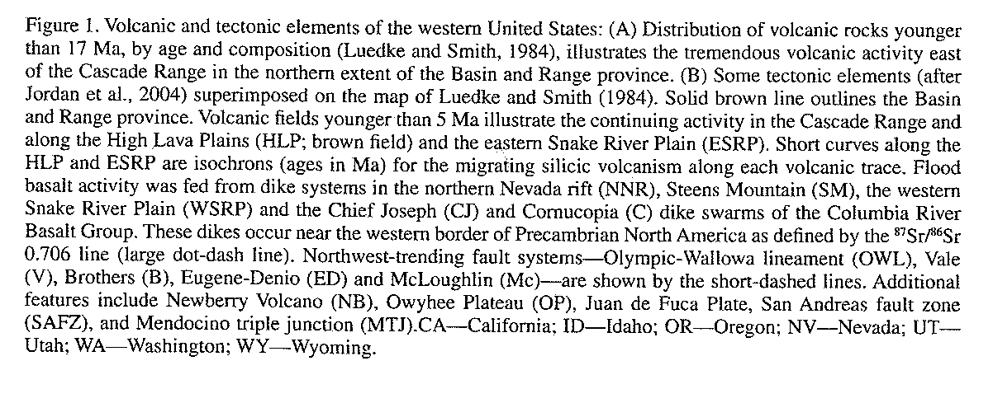
Cascade and HLP
isotopic similarities
low K-tholeiites
Fe Rich Rhyolites
End at Newberry
Quaternary mafic
35-42 km crust
Rattlesnake Tuff

Slide 9
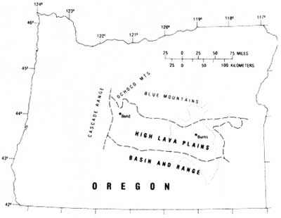
Ash-Flow Tuffs hundreds kmc
9.7 Ma Devine Canyon 195 kmc
8.4 Ma Prater Creek
7.05 Ma Rattlesnake
2x Devine?
7 to 8 Ma W. Harney Basin
Dome Complexes
Basaltic pulse initiated?

