Slide 1
Effects of Traffic and Ditch Maintenance on Forest Road Sediment Production
Charles H. Luce and Thomas A. Black
Austin Wegner

Slide 2
Outline
Ditch Maintenance
Techniques
Types
Results
Traffic Erosion
Sediment yield produced
Preventability
Methods
Study and Research Interpretation

Slide 3
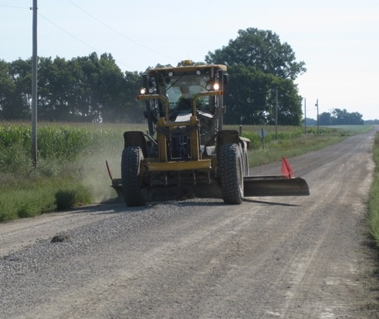
Ditch and Road Maintenance
Road Grading
Levels road surface
Restores proper road drainage
Ditch Blading
Allows for higher sediment flow
Should be done on a case by case basis

Slide 4
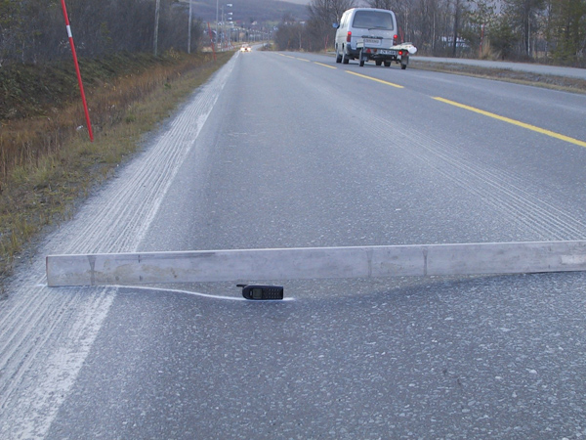
Traffic Erosion
General wear and tear
Wheel Ruts
Encourages fines erosion

Slide 5
3 Hypotheses
Trade-off
Effects are less than the sum of their parts
Additive
Results of each variable are independent but combined
Multiplicative
Results of each variable multiply each other

Slide 6
Method
12 road segments split into 4 categories
No traffic, No ditch grading (NTNG)
Traffic and no ditch grading (TNG)
No traffic, Grading (NTG)
Traffic and Grading (TG)
As similar environments as possible (attached)
Trucks make 10 round trips per day from Nov. 15 to Dec. 14
Sediment collected and measured in runoff tanks

Slide 7
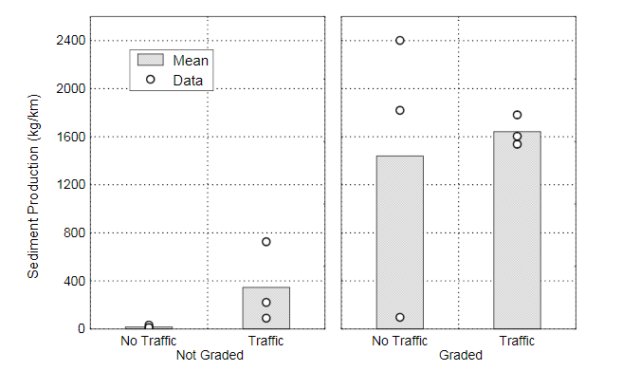
Results and Data

Slide 8
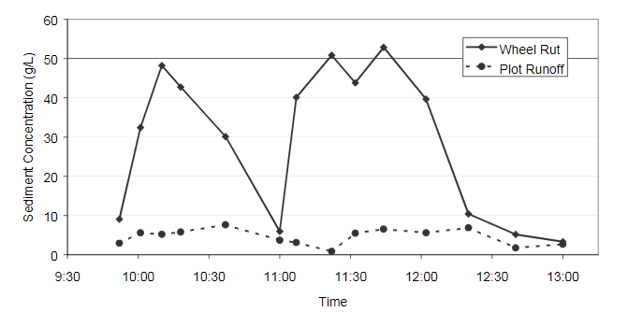
Sediment Concentration During Traffic Passes

Slide 9
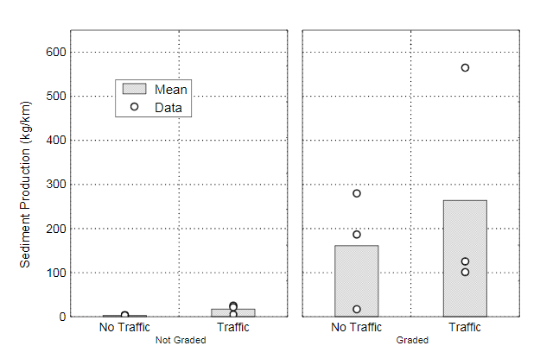
Sediment yield in post traffic period
No traffic period:
Jan11-Jun13

Slide 10
Interpretations
Grading Increases sed. Yield
Traffic Increases sed. Yield
Traffic vs None in graded is not statistically significant
Traffic vs None in ungraded IS statistically significant
Grading lowers impact of traffic (more predictable sediment flows)

Slide 11
Conclusion
Additive Hypothesis
Multiplicative Hypothesis
Trade Off Hypothesis

Slide 12
Conclusion
Additive Hypothesis
Multiplicative Hypothesis
Trade Off Hypothesis

Slide 13
Conclusion
Additive Hypothesis
Multiplicative Hypothesis
Trade Off Hypothesis

