Slide 1
Assessing mechanisms of climate change impact on the upland forest water balance of the Willamette River Basin, Oregon Turner, et al., 2017
Samantha Abel
Earth and Physical Science Department
Western Oregon University
Monmouth, Oregon
Email: sabel14@wou.edu

Slide 2
OUTLINE
Introduction
Methods
Results
Discussion & Summary

Slide 3
INTRODUCTION
Evapotranspiration (ET) large portion of precipitation
Climate change alteration
Influenced by vegetation changes
Forest disturbances
$↑{CO}_{2}= ↓$ stoma density / conductance
Willamette River Basin

Slide 4
METHODS
Simulated basin response to climate and land use change over the 21st century
Climate scenarios
High, low, reference models
Landscape simulator
Annual changes in land cover, vegetation type, and LAI
Hydrology model
Rain and snow
Canopy transpiration + soil evaporation
Canopy rain evaporation / sublimation
Soil water status
Snow melt

Slide 5
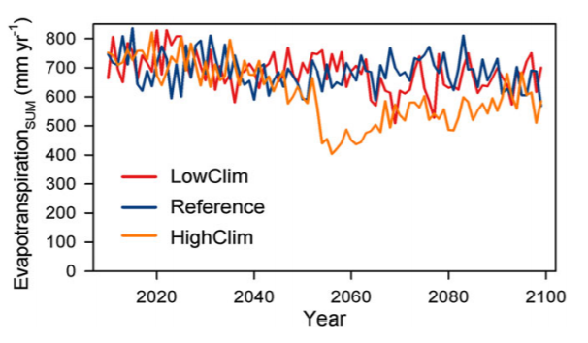
RESULTS
Private vs. public ownership
Effects harvest rate
Highest ET at mid-elevations, high LAI
Low at lower because of clearcutting
Basin-wide response to fire
LAI decrease 12-30%
${ET}_{SUM}$ decrease 4-20%

Slide 6
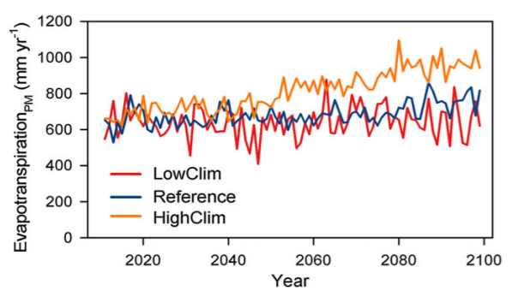
RESULTS
Above; just mean ET
40% increase in evaporative demand
Below; vegetation change, soil water, vapor pressure, ${CO}_{2}$
General decrease
Additional 11-18% reduction by ${CO}_{2}$

Slide 7
DISCUSSION & SUMMARY
Increases in mean annual temperature
Warm, wet winters
Dry summers
Uplands remain forested
Mixed conifer‐hardwood forest types
Initial increase in fire probability
Decrease in LAI effects ET, rain and snow interception
${CO}_{2}$ effect greater in high and reference climate models
Evidence from Pleistocene era

Slide 8
Vulnerability of water supply from the Oregon Cascades to changing climate: Linking science to users and policy Farley, et al., 2010
Samantha Abel
Earth and Physical Science Department
Western Oregon University
Monmouth, Oregon
Email: sabel14@wou.edu

Slide 9
OUTLINE
Introduction
Geography & Geology Setting
Approach
Vulnerability Results
Conclusion
Summary

Slide 10
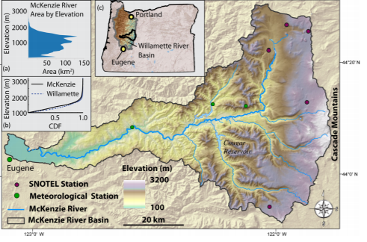
INTRODUCTION
McKenzie Basin
Climate change
Biophysical
Societal
Water uses:
Commercial
Industrial
Residential

Slide 11
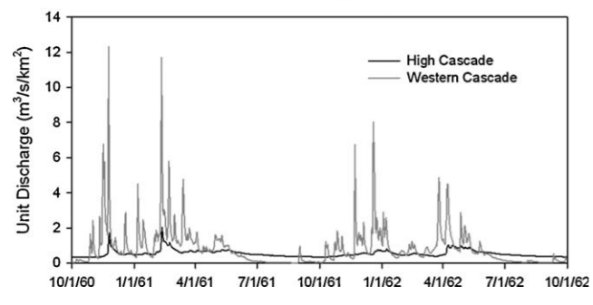
GEOGRAPHY AND GEOLOGY
Western
Surface-flow
High
Infiltration
Spring-fed
Rain-snow transition line

Slide 12
APPROACH
Past scientific data
Interviews
18 experts
4 sectors: fish habitat, municipal, food, rec
Vulnerability
Sensitivity
Adaptability

Slide 13
RESULTS
Drier summers
Greater reliance on Western Cascade flows
Less fish habitat
More flood risk in winter
R-o-s, early melt
Problems of water use in the dry season

Slide 14
CONCLUSION & SUMMARY
Impacts on human-nature system
Adaptability
Anticipatory
Reactive
Social
Ecological
Barriers to adaptability
Long time period
Infrastructure
Fish recovery plan
Inflexible legislation
Not enough data
Some institutions are flexible; others are not

Slide 15
Thank you!

