Slide 1
Precipitation-snowmelt timing and snowmelt augmentation of large peak flow events, western Cascades, Oregon Jennings and Jones, 2015
Samantha Abel
Earth and Physical Science Department
Western Oregon University
Monmouth, Oregon
Email: sabel14@wou.edu

Slide 2
OUTLINE
Introduction
Study Site & Data
Methods
Results
Discussion & Summary

Slide 3
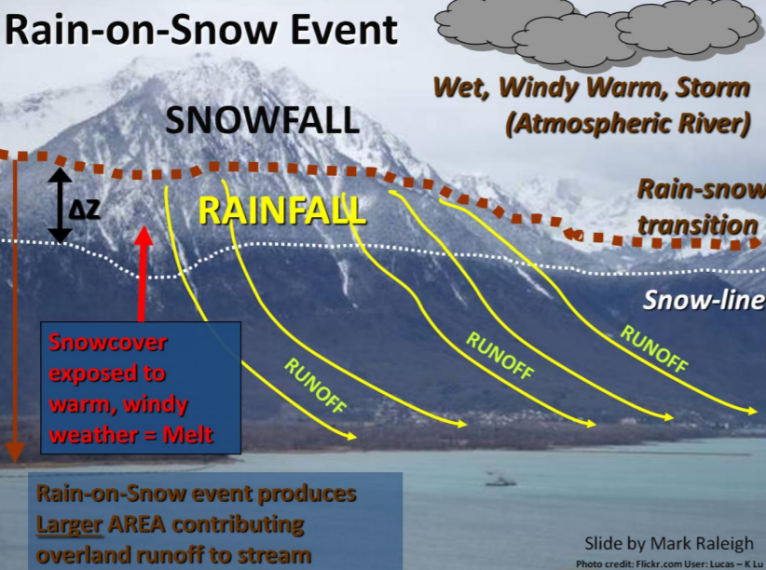
INTRODUCTION
Rain-on-snow events
Rain-snow transition zone
Hydrologic mechanisms
Internal dynamics
Saturation

Slide 4
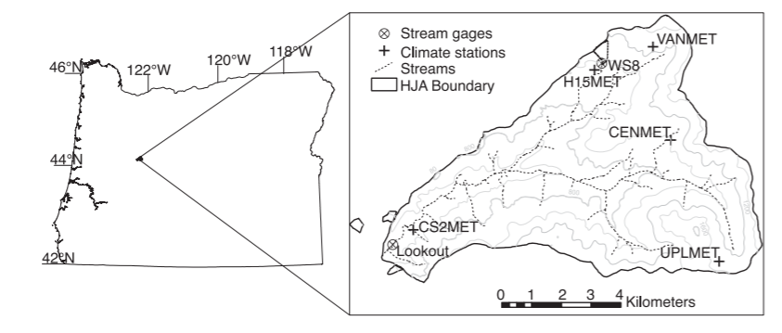
Study Site & Data
HJ Andrews Experimental Forest
R-o-s: Nov-Mar
Watershed 8 data
Gauge flow
SWE (SNOTEL)
Air, dewpoint, wind
Hourly resolution

Slide 5
METHODS
4 hypotheses
Identified 32 large storms
March 12, 1992-Sept 15 2012
> 150 mm at CS2met station (482 m elevation)
> 3.3 mm h-1 Lookout Creek streamflow
Plotted events
Net snowpack outflow on y-axis
Precipitation on x-axis
Wavelet coherence analysis

Slide 6
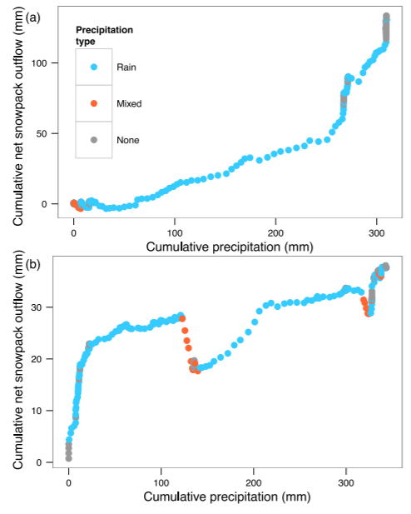
RESULTS
Largest floods were r-o-s
26 storms from 1992 to 2012
Outflow positively related to precipitation
< 4 mm hr-1
Precipitation pulses = pulses of net outflow
12–32 hrs

Slide 7
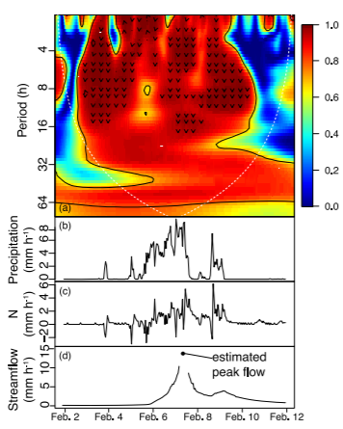
RESULTS
Feb 2, 1996 event
Wavelet coherence
1 = high degree of precipitation-outflow
Black contours = statistically significant coherence
N = net snowpack outflow

Slide 8
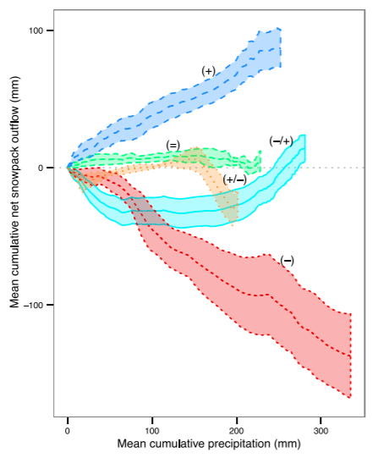
RESULTS
Persistent melt (+)
Late melt (-/+)
Late accumulation (+/-)
Flat (=)
Persistent accumulation (-)

Slide 9
DISCUSSION & SUMMARY
Snowpack saturates and melts
Water driven out via pressure waves
R-o-s events common
Extreme floods rare
Climate change
Reduce PNW snow
Effects on r-o-s
Circumstances necessary:
Multiple days
Melt within pack
Near-saturated zone
Transmits pressure waves into streams

Slide 10
Thank you!

