Slide 1
Future snow? A spatial-probabilistic assessment of the extraordinarily low snowpacks of 2014 and 2015 in the Oregon Cascades Sproles, Roth and Nolin, 2017
Samantha Abel
Earth and Physical Science Department
Western Oregon University
Monmouth, Oregon
Email: sabel14@wou.edu

Slide 2
OUTLINE
Introduction
Terminology
Research Methods
Results
Snow Water Storage
SWE : P
Summary

Slide 3
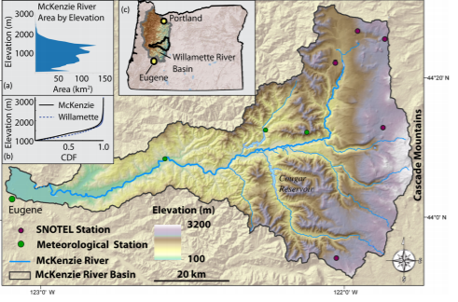
INTRODUCTION
PNW
WRB / MRB
“At risk” zone
HJ Andrews
Winter time frame:
2013–2014,
2014–2015
Temperature increase, elevation rise

Slide 4
TERMINOLOGY
SWE
“Snow water equivalent”
Amount of water within snowpack
SWE : P
SWE relative to cumulative precipitation over time
Dimensionless ratio
SNOTEL
NRCS Snowpack Telemetry network
Snow analogs
Water year

Slide 5
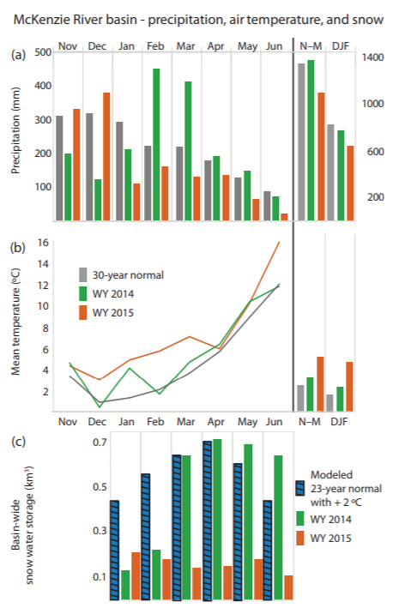
RESEARCH METHODS
3 questions
Low basin wide snow storage
Spatial-probabilistic
23 WY under + $2℃$
SnowModel – WY 1989-2012
Exceedance probability

Slide 6
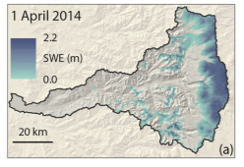
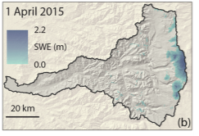
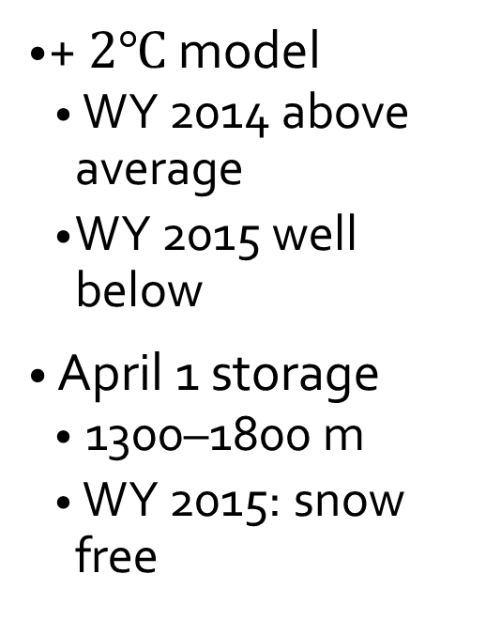
RESULTS: Snow Water Storage
+ $2℃$ model
WY 2014 above average
WY 2015 well below
April 1 storage
1300–1800 m
WY 2015: snow free

Slide 7
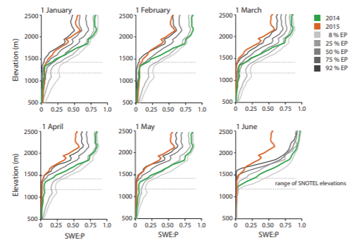
RESULTS: SWE : P
Elevation shift
Rain to snow
Late season storms

Slide 8
SUMMARY
Low 2014 + 2015 snowpacks
High temps
Average precipitation as rainfall
Shifts upslope
Analogs for future
Social consequences
Planning

Slide 9
Thank you!

