Slide 1
Forest Landscape Hydrology in a ‘New Normal’ Era of Climate and Land Use Change
Samantha Abel
Earth and Physical Science Department
Western Oregon University
Monmouth, Oregon
Email: sabel14@wou.edu

Slide 2
Changes in forest (due to both natural disturbance and human activities) affect how incoming precipitation is partitioned between evapotranspiration and streamflow.
— Jones and Wei, et. al, 2019
Introduction

Slide 3
Overview
Introduction and Overview
Current Forest Changes
Natural
Anthropogenic (Human-Driven)
Anticipated Forest Changes
Climate Change
Forest Management
Forest Succession
Climate / Hydrology Reconstruction
Recap and Conclusion

Slide 4
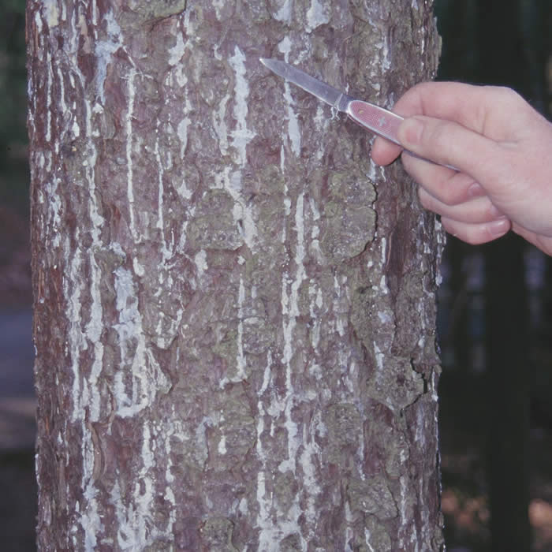
Current Forest Changes
Natural
Wildfire
Pathogens and Disease
Insect Attacks
Invasive Species
E.G. weeds
Ice Storms

Slide 5
Current Forest Changes
Anthropogenic (Human-Driven)
Silviculture
Age, biodiversity, thinning, harvest
Plantations
Agroforestry
Urban and Peri-Urban Forestry

Slide 6
Anticipated Forest Changes
Climate Change
Wetter and Drier Environments
More ${CO}^{2}$in Atmosphere
$→$ increased forest growth
Extreme Drought
Can lead to stress and tree mortality
Alter Streamflow and Local Hydrology
E.G. annual to ephemeral streams

Slide 7
Anticipated Forest Changes
Forest Management
Deforestation
Loss of riparian forests
Loss of urban trees
Expansion of agriculture

Slide 8
Anticipated Forest Changes
Forest Succession
Changes in Forest Populations:
Age
Species type and number
Structure
Impacts Water Yield / Storage

Slide 9
Climate / Hydrology Reconstruction
Tree Rings
Multi-century reconstructions
Reflects regional history of the water table, flooding, droughts, and precipitation
Stable Water Isotopes
Oxygen, Hydrogen, Carbon
Trace origin of air masses and precipitation

Slide 10
Recap
Overview and Introduction
Current Forest Changes
Natural
Anthropogenic (Human-Driven)
Anticipated Forest Changes
Climate Change
Forest Management
Forest Succession
Climate / Hydrology Reconstruction
Recap and Conclusion

Slide 11
Conclusion
$$Happy Forest=Ideal Hydrology$$
aka “trees are good”

Slide 12
– Thank You –
Samantha Abel
Earth and Physical Science Department
Western Oregon University
Monmouth, Oregon
Email: sabel14@wou.edu

