Slide 1
Channel Network Extension by Logging Roads in Two Basins, Western Cascades, OR
Austin Wegner

Slide 2
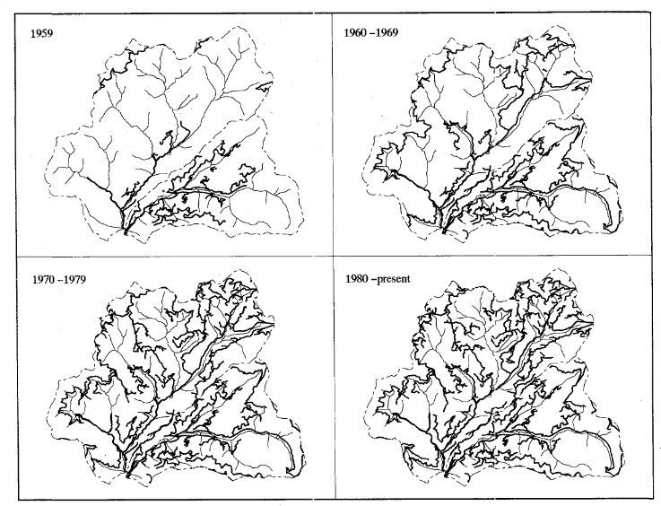
Outline
Introduction
Study Area
Methods
Results
Conclusion

Slide 3
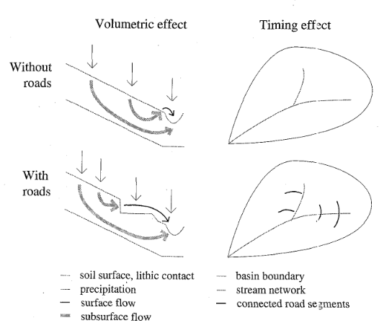
Introduction
Environmental impact of logging roads is well known
Roads contribute to sediment in streams but also act as channels alongside the stream network

Slide 4
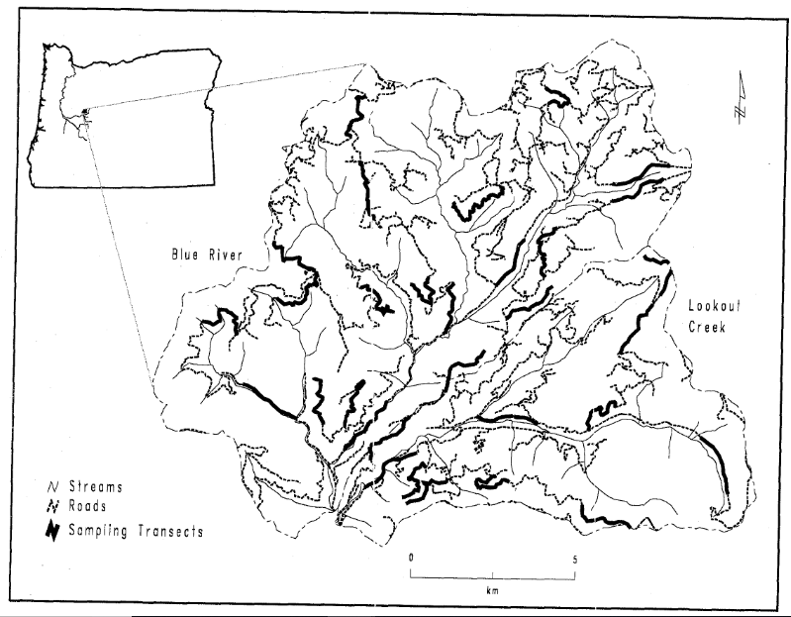
Study Area
HJ Andrews Experimental Forest
Lookout Creek (sq. 62km)
Blue River (sq. 119km)
Similar paired watersheds

Slide 5
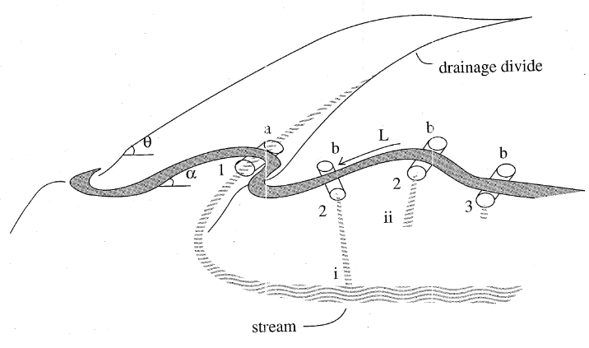
Methods
Determine the increase in drainage density attributed to connectivity
Examine factors that contribute to connectivity
Does connectivity explain changes in flow?

Slide 6
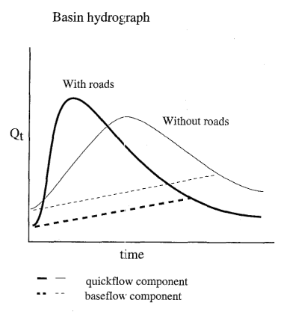
Results
>57% of road length surveyed works as a connected flood path
Increase drainage density by 36-39%
Allows for a model of the magnitude of effect from forest roads

Slide 7
Conclusion
Large portion (~57%) of road networks are hydrologically connected to streams
Enhanced flow efficiency could account for changes in hydrograph after road construction
Timing of road development correlates to increases in peak flows for each system

Slide 8
Forest Roads and Geomorphic Process Interactions, Cascade Range, OR
Austin Wegner

Slide 9
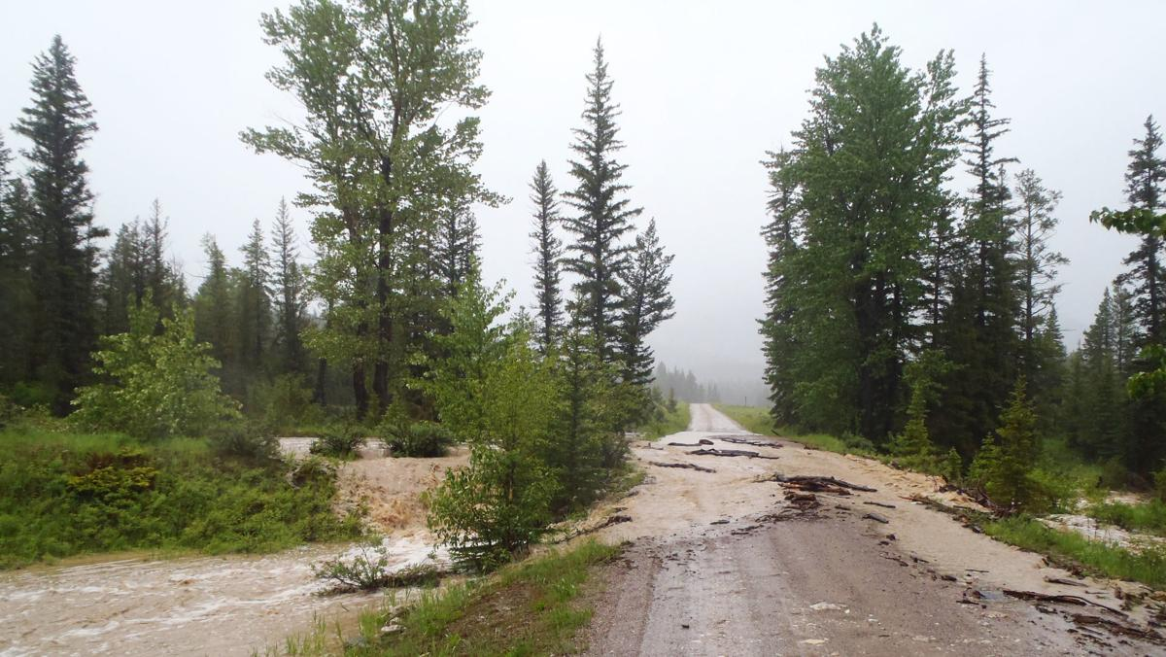
Outline
Introduction
Study Area
Methods
Results
Conclusion

Slide 10
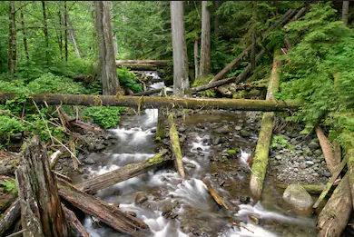
Introduction
Study focuses on hillslope and basin scale effects during a storm event
1996 storm provided an abundance of data for road/geomorphology process interactions

Slide 11
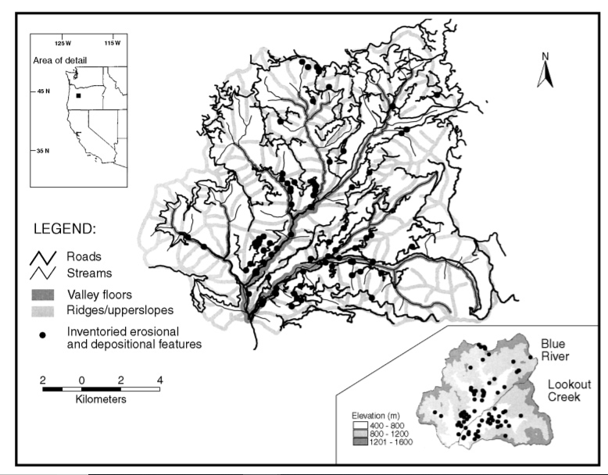
Study Area
HJ Andrews Experimental Forest
Lookout Creek(62 sq. km)
Blue River (119 sq. km)
Same area examined as in author’s previous paper

Slide 12
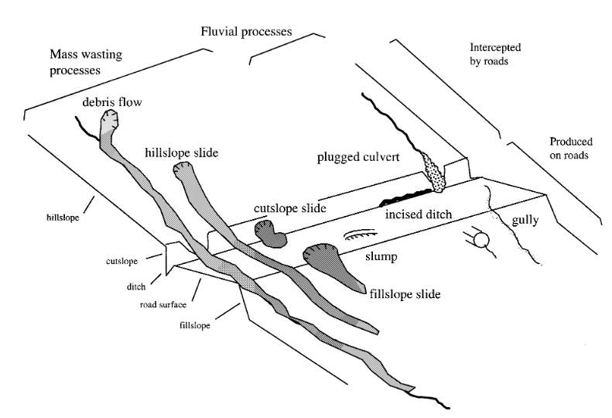
Methods
Damage of the area was quickly surveyed after the ‘96 storm
Info was converted Into GIS data
5 mass wasting types mapped for road interactions

Slide 13
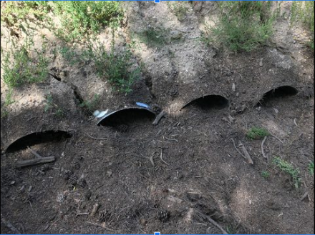
Results
Roads encourage “disturbance cascades”
Sediment production from roads was 66% of events vs 33% capture
Plugged culverts accounted for >50% of fluvial features post storm

Slide 14
Conclusion
‘96 storm created complex erosional and depositional paths involving road networks
Roads acted as both initiation and depositional sites
35 of 80 slides during the storm were road related
Higher and steeper road cuts leaned towards erosional
Increase in deposition towards valley bottom
Roads caused 79% of mid-slope mass wasting

