Slide 1
Long-Term Patterns of Sediment Production Following Road Construction and Logging in the Oregon Coast Range
Austin Wegner

Slide 2
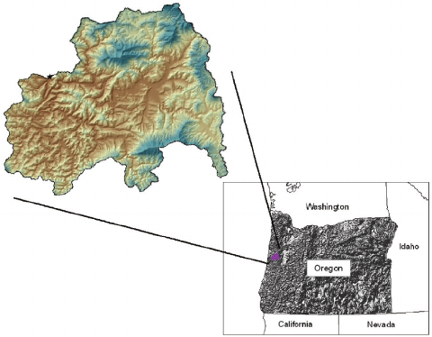
Overview
Introduction
Alsea Watershed Area
Description of the Study
Results
Discussion and Findings

Slide 3
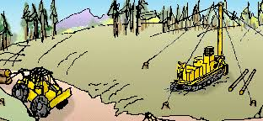
Introduction
Road construction, timber yarding, and slash disposal all contribute to sediment increases, often through mass wasting events
Road construction increases slope failure rates by 25-340 times
Some practices are less harmful than others
https://www.youtube.com/watch?v=ixEeWZNWlhA

Slide 4
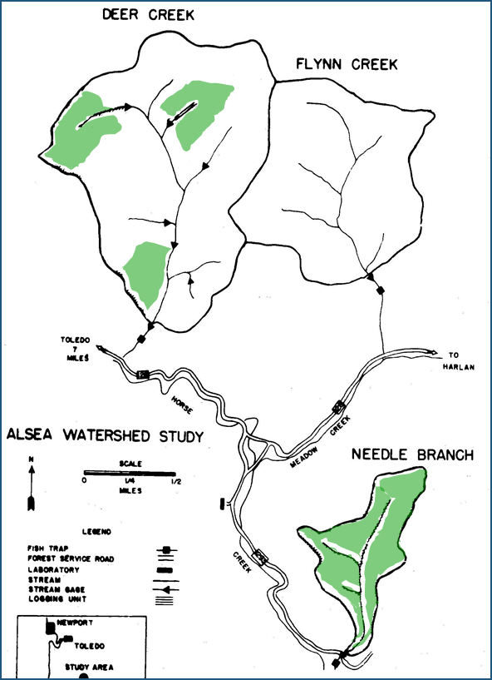
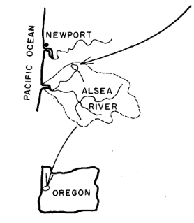
Alsea Watershed Area

Slide 5
Alsea Watershed Study
Fall 1958- 1973
3 Watersheds were involved
Needle Branch Watershed (75 ha)
Deer Creek (304 ha)
Flynn Creek (202 ha)-- Experimental Control
Treatments
Needle Branch Watershed 82% clear cut
Deer Creek Watershed 25% clear cut
Flynn Creek left untreated

Slide 6
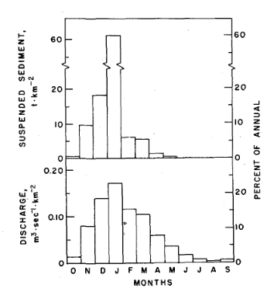
Results
Average Annual Sediment Yields vs Sediment Yields by Month
Long term averages can be deceiving

Slide 7
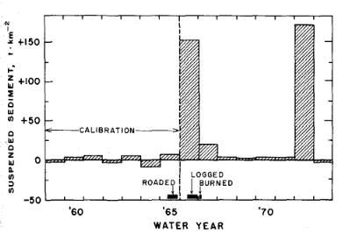
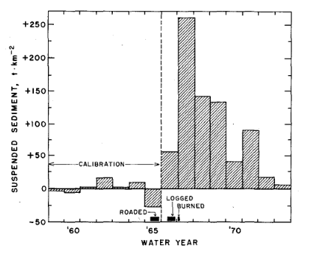
Suspended Sediment by Year
Deer Creek (25% clear cut)
Needle Branch (82% clear cut)

Slide 8
Discussion and Conclusions
Both timing and magnitude of sediment loss are affected by forest harvesting operations
Mass wasting events in both experimental watersheds attributed to road building
These events did not occur until 7 years after the actual watershed treatments

