Slide 1
Suspended Sediment and Turbidity After Road Construction/Improvement and Forest Harvest in Streams of the Trask River Watershed Study, Oregon
Austin Wegner

Slide 2
Outline
Introduction
Hypothesis of the Study
Study Area
Methods
Results
Conclusions

Slide 3
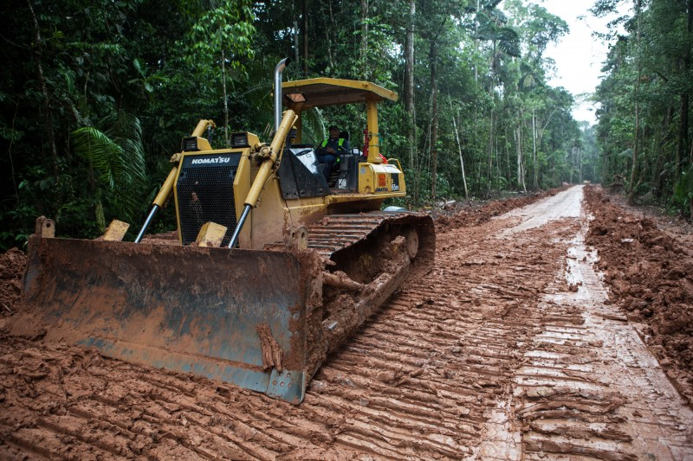
Introduction
Forestry practices used to be very destructive
Large episodic sediment fluctuations
Poor rehabilitation methods
Sediment drain directly into rivers
Buried organic debris
Far reaching biological impacts
Newer practices seek to mitigate sediment suspension in rivers
Variability in transport systems makes it difficult to pinpoint specific sediment contribution by management practices

Slide 4
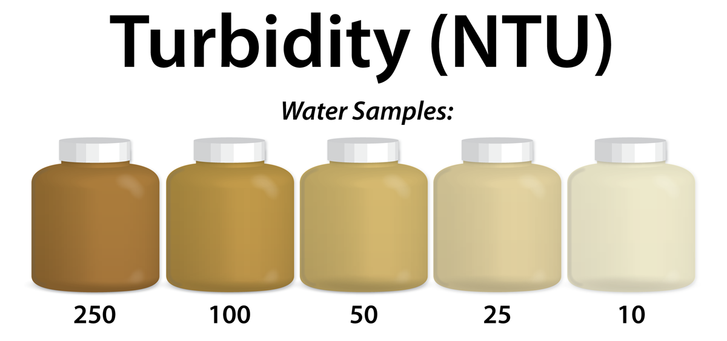
Hypothesis
Combined effects of road construction/improvement, forest harvest, and hauling increase both turbidity and suspended sediment concentrations in adjacent streams.
If so, how often does sediment transport downstream occur?

Slide 5
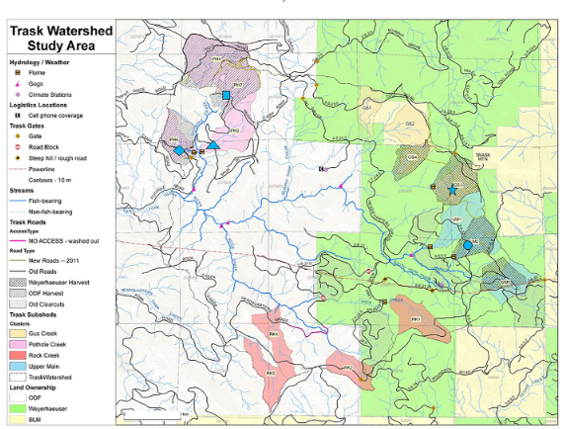
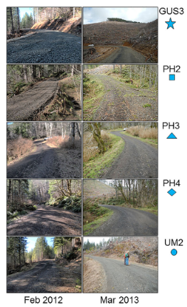
Study Area

Slide 6
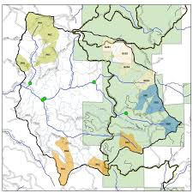
Trask Watershed Study Area
Composed of volcanic and sedimentary formations
Combination of long smooth slopes and steep dissected slopes near stream
Generally stable slopes (<20% grade)
Steeper slopes more in volcanic terrain
“Tillamook Burn”-- Series of large scale man made forest fires from 1933 to 1951

Slide 7
Methods
5 Road crossings studied
Sensors are placed above and below harvest site
Measurements of turbidity, SSC, and discharge are taken
Data is collected at 3 separate times in the forestry process
Data is then analyzed and compared to determine statistical relationships

Slide 8
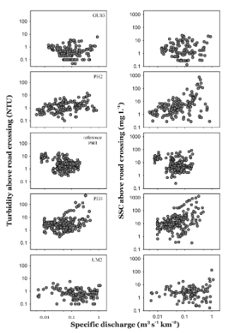
Results
Correlation between turbidity and suspended sediment concentration given a specific discharge
Turbidity measured in NTU
SSC measured in mg/L

Slide 9
Turbidity above and below pair (left)
Plotted against 1:1 ratio
Turbidity plotted at specific intervals (right)
Dots represent 5th and 95th percentile range
Dashed line is given biological impact threshold

Slide 10
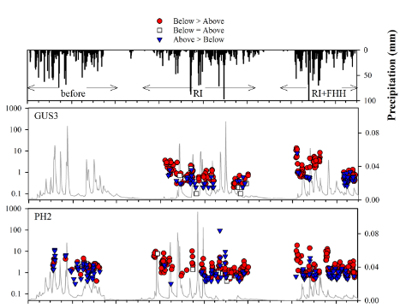
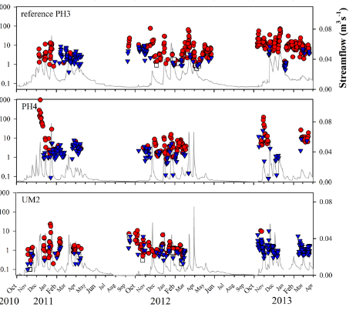
Turbidity at sensor location below the road crossings

Slide 11
Conclusions
Road construction and forest harvest and hauling did NOT result in significant increase in SSC or turbidity downstream
Only minor and nonsignificant increases were found
Likely had little to no biological impact
Only study site PH3 acted in a way that would support the hypothesis
Significant increases in SSC and turbidity during road improvement and hauling
Significant increases also occurred during periods of high flow
Suggests that stream adjacent processes can contribute high sediment yields
Highlights the importance of local factors

