Slide 1
Debris Flows Through Different Forest Age Classes
Article by: Christine L. May
Presentation: Hunter Collins

Slide 2
Overview
Introduction
Background
Study Area
Methods
Results
Conclusion

Slide 3
Introduction
Published in 2002
Looking at relationship between tree age class and debris flow characteristics
Volume of sediment and wood is related to runout length
Runout length: Distance travelled by debris flow
Erosion and sedimentation are good for river channels
Provide nutrients to promote biodiversity

Slide 4
Background
Difference between landslides and debris flow is water saturation
Landslides move mass of rock but do not always create debris flows
Morrison (1975) reported on landslides & debris flow in OR Cascades
Clearcut areas had 2.5-5.6 times greater chance for mass soil movement when looking at comparable forested areas
Debris flows in this study were 8.8 times more likely and had more mass

Slide 5
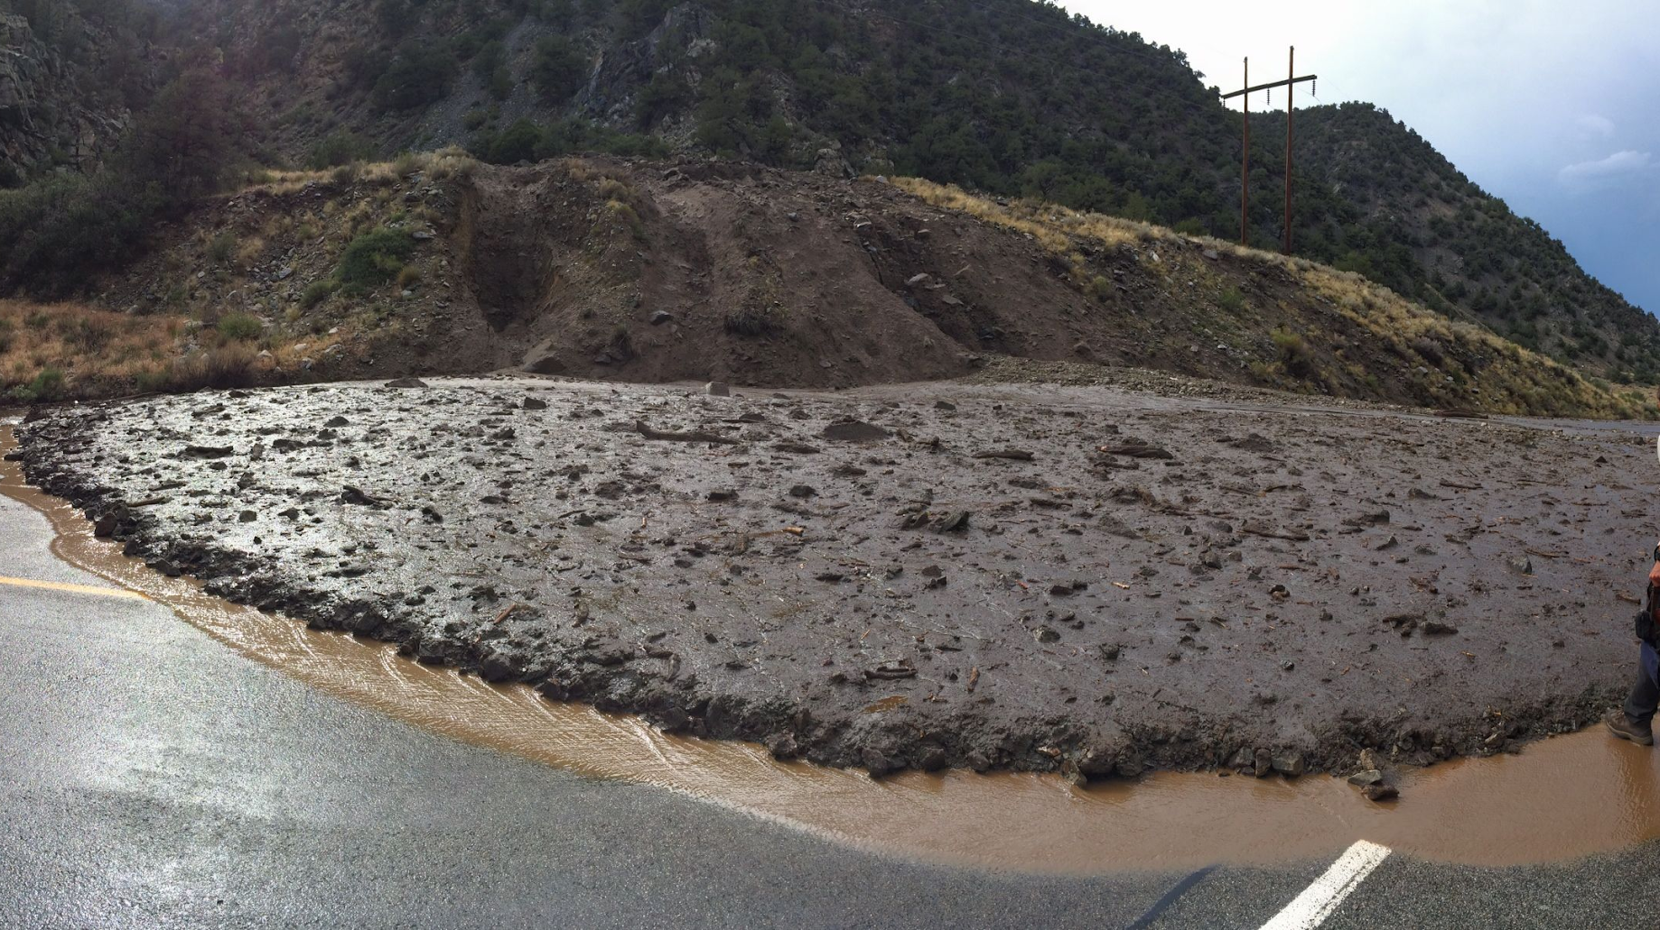
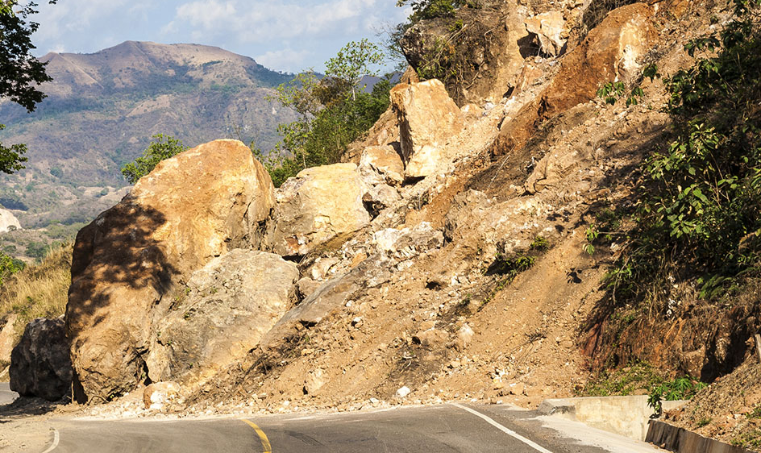

Slide 6
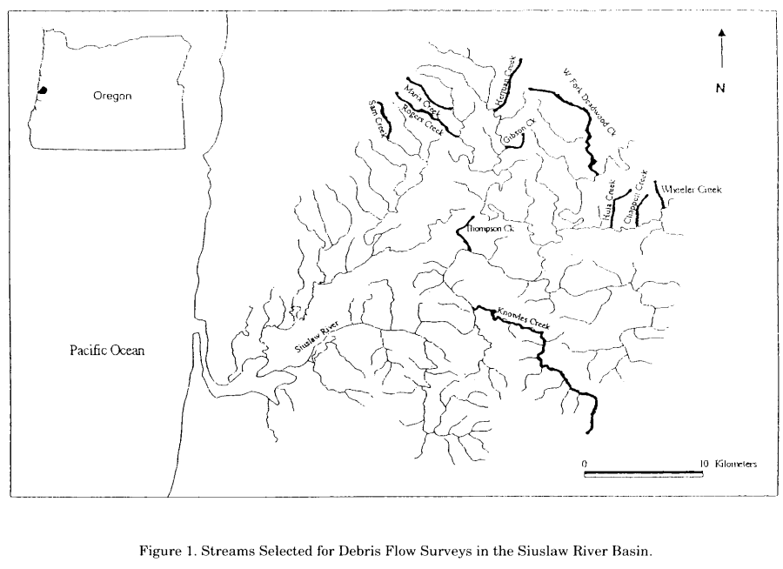
Study Area
Near Oregon Coast in Cascades
Large winter storm 1996
Siuslaw River Drainage (2010 km^2)
Underlain by Tyee Formation
Mainly sandstones interbedded with silt and mudstones
11 streams were selected
Selected for having previous data
Broad range of age classes, also with “mixed” forests

Slide 7
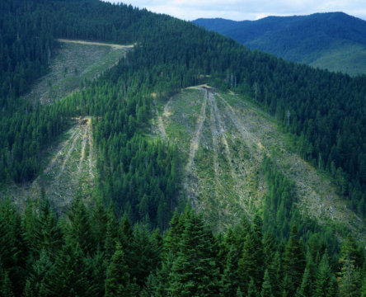
Methods
Some debris flows and landslides were not detected due to being too high up or hidden by vegetation
Age Classes defined by diameter at breast height (dbh)
Clearcut: less than 10cm dbh
2nd Growth: 20-50cm dbh
Mature: greater than 50cm dbh
Most of the debris flows were measured however some needed to be visually estimated
Also took note of “road related” landslides (being within 20m of a road)

Slide 8
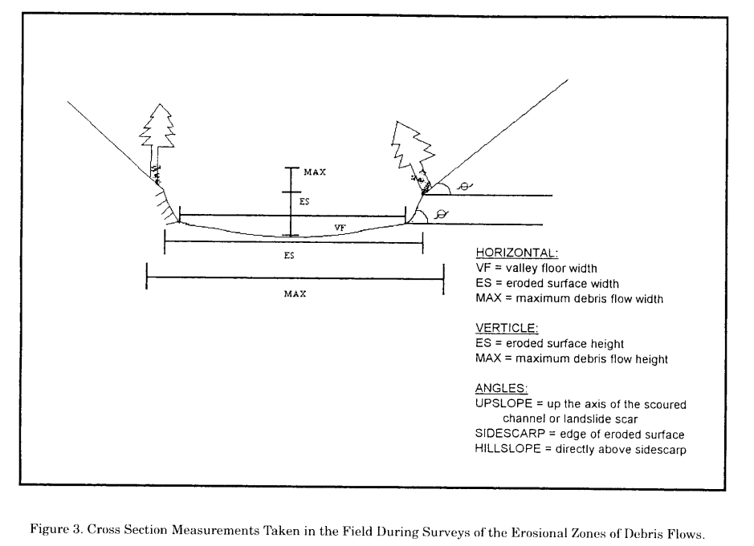

Slide 9
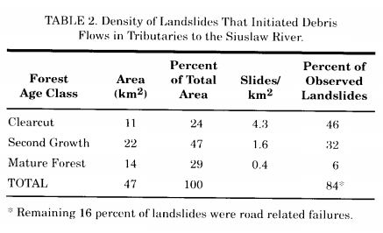
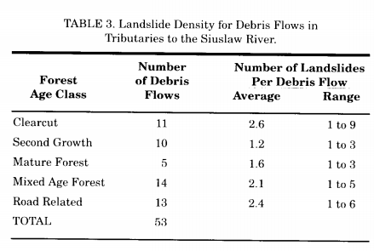
Results
Total of 53 debris flows were detected
106 landslides
41 of which were in Mixed Age
Table 2 shows more landslides happened in clearcut
Table 3 shows number of debris flows for each condition
Also shows the amount and range of landslides for that area/condition

Slide 10
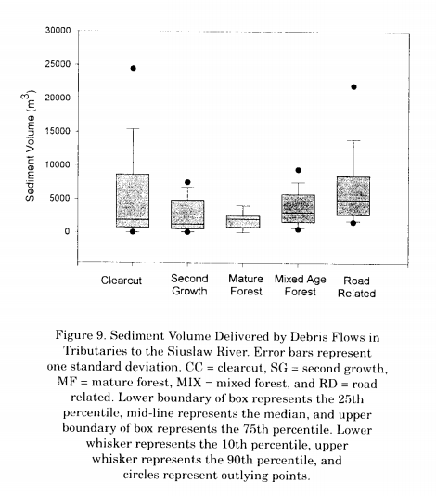
Results
Figure 9 shows total sediment volume delivered (m^3) for each debris flow condition
Both clearcut and road related have large outliers
Mature forest has smallest range of sed volume delivered
Figure 6 shows runout length of the debris flows in two parts
Primary being the “main” landslide for a debris flow complex

Slide 11
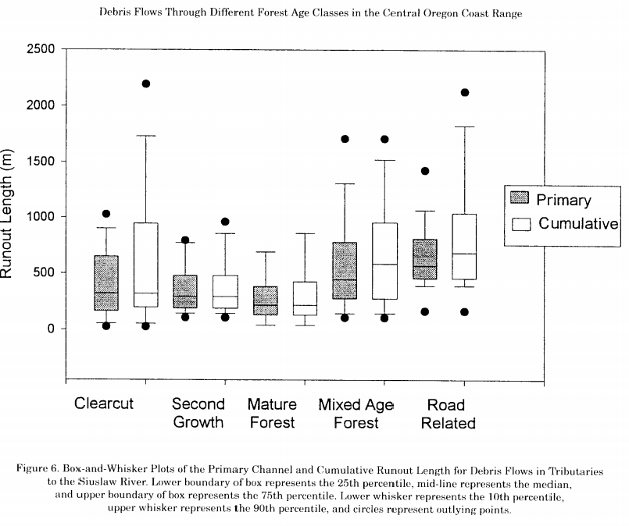

Slide 12
Conclusion
Connection between age class and debris flows are evident in the data
Sample size required would be too large with amount of variability observed
There was statistically significant evidence to show relation between volume of sediment and runout length (figure 8 in handout)
Clearcut and second growth had 180 and 210 m^3 mean landslide volume compared to mature forest 90 m^3
Although clearcut and mature occupy about same amount of study area, clearcut had 40% more landslides and double the debris flows
This study should help inform forestry practices of dangers of timber harvest on debris flow recurrence

