Slide 1
SUSPENDED SEDIMENT DYNAMICS IN SMALL FOREST STREAMS OF THE PWN
ES 407 SENIOR SEMINAR, Dr. Taylor
PRESTENTED BY: Timothy Hagen

Slide 2
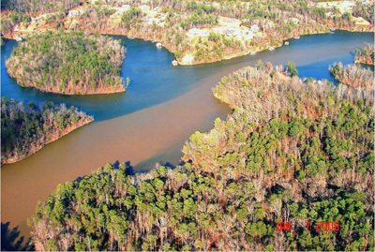
OVERVIEW
Introduction
Goals
Sources
External
Internal
Forest management
Summary and conclusion

Slide 3
INTRODUCTION TO ARTICLE

Slide 4
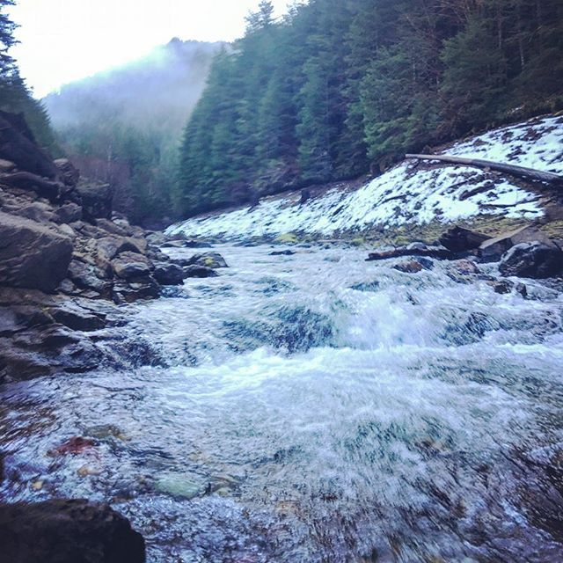
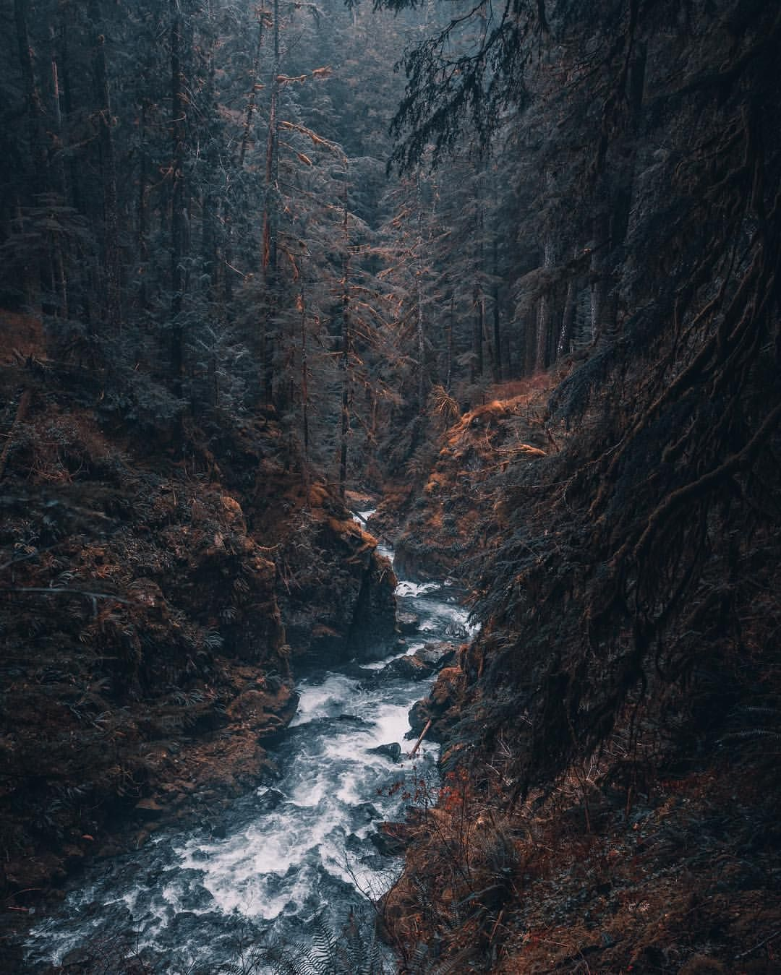
INTRODUCTION
Suspended sediment in streams effects many factors
living
Non living
Focus here is small streams
Learn from these observations

Slide 5
GOALS/TOPICS ADDRESED

Slide 6
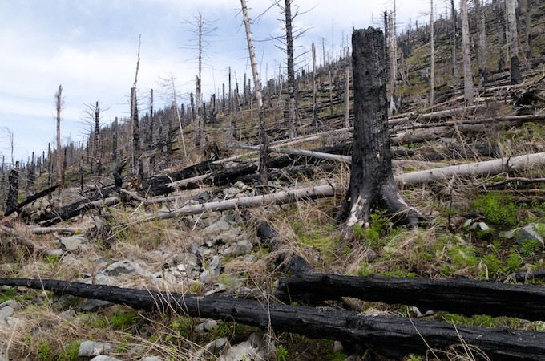
GOALS AND TOPICS
How quickly do post harvest sediments erode?
Does erosion very greatly between scales ?
To what effect are we on harvesting vs sediment run off?

Slide 7
SEDIMENT SOURSES

Slide 8
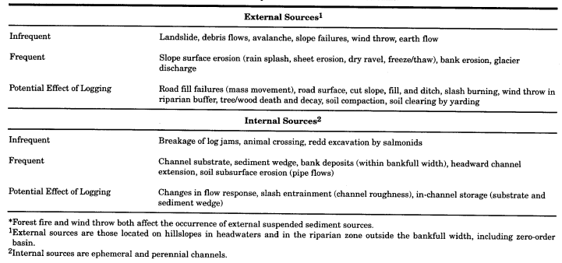
SOURSES
External (outside the stream that comes into the stream)
Internal (within the stream)

Slide 9
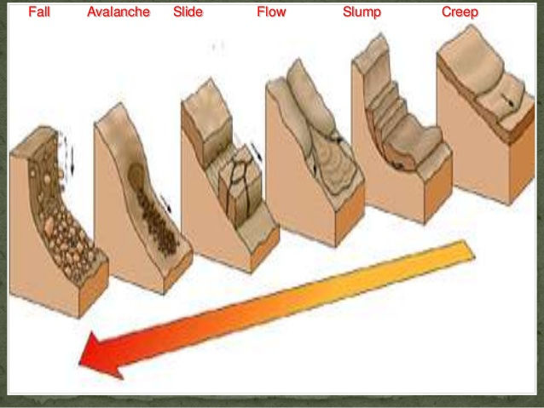
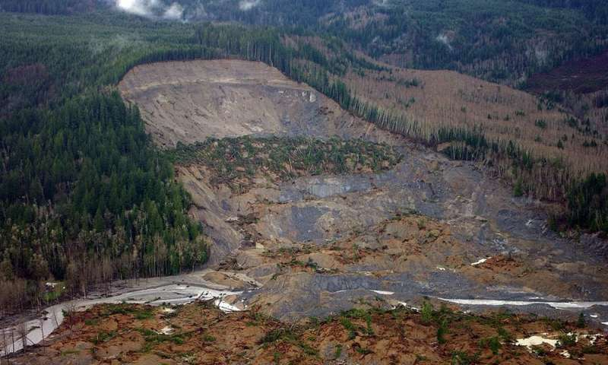
SOURCES CONT.
External sources can be very destructive and large.
Mass movement
Sediment introduction depends on many factors

Slide 10
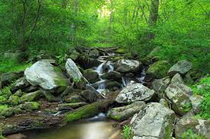
SOURCES CONT.
Internal sources are more within the system
Objects such as trees and boulders
Anything that enters the system

Slide 11
EFFECTS OF FOREST MANAGEMENT

Slide 12
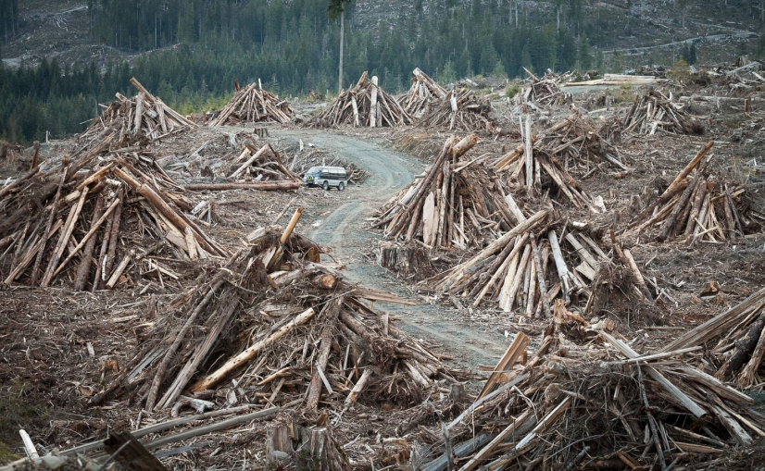
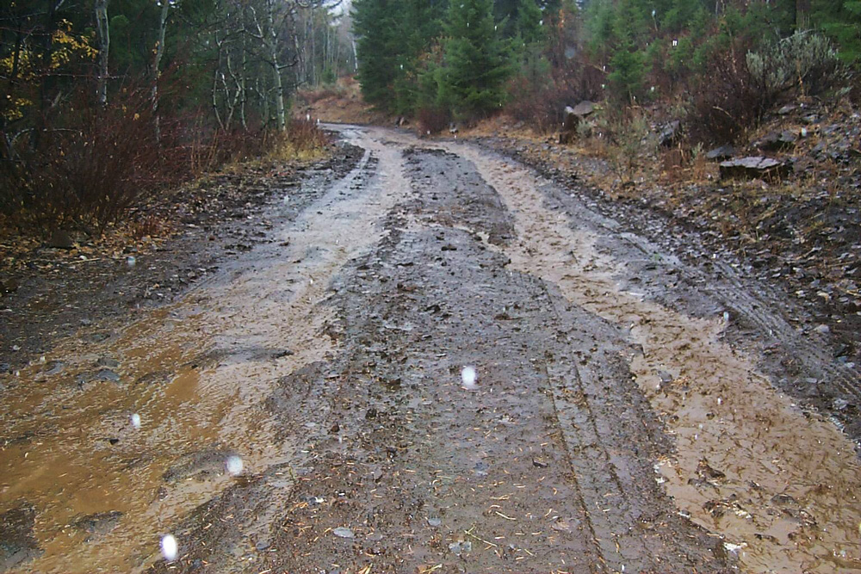
FOREST MANAGAGMENT
The way we treat out forests has a big effect
Roads
Logging
Other activities

Slide 13
CONCLUTION/SUMMARY

Slide 14
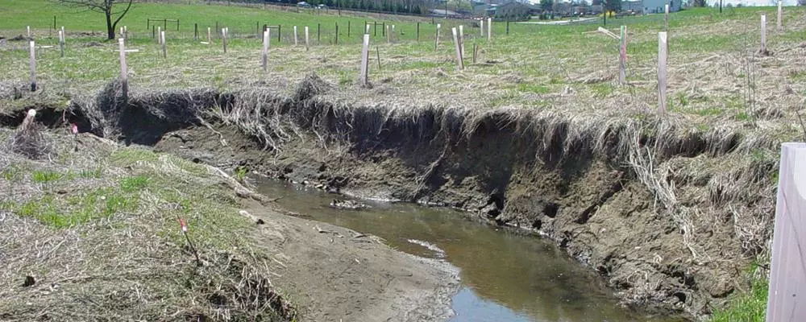
CONCLUTION AND SUMMARY
Sediment has a big effect on streams in many ways
The way we do things in turn effects the streams
Sediment is moved in many different ways through streams
Sources of sediment can range widely
The increase of research needed in this field

