Slide 1
Impacts on suspended sediment, bedload and bank erosion dynamics. Article Summary
Presented by: Timothy Hagen
ES 407 Senior Seminar
Dr. Taylor

Slide 2
Overview
Introduction
Location
Goals
Methods
Results
Temperatures and erosion
Suspended sediment
Summary and conclusion

Slide 3
Introduction to article

Slide 4
Introduction
Fresh water sources and forest management
Increase sediment in fresh water
Implications of erosion
Very methodical and detailed studies performed
Comparing with other countries

Slide 5
Location

Slide 6
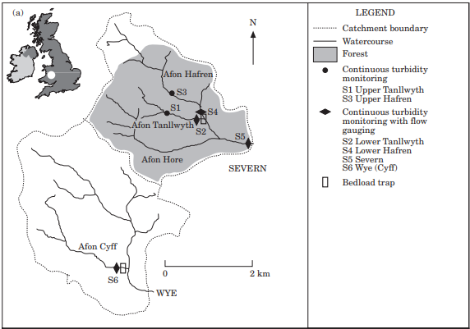
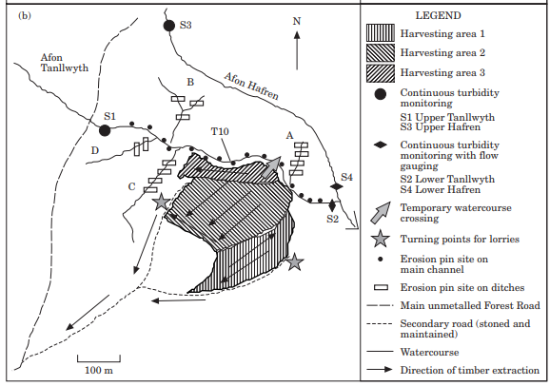
Location of study
Plynlimon United Kingdom
Severn
3 harvested areas
4 continuous monitoring stations
Control stations Wye (Cyff) and Afon Hore

Slide 7
Goals of the study

Slide 8
Goals
Monitor suspended sediment loads
Monitor bedload dynamics
Monitor Bank and forest ditch erosion
Compare results and interpret the data
Better improve methods

Slide 9
Methods Used in experiment

Slide 10
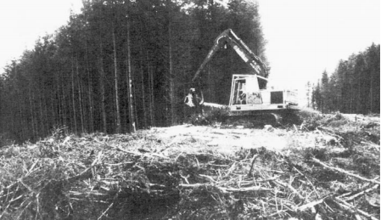
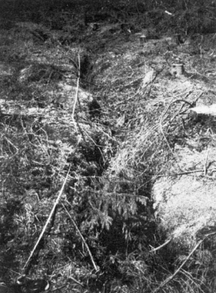
Methods
Flumes measure sediment flows
Single machine logged
Use of brashings
Extracted away from water source
Bedload traps
Erosion pins
Roughly 3400 pins used

Slide 11
Results and data from study

Slide 12
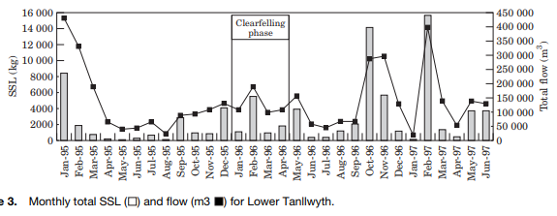
Results: SSL
Lots of data from study
This chart sums the SSL for the Lower Tanllwyth
After harvest erosion and SSL increased significantly

Slide 13
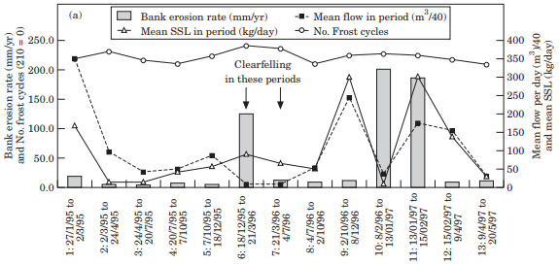
Results: Bank erosion and Temp
Temperature increase was noted.
Lead to increase in frost melting
More bank erosion

Slide 14
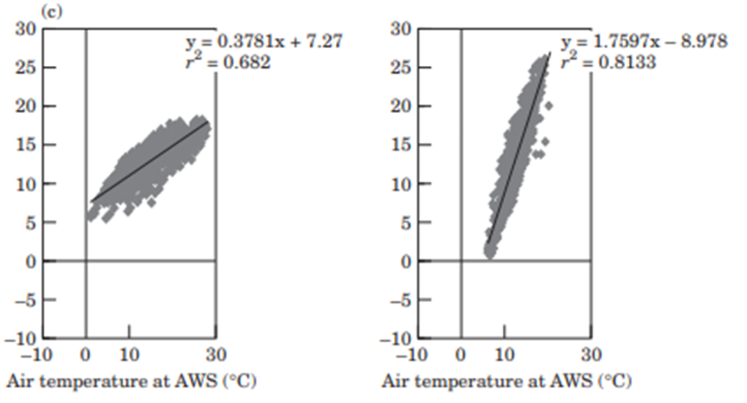
Results: Temperature
Temperature increases before and after harvesting
Less shade cover means high temperature on the ground

Slide 15
Summary and Conclusion

Slide 16
Summary and Conclusion
The goals of the experiment were met
Increases in bank erosion, SSL, and bedload were noted
Some outlier data from the experiment
Use of flumes and pins to help monitor movement and erosion
Learned that proximity of machinery and technics needed to be improved

Slide 17
Thank you

