Slide 1
Complex Mass-Movement Terrains in the Western Cascade Range, Oregon
Article by Swanson and Swanston
Presentation by Hunter Collins

Slide 2
Outline
Introduction
Background
Factors
Study Area
Methods
Results
Conclusion

Slide 3
Introduction
Two case studies from mid 70s
Looking at creep, slump, and earthflow
What leads to them
What makes them worse
How they can interact
Specifically looking at the Western Oregon area

Slide 4
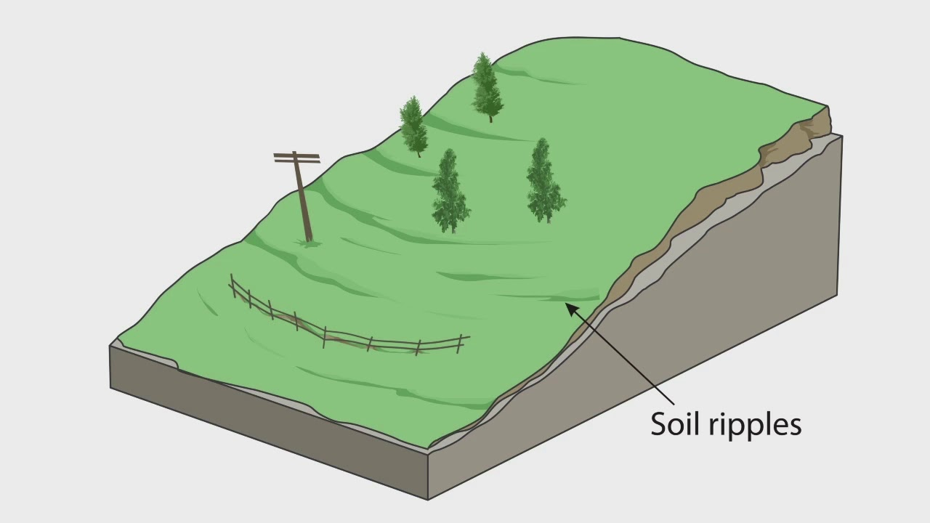
Creep
Creep is slow downslope movement by gravity
Caused by excess water within the sediment
Most widespread of mass erosion processes
90% of landscape in small watersheds

Slide 5
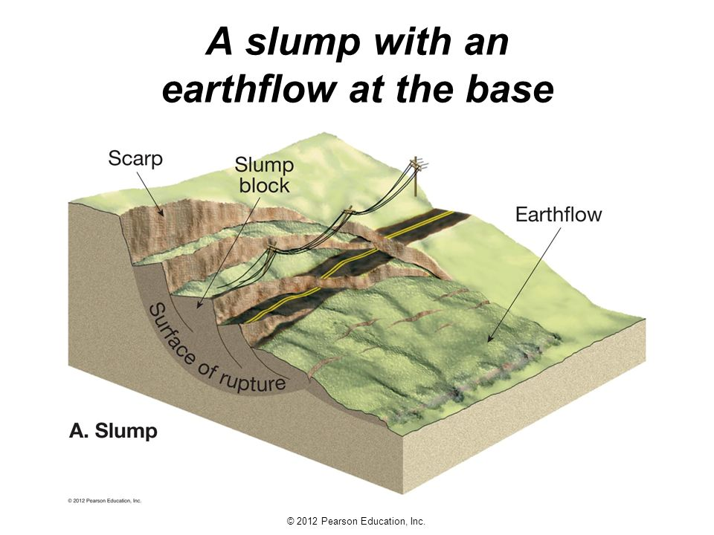
Slump/Earthflow
Creep-induced shear stress overcomes strength of material
Failure leads to slumps and earthflow

Slide 6
Factors
Three main factors affect mass movement rates
Underlying geology and soil composition
Climate of the area
Vegetation
Removal of forest cover

Slide 7
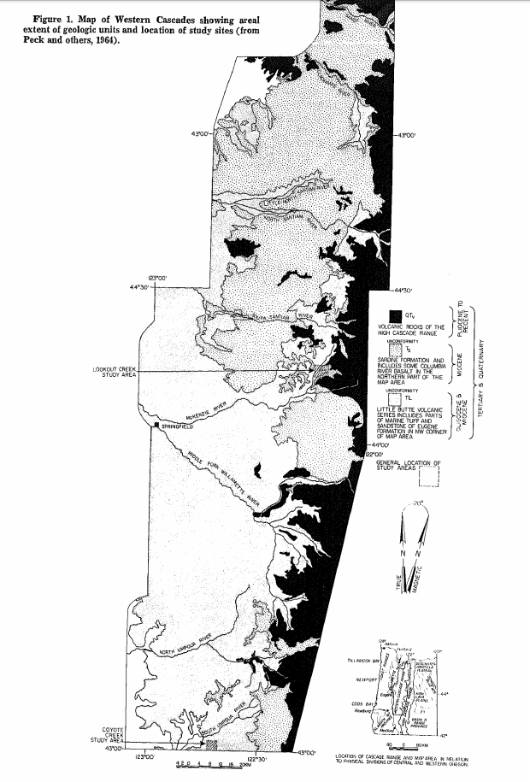
Study Area
Two areas of study in Cascade Range
Lookout Creek and Coyote Creek
Different logging background and normal disturbances

Slide 8
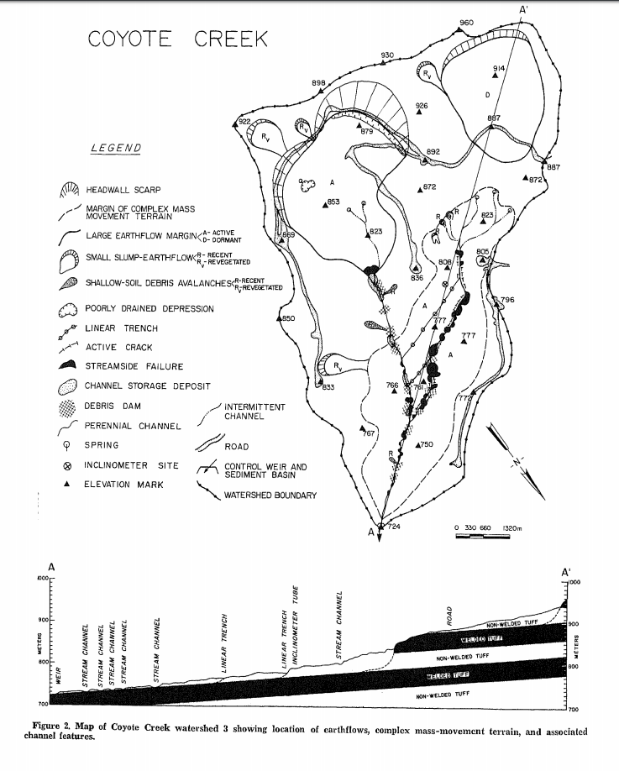
Coyote Creek
South of Umpqua Experimental forest
Watershed 3, 50 ha
Two roads constructed for logging in 71, clearcut in 72
Annual bedload went from 0.01m^3/m*yr to 0.05 after roads, 0.16m^3 after clearcut

Slide 9
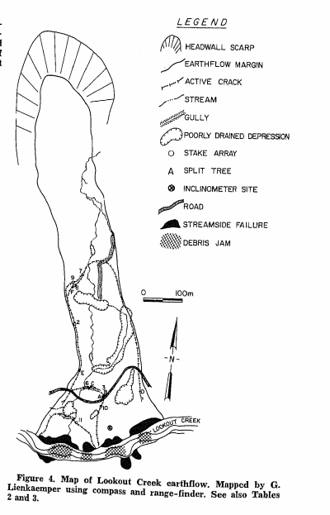
Lookout Creek
HJ Andrews Experimental Forest
20 ha and goes down almost 700m in elevation
Many streamside debris avalanches
High concentrations of potentially mobile material

Slide 10
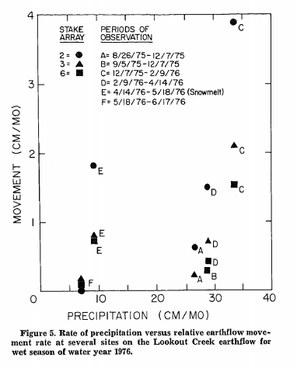
Methods
Mainly observational
In Lookout Creek set up stakes to monitor movement and precipitation
Checked every 1-4 months
Looked at tree rings as well to age some of the mass movement history

Slide 11
Results/Conclusion
Varying rates of creep (8-15mm/yr) lead to unstable terrain
Instability leads to other processes like slump and earthflow, which in turn cause more creep
Creates a “complex terrain”
Extensively altered material are the most prone to activity
Tree ring data suggests mass movements been happening for centuries

Slide 12
Deep-Seated Landslides Drive Variability in Valley Width and Increase Connectivity of Salmon Habitat in the Oregon Coast Range
Article by Beeson et. al
Presentation by Hunter Collins

Slide 13
Outline
Introduction
Background
Study Area
Methods
Results
Conclusion

Slide 14
Introduction
Main question: can km-scale hillslope processes give information on salmonid restoration priorities?
Salmon are adapted to natural disturbance areas
Landforms control types and distribution of habitats

Slide 15
Background
Deep Seated Landslides defined as slope failure of majority of hillslopes in watershed
3 primary controls on salmon habitat
Streamflow, valley constraint, and channel gradient
5-25% of ORCR has evidence of DSLs, more potential to affect river than normal landslides

Slide 16
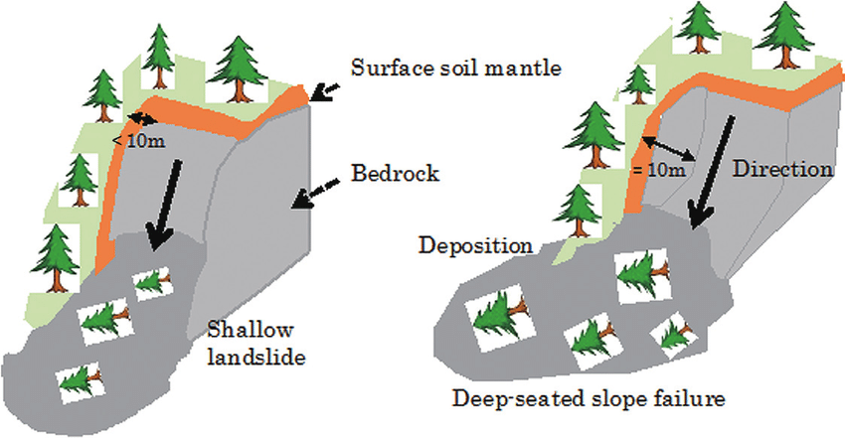
DSLs
Much greater effect on river environment
As well as surrounding topography
https://www.youtube.com/watch?v=5KSS4A1Z8xc
Initiated by seismic activity, stream erosion, high groundwater levels

Slide 17
Study Area
Umpqua River Basin, OR Cascade Range
Lots of good records for geomorphology, also salmon habitat research done here
5 DSL streams: Halfway, Sand, Rock, Scare, Yellow
5 non-DSL streams: Charlotte, Dean, Herb, Scholfied, Sweden

Slide 18
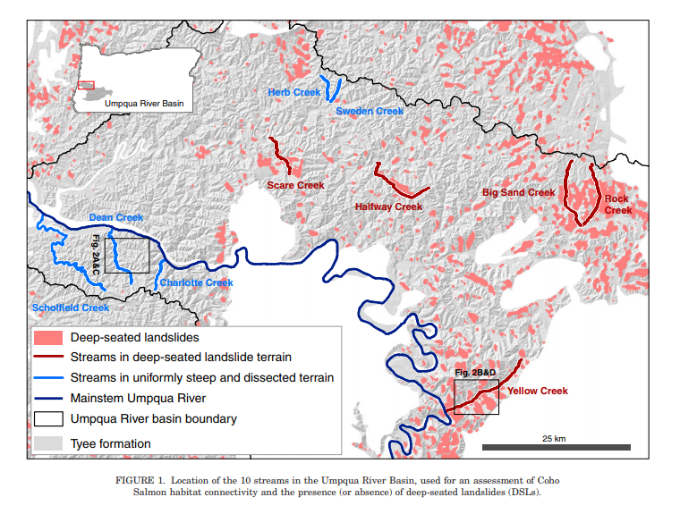

Slide 19
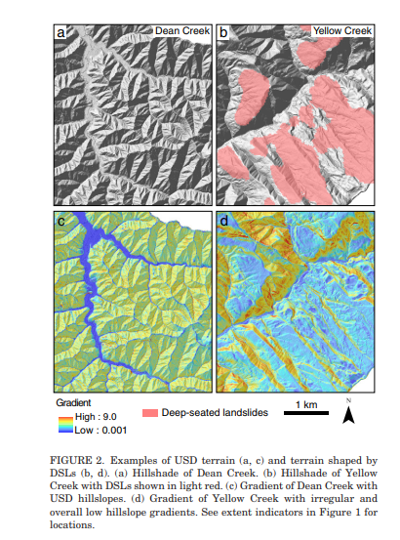
Methods
DSL terrains identified using an automated algorithm
Developed by Roering
Used LIDAR to estimate valley floor width

Slide 20
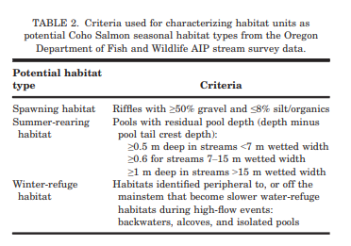
Methods continued
Observed multiple streams, deciding which habitat each would be
Spawning, summer/winter refuge, highly connected (spawn and summer), or comprehensive
Looked at distances between habitats in each stream and abundance

Slide 21
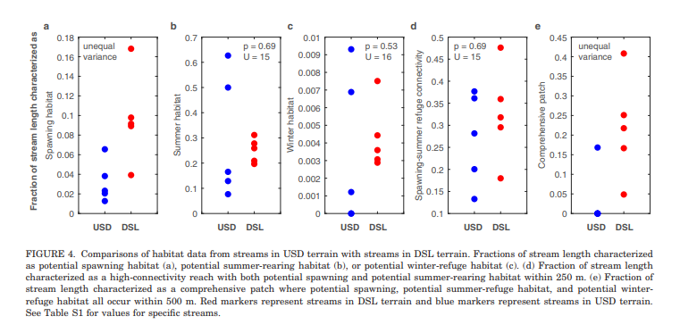

Slide 22
Results
DSL streams had higher median % stream length, lower median absolute deviation
DSL also had shorter mean distances between habitats, as well as median minimum distance
Overall ⅗ DSL basins show weaker relation between between valley floor width and drainage area, not significantly dif from USD

Slide 23
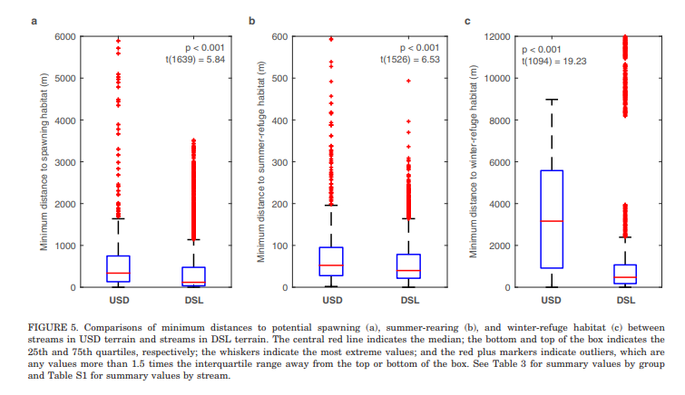

Slide 24
Conclusion
Winter habitats are limiting factor for comprehensive, restoration could help population
Spawning habitat limits high connectivity areas
Summer could also limit HC if area dries out fast
Isolated wide valleys in DSL terrain would be ideal habitats

