Slide 1
Impact of Clear-Cutting and Roads on Soil Erosion
(1975)
By: Hunter Collins
Article From Swanson and Dyrness

Slide 2
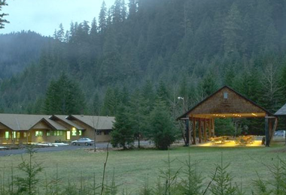
Overview
Introduction
Background
Study Area
Methods
Results
Conclusion

Slide 3
Introduction
Paper from 1975
Looking at soil erosion by landslides
Timber harvest and roads effect
“Progress report” on one phase of erosion studies
Knew that current science was underestimating the impact

Slide 4
Introduction Cont’d
Stable vs. Unstable Zone
Lava-flow vs. Volcaniclastic terranes
Rapid, shallow failures
Less than 5m depth, 75m^3 soil material
Slides bring soil into streams

Slide 5
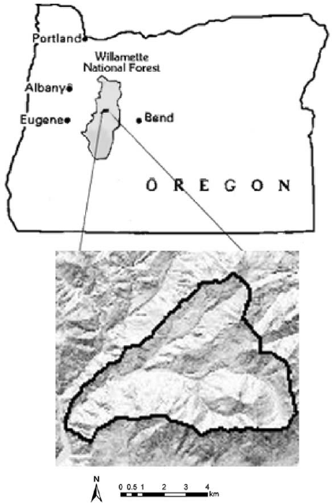
Study Area
HJ Andrews Experimental Forest
Eastern edge of Western Cascades
6100 ha watershed, elev range: 450-1630m
Underlain by volcaniclastic below 1000m
By unaltered lava flows above
Much of area above 900m was glaciated during late Pleistocene

Slide 6
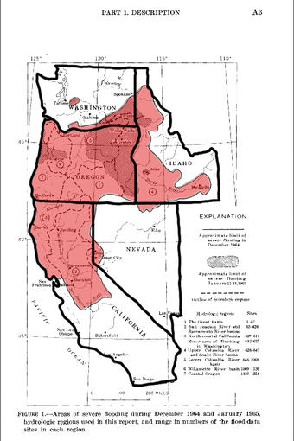
Background
Large storms in ‘64 and ‘65
Studied in detail by Dyrness in ‘67
Two observational reports by Fredriksen (‘65,’70) on the watersheds
Road cutting began in 1950
Extensive research in Andrews helped provide data

Slide 7
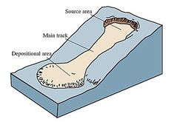
Methods
Combined info above with aerial photos
Interviewed forestry personnel
Field observations
Height, width, depth of scars
Bedrock geology, geomorphic setting, land use, revegetation
Events were “dated” using photos, etc.

Slide 8
Results
More than 98% of slides took place in unstable zone
Less than half the total forest area
Only two road related slides recorded in stable zone
Slides in clear-cut transported 3x greater volume of soil when compared to forested
Roads accounted for 30x more soil than forested areas

Slide 9
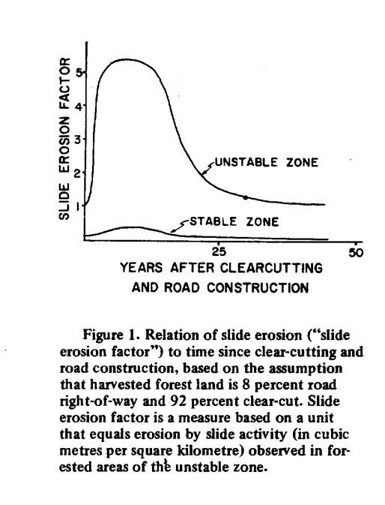

Slide 10
Why?
Deforestation causes decreased root strength
Transpiration decreases and snowmelt may increase
Especially dangerous during decomp and regrowth of trees
Roads cause interruption and redirection of sediment and water flow by creating a “channel”

Slide 11
Conclusion
While data looked bad they were optimistic
Road design and implementation could be improved
New logging methods
However most of the stable terrane was unlogged at the time
Impact of these two factors reduced after 10-20 yrs
2 road related landslides in stable zone, 139 in unstable

