Slide 1
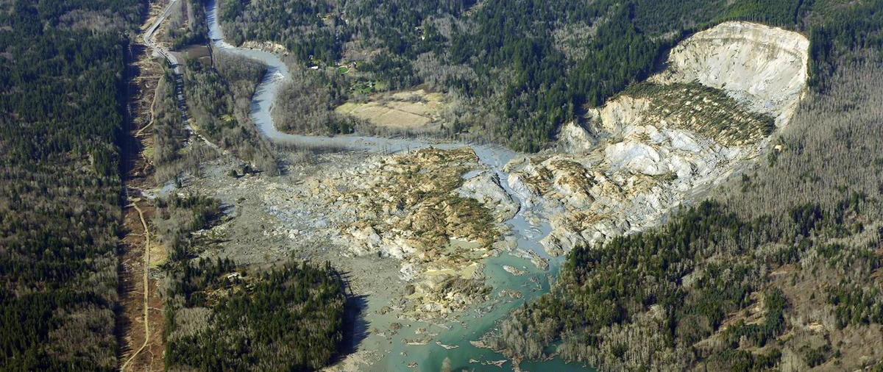
Forestry Practices, Soil Moisture and Headwater Stream Temperatures
By Palmer Baldwin

Slide 2
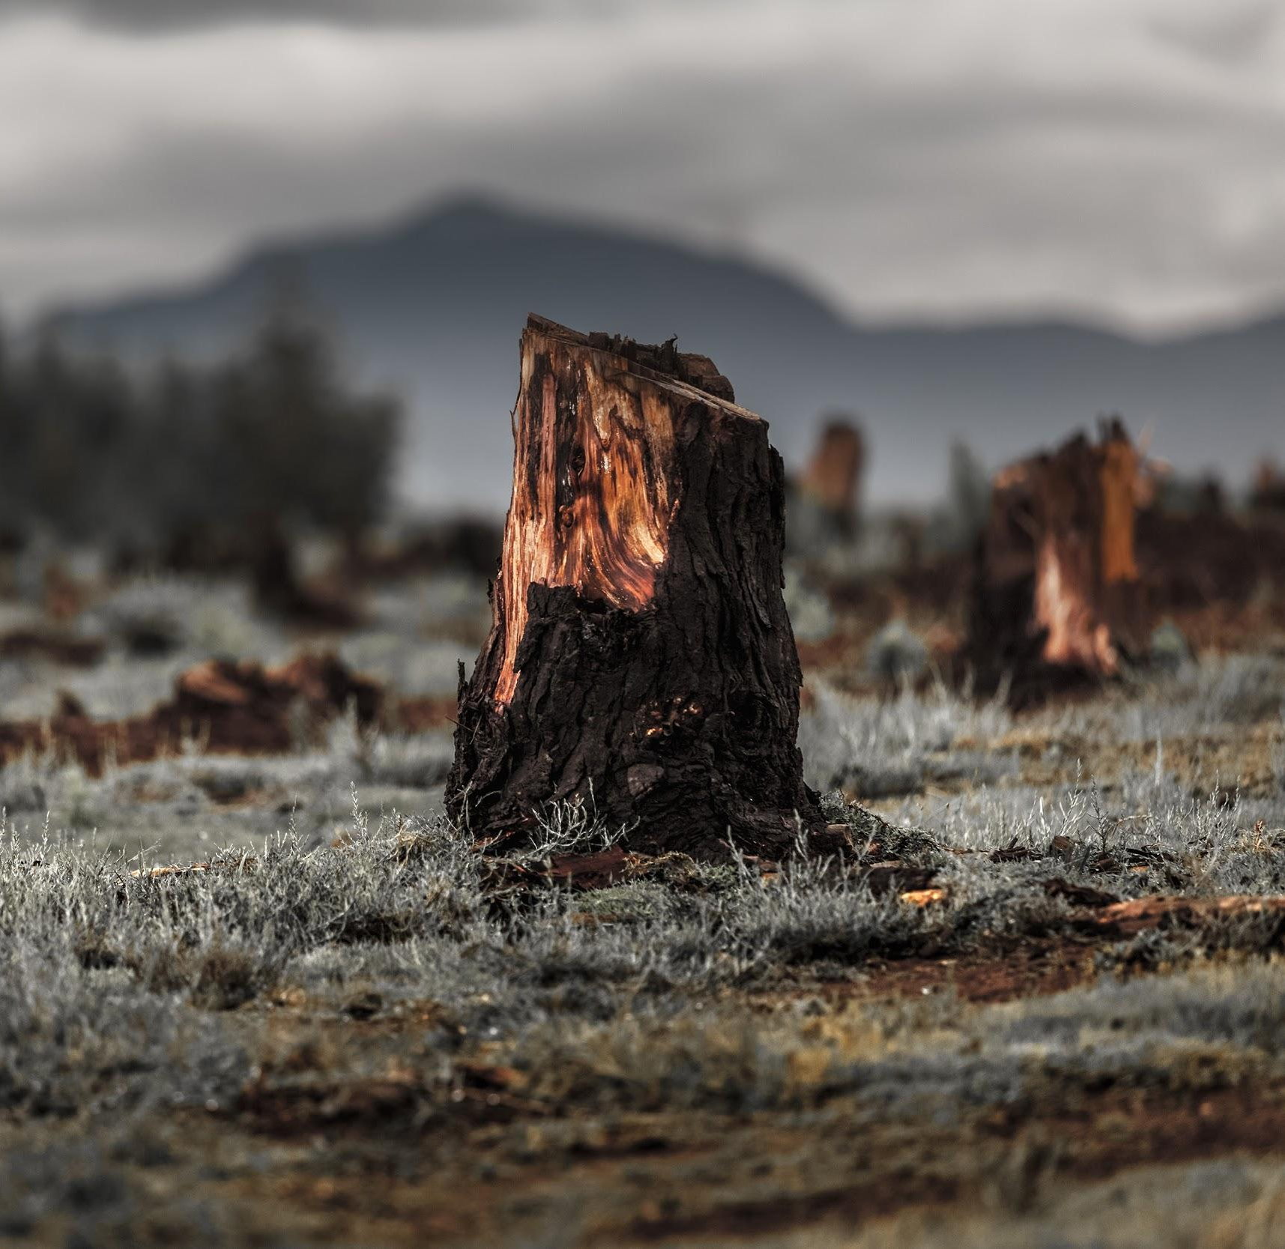
Table of Contents
Introduction
Topic: Soil Moisture
Topic: Stream Temperatures
Acknowledgements

Slide 3
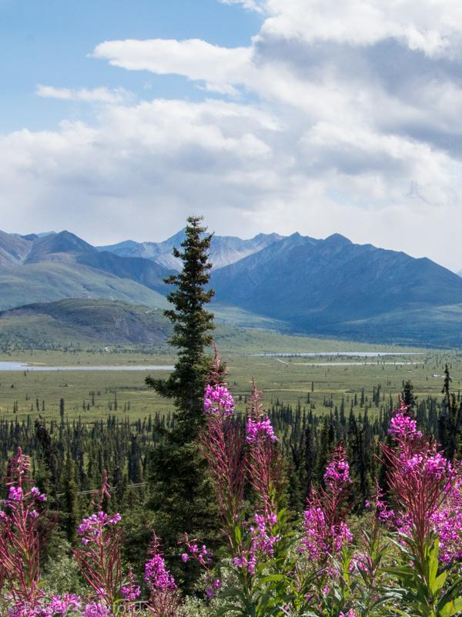
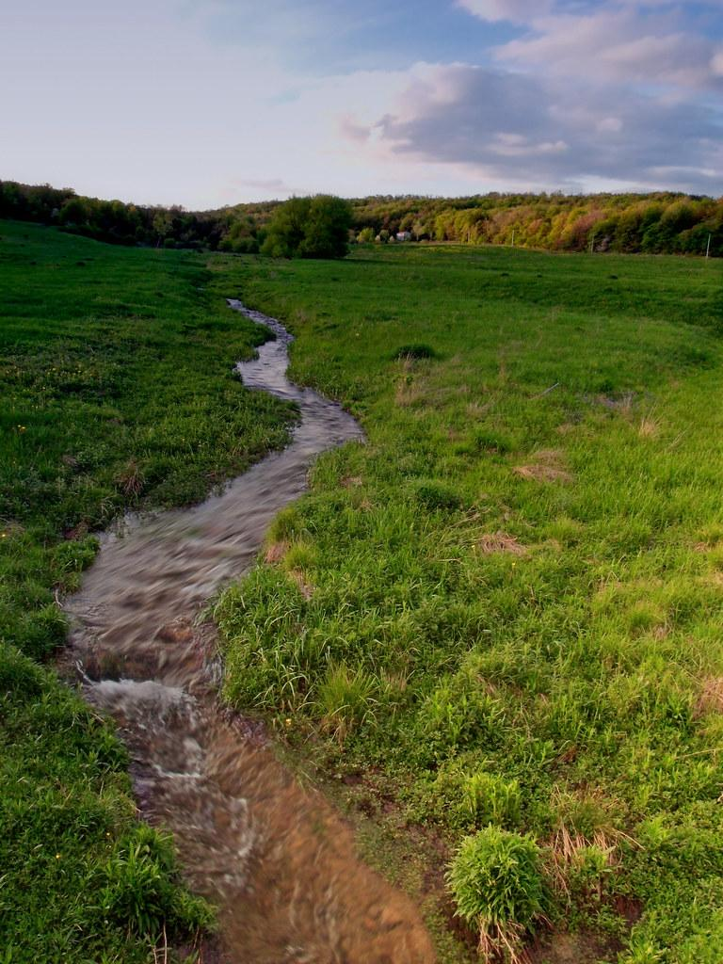
Introduction
Soil Moisture and Revegetation
Stream Temperature Variability

Slide 4
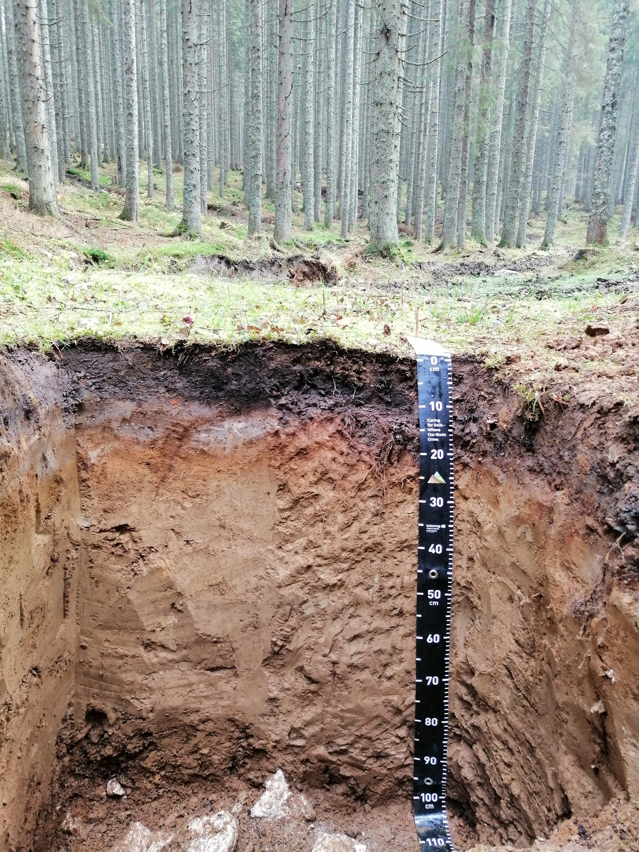
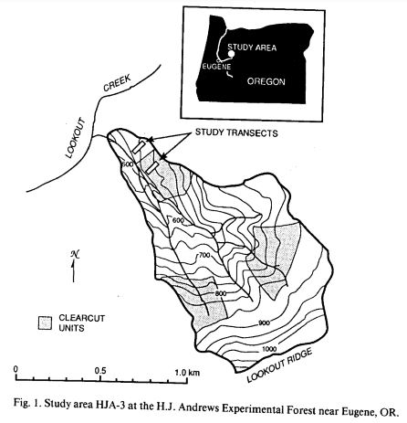
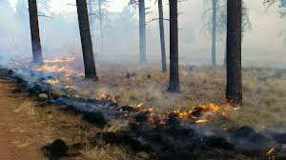
Soil Moisture
Varies seasonally
Plant cover decreases moisture content
Wilting-point: no coming back
Clearcut, broadcast burned forest examined

Slide 5
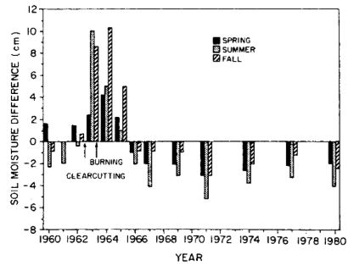
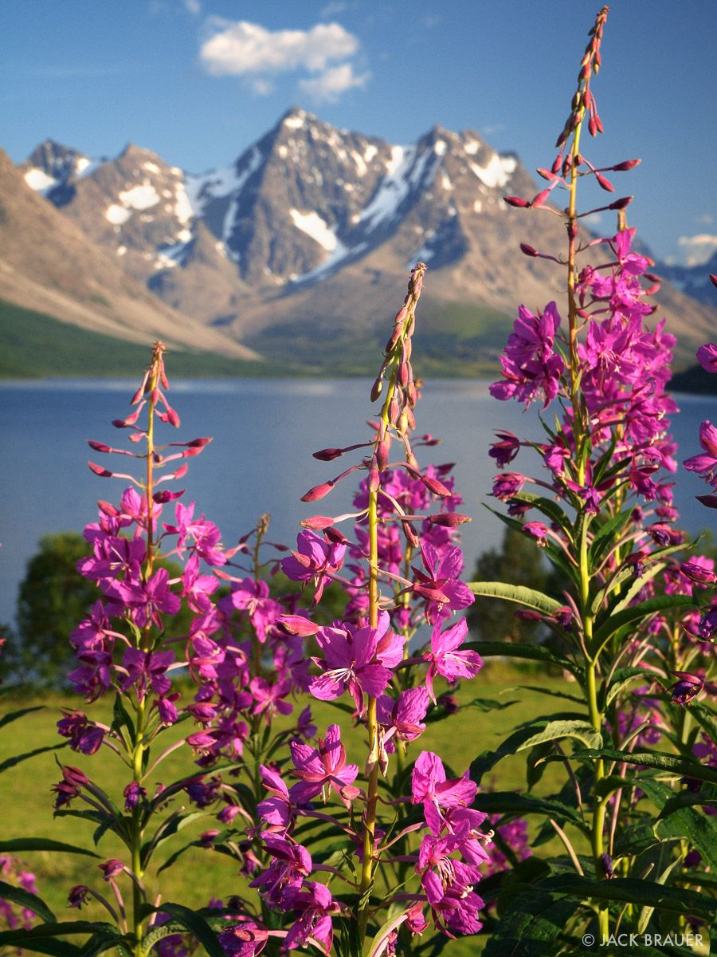
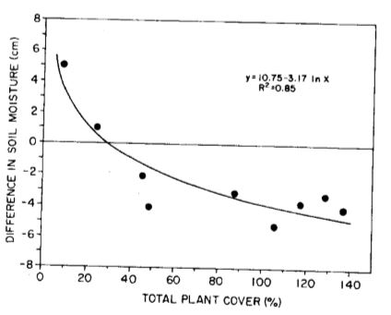
After treatment:
Soil moisture increases after treatment
Decreases after reclamation
Persistent deficit for remainder of study

Slide 6
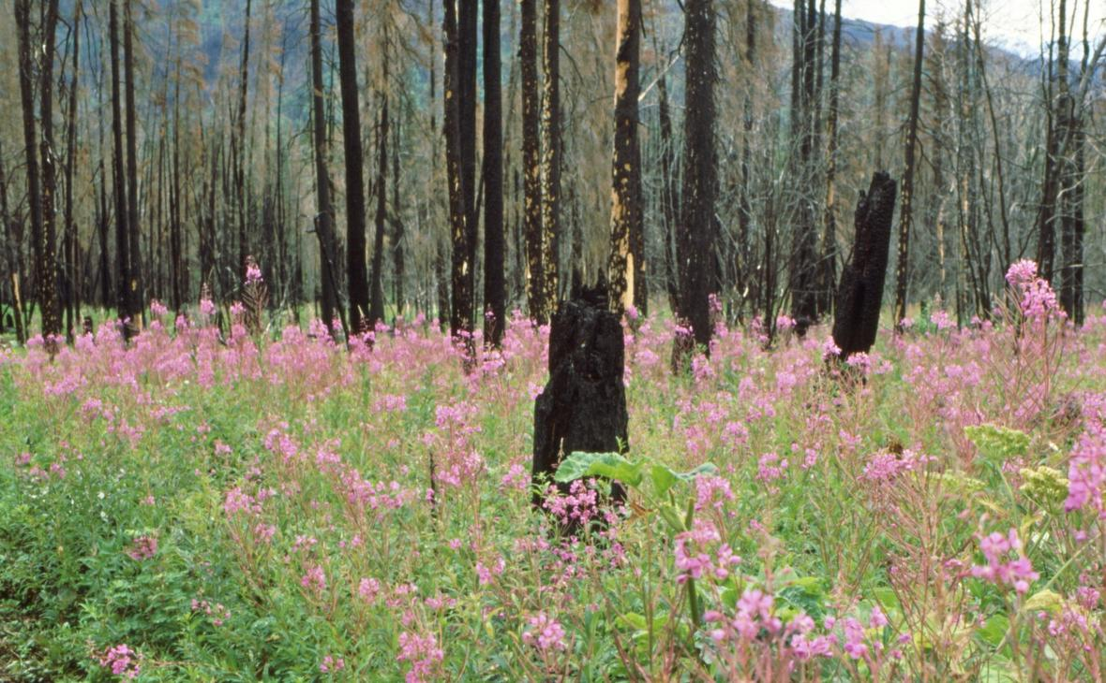
discussion
Revegetation rapidly decreases soil moisture
Persistent moisture decrease= decreased forest regeneration
Burning reduces wettability, infiltration

Slide 7
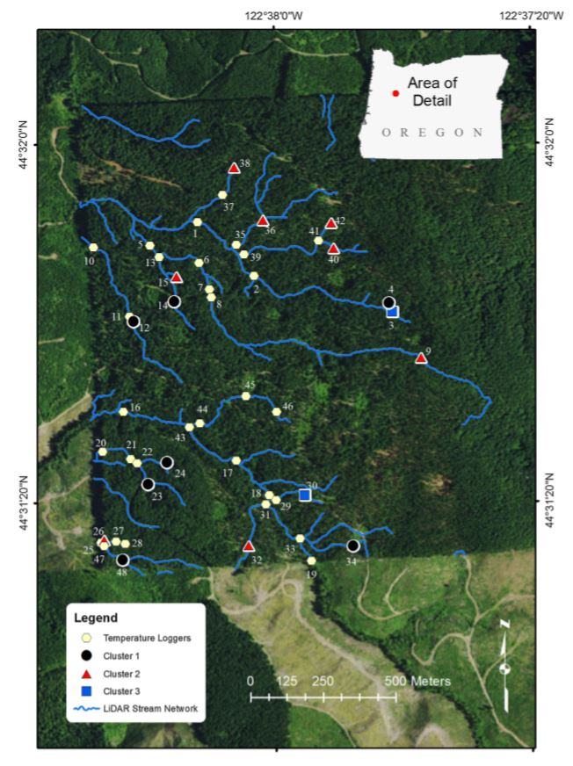
Streams
Stream temperatures affect ecosystem, wildlife
Forestry treatments affect stream temperatures
Variations are larger in smaller order streams

Slide 8
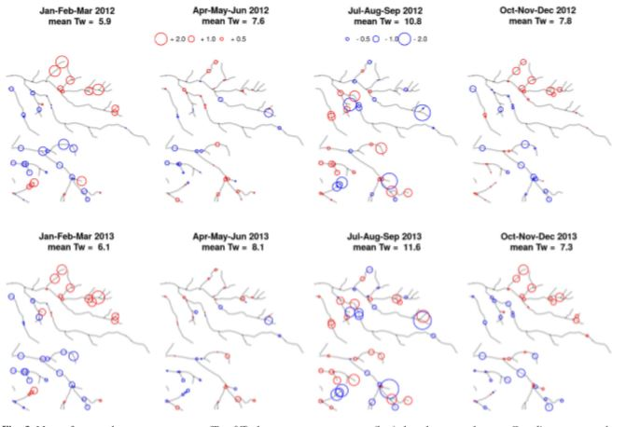
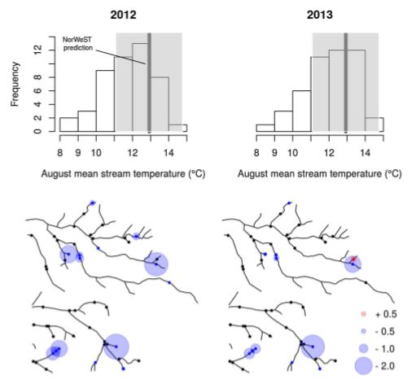
Spatial variability is higher in smaller order streams
Land management models don’t work on fine spatial scale

Slide 9
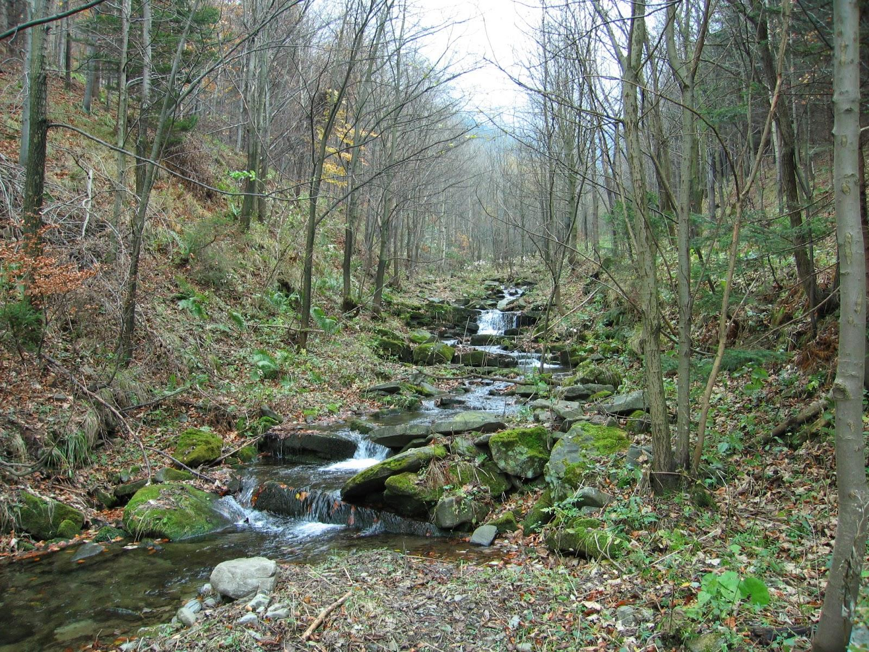
Discussion
Stream temperatures legally mandated
Temperature affects ecosystem service providers
Better models needed
Currently Measured on too broad a scale

