Slide 1
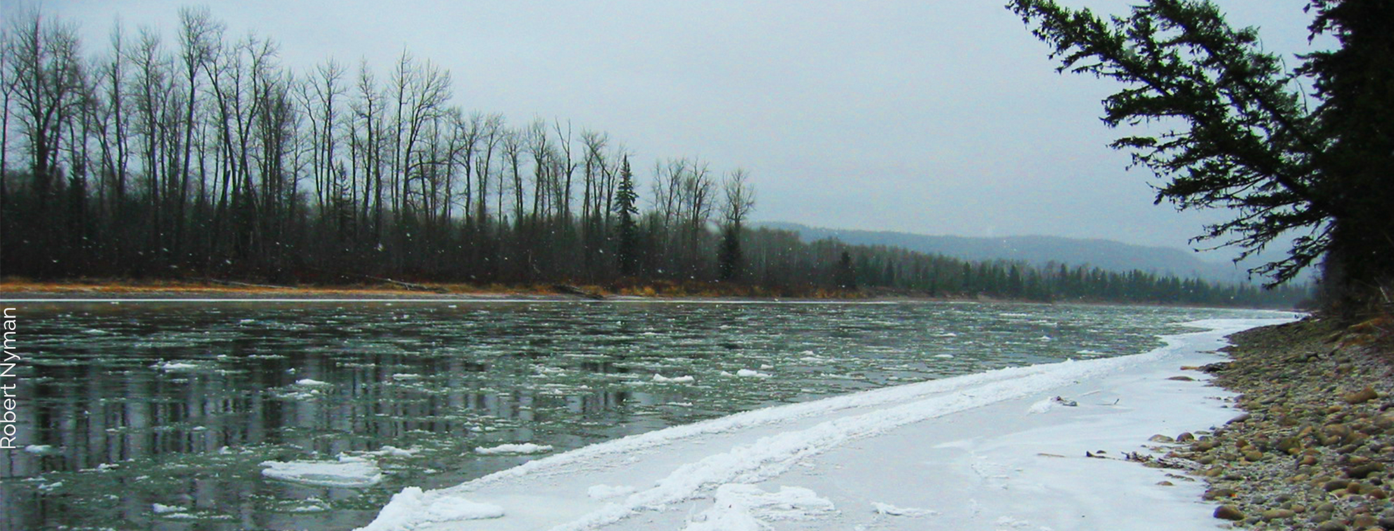
Suspended Sediment Concentration, Stream Discharge, Snowmelt, Forestry
By Palmer Baldwin

Slide 2
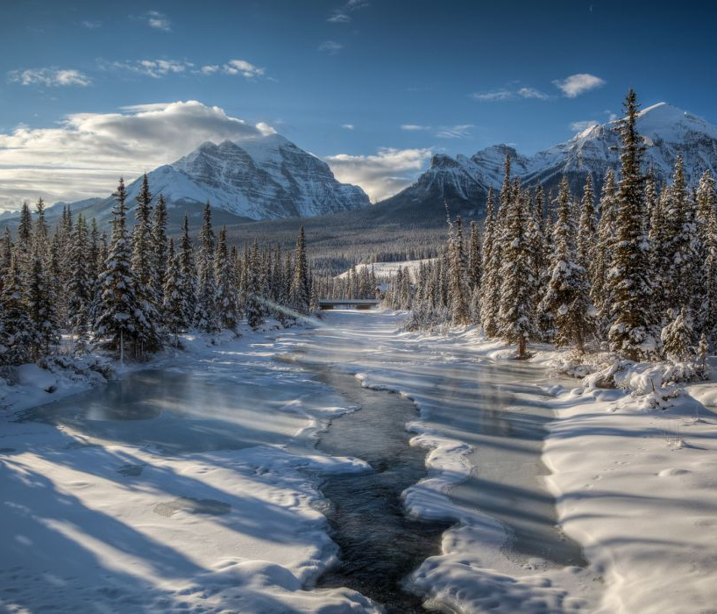
Table Of Contents
Introduction
Materials/Methods
Results
Discussion
Conclusion
Acknowledgements

Slide 3
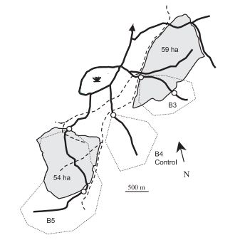
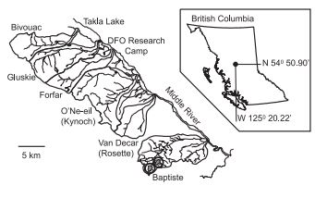
Introduction
Three 1st order sub-boreal streams
6 year study
Freshet events
Measuring TSS, stream discharge

Slide 4
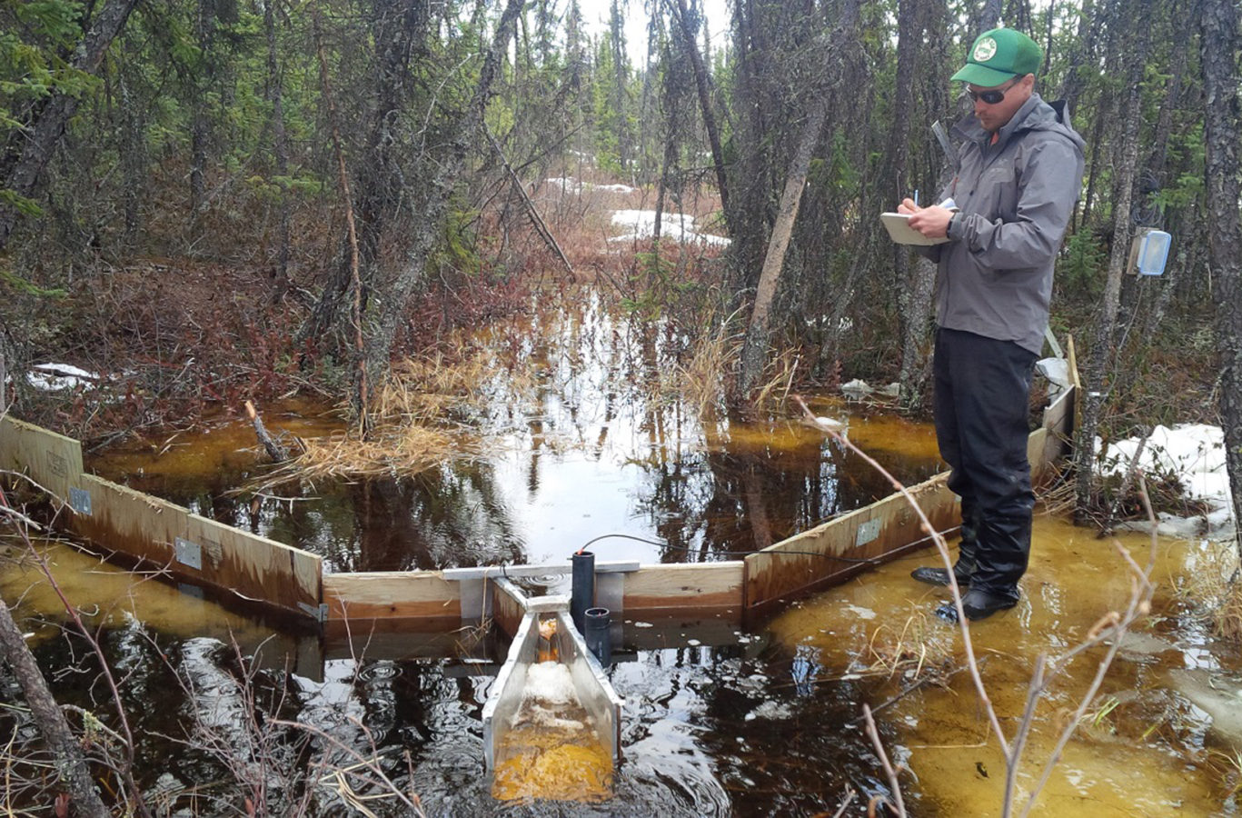
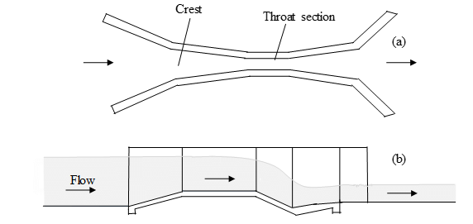
materials/methods
Parshall Flumes utilized
Measuring freshet events only
Forests within 20m of streams treated (or not)
1 year of base data collected before forest treatments
3 watersheds, Closely matching hydrographic/TSS relationships

Slide 5
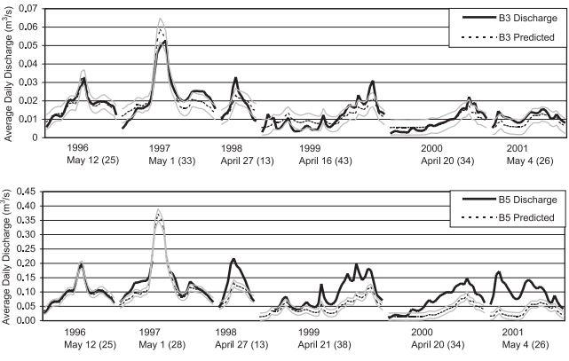
Results
Increase in peak snowmelt and total freshet discharge - persisting
Increase in TSS- effects degrade over 3 years

Slide 6
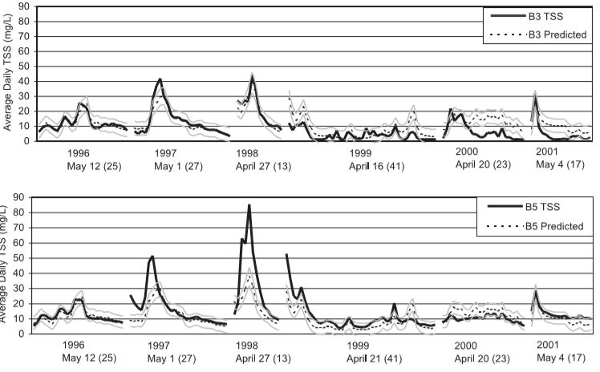
Discussion
Cutblocks accumulated more snow
Increased snow= increased peak flow
&
Increased mean daily discharge

Slide 7
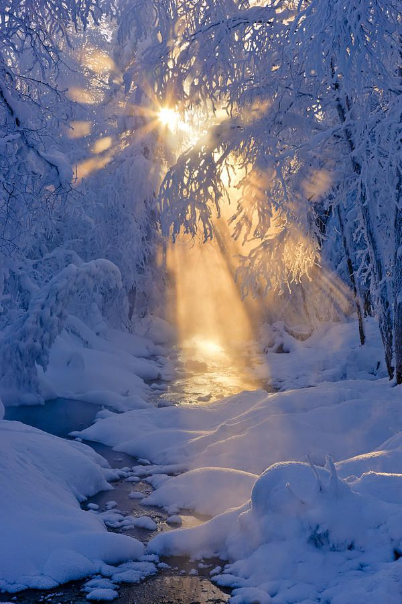
Conclusion
Riparian treatments:
- increase TSS, discharge in freshet
events
- increase daily peak discharge
-increase snowpack accumulation
-protect streambanks BUT alter balance

Slide 8
Acknowledgements
Title Slide: Sub-boreal stream, accessed 4/29/2019 from: https://www.sierraclub.bc.ca%2Fecomap%2Fsub-boreal-interior%2F&psig=AOvVaw1SH5hDYPkGNc54ngG3Xtxw&ust=1556812749554982
Handout imagery of Parshall flume retrieved 4/29/2019 from www.fao.org/3/T0848E/t0848e-09.htm
Image of DUcks Unlimited researchers using Parshall Flume, accessed 5/1/2019 at: http://boreal.ducks.ca/extreme-camping/
Parshall flume layout: accessed 5/1/2019 at: https://www.researchgate.net/figure/Top-a-and-side-b-views-of-a-Parshall-flume_fig2_319114301
Conclusion slide: “small stream in a hoarfrost” picture by Kevin Smith accessed 5/1/2019 at https://www.pinterest.com/pin/316800155025529857/

