Slide 1
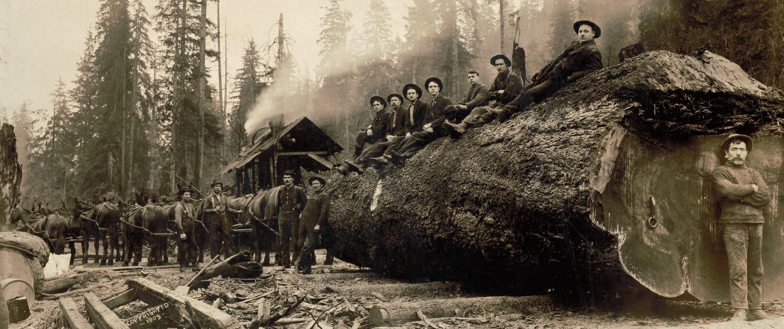
Forestry Practices and Peakflow Response in the Western Cascades
By Palmer Baldwin

Slide 2
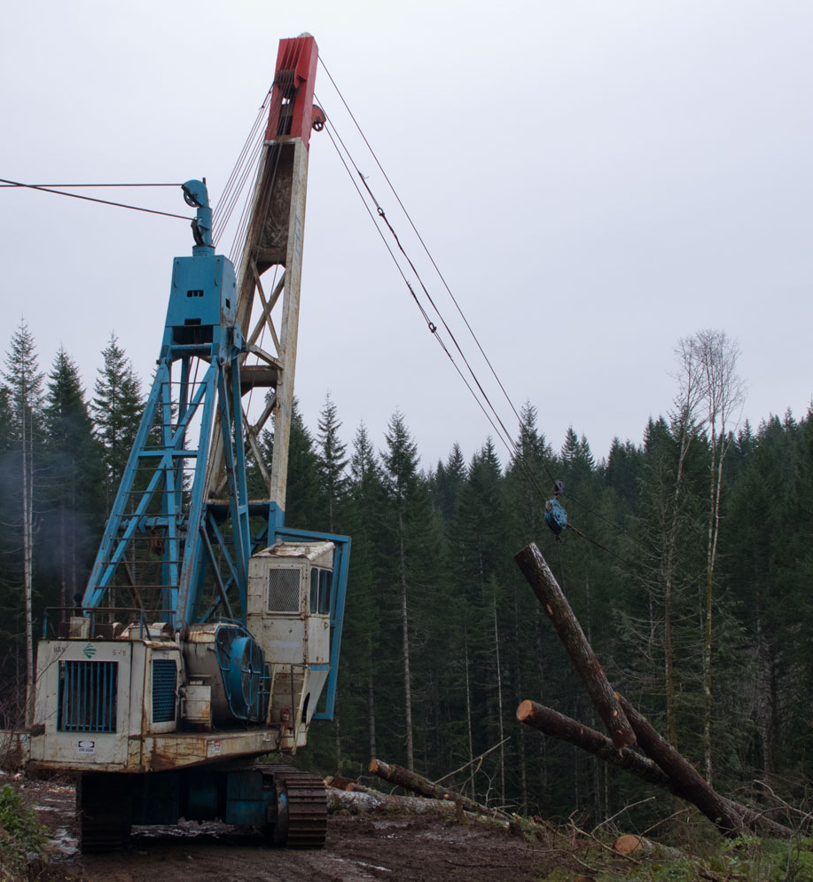
Table of Contents
Introduction
Study Objectives
Results
Discussion
Acknowledgements

Slide 3
Introduction
3 small watersheds (60-101 ha)
Long calibration period
WS2= control
6 large basins (62-640 km^2)
Notes:
The analysis looks at watersheds 1, 2, and 3 at hJ Andrews experimental forest and 6 larger watersheds in the Cascades, using stream guage data to identify and analyze the eventswith onger recurrence intervals

Slide 4
Study Objectives
Peakflows and land management
Data quality
Small watershed analysis
Large watershed analysis
Notes:
The authors identify a range of peakflows that are of interest to forest land managers, and then discuss the treatment of peakflow data to address data quality. The study focuses on large peakflow events from 3 small watersheds (1 control, 2 recieving forestry treatments) and 6 large basins in the western cascades

Slide 5
Results
Small watersheds= increased small peakflows after treatment
large RI peakflow= decreased response
Large Basins=no increase in small OR large peakflow events

Slide 6
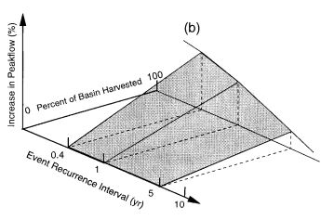
Discussion
Larger RI, smaller increase
Larger area, smaller effect

Slide 7
Acknowledgments
Title slide: Horses hauling a spruce log 30ft in circumference, Washington, 1905. Darius Kinsey, Library of Congress, accessed 4/22/19 at: https://timeline.com/logging-photos-of-washington-states-old-growth-forests-bf18aef19955
TOC, Introduction imagery obtained from HJ andrews experimental forest website, accessed 4/22/19 @ https://andrewsforest.oregonstate.edu/

