Slide 1
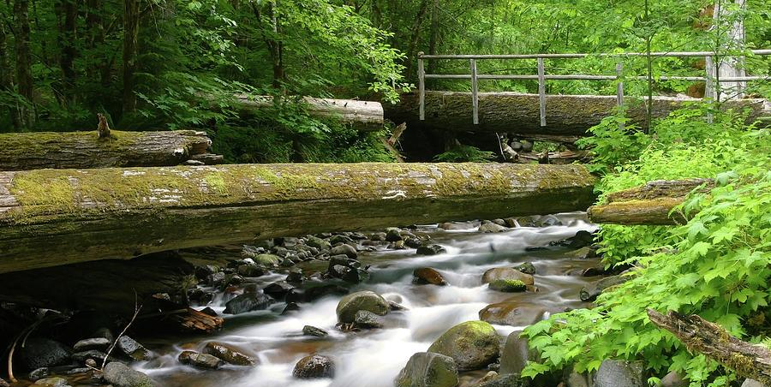
Forestry Treatments and Hydrologic Balance
By Palmer Baldwin
Notes:
Today I’ll be talking to you about the effects of anthropogenic activity on the hydrological balance of forest basins in the western Cascades, based on research obtained from H.J. Andrews Experimental Forest.

Slide 2
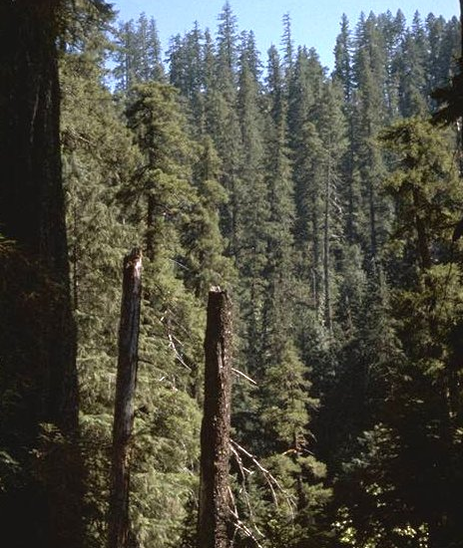
Table of Contents
Hydrologic Balance of forest basins
Responses to forest canopy removal
Experimental design/results
Discussion
Conclusion
Watershed 1 before logging, looking up south tributary above the forks. Photographed by Dick Fredriksen 07/1962 Photo: AAB-020

Slide 3
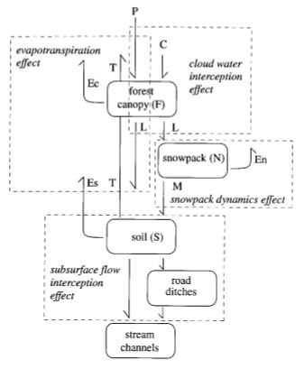
Components of Water Balance
Storage Locations
Forest Canopy
Snowpack
Soil and Regolith
Movement Mechanisms
Precipitation
Evaporation
Transpiration
Snowmelt
Throughfall
Notes:
There are some fundamental concepts about water balance and routing in hydrology. Water is always moving between storage locations in the forest, sometimes being caught as rain in the leaves and branches of the various trees and plants that grow there, only to be evaporated again. Some of the water that makes it through the canopy and to the ground is being sucked up by roots and pulled back up and released through transpiration. Water can be stored as snowpack, which will melt under rainfall and can increase peak discharges in rain after snow events. Soil and Regolith store water, slowly leaking it back into the streams over time.

Slide 4
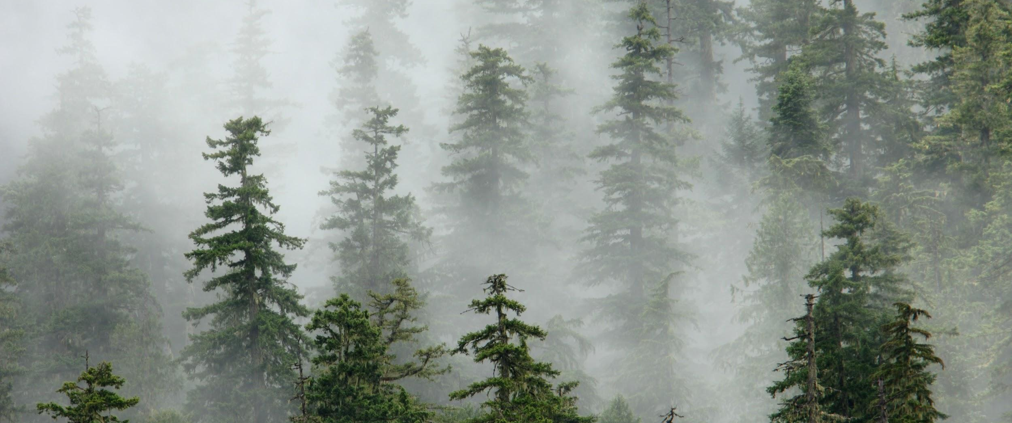
Forest Canopy
Water Input: precipitation, cloud water interception
Water output: evaporation, throughfall
Image retrieved 4/13/2019 courtesy of https://www.nsf.gov/news/mmg/mmg_disp.jsp?med_id=73771&from=

Slide 5
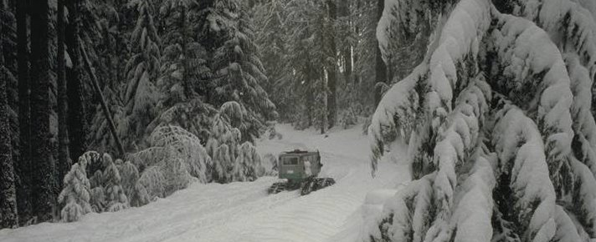
Snowpack
Water Input: Throughfall
Water output: Evaporation, Snowmelt
Image retrieved 4/13/2019 courtesy of https://andrewsforest.oregonstate.edu

Slide 6
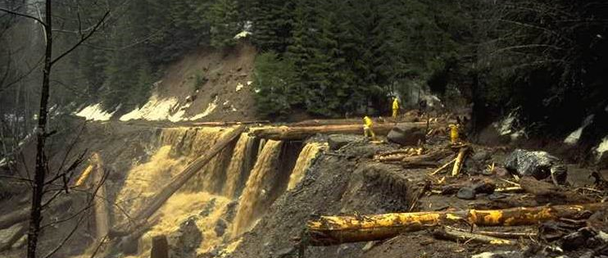
Soil and Regolith
Water input: Throughfall, Snowmelt
Water output: Evaporation, Transpiration
“Debris flow from WS 3,” photographed by Al Levno (Feb. 7, 1996), photo AAD-042, HJ Andrews Experimental Forest research program. Retrieved 4/13/2019 courtesy of http://common-place.org/book/at-the-experimental-forest/

Slide 7
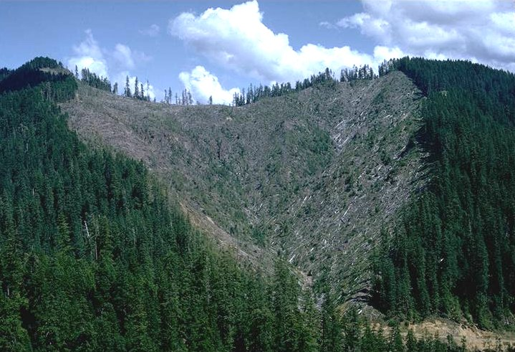
Responses to Forest Canopy Removal
Evapotranspiration effect:
Reduces canopy storage
Increases throughfall to soil
Reduces evapotranspiration
Decreases cloud water interception
Cloud water interception effect:
Decreases cloud water interception (seasonal)
Photo: HJA watershed 1 after forest removal, 07/1966. Dick Fredriksen. accessed 4/13/2019. andrewsforest.oregonstate.edu/sites/default/files/lter/research/component/veg/vegscpic.htm
Notes:
Removing the part or all of the forest canopy either by logging or just placing roads means less water can be stored there. The Throughfall increases, transpiration from the soil decreases, and evaporation from canopy storage decreases as well. These factors all increase water delivery to the soil, which leads to larger amounts of runoff as the soils storage capacity is exceeded. This process is called the Evapotranspiration effect, which is offset to some extent by the decreased input from cloud water interception, which normally happens in . HJA Watershed 1 logging nearly completed, July 1966

Slide 8
Responses continued
Snowpack Dynamics Effect:
Decreased canopy evaporation
Increased snowpack accumulation/storage
Rain-on snow-events= increased soil moisture and runoff
Subsurface Flow interception effect
Road construction= canopy gaps
Alters water routing to streams
Notes:
In winter, following canopy removal, more snow is able to make it to the ground, increasing snowpack accumulation. Removing the canopy also leaves snowpack more susceptible to rain events, which can enhance snowpack melting, which increases soil moisture and runoff.

Slide 9
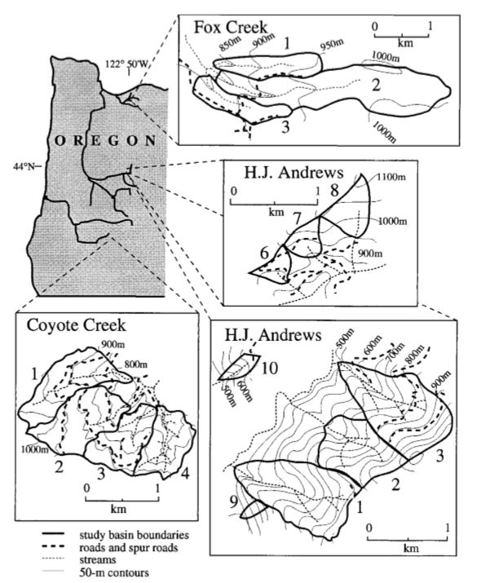
Experimental design
14 experimental basins, 3 LTERs (HJA, Fox Creek, Coyote Creek)
Looking for changes in average magnitude of peak discharge events
Size of event= 0.22-0.28 (4-5 largest peak discharge events/year)
100%, 50%, and 25% forest canopy removal groups
Basins being studied in this experiment. From: JA Jones, 2000
Notes:
14 experimental basins were used, 10 in matched pairs: 5 forested, and 5 with the forest canopies removed. Pairings took into consideration the altitude, geographic orientation, roads, and amount of forest canopy removal. Analysis of peak event discharge during certain sized events, taking into account the season

Slide 10
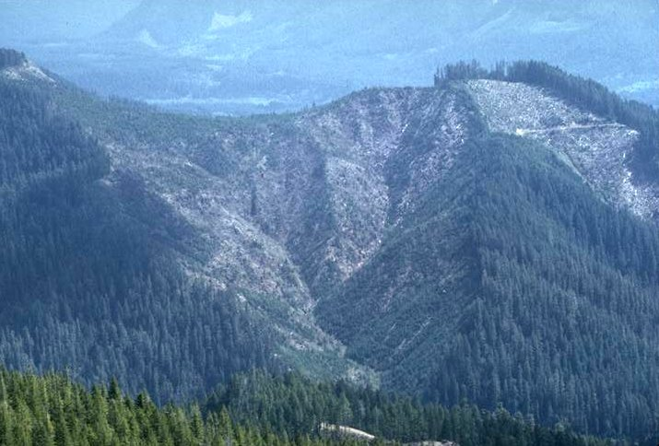
Results
Large increases in peak discharge after forest canopy removal
Decreasing effect over time
Proportional to canopy removal percentages
Consistent in all 3 locations
Photo: HJA Watershed 1, 20 years following slash burning, 04/1986. Al Levno, AAB-032 accessed 4/113/2019. https://andrewsforest.oregonstate.edu/sites/default/files/lter/research/component/veg/vegscpic.htm

Slide 11
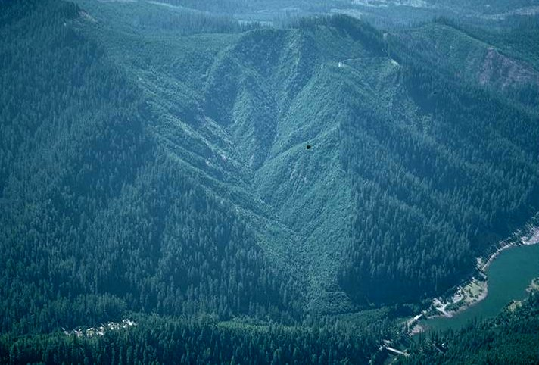
Conclusion
Increased canopy removal=increased runoff
Increased roads=increased runoff
Roads reroute surface and subsurface water flow
Aerial oblique of Watershed 1, 24 years following slash burning.
Photographed by Al Levno ..... Date: 07/16/1990
Photo: AAB-033

Slide 12
Acknowledgments
Title slide: Lookout Creek, The H. J. Andrews Experimental Forest And Long-term Ecological Research Site. Photograph by Robert Mutch, accessed 4/2/2019 from https://fineartamerica.com/featured/lookout-creek-the-h-j-andrews-experimental-forest-and-long-term-ecological-research-site-robert-mutch.html

