Slide 1
Oregon Case Studies
Ryan Johnson

Slide 2
Studies
The response of impounded sediment to a culvert replacement project on Sutter Creek, a tributary of Honey Grove Creek, in the Alsea River Basin of the Central Oregon Coast Range
East Fork Williams Creek sediment analysis/East Fork private road inventory and sediment analysis, 2003, C. Rodgers, Williams Creek Watershed Council

Slide 3
Sutter Creek
Located in Alsea River Basin
Tributary of Honey Grove Creek
Small floodplain upstream of road on both sides
Fluvial or lacustrine? Combination?

Slide 4
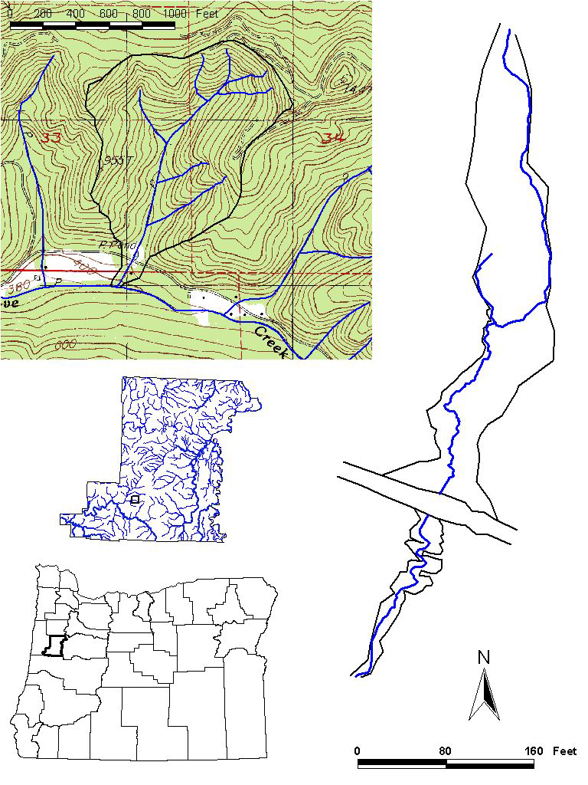

Slide 5
Study
Effect of culvert at Honey Grove Road crossing on sedimentation of Sutter Creek
Impounding of water upstream of crossing
Incising channel upstream of crossing

Slide 6
History
Long history of logging
Douglas Fir
Active since WWII
Basin has been clear-cut since 1950
Significant soil erosion
Culvert present since at least 1940’s
Replaced multiple times

Slide 7
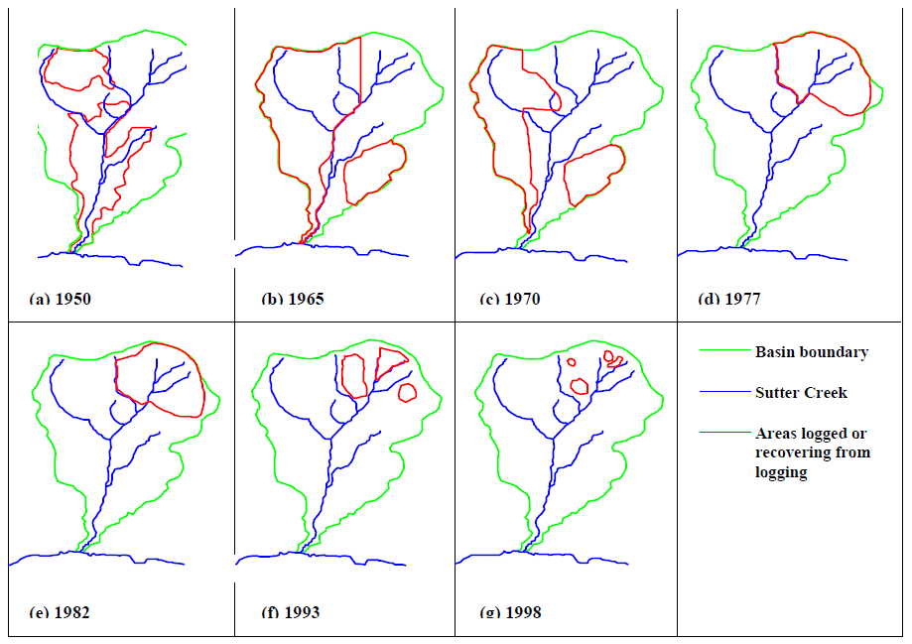

Slide 8
Methods
Characterization of floodplain and channel bed sediments
Transects established across impounded sediment surface
Clam gun used at several points across transect
Channel topography survey
Discharge measured
Stage & flow velocity
Measurement of sediment transport
Bedload & suspended load

Slide 9
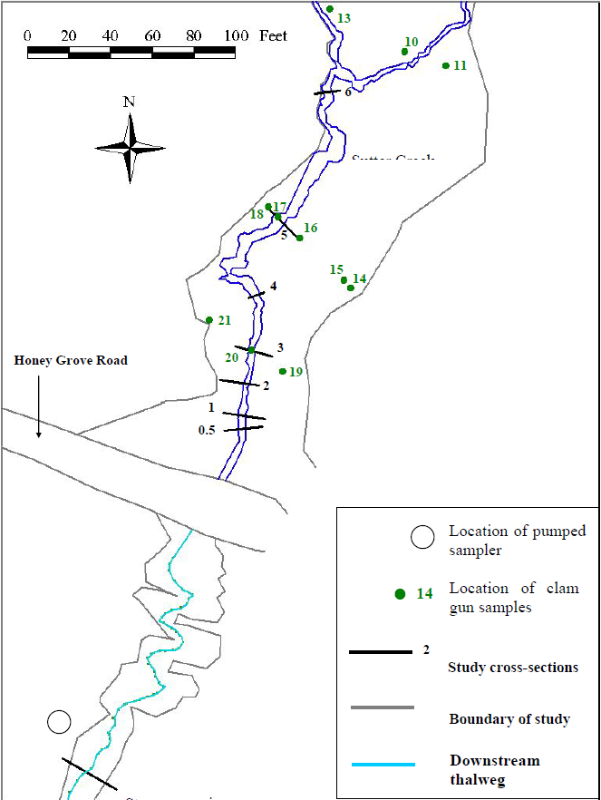

Slide 10
Data Analysis
2D Analysis of stream cross-section
Significant drop in bed elevation during high flows
3D Analysis of sediment volumes eroded
ArcGIS
Calculation of discharge rating curve
Calculation of median grain size for floodplain and channel bed samples

Slide 11
Results
Still many unknown relationships between events
Logging vs. installation of road
Depth of valley floor prior to disturbances
Mobilization of fines during storm event
Collection upstream of road
Cohesion and compaction
Impounded sediment deposited into standing water
Intent to continue actively studying area

Slide 12
East Fork Williams Creek
Siskiyou Mountains of southwestern Oregon
Mostly forestry land use within the watershed
Watershed contains 67 potential sensitive species

Slide 13
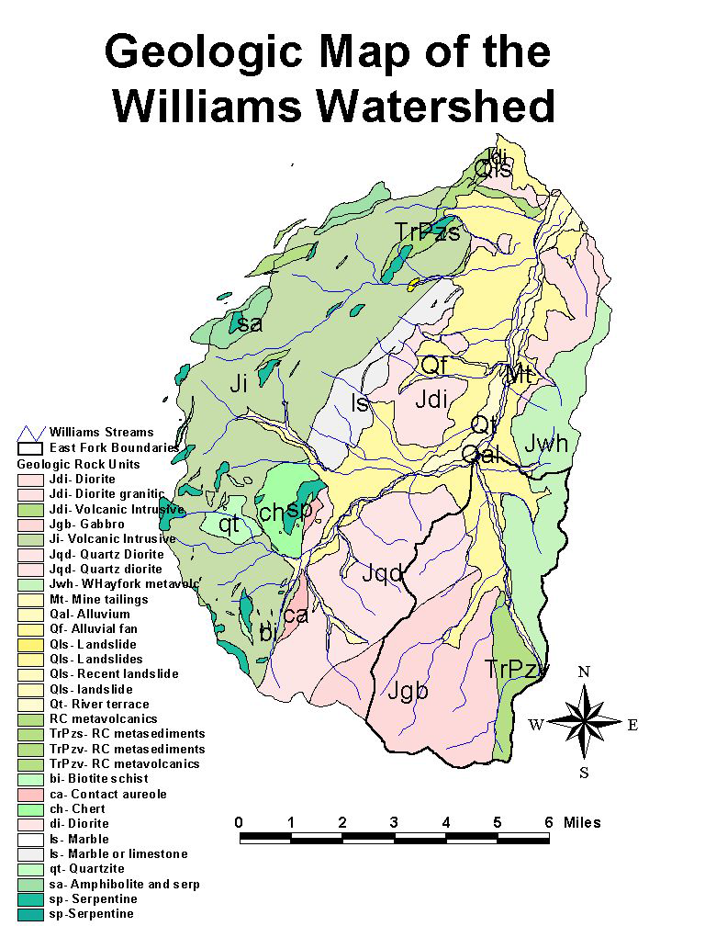

Slide 14
Purpose
Address observations of high sediment loads in East Fork Williams Creek
Study conditions of private roads an their impact on sediment delivery to local streams in East Fork branch
Determine non-point sediment sources

Slide 15
Problem
Recognized as source for high sediment loads
During heavy rain events
DEQ listing as “streams exceeding water quality standards”
Channelization and instream wood removal
No floodplain relief
Excessive discharge during high flows
Can remove acres of land within hours

Slide 16
Erosion/Sedimentation Sources
Private roads
Culvert diversions along roads
Ditches along roadbeds
Over-steepened road cuts
Runoff from grazing lands
Degraded farm roads
Excessive livestock riparian zone
Reduced riparian vegetation
Intrusive igneous rock (fine sediment)

Slide 17
Upper East Fork Road erosion

Slide 18
Fine sediment runoff during rainstorm

Slide 19
Methods
Data collection of conditions of private roads
Ditch and culvert conditions
Turbidity levels during high water at 12 locations
Bedload samples in several tributaries
Cross-sections at select locations
Wolman pebble counts
Observation of erosion sites and unstable stream banks
Combined with geologic mapping
Identify rock types contributing greatly to sedimentation

Slide 20
Solutions
Road improvement or decommission
Most effective option
Revegetation
Reduction of grazing in riparian zones
Erosion control structures
Restoration of stream bank habitat

Slide 21
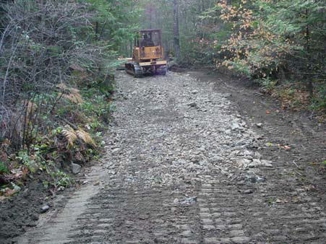
Road repair in progress

Slide 22
Conclusion
Sutter Creek
Impounded sediment upstream of road crossing culvert
Downcutting of channel upstream of culvert
Further study underway
East Fork Williams Creek
Excessive sediment transport
Main cause unmaintained private roads
Repair of roads, and maintenance of ditches and culverts show positive results
Further road work intended

