Slide 1
Channel Modification
Washington Dept. Forestry, 2004, Channel Modification Techniques
Katie Halvorson

Slide 2
Overview:
Purpose
What makes for successful modification
Channel form
  Planform
  Cross section
  Channel profile
Sediment transport
Design
Bank reconstruction
Monitoring

Slide 3
Channel modification projects:
Purpose: “accelerate recovery to a stable, sustainable channel form that is in dynamic balance with its sediment, large-wood, and flow regime.”
Immediate benefits by creating improved habitats

Slide 4
Successful channel modification will include:
Improved stability
Improved sorting of gravels for spawning habitats
Improved water access to floodplain
Greater diversity in channel bedforms
Improved riparian zones
Improved habitat quality

Slide 5
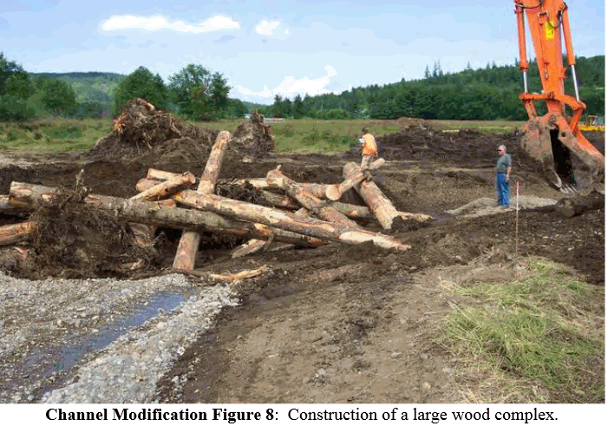
Physical effects of channel modification
Alters way energy is dissipated through reach and it effects:
  Volume of sediment transported
  Hydraulic variables
  Large wood transport and retention

Slide 6
Channel Form
Planform
  Shape in map view
  Defined by sinuosity
Cross-section
  Width and depth from bank to bank and across floodplain
Profile
  Slope variability along channel bed

Slide 7
Channel form cont.
Integrated feature
Modifications
  Reconstruction of channel
  Installation of structural feature to induce change
Helps reduce bank erosion and control channel migration

Slide 8
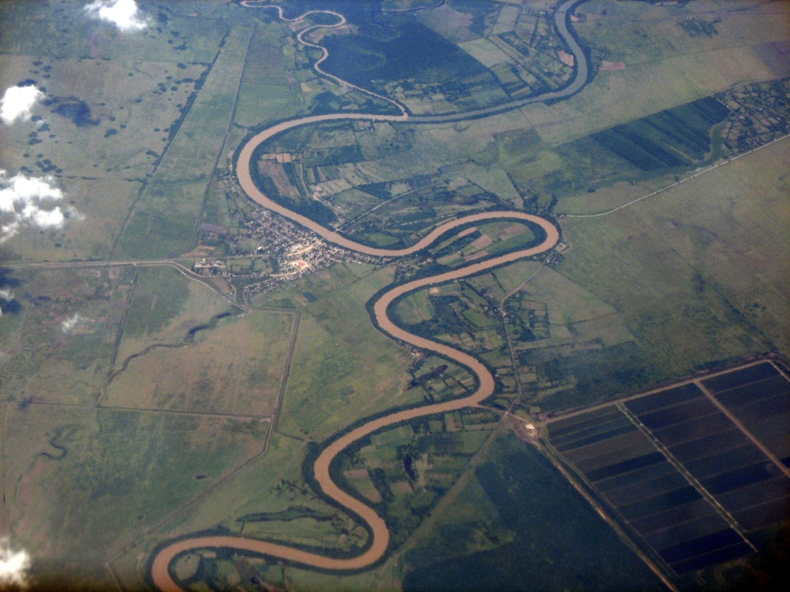
Planform
How to increase sinuosity:
  increase diversity of sizes and sorting of sediment
  Increase vertical topography
  Addition of point bars

Slide 9
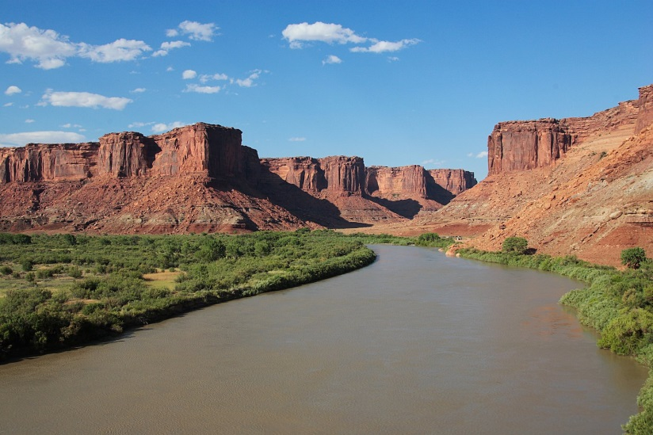
Cross section change
Alter depth, shape, width and modification of banks and bars.
Accomplished by:
  narrowing channel by restoring vegetation that redirects flow
  removing levees

Slide 10
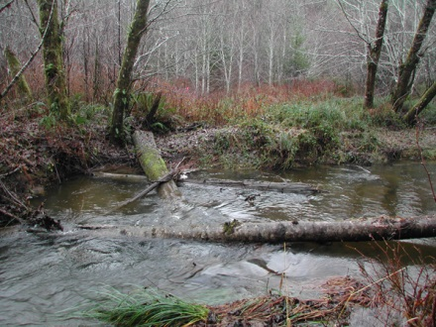
Channel profile
Refers to variation of slope in a channel bed
Influences the passage of fish
Placement of large woody debris
Reconfiguration of stream length

Slide 11
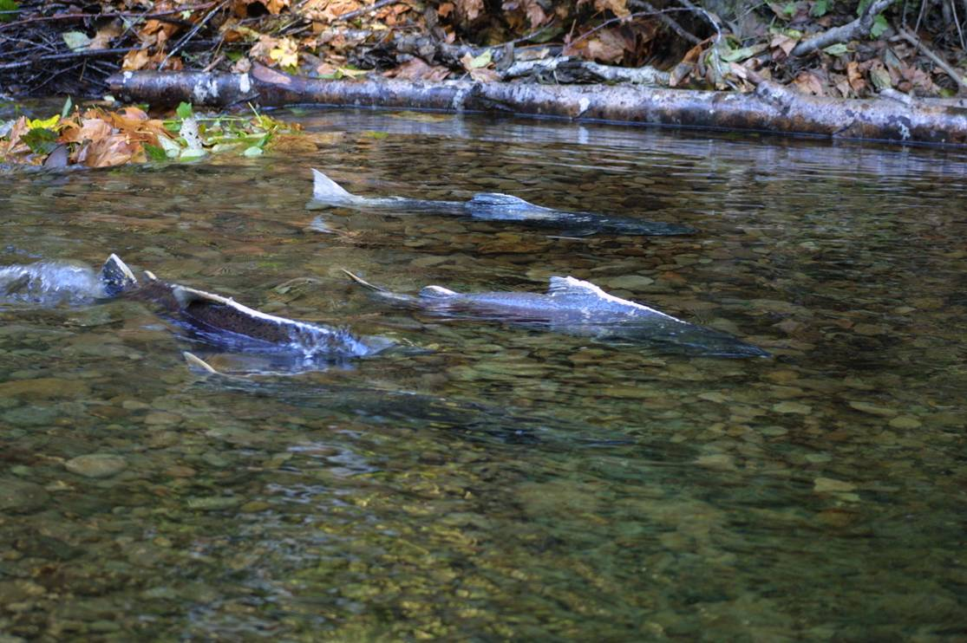
Sediment transport
Can enhance and provide habitat
Size and shape will influence quality of habitat
Size and shape of channel will determine size and sorting of material

Slide 12
Channel modification design
Analog- replicating channel from historical data
  Best used when watershed hydrologic and sediment have not been changed much
Empirical- uses equations
  Helps relate channel characteristics derived from universal data sets
Analytical- equations and models
  Used when sediment dynamics and hydrology are changing

Slide 13
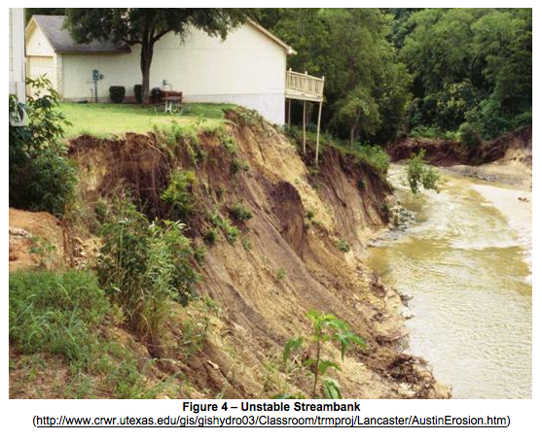
Bank reconstruction
Most channels will require reconstruction on at least one side
Will change hydraulic conditions
Can affect stability of other banks

Slide 14
Monitoring:
Not a large enough emphasis
“the importance of reporting project monitoring results cannot be overstated.”
Only way to learn what does and doesn’t work

Slide 15
In conclusion:
Purpose: “accelerate recovery to a stable, sustainable channel form that is in dynamic balance with its sediment, large-wood, and flow regime.”
Look at channel form and specifics to come up with a design and continue to monitor during and after modifications.

