Slide 1
Re-Meandering Of Lowland Streams: Will Disobeying the Laws of Geomorphology Have Ecological Consequences? Pedersen, Kristensen, Friberg, 2014, PlosOne, Volume 9, 1-10
Katie Halvorson

Slide 2
Overview
Introduction to area
Methods and ideas on project
Results from project
Summary

Slide 3
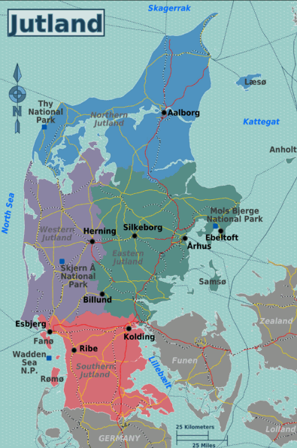
Where the study was done
Catchment areas of Jutland, Denmark

Slide 4
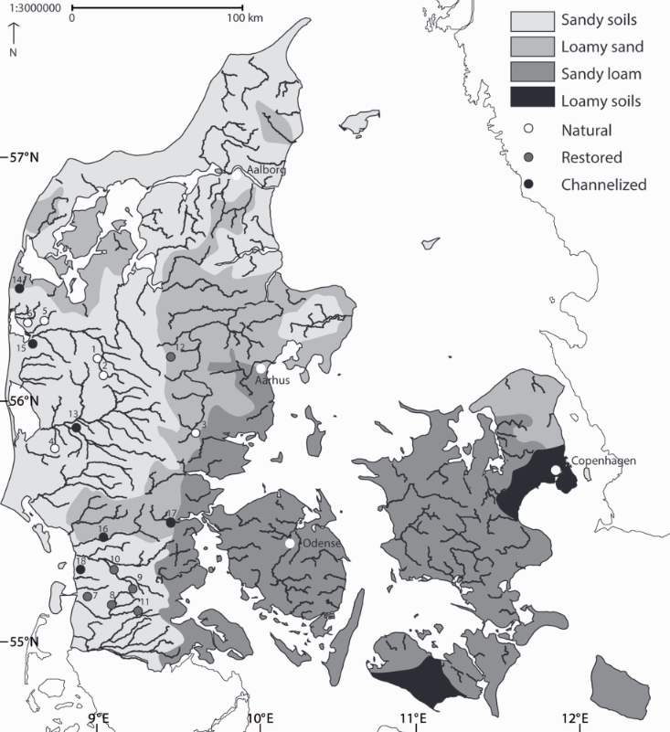
Jutland areas based on last glaciation
Western: ice-free
Eastern: sub-glacial loamy moraine

Slide 5
Key Ideas:
Determine how natural streams and rivers are structured
Physical habitat
Flow
Sediment regime
Improve ecological status of bodies of water in Europe

Slide 6
The goal:
“All restoration measures were aimed at creating a more heterogeneous and natural stream reach.”

Slide 7
Morphology of river depends on:
Catchment–scale controls
Hydrology, geology
Differences in channel pattern at reach scale
local slope, geology
Variations in structure and composition
bank material, flow, and turbulent structure

Slide 8
The study:
18 reaches selected
6 natural meandering streams with little alterations
6 channelized
6 formally channelized
Field work done over 40days in April and May 2002

Slide 9
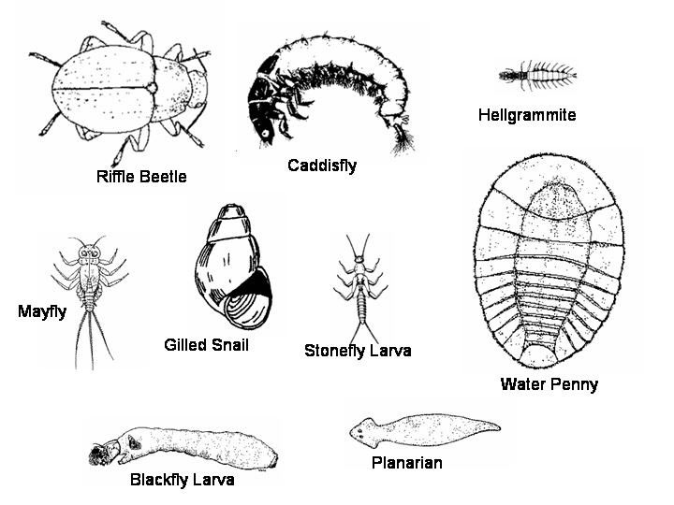
Looked at:
Water chemistry
Physical habitats
Macroinvertebrates

Slide 10
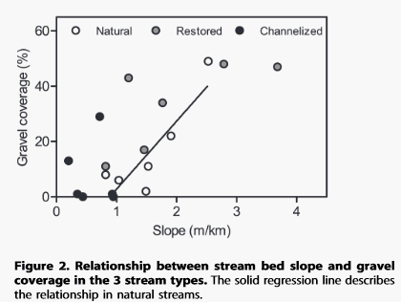
Results:
Composition of stream bed varied significantly among stream types.
Cobble and pebble dominant in restored streams
Sand in natural and channelized streams

Slide 11
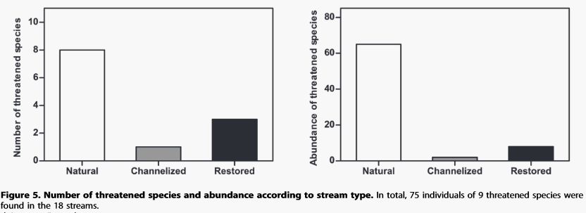
Results cont.
Natural streams width variation was significantly higher than in channelized streams.
Macroinvertebrate communities differed in species by stream type.

Slide 12
Results cont.
Huge change in physical habitats of the restored streams (pebble and gravel) compared to natural and channelized streams (sand).
Stream bed slope differed between the three
High slopes = restored
Lowest = channelized

Slide 13
In summary:
Natural functioning of the geomorphological process is affected by both channelization and restoration and that restoration DOES NOT re-establish the natural functioning at a 3+ year time-scale.

