Slide 1
Side Channel and Off Channel Habitat Restoration Washington Dept. Forestry, 2004, Side Channel Restoration
Dylan Castle

Slide 2
Overview
Description of Side Channels
Benefits of Side Channels
Risks of Restoration
Restoration Site Considerations
Goal of restoration
Selecting a good site

Slide 3
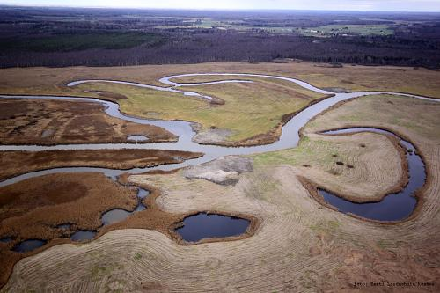
Side Channels
Small watered remnants of river meanders
Abandoned River Channels
Oxbow Lakes
Lower Ends of Terrace Tributaries

Slide 4
Types of Side Channels
Overflow Channels
Relic river channels
Directly connected during times high flow
Very dynamic due to influx of debris
Helps clean and re-distribute spawning material

Slide 5
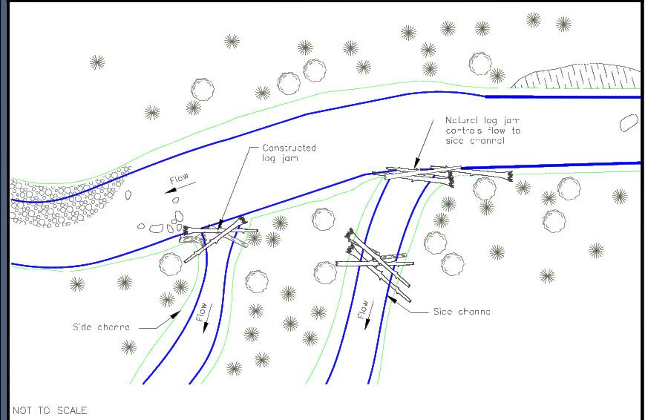
Types of Side Channels
Perc Channels
Relic river or floodplain channels
Primarily supplied from hyporheic zone
Winter and summer refuge for juvenile fish
Spawning habitat for fish and amphibians
Foraging habitat for many birds and mammals

Slide 6
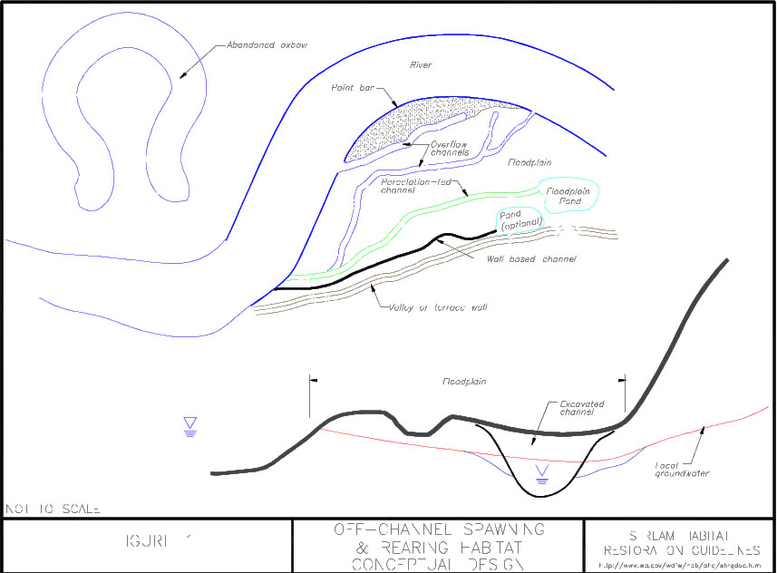
Types of Side Channels
Floodplain Ponds
Natural or constructed ponds
Ponds, oxbows, gravel pits or mill ponds

Slide 7
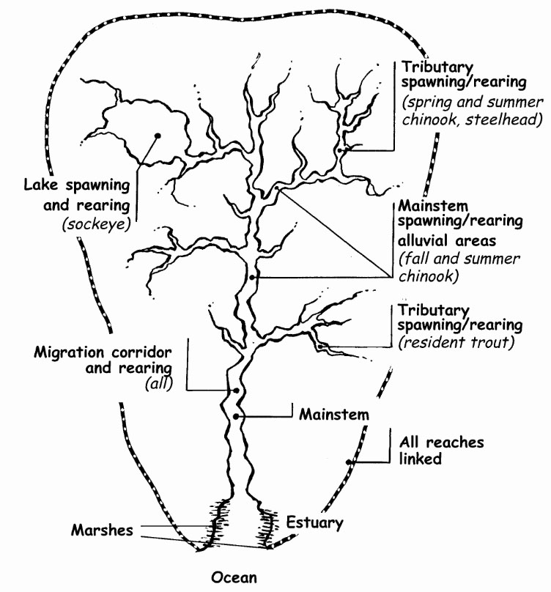
Side Channel Benefits
Critical habitat for salmonids
Protection from storms and predators
Spawning areas for chum and coho
Rearing habitat for fry

Slide 8
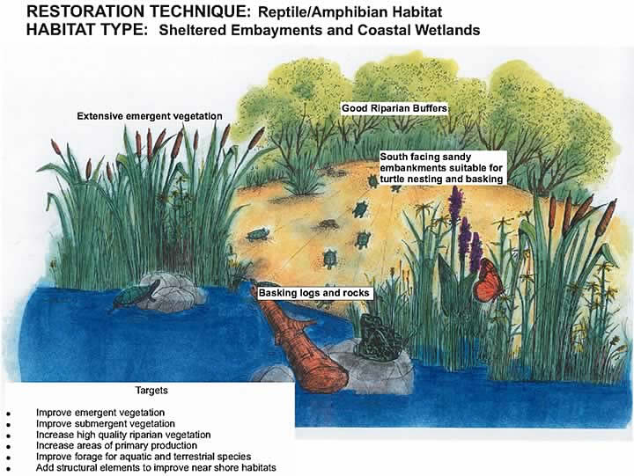
Benefit Other Wildlife
Rearing of many amphibians
Reproductive habitat for many bird species
Many organisms feed on salmon carcasses
Vegetation diversity

Slide 9
Benefits Cont.
Average length (inches) of coho and chinook, respectively
Unfertilized river: 30.38 and 41.25
Unfertilized Pond: 46.38 and 56.61
Fertilized Pond: 49.60 and 66.52
61% length increase for coho and 62% for chinook

Slide 10
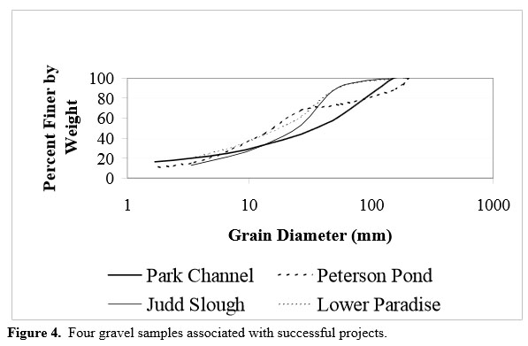
Site Restorations
Side Channels are naturally occurring
Habitat loss mostly from restriction or constraints
Restorations need to
be self-sustaining
Easiest restorations are removing restrictions

Slide 11
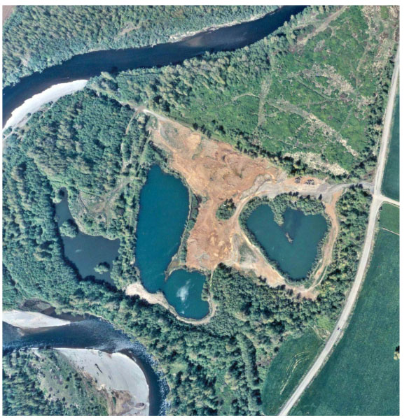
Site Restorations
Selecting a good site is critical
Geologic Conditions
River channels
Vegetation
Groundwater
Elevation
Annual Flows
Water Quality

Slide 12
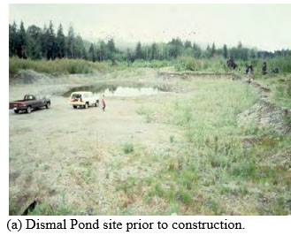
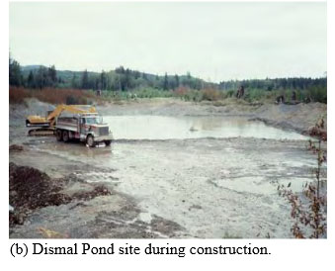
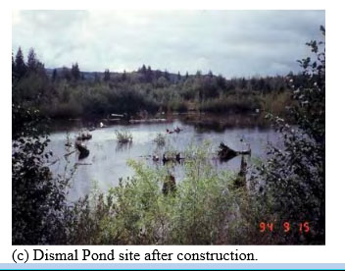
Site Restorations
Data Needs
Current Fish Use - Flow Rates
Topography - Water Levels/Quality
Establishing Baseline

Slide 13
Site Restorations Risks; Habitat
Increase Turbidity
Vegetation and Wildlife Displacement
Soil Displacement
Bed or Bank Scour
Avulsion
High velocity flows can
displace woody material

Slide 14
Site Restorations Risks; Wildlife
Fish stranded in restored channels.
Little water turnover
No vegetative cover
Most risks are easily manageable and most are only temporary.

Slide 15
Monitoring
Monitoring biological data is critical to determining success
Fish Counts
Adults, not smolt
Development of Vegetation
Photographs
Maintenance should be minimal

Slide 16
Conclusion
Side channels: small watered remnants of river meanders
Provide spawning and rearing habitat for salmonids
Habitat for birds and amphibians
Allows diversification of vegetation
Many factors to consider when determining possible site
Vegetation, water quality and flow, current use, groundwater

Slide 17
