Slide 1
Riparian Vegetation, Riparian Degradation and Restoration
Ian McBride
Earth and Physical Science Department
Western Oregon University
Monmouth, Oregon
Email: imcbride11@wou.edu

Slide 2
Outline
Part 1: Introduction to Riparian Zones
The pieces of a riparian zone
Importance of riparian zones
Part 2: Land Use and Invasive Species
Detrimental land use
Invasive plant species

Slide 3
Outline
Part 3: Restoration and Mitigation
Fencing
Buffer zones
Removal of invasive plants
Part 4: Case study
Habitat protection project, Sandy River
Summary

Slide 4
INTRODUCTION

Slide 5
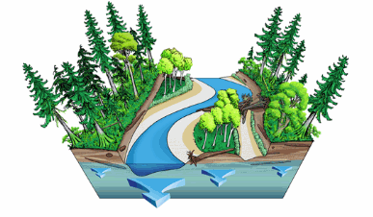
Riparian Zones
What is a riparian zone?
Where the river meets the land
Complex and sensitive system
An important biome
Two major parts

Slide 6
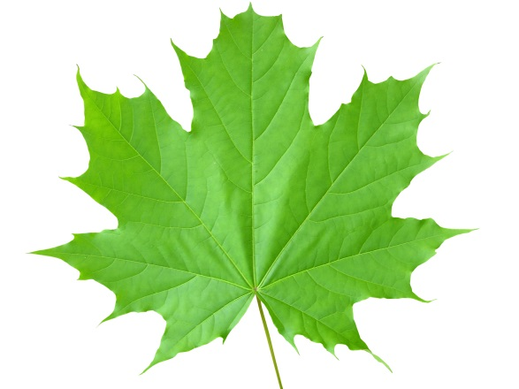
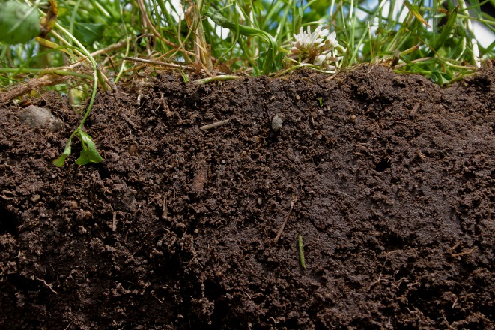
The Parts of a Riparian Zone
Plants
Control stream temperature
Anchor banks
Soil
Stores ground water
Filters toxin
Buffer for river

Slide 7
The Plants
Riparian vegetation is critical to stream health
Shading
Bank stabilization
Provide habitat and nutrients

Slide 8
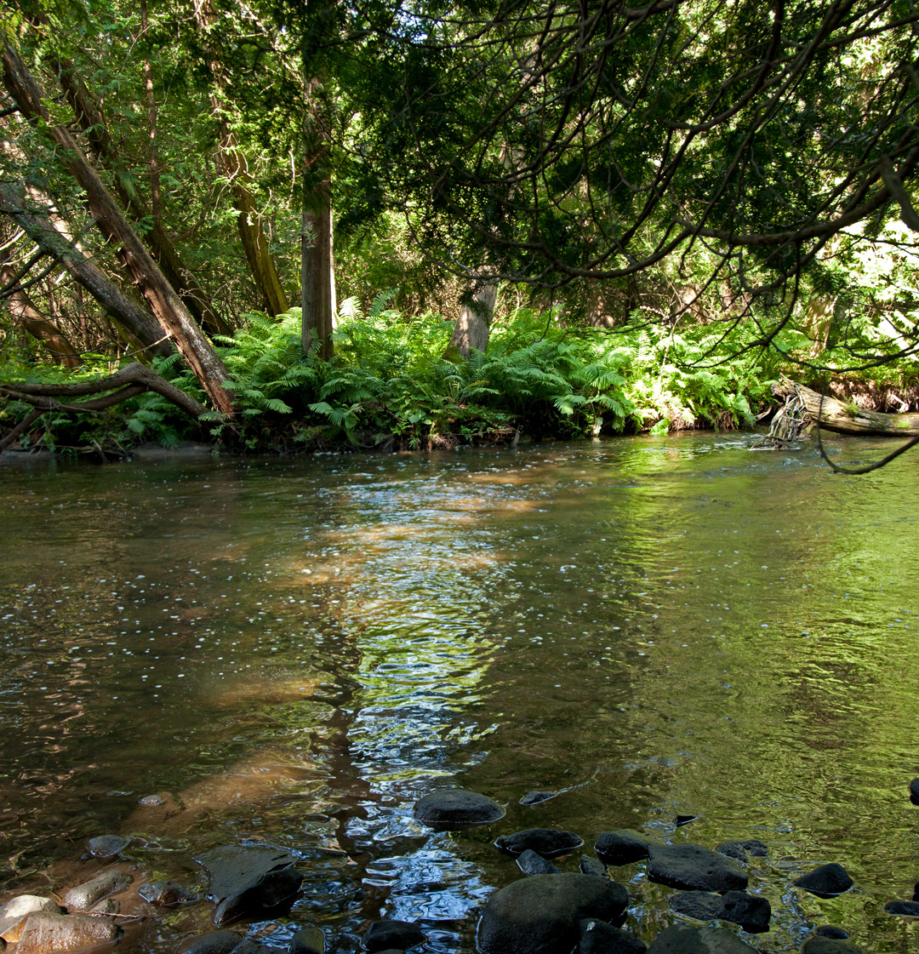
Shading
Riparian canopy
Regulates water temperature
Provides leafy debris

Slide 9
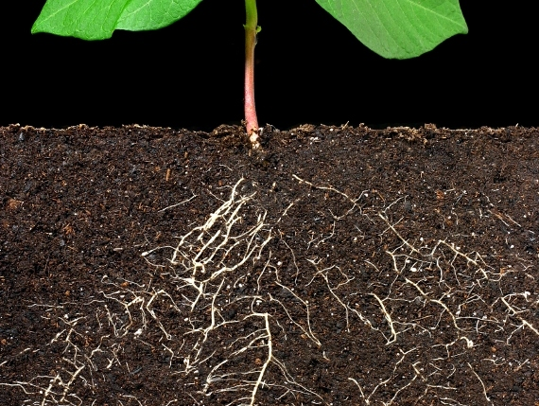
Bank Stabilization
Combats bank erosion
Lessens sediment input

Slide 10
Stream temperature fluctuations in open and closed canopy environments

Slide 11
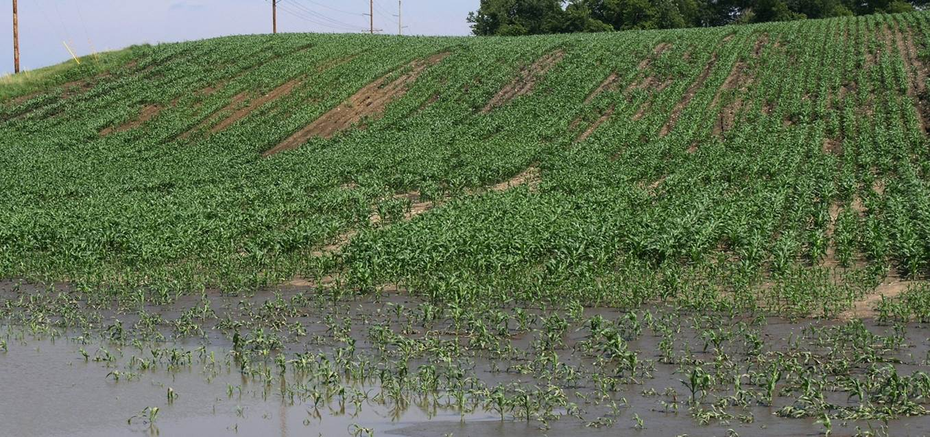
The Soil
Acts as a buffer for:
Water
Nutrients
Toxins

Slide 12
RIPARIAN DEGRADATION

Slide 13
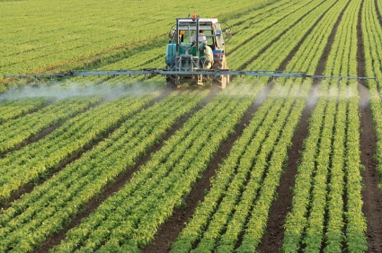
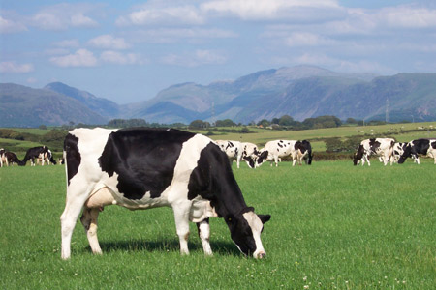
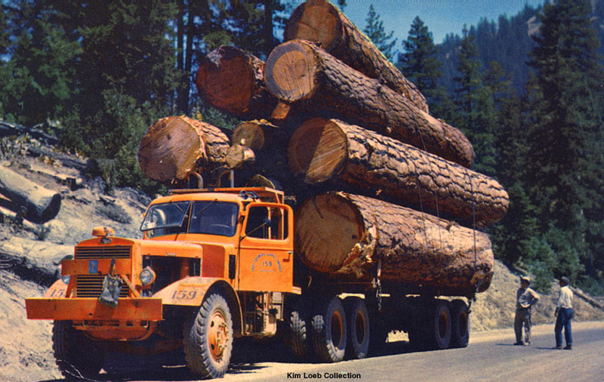
Land Use
Grazing animals
Logging
Agriculture

Slide 14
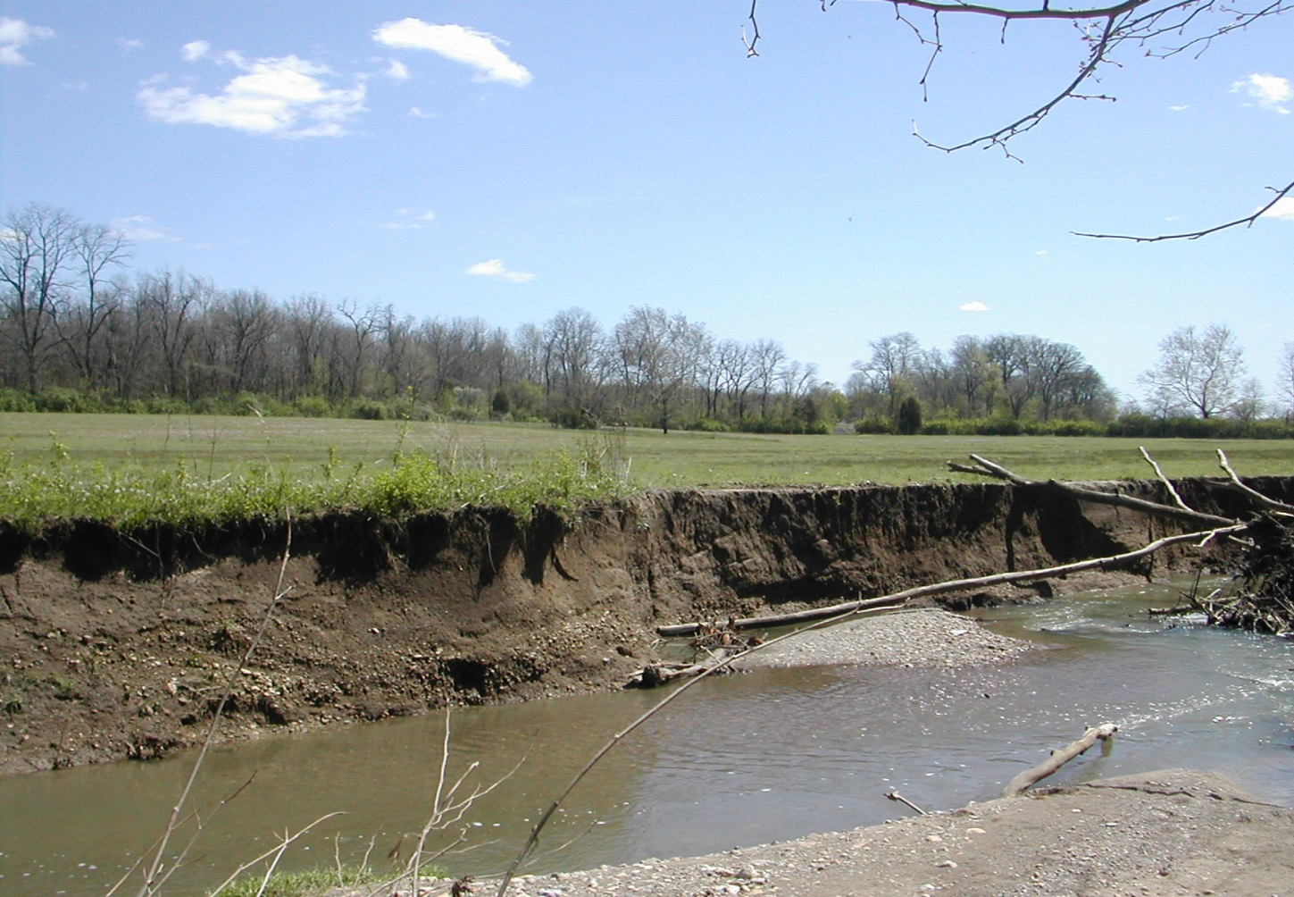
Grazing
Animal grazing poses threats to riparian health:
Bank degradation
Loss of riparian vegetation

Slide 15
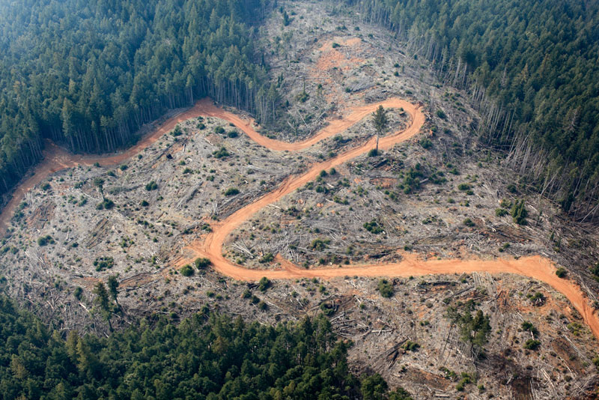
Logging
Depletes riparian vegetation:
Physical and chemical degradation
Loosens bank sediment

Slide 16
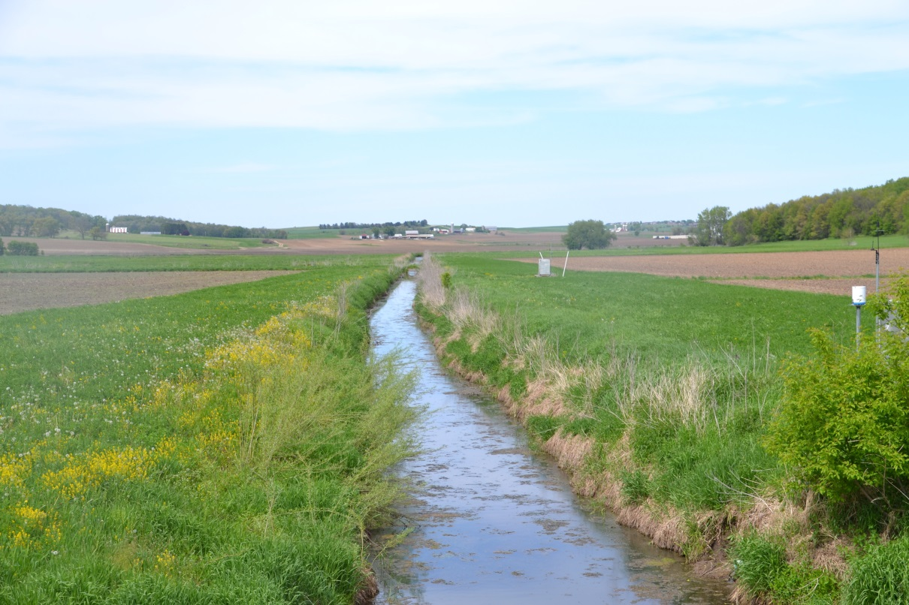
Agriculture:
Input of harmful chemicals into river systems

Slide 17
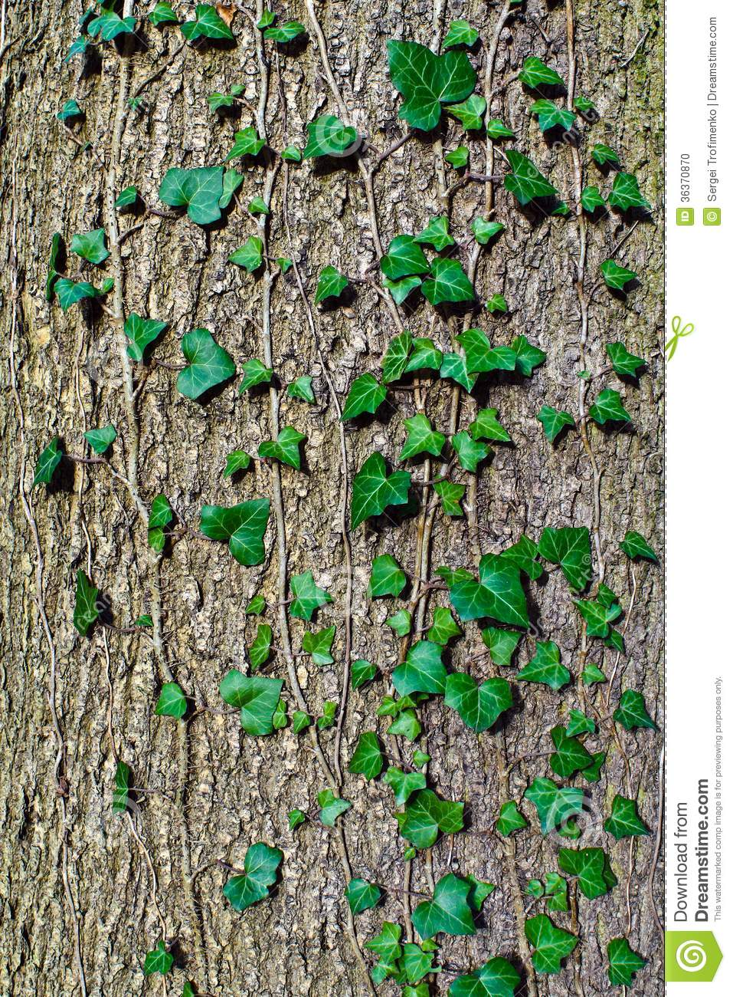
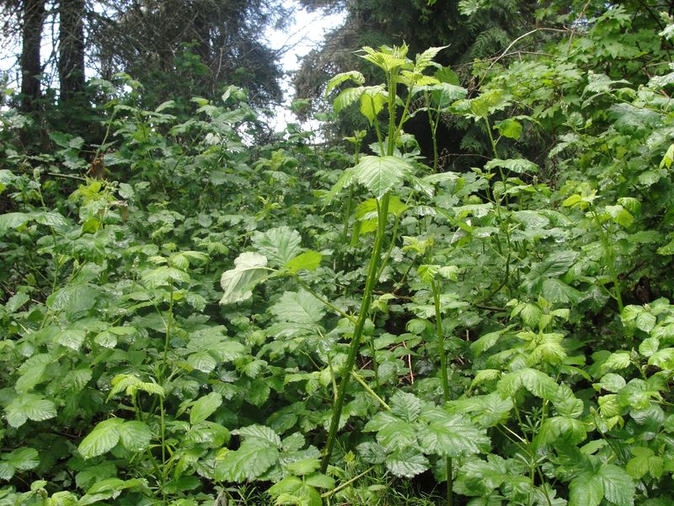
Invasive Species
Out-compete native plants
Do not allow for diversity
Himalayan Blackberry
English Ivy

Slide 18
RESTORATION AND MITIGATION

Slide 19
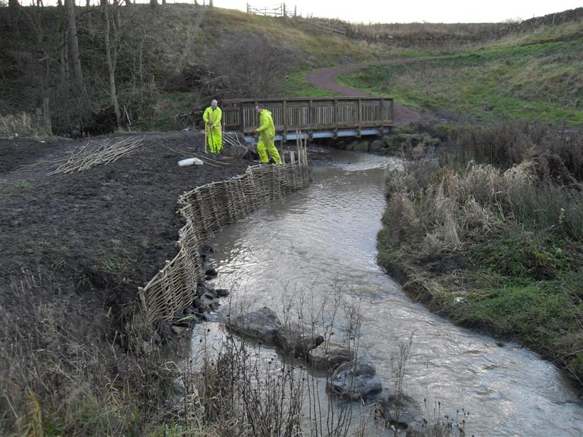
Combating Stream Degradation
Graze protection
Providing buffer zones
Removal of invasive species

Slide 20
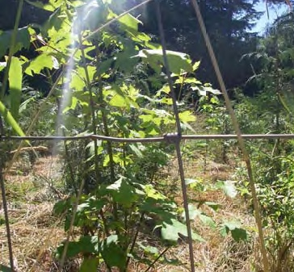
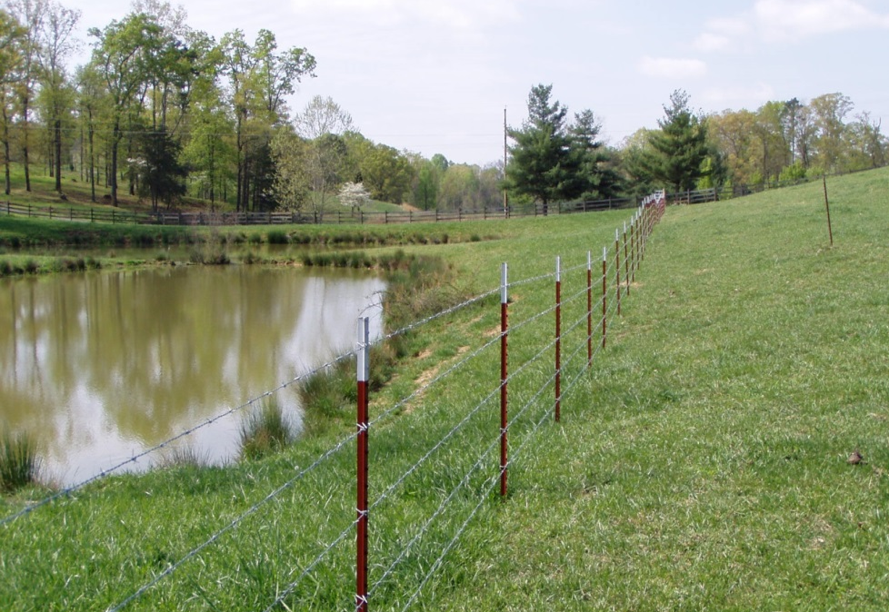
Grazing
Fencing of riparian zones
Protecting young plants
Deterring grazing animals

Slide 21
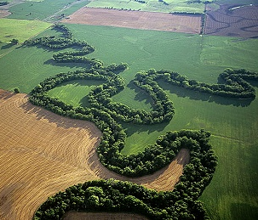
Buffer Zones
A riparian zone is a buffer against:
Water
Heat
Sediment
Nutrients
Toxins

Slide 22
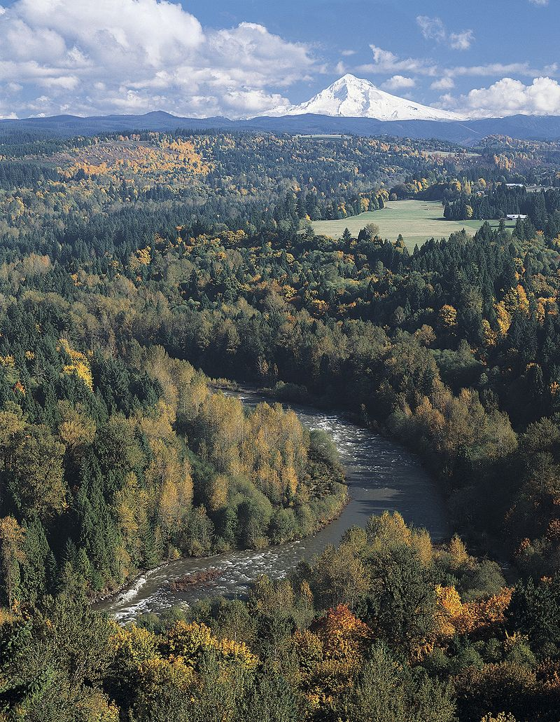
Case Study
Sandy River Riparian Habitat Protection Project Report 2006, The Nature Conservancy, Oregon Field Office

Slide 23
Introduction
Riparian restoration of Sandy River
4 year span 2002-2006
Major focus on removal of invasive plants

Slide 24
Scope
395 individual microsites
Infestations of non-native invasive plants
Tens of millions of dollars
25 years time scale

Slide 25
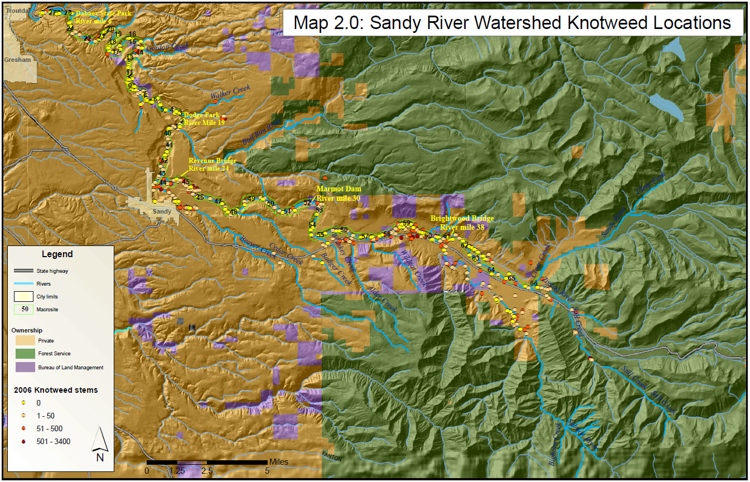
Knotweed sites along a reach of the sandy river

Slide 26
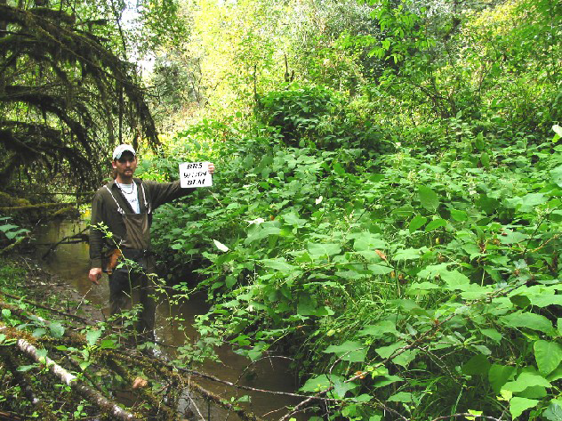
Knotweed
Non-native shrub
Extremely invasive
Rhizomal
Out-competes native species

Slide 27
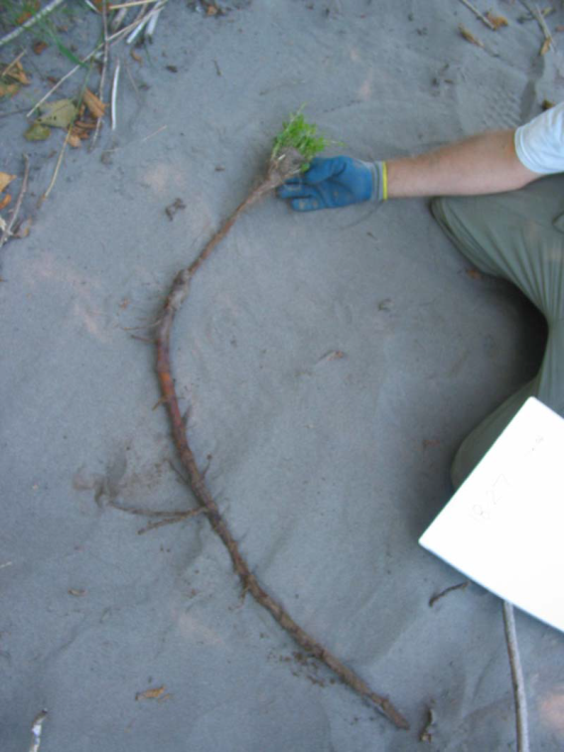
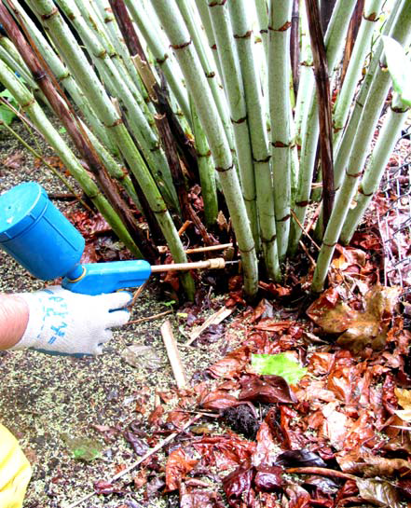
Methods of Removal
Physical
Cutting
Rhizome extraction
Chemical
Herbicidal spray
Herbicidal injection

Slide 28
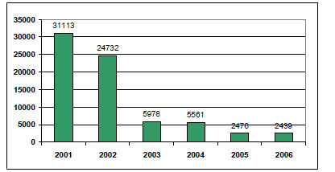
Results
Number of knotweed stems found per year

Slide 29
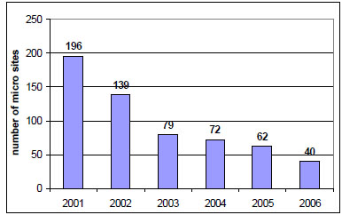
Results
Number of micro-sites with knotweed present

Slide 30
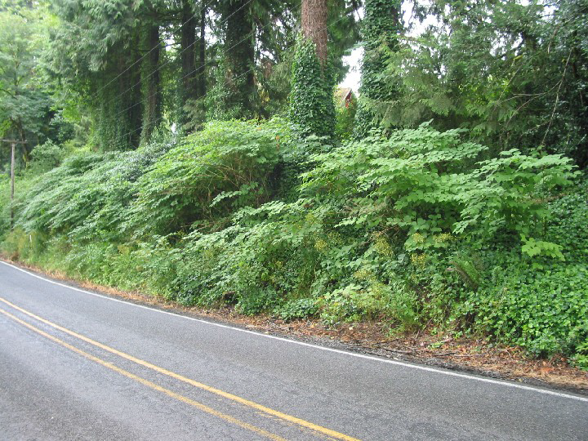
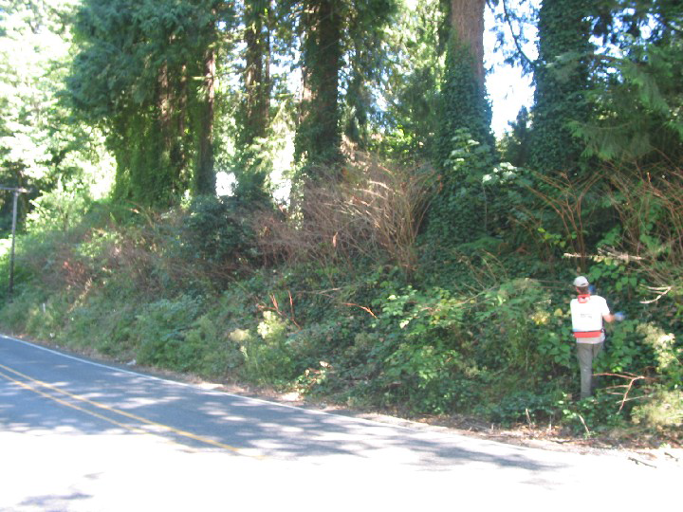
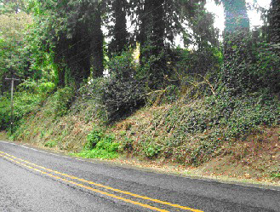
Results
2004
2005
2006

Slide 31
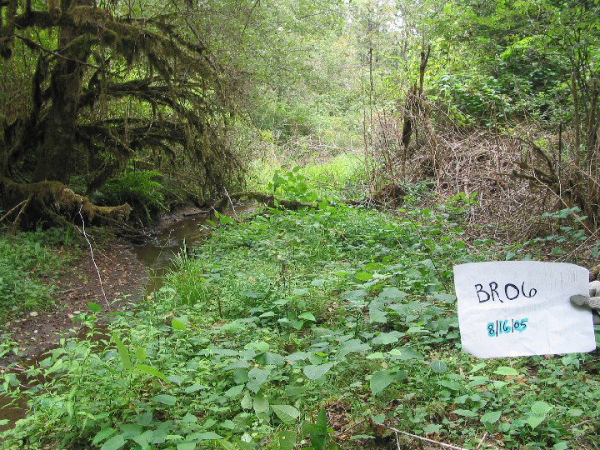
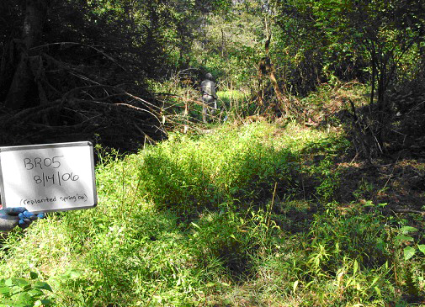
2004
2005
2006

Slide 32
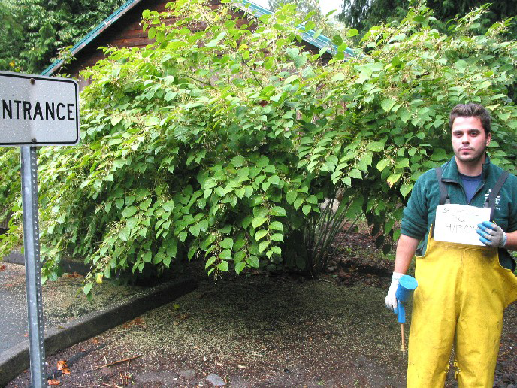
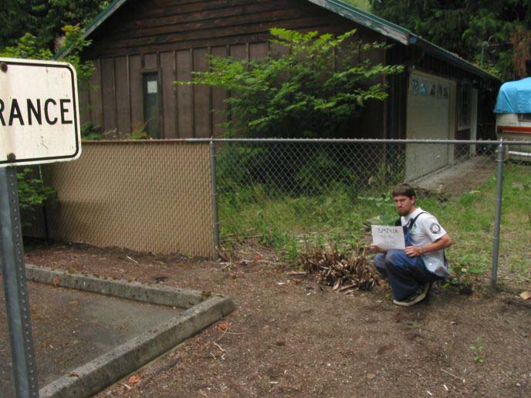
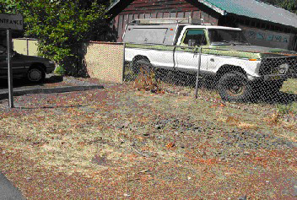
2004
2005
2006

Slide 33
SUMMARY
Riparian vegetation is crucial to river health
Riparian zones buffer streams
Riparian zones are easily disturbed
Mitigation and restoration efforts can improve riparian health
Riparian health leads to stream health

Slide 34
Five-Minute River Interlude
https://www.youtube.com/watch?v=8Jq1U8JyHW4
Youtube - Salmon Spawning

