Slide 1
Riparian Restoration on Different Scales
Ian McBride

Slide 2
Overview
Part 1: Project Monitoring Report OWEB Grant 204-372C – Coos Watershed Association Projects 2004 Riparian Coos Watershed Association October 23, 2008
Part 2: Sandy River Riparian Habitat Protection Project Report 2006, The Nature Conservancy, Oregon Field Office
Part 3: Statewide Survey of Oregon Watershed Enhancement Board Riparian and Stream Enhancement Projects 2002, By: Matthew Anderson and Gino Graziano

Slide 3
Part 1: OWEB Project Monitoring,
Coos Watershed Association 2008

Slide 4
Introduction
Monitoring report from 2002-2008
Coos Watershed
Riparian restoration through planting
Completed with grant money

Slide 5
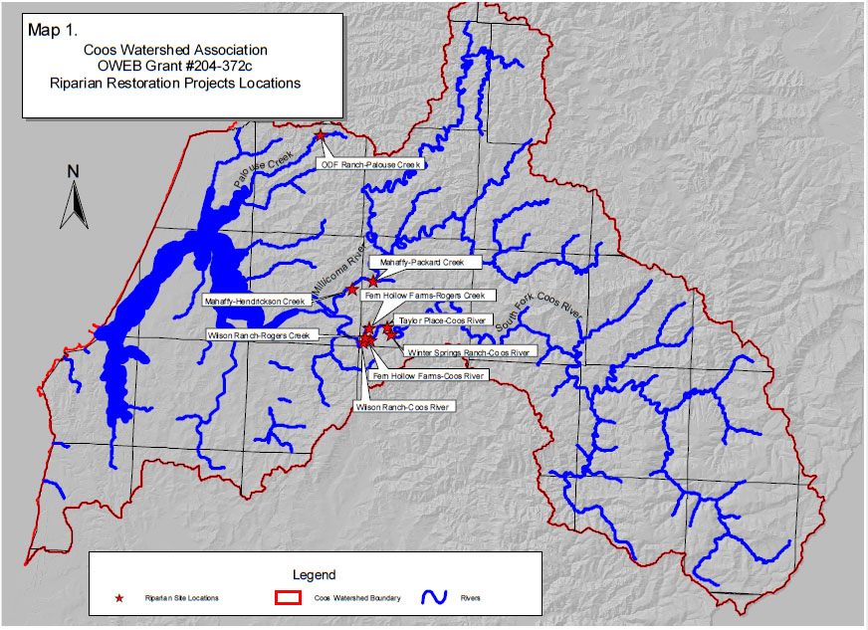
Scope
40 acres
6 years
6 land owners
Over $47,000

Slide 6
Focus
Restoring riparian areas
Increase salmonid production
Limiting live stock degradation

Slide 7
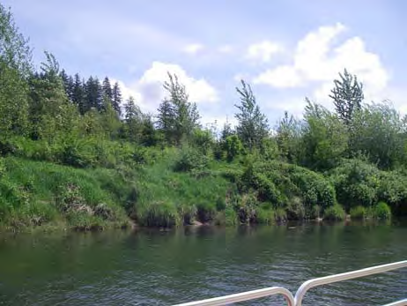
Method
Planting of riparian vegetation
Large variation of species
Land owner involvement

Slide 8
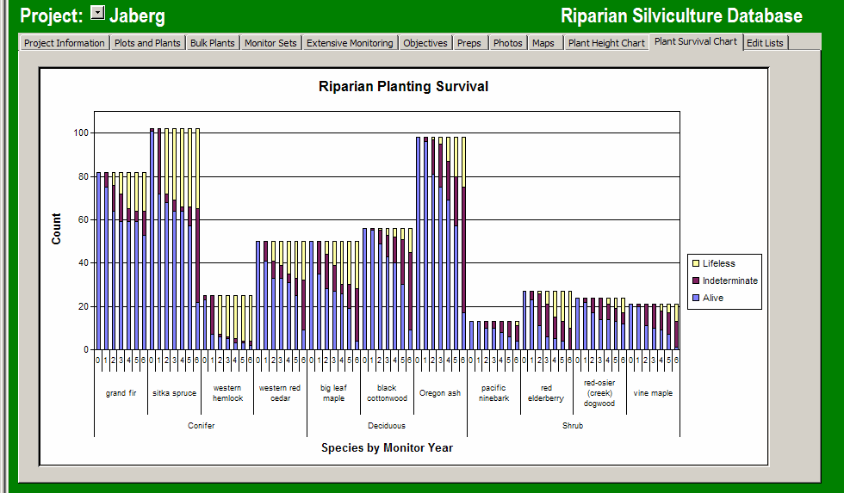
Results
Very successful riparian vegetation restoration

Slide 9
Results
Successful Species
Sitka Spruce
Western Red Cedar
Unsuccessful Species
Red Elder Berry
Dogwood
Vine Maple

Slide 10
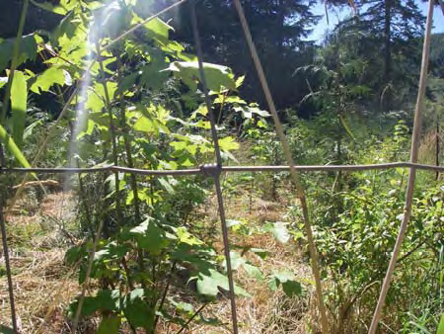
Results
Land owners have stayed committed
Grazing limited away from riparian zone

Slide 11
Conclusion
Annual monitoring
Continued up-keep
Landowner involvement

Slide 12
Part 2: Sandy River Riparian Habitat Protection Project Report 2006, The Nature Conservancy, Oregon Field Office

Slide 13
Introduction
Riparian restoration of sandy river
4 year span 2002-2006
Major focus on removal of invasives

Slide 14
Scope
395 individual microsites
Infestations of non-native invasive plants
Tens of millions of dollars
25 years time scale

Slide 15
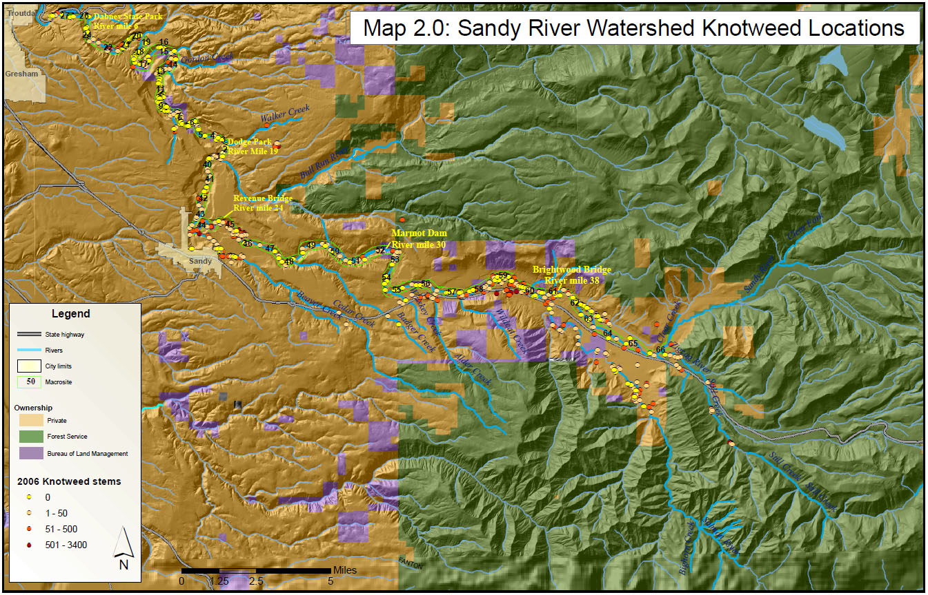
Scope

Slide 16
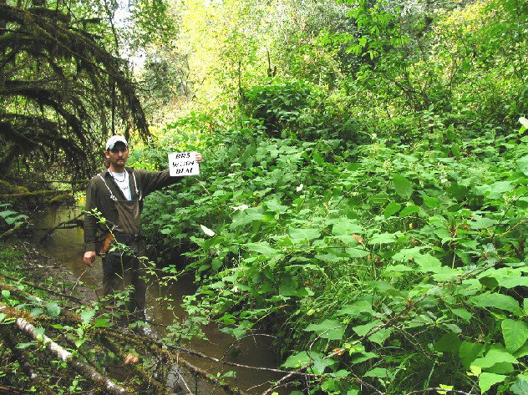
Knotweed
Non-native shrub
Extremely invasive
Rhizomal
Out competes better species

Slide 17
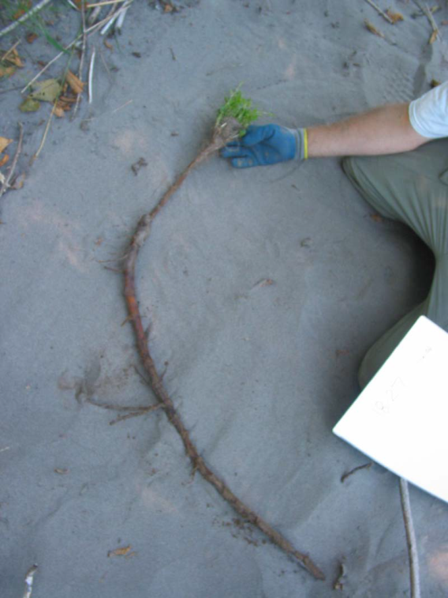
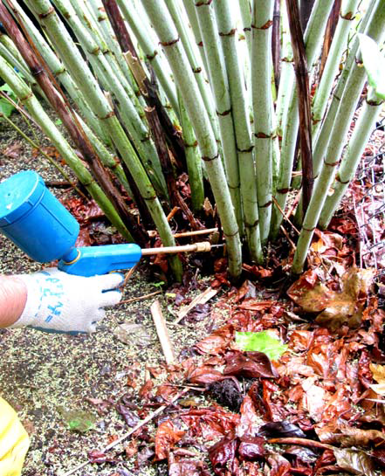
Methods of Removal
Physical
Cutting
Rhizome extraction
Chemical
Herbicidal spray
Herbicidal injection

Slide 18
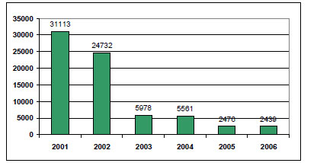
Results
Number of knotweed steams found per year

Slide 19
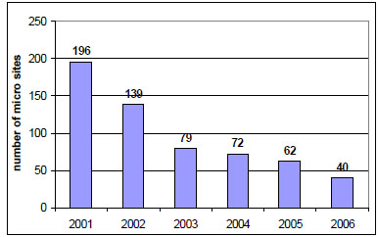
Results
Number of micro sites with knotweed present

Slide 20
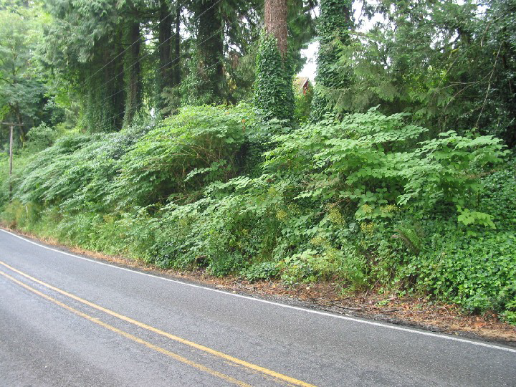
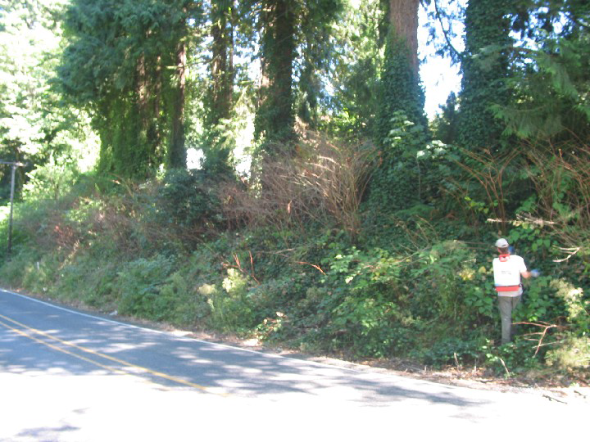
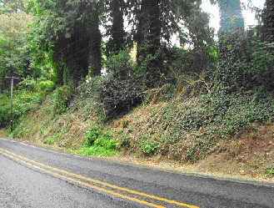
Results
2004
2005
2006

Slide 21
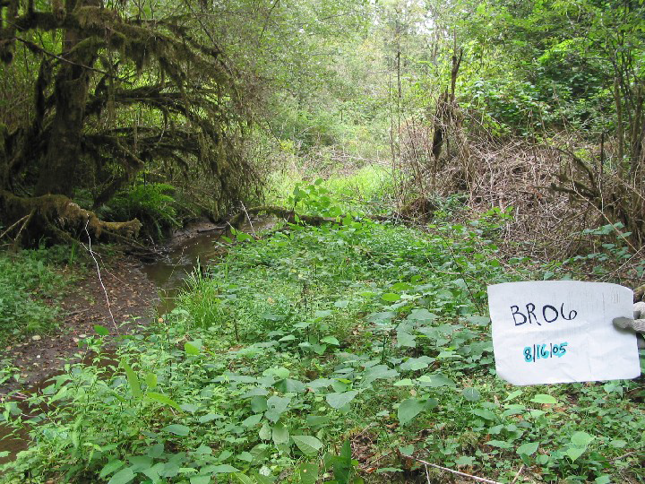
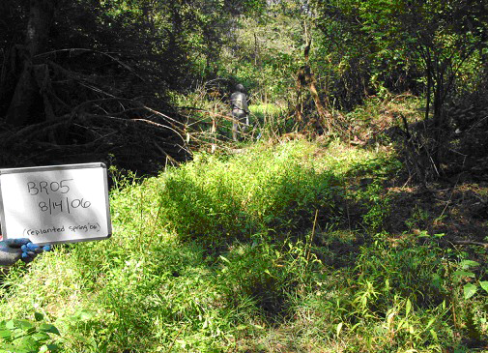
Results
2004
2005
2006

Slide 22
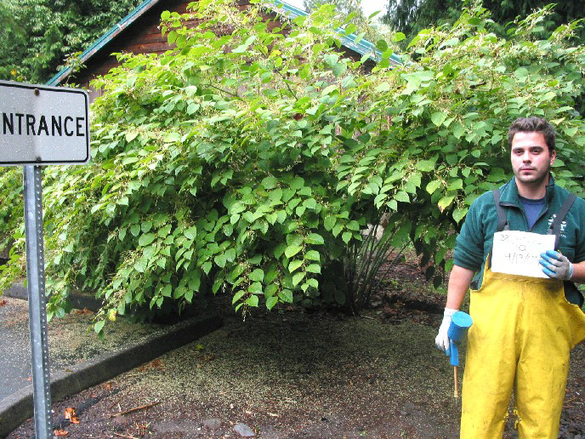
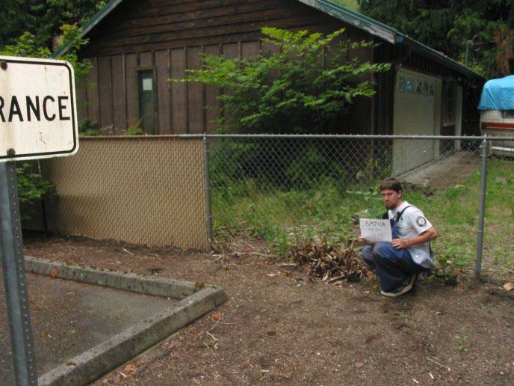
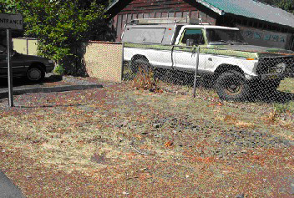
Results
2005
2004
2006

Slide 23
Part 3: Statewide Survey of Oregon Watershed Enhancement Board Riparian and Stream Enhancement Projects 2002
By: Matthew Anderson and Gino Graziano

Slide 24
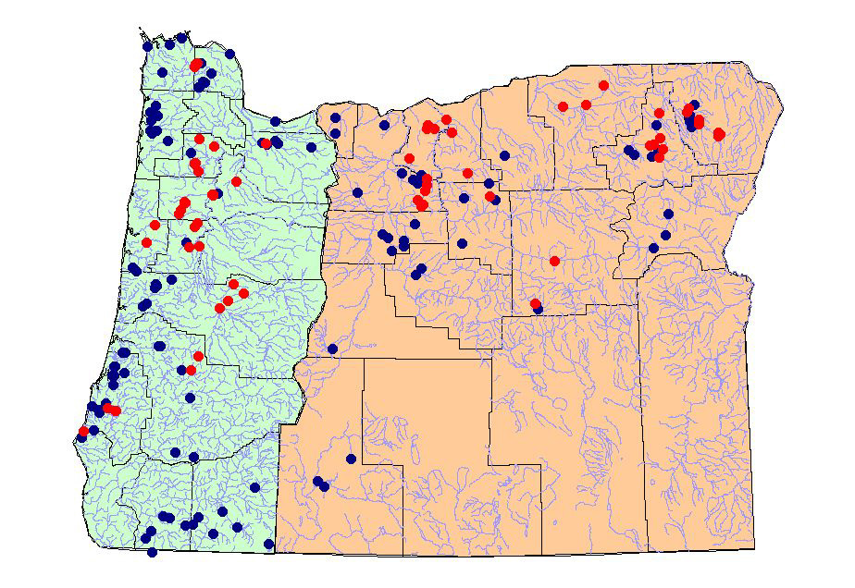

Scope
Compilation of restoration projects
Entire state of Oregon
15 years of OWEB data 1987-2002

Slide 25
Findings
Riparian plant mortality in different areas of the state varies greatly
Potential reported causes:
  Animal Damage
  Desiccation
  Plant Competition
  Soil Conditions

Slide 26
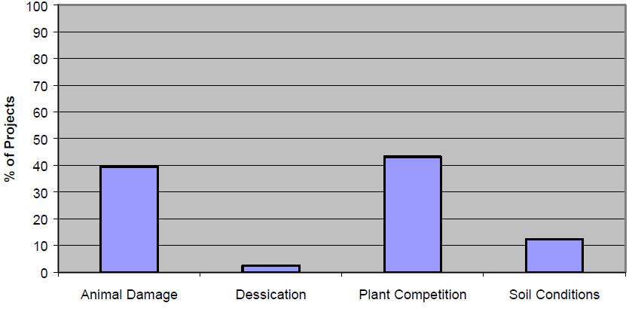
Willamette, North Coast, South Coast, and Lower Columbia Basins
Coos watershed
Sandy watershed

Slide 27
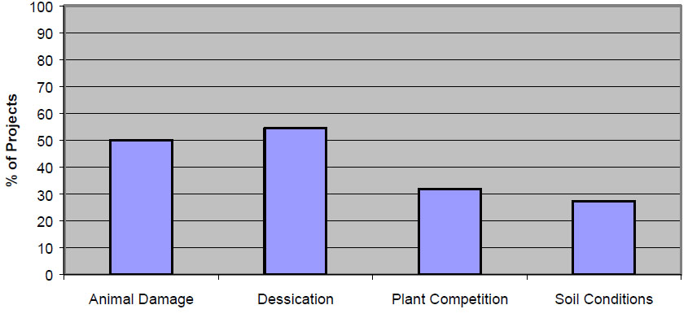
Umpqua, Rogue, and Klamath Basins

Slide 28
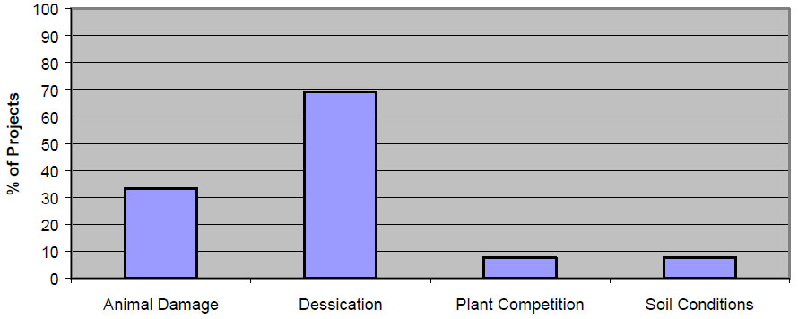
Deschutes, John Day, and Umatilla Basins

Slide 29
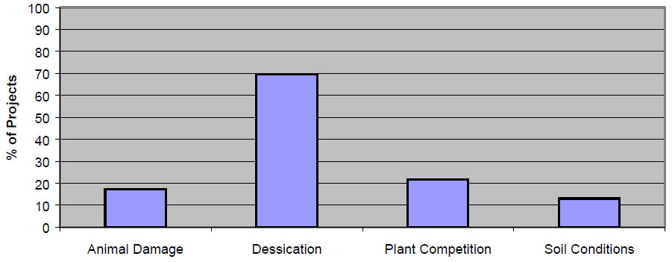
Grande Ronde and Powder Basins

Slide 30
Conclusion
Part 1 and Part 2
Similar climates
Similar challenges
Very different scales
Part 3
Illustrate differences state wide
Magnitude of scope
Tailor projects accordingly

Slide 31
Conclusion
Components of success state wide:
Preparedness
Knowledge of region
Landowner coordination and cooperation
Continued up-keep and monitoring

Slide 32
Thank You!

