Slide 1
Fluvial Hydrology, Fish Passage, and Sedimentation
Ryan Johnson
Earth and Physical Science Department
Western Oregon University
Monmouth, Oregon
Email: rjohnson11@wou.edu

Slide 2
Outline
Introduction
River Hydrology
Stream Flow
Sediment Transportation
Salmonid in the Pacific Northwest
Life-Cycle
Passage Blockage
Summary

Slide 3
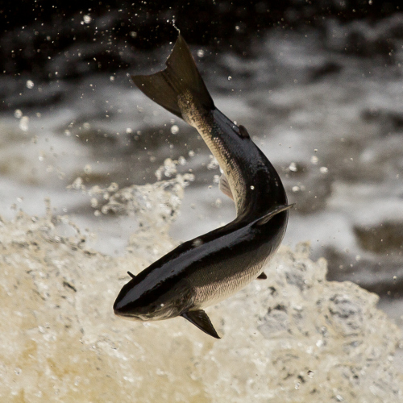
Salmonid Species and Rivers
Numerous species in Pacific Northwest
Anadromous
Freshwater
Complex relationships
Habitat conditions
Spawning sediment

Slide 4
RIVER HYDROLOGY

Slide 5
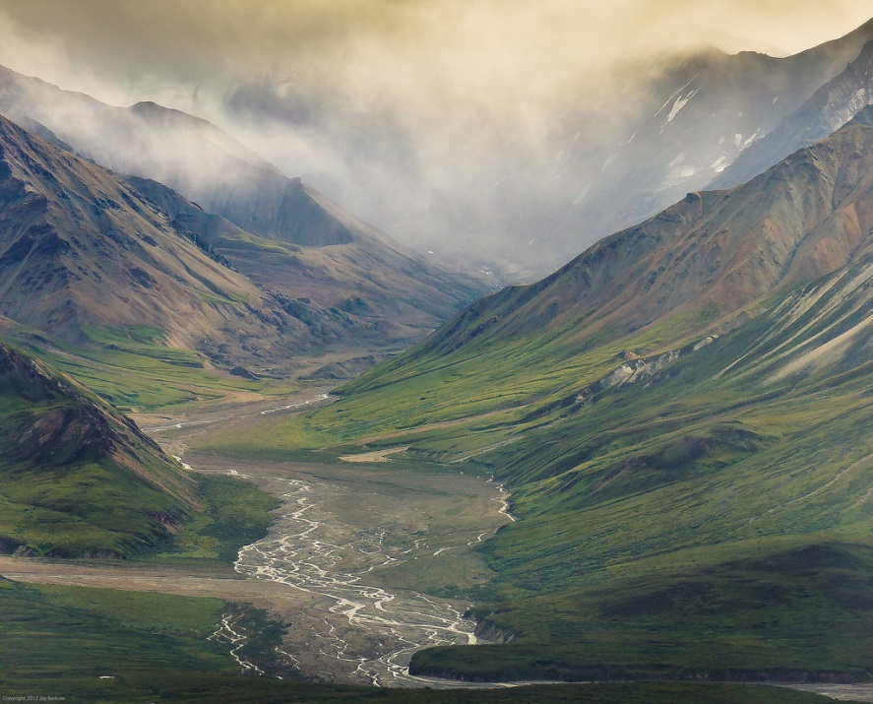
What does a river want to do?
Equilibrium
Energy In = Energy Out
Balance of deposition and erosion

Slide 6
Controlling Factors
Climate & Geology
Influence ecosystem components
Primary Factors
Soil
Vegetation
Water

Slide 7
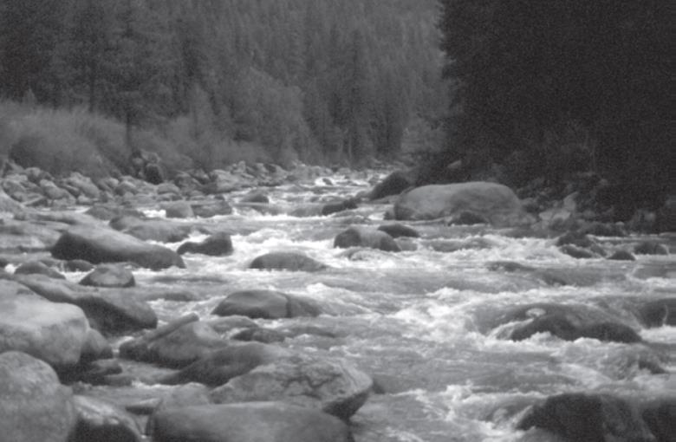
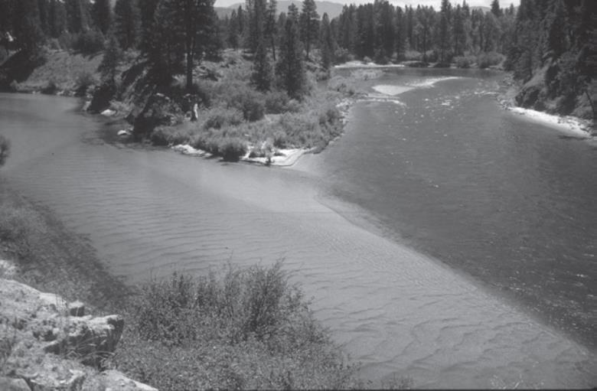
Stream Morphology
Controlled by:
Stream Energy
Water Supply
Sediment Transport
Structural Elements

Slide 8
Braided Stream vs.
Meandering Stream

Slide 9
Sediment Transport
More Energy -> Larger Caliber Sediment
Coarse gravel deposits
Less Energy -> Smaller Caliber Sediment
Fine sand/silt deposits
Sediment Traps
Creates complex energy environments

Slide 10
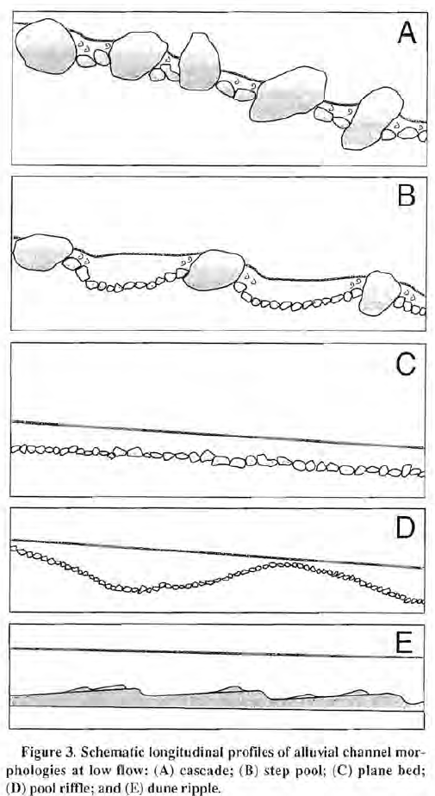
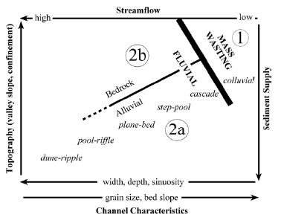
Channel Bed Configuration
Silt/Clay - Low Energy
Sand - Low-Moderate Energy
Gravel - High Energy

Slide 11
SALMONID IN THE PACIFIC NORTHWEST

Slide 12
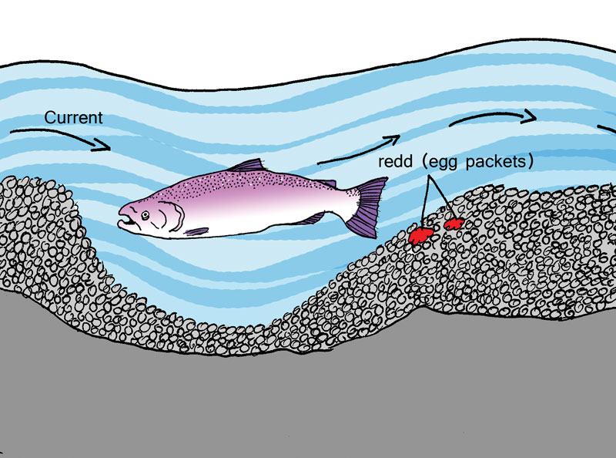
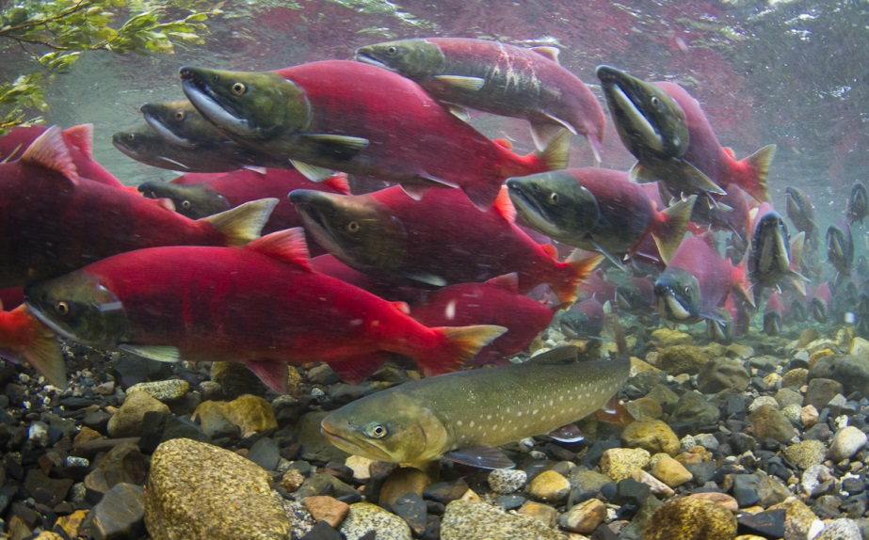
Spawning Sediment
Salmonid preferences
Mostly small gravel
Some larger gravel
Rounded

Slide 13
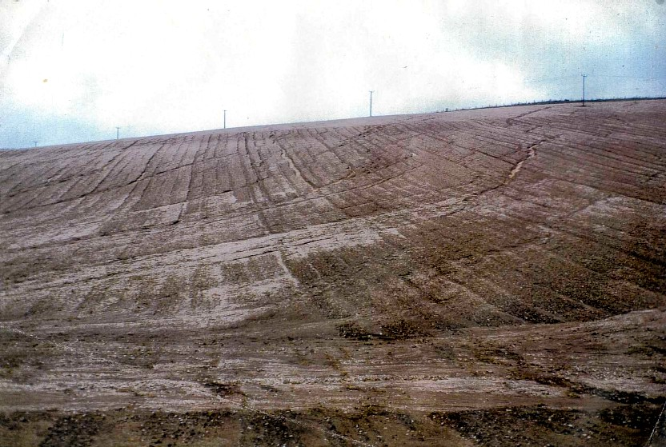
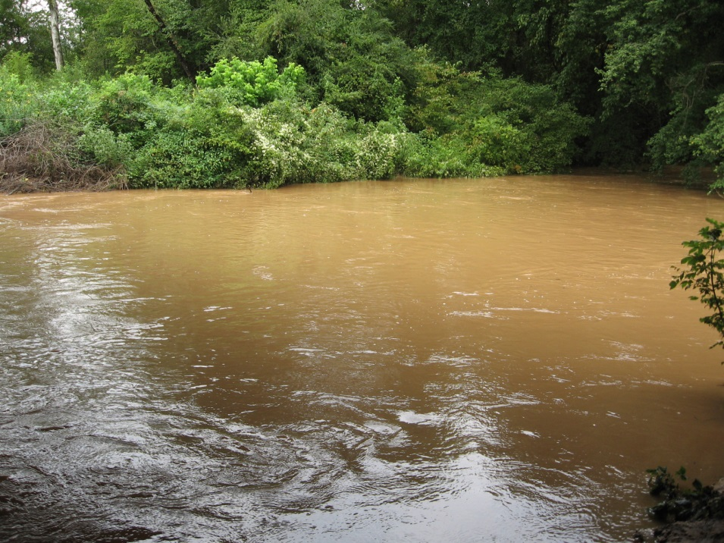
Excessive Fine Sediment
Buries spawning gravel
Blocks pore spaces between gravel
Lowers dissolved oxygen for eggs
Displaces primary food source

Slide 14
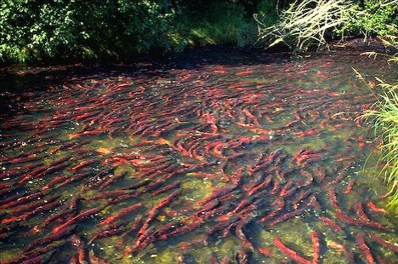
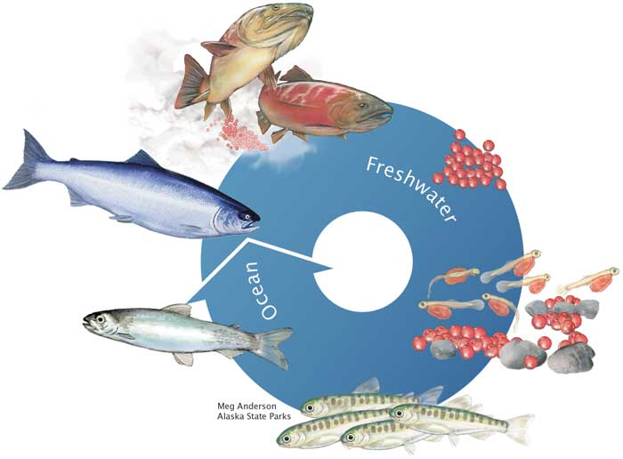
Fish Migration and Passage
Require unimpeded access
Reproduction, feeding, and refuge
Passage timing, frequency, and duration
Migration and residence time

Slide 15
Major Salmonid Migration in the Pacific Northwest

Slide 16
MIGRATION BARRIERS

Slide 17
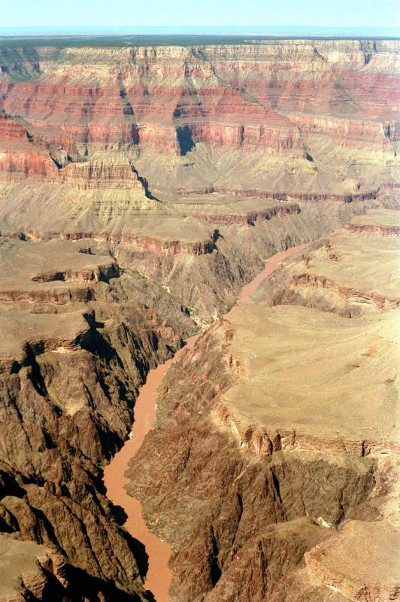
Stream Crossings
MIGRATION BARRIERS
Humans like to traverse streams
Need to maintain river flow
Two primary solutions:
Bridges
Culverts

Slide 18
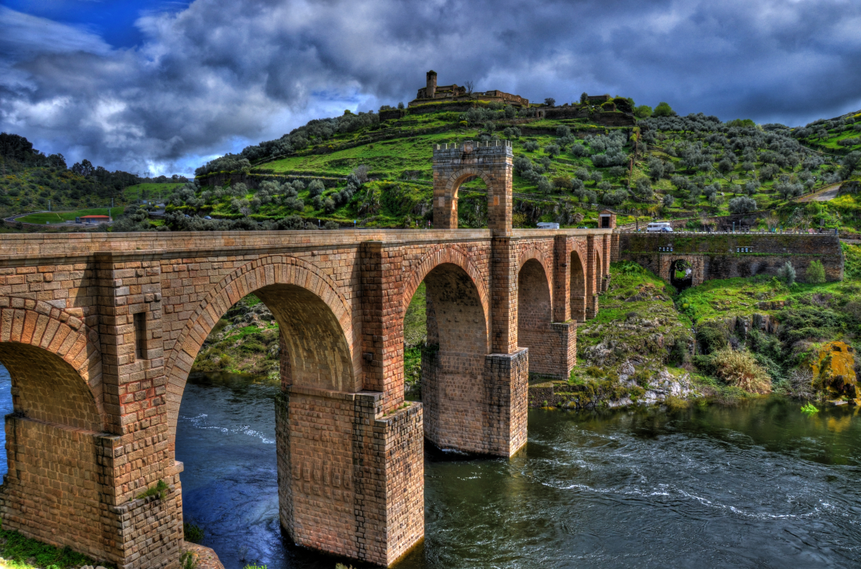
Bridges
Depends on design
Usually minimal impact
Can trap large woody debris
Can be costly

Slide 19
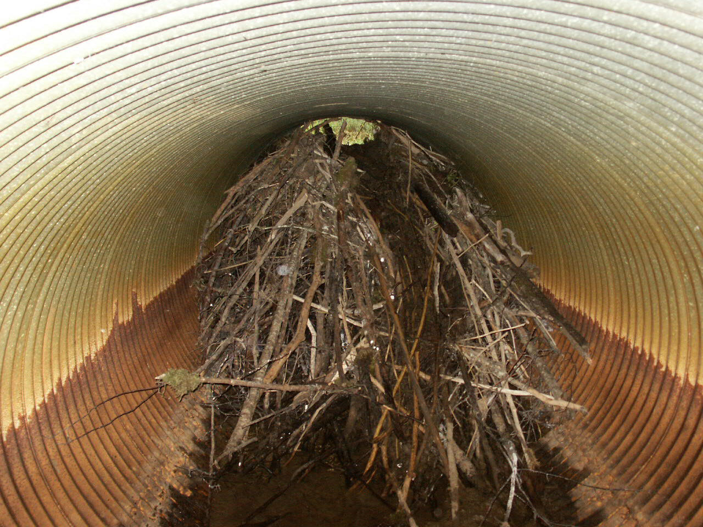
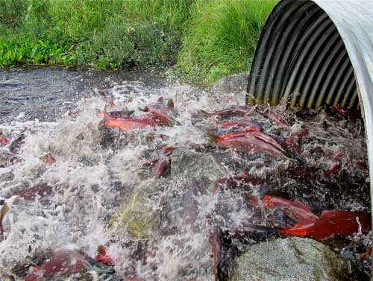
Culverts
Usually cheap and easy to install
Prone to becoming blocked
Restoration is simple
Culvert configuration important

Slide 20
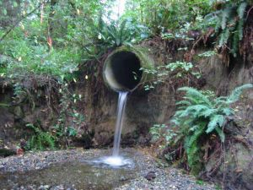
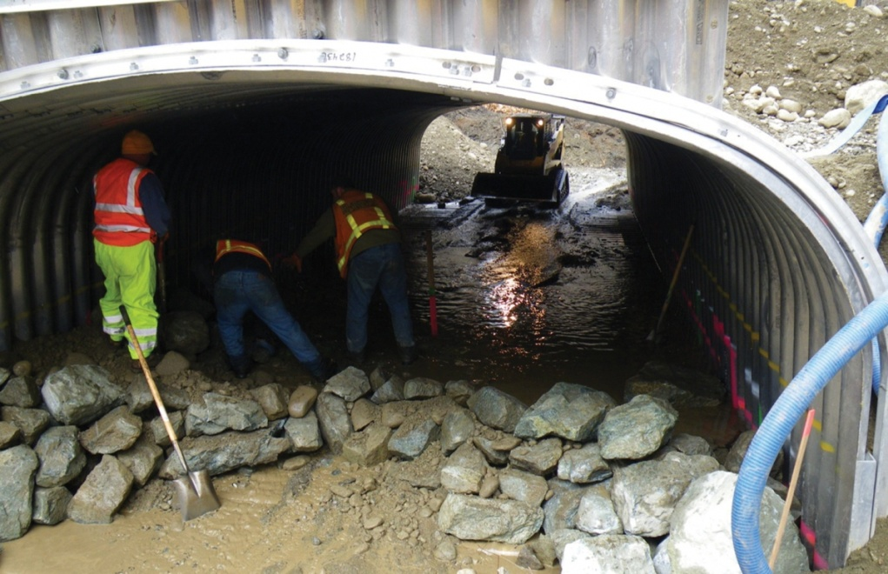
Culvert Configuration is Important!

Slide 21
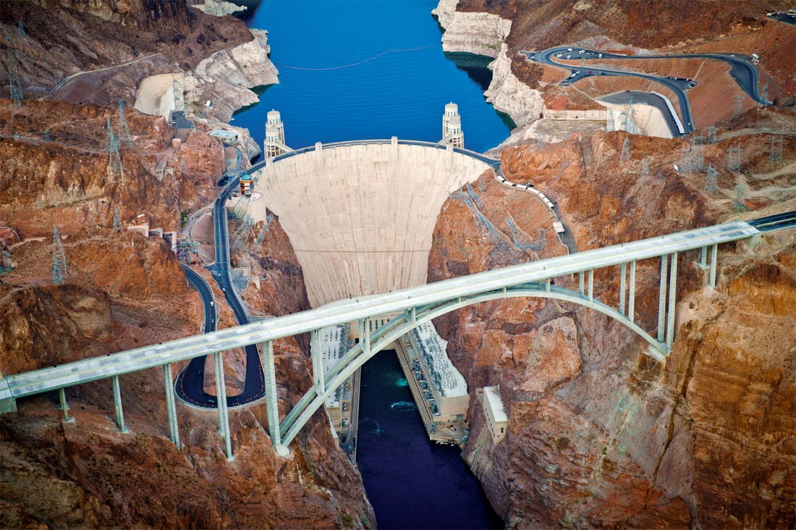
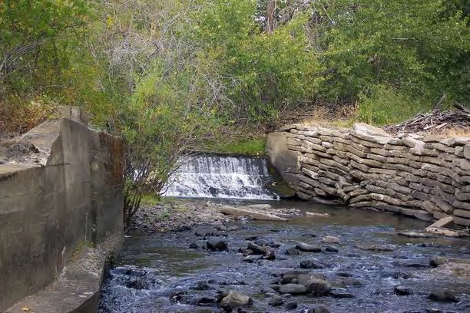
Washington Blockages, 2004
2,256 road crossings of fish-bearing streams
1,036 considered barriers
Estimated >33,000 salmonid blockages

Slide 22
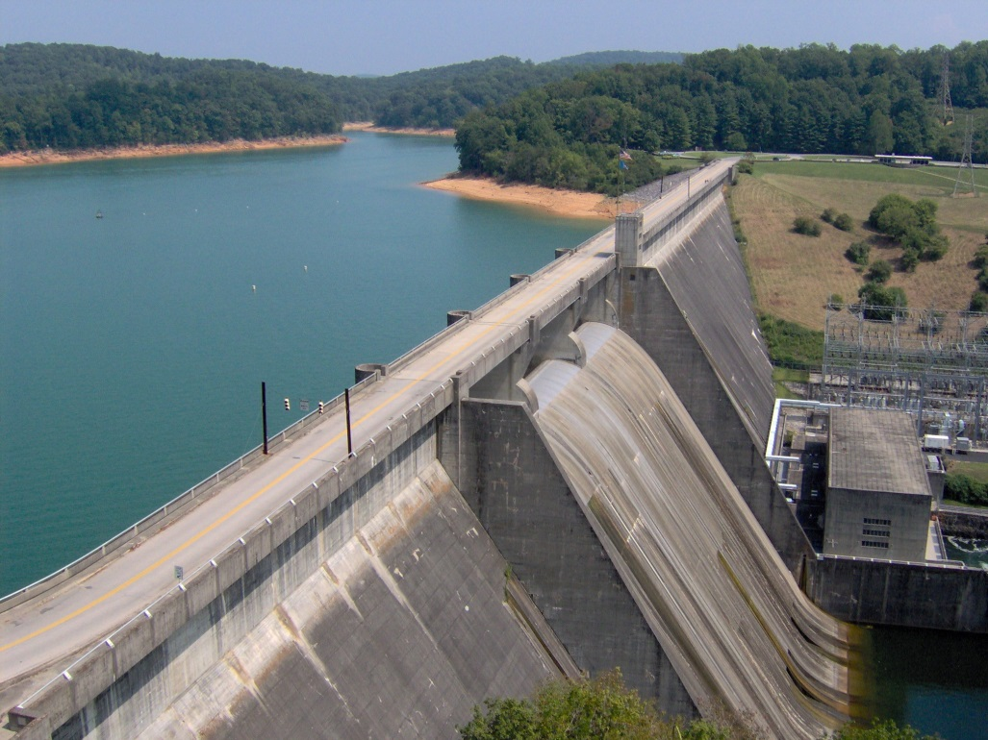
Dams
Used to control discharge within a stream
Very invasive to fish
Blocks fish passage

Slide 23
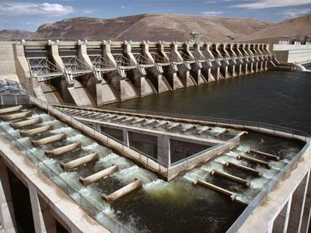
Solutions
Most effective is removal of dam
Fish ladders
Gradual steps, traversed by jumping

Slide 24
Salmon Cannon!

Slide 25
Summary
Stream Hydrology: energy in = energy out
Stream energy controls sedimentation
Salmonid require proper sediment for spawning
Salmonid need access to rivers and tributaries to complete life cycle
Human crossings can block fish passage if not maintained
Restoration required
Youtube - Meet the Salmon Canon

Slide 26
Five-Minute River Interlude
https://www.youtube.com/watch?v=8Jq1U8JyHW4
Youtube - Salmon Spawning

