Slide 1
Watershed Assessment and River Restoration Strategies
Katie Halvorson
Earth and Physical Science Department
Western Oregon University
Monmouth, Oregon

Slide 2
Outline
Introduction
River Morphology
Fluvial Processes
Watersheds
What are they?
River Restoration
Criteria
What is river restoration?
Summary

Slide 3
RIVER MORPHOLOGY

Slide 4
Federally Designated Wild and Scenic Rivers

Slide 5
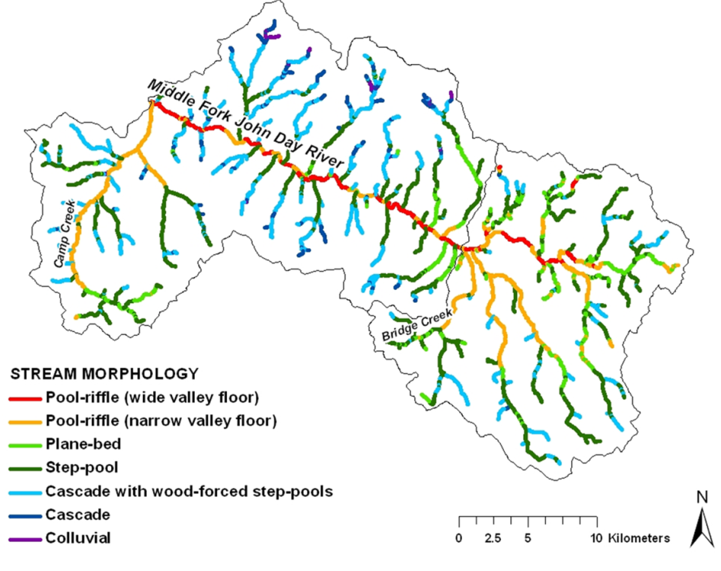
River Morphology:
Catchment scale
Hydrology, geology
Channel pattern at reach scale
Local slope, geology
Variations in structure
Bank material, flow

Slide 6
Water Quality:
Cool temperatures and dissolved oxygen
Essential for salmonids and aquatic community
64ºF established as basis of sub-lethal for salmonids

Slide 7
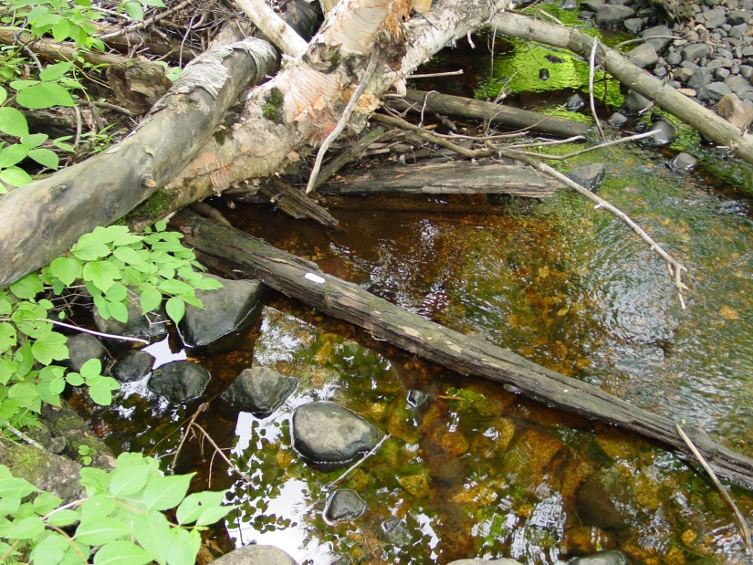
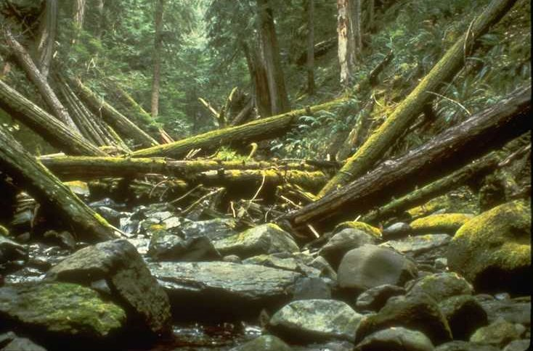
Large Woody Debris (LWD):
LWD increases channel roughness
High flow refuge for fish
Gravel retention and in-stream habitat

Slide 8
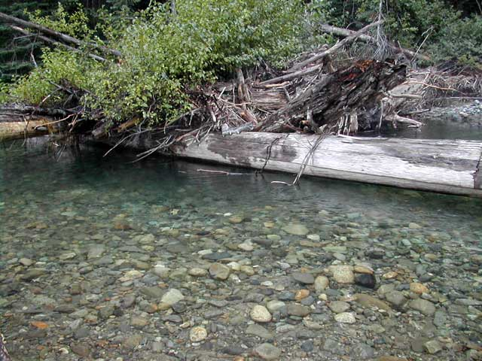
Importance of Channel Wood:
Pool development
Sediment retention
High-quality spawning habitat
Increases stream elevation to connect channel with floodplain
Nutrient cycle processes

Slide 9
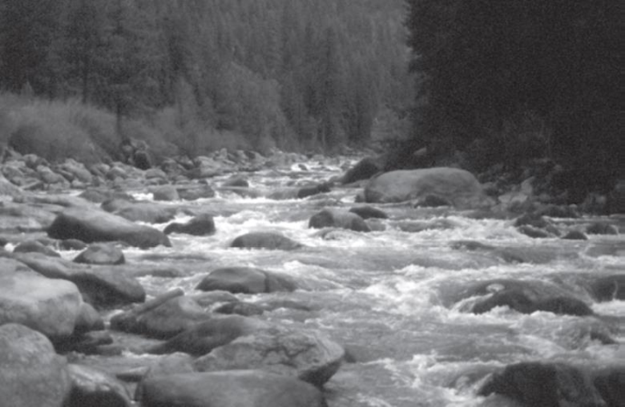
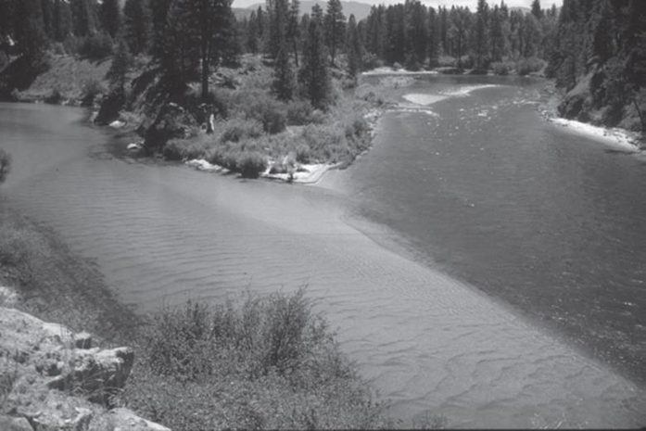
Sediment Transport:
Enhances habitat
Size and shape influences quality of habitat
Channel process controls size and sorting of material

Slide 10
WATERSHEDS

Slide 12
Significance of a Watershed:
“Area of land that drains downslope to the lowest point”- OWEB
Assessments should occur at the watershed level due to connectivity
Activity affecting the watershed at one location will affect the system downstream

Slide 14
Watershed Processes:
Controlled by geology, climate, and disturbances
Geology: uplift can influence slope
Climate: elevation, precipitation, and vegetation
Disturbances: large or small scale
Small Scale: trees blown into a stream
Large Scale: fire or flood

Slide 15
RIVER RESTORATION

Slide 16
What is River Restoration?
“assisting the establishment of improved hydrologic, geomorphic, and ecological processes in a degraded watershed system and replacing lost, damaged, or compromised elements of the natural system” (Wohl et al., 2005)

Slide 17
Census of River Restoration Projects in the United States (1995-2005)

Slide 18
Types of Restoration Projects in Pacific Northwest

Slide 19
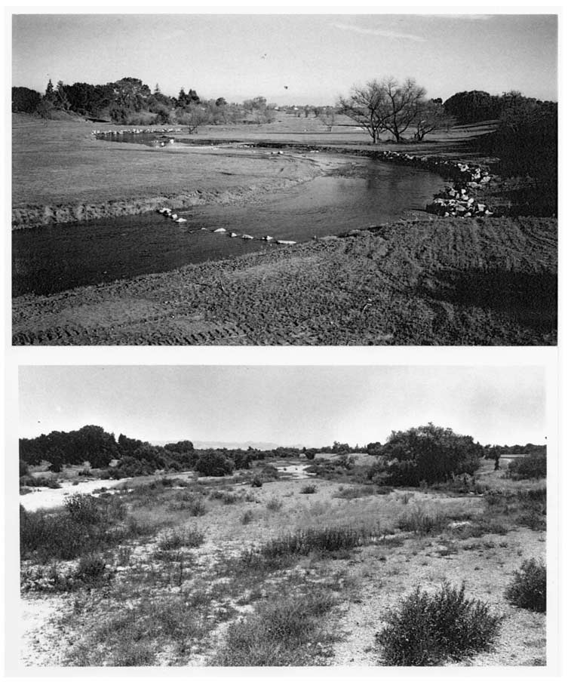
Five Criteria for Measuring Successful Restoration Projects:
Guiding Image
Improved Ecosystem
Increased Resilience
Harmless to Habitat
Pre- and Post-Project
Assessment
Palmer et al., 2005
Failed Meander Design, Uvas Creek, CA

Slide 20
River Restoration Guidelines:
TARGET the root causes of habitat and ecosystem change
TAILOR restoration actions to local potential
MATCH the scale of restoration to the scale of physical and biological processes
OUTCOMES - Develop explicit expected outcomes, including recovery time
T. Beechie et al., 2010

Slide 21
Rules for the Road in River Restoration:
Clear statement of objectives
Incorporate geomorphic process
Promote quality habitat
Promote hydrologic complexity in the channel

Slide 22
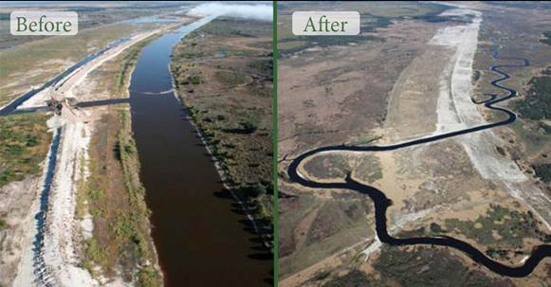
Channel Modification Projects:
Purpose: “accelerate recovery to a stable, sustainable channel form that is in dynamic balance with its sediment, large-wood, and flow regime.”
Washington Dept. Forestry, 2004

Slide 23
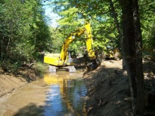
Elements of Channel Modification:
Improved stability
Improved sorting of gravels for spawning habitats
Improved water access to floodplain
Greater diversity in channel bedforms
Improved riparian zones
Improved habitat quality

Slide 24
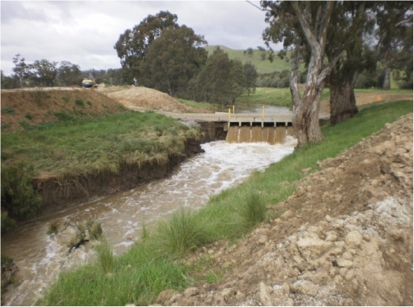
Example:
Problem: Channel disconnected from floodplain in large lowland rivers
Option 1: Levee breaching or widening
Option 2: Periodic dredging

Slide 25
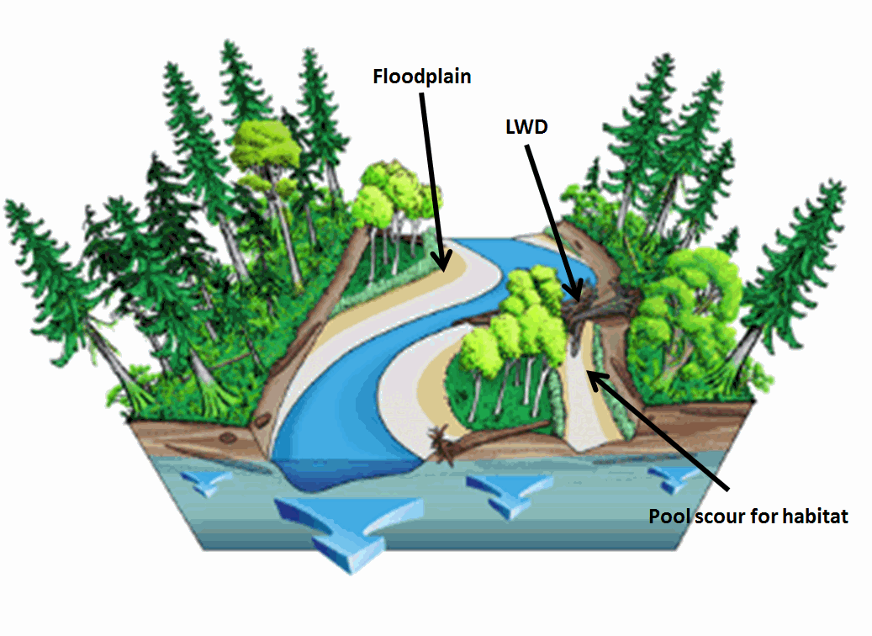
Example (Cont.)
Preferred Solution: Restore a natural periodic process benefits propagation of native species and natural flood retention.
Option 2 is costly and significantly disrupts ecology. Also requires regular maintenance.

Slide 26
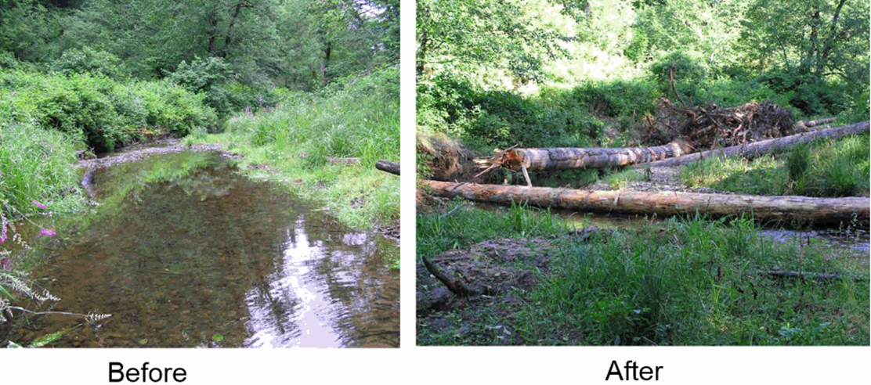
Restoration Exemplified:
Added LWD
Allowed for pool scours to form
Stream complexity enhanced
No stream complexity
Lack of turbulent flow

Slide 27
Summary
River restoration: “assisting the establishment of improved hydrologic, geomorphic, and ecological processes in a degraded watershed system and replacing lost, damaged, or compromised elements of the natural system” (Wohl et al., 2005)
Requires process-based approach, with clear objectives and assessment strategy
Successful river restoration is important to increase the complexity of a river for habitats, water quality, and sediment transport

Slide 28
Five-Minute River Interlude
https://www.youtube.com/watch?v=8Jq1U8JyHW4
Youtube - Salmon Spawning

