Slide 1
Restoring Rivers One Reach at a Time: Results from a Survey of U.S River Restoration Practitioners
Ian McBride

Slide 2
Introduction
“river restoration” is a broad term
Often the outcomes of river restoration projects are not evaluated
River restoration efforts are growing exponentially
1 billion dollars annually

Slide 3
National River Restoration Science Synthesis
The NRRSS aims to provide a national level synthesis of river restoration science
Evaluate success levels of river restoration projects
Identify specific aspects of a successful project
Inform future river restoration projects

Slide 4
Methods
Compile and organize data on a national scale
Make data readily available to inform future projects

Slide 5
NRRSS Summary Database
Collection of project summaries from completed river restoration projects
Aimed to understand the current state of river restoration in the United States
Included projects with the purpose of improving stream condition
The effort can be evaluated

Slide 6
NRRSS Interview Database
Formed for a subset of the summary database
Interviews of project contacts
Projects completed from 1996-2002

Slide 7
Criteria
Able to interview appropriate Practitioners
Goal of project:
Riparian Management
Water quality
In-stream habitat improvement
Channel reconfiguration
Type of monitoring done (see Table 3)

Slide 8
Results
317 interviews about unique projects
Large of variation in restoration projects style and method
Varying levels of success of projects
Very successful
Somewhat successful
Unsuccessful
To early to tell

Slide 9
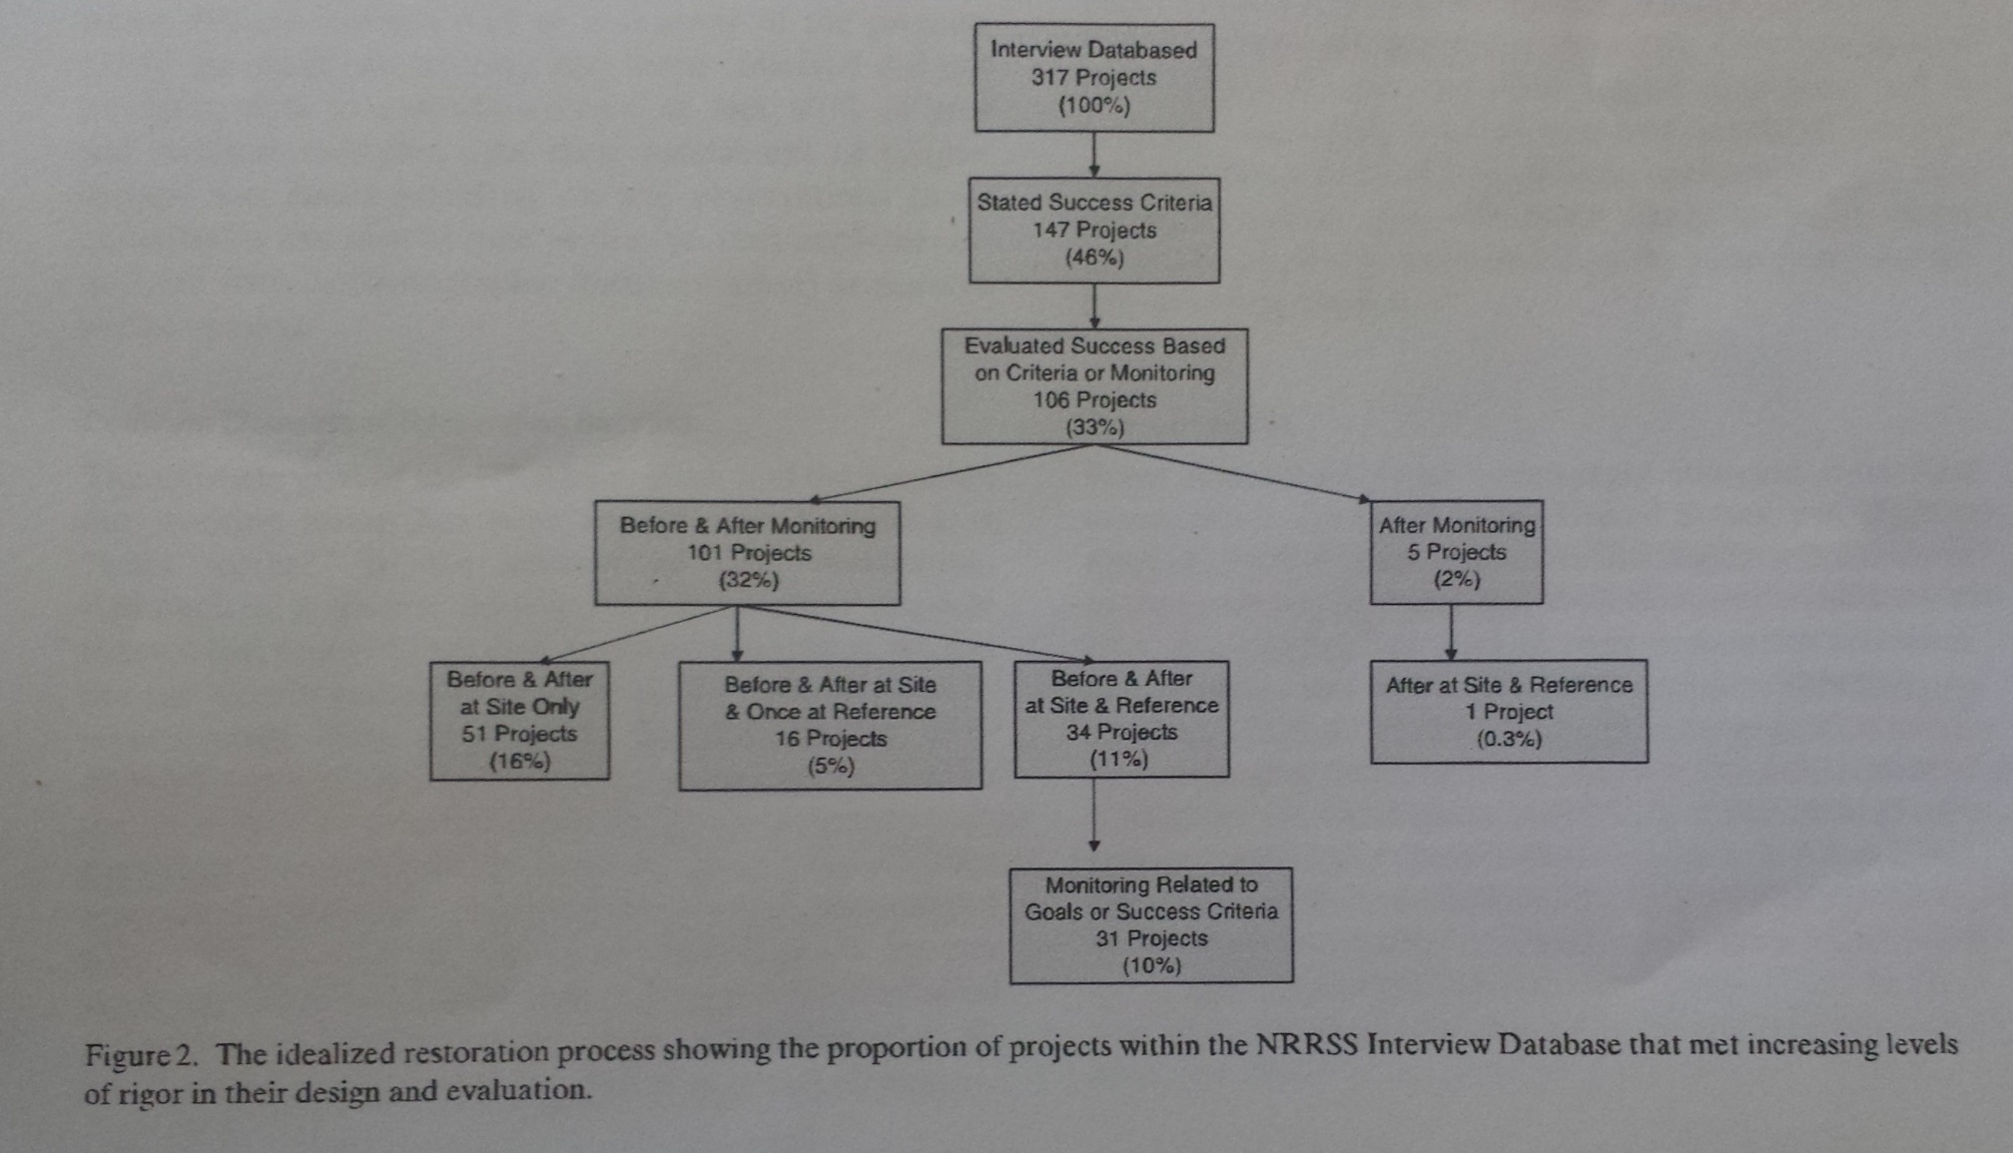
Results (cont.)

Slide 10
Discussion
Were there distinct features of successful and unsuccessful projects?
No. Motivation, members of restoration team, type of monitoring and funding sources showed no trend in successful vs. unsuccessful projects

Slide 11
Discussion (cont.)
Did projects that followed the idealized process show any unique characteristics?
Not in cost, size, participants, funding source or region.

Slide 12
Discussion (cont.)
Over two thirds of the projects that employed a highly effective process had:
Significant community involvement
An advisory committee associated with the project

Slide 13
Conclusion
River restoration projects are extremely variable
Many factors appear to have little influence on success
Community involvement and having an advisory committee seem to correlate with success

Slide 14
Conclusion (cont.)
The NRRSS has an outline that correlates with a success
Restoration practices need rigorous scientific evaluation to determine a level of success
Agencies involved in restoration should take this information and re-evaluate methods

