Slide 1
Morphology and Controls on the Position of a Gravel-Sand Transition: Fraiser River, British Colombia Jeremy Veditti and Michael Church
Article summary
by Ian McBride

Slide 2
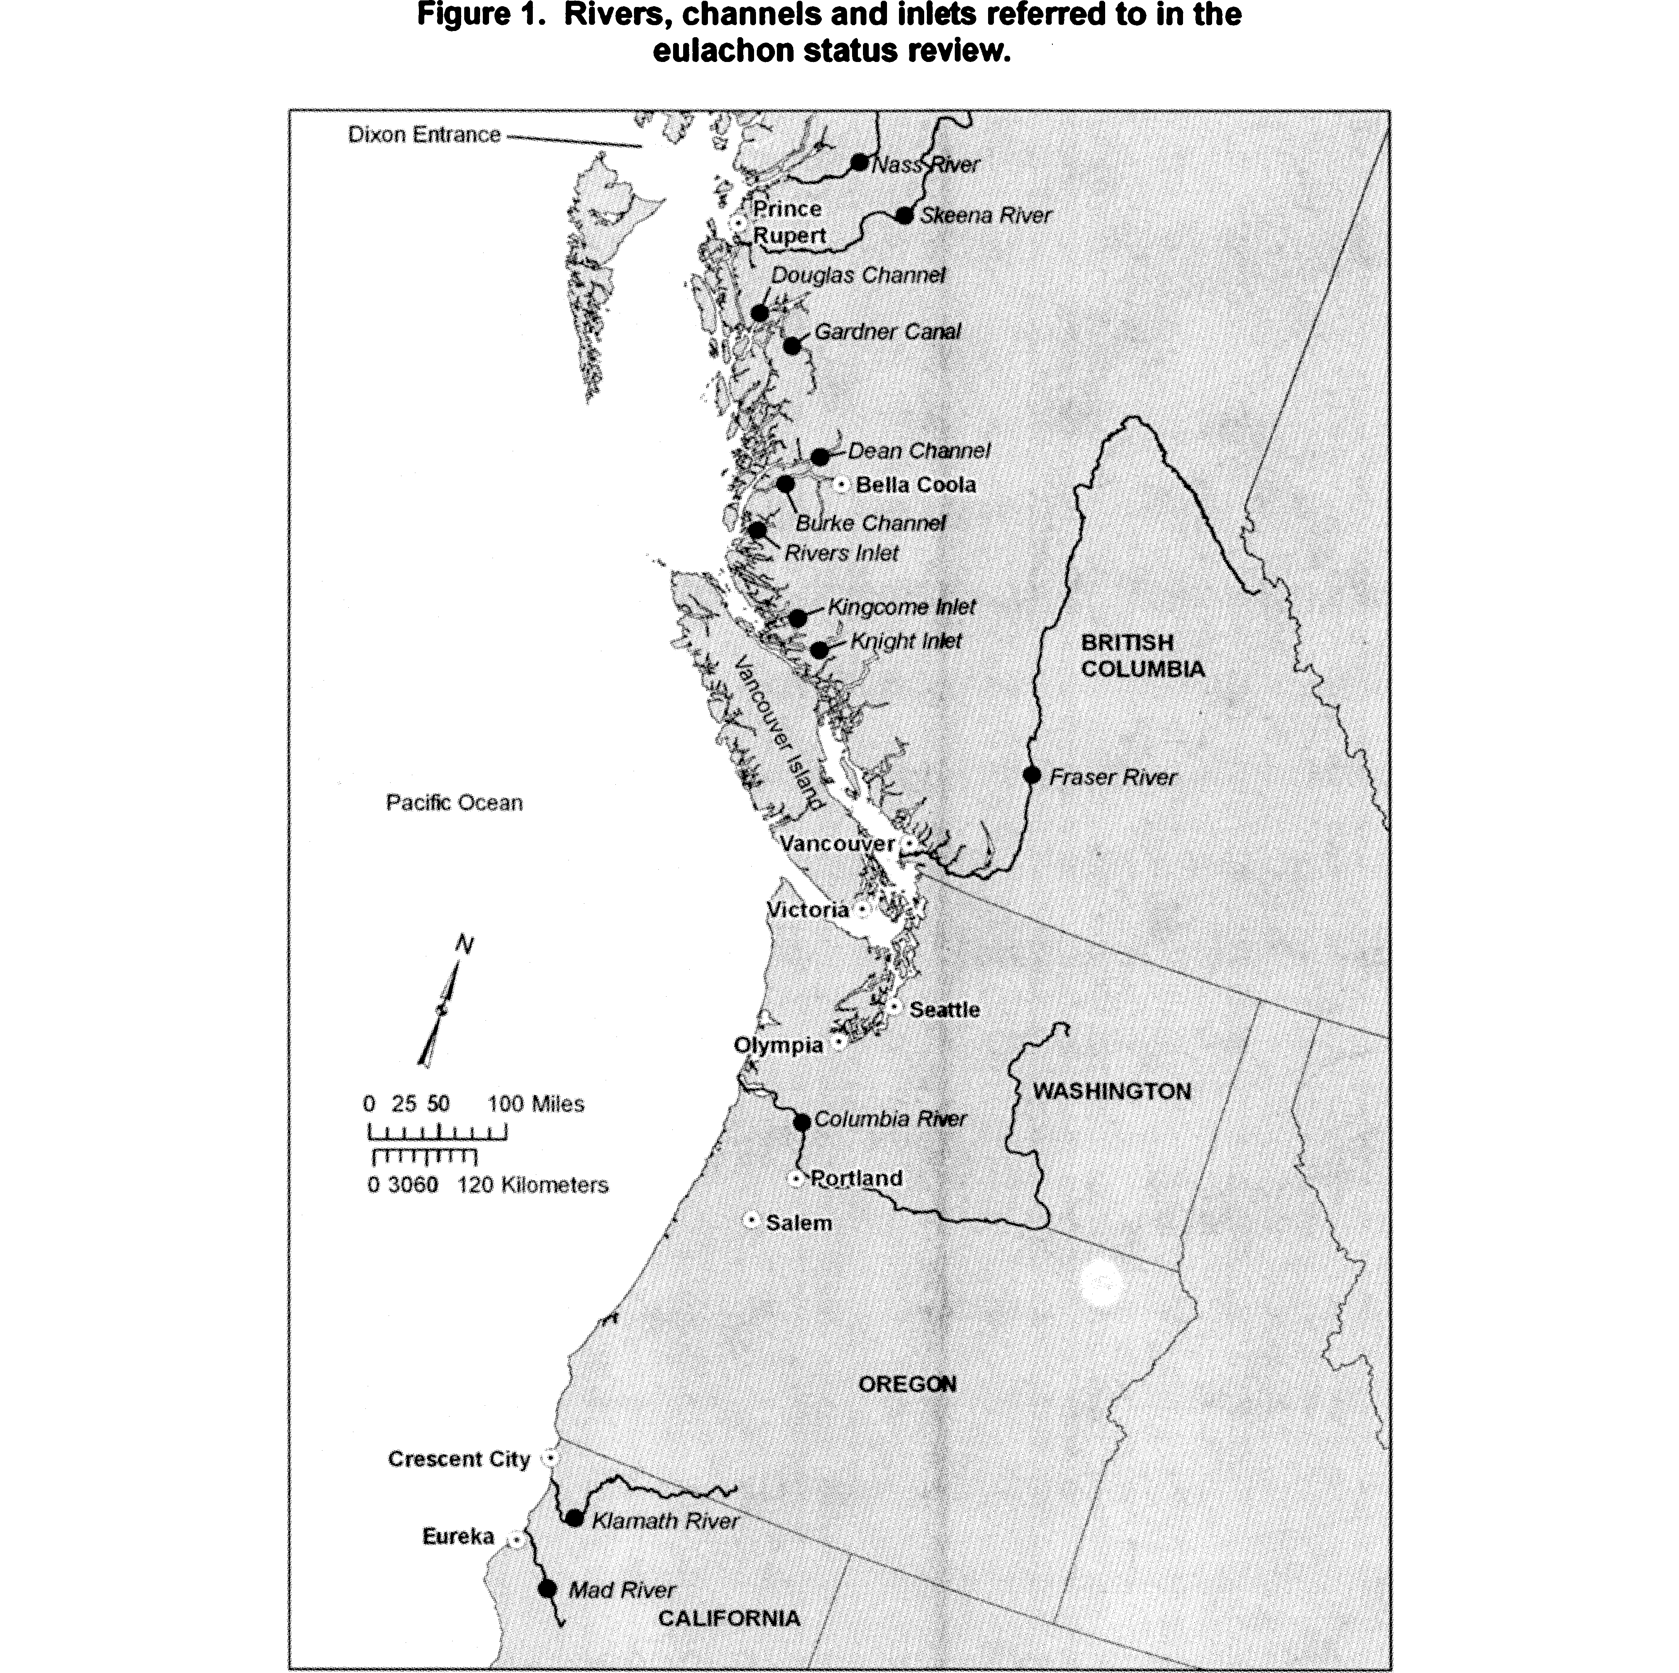
Overview
Bed sediments in river
channels generally becomes finer downstream
This can be caused by a
variety of different factors

Slide 3
Previous Studies
Some studies have pointed towards an exponential decline in sediment grain size. [e.g., Sternberg, 1875; Yatsu, 1955; Church and Kellerhals, 1978; Rice and Church, 1998]
Others have found a more distinct Gravel to sand transition (GST). [e.g., Gran et al., 2006; Gran, 2012]

Slide 4
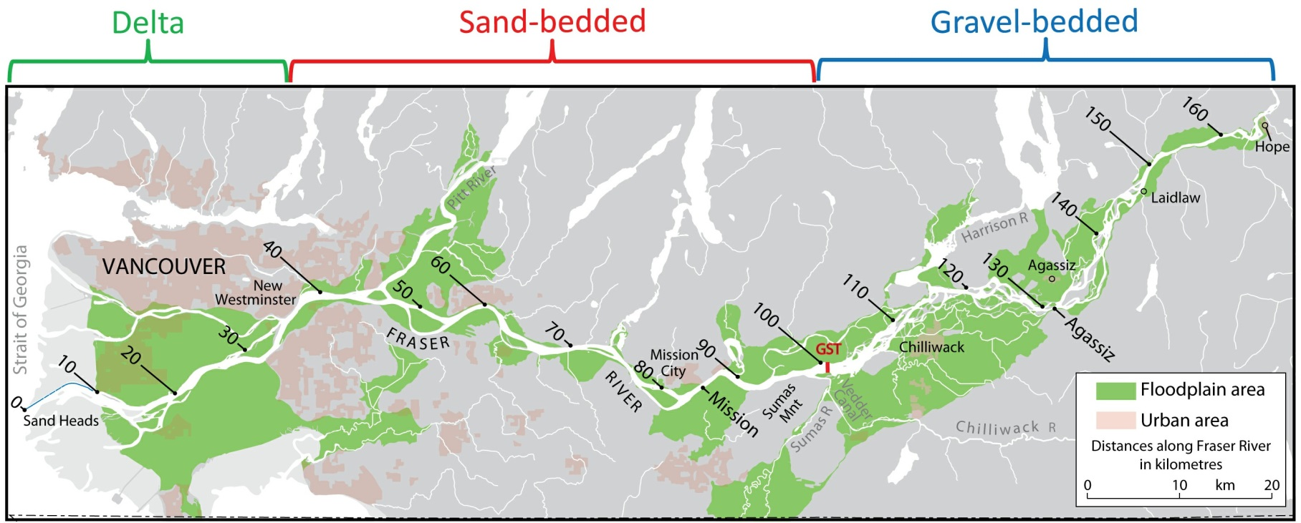
Locating a GST
Based on river bed sedimentology a Gravel-Sand Transition (GST) was approximately located

Slide 5
Contributing Factors to a GST
The disintegration of gravel particles into sand-sized mineral grains during the transport process
Selective transport caused by a decline in the capacity of the river to carry larger particles
External factors that generates a backwater effect and a rapid decline in transport capacity
What these mechanisms have in common, a general stop in transport by the river of grains coarser than sand.

Slide 6
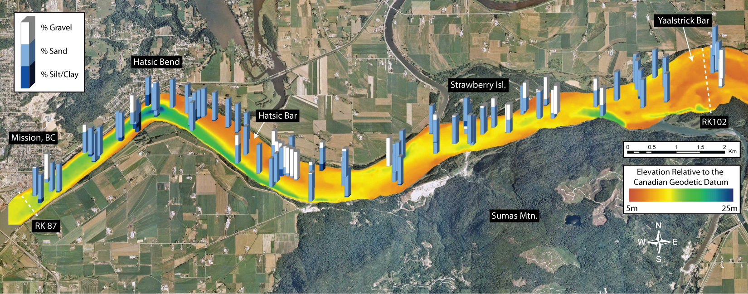
Data
Within 10km most of the gravel is gone.

Slide 7
Conclusion
The GST occurs at a specific site on the river where multiple factors convene
Distance from head waters
Channel width increase
Change river surroundings (rural to urban)

