Slide 1
Diagenetic variation in The Oregon Coast Range: Implications for rock strength, soil production, hillslope form, and landscape evolution
Overview given by:
Katie Halvorson

Slide 2
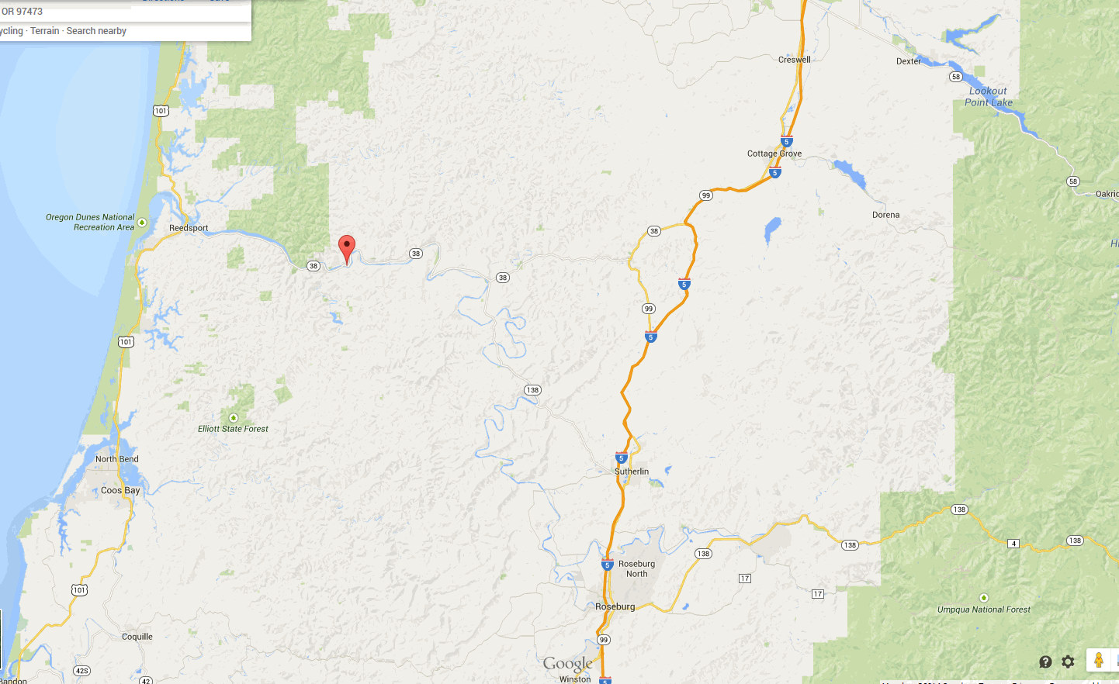
Overview
Adjacent watersheds that drain into Umpqua just west of Scottsburg, Or.
Both Eocene Tyee Formation
Studied how different the
two watersheds, Franklin
and Harvey, are in
different rock properties.

Slide 3
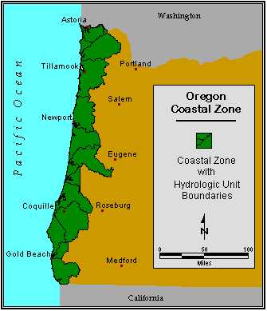
Background
Tyee Formation extends over 10,000 km^2
Tyee contains primarily massive sandstone beds with a range of 1-10m thick.
Other studies have shown that long-term erosion rates balance rates of rock uplift.

Slide 4
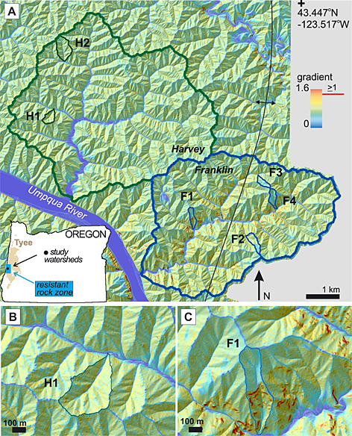
Study focused on…
Geological setting, Petrology, rock mechanics, lidar, and fieldwork of the area.
They wanted to know how
resistant the bed were
compared to each other.

Slide 5
Ideas:
They expected to find that harder rock will resist erosion and will produce steeper slopes.
Denudation rates (Rate the surface is being lowered by erosion) must be higher than the resistant rock weathering rate to give the hillslope form that is found there.

Slide 6
Findings:
Hillslopes perched above resistant beds erode at app. half the pace of hillslopes that are by knickpoints/waterfalls.
Thin sections found no significant difference in grain size, porosity, or mineral composition between typical and resistant Tyee samples BUT small tributary hillslope gradients vary significantly depending on the presence/absence of resistant rock.

Slide 7
Conclusion
Franklin watershed may be lasting only a shorter time more than Harvey.
Minerals and clay cements strengthen cliff-forming bed in Franklin.
When using lidar, they concluded that Harvey hillslopes are 1.3 times steeper than Franklin.

Slide 8
Thank you!

