Slide 1
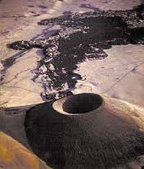
Development of Topographic asymmetry: insights from dated cinder cones in the western united states
Mcguire et all., 2014
Article summary By kaitlyn hugmeyer

Slide 2
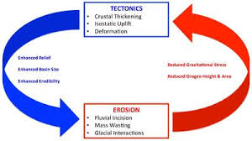
What is Ecohydrogeomorphic feedback?
Climate, water, and the earth’s surface
Driving a system forward
Erosion

Slide 3
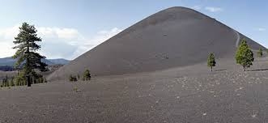
Why cinder cones?
Remember?
      Steep and conical
      Volcaniclastic debris
They’re datable
      Radiometric
They’re consistent
      Mineralogically homogenous
      Formation-days to years
      Highly permiable
They’re symmetrical (for the most part)
      Ideal young cinder cones are radially symmetric
      26-36 degree hillslope angles
      Not all cinder cones chosen-asymmetries

Slide 4
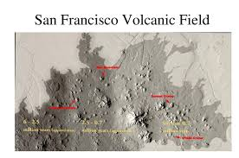
The study
The SFVF (San Francisco Volcanic Field)
    Northeastern Arizona
    600 volcanic vents, several hundred basalt cinder cones
    Active for 6ma
    Semi arid (varies with elevation)
    250-580mm annual precipitation
    2000-2300m cinder cone elevation

Slide 5
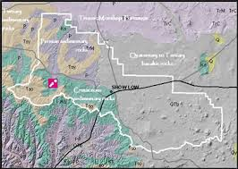
The Study
The SVF (Springerville Volcanic field)
    East-central Arizona
    Covers 3000km^2
    One large stratovolcano
    Pliocene-Pleistocene basaltic cinder cones
    2.1-.3ma based on Ar/K dating
    1900-3000m
    250-750mm annual precipitation

Slide 6
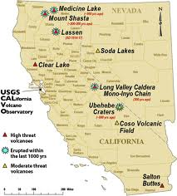
The study
The MLVF (the Medicine Lake Volcanic Field)
    Northeast California
    Large shield volcano and central caldera
    Basalt and basaltic andesite
    Southern part of Cascade Volcanic Arc
    1500-2000m
    Average 750mm annual precipitation

Slide 7
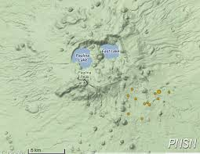
The study
The NVF (The Newberry Volcanic Field)
    Central Oregon
    Eastern side of cascade range
    Over 400 Halocene-late Pleistocene cinder cones
    Most cinder cones 1500-1800m
    400-800mm annual precipitation (elevation dependent)
    *** some Devils Garden Volcanic Field
        basaltic cinder cones included
        in the study (30km SE of Newberry)

Slide 8
methods
Gathering Data
    Hillslope angles
    Drainage density
      Area of all the streams and rivers divided by area of basin
    Lidar-derived DEMs- digital elevation models
    Previous geologic data (cinder cones)
    NDVI- normalized difference vegetation index (quantify for a controlled study)
      North-facing
        Solar radiation
        Albedo characteristics
    Pollen and sediment data for ancient vegetation data
    Deuterium concentrations in atmosphere for ancient climate-Vostok, Antarctica

Slide 9

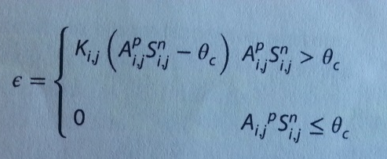
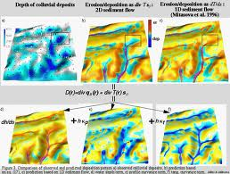
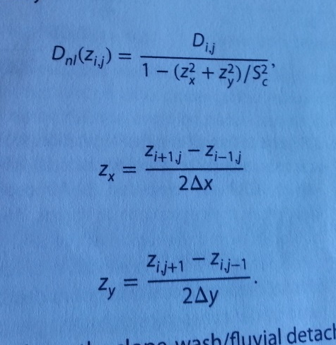
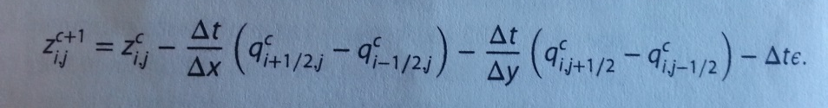
Crazy math
NDVI=NIR-VIS/NIR+VIS (spectral reflectance in the near-infrared and visible regions)
(precipitation effectiveness)
(along-channel bed slope)
(flow routing method)
(sediment flux)
(colluvium coefficient)

Slide 10
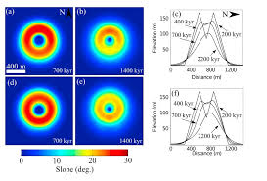
results
-The slope of the cinder cone gets shallower with age.
-higher hillslope angles on north slopes. More erosion on south-facing slope.
-average angles are approximately 20 degrees. (200-330 ka for slopes to degrade to that angle.
-mechanisms that drive asymmetry (freeze-thaw and bioturbation) require soil development capable of holding moisture and vegetation.

Slide 11
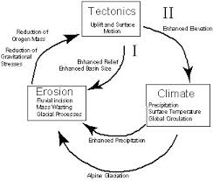
Results
-drainage density is low, but increases with age. Young cinder cones are extremely porous and permeable which makes it difficult to retain moisture and develop soil. When relief degrades, it decreases again.
-less vegetation means more slope wash.
-vegetation impacts slope stability.
-climate and elevation effect sediment transport mechanisms, which effect hillslope gradients.

Slide 12

Thank you

